Slide 1

EDEXCEL GCSE MATHS · FOUNDATION & HIGHER
3D solids
Transformations and constructions
Lesson 1 of 8
openrevise.com

Slide 2

EDEXCEL GCSE MATHS · FOUNDATION & HIGHER
Warm-up
Answer each one, then check.
1
How many faces does a cube have?
2
What is the name of a 3D shape with a circular base and one curved surface ending at a point?
3
What is the volume of a cuboid 2 by 3 by 4?
4
What shape is the cross-section of a cylinder cut straight across?
5
What is a polygon with 6 sides called?
Transformations and constructions
openrevise.com
Lesson 1 of 8

Slide 3
EDEXCEL GCSE MATHS · FOUNDATION & HIGHER
Warm-up - Answers
How many faces does a cube have?
6
1
What is the name of a 3D shape with a circular base and one curved surface ending at a point?
A cone
2
What is the volume of a cuboid 2 by 3 by 4?
24
3
What shape is the cross-section of a cylinder cut straight across?
A circle
4
What is a polygon with 6 sides called?
A hexagon
5
Transformations and constructions
openrevise.com
Lesson 1 of 8

Slide 4

EDEXCEL GCSE MATHS · FOUNDATION & HIGHER
Learning Objectives
Name common 3D solids.
1
Count faces, edges and vertices.
2
Draw and interpret plans and elevations.
3
Use a 3D drawing to work out how many cubes make a solid.
4
Transformations and constructions
openrevise.com
Lesson 1 of 8

Slide 5

EDEXCEL GCSE MATHS · FOUNDATION & HIGHER
Faces, Edges and Vertices
A face is a flat surface, an edge is where two faces meet, and a vertex is a corner.
Solid
Faces
Edges
Vertices
Cuboid
6
12
8
Triangular prism
5
9
6
Square-based pyramid
5
8
5
Cylinder
3
2
0
Cone
2
1
1
Sphere
1
0
0
Transformations and constructions
openrevise.com
Lesson 1 of 8

Slide 6

EDEXCEL GCSE MATHS · FOUNDATION & HIGHER
Naming Solids
The name comes from the shape of the base or cross-section.
Prism
The same cross-section all the way along: a triangular prism, a hexagonal prism.
Pyramid
A polygon base with triangular faces that meet at one apex.
Cylinder, cone, sphere
Solids with curved surfaces; a sphere is a perfect ball.
Tetrahedron
A pyramid with four triangular faces.
Transformations and constructions
openrevise.com
Lesson 1 of 8

Slide 7

EDEXCEL GCSE MATHS · FOUNDATION & HIGHER
EULER'S FORMULA
For any solid with flat faces, faces plus vertices minus edges equals 2.
Cuboid: 6 + 8 − 12 = 2. Square-based pyramid: 5 + 5 − 8 = 2.
Transformations and constructions
openrevise.com
Lesson 1 of 8

Slide 8
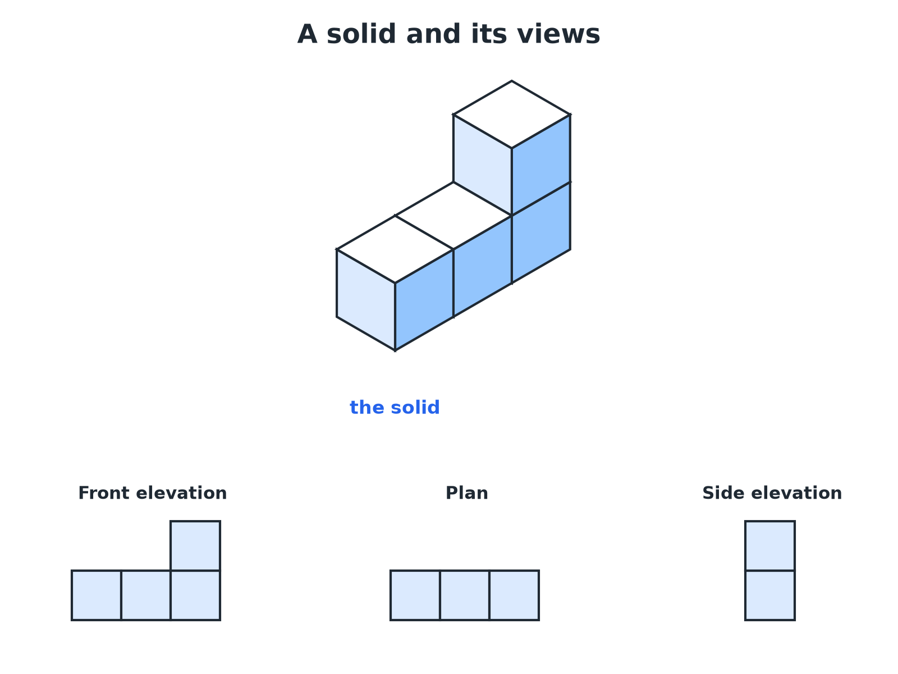

EDEXCEL GCSE MATHS · FOUNDATION & HIGHER
Plan and Elevations
The plan is the view from above; elevations are views from the front and the side.
Transformations and constructions
openrevise.com
Lesson 1 of 8

Slide 9
EDEXCEL GCSE MATHS · FOUNDATION & HIGHER
The Three Views
Plan
The view from directly above.
Front elevation
The view from the front, looking straight at the face you choose to call the front.
Side elevation
The view from one side, usually the right, looking straight at that face.
Transformations and constructions
openrevise.com
Lesson 1 of 8

Slide 10

EDEXCEL GCSE MATHS · FOUNDATION & HIGHER
Drawing the Elevations
A solid is made from four cubes: a row of three, with one more cube on top of the right-hand cube. Draw the front elevation, the plan and the side elevation viewed from the right.
Front elevation: what you see facing the row
Three squares wide; the right column is two high
1
Plan: look down from above
Three squares in a row (the top cube is hidden above the right one)
2
Side elevation from the right: you see the end
One square wide and two squares high
3
ANSWER
Front elevation: an L-shape of 4 squares. Plan: 3 squares in a row. Side elevation: 2 squares in a column.
Transformations and constructions
openrevise.com
Lesson 1 of 8

Slide 11

EDEXCEL GCSE MATHS · FOUNDATION & HIGHER
Tips for Elevations
Draw only what you can see, with straight lines.
Hidden edges
Do not draw edges you cannot see from that direction.
Use a grid
One square on the grid stands for one edge of a cube.
Check your views agree
The front elevation and plan must have the same width; the front and side must have the same height.
Transformations and constructions
openrevise.com
Lesson 1 of 8

Slide 12

EDEXCEL GCSE MATHS · FOUNDATION & HIGHER
Key Terms
Face
A flat surface of a solid.
Edge
A line where two faces meet.
Vertex
A corner where edges meet (plural: vertices).
Plan
The view of a solid from above.
Elevation
The view of a solid from the front or side.
Prism
A solid with the same cross-section all the way through.
Transformations and constructions
openrevise.com
Lesson 1 of 8

Slide 13

EDEXCEL GCSE MATHS · FOUNDATION & HIGHER
YOUR TASK
12 minutes
Build and Draw
Build a solid from 5 cubes: a row of three cubes, a fourth cube placed directly behind the middle cube of the row, and a fifth cube on top of the left-hand cube of the row. Draw its plan and its front elevation.
1
Build the solid.
2
Look from each direction.
3
Draw only what you see.
WHAT A GOOD ANSWER SHOWS
Plan: a row of three squares with a fourth square behind the middle one (a T-shape). Front elevation: three squares wide, with the left column two squares high and the other two columns one square high.
Transformations and constructions
openrevise.com
Lesson 1 of 8
Notes:
Ask students to compare with a partner and check the three views agree.

Slide 14

EDEXCEL GCSE MATHS · FOUNDATION & HIGHER
Can I...?
Name the common solids.
Draw a front elevation.
Count faces, edges and vertices.
Draw a side elevation.
Check with Euler's formula.
Match views to a solid.
Say what a plan is.
Work out the volume of a cube solid from its views.
Transformations and constructions
openrevise.com
Lesson 1 of 8

Slide 15
EDEXCEL GCSE MATHS · FOUNDATION & HIGHER
Summary & Exam Focus
Faces, edges, vertices: count carefully and check with F + V − E = 2.
Plan is from above; elevations are from the sides.
Draw with straight lines on a grid.
Compare your views for consistency.
EXAM FOCUS
A solid is made of 4 cubes: a row of three cubes with one cube on top of the right-hand cube. Draw the front elevation of the solid on a square grid. (2 marks)
Look at the solid from the front only and draw what is visible: an L-shape here. Do not add depth lines.
openrevise.com

Slide 16
EDEXCEL GCSE MATHS · FOUNDATION & HIGHER
Exam Practice: 3D Solids
Answer all questions. · 20 minutes
Question 1 · 2 marks · Non-calculator
Write down the number of faces, edges and vertices of a square-based pyramid.
Question 2 · 2 marks · Non-calculator
A solid has 5 faces, 9 edges and 6 vertices. Two of its faces are triangles. Write down the name of the solid.
Question 3 · 2 marks · Non-calculator
Write down the shape of the plan of a cylinder standing on a flat table.
Transformations and constructions
openrevise.com
Lesson 1 of 8

Slide 17
EDEXCEL GCSE MATHS · FOUNDATION & HIGHER
Exam Practice: 3D Solids (cont.)
Question 4 · 2 marks · Non-calculator
The diagram shows a solid made from four identical cubes. On the grid, draw the front elevation of the solid, viewed from the direction of…
Question 5 · 2 marks · Non-calculator
For the solid in the last question, draw the plan.
Question 6 · 3 marks · Non-calculator
For the same solid, draw the side elevation viewed from the right.
Transformations and constructions
openrevise.com
Lesson 1 of 8

Slide 18
EDEXCEL GCSE MATHS · FOUNDATION & HIGHER
Question 1 · 2 marks · Non-calculator
“
Write down the number of faces, edges and vertices of a square-based pyramid.
HOW TO ANSWER IT
Command word: Non-calculator. Worth 2 marks, so plan before writing.
Transformations and constructions
openrevise.com
Lesson 1 of 8

Slide 19
EDEXCEL GCSE MATHS · FOUNDATION & HIGHER
Question 1 · mark scheme
2 marks available. Award a mark for each point made.
Two correct
B1
All three correct
B1
Transformations and constructions
openrevise.com
Lesson 1 of 8

Slide 20
EDEXCEL GCSE MATHS · FOUNDATION & HIGHER
Question 2 · 2 marks · Non-calculator
“
A solid has 5 faces, 9 edges and 6 vertices. Two of its faces are triangles. Write down the name of the solid.
HOW TO ANSWER IT
Command word: Non-calculator. Worth 2 marks, so plan before writing.
Transformations and constructions
openrevise.com
Lesson 1 of 8

Slide 21
EDEXCEL GCSE MATHS · FOUNDATION & HIGHER
Question 2 · mark scheme
2 marks available. Award a mark for each point made.
Triangular prism
B2
Transformations and constructions
openrevise.com
Lesson 1 of 8

Slide 22
EDEXCEL GCSE MATHS · FOUNDATION & HIGHER
Question 3 · 2 marks · Non-calculator
“
Write down the shape of the plan of a cylinder standing on a flat table.
HOW TO ANSWER IT
Command word: Non-calculator. Worth 2 marks, so plan before writing.
Transformations and constructions
openrevise.com
Lesson 1 of 8

Slide 23
EDEXCEL GCSE MATHS · FOUNDATION & HIGHER
Question 3 · mark scheme
2 marks available. Award a mark for each point made.
Circle
B2
Transformations and constructions
openrevise.com
Lesson 1 of 8

Slide 24
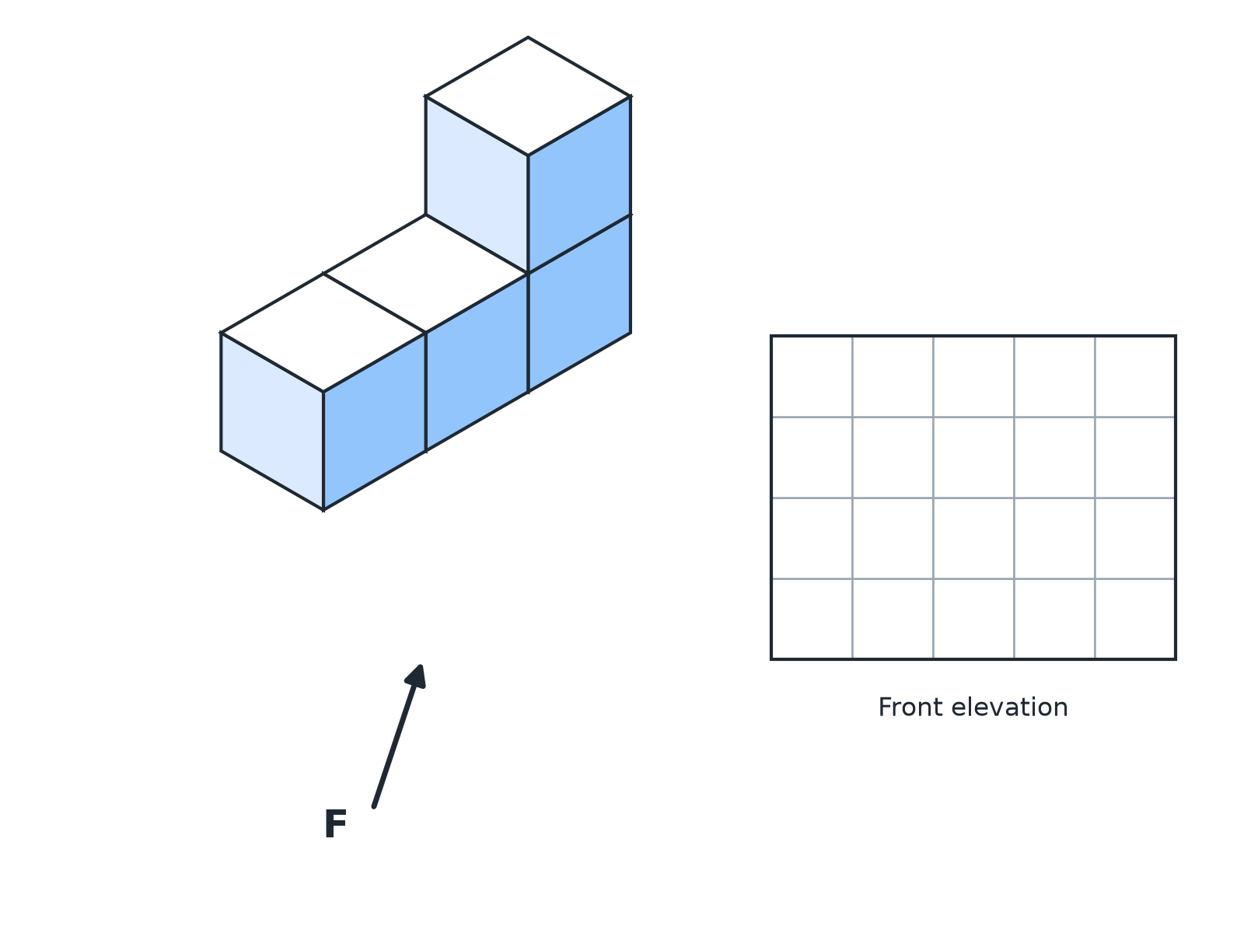
EDEXCEL GCSE MATHS · FOUNDATION & HIGHER
Question 4 · 2 marks · Non-calculator
The diagram shows a solid made from four identical cubes. On the grid, draw the front elevation of the solid, viewed from the direction of the arrow F. (2 marks)
Transformations and constructions
openrevise.com
Lesson 1 of 8

Slide 25
EDEXCEL GCSE MATHS · FOUNDATION & HIGHER
Question 4 · mark scheme
2 marks available. Award a mark for each point made.
Correct number of columns and heights
M1
A fully correct front elevation
A1
Transformations and constructions
openrevise.com
Lesson 1 of 8

Slide 26
EDEXCEL GCSE MATHS · FOUNDATION & HIGHER
Question 5 · 2 marks · Non-calculator
“
For the solid in the last question, draw the plan.
HOW TO ANSWER IT
Command word: Non-calculator. Worth 2 marks, so plan before writing.
Transformations and constructions
openrevise.com
Lesson 1 of 8

Slide 27
EDEXCEL GCSE MATHS · FOUNDATION & HIGHER
Question 5 · mark scheme
2 marks available. Award a mark for each point made.
Three squares in a row
B2
Transformations and constructions
openrevise.com
Lesson 1 of 8

Slide 28
EDEXCEL GCSE MATHS · FOUNDATION & HIGHER
Question 6 · 3 marks · Non-calculator
“
For the same solid, draw the side elevation viewed from the right.
HOW TO ANSWER IT
Command word: Non-calculator. Worth 3 marks, so plan before writing.
Transformations and constructions
openrevise.com
Lesson 1 of 8

Slide 29
EDEXCEL GCSE MATHS · FOUNDATION & HIGHER
Question 6 · mark scheme
3 marks available. Award a mark for each point made.
One square wide
M1
Two squares high
M1
A fully correct drawing
A1
Transformations and constructions
openrevise.com
Lesson 1 of 8

