Slide 1
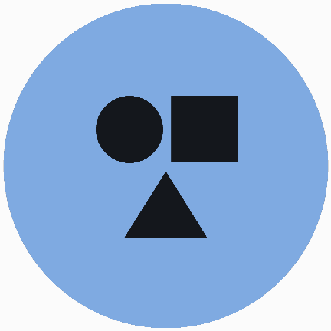
EDEXCEL GCSE MATHS · FOUNDATION & HIGHER
Reflection and rotation
Transformations and constructions
Lesson 2 of 8
openrevise.com

Slide 2

EDEXCEL GCSE MATHS · FOUNDATION & HIGHER
Warm-up
Answer each one, then check.
1
What are the coordinates of the origin?
2
What is the equation of the y-axis?
3
What is the equation of the x-axis?
4
How many degrees in a half turn?
5
What is the reflection of (2, 3) in the y-axis?
Transformations and constructions
openrevise.com
Lesson 2 of 8

Slide 3
EDEXCEL GCSE MATHS · FOUNDATION & HIGHER
Warm-up - Answers
What are the coordinates of the origin?
(0, 0)
1
What is the equation of the y-axis?
x = 0
2
What is the equation of the x-axis?
y = 0
3
How many degrees in a half turn?
180
4
What is the reflection of (2, 3) in the y-axis?
(−2, 3)
5
Transformations and constructions
openrevise.com
Lesson 2 of 8

Slide 4

EDEXCEL GCSE MATHS · FOUNDATION & HIGHER
Learning Objectives
Reflect a shape in a mirror line, including y = x.
1
Rotate a shape about a centre through 90° or 180°.
2
Describe a reflection fully.
3
Describe a rotation fully.
4
Transformations and constructions
openrevise.com
Lesson 2 of 8

Slide 5

EDEXCEL GCSE MATHS · FOUNDATION & HIGHER
Congruent Transformations
Object and image
The original shape is the object; the shape after the transformation is the image.
Congruent
Reflection and rotation keep the size and shape the same, so the image is congruent to the object.
Orientation
A reflection flips the shape; a rotation turns it.
Describe fully
Name the transformation and give all the details needed.
Transformations and constructions
openrevise.com
Lesson 2 of 8

Slide 6
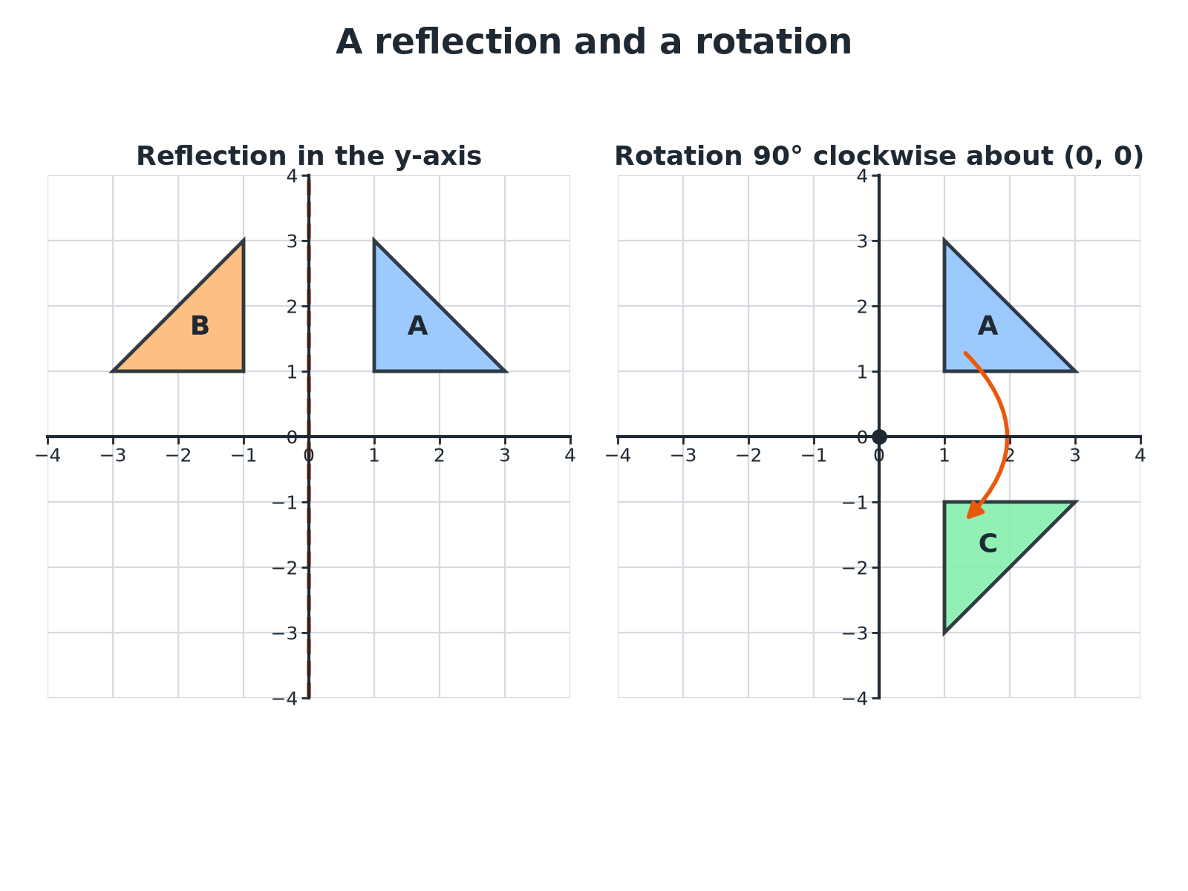

EDEXCEL GCSE MATHS · FOUNDATION & HIGHER
A Reflection and a Rotation
Each point of the image is the same distance from the mirror line, or the same distance from the centre of rotation.
Transformations and constructions
openrevise.com
Lesson 2 of 8

Slide 7

EDEXCEL GCSE MATHS · FOUNDATION & HIGHER
Reflection or Rotation?
REFLECTION
ROTATION
• Flips the shape over a mirror line.
• Each point and its image are the same distance from the line, on opposite sides.
• Describe with the equation of the mirror line, e.g. x = 4, y = x.
• Turns the shape about a fixed point, the centre.
• Each point and its image are the same distance from the centre.
• Describe with the angle, the direction (clockwise or anticlockwise) and the centre.
Transformations and constructions
openrevise.com
Lesson 2 of 8

Slide 8

EDEXCEL GCSE MATHS · FOUNDATION & HIGHER
Reflecting in a Line
Triangle A has vertices (1, 1), (1, 3) and (3, 1). Reflect it in the line x = 4.
Each point is 3, 3 and 1 away from the line x = 4 horizontally
(1, 1) is 3 to the left
1
Go the same distance to the right of the line
(7, 1)
2
Do the same for the other vertices
(1, 3) → (7, 3) and (3, 1) → (5, 1)
3
ANSWER
The image has vertices (7, 1), (7, 3) and (5, 1).
Transformations and constructions
openrevise.com
Lesson 2 of 8

Slide 9
EDEXCEL GCSE MATHS · FOUNDATION & HIGHER
Rotating About the Origin
Rotate triangle A, with vertices (1, 1), (1, 3) and (3, 1), through 90° clockwise about the origin.
Rule for 90° clockwise about the origin
(x, y) → (y, −x)
1
Apply it
(1, 1) → (1, −1)
2
The other vertices
(1, 3) → (3, −1) and (3, 1) → (1, −3)
3
ANSWER
The image has vertices (1, −1), (3, −1) and (1, −3).
Transformations and constructions
openrevise.com
Lesson 2 of 8

Slide 10
EDEXCEL GCSE MATHS · FOUNDATION & HIGHER
Describing a Rotation
Triangle A has vertices (1, 1), (1, 3) and (3, 1). Triangle B has vertices (−1, −1), (−1, −3) and (−3, −1). Describe fully the single transformation that maps A onto B.
The shape has turned upside down
A half turn
1
Each x and y has changed sign
Centre at the origin
2
Name the transformation with the three details
Rotation, 180°, centre (0, 0)
3
ANSWER
A rotation of 180° about the centre (0, 0).
Transformations and constructions
openrevise.com
Lesson 2 of 8

Slide 11
EDEXCEL GCSE MATHS · FOUNDATION & HIGHER
Quick Rules About the Origin
Handy for checking your answers.
Transformation
Rule for (x, y)
Reflection in the y-axis
(−x, y)
Reflection in the x-axis
(x, −y)
Reflection in y = x
(y, x)
Rotation 90° clockwise
(y, −x)
Rotation 90° anticlockwise
(−y, x)
Rotation 180°
(−x, −y)
Transformations and constructions
openrevise.com
Lesson 2 of 8

Slide 12

EDEXCEL GCSE MATHS · FOUNDATION & HIGHER
Key Terms
Object
The original shape before a transformation.
Image
The shape after a transformation.
Congruent
The same shape and size, possibly turned or flipped.
Mirror line
The line a shape is reflected in.
Centre of rotation
The fixed point a shape turns about.
Clockwise
The direction the hands of a clock move.
Transformations and constructions
openrevise.com
Lesson 2 of 8

Slide 13

EDEXCEL GCSE MATHS · FOUNDATION & HIGHER
YOUR TASK
12 minutes
Transformation Detective
Triangle A has vertices (1, 1), (1, 3) and (3, 1). Work out the vertices of its image under (a) reflection in the x-axis (b) reflection in y = x (c) rotation 90° anticlockwise about the origin. Then say which of the three images touches the original at a point.
1
Apply the rule.
2
Plot the image.
3
Check distances from the mirror line.
WHAT A GOOD ANSWER SHOWS
(a) (1, −1), (1, −3), (3, −1). (b) (1, 1), (3, 1), (1, 3), which is the same triangle. (c) (−1, 1), (−3, 1), (−1, 3). Image (b) coincides with A because A is symmetrical about y = x.
Transformations and constructions
openrevise.com
Lesson 2 of 8
Notes:
Ask why the reflection in y = x leaves A unchanged.

Slide 14

EDEXCEL GCSE MATHS · FOUNDATION & HIGHER
Can I...?
Reflect in the axes.
Rotate about another point.
Reflect in a line such as x = 4.
Describe a reflection fully.
Reflect in y = x.
Describe a rotation fully.
Rotate about the origin.
Use the rules for coordinates.
Transformations and constructions
openrevise.com
Lesson 2 of 8

Slide 15
EDEXCEL GCSE MATHS · FOUNDATION & HIGHER
Summary & Exam Focus
Reflection: name it and give the mirror line equation.
Rotation: give the angle, the direction and the centre.
Distances from the mirror line or the centre are preserved.
Rotations and reflections keep the shape congruent.
EXAM FOCUS
Describe fully the single transformation that maps triangle P onto triangle Q, where the vertices of P are (1, 1), (1, 3), (3, 1) and the vertices of Q are (7, 1), (7, 3), (5, 1). (3 marks)
A full description needs the name of the transformation and all its details: for a reflection, the equation of the mirror line.
openrevise.com

Slide 16
EDEXCEL GCSE MATHS · FOUNDATION & HIGHER
Exam Practice: Reflection and Rotation
Answer all questions. Show your working. · 25 minutes
Question 1 · 2 marks · Non-calculator
Triangle A has vertices (1, 1), (1, 3) and (3, 1). It is reflected in the y-axis. Write down the coordinates of the vertices of the image.
Question 2 · 3 marks · Non-calculator
Triangle A has vertices (1, 1), (1, 3) and (3, 1). Triangle B has vertices (−1, −1), (−1, −3) and (−3, −1). Describe fully the single…
Question 3 · 3 marks · Non-calculator
The diagram shows triangles P and Q on a grid. Describe fully the single transformation that maps triangle P onto triangle Q.
Transformations and constructions
openrevise.com
Lesson 2 of 8

Slide 17
EDEXCEL GCSE MATHS · FOUNDATION & HIGHER
Exam Practice: Reflection and Rotation (cont.)
Question 4 · 2 marks · Non-calculator
The point (2, 5) is reflected in the line y = x. Write down the coordinates of the image.
Question 5 · 3 marks · Non-calculator
The point P(3, 1) is rotated 90° anticlockwise about the origin. Write down the coordinates of the image of P.
Question 6 · 3 marks · Non-calculator
The point P(4, 2) is rotated 90° clockwise about the point C(2, 1). Find the coordinates of the image of P.
Transformations and constructions
openrevise.com
Lesson 2 of 8

Slide 18
EDEXCEL GCSE MATHS · FOUNDATION & HIGHER
Question 1 · 2 marks · Non-calculator
“
Triangle A has vertices (1, 1), (1, 3) and (3, 1). It is reflected in the y-axis. Write down the coordinates of the vertices of the image.
HOW TO ANSWER IT
Command word: Non-calculator. Worth 2 marks, so plan before writing.
Transformations and constructions
openrevise.com
Lesson 2 of 8

Slide 19
EDEXCEL GCSE MATHS · FOUNDATION & HIGHER
Question 1 · mark scheme
2 marks available. Award a mark for each point made.
Two vertices correct
B1
All three correct
B1
Transformations and constructions
openrevise.com
Lesson 2 of 8

Slide 20
EDEXCEL GCSE MATHS · FOUNDATION & HIGHER
Question 2 · 3 marks · Non-calculator
“
Triangle A has vertices (1, 1), (1, 3) and (3, 1). Triangle B has vertices (−1, −1), (−1, −3) and (−3, −1). Describe fully the single transformation that maps triangle A onto triangle B.
HOW TO ANSWER IT
Command word: Non-calculator. Worth 3 marks, so plan before writing.
Transformations and constructions
openrevise.com
Lesson 2 of 8

Slide 21
EDEXCEL GCSE MATHS · FOUNDATION & HIGHER
Question 2 · mark scheme
3 marks available. Award a mark for each point made.
Rotation
B1
180°
B1
Centre (0, 0)
B1
Transformations and constructions
openrevise.com
Lesson 2 of 8

Slide 22
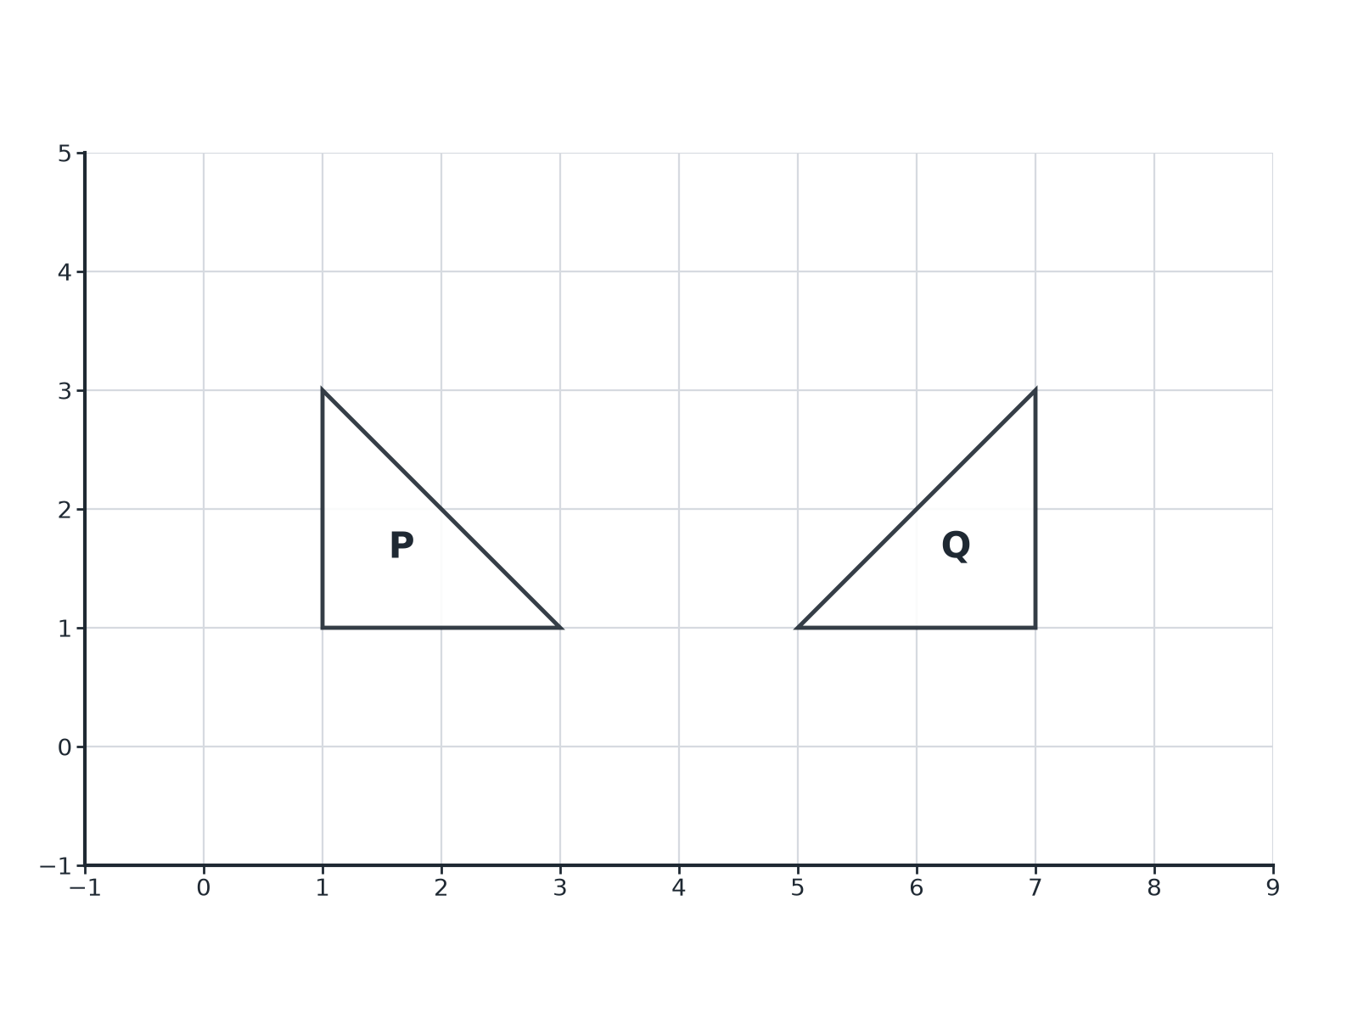
EDEXCEL GCSE MATHS · FOUNDATION & HIGHER
Question 3 · 3 marks · Non-calculator
The diagram shows triangles P and Q on a grid. Describe fully the single transformation that maps triangle P onto triangle Q. (3 marks)
Transformations and constructions
openrevise.com
Lesson 2 of 8

Slide 23
EDEXCEL GCSE MATHS · FOUNDATION & HIGHER
Question 3 · mark scheme
3 marks available. Award a mark for each point made.
Reflection
B1
The line x = 4
B2
Transformations and constructions
openrevise.com
Lesson 2 of 8

Slide 24
EDEXCEL GCSE MATHS · FOUNDATION & HIGHER
Question 4 · 2 marks · Non-calculator
“
The point (2, 5) is reflected in the line y = x. Write down the coordinates of the image.
HOW TO ANSWER IT
Command word: Non-calculator. Worth 2 marks, so plan before writing.
Transformations and constructions
openrevise.com
Lesson 2 of 8

Slide 25
EDEXCEL GCSE MATHS · FOUNDATION & HIGHER
Question 4 · mark scheme
2 marks available. Award a mark for each point made.
One coordinate correct
M1
(5, 2)
A1
Transformations and constructions
openrevise.com
Lesson 2 of 8

Slide 26
EDEXCEL GCSE MATHS · FOUNDATION & HIGHER
Question 5 · 3 marks · Non-calculator
“
The point P(3, 1) is rotated 90° anticlockwise about the origin. Write down the coordinates of the image of P.
HOW TO ANSWER IT
Command word: Non-calculator. Worth 3 marks, so plan before writing.
Transformations and constructions
openrevise.com
Lesson 2 of 8

Slide 27
EDEXCEL GCSE MATHS · FOUNDATION & HIGHER
Question 5 · mark scheme
3 marks available. Award a mark for each point made.
A correct rotation method
M1
One coordinate correct
A1
(−1, 3)
A1
Transformations and constructions
openrevise.com
Lesson 2 of 8

Slide 28
EDEXCEL GCSE MATHS · FOUNDATION & HIGHER
Question 6 · 3 marks · Non-calculator
“
The point P(4, 2) is rotated 90° clockwise about the point C(2, 1). Find the coordinates of the image of P.
HOW TO ANSWER IT
Command word: Non-calculator. Worth 3 marks, so plan before writing.
Transformations and constructions
openrevise.com
Lesson 2 of 8

Slide 29
EDEXCEL GCSE MATHS · FOUNDATION & HIGHER
Question 6 · mark scheme
3 marks available. Award a mark for each point made.
Vector from C to P is (2, 1)
M1
Rotated vector (1, −2)
M1
(3, −1)
A1
Transformations and constructions
openrevise.com
Lesson 2 of 8

