Slide 1

EDEXCEL GCSE MATHS · FOUNDATION & HIGHER
Translations and combinations of different transformations
Transformations and constructions
Lesson 4 of 8
openrevise.com

Slide 2

EDEXCEL GCSE MATHS · FOUNDATION & HIGHER
Warm-up
Answer each one, then check.
1
What is the reflection of (3, 1) in the y-axis?
2
What is the image of (2, 3) under a 180° rotation about the origin?
3
What does congruent mean?
4
Work out (5, 2) + (3, −4) as coordinates.
5
What is a scale factor?
Transformations and constructions
openrevise.com
Lesson 4 of 8

Slide 3
EDEXCEL GCSE MATHS · FOUNDATION & HIGHER
Warm-up - Answers
What is the reflection of (3, 1) in the y-axis?
(−3, 1)
1
What is the image of (2, 3) under a 180° rotation about the origin?
(−2, −3)
2
What does congruent mean?
Same shape and size
3
Work out (5, 2) + (3, −4) as coordinates.
(8, −2)
4
What is a scale factor?
The number lengths are multiplied by
5
Transformations and constructions
openrevise.com
Lesson 4 of 8

Slide 4

EDEXCEL GCSE MATHS · FOUNDATION & HIGHER
Learning Objectives
Translate a shape using a column vector.
1
Describe a translation with a vector.
2
Carry out and describe combinations of transformations.
3
Find the single transformation equivalent to a combination.
4
Transformations and constructions
openrevise.com
Lesson 4 of 8

Slide 5

EDEXCEL GCSE MATHS · FOUNDATION & HIGHER
THE KEY IDEA
A translation slides every point of a shape the same distance in the same direction.
It is described by a column vector: the top number is the move right (negative means left), the bottom number is the move up (negative means down).
Transformations and constructions
openrevise.com
Lesson 4 of 8

Slide 6
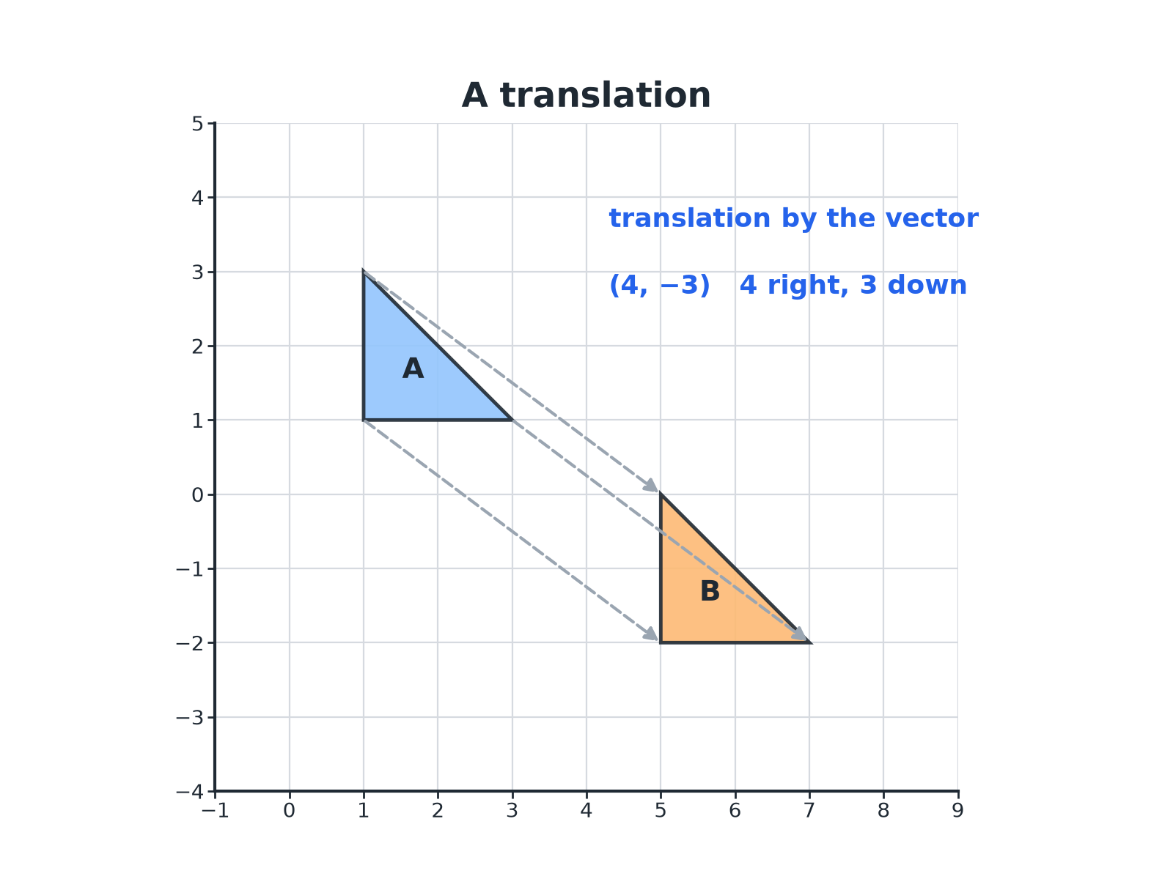

EDEXCEL GCSE MATHS · FOUNDATION & HIGHER
A Translation
Every point moves the same way.
Transformations and constructions
openrevise.com
Lesson 4 of 8

Slide 7

EDEXCEL GCSE MATHS · FOUNDATION & HIGHER
Translating a Shape
Triangle A has vertices (1, 1), (1, 3) and (3, 1). Translate it by the vector beginpmatrix 4 \ −3 endpmatrix.
Add 4 to each x-coordinate (move right)
1 + 4 = 5
1
Subtract 3 from each y-coordinate (move down)
1 − 3 = −2
2
Apply it to every vertex
(1, 1) → (5, −2), (1, 3) → (5, 0), (3, 1) → (7, −2)
3
ANSWER
The image has vertices (5, −2), (5, 0) and (7, −2).
Transformations and constructions
openrevise.com
Lesson 4 of 8

Slide 8
EDEXCEL GCSE MATHS · FOUNDATION & HIGHER
Describing a Translation
Point P is at (2, 5) and its image is at (−1, 2). Describe the translation.
Change in x
−1 − 2 = −3: 3 to the left
1
Change in y
2 − 5 = −3: 3 down
2
Write as a vector
beginpmatrix −3 \ −3 endpmatrix
3
ANSWER
A translation by the vector beginpmatrix −3 \ −3 endpmatrix.
Transformations and constructions
openrevise.com
Lesson 4 of 8

Slide 9

EDEXCEL GCSE MATHS · FOUNDATION & HIGHER
PART TWO
Combining Transformations
Do them one after the other.
openrevise.com

Slide 10

EDEXCEL GCSE MATHS · FOUNDATION & HIGHER
A Combination of Two Transformations
Apply the first, then the second to the image.
Do them in order
The order can change the answer, so work through the steps carefully.
Label each image
Name the shapes A, B and C to keep track.
Find the single equivalent
Look for the one transformation that takes the original straight to the final image.
Transformations and constructions
openrevise.com
Lesson 4 of 8

Slide 11

EDEXCEL GCSE MATHS · FOUNDATION & HIGHER
Useful Combinations
Two reflections in parallel lines
Equivalent to a translation.
Two reflections in lines that cross
Equivalent to a rotation about the crossing point.
Two rotations about the same centre
Equivalent to one rotation about that centre.
Two translations
Equivalent to one translation: add the vectors.
Transformations and constructions
openrevise.com
Lesson 4 of 8

Slide 12
EDEXCEL GCSE MATHS · FOUNDATION & HIGHER
Describing a Combination
Triangle A has vertices (1, 1), (1, 3), (3, 1). Triangle B is A reflected in the y-axis. Triangle C is B reflected in the x-axis. Describe the single transformation that maps A onto C.
B has vertices
(−1, 1), (−1, 3), (−3, 1)
1
C is B reflected in the x-axis
(−1, −1), (−1, −3), (−3, −1)
2
Compare A and C
Every coordinate has changed sign
3
Identify
A half turn about the origin
4
ANSWER
A rotation of 180° about (0, 0).
Transformations and constructions
openrevise.com
Lesson 4 of 8

Slide 13

EDEXCEL GCSE MATHS · FOUNDATION & HIGHER
Key Terms
Translation
A slide of every point by the same vector.
Column vector
A pair of numbers, one above the other, giving a move right and up.
Combination
Two or more transformations done one after the other.
Single transformation
One transformation that does the same job as a combination.
Invariant point
A point that does not move under a transformation.
Image
The shape after a transformation.
Transformations and constructions
openrevise.com
Lesson 4 of 8

Slide 14

EDEXCEL GCSE MATHS · FOUNDATION & HIGHER
YOUR TASK
12 minutes
Slide and Flip
Shape A has vertices (1, 1), (3, 1), (1, 2). Translate A by beginpmatrix 2 \ 3 endpmatrix to get B, then reflect B in the y-axis to get C. Write the vertices of B and C, and describe fully the single transformation that maps B onto C.
1
Do the translation first.
2
Reflect the image.
3
Compare with the original.
WHAT A GOOD ANSWER SHOWS
B has vertices (3, 4), (5, 4), (3, 5). C has vertices (−3, 4), (−5, 4), (−3, 5). B maps onto C by a reflection in the y-axis (the line x = 0).
Transformations and constructions
openrevise.com
Lesson 4 of 8
Notes:
Ask what the combination would be if the order were swapped.

Slide 15

EDEXCEL GCSE MATHS · FOUNDATION & HIGHER
Can I...?
Translate using a column vector.
Label images clearly.
Describe a translation with a vector.
Find a single equivalent transformation.
Add vectors for two translations.
Identify invariant points.
Do a combination in the right order.
Describe every transformation fully.
Transformations and constructions
openrevise.com
Lesson 4 of 8

Slide 16
EDEXCEL GCSE MATHS · FOUNDATION & HIGHER
Summary & Exam Focus
Translation vector: right/left on top, up/down underneath.
Two translations add.
Work through combinations one step at a time.
Always describe fully: name plus details.
EXAM FOCUS
Triangle B is the reflection of triangle A in the y-axis. Triangle C is the reflection of triangle B in the x-axis. Describe fully the single transformation that maps triangle A onto triangle C. (3 marks)
Find the coordinates of A and C and compare them. Every sign changing points to a half turn about the origin.
openrevise.com

Slide 17
EDEXCEL GCSE MATHS · FOUNDATION & HIGHER
Exam Practice: Translations and Combinations
Answer all questions. Show your working. · 30 minutes
Question 1 · 2 marks · Non-calculator
Triangle A has vertices (1, 1), (1, 3) and (3, 1). It is translated by the vector beginpmatrix 4 \ −3 endpmatrix. Write down the…
Question 2 · 2 marks · Non-calculator
The point P(2, 5) is mapped to P'(−1, 2) by a translation. Write the translation as a column vector.
Question 3 · 4 marks · Non-calculator
The diagram shows triangles A, B and C. (a) Describe fully the single transformation that maps A onto B. (b) Describe fully the single…
Transformations and constructions
openrevise.com
Lesson 4 of 8

Slide 18
EDEXCEL GCSE MATHS · FOUNDATION & HIGHER
Exam Practice: Translations and Combinations (cont.)
Question 4 · 3 marks · Non-calculator
Using the diagram in the last question, describe fully the single transformation that maps triangle A onto triangle C.
Question 5 · 2 marks · Non-calculator
A shape is translated by beginpmatrix 3 \ 2 endpmatrix and then by beginpmatrix −5 \ 4 endpmatrix. Write down the single translation that…
Question 6 · 3 marks · Non-calculator
The shape P is reflected in the line x = 1 and then the image is reflected in the line x = 4. Describe fully the single transformation that…
Transformations and constructions
openrevise.com
Lesson 4 of 8

Slide 19
EDEXCEL GCSE MATHS · FOUNDATION & HIGHER
Question 1 · 2 marks · Non-calculator
“
Triangle A has vertices (1, 1), (1, 3) and (3, 1). It is translated by the vector beginpmatrix 4 \ −3 endpmatrix. Write down the coordinates of the vertices of the image.
HOW TO ANSWER IT
Command word: Non-calculator. Worth 2 marks, so plan before writing.
Transformations and constructions
openrevise.com
Lesson 4 of 8

Slide 20
EDEXCEL GCSE MATHS · FOUNDATION & HIGHER
Question 1 · mark scheme
2 marks available. Award a mark for each point made.
Two vertices correct
B1
All three correct
B1
Transformations and constructions
openrevise.com
Lesson 4 of 8

Slide 21
EDEXCEL GCSE MATHS · FOUNDATION & HIGHER
Question 2 · 2 marks · Non-calculator
“
The point P(2, 5) is mapped to P'(−1, 2) by a translation. Write the translation as a column vector.
HOW TO ANSWER IT
Command word: Non-calculator. Worth 2 marks, so plan before writing.
Transformations and constructions
openrevise.com
Lesson 4 of 8

Slide 22
EDEXCEL GCSE MATHS · FOUNDATION & HIGHER
Question 2 · mark scheme
2 marks available. Award a mark for each point made.
One number correct
M1
Both correct
A1
Transformations and constructions
openrevise.com
Lesson 4 of 8

Slide 23
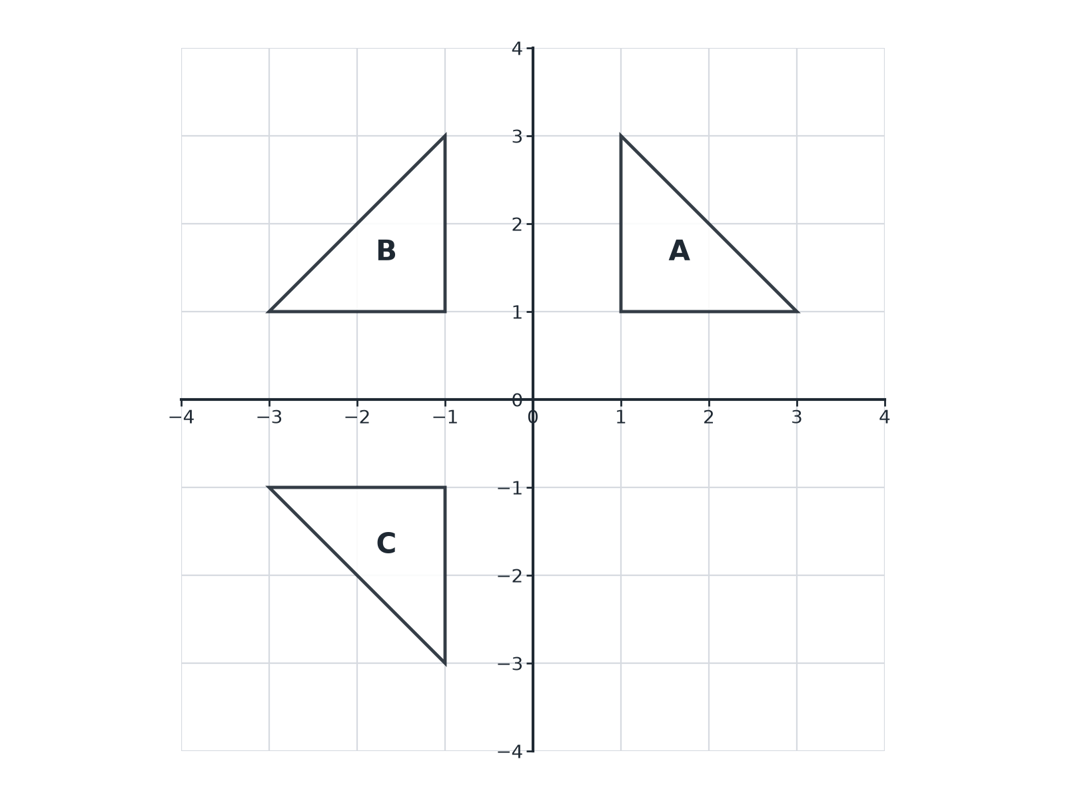
EDEXCEL GCSE MATHS · FOUNDATION & HIGHER
Question 3 · 4 marks · Non-calculator
The diagram shows triangles A, B and C. (a) Describe fully the single transformation that maps A onto B. (b) Describe fully the single transformation that maps B onto C. (4 marks)
Transformations and constructions
openrevise.com
Lesson 4 of 8

Slide 24
EDEXCEL GCSE MATHS · FOUNDATION & HIGHER
Question 3 · mark scheme
4 marks available. Award a mark for each point made.
(a) Reflection
B1
(a) The y-axis, or x = 0
B1
(b) Reflection
B1
(b) The x-axis, or y = 0
B1
Transformations and constructions
openrevise.com
Lesson 4 of 8

Slide 25
EDEXCEL GCSE MATHS · FOUNDATION & HIGHER
Question 4 · 3 marks · Non-calculator
“
Using the diagram in the last question, describe fully the single transformation that maps triangle A onto triangle C.
HOW TO ANSWER IT
Command word: Non-calculator. Worth 3 marks, so plan before writing.
Transformations and constructions
openrevise.com
Lesson 4 of 8

Slide 26
EDEXCEL GCSE MATHS · FOUNDATION & HIGHER
Question 4 · mark scheme
3 marks available. Award a mark for each point made.
Rotation
B1
180°
B1
Centre (0, 0)
B1
Transformations and constructions
openrevise.com
Lesson 4 of 8

Slide 27
EDEXCEL GCSE MATHS · FOUNDATION & HIGHER
Question 5 · 2 marks · Non-calculator
“
A shape is translated by beginpmatrix 3 \ 2 endpmatrix and then by beginpmatrix −5 \ 4 endpmatrix. Write down the single translation that does the same job.
HOW TO ANSWER IT
Command word: Non-calculator. Worth 2 marks, so plan before writing.
Transformations and constructions
openrevise.com
Lesson 4 of 8

Slide 28
EDEXCEL GCSE MATHS · FOUNDATION & HIGHER
Question 5 · mark scheme
2 marks available. Award a mark for each point made.
Adding the vectors
M1
beginpmatrix −2 \ 6 endpmatrix
A1
Transformations and constructions
openrevise.com
Lesson 4 of 8

Slide 29
EDEXCEL GCSE MATHS · FOUNDATION & HIGHER
Question 6 · 3 marks · Non-calculator
“
The shape P is reflected in the line x = 1 and then the image is reflected in the line x = 4. Describe fully the single transformation that is equivalent to these two reflections.
HOW TO ANSWER IT
Command word: Non-calculator. Worth 3 marks, so plan before writing.
Transformations and constructions
openrevise.com
Lesson 4 of 8

Slide 30
EDEXCEL GCSE MATHS · FOUNDATION & HIGHER
Question 6 · mark scheme
3 marks available. Award a mark for each point made.
Translation
B1
Distance 6 (twice the gap between the lines)
M1
beginpmatrix 6 \ 0 endpmatrix
A1
Transformations and constructions
openrevise.com
Lesson 4 of 8

