Slide 1

EDEXCEL GCSE MATHS · FOUNDATION & HIGHER
Scale drawings and bearings
Transformations and constructions
Lesson 5 of 8
openrevise.com

Slide 2

EDEXCEL GCSE MATHS · FOUNDATION & HIGHER
Warm-up
Answer each one, then check.
1
How many centimetres are in a kilometre?
2
What do the angles round a point add up to?
3
What do co-interior angles add up to?
4
Work out 3.2 × 50 000.
5
What is the compass direction opposite to north-east?
Transformations and constructions
openrevise.com
Lesson 5 of 8

Slide 3
EDEXCEL GCSE MATHS · FOUNDATION & HIGHER
Warm-up - Answers
How many centimetres are in a kilometre?
100 000
1
What do the angles round a point add up to?
360°
2
What do co-interior angles add up to?
180°
3
Work out 3.2 × 50 000.
160 000
4
What is the compass direction opposite to north-east?
South-west
5
Transformations and constructions
openrevise.com
Lesson 5 of 8

Slide 4

EDEXCEL GCSE MATHS · FOUNDATION & HIGHER
Learning Objectives
Use a scale in the form 1 : n to change between drawing and real lengths.
1
Measure and write three-figure bearings.
2
Find the bearing back from B to A.
3
Solve problems using bearings and right-angled triangles.
4
Transformations and constructions
openrevise.com
Lesson 5 of 8

Slide 5

EDEXCEL GCSE MATHS · FOUNDATION & HIGHER
Map Scales
A scale of 1 : 50 000 means 1 cm on the map is 50 000 cm in real life.
Map to real
Multiply by the scale, then change units. 3.2 cm on a 1 : 50 000 map is 160 000 cm, which is 1.6 km.
Real to map
Divide by the scale. 4.5 km is 450 000 cm, so on a 1 : 25 000 map it is 450 000 ÷ 25 000 = 18 cm.
Units
100 000 cm = 1 km and 100 cm = 1 m.
Transformations and constructions
openrevise.com
Lesson 5 of 8

Slide 6

EDEXCEL GCSE MATHS · FOUNDATION & HIGHER
BEARINGS
A bearing is an angle measured clockwise from north, always written with three figures.
North is 000°, east is 090°, south is 180° and west is 270°.
Transformations and constructions
openrevise.com
Lesson 5 of 8

Slide 7
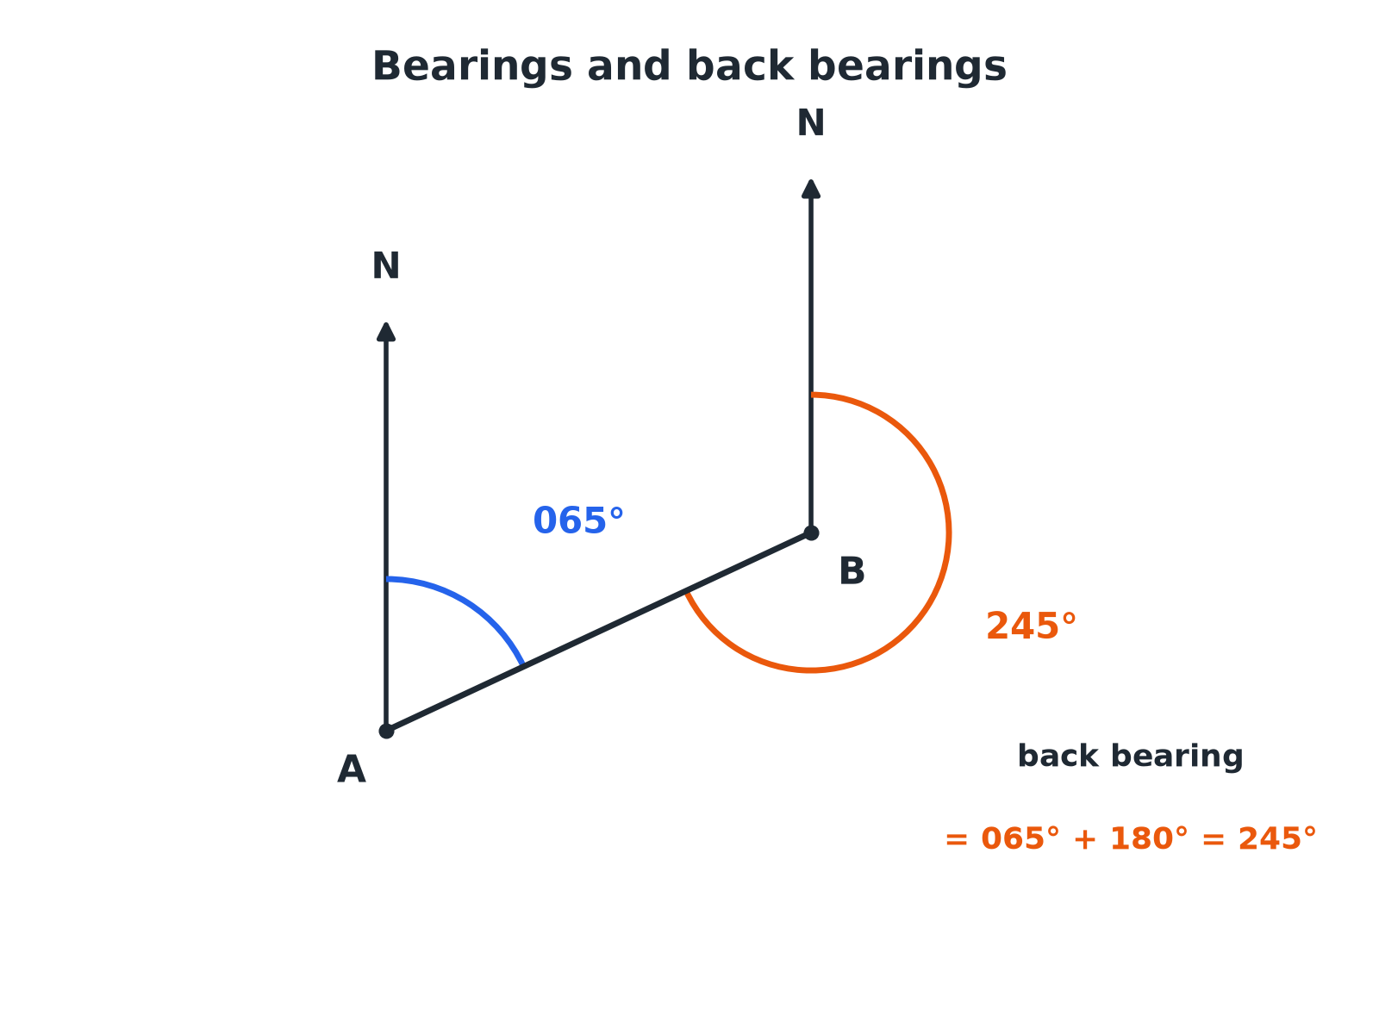

EDEXCEL GCSE MATHS · FOUNDATION & HIGHER
Reading a Bearing
Measure clockwise from north, at the point you are travelling from.
Transformations and constructions
openrevise.com
Lesson 5 of 8

Slide 8

EDEXCEL GCSE MATHS · FOUNDATION & HIGHER
Measuring a Bearing
Follow the same steps every time.
1
2
3
4
Find the starting point
The bearing of B from A starts at A.
Draw or imagine a north line at A
It points straight up the page.
Measure clockwise
From the north line round to the line AB.
Write three figures
Add zeros at the front, e.g. 065°.
Transformations and constructions
openrevise.com
Lesson 5 of 8

Slide 9

EDEXCEL GCSE MATHS · FOUNDATION & HIGHER
A Back Bearing
The bearing of B from A is 065°. Work out the bearing of A from B.
The north lines at A and B are parallel
Co-interior angles add up to 180°
1
Add 180° to a bearing under 180°
065 + 180
2
Work it out
245
3
ANSWER
245°
Transformations and constructions
openrevise.com
Lesson 5 of 8

Slide 10
EDEXCEL GCSE MATHS · FOUNDATION & HIGHER
A Journey with Bearings
A ship sails 8 km on a bearing of 070° and then 6 km on a bearing of 160°. How far is it from its starting point?
The two bearings differ by
160 − 70 = 90, so the path turns through a right angle
1
Use Pythagoras
8² + 6² = 64 + 36 = 100
2
Distance
√100 = 10
3
ANSWER
10 km
Transformations and constructions
openrevise.com
Lesson 5 of 8

Slide 11
EDEXCEL GCSE MATHS · FOUNDATION & HIGHER
Using a Map Scale
Two towns are 3.2 cm apart on a map with scale 1 : 50 000. How far apart are they in real life?
Real length in cm
3.2 × 50 000 = 160 000
1
Change to kilometres
160 000 ÷ 100 000
2
ANSWER
1.6 km
Transformations and constructions
openrevise.com
Lesson 5 of 8

Slide 12

EDEXCEL GCSE MATHS · FOUNDATION & HIGHER
Back Bearings
Add or subtract 180 so the answer stays between 0 and 360.
Bearing of B from A
Rule
Bearing of A from B
065°
+ 180°
245°
130°
+ 180°
310°
250°
− 180°
070°
305°
− 180°
125°
Transformations and constructions
openrevise.com
Lesson 5 of 8

Slide 13

EDEXCEL GCSE MATHS · FOUNDATION & HIGHER
Key Terms
Bearing
An angle measured clockwise from north, written with three figures.
Scale
The ratio of a length on a drawing to the real length.
Back bearing
The bearing of A from B when you know the bearing of B from A.
Clockwise
The direction the hands of a clock turn.
Three-figure bearing
A bearing written with hundreds, tens and units, such as 045°.
Compass point
One of N, E, S, W and their combinations.
Transformations and constructions
openrevise.com
Lesson 5 of 8

Slide 14

EDEXCEL GCSE MATHS · FOUNDATION & HIGHER
YOUR TASK
15 minutes
Treasure Trail
Start at a point marked A. Draw the route: 5 cm on a bearing of 050°, then 4 cm on a bearing of 140°, then 6 cm on a bearing of 230°. Measure the final distance and bearing back to A. If the scale is 1 cm to 100 m, work out the real distance.
1
Draw a north line at each point.
2
Use a protractor from north.
3
Convert with the scale.
WHAT A GOOD ANSWER SHOWS
Students should end near the start; the route back to A is roughly 3 to 4 cm on a bearing near 300°. Real distance is about 300 to 400 m.
Transformations and constructions
openrevise.com
Lesson 5 of 8
Notes:
Check students measure clockwise from a north line drawn at each turning point.

Slide 15

EDEXCEL GCSE MATHS · FOUNDATION & HIGHER
Can I...?
Use a map scale 1 : n.
Find a back bearing.
Convert between cm, m and km.
Draw a bearing accurately.
Measure a bearing.
Use bearings with Pythagoras.
Write a bearing with three figures.
Explain why the north lines are parallel.
Transformations and constructions
openrevise.com
Lesson 5 of 8

Slide 16
EDEXCEL GCSE MATHS · FOUNDATION & HIGHER
Summary & Exam Focus
Bearings are measured clockwise from north, with three figures.
Back bearing: ± 180°.
Scale 1 : n: multiply to get the real length; divide to get the drawing length.
Draw a sketch and mark north lines.
EXAM FOCUS
The bearing of B from A is 072°. Work out the bearing of A from B. (3 marks)
Add 180 when the bearing is less than 180, and subtract 180 when it is more. Draw a north line at both points and mark the co-interior angles.
openrevise.com

Slide 17
EDEXCEL GCSE MATHS · FOUNDATION & HIGHER
Exam Practice: Scale Drawings and Bearings
Answer all questions. Show your working. · 30 minutes
Question 1 · 2 marks · Non-calculator
The scale on a map is 1 : 50 000. Two towns are 3.2 cm apart on the map. Work out the real distance between the towns, in kilometres.
Question 2 · 2 marks · Non-calculator
Two villages are 4.5 km apart. Work out the distance between them on a map with scale 1 : 25 000. Give your answer in centimetres.
Question 3 · 3 marks · Non-calculator
The diagram shows two points, A and B. The bearing of B from A is 072°. Work out the bearing of A from B.
Transformations and constructions
openrevise.com
Lesson 5 of 8

Slide 18
EDEXCEL GCSE MATHS · FOUNDATION & HIGHER
Exam Practice: Scale Drawings and Bearings (cont.)
Question 4 · 4 marks · Calculator
A ship sails 8 km on a bearing of 070°. It then sails 6 km on a bearing of 160°. Work out the distance of the ship from its starting point.
Question 5 · 2 marks · Non-calculator
A lighthouse is due south-west of a harbour. Write down the bearing of the lighthouse from the harbour.
Question 6 · 2 marks · Non-calculator
The bearing of Q from P is 250°. Work out the bearing of P from Q.
Transformations and constructions
openrevise.com
Lesson 5 of 8

Slide 19
EDEXCEL GCSE MATHS · FOUNDATION & HIGHER
Question 1 · 2 marks · Non-calculator
“
The scale on a map is 1 : 50 000. Two towns are 3.2 cm apart on the map. Work out the real distance between the towns, in kilometres.
HOW TO ANSWER IT
Command word: Non-calculator. Worth 2 marks, so plan before writing.
Transformations and constructions
openrevise.com
Lesson 5 of 8

Slide 20
EDEXCEL GCSE MATHS · FOUNDATION & HIGHER
Question 1 · mark scheme
2 marks available. Award a mark for each point made.
3.2 × 50 000
M1
1.6
A1
Transformations and constructions
openrevise.com
Lesson 5 of 8

Slide 21
EDEXCEL GCSE MATHS · FOUNDATION & HIGHER
Question 2 · 2 marks · Non-calculator
“
Two villages are 4.5 km apart. Work out the distance between them on a map with scale 1 : 25 000. Give your answer in centimetres.
HOW TO ANSWER IT
Command word: Non-calculator. Worth 2 marks, so plan before writing.
Transformations and constructions
openrevise.com
Lesson 5 of 8

Slide 22
EDEXCEL GCSE MATHS · FOUNDATION & HIGHER
Question 2 · mark scheme
2 marks available. Award a mark for each point made.
450 000 seen
M1
18
A1
Transformations and constructions
openrevise.com
Lesson 5 of 8

Slide 23
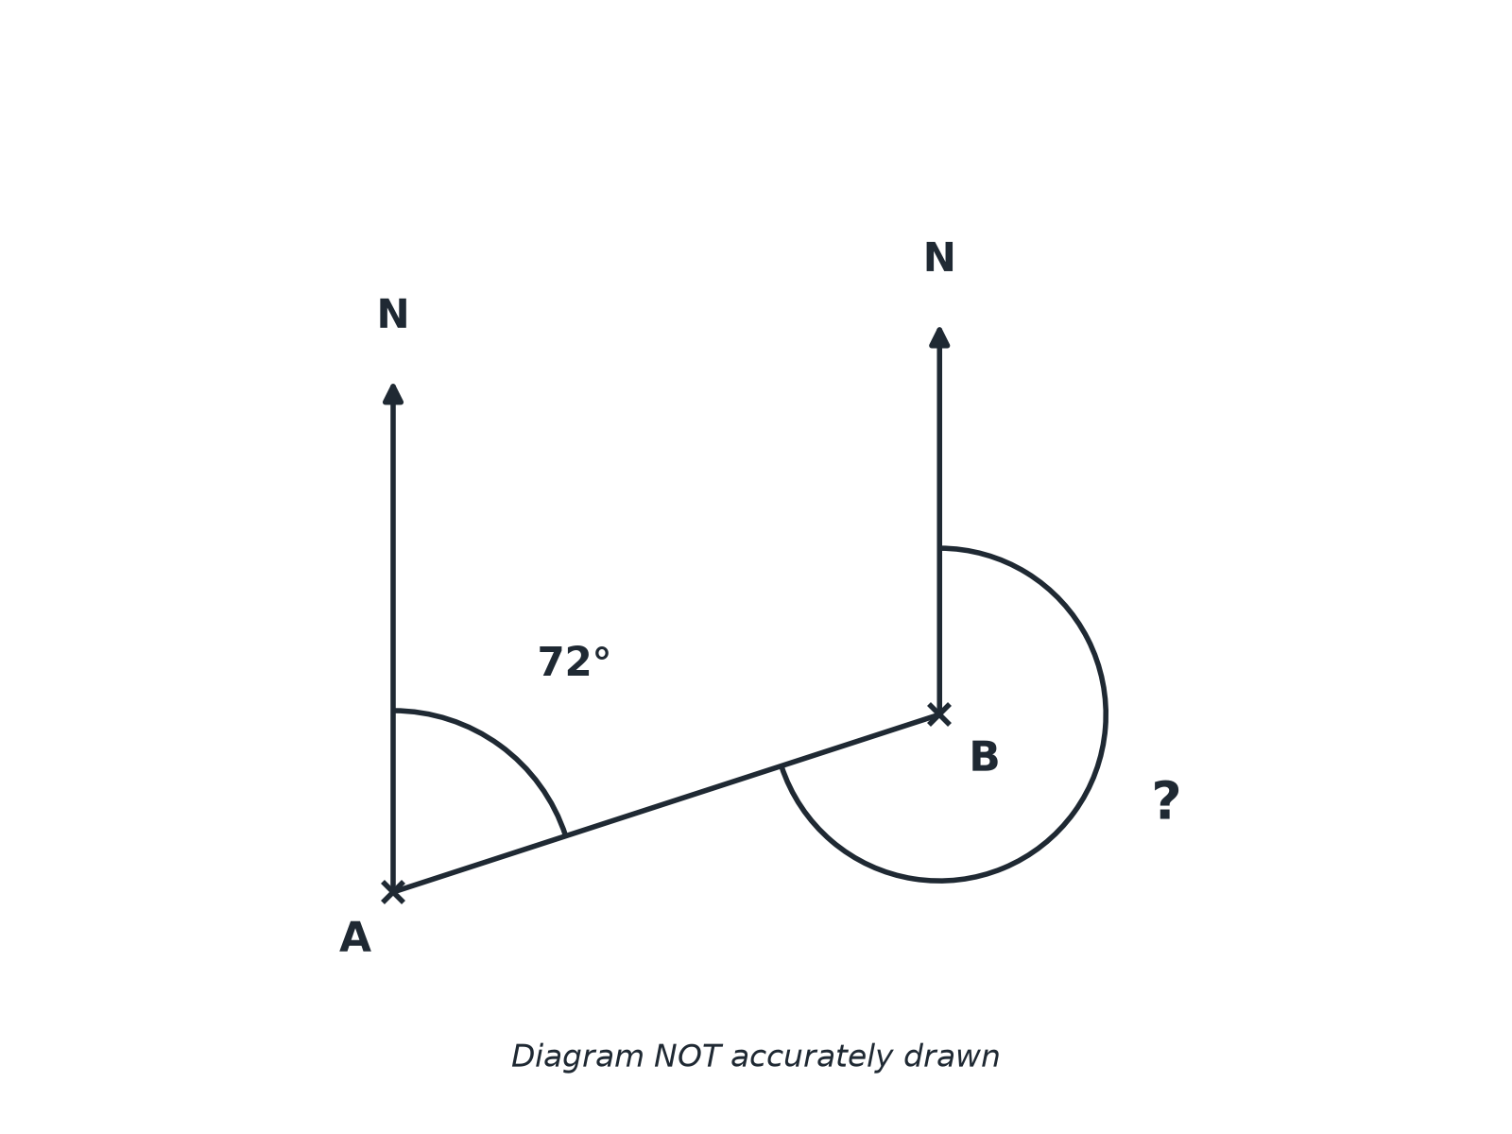
EDEXCEL GCSE MATHS · FOUNDATION & HIGHER
Question 3 · 3 marks · Non-calculator
The diagram shows two points, A and B. The bearing of B from A is 072°. Work out the bearing of A from B. (3 marks)
Transformations and constructions
openrevise.com
Lesson 5 of 8

Slide 24
EDEXCEL GCSE MATHS · FOUNDATION & HIGHER
Question 3 · mark scheme
3 marks available. Award a mark for each point made.
180 + 72 or 360 − (180 − 72)
M1
252
A1
A reason: parallel lines or back bearing
C1
Transformations and constructions
openrevise.com
Lesson 5 of 8

Slide 25
EDEXCEL GCSE MATHS · FOUNDATION & HIGHER
Question 4 · 4 marks · Calculator
“
A ship sails 8 km on a bearing of 070°. It then sails 6 km on a bearing of 160°. Work out the distance of the ship from its starting point.
HOW TO ANSWER IT
Command word: Calculator. Worth 4 marks, so plan before writing.
Transformations and constructions
openrevise.com
Lesson 5 of 8

Slide 26
EDEXCEL GCSE MATHS · FOUNDATION & HIGHER
Question 4 · mark scheme
4 marks available. Award a mark for each point made.
Right angle found
M1
8² + 6²
M1
100
A1
10
A1
Transformations and constructions
openrevise.com
Lesson 5 of 8

Slide 27
EDEXCEL GCSE MATHS · FOUNDATION & HIGHER
Question 5 · 2 marks · Non-calculator
“
A lighthouse is due south-west of a harbour. Write down the bearing of the lighthouse from the harbour.
HOW TO ANSWER IT
Command word: Non-calculator. Worth 2 marks, so plan before writing.
Transformations and constructions
openrevise.com
Lesson 5 of 8

Slide 28
EDEXCEL GCSE MATHS · FOUNDATION & HIGHER
Question 5 · mark scheme
2 marks available. Award a mark for each point made.
225
B2
Transformations and constructions
openrevise.com
Lesson 5 of 8

Slide 29
EDEXCEL GCSE MATHS · FOUNDATION & HIGHER
Question 6 · 2 marks · Non-calculator
“
The bearing of Q from P is 250°. Work out the bearing of P from Q.
HOW TO ANSWER IT
Command word: Non-calculator. Worth 2 marks, so plan before writing.
Transformations and constructions
openrevise.com
Lesson 5 of 8

Slide 30
EDEXCEL GCSE MATHS · FOUNDATION & HIGHER
Question 6 · mark scheme
2 marks available. Award a mark for each point made.
250 − 180
M1
070
A1
Transformations and constructions
openrevise.com
Lesson 5 of 8

