Slide 1

EDEXCEL GCSE MATHS · FOUNDATION & HIGHER
Loci
Transformations and constructions
Lesson 8 of 8
openrevise.com

Slide 2

EDEXCEL GCSE MATHS · FOUNDATION & HIGHER
Warm-up
Answer each one, then check.
1
What is the distance round a circle called?
2
What is a perpendicular bisector?
3
What does an angle bisector do?
4
What is the radius of a circle with diameter 8 cm?
5
What does equidistant mean?
Transformations and constructions
openrevise.com
Lesson 8 of 8

Slide 3
EDEXCEL GCSE MATHS · FOUNDATION & HIGHER
Warm-up - Answers
What is the distance round a circle called?
The circumference
1
What is a perpendicular bisector?
A line at 90° through the midpoint of a segment
2
What does an angle bisector do?
Cuts an angle in half
3
What is the radius of a circle with diameter 8 cm?
4 cm
4
What does equidistant mean?
The same distance from
5
Transformations and constructions
openrevise.com
Lesson 8 of 8

Slide 4

EDEXCEL GCSE MATHS · FOUNDATION & HIGHER
Learning Objectives
Explain what a locus is.
1
Draw the four standard loci.
2
Combine loci to find a region.
3
Solve problems in context, using a scale.
4
Transformations and constructions
openrevise.com
Lesson 8 of 8

Slide 5

EDEXCEL GCSE MATHS · FOUNDATION & HIGHER
LOCUS
A locus is the set of all points that follow a rule.
The plural is loci.
Transformations and constructions
openrevise.com
Lesson 8 of 8

Slide 6
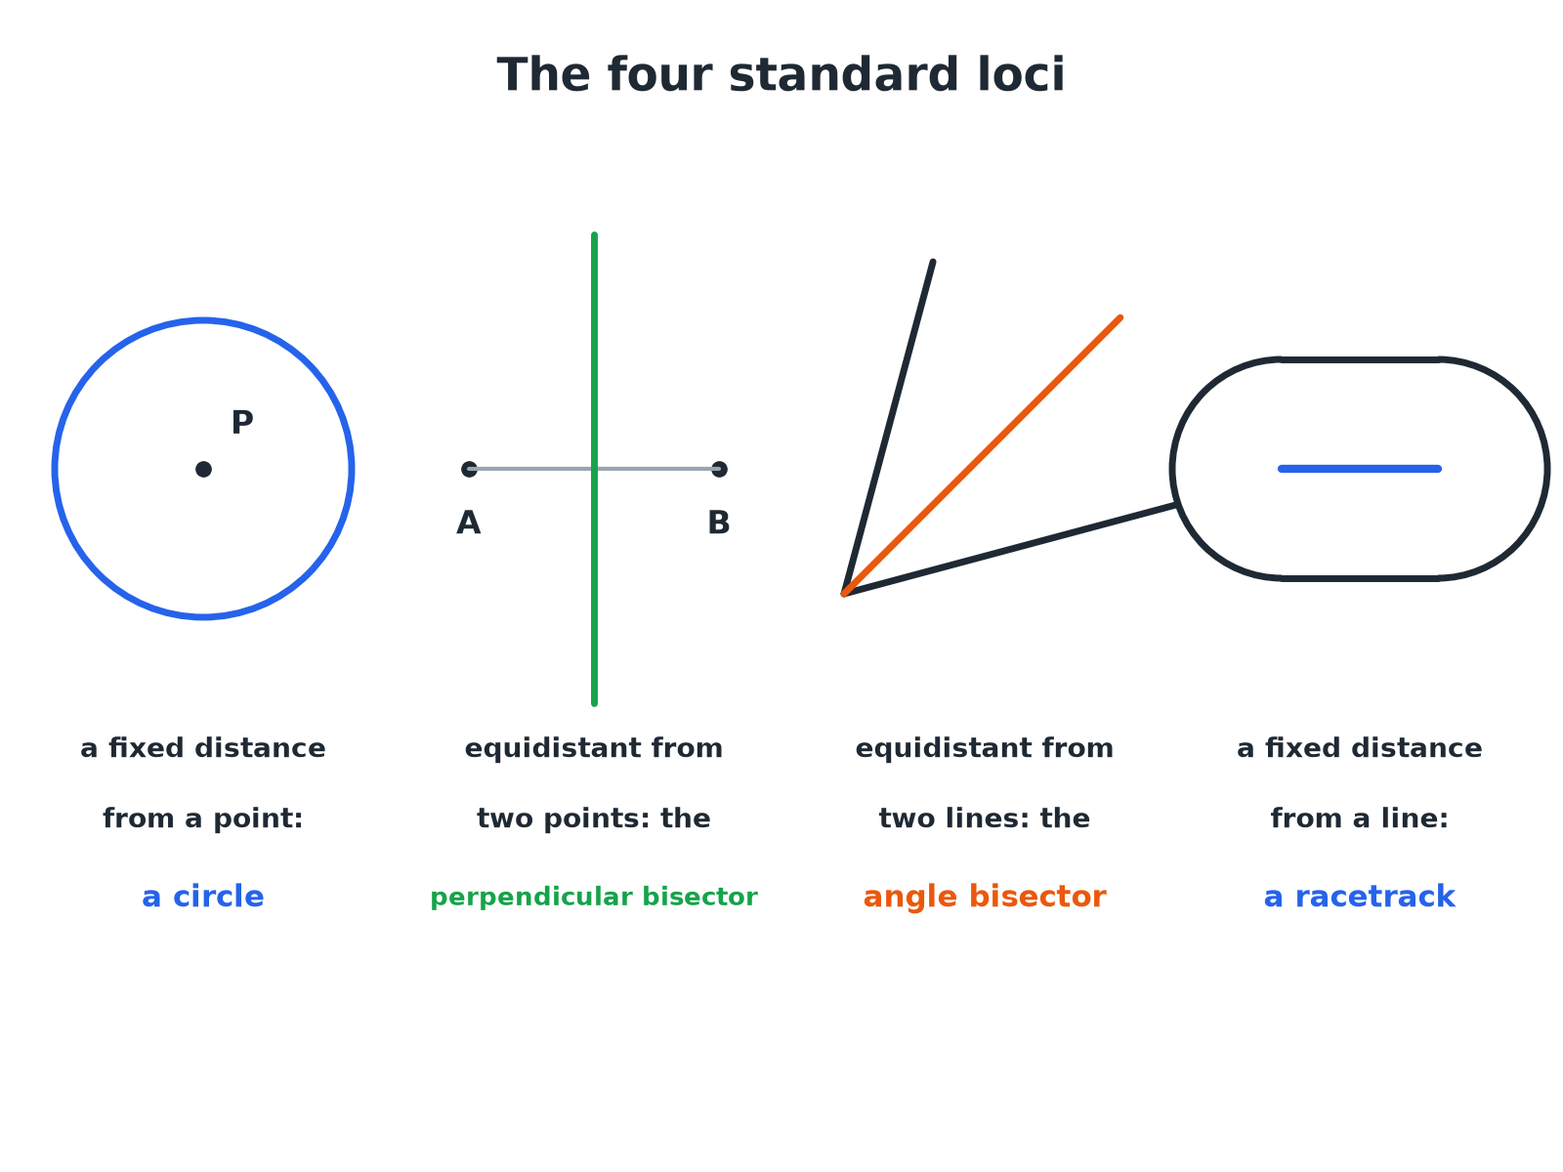

EDEXCEL GCSE MATHS · FOUNDATION & HIGHER
The Standard Loci
Learn these four and you can solve most locus questions.
Transformations and constructions
openrevise.com
Lesson 8 of 8

Slide 7

EDEXCEL GCSE MATHS · FOUNDATION & HIGHER
The Four Standard Loci
A fixed distance from a point
A circle, centred on the point.
Equidistant from two points
The perpendicular bisector of the line joining the points.
Equidistant from two lines
The angle bisector of the angle between them.
A fixed distance from a line
A racetrack: two parallel lines with semicircular ends.
Transformations and constructions
openrevise.com
Lesson 8 of 8

Slide 8

EDEXCEL GCSE MATHS · FOUNDATION & HIGHER
A Region Bounded by Two Loci
ABCD is a rectangle with A at (0, 0), B at (8, 0), C at (8, 5) and D at (0, 5), with 1 cm representing 1 m. A tree is nearer to AB than to AD and less than 4 m from C. Describe the region where the tree can be.
Equidistant from AB and AD
The bisector of angle DAB, the line from A at 45°
1
Nearer to AB than AD
The side of the bisector next to AB (below the line y = x)
2
Less than 4 m from C
Inside a circle of radius 4 cm centred on C
3
Combine
The part of the rectangle that is both below the bisector and inside the circle
4
ANSWER
The region inside the rectangle, below the bisector from A and inside the circle of radius 4 cm centred on C.
Transformations and constructions
openrevise.com
Lesson 8 of 8

Slide 9

EDEXCEL GCSE MATHS · FOUNDATION & HIGHER
Tackling a Locus Question
Split the rule into simple loci.
1
2
3
4
Read the rule
Underline each condition.
Draw the standard locus for each
Circle, bisector, perpendicular bisector, or parallel lines.
Decide which side
Use a test point.
Shade the region
Or mark the route required.
Transformations and constructions
openrevise.com
Lesson 8 of 8

Slide 10
EDEXCEL GCSE MATHS · FOUNDATION & HIGHER
Equidistant from Two Points
P and Q are 6 cm apart. Draw the locus of points equidistant from P and Q, and within 4 cm of P.
The locus of points equidistant from P and Q
The perpendicular bisector of PQ
1
Within 4 cm of P
Inside a circle of radius 4 cm centred on P
2
The part of the bisector inside the circle
A line segment where the bisector crosses the circle
3
ANSWER
The segment of the perpendicular bisector of PQ that lies inside the circle of radius 4 cm centred on P.
Transformations and constructions
openrevise.com
Lesson 8 of 8

Slide 11
EDEXCEL GCSE MATHS · FOUNDATION & HIGHER
A Fixed Distance from a Line
A path is 6 m long. A dog is allowed within 2 m of the path. Describe the boundary of the area.
The set of points 2 m from a line
Two parallel lines, 2 m either side
1
Ends of the path
Two semicircles of radius 2 m
2
Together
A racetrack shape around the path
3
ANSWER
A racetrack: two parallel lines 2 m either side of the path with a semicircle of radius 2 m at each end.
Transformations and constructions
openrevise.com
Lesson 8 of 8

Slide 12

EDEXCEL GCSE MATHS · FOUNDATION & HIGHER
Key Terms
Locus
A set of points that all obey a rule.
Loci
More than one locus.
Equidistant
The same distance from two points or lines.
Region
An area of the plane described by one or more rules.
Perpendicular bisector
The locus of points equidistant from two points.
Angle bisector
The locus of points equidistant from two lines.
Transformations and constructions
openrevise.com
Lesson 8 of 8

Slide 13

EDEXCEL GCSE MATHS · FOUNDATION & HIGHER
YOUR TASK
15 minutes
Where Should the Mast Go?
Three villages A, B and C form a triangle. A phone mast must be equidistant from A and B, and no more than 5 km from C. Draw the triangle (AB = 8 cm, AC = 6 cm, BC = 7 cm, where 1 cm = 1 km), construct the perpendicular bisector of AB, draw the circle of radius 5 cm about C, and shade the possible positions.
1
Construct the triangle.
2
Draw the two loci.
3
Identify the overlap.
WHAT A GOOD ANSWER SHOWS
The possible positions lie along the segment of the perpendicular bisector of AB that lies within the circle. Students should show construction arcs for the bisector and mark the two points where it meets the circle.
Transformations and constructions
openrevise.com
Lesson 8 of 8
Notes:
Ask what would change if the mast had to be closer to A than to B.

Slide 14

EDEXCEL GCSE MATHS · FOUNDATION & HIGHER
Can I...?
Explain what a locus is.
Draw a racetrack locus.
Draw a circle locus.
Combine two loci.
Draw a perpendicular bisector locus.
Use a scale in a locus problem.
Draw an angle bisector locus.
Shade the correct region.
Transformations and constructions
openrevise.com
Lesson 8 of 8

Slide 15
EDEXCEL GCSE MATHS · FOUNDATION & HIGHER
Summary & Exam Focus
Circle: a fixed distance from a point.
Perpendicular bisector: equidistant from two points.
Angle bisector: equidistant from two lines.
Racetrack: a fixed distance from a line segment.
EXAM FOCUS
ABCD is a rectangle with AB = 8 cm and BC = 5 cm. A point is nearer to AB than to AD, and is less than 4 cm from C. Shade the region that contains all such points. (4 marks)
Draw each locus, then use one test point in the rectangle to decide which side of each locus to shade.
openrevise.com

Slide 16
EDEXCEL GCSE MATHS · FOUNDATION & HIGHER
Exam Practice: Loci
Answer all questions. Use ruler and compasses and show all construction lines. · 30 minutes
Question 1 · 2 marks · Draw
P is a point. Draw the locus of all the points that are 3 cm from P.
Question 2 · 3 marks · Construct
A and B are two points 6 cm apart. Using ruler and compasses only, construct the locus of points that are the same distance from A and from…
Question 3 · 4 marks · Construct
The diagram shows a rectangle ABCD. The scale is 1 cm to 1 m. A tree will be planted nearer to AB than to AD and less than 4 m from C…
Transformations and constructions
openrevise.com
Lesson 8 of 8

Slide 17
EDEXCEL GCSE MATHS · FOUNDATION & HIGHER
Exam Practice: Loci (cont.)
Question 4 · 2 marks · Describe
A robot moves so that it is always 2 m from a straight fence 6 m long. Describe the shape of its path.
Question 5 · 3 marks · Construct
Two straight roads meet at a point O. A phone mast must be the same distance from both roads. Describe how to find the possible positions…
Transformations and constructions
openrevise.com
Lesson 8 of 8

Slide 18
EDEXCEL GCSE MATHS · FOUNDATION & HIGHER
Question 1 · 2 marks · Draw
“
P is a point. Draw the locus of all the points that are 3 cm from P.
HOW TO ANSWER IT
Command word: Draw. Worth 2 marks, so plan before writing.
Transformations and constructions
openrevise.com
Lesson 8 of 8

Slide 19
EDEXCEL GCSE MATHS · FOUNDATION & HIGHER
Question 1 · mark scheme
2 marks available. Award a mark for each point made.
A circle drawn, centre P
M1
Radius 3 cm
A1
Transformations and constructions
openrevise.com
Lesson 8 of 8

Slide 20
EDEXCEL GCSE MATHS · FOUNDATION & HIGHER
Question 2 · 3 marks · Construct
“
A and B are two points 6 cm apart. Using ruler and compasses only, construct the locus of points that are the same distance from A and from B.
HOW TO ANSWER IT
Command word: Construct. Worth 3 marks, so plan before writing.
Transformations and constructions
openrevise.com
Lesson 8 of 8

Slide 21
EDEXCEL GCSE MATHS · FOUNDATION & HIGHER
Question 2 · mark scheme
3 marks available. Award a mark for each point made.
Equal arcs from A and B
M1
Crossings joined
M1
A correct line with arcs shown
A1
Transformations and constructions
openrevise.com
Lesson 8 of 8

Slide 22
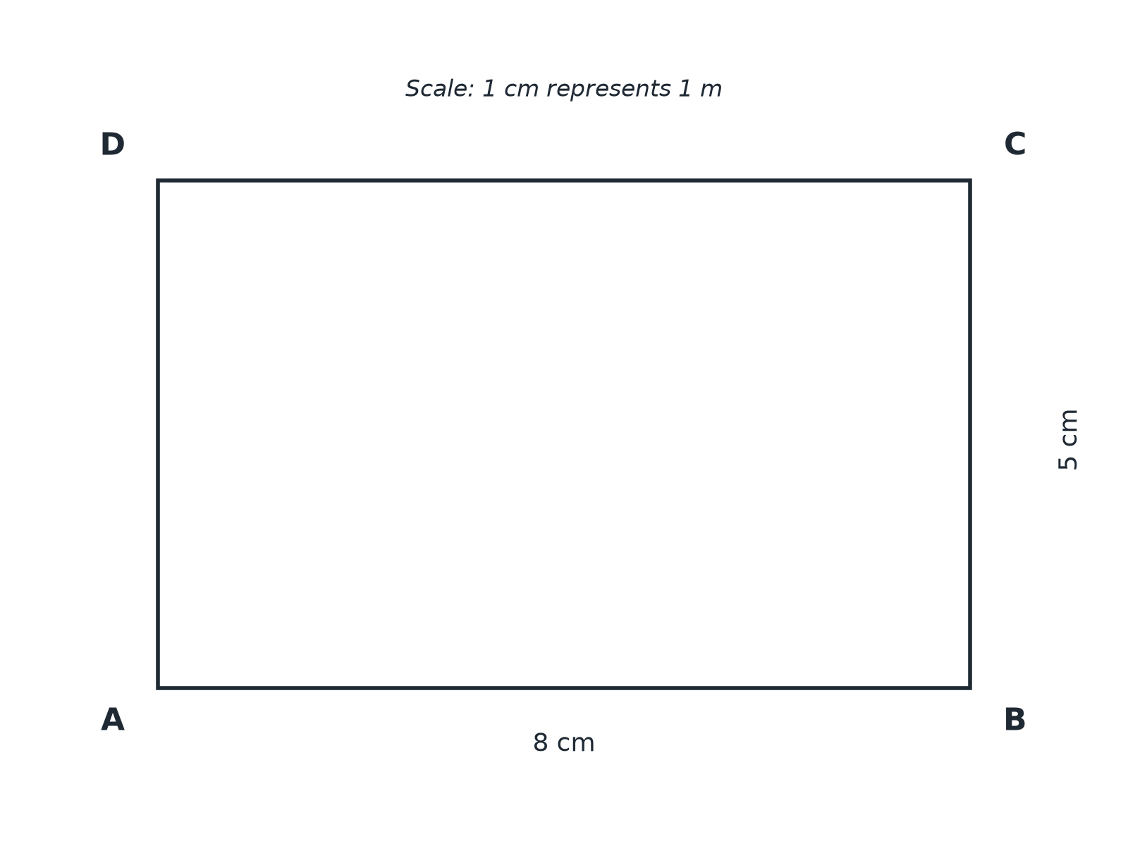
EDEXCEL GCSE MATHS · FOUNDATION & HIGHER
Question 3 · 4 marks · Construct
The diagram shows a rectangle ABCD. The scale is 1 cm to 1 m. A tree will be planted nearer to AB than to AD and less than 4 m from C. Shade the region where the tree can be planted. (4 marks)
Transformations and constructions
openrevise.com
Lesson 8 of 8

Slide 23
EDEXCEL GCSE MATHS · FOUNDATION & HIGHER
Question 3 · mark scheme
4 marks available. Award a mark for each point made.
Bisector of angle DAB
M1
Circle of radius 4 cm centred on C
M1
Correct side of each locus
M1
Correct region shaded
A1
Transformations and constructions
openrevise.com
Lesson 8 of 8

Slide 24
EDEXCEL GCSE MATHS · FOUNDATION & HIGHER
Question 4 · 2 marks · Describe
“
A robot moves so that it is always 2 m from a straight fence 6 m long. Describe the shape of its path.
HOW TO ANSWER IT
Command word: Describe. Worth 2 marks, so plan before writing.
Transformations and constructions
openrevise.com
Lesson 8 of 8

Slide 25
EDEXCEL GCSE MATHS · FOUNDATION & HIGHER
Question 4 · mark scheme
2 marks available. Award a mark for each point made.
Two parallel lines 2 m from the fence
B1
Semicircular ends
B1
Transformations and constructions
openrevise.com
Lesson 8 of 8

Slide 26
EDEXCEL GCSE MATHS · FOUNDATION & HIGHER
Question 5 · 3 marks · Construct
“
Two straight roads meet at a point O. A phone mast must be the same distance from both roads. Describe how to find the possible positions of the mast on a map.
HOW TO ANSWER IT
Command word: Construct. Worth 3 marks, so plan before writing.
Transformations and constructions
openrevise.com
Lesson 8 of 8

Slide 27
EDEXCEL GCSE MATHS · FOUNDATION & HIGHER
Question 5 · mark scheme
3 marks available. Award a mark for each point made.
Angle bisector
B1
Construction method: arcs from O, then from the crossings
M1
The mast can be anywhere on the bisector
A1
Transformations and constructions
openrevise.com
Lesson 8 of 8

