Slide 1

EDEXCEL GCSE MATHS · FOUNDATION & HIGHER
Solving linear inequalities
Equations and inequalities
Lesson 1 of 7
openrevise.com

Slide 2

EDEXCEL GCSE MATHS · FOUNDATION & HIGHER
Warm-up
Answer each one, then check.
1
Solve 2x + 3 = 11.
2
Solve 5x = −20.
3
Which is bigger, −3 or −5?
4
What is the symbol for "less than or equal to"?
5
Solve x/3 = 6.
Equations and inequalities
openrevise.com
Lesson 1 of 7

Slide 3
EDEXCEL GCSE MATHS · FOUNDATION & HIGHER
Warm-up - Answers
Solve 2x + 3 = 11.
x = 4
1
Solve 5x = −20.
x = −4
2
Which is bigger, −3 or −5?
−3
3
What is the symbol for "less than or equal to"?
≤
4
Solve x/3 = 6.
x = 18
5
Equations and inequalities
openrevise.com
Lesson 1 of 7

Slide 4

EDEXCEL GCSE MATHS · FOUNDATION & HIGHER
Learning Objectives
Use the inequality symbols <, >, ≤ and ≥.
1
Show inequalities on a number line.
2
Solve linear inequalities, including reversing the sign.
3
Write down integer solutions and solve double inequalities.
4
Equations and inequalities
openrevise.com
Lesson 1 of 7

Slide 5

EDEXCEL GCSE MATHS · FOUNDATION & HIGHER
Inequality Symbols
The open end of the symbol points at the bigger number.
Symbol
Meaning
Circle on a number line
x > 3
x is greater than 3
Open circle at 3
x ≥ 3
x is greater than or equal to 3
Filled circle at 3
x < 3
x is less than 3
Open circle at 3
x ≤ 3
x is less than or equal to 3
Filled circle at 3
Equations and inequalities
openrevise.com
Lesson 1 of 7

Slide 6
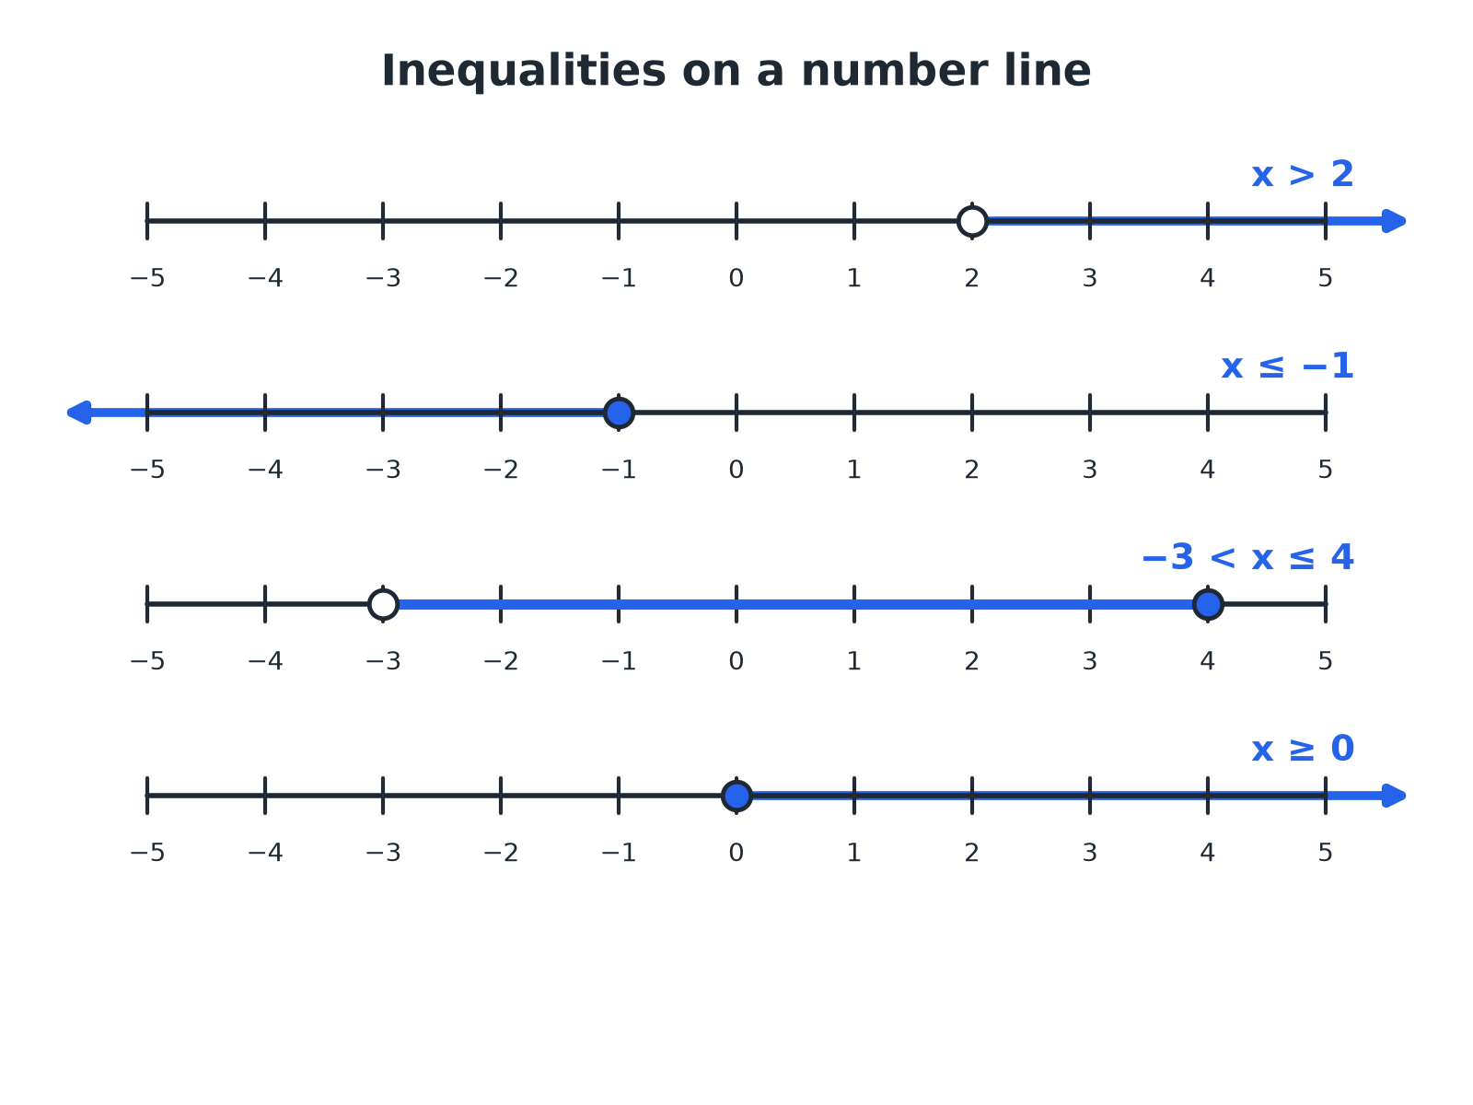

EDEXCEL GCSE MATHS · FOUNDATION & HIGHER
Inequalities on a Number Line
Open circle: not included. Filled circle: included.
Equations and inequalities
openrevise.com
Lesson 1 of 7

Slide 7

EDEXCEL GCSE MATHS · FOUNDATION & HIGHER
Solving an Inequality
Solve 3x + 2 ≤ 14.
Subtract 2 from both sides
3x ≤ 12
1
Divide both sides by 3
x ≤ 4
2
ANSWER
x ≤ 4
Equations and inequalities
openrevise.com
Lesson 1 of 7

Slide 8

EDEXCEL GCSE MATHS · FOUNDATION & HIGHER
THE ONE NEW RULE
When you multiply or divide an inequality by a negative number, reverse the inequality sign.
Otherwise solve exactly as you would an equation.
Equations and inequalities
openrevise.com
Lesson 1 of 7

Slide 9
EDEXCEL GCSE MATHS · FOUNDATION & HIGHER
A Negative Coefficient
Solve 5 − 2x > 11.
Subtract 5 from both sides
−2x > 6
1
Divide by −2 and reverse the sign
x < −3
2
Check with a value, x = −4
5 − 2(−4) = 13 > 11
3
ANSWER
x < −3
Equations and inequalities
openrevise.com
Lesson 1 of 7

Slide 10
EDEXCEL GCSE MATHS · FOUNDATION & HIGHER
A Double Inequality
Solve 5 < 2x − 1 ≤ 9.
Add 1 to all three parts
6 < 2x ≤ 10
1
Divide all three parts by 2
3 < x ≤ 5
2
ANSWER
3 < x ≤ 5
Equations and inequalities
openrevise.com
Lesson 1 of 7

Slide 11
EDEXCEL GCSE MATHS · FOUNDATION & HIGHER
Integer Solutions
List the integers that satisfy −2 < x ≤ 3.
−2 itself is not included
Start at −1
1
3 is included
End at 3
2
ANSWER
−1, 0, 1, 2, 3
Equations and inequalities
openrevise.com
Lesson 1 of 7

Slide 12

EDEXCEL GCSE MATHS · FOUNDATION & HIGHER
HIGHER TIER
Inequalities on a Graph
Shading regions.
openrevise.com

Slide 13
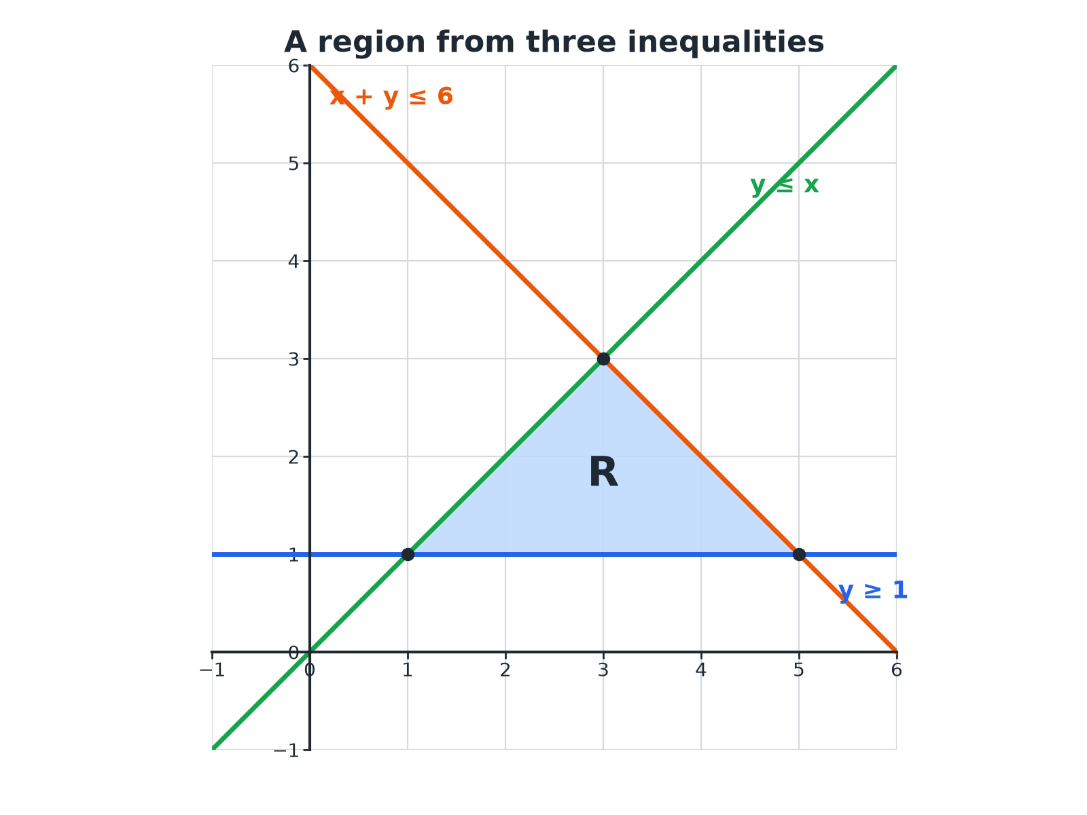
EDEXCEL GCSE MATHS · FOUNDATION & HIGHER
Shading a Region
Solid line for ≤ or ≥, dashed line for < or >.
Equations and inequalities
openrevise.com
Lesson 1 of 7

Slide 14

EDEXCEL GCSE MATHS · FOUNDATION & HIGHER
Showing an Inequality on a Graph
Draw the boundary, then decide which side to shade.
1
2
3
4
Draw the line
Replace the inequality sign with = and draw it
Solid or dashed
Solid for ≤ and ≥; dashed for < and >
Test a point
For example (0, 0), if it is not on the line
Shade the side that works
Shade the wanted region, or the unwanted region, as the question asks
Equations and inequalities
openrevise.com
Lesson 1 of 7

Slide 15
EDEXCEL GCSE MATHS · FOUNDATION & HIGHER
A Region from Three Inequalities
Higher
A region R satisfies y ≥ 1, y ≤ x and x + y ≤ 6. Find the vertices of R.
y = 1 meets y = x
(1, 1)
1
y = 1 meets x + y = 6
(5, 1)
2
y = x meets x + y = 6
x + x = 6, so (3, 3)
3
ANSWER
R is a triangle with vertices (1, 1), (5, 1) and (3, 3).
Equations and inequalities
openrevise.com
Lesson 1 of 7

Slide 16
EDEXCEL GCSE MATHS · FOUNDATION & HIGHER
A Quadratic Inequality
Higher
Solve x² − x − 6 < 0.
Factorise
(x − 3)(x + 2) < 0
1
The roots are
x = 3 and x = −2
2
The graph is U-shaped, below the axis between the roots
−2 < x < 3
3
ANSWER
−2 < x < 3
Equations and inequalities
openrevise.com
Lesson 1 of 7

Slide 17

EDEXCEL GCSE MATHS · FOUNDATION & HIGHER
Key Terms
Inequality
A statement that compares two values using <, >, ≤ or ≥.
Integer
A whole number, positive, negative or zero.
Solution set
All the values that make an inequality true.
Boundary line
The line that separates a region on a graph.
Region
An area of a graph that satisfies one or more inequalities.
Strict inequality
One with < or >, not including the boundary.
Equations and inequalities
openrevise.com
Lesson 1 of 7

Slide 18

EDEXCEL GCSE MATHS · FOUNDATION & HIGHER
YOUR TASK
10 minutes
True or False?
Decide whether each statement is true or false, and correct it if it is false. (a) −3 > −2 (b) x ≥ 5 includes 5 (c) if −x < 4 then x < −4 (d) the integers satisfying 1 ≤ x < 4 are 1, 2, 3, 4.
Use a number line.
1
Test values.
2
WHAT A GOOD ANSWER SHOWS
(a) False: −3 < −2. (b) True. (c) False: reversing the sign gives x > −4. (d) False: 4 is not included, so the integers are 1, 2, 3.
Equations and inequalities
openrevise.com
Lesson 1 of 7
Notes:
Ask students to test with numbers on a number line.

Slide 19

EDEXCEL GCSE MATHS · FOUNDATION & HIGHER
Can I...?
Use the four inequality symbols.
Solve a double inequality.
Draw an inequality on a number line.
List integer solutions.
Solve a linear inequality.
Shade a region on a graph (Higher).
Reverse the sign when multiplying by a negative.
Solve a quadratic inequality (Higher).
Equations and inequalities
openrevise.com
Lesson 1 of 7

Slide 20
EDEXCEL GCSE MATHS · FOUNDATION & HIGHER
Summary & Exam Focus
Open circle for < and >; filled circle for ≤ and ≥.
Solve like an equation, but reverse the sign when dividing by a negative.
Double inequality: do the same to all three parts.
Higher: solid boundary for ≤, ≥; dashed for <, >.
EXAM FOCUS
Solve 5 − 2x > 11. (3 marks)
Dividing by a negative number flips the sign. Check your answer with a test value.
openrevise.com

Slide 21
EDEXCEL GCSE MATHS · FOUNDATION & HIGHER
Exam Practice: Solving Linear Inequalities
Answer all questions. Show your working. · 30 minutes
Question 1 · 2 marks · Non-calculator
Solve 3x + 2 ≤ 14.
Question 2 · 3 marks · Non-calculator
Solve 5 − 2x > 11.
Question 3 · 2 marks · Non-calculator
The number line shows an inequality. Write down the inequality.
Equations and inequalities
openrevise.com
Lesson 1 of 7

Slide 22
EDEXCEL GCSE MATHS · FOUNDATION & HIGHER
Exam Practice: Solving Linear Inequalities (cont.)
Question 4 · 2 marks · Non-calculator
n is an integer. Write down all the possible values of n when −2 < n ≤ 3.
Question 5 · 3 marks · Non-calculator
Solve 5 < 2x − 1 ≤ 9.
Question 6 · 4 marks · Non-calculator
On the grid, the region R satisfies y ≥ 1, y ≤ x and x + y ≤ 6. Mark the region R with an R.
Equations and inequalities
openrevise.com
Lesson 1 of 7

Slide 23
EDEXCEL GCSE MATHS · FOUNDATION & HIGHER
Question 1 · 2 marks · Non-calculator
“
Solve 3x + 2 ≤ 14.
HOW TO ANSWER IT
Command word: Non-calculator. Worth 2 marks, so plan before writing.
Equations and inequalities
openrevise.com
Lesson 1 of 7

Slide 24
EDEXCEL GCSE MATHS · FOUNDATION & HIGHER
Question 1 · mark scheme
2 marks available. Award a mark for each point made.
3x ≤ 12
M1
x ≤ 4
A1
Equations and inequalities
openrevise.com
Lesson 1 of 7

Slide 25
EDEXCEL GCSE MATHS · FOUNDATION & HIGHER
Question 2 · 3 marks · Non-calculator
“
Solve 5 − 2x > 11.
HOW TO ANSWER IT
Command word: Non-calculator. Worth 3 marks, so plan before writing.
Equations and inequalities
openrevise.com
Lesson 1 of 7

Slide 26
EDEXCEL GCSE MATHS · FOUNDATION & HIGHER
Question 2 · mark scheme
3 marks available. Award a mark for each point made.
−2x > 6
M1
Dividing by −2
M1
x < −3
A1
Equations and inequalities
openrevise.com
Lesson 1 of 7

Slide 27
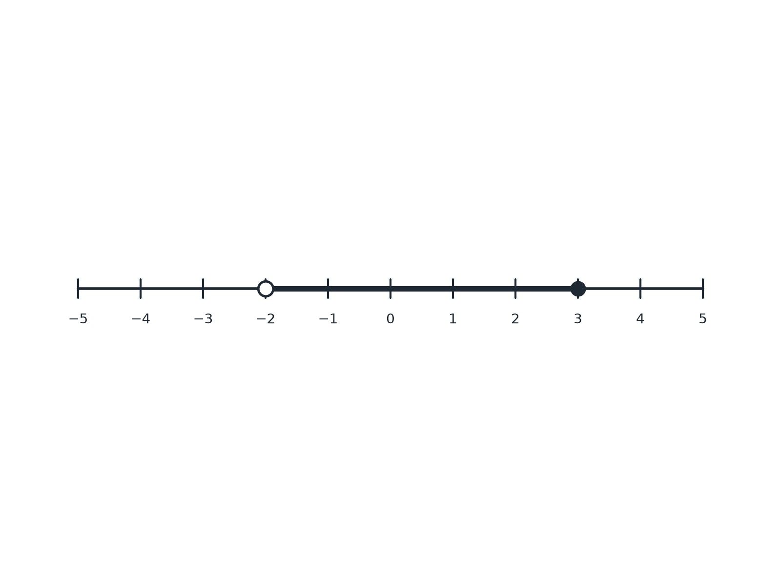
EDEXCEL GCSE MATHS · FOUNDATION & HIGHER
Question 3 · 2 marks · Non-calculator
The number line shows an inequality. Write down the inequality. (2 marks)
Equations and inequalities
openrevise.com
Lesson 1 of 7

Slide 28
EDEXCEL GCSE MATHS · FOUNDATION & HIGHER
Question 3 · mark scheme
2 marks available. Award a mark for each point made.
x ≤ 3 or x > −2
B1
−2 < x ≤ 3
B1
Equations and inequalities
openrevise.com
Lesson 1 of 7

Slide 29
EDEXCEL GCSE MATHS · FOUNDATION & HIGHER
Question 4 · 2 marks · Non-calculator
“
n is an integer. Write down all the possible values of n when −2 < n ≤ 3.
HOW TO ANSWER IT
Command word: Non-calculator. Worth 2 marks, so plan before writing.
Equations and inequalities
openrevise.com
Lesson 1 of 7

Slide 30
EDEXCEL GCSE MATHS · FOUNDATION & HIGHER
Question 4 · mark scheme
2 marks available. Award a mark for each point made.
At least four correct values
M1
All correct
A1
Equations and inequalities
openrevise.com
Lesson 1 of 7

Slide 31
EDEXCEL GCSE MATHS · FOUNDATION & HIGHER
Question 5 · 3 marks · Non-calculator
“
Solve 5 < 2x − 1 ≤ 9.
HOW TO ANSWER IT
Command word: Non-calculator. Worth 3 marks, so plan before writing.
Equations and inequalities
openrevise.com
Lesson 1 of 7

Slide 32
EDEXCEL GCSE MATHS · FOUNDATION & HIGHER
Question 5 · mark scheme
3 marks available. Award a mark for each point made.
Adding 1 to all parts
M1
Dividing all parts by 2
M1
3 < x ≤ 5
A1
Equations and inequalities
openrevise.com
Lesson 1 of 7

Slide 33
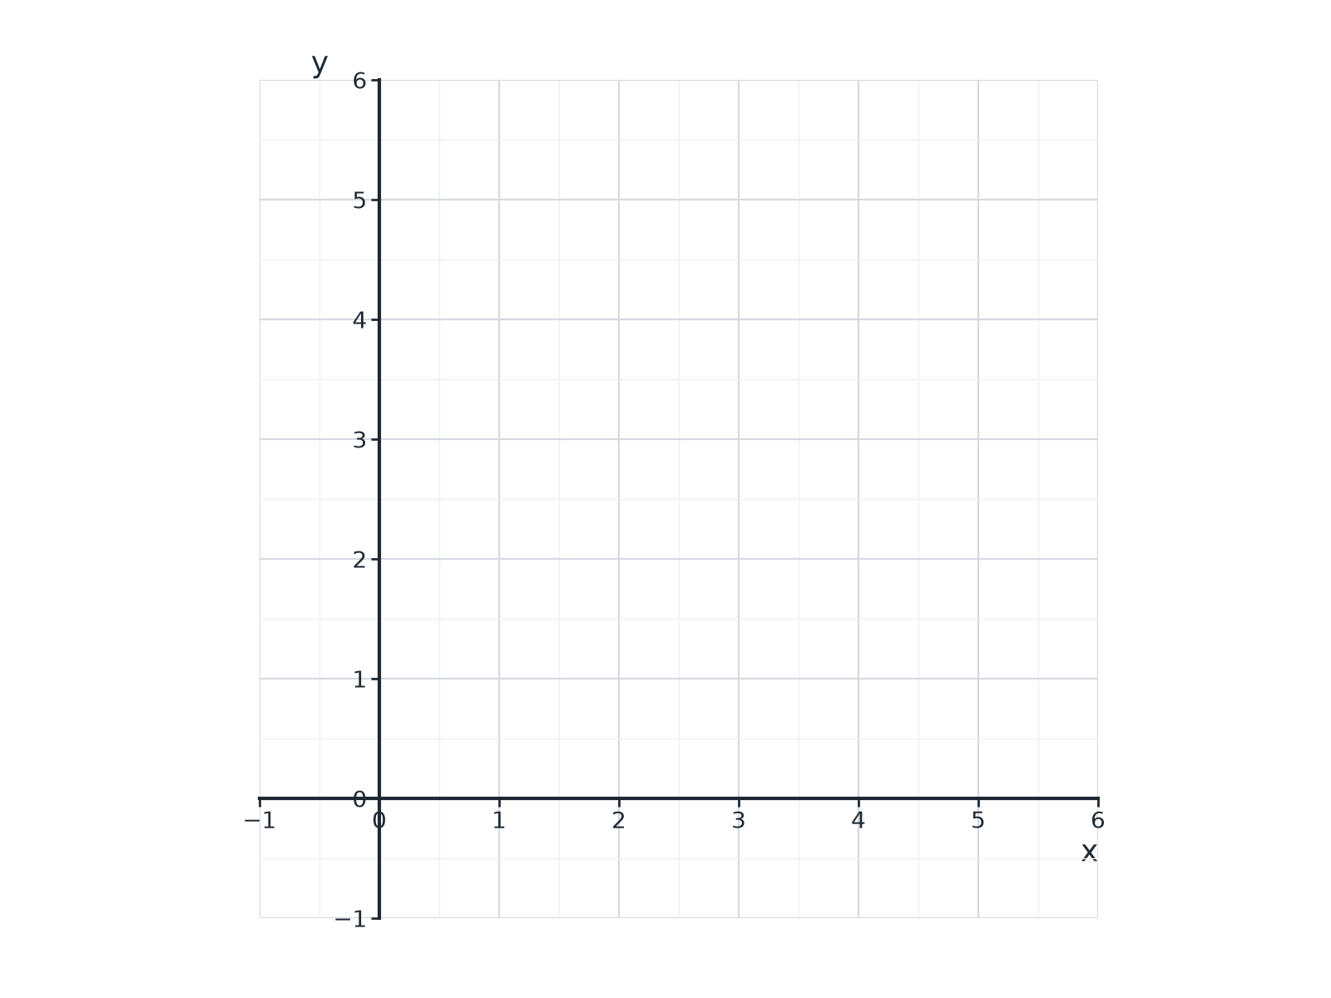
EDEXCEL GCSE MATHS · FOUNDATION & HIGHER
Question 6 · 4 marks · Non-calculator
On the grid, the region R satisfies y ≥ 1, y ≤ x and x + y ≤ 6. Mark the region R with an R. (4 marks)
Equations and inequalities
openrevise.com
Lesson 1 of 7

Slide 34
EDEXCEL GCSE MATHS · FOUNDATION & HIGHER
Question 6 · mark scheme
4 marks available. Award a mark for each point made.
One line drawn correctly
M1
All three lines drawn correctly
M1
The correct region
M1
R labelled
A1
Equations and inequalities
openrevise.com
Lesson 1 of 7

