Slide 1

EDEXCEL GCSE MATHS · FOUNDATION & HIGHER
Solving simple simultaneous equations
Equations and inequalities
Lesson 5 of 7
openrevise.com

Slide 2

EDEXCEL GCSE MATHS · FOUNDATION & HIGHER
Warm-up
Answer each one, then check.
1
Solve 2x + 3 = 11.
2
What is 7 − (−3)?
3
Substitute x = 2 into y = 3x − 1.
4
What is the y-intercept of y = 2x + 5?
5
Solve x − 4 = −1.
Equations and inequalities
openrevise.com
Lesson 5 of 7

Slide 3
EDEXCEL GCSE MATHS · FOUNDATION & HIGHER
Warm-up - Answers
Solve 2x + 3 = 11.
x = 4
1
What is 7 − (−3)?
10
2
Substitute x = 2 into y = 3x − 1.
y = 5
3
What is the y-intercept of y = 2x + 5?
5
4
Solve x − 4 = −1.
x = 3
5
Equations and inequalities
openrevise.com
Lesson 5 of 7

Slide 4

EDEXCEL GCSE MATHS · FOUNDATION & HIGHER
Learning Objectives
Explain what simultaneous equations are.
1
Solve by elimination when a pair of coefficients match.
2
Solve by substitution.
3
Set up simultaneous equations from a problem and read solutions from graphs.
4
Equations and inequalities
openrevise.com
Lesson 5 of 7

Slide 5

EDEXCEL GCSE MATHS · FOUNDATION & HIGHER
SIMULTANEOUS EQUATIONS
Simultaneous equations have two unknowns, and the solution is the pair of values that makes both equations true at the same time.
On a graph, the solution is where the two lines cross.
Equations and inequalities
openrevise.com
Lesson 5 of 7

Slide 6
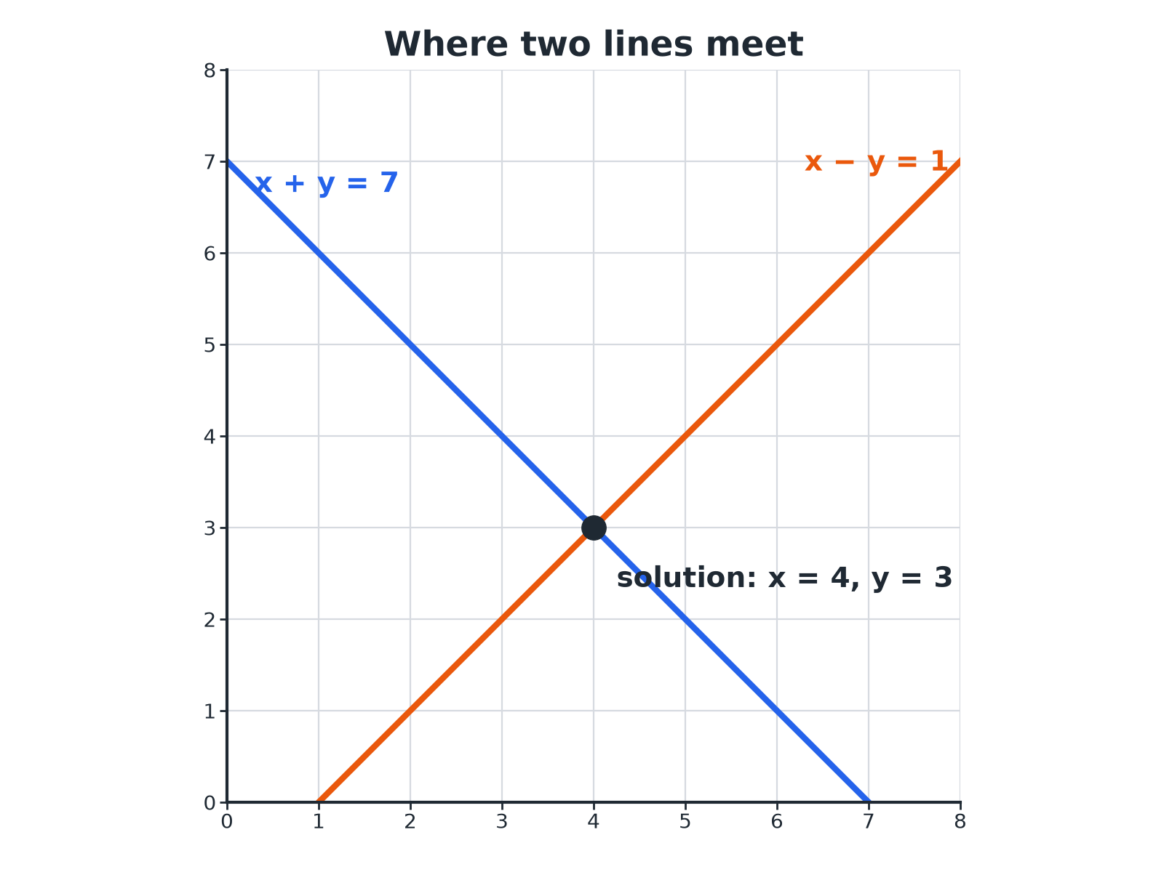

EDEXCEL GCSE MATHS · FOUNDATION & HIGHER
Where Two Lines Meet
The crossing point is the only pair of values on both lines.
Equations and inequalities
openrevise.com
Lesson 5 of 7

Slide 7

EDEXCEL GCSE MATHS · FOUNDATION & HIGHER
Solving by Elimination
Make one unknown disappear.
1
2
3
4
5
Label the equations
Call them (1) and (2)
Match the coefficients
If they are already equal or opposite, go on; if not, multiply
Add or subtract
Add if the signs are opposite; subtract if they are the same
Solve for one unknown
You now have a one-variable equation
Substitute back
Find the other unknown, then check in the other equation
Equations and inequalities
openrevise.com
Lesson 5 of 7

Slide 8

EDEXCEL GCSE MATHS · FOUNDATION & HIGHER
Elimination by Adding
Solve x + y = 7 and x − y = 1.
The y terms have opposite signs, so add
(x + y) + (x − y) = 7 + 1
1
Simplify
2x = 8, so x = 4
2
Substitute into x + y = 7
4 + y = 7, so y = 3
3
Check in x − y = 1
4 − 3 = 1
4
ANSWER
x = 4 and y = 3
Equations and inequalities
openrevise.com
Lesson 5 of 7

Slide 9
EDEXCEL GCSE MATHS · FOUNDATION & HIGHER
Elimination by Subtracting
Solve 2x + y = 11 and x + y = 7.
The y terms have the same sign, so subtract
(2x + y) − (x + y) = 11 − 7
1
Simplify
x = 4
2
Substitute into x + y = 7
y = 3
3
Check
2 × 4 + 3 = 11
4
ANSWER
x = 4 and y = 3
Equations and inequalities
openrevise.com
Lesson 5 of 7

Slide 10
EDEXCEL GCSE MATHS · FOUNDATION & HIGHER
Solving by Substitution
Solve y = 2x − 1 and x + y = 8.
Substitute y = 2x − 1 into the second equation
x + (2x − 1) = 8
1
Simplify
3x − 1 = 8, so 3x = 9 and x = 3
2
Find y
y = 2 × 3 − 1 = 5
3
ANSWER
x = 3 and y = 5
Equations and inequalities
openrevise.com
Lesson 5 of 7

Slide 11
EDEXCEL GCSE MATHS · FOUNDATION & HIGHER
A Word Problem
2 adult tickets and 3 child tickets cost £27. 1 adult ticket and 2 child tickets cost £15. Find the cost of each ticket.
Let a be an adult ticket and c a child ticket
2a + 3c = 27 and a + 2c = 15
1
Rearrange the second
a = 15 − 2c
2
Substitute
2(15 − 2c) + 3c = 27, so 30 − 4c + 3c = 27
3
Solve
c = 3, so a = 15 − 6 = 9
4
ANSWER
An adult ticket costs £9 and a child ticket costs £3.
Equations and inequalities
openrevise.com
Lesson 5 of 7

Slide 12

EDEXCEL GCSE MATHS · FOUNDATION & HIGHER
Elimination or Substitution?
ELIMINATION
SUBSTITUTION
• Best when the equations are both in the form ax + by = c.
• Add or subtract to remove one unknown.
• Needs matching coefficients.
• Best when one equation already gives y = … or x = ….
• Replace the unknown in the other equation.
• Watch brackets and signs.
Equations and inequalities
openrevise.com
Lesson 5 of 7

Slide 13

EDEXCEL GCSE MATHS · FOUNDATION & HIGHER
Key Terms
Simultaneous equations
Two or more equations that are true at the same time.
Unknown
A letter standing for a number to be found.
Elimination
Removing one unknown by adding or subtracting equations.
Substitution
Replacing an unknown with an expression.
Solution
The pair of values that satisfies both equations.
Coefficient
The number multiplying an unknown.
Equations and inequalities
openrevise.com
Lesson 5 of 7

Slide 14

EDEXCEL GCSE MATHS · FOUNDATION & HIGHER
YOUR TASK
12 minutes
Solve and Check
Solve each pair of simultaneous equations, then check your answer in both equations. (a) x + y = 10, x − y = 4 (b) 3x + y = 14, x + y = 8 (c) y = x + 2, 2x + y = 11.
1
Choose elimination or substitution.
2
Solve.
3
Check in both equations.
WHAT A GOOD ANSWER SHOWS
(a) x = 7, y = 3. (b) 2x = 6, so x = 3, y = 5. (c) 2x + x + 2 = 11, so x = 3, y = 5.
Equations and inequalities
openrevise.com
Lesson 5 of 7
Notes:
Encourage students to write each step under the equation numbers.

Slide 15

EDEXCEL GCSE MATHS · FOUNDATION & HIGHER
Can I...?
Explain what simultaneous equations are.
Find both unknowns.
Eliminate by adding.
Check my solution.
Eliminate by subtracting.
Set up equations from a problem.
Substitute one equation into the other.
Read the solution from a graph.
Equations and inequalities
openrevise.com
Lesson 5 of 7

Slide 16
EDEXCEL GCSE MATHS · FOUNDATION & HIGHER
Summary & Exam Focus
Same signs: subtract. Opposite signs: add.
Substitute back to find the second unknown.
Always check in both equations.
On a graph, the solution is the crossing point.
EXAM FOCUS
2 adult tickets and 3 child tickets cost £27. 1 adult ticket and 2 child tickets cost £15. Work out the cost of an adult ticket and the cost of a child ticket. (4 marks)
Define letters, write two equations, then solve. Check that both original equations work with your answer.
openrevise.com

Slide 17
EDEXCEL GCSE MATHS · FOUNDATION & HIGHER
Exam Practice: Solving Simple Simultaneous Equations
Answer all questions. Show your working. · 30 minutes
Question 1 · 3 marks · Non-calculator
Solve the simultaneous equations x + y = 7 and x − y = 1.
Question 2 · 3 marks · Non-calculator
Solve the simultaneous equations 2x + y = 11 and x + y = 7.
Question 3 · 3 marks · Non-calculator
Solve the simultaneous equations y = 2x − 1 and x + y = 8.
Equations and inequalities
openrevise.com
Lesson 5 of 7

Slide 18
EDEXCEL GCSE MATHS · FOUNDATION & HIGHER
Exam Practice: Solving Simple Simultaneous Equations (cont.)
Question 4 · 4 marks · Non-calculator
2 adult tickets and 3 child tickets cost £27 in total. 1 adult ticket and 2 child tickets cost £15 in total. Work out the cost of an adult…
Question 5 · 2 marks · Non-calculator
The graph shows the lines y = 2x − 3 and x + y = 6. Use the graph to solve the simultaneous equations y = 2x − 3 and x + y = 6.
Question 6 · 3 marks · Non-calculator
Solve the simultaneous equations 3x + 2y = 16 and x − y = 2.
Equations and inequalities
openrevise.com
Lesson 5 of 7

Slide 19
EDEXCEL GCSE MATHS · FOUNDATION & HIGHER
Question 1 · 3 marks · Non-calculator
“
Solve the simultaneous equations x + y = 7 and x − y = 1.
HOW TO ANSWER IT
Command word: Non-calculator. Worth 3 marks, so plan before writing.
Equations and inequalities
openrevise.com
Lesson 5 of 7

Slide 20
EDEXCEL GCSE MATHS · FOUNDATION & HIGHER
Question 1 · mark scheme
3 marks available. Award a mark for each point made.
Adding or a correct elimination
M1
x = 4
A1
y = 3
A1
Equations and inequalities
openrevise.com
Lesson 5 of 7

Slide 21
EDEXCEL GCSE MATHS · FOUNDATION & HIGHER
Question 2 · 3 marks · Non-calculator
“
Solve the simultaneous equations 2x + y = 11 and x + y = 7.
HOW TO ANSWER IT
Command word: Non-calculator. Worth 3 marks, so plan before writing.
Equations and inequalities
openrevise.com
Lesson 5 of 7

Slide 22
EDEXCEL GCSE MATHS · FOUNDATION & HIGHER
Question 2 · mark scheme
3 marks available. Award a mark for each point made.
Subtracting the equations
M1
x = 4
A1
y = 3
A1
Equations and inequalities
openrevise.com
Lesson 5 of 7

Slide 23
EDEXCEL GCSE MATHS · FOUNDATION & HIGHER
Question 3 · 3 marks · Non-calculator
“
Solve the simultaneous equations y = 2x − 1 and x + y = 8.
HOW TO ANSWER IT
Command word: Non-calculator. Worth 3 marks, so plan before writing.
Equations and inequalities
openrevise.com
Lesson 5 of 7

Slide 24
EDEXCEL GCSE MATHS · FOUNDATION & HIGHER
Question 3 · mark scheme
3 marks available. Award a mark for each point made.
Substituting
M1
x = 3
A1
y = 5
A1
Equations and inequalities
openrevise.com
Lesson 5 of 7

Slide 25
EDEXCEL GCSE MATHS · FOUNDATION & HIGHER
Question 4 · 4 marks · Non-calculator
“
2 adult tickets and 3 child tickets cost £27 in total. 1 adult ticket and 2 child tickets cost £15 in total. Work out the cost of an adult ticket and the cost of a child ticket.
HOW TO ANSWER IT
Command word: Non-calculator. Worth 4 marks, so plan before writing.
Equations and inequalities
openrevise.com
Lesson 5 of 7

Slide 26
EDEXCEL GCSE MATHS · FOUNDATION & HIGHER
Question 4 · mark scheme
4 marks available. Award a mark for each point made.
Forming both equations
M1
A correct elimination or substitution
M1
One value correct
A1
Both values with units
A1
Equations and inequalities
openrevise.com
Lesson 5 of 7

Slide 27
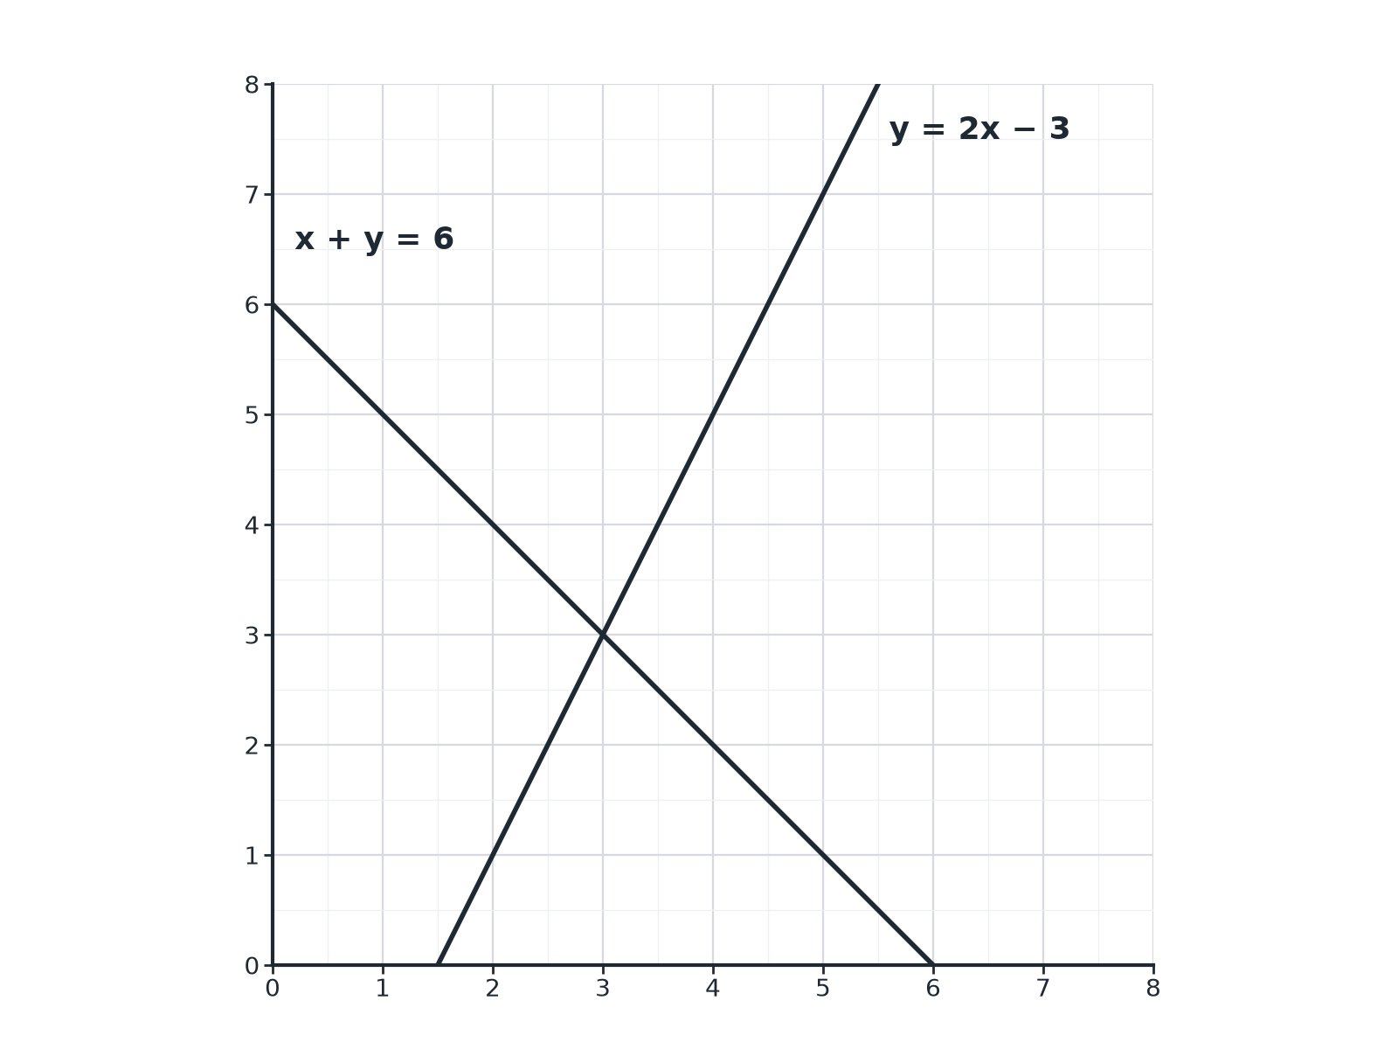
EDEXCEL GCSE MATHS · FOUNDATION & HIGHER
Question 5 · 2 marks · Non-calculator
The graph shows the lines y = 2x − 3 and x + y = 6. Use the graph to solve the simultaneous equations y = 2x − 3 and x + y = 6. (2 marks)
Equations and inequalities
openrevise.com
Lesson 5 of 7

Slide 28
EDEXCEL GCSE MATHS · FOUNDATION & HIGHER
Question 5 · mark scheme
2 marks available. Award a mark for each point made.
Reading the crossing point
M1
x = 3 and y = 3
A1
Equations and inequalities
openrevise.com
Lesson 5 of 7

Slide 29
EDEXCEL GCSE MATHS · FOUNDATION & HIGHER
Question 6 · 3 marks · Non-calculator
“
Solve the simultaneous equations 3x + 2y = 16 and x − y = 2.
HOW TO ANSWER IT
Command word: Non-calculator. Worth 3 marks, so plan before writing.
Equations and inequalities
openrevise.com
Lesson 5 of 7

Slide 30
EDEXCEL GCSE MATHS · FOUNDATION & HIGHER
Question 6 · mark scheme
3 marks available. Award a mark for each point made.
Substituting or multiplying to match
M1
y = 2
A1
x = 4
A1
Equations and inequalities
openrevise.com
Lesson 5 of 7

