Slide 1

EDEXCEL GCSE MATHS · FOUNDATION & HIGHER
Combined events
Probability
Lesson 1 of 6
openrevise.com

Slide 2

EDEXCEL GCSE MATHS · FOUNDATION & HIGHER
Warm-up
Answer each one, then check.
1
What is the probability of rolling a 3 on a fair dice?
2
What is the probability of getting tails on a fair coin?
3
Simplify 6/36.
4
What do all the probabilities of an event add up to?
5
If P(rain) = 0.3, what is P(not rain)?
Probability
openrevise.com
Lesson 1 of 6

Slide 3
EDEXCEL GCSE MATHS · FOUNDATION & HIGHER
Warm-up - Answers
What is the probability of rolling a 3 on a fair dice?
1/6
1
What is the probability of getting tails on a fair coin?
½
2
Simplify 6/36.
1/6
3
What do all the probabilities of an event add up to?
1
4
If P(rain) = 0.3, what is P(not rain)?
0.7
5
Probability
openrevise.com
Lesson 1 of 6

Slide 4

EDEXCEL GCSE MATHS · FOUNDATION & HIGHER
Learning Objectives
Use the probability scale and the formula for equally likely outcomes.
1
List the outcomes of two events systematically.
2
Draw and use a sample space diagram.
3
Work out probabilities of combined events.
4
Probability
openrevise.com
Lesson 1 of 6

Slide 5

EDEXCEL GCSE MATHS · FOUNDATION & HIGHER
THE FORMULA
For equally likely outcomes, probability is the number of successful outcomes divided by the total number of possible outcomes.
P(event) = (number of ways the event can happen)/(total number of equally likely outcomes)
Probability
openrevise.com
Lesson 1 of 6

Slide 6

EDEXCEL GCSE MATHS · FOUNDATION & HIGHER
Listing Outcomes
A fair coin is flipped and a fair dice is rolled. List all the possible outcomes, and find the probability of a head and a 6.
Write each coin outcome with each dice outcome
H1, H2, H3, H4, H5, H6, T1, T2, T3, T4, T5, T6
1
Count the outcomes
12
2
Only one of these is a head with a 6
H6
3
ANSWER
There are 12 outcomes, so P(head and 6) = 1/12.
Probability
openrevise.com
Lesson 1 of 6

Slide 7
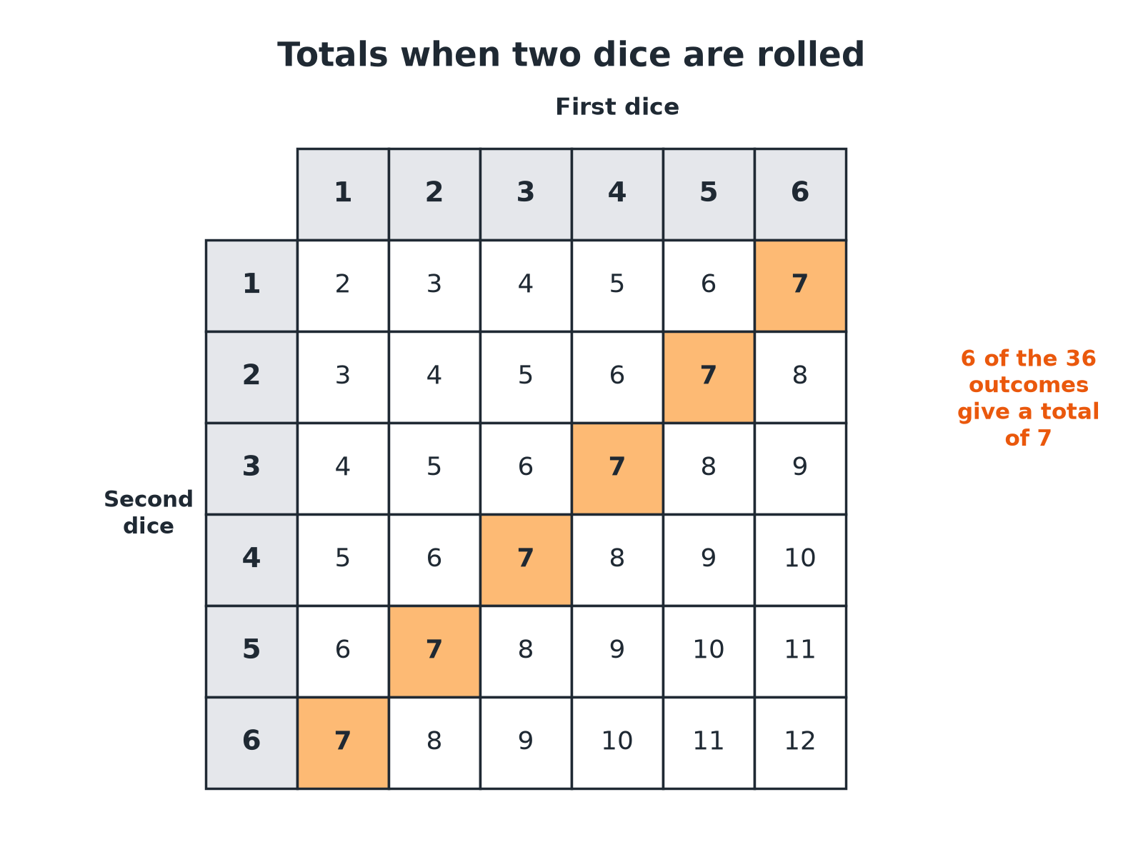

EDEXCEL GCSE MATHS · FOUNDATION & HIGHER
A Sample Space Diagram
A sample space diagram shows every outcome, so nothing is missed.
Probability
openrevise.com
Lesson 1 of 6

Slide 8

EDEXCEL GCSE MATHS · FOUNDATION & HIGHER
Totals from Two Dice
Each cell is the sum of the two dice.
First dice
1
2
3
4
1
2
3
4
5 | 6 | 7
2
3
4
5
6 | 7 | 8
3
4
5
6
7 | 8 | 9
4
5
6
7
8 | 9 | 10
5
6
7
8
9 | 10 | 11
6
7
8
9
10 | 11 | 12
Probability
openrevise.com
Lesson 1 of 6

Slide 9
EDEXCEL GCSE MATHS · FOUNDATION & HIGHER
Using the Table
Two fair dice are rolled and the scores are added. Find (a) P(total is 7) and (b) P(total is at least 10).
(a) Count the 7s in the table
6 out of 36
1
(a) Simplify
6/36 = 1/6
2
(b) Count the totals 10, 11 or 12
3 + 2 + 1 = 6
3
(b) Probability
6/36 = 1/6
4
ANSWER
(a) 1/6 (b) 1/6
Probability
openrevise.com
Lesson 1 of 6

Slide 10
EDEXCEL GCSE MATHS · FOUNDATION & HIGHER
Two Spinners
Spinner A has three equal sections numbered 1, 2, 3. Spinner B has four equal sections numbered 1, 2, 3, 4. Both are spun and the scores added. Find the probability that the total is 5, and that it is even.
1
Number of outcomes
3 × 4 = 12
2
Totals of 5 come from
(1, 4), (2, 3), (3, 2)
3
P(total is 5)
3/12 = ¼
4
Even totals: both odd or both even
(1,1), (1,3), (3,1), (3,3), (2,2), (2,4)
5
P(even)
6/12 = ½
ANSWER
P(total 5) = ¼ and P(even) = ½.
Probability
openrevise.com
Lesson 1 of 6

Slide 11
EDEXCEL GCSE MATHS · FOUNDATION & HIGHER
Systematic Listing
A system stops you missing outcomes or counting one twice.
Fix the first event
Write every second-event outcome beside it, then move to the next first-event outcome.
Use a table
Rows for one event, columns for the other.
Count
The total number of outcomes is the product of the number of outcomes of each event.
Probability
openrevise.com
Lesson 1 of 6

Slide 12

EDEXCEL GCSE MATHS · FOUNDATION & HIGHER
Key Terms
Outcome
One possible result of an event.
Event
One or more outcomes.
Equally likely
Each outcome has the same chance.
Sample space
The set of all possible outcomes.
Sample space diagram
A table or list showing every outcome.
Probability
A number from 0 to 1 showing how likely an event is.
Probability
openrevise.com
Lesson 1 of 6

Slide 13

EDEXCEL GCSE MATHS · FOUNDATION & HIGHER
YOUR TASK
12 minutes
Two-Dice Game
In a game, two dice are rolled and the smaller number is subtracted from the larger (or 0 if they are equal). Complete a table of differences. Which difference is most likely, and what is its probability?
1
Fill in a 6 by 6 table.
2
Count each difference.
3
Divide by 36.
WHAT A GOOD ANSWER SHOWS
The differences 0 to 5 occur 6, 10, 8, 6, 4 and 2 times out of 36. The most likely is 1, with probability 10/36 = 5/18.
Probability
openrevise.com
Lesson 1 of 6
Notes:
Ask students to draw the table before counting.

Slide 14

EDEXCEL GCSE MATHS · FOUNDATION & HIGHER
Can I...?
Write a probability as a fraction.
Work out probabilities from a table.
List outcomes systematically.
Simplify probabilities.
Draw a sample space diagram.
Use 3 × 4 = 12 to count outcomes.
Count successful outcomes.
Avoid double-counting.
Probability
openrevise.com
Lesson 1 of 6

Slide 15
EDEXCEL GCSE MATHS · FOUNDATION & HIGHER
Summary & Exam Focus
Probability = (successful outcomes)/(total outcomes).
Use a table or systematic list to find all outcomes.
The total number of outcomes for two events is the product.
Simplify your final fraction.
EXAM FOCUS
Two fair dice are rolled and their scores are added. Work out the probability that the total is 7. (3 marks)
Draw a 6 by 6 table. Count the 7s (there are 6) and divide by 36.
openrevise.com

Slide 16
EDEXCEL GCSE MATHS · FOUNDATION & HIGHER
Exam Practice: Combined Events
Answer all questions. Show your working. · 25 minutes
Question 1 · 2 marks · Non-calculator
A fair coin is flipped and a fair dice is rolled. Write down the probability of getting a head and a 6.
Question 2 · 3 marks · Non-calculator
Two fair dice are rolled and the scores are added. Work out the probability that the total is 7.
Question 3 · 3 marks · Non-calculator
Spinner A has three equal sections numbered 1, 2 and 3. Spinner B has four equal sections numbered 1, 2, 3 and 4. Both spinners are spun…
Probability
openrevise.com
Lesson 1 of 6

Slide 17
EDEXCEL GCSE MATHS · FOUNDATION & HIGHER
Exam Practice: Combined Events (cont.)
Question 4 · 2 marks · Non-calculator
For the same two spinners, work out the probability that the total is even.
Question 5 · 3 marks · Non-calculator
Two fair dice are rolled and the scores are added. Work out the probability that the total is at least 10.
Question 6 · 2 marks · Non-calculator
Two fair dice are rolled. Work out the probability of getting a double (the same number on both dice).
Probability
openrevise.com
Lesson 1 of 6

Slide 18
EDEXCEL GCSE MATHS · FOUNDATION & HIGHER
Question 1 · 2 marks · Non-calculator
“
A fair coin is flipped and a fair dice is rolled. Write down the probability of getting a head and a 6.
HOW TO ANSWER IT
Command word: Non-calculator. Worth 2 marks, so plan before writing.
Probability
openrevise.com
Lesson 1 of 6

Slide 19
EDEXCEL GCSE MATHS · FOUNDATION & HIGHER
Question 1 · mark scheme
2 marks available. Award a mark for each point made.
12 outcomes
M1
1/12
A1
Probability
openrevise.com
Lesson 1 of 6

Slide 20
EDEXCEL GCSE MATHS · FOUNDATION & HIGHER
Question 2 · 3 marks · Non-calculator
“
Two fair dice are rolled and the scores are added. Work out the probability that the total is 7.
HOW TO ANSWER IT
Command word: Non-calculator. Worth 3 marks, so plan before writing.
Probability
openrevise.com
Lesson 1 of 6

Slide 21
EDEXCEL GCSE MATHS · FOUNDATION & HIGHER
Question 2 · mark scheme
3 marks available. Award a mark for each point made.
36 outcomes
M1
6 successful outcomes
M1
1/6
A1
Probability
openrevise.com
Lesson 1 of 6

Slide 22
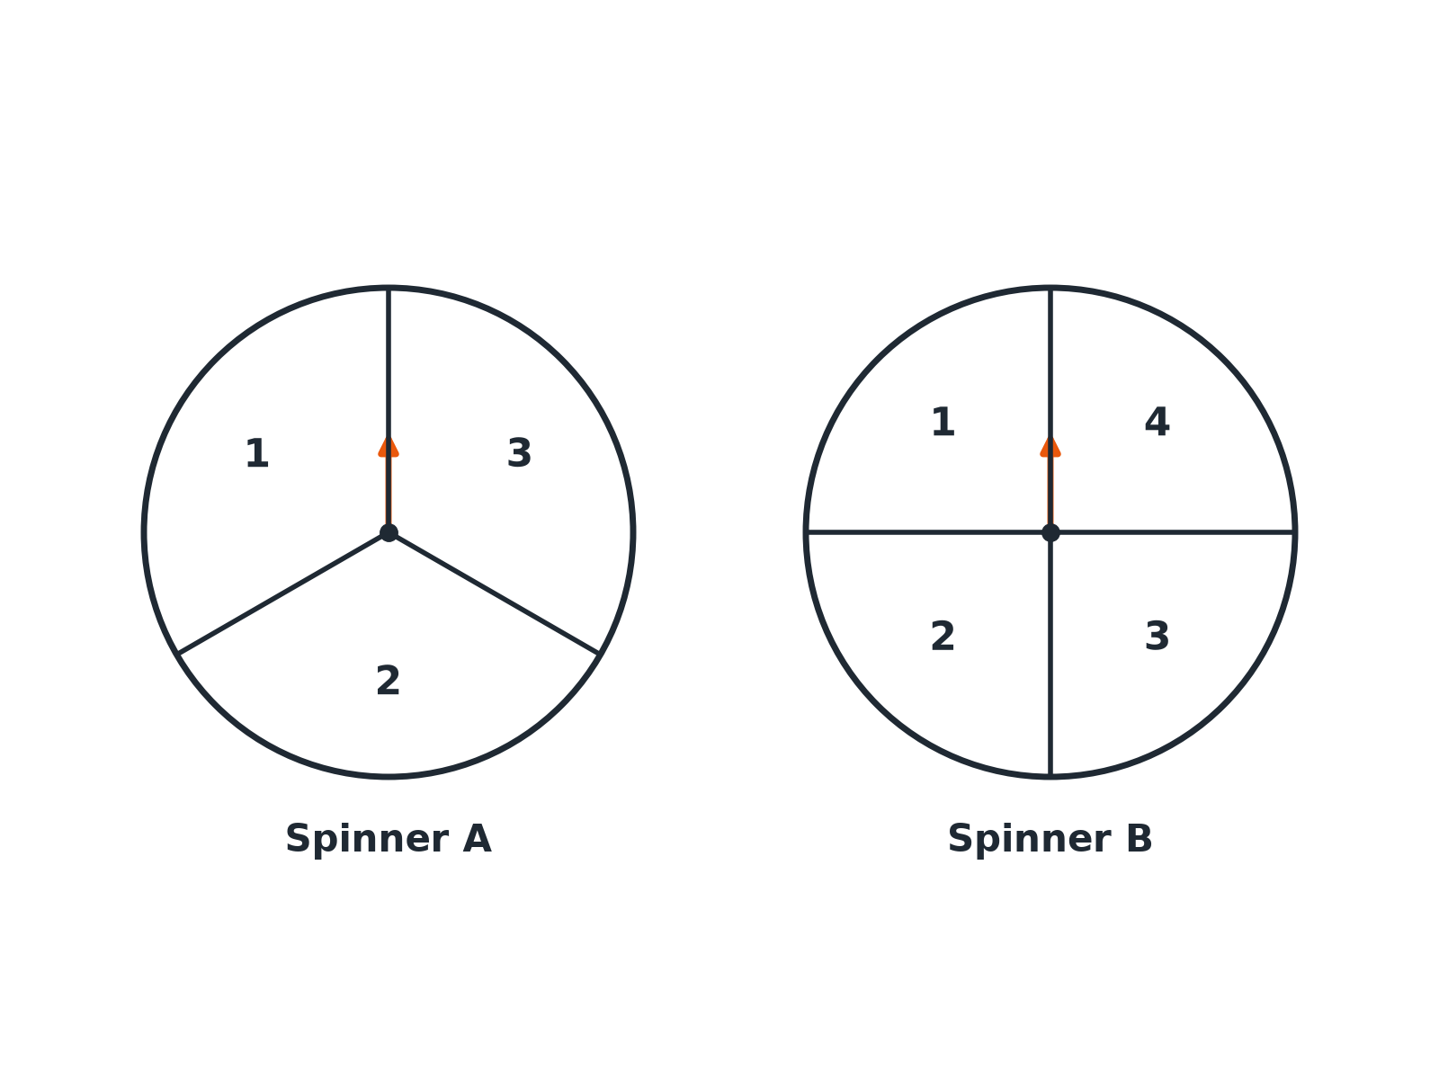
EDEXCEL GCSE MATHS · FOUNDATION & HIGHER
Question 3 · 3 marks · Non-calculator
Spinner A has three equal sections numbered 1, 2 and 3. Spinner B has four equal sections numbered 1, 2, 3 and 4. Both spinners are spun and the two scores are added. Work out the probability that the total is 5. (3 marks)
Probability
openrevise.com
Lesson 1 of 6

Slide 23
EDEXCEL GCSE MATHS · FOUNDATION & HIGHER
Question 3 · mark scheme
3 marks available. Award a mark for each point made.
12 outcomes
M1
Three ways to make 5
M1
¼
A1
Probability
openrevise.com
Lesson 1 of 6

Slide 24
EDEXCEL GCSE MATHS · FOUNDATION & HIGHER
Question 4 · 2 marks · Non-calculator
“
For the same two spinners, work out the probability that the total is even.
HOW TO ANSWER IT
Command word: Non-calculator. Worth 2 marks, so plan before writing.
Probability
openrevise.com
Lesson 1 of 6

Slide 25
EDEXCEL GCSE MATHS · FOUNDATION & HIGHER
Question 4 · mark scheme
2 marks available. Award a mark for each point made.
6 successful outcomes
M1
½
A1
Probability
openrevise.com
Lesson 1 of 6

Slide 26
EDEXCEL GCSE MATHS · FOUNDATION & HIGHER
Question 5 · 3 marks · Non-calculator
“
Two fair dice are rolled and the scores are added. Work out the probability that the total is at least 10.
HOW TO ANSWER IT
Command word: Non-calculator. Worth 3 marks, so plan before writing.
Probability
openrevise.com
Lesson 1 of 6

Slide 27
EDEXCEL GCSE MATHS · FOUNDATION & HIGHER
Question 5 · mark scheme
3 marks available. Award a mark for each point made.
6 successful outcomes
M1
6/36
M1
1/6
A1
Probability
openrevise.com
Lesson 1 of 6

Slide 28
EDEXCEL GCSE MATHS · FOUNDATION & HIGHER
Question 6 · 2 marks · Non-calculator
“
Two fair dice are rolled. Work out the probability of getting a double (the same number on both dice).
HOW TO ANSWER IT
Command word: Non-calculator. Worth 2 marks, so plan before writing.
Probability
openrevise.com
Lesson 1 of 6

Slide 29
EDEXCEL GCSE MATHS · FOUNDATION & HIGHER
Question 6 · mark scheme
2 marks available. Award a mark for each point made.
6 doubles
M1
1/6
A1
Probability
openrevise.com
Lesson 1 of 6

