Slide 1

EDEXCEL GCSE MATHS · FOUNDATION & HIGHER
Venn diagrams and set notation
Probability
Lesson 6 of 6
openrevise.com

Slide 2

EDEXCEL GCSE MATHS · FOUNDATION & HIGHER
Warm-up
Answer each one, then check.
1
List the even numbers from 1 to 10.
2
List the multiples of 3 from 1 to 10.
3
What number is in both lists above?
4
Work out 40 − 29.
5
Simplify 8/16.
Probability
openrevise.com
Lesson 6 of 6

Slide 3
EDEXCEL GCSE MATHS · FOUNDATION & HIGHER
Warm-up - Answers
List the even numbers from 1 to 10.
2, 4, 6, 8, 10
1
List the multiples of 3 from 1 to 10.
3, 6, 9
2
What number is in both lists above?
6
3
Work out 40 − 29.
11
4
Simplify 8/16.
½
5
Probability
openrevise.com
Lesson 6 of 6

Slide 4

EDEXCEL GCSE MATHS · FOUNDATION & HIGHER
Learning Objectives
Use set notation: ∈, ∪, ∩, A', xi and n(A).
1
Draw and complete a Venn diagram.
2
Shade the region for a set expression.
3
Find probabilities from a Venn diagram, including conditional ones (Higher).
4
Probability
openrevise.com
Lesson 6 of 6

Slide 5

EDEXCEL GCSE MATHS · FOUNDATION & HIGHER
Set Notation
Learn these symbols.
Symbol
Meaning
Example
xi
The universal set: everything being considered
xi= {1, 2, ..., 10}
A ∪ B
Union: in A or B or both
{2, 3, 4, 6, 8, 9, 10}
A ∩ B
Intersection: in both A and B
{6}
A'
Complement: not in A
{1, 3, 5, 7, 9}
n(A)
The number of elements in A
n(A) = 5
∈
"is an element of"
4 ∈A
Probability
openrevise.com
Lesson 6 of 6

Slide 6
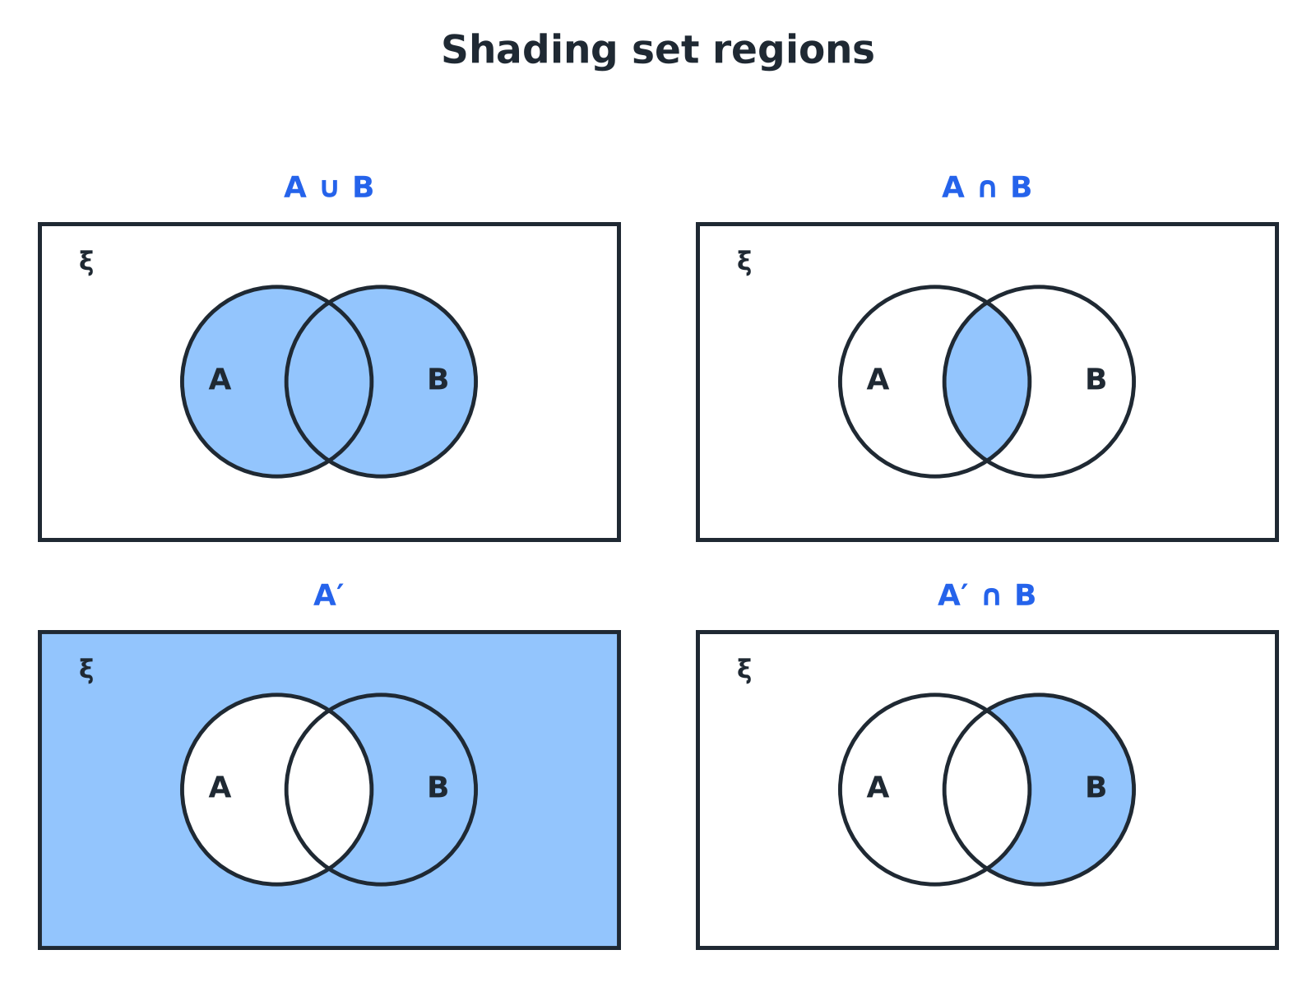

EDEXCEL GCSE MATHS · FOUNDATION & HIGHER
Shading Set Regions
Shade the region that matches the notation.
Probability
openrevise.com
Lesson 6 of 6

Slide 7

EDEXCEL GCSE MATHS · FOUNDATION & HIGHER
Sets of Numbers
xi= {1, 2, 3, ..., 10}, A = the even numbers and B = the multiples of 3. List A, B, A ∩ B, A ∪ B and A'.
1
A
{2, 4, 6, 8, 10}
2
B
{3, 6, 9}
3
In both
A ∩ B = {6}
4
In either
A ∪ B = {2, 3, 4, 6, 8, 9, 10}
5
Not in A
A' = {1, 3, 5, 7, 9}
ANSWER
See the lists above; n(A ∪ B) = 7.
Probability
openrevise.com
Lesson 6 of 6

Slide 8

EDEXCEL GCSE MATHS · FOUNDATION & HIGHER
Completing a Venn Diagram
Start in the middle and work outwards.
1
2
3
4
Fill in the overlap first
The number in both sets
Work out the rest of each set
Subtract the overlap from each total
Fill the outside
Universal total minus everything inside the circles
Check
All the numbers add up to the universal total
Probability
openrevise.com
Lesson 6 of 6

Slide 9
EDEXCEL GCSE MATHS · FOUNDATION & HIGHER
A Survey
40 students were asked about music (M) and art (R). 22 take music, 15 take art and 8 take both. Complete the Venn diagram and find the number who take neither.
1
Both
8
2
Music only
22 − 8 = 14
3
Art only
15 − 8 = 7
4
Inside the circles
14 + 8 + 7 = 29
5
Neither
40 − 29 = 11
ANSWER
Music only 14, both 8, art only 7, neither 11.
Probability
openrevise.com
Lesson 6 of 6

Slide 10
EDEXCEL GCSE MATHS · FOUNDATION & HIGHER
Probabilities from a Venn Diagram
For the survey, a student is chosen at random. Find (a) P(neither), (b) P(M ∪ R).
(a) Neither
11/40
1
(b) Music or art (or both)
14 + 8 + 7 = 29, so 29/40
2
ANSWER
(a) 11/40 (b) 29/40
Probability
openrevise.com
Lesson 6 of 6

Slide 11

EDEXCEL GCSE MATHS · FOUNDATION & HIGHER
HIGHER TIER
Conditional Probability from a Venn Diagram
Restrict to the given set.
openrevise.com

Slide 12
EDEXCEL GCSE MATHS · FOUNDATION & HIGHER
Given That
Higher
For the survey, find P(M midR): the probability a student takes music, given that they take art.
"Given that they take art" restricts to the art circle
15 students
1
Of these, the number who also take music
8
2
Probability
8/15
3
ANSWER
8/15
Probability
openrevise.com
Lesson 6 of 6

Slide 13

EDEXCEL GCSE MATHS · FOUNDATION & HIGHER
Key Terms
Set
A collection of items.
Element
One item in a set.
Universal set
The set of everything being considered, xi.
Union
Items in one set or the other or both, ∪.
Intersection
Items in both sets, ∩.
Complement
Items not in the set, A'.
Probability
openrevise.com
Lesson 6 of 6

Slide 14

EDEXCEL GCSE MATHS · FOUNDATION & HIGHER
YOUR TASK
12 minutes
Class Survey
In a class of 30 students, 18 have a dog, 12 have a cat and 5 have both. Draw a Venn diagram, and find the probability that a randomly chosen student has (a) a dog only (b) neither (c) a cat given that they have a dog.
1
Fill in the overlap first.
2
Subtract for the other regions.
3
Use the right total.
WHAT A GOOD ANSWER SHOWS
Dog only 18 − 5 = 13, cat only 12 − 5 = 7, both 5, neither 30 − 25 = 5. (a) 13/30 (b) 5/30 = 1/6 (c) 5/18.
Probability
openrevise.com
Lesson 6 of 6
Notes:
Point out that part (c) restricts the total to the 18 dog owners.

Slide 15

EDEXCEL GCSE MATHS · FOUNDATION & HIGHER
Can I...?
Use the set notation symbols.
Shade the correct region.
List the elements of A ∩ B and A ∪ B.
Find a probability from a Venn diagram.
Find A'.
Find P(A midB) (Higher).
Fill in a Venn diagram from totals.
Check the total.
Probability
openrevise.com
Lesson 6 of 6

Slide 16
EDEXCEL GCSE MATHS · FOUNDATION & HIGHER
Summary & Exam Focus
A ∪ B: in A or B. A ∩ B: in both. A': not in A.
Fill the overlap first, then each circle, then the outside.
The numbers must add up to the universal total.
Higher: P(A midB) uses B as the new total.
EXAM FOCUS
40 students were asked about music and art. 22 take music, 15 take art and 8 take both. Draw a Venn diagram to show this information. (4 marks)
Start with the overlap (8), then subtract it from each circle total. Finish with the number outside.
openrevise.com

Slide 17
EDEXCEL GCSE MATHS · FOUNDATION & HIGHER
Exam Practice: Venn Diagrams and Set Notation
Answer all questions. Show your working. · 30 minutes
Question 1 · 2 marks · Non-calculator
xi= {1, 2, 3, 4, 5, 6, 7, 8, 9, 10}, A = {even numbers} and B = {multiples of 3}. List the members of A ∩ B.
Question 2 · 2 marks · Non-calculator
Using the same sets, list the members of A'.
Question 3 · 4 marks · Non-calculator
40 students were asked whether they take music (M) and art (R). 22 take music, 15 take art and 8 take both. Complete the Venn diagram.
Probability
openrevise.com
Lesson 6 of 6

Slide 18
EDEXCEL GCSE MATHS · FOUNDATION & HIGHER
Exam Practice: Venn Diagrams and Set Notation (cont.)
Question 4 · 2 marks · Non-calculator
One of the 40 students is chosen at random. Use your Venn diagram to work out the probability that the student takes neither music nor art.
Question 5 · 2 marks · Non-calculator
Write down the number of students in M ∪ R.
Question 6 · 3 marks · Non-calculator
One of the 40 students is chosen at random. Given that the student takes art, work out the probability that they also take music.
Probability
openrevise.com
Lesson 6 of 6

Slide 19
EDEXCEL GCSE MATHS · FOUNDATION & HIGHER
Question 1 · 2 marks · Non-calculator
“
xi= {1, 2, 3, 4, 5, 6, 7, 8, 9, 10}, A = {even numbers} and B = {multiples of 3}. List the members of A ∩ B.
HOW TO ANSWER IT
Command word: Non-calculator. Worth 2 marks, so plan before writing.
Probability
openrevise.com
Lesson 6 of 6

Slide 20
EDEXCEL GCSE MATHS · FOUNDATION & HIGHER
Question 1 · mark scheme
2 marks available. Award a mark for each point made.
A = {2, 4, 6, 8, 10} and B = {3, 6, 9}
M1
{6}
A1
Probability
openrevise.com
Lesson 6 of 6

Slide 21
EDEXCEL GCSE MATHS · FOUNDATION & HIGHER
Question 2 · 2 marks · Non-calculator
“
Using the same sets, list the members of A'.
HOW TO ANSWER IT
Command word: Non-calculator. Worth 2 marks, so plan before writing.
Probability
openrevise.com
Lesson 6 of 6

Slide 22
EDEXCEL GCSE MATHS · FOUNDATION & HIGHER
Question 2 · mark scheme
2 marks available. Award a mark for each point made.
Odd numbers seen
M1
{1, 3, 5, 7, 9}
A1
Probability
openrevise.com
Lesson 6 of 6

Slide 23
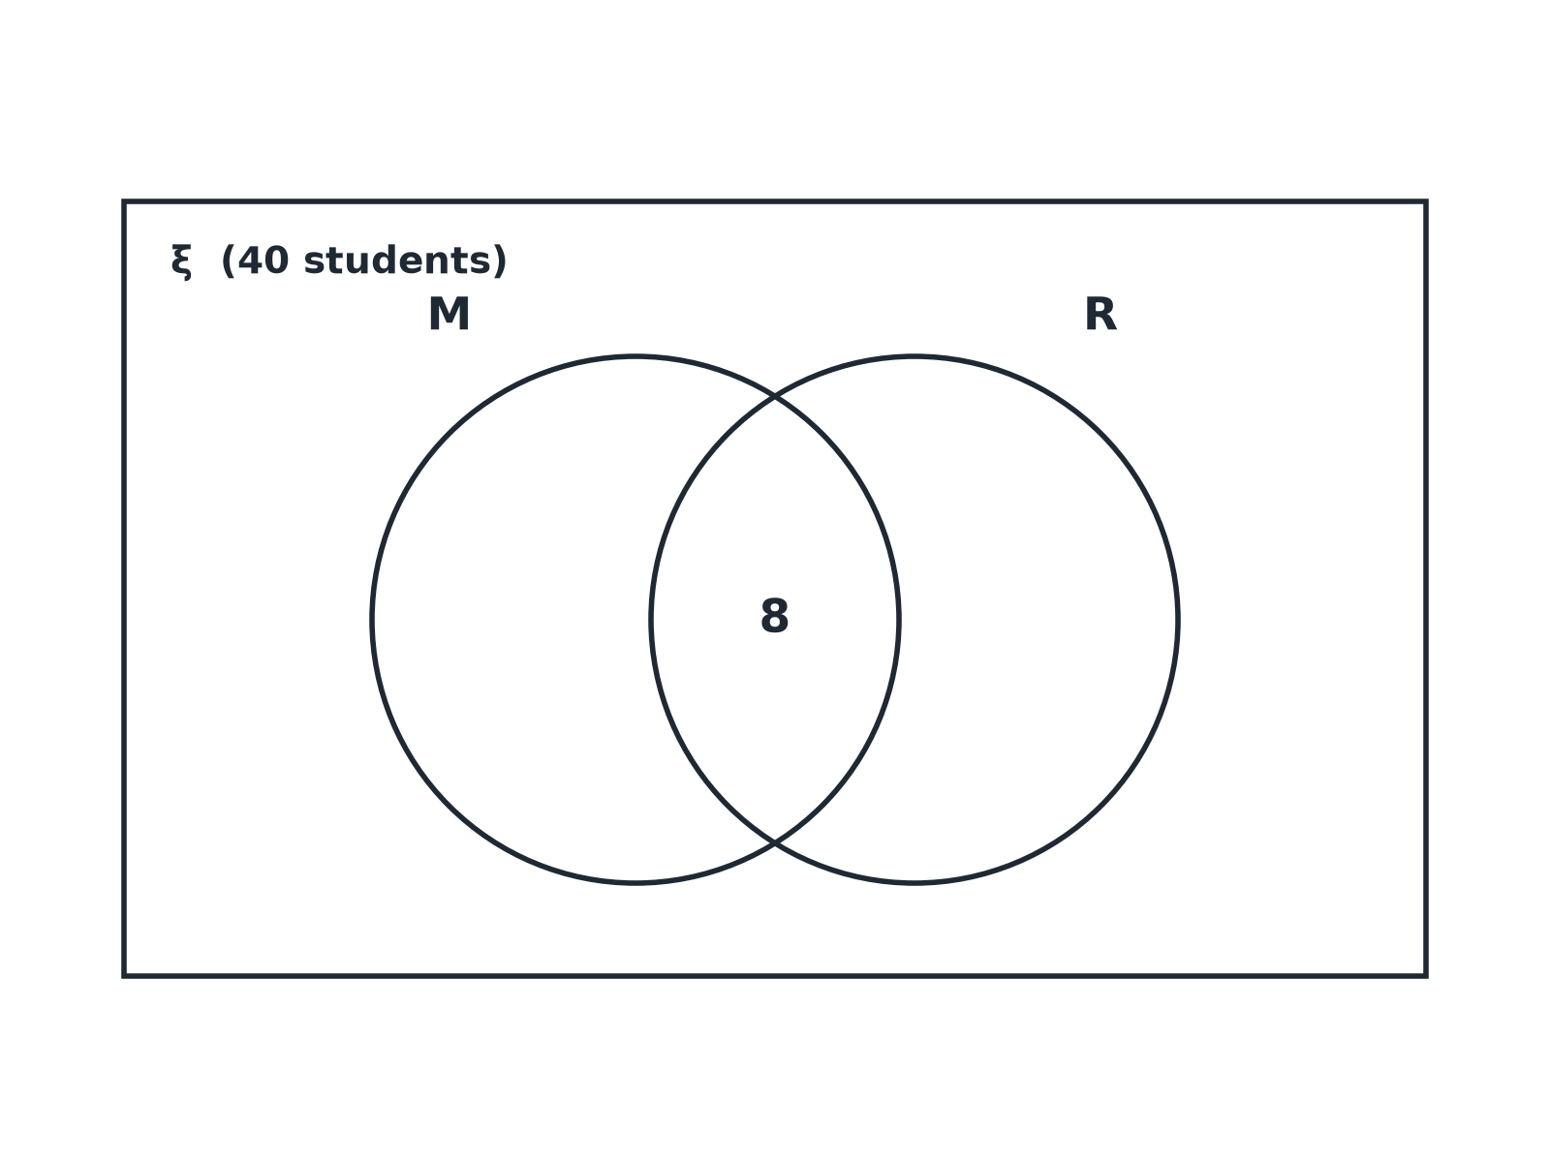
EDEXCEL GCSE MATHS · FOUNDATION & HIGHER
Question 3 · 4 marks · Non-calculator
40 students were asked whether they take music (M) and art (R). 22 take music, 15 take art and 8 take both. Complete the Venn diagram. (4 marks)
Probability
openrevise.com
Lesson 6 of 6

Slide 24
EDEXCEL GCSE MATHS · FOUNDATION & HIGHER
Question 3 · mark scheme
4 marks available. Award a mark for each point made.
Overlap 8
B1
M only 14
B1
R only 7
B1
Outside 11
B1
Probability
openrevise.com
Lesson 6 of 6

Slide 25
EDEXCEL GCSE MATHS · FOUNDATION & HIGHER
Question 4 · 2 marks · Non-calculator
“
One of the 40 students is chosen at random. Use your Venn diagram to work out the probability that the student takes neither music nor art.
HOW TO ANSWER IT
Command word: Non-calculator. Worth 2 marks, so plan before writing.
Probability
openrevise.com
Lesson 6 of 6

Slide 26
EDEXCEL GCSE MATHS · FOUNDATION & HIGHER
Question 4 · mark scheme
2 marks available. Award a mark for each point made.
11
M1
11/40
A1
Probability
openrevise.com
Lesson 6 of 6

Slide 27
EDEXCEL GCSE MATHS · FOUNDATION & HIGHER
Question 5 · 2 marks · Non-calculator
“
Write down the number of students in M ∪ R.
HOW TO ANSWER IT
Command word: Non-calculator. Worth 2 marks, so plan before writing.
Probability
openrevise.com
Lesson 6 of 6

Slide 28
EDEXCEL GCSE MATHS · FOUNDATION & HIGHER
Question 5 · mark scheme
2 marks available. Award a mark for each point made.
Adding the three regions
M1
29
A1
Probability
openrevise.com
Lesson 6 of 6

Slide 29
EDEXCEL GCSE MATHS · FOUNDATION & HIGHER
Question 6 · 3 marks · Non-calculator
“
One of the 40 students is chosen at random. Given that the student takes art, work out the probability that they also take music.
HOW TO ANSWER IT
Command word: Non-calculator. Worth 3 marks, so plan before writing.
Probability
openrevise.com
Lesson 6 of 6

Slide 30
EDEXCEL GCSE MATHS · FOUNDATION & HIGHER
Question 6 · mark scheme
3 marks available. Award a mark for each point made.
15 as the total
M1
8/15
A1
A correct conclusion
C1
Probability
openrevise.com
Lesson 6 of 6

