Slide 1

EDEXCEL GCSE MATHS · FOUNDATION & HIGHER
Compound measures
Multiplicative reasoning
Lesson 2 of 4
openrevise.com

Slide 2

EDEXCEL GCSE MATHS · FOUNDATION & HIGHER
Warm-up
Answer each one, then check.
1
How many metres in a kilometre?
2
How many seconds in an hour?
3
Work out 240 ÷ 3.
4
How many cm³ in a litre?
5
What is the area of a rectangle 20 cm by 10 cm?
Multiplicative reasoning
openrevise.com
Lesson 2 of 4

Slide 3
EDEXCEL GCSE MATHS · FOUNDATION & HIGHER
Warm-up - Answers
How many metres in a kilometre?
1000
1
How many seconds in an hour?
3600
2
Work out 240 ÷ 3.
80
3
How many cm³ in a litre?
1000
4
What is the area of a rectangle 20 cm by 10 cm?
200 cm²
5
Multiplicative reasoning
openrevise.com
Lesson 2 of 4

Slide 4

EDEXCEL GCSE MATHS · FOUNDATION & HIGHER
Learning Objectives
Use speed = distance/time.
1
Use density = mass/volume.
2
Use pressure = force/area.
3
Convert between units for compound measures.
4
Multiplicative reasoning
openrevise.com
Lesson 2 of 4

Slide 5
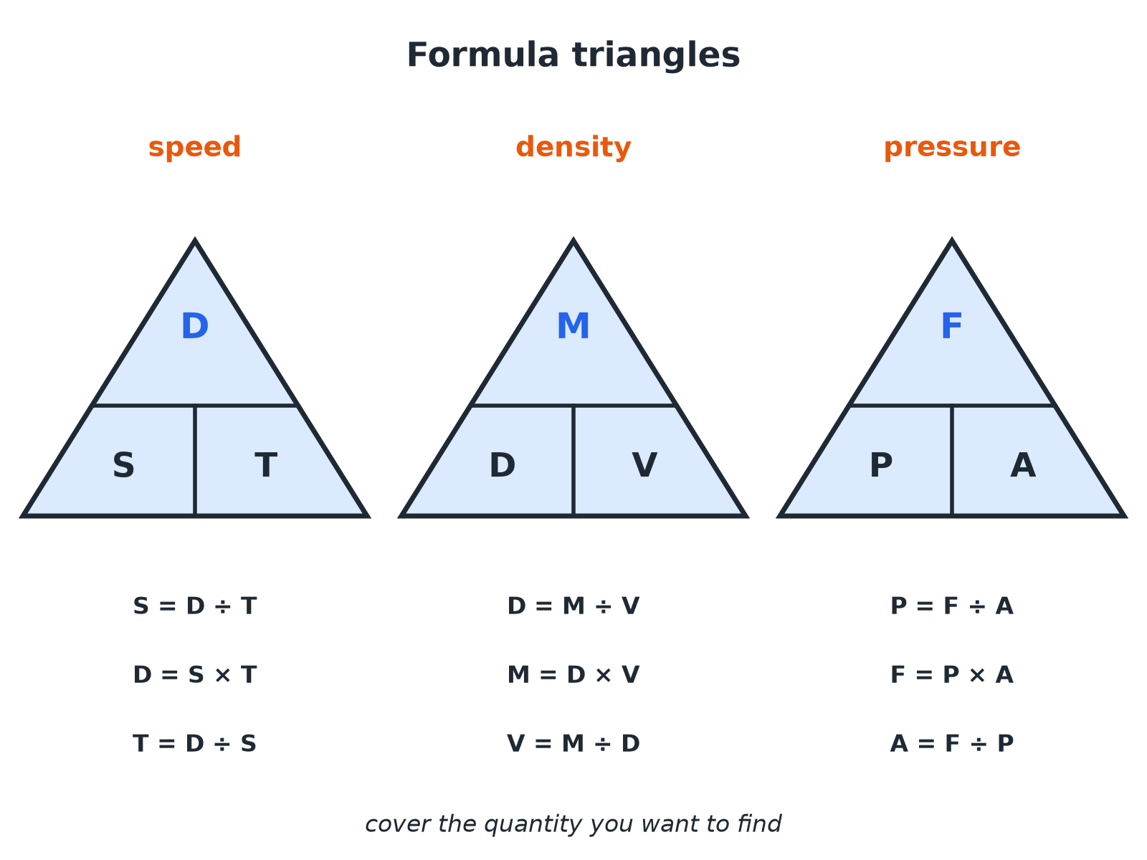

EDEXCEL GCSE MATHS · FOUNDATION & HIGHER
Formula Triangles
Cover what you want to find; what is left tells you what to do.
Multiplicative reasoning
openrevise.com
Lesson 2 of 4

Slide 6

EDEXCEL GCSE MATHS · FOUNDATION & HIGHER
The Three Formulae
Know these and their units.
Measure
Formula
Typical units
Speed
distance/time
km/h, m/s
Density
mass/volume
g/cm³, kg/m³
Pressure
force/area
N/m², Pa
Multiplicative reasoning
openrevise.com
Lesson 2 of 4

Slide 7

EDEXCEL GCSE MATHS · FOUNDATION & HIGHER
Speed
A train travels 240 km in 3 hours. Find its average speed.
Speed = distance/time
240/3
1
Work it out
80
2
ANSWER
80 km/h
Multiplicative reasoning
openrevise.com
Lesson 2 of 4

Slide 8
EDEXCEL GCSE MATHS · FOUNDATION & HIGHER
Density
A block of metal has mass 450 g and volume 60 cm³. Find its density.
Density = mass/volume
450/60
1
Work it out
7.5
2
ANSWER
7.5 g/cm³
Multiplicative reasoning
openrevise.com
Lesson 2 of 4

Slide 9
EDEXCEL GCSE MATHS · FOUNDATION & HIGHER
Pressure
A force of 600 N acts on an area of 0.5 m². Find the pressure.
Pressure = force/area
600/0.5
1
Work it out
1200
2
ANSWER
1200 N/m² (1200 Pa)
Multiplicative reasoning
openrevise.com
Lesson 2 of 4

Slide 10
EDEXCEL GCSE MATHS · FOUNDATION & HIGHER
Changing Units
Change 90 km/h into metres per second.
90 km is 90 000 m
90 × 1000
1
1 hour is 3600 s
90 000 ÷ 3600
2
Work it out
25
3
ANSWER
25 m/s
Multiplicative reasoning
openrevise.com
Lesson 2 of 4

Slide 11
EDEXCEL GCSE MATHS · FOUNDATION & HIGHER
Rearranging a Formula
Aluminium has density 2.7 g/cm³. Find the mass of a piece with volume 40 cm³.
Mass = density × volume
2.7 × 40
1
Work it out
108
2
ANSWER
108 g
Multiplicative reasoning
openrevise.com
Lesson 2 of 4

Slide 12

EDEXCEL GCSE MATHS · FOUNDATION & HIGHER
Watch the Units
Units must match before you divide.
Time
Change minutes to hours before dividing by km per hour: 30 minutes is 0.5 hours.
Area
1 m² is 10 000 cm², so pressure in N/m² needs area in m².
Density
1 g/cm³ is 1000 kg/m³.
Multiplicative reasoning
openrevise.com
Lesson 2 of 4

Slide 13

EDEXCEL GCSE MATHS · FOUNDATION & HIGHER
Key Terms
Compound measure
A measure made from two other measures, such as speed.
Speed
Distance travelled per unit of time.
Density
Mass per unit of volume.
Pressure
Force per unit of area.
Newton (N)
The unit of force.
Pascal (Pa)
One newton per square metre.
Multiplicative reasoning
openrevise.com
Lesson 2 of 4

Slide 14

EDEXCEL GCSE MATHS · FOUNDATION & HIGHER
YOUR TASK
12 minutes
Which Metal?
A mystery block has mass 540 g and volume 200 cm³. Work out its density and use the table to decide which metal it is: aluminium 2.7 g/cm³, iron 7.9 g/cm³, copper 8.9 g/cm³.
Divide mass by volume.
1
Compare with the table.
2
WHAT A GOOD ANSWER SHOWS
Density = 540 ÷ 200 = 2.7 g/cm³, so the block is aluminium.
Multiplicative reasoning
openrevise.com
Lesson 2 of 4

Slide 15

EDEXCEL GCSE MATHS · FOUNDATION & HIGHER
Can I...?
Use S = D ÷ T in all three forms.
Convert minutes to hours.
Use D = M ÷ V in all three forms.
Use the correct units in an answer.
Use P = F ÷ A in all three forms.
Choose the right formula.
Convert km/h to m/s.
Rearrange a formula.
Multiplicative reasoning
openrevise.com
Lesson 2 of 4

Slide 16
EDEXCEL GCSE MATHS · FOUNDATION & HIGHER
Summary & Exam Focus
Speed = distance ÷ time.
Density = mass ÷ volume.
Pressure = force ÷ area.
Convert units before calculating.
EXAM FOCUS
A block of metal has weight 40 N. Its largest face has area 0.02 m². Work out the pressure on the ground when it rests on this face. (2 marks)
Pressure is force divided by area, so the smaller the area, the greater the pressure. Make sure the area is in m² if the answer is in N/m².
openrevise.com

