Slide 1

EDEXCEL GCSE MATHS · FOUNDATION & HIGHER
More compound measures
Multiplicative reasoning
Lesson 3 of 4
openrevise.com

Slide 2

EDEXCEL GCSE MATHS · FOUNDATION & HIGHER
Warm-up
Answer each one, then check.
1
Change 2.5 hours into hours and minutes.
2
What is density?
3
Work out 60 ÷ 1.5.
4
Work out 60 ÷ 60.
5
How many litres in 1 m³?
Multiplicative reasoning
openrevise.com
Lesson 3 of 4

Slide 3
EDEXCEL GCSE MATHS · FOUNDATION & HIGHER
Warm-up - Answers
Change 2.5 hours into hours and minutes.
2 h 30 min
1
What is density?
Mass divided by volume
2
Work out 60 ÷ 1.5.
40
3
Work out 60 ÷ 60.
1
4
How many litres in 1 m³?
1000
5
Multiplicative reasoning
openrevise.com
Lesson 3 of 4

Slide 4

EDEXCEL GCSE MATHS · FOUNDATION & HIGHER
Learning Objectives
Use rates such as population density and flow rate.
1
Work out average speed for a journey in stages.
2
Convert compound units, including density.
3
Solve multi-step problems with compound measures.
4
Multiplicative reasoning
openrevise.com
Lesson 3 of 4

Slide 5

EDEXCEL GCSE MATHS · FOUNDATION & HIGHER
Everyday Compound Measures
Population density
population/area, for example people per km².
Rate of flow
volume/time, for example litres per minute.
Unit price
cost/quantity, for example £ per kg.
Average speed
(total distance)/(total time).
Multiplicative reasoning
openrevise.com
Lesson 3 of 4

Slide 6

EDEXCEL GCSE MATHS · FOUNDATION & HIGHER
Population Density
A town has 60 000 people and an area of 25 km². Find its population density.
Density = population/area
(60 000)/25
1
Work it out
2400
2
ANSWER
2400 people per km²
Multiplicative reasoning
openrevise.com
Lesson 3 of 4

Slide 7
EDEXCEL GCSE MATHS · FOUNDATION & HIGHER
Rate of Flow
A tank holds 1200 litres. Water runs into it at 15 litres per minute. How long does it take to fill, in hours and minutes?
Time = volume/rate
1200/15
1
Work it out
80 minutes
2
Convert
1 hour 20 minutes
3
ANSWER
1 hour 20 minutes
Multiplicative reasoning
openrevise.com
Lesson 3 of 4

Slide 8
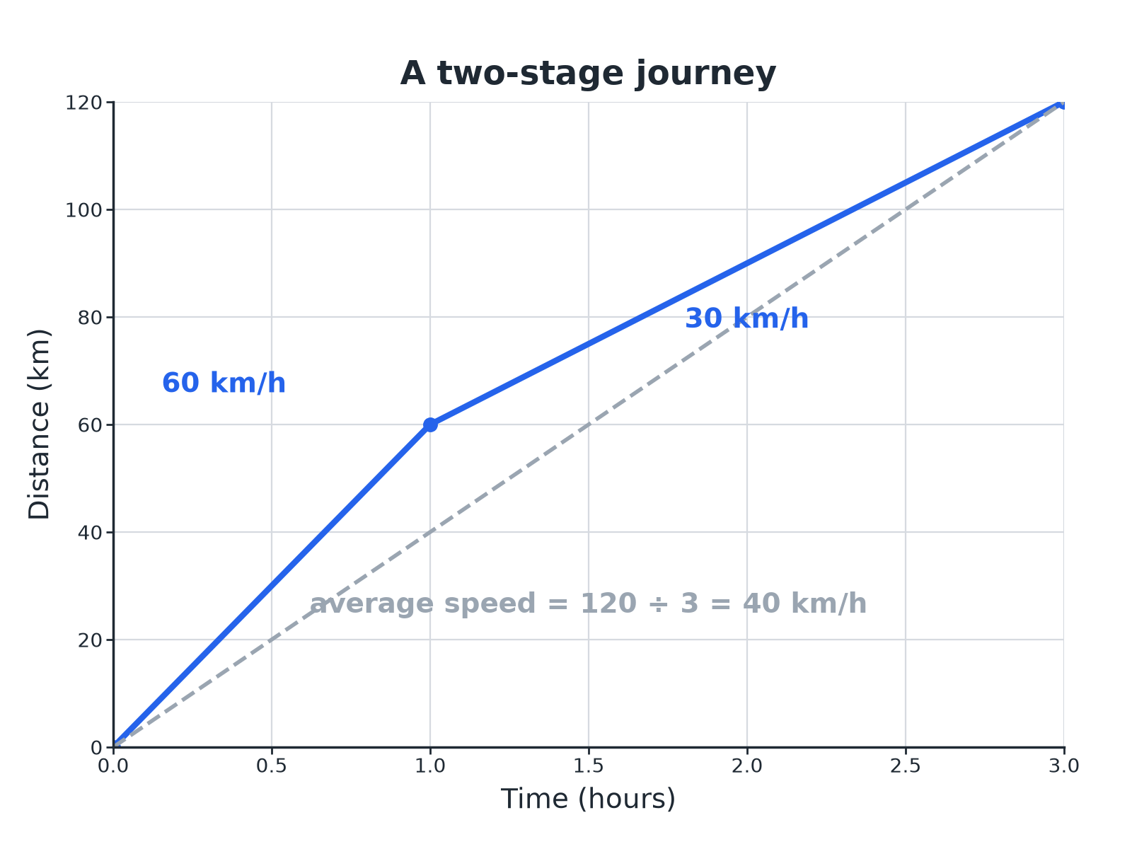

EDEXCEL GCSE MATHS · FOUNDATION & HIGHER
A Two-Stage Journey
Average speed uses the whole distance and the whole time.
Multiplicative reasoning
openrevise.com
Lesson 3 of 4

Slide 9
EDEXCEL GCSE MATHS · FOUNDATION & HIGHER
Average Speed in Two Stages
A car travels 60 km at 40 km/h and then 60 km at 60 km/h. Find its average speed for the whole journey.
Time for stage 1
60 ÷ 40 = 1.5 hours
1
Time for stage 2
60 ÷ 60 = 1 hour
2
Total distance and time
120 km in 2.5 hours
3
Average speed
120 ÷ 2.5 = 48
4
ANSWER
48 km/h (not 50 km/h)
Multiplicative reasoning
openrevise.com
Lesson 3 of 4

Slide 10
EDEXCEL GCSE MATHS · FOUNDATION & HIGHER
Converting Density
Steel has density 7.8 g/cm³. Write this in kg/m³.
1 g is 0.001 kg and 1 cm³ is 0.000 001 m³
1 g/cm³ = 0.001/(0.000 001) kg/m³
1
Simplify
1 g/cm³ = 1000 kg/m³
2
Multiply
7.8 × 1000
3
ANSWER
7800 kg/m³
Multiplicative reasoning
openrevise.com
Lesson 3 of 4

Slide 11
EDEXCEL GCSE MATHS · FOUNDATION & HIGHER
Converting Speed the Other Way
A cyclist rides at 15 m/s. Find her speed in km/h.
15 m per second in 1 hour
15 × 3600 = 54 000 m
1
Change to km
54 000 ÷ 1000
2
ANSWER
54 km/h
Multiplicative reasoning
openrevise.com
Lesson 3 of 4

Slide 12
EDEXCEL GCSE MATHS · FOUNDATION & HIGHER
Handy Conversions
Learn or work these out.
From
To
Rule
m/s
km/h
Multiply by 3.6
km/h
m/s
Divide by 3.6
g/cm³
kg/m³
Multiply by 1000
cm²
m²
Divide by 10 000
litres
cm³
Multiply by 1000
Multiplicative reasoning
openrevise.com
Lesson 3 of 4

Slide 13

EDEXCEL GCSE MATHS · FOUNDATION & HIGHER
Key Terms
Rate
A quantity compared with another, such as litres per minute.
Population density
The number of people per unit of area.
Average speed
Total distance divided by total time.
Flow rate
The volume passing a point per unit of time.
Unit price
The cost of one unit of a product.
Conversion
Changing from one unit to another.
Multiplicative reasoning
openrevise.com
Lesson 3 of 4

Slide 14

EDEXCEL GCSE MATHS · FOUNDATION & HIGHER
YOUR TASK
12 minutes
Best Journey
Ali drives 90 km at 60 km/h and then 90 km at 90 km/h. Ben drives the whole 180 km at 72 km/h. Who has the higher average speed, and by how much?
1
Find each time.
2
Total distance over total time.
3
Compare.
WHAT A GOOD ANSWER SHOWS
Ali: times 1.5 h and 1 h, so 2.5 h for 180 km: 72 km/h. Ben: 72 km/h. They have the same average speed, even though Ali's speeds average to 75 km/h.
Multiplicative reasoning
openrevise.com
Lesson 3 of 4
Notes:
Use this to show why averaging the speeds gives the wrong answer.

Slide 15

EDEXCEL GCSE MATHS · FOUNDATION & HIGHER
Can I...?
Work out population density.
Convert m/s to km/h.
Work out a rate of flow.
Convert g/cm³ to kg/m³.
Find average speed for a whole journey.
Use unit prices.
Avoid averaging the speeds.
Show clear working.
Multiplicative reasoning
openrevise.com
Lesson 3 of 4

Slide 16
EDEXCEL GCSE MATHS · FOUNDATION & HIGHER
Summary & Exam Focus
Average speed = total distance ÷ total time.
Density, pressure and flow rate are all "one thing per another".
Convert units before dividing.
m/s to km/h: multiply by 3.6.
EXAM FOCUS
A car travels 60 km at 40 km/h and then 60 km at 60 km/h. Work out its average speed for the whole journey. (4 marks)
Find the time for each stage, then divide the total distance by the total time. The answer is not the average of the two speeds.
openrevise.com

Slide 17
EDEXCEL GCSE MATHS · FOUNDATION & HIGHER
Exam Practice: More Compound Measures
Answer all questions. Show your working. · 30 minutes
Question 1 · 3 marks · Calculator
A town has a population of 60 000 and an area of 25 km². Work out the population density of the town in people per km².
Question 2 · 2 marks · Non-calculator
A cyclist travels at 15 metres per second. Work out her speed in kilometres per hour.
Question 3 · 3 marks · Calculator
A tank holds 1200 litres of water. Water runs into the tank at 15 litres per minute. Work out how long the tank takes to fill. Give your…
Multiplicative reasoning
openrevise.com
Lesson 3 of 4

Slide 18
EDEXCEL GCSE MATHS · FOUNDATION & HIGHER
Exam Practice: More Compound Measures (cont.)
Question 4 · 4 marks · Calculator
A car travels 60 km at 40 km/h and then 60 km at 60 km/h. Work out the average speed of the car for the whole journey.
Question 5 · 4 marks · Calculator
The distance-time graph shows a car journey. (a) Work out the speed of the car during the last part of the journey. (b) Work out the…
Question 6 · 2 marks · Non-calculator
Steel has a density of 7.8 g/cm³. Write this density in kg/m³.
Multiplicative reasoning
openrevise.com
Lesson 3 of 4

Slide 19
EDEXCEL GCSE MATHS · FOUNDATION & HIGHER
Question 1 · 3 marks · Calculator
“
A town has a population of 60 000 and an area of 25 km². Work out the population density of the town in people per km².
HOW TO ANSWER IT
Command word: Calculator. Worth 3 marks, so plan before writing.
Multiplicative reasoning
openrevise.com
Lesson 3 of 4

Slide 20
EDEXCEL GCSE MATHS · FOUNDATION & HIGHER
Question 1 · mark scheme
3 marks available. Award a mark for each point made.
60 000 ÷ 25
M1
2400
A1
Units
B1
Multiplicative reasoning
openrevise.com
Lesson 3 of 4

Slide 21
EDEXCEL GCSE MATHS · FOUNDATION & HIGHER
Question 2 · 2 marks · Non-calculator
“
A cyclist travels at 15 metres per second. Work out her speed in kilometres per hour.
HOW TO ANSWER IT
Command word: Non-calculator. Worth 2 marks, so plan before writing.
Multiplicative reasoning
openrevise.com
Lesson 3 of 4

Slide 22
EDEXCEL GCSE MATHS · FOUNDATION & HIGHER
Question 2 · mark scheme
2 marks available. Award a mark for each point made.
15 × 3600 or 15 × 3.6
M1
54
A1
Multiplicative reasoning
openrevise.com
Lesson 3 of 4

Slide 23
EDEXCEL GCSE MATHS · FOUNDATION & HIGHER
Question 3 · 3 marks · Calculator
“
A tank holds 1200 litres of water. Water runs into the tank at 15 litres per minute. Work out how long the tank takes to fill. Give your answer in hours and minutes.
HOW TO ANSWER IT
Command word: Calculator. Worth 3 marks, so plan before writing.
Multiplicative reasoning
openrevise.com
Lesson 3 of 4

Slide 24
EDEXCEL GCSE MATHS · FOUNDATION & HIGHER
Question 3 · mark scheme
3 marks available. Award a mark for each point made.
1200 ÷ 15
M1
80 minutes
A1
1 hour 20 minutes
A1
Multiplicative reasoning
openrevise.com
Lesson 3 of 4

Slide 25
EDEXCEL GCSE MATHS · FOUNDATION & HIGHER
Question 4 · 4 marks · Calculator
“
A car travels 60 km at 40 km/h and then 60 km at 60 km/h. Work out the average speed of the car for the whole journey.
HOW TO ANSWER IT
Command word: Calculator. Worth 4 marks, so plan before writing.
Multiplicative reasoning
openrevise.com
Lesson 3 of 4

Slide 26
EDEXCEL GCSE MATHS · FOUNDATION & HIGHER
Question 4 · mark scheme
4 marks available. Award a mark for each point made.
60 ÷ 40
M1
Total time 2.5 hours
M1
120 ÷ 2.5
M1
48
A1
Multiplicative reasoning
openrevise.com
Lesson 3 of 4

Slide 27
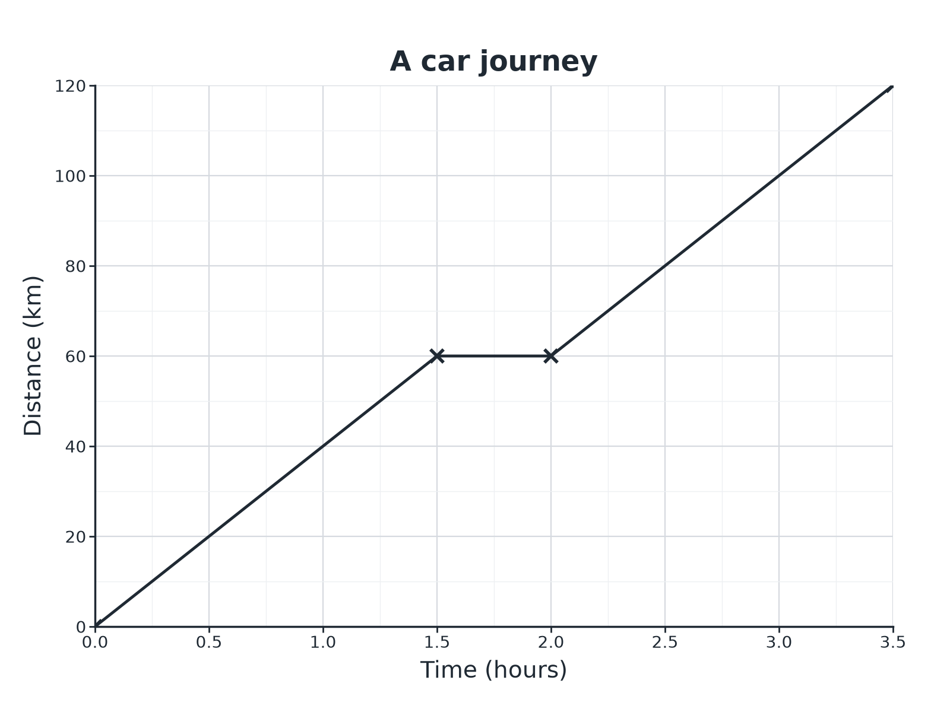
EDEXCEL GCSE MATHS · FOUNDATION & HIGHER
Question 5 · 4 marks · Calculator
The distance-time graph shows a car journey. (a) Work out the speed of the car during the last part of the journey. (b) Work out the average speed for the whole journey. (4 marks)
Multiplicative reasoning
openrevise.com
Lesson 3 of 4

Slide 28
EDEXCEL GCSE MATHS · FOUNDATION & HIGHER
Question 5 · mark scheme
4 marks available. Award a mark for each point made.
(a) 60 ÷ 1.5
M1
(a) 40
A1
(b) 120 ÷ 3.5
M1
(b) 34.3
A1
Multiplicative reasoning
openrevise.com
Lesson 3 of 4

Slide 29
EDEXCEL GCSE MATHS · FOUNDATION & HIGHER
Question 6 · 2 marks · Non-calculator
“
Steel has a density of 7.8 g/cm³. Write this density in kg/m³.
HOW TO ANSWER IT
Command word: Non-calculator. Worth 2 marks, so plan before writing.
Multiplicative reasoning
openrevise.com
Lesson 3 of 4

Slide 30
EDEXCEL GCSE MATHS · FOUNDATION & HIGHER
Question 6 · mark scheme
2 marks available. Award a mark for each point made.
7.8 × 1000
M1
7800
A1
Multiplicative reasoning
openrevise.com
Lesson 3 of 4

