Slide 1

EDEXCEL GCSE MATHS · FOUNDATION & HIGHER
Ratio and proportion
Multiplicative reasoning
Lesson 4 of 4
openrevise.com

Slide 2

EDEXCEL GCSE MATHS · FOUNDATION & HIGHER
Warm-up
Answer each one, then check.
1
4 pens cost £3.20. How much does 1 pen cost?
2
If y = 3x and x = 5, what is y?
3
Solve 12 = k/4.
4
Work out 48 ÷ 6.
5
What does "directly proportional" mean?
Multiplicative reasoning
openrevise.com
Lesson 4 of 4

Slide 3
EDEXCEL GCSE MATHS · FOUNDATION & HIGHER
Warm-up - Answers
4 pens cost £3.20. How much does 1 pen cost?
£0.80
1
If y = 3x and x = 5, what is y?
15
2
Solve 12 = k/4.
k = 48
3
Work out 48 ÷ 6.
8
4
What does "directly proportional" mean?
Both increase in the same ratio
5
Multiplicative reasoning
openrevise.com
Lesson 4 of 4

Slide 4

EDEXCEL GCSE MATHS · FOUNDATION & HIGHER
Learning Objectives
Solve direct proportion problems with y = kx.
1
Solve inverse proportion problems with y = k/x.
2
Recognise proportion from a table or graph.
3
Use y ∝ x², y ∝ x³ and y ∝ √x (Higher).
4
Multiplicative reasoning
openrevise.com
Lesson 4 of 4

Slide 5
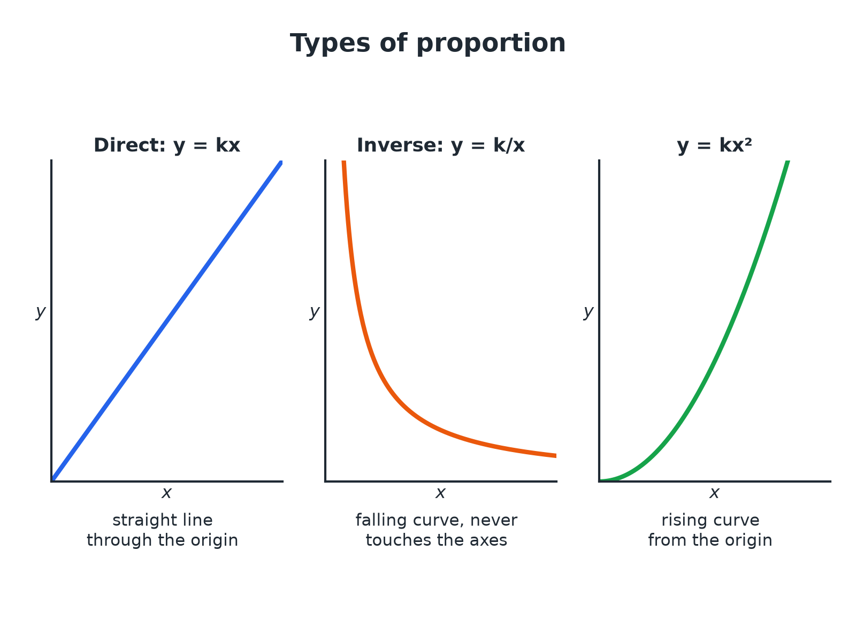

EDEXCEL GCSE MATHS · FOUNDATION & HIGHER
Proportion Graphs
The shape of the graph tells you the type of proportion.
Multiplicative reasoning
openrevise.com
Lesson 4 of 4

Slide 6

EDEXCEL GCSE MATHS · FOUNDATION & HIGHER
Direct and Inverse Proportion
DIRECT PROPORTION
INVERSE PROPORTION
• As x increases, y increases in the same ratio.
• y = kx, so y/x is constant.
• The graph is a straight line through the origin.
• As x increases, y decreases in the opposite ratio.
• y = k/x, so xy is constant.
• The graph is a curve that never touches the axes.
Multiplicative reasoning
openrevise.com
Lesson 4 of 4

Slide 7

EDEXCEL GCSE MATHS · FOUNDATION & HIGHER
Direct Proportion
y is directly proportional to x. When x = 7, y = 21. Find y when x = 10.
Write y = kx
21 = k × 7
1
Find k
k = 3
2
Substitute x = 10
y = 3 × 10
3
ANSWER
y = 30
Multiplicative reasoning
openrevise.com
Lesson 4 of 4

Slide 8
EDEXCEL GCSE MATHS · FOUNDATION & HIGHER
Inverse Proportion
y is inversely proportional to x. When x = 4, y = 12. Find y when x = 6.
Write y = k/x
12 = k/4
1
Find k
k = 48
2
Substitute x = 6
y = 48/6
3
ANSWER
y = 8
Multiplicative reasoning
openrevise.com
Lesson 4 of 4

Slide 9
EDEXCEL GCSE MATHS · FOUNDATION & HIGHER
A Worker Problem
5 workers take 12 days to build a wall. How long would 8 workers take, working at the same rate?
More workers means fewer days: inverse proportion
Workers × days is constant
1
Constant
5 × 12 = 60
2
Days for 8 workers
60 ÷ 8
3
ANSWER
7.5 days
Multiplicative reasoning
openrevise.com
Lesson 4 of 4

Slide 10

EDEXCEL GCSE MATHS · FOUNDATION & HIGHER
HIGHER TIER
Other Proportions
Squares, cubes and square roots.
openrevise.com

Slide 11
EDEXCEL GCSE MATHS · FOUNDATION & HIGHER
Proportional to a Square
Higher
y is directly proportional to x². When x = 2, y = 20. Find y when x = 3.
Write y = kx²
20 = k × 4
1
Find k
k = 5
2
Substitute x = 3
y = 5 × 9
3
ANSWER
y = 45
Multiplicative reasoning
openrevise.com
Lesson 4 of 4

Slide 12
EDEXCEL GCSE MATHS · FOUNDATION & HIGHER
Proportional to a Square Root
Higher
y is directly proportional to √x. When x = 4, y = 6. Find y when x = 25.
Write y = k√x
6 = k × 2
1
Find k
k = 3
2
Substitute x = 25
y = 3 × 5
3
ANSWER
y = 15
Multiplicative reasoning
openrevise.com
Lesson 4 of 4

Slide 13

EDEXCEL GCSE MATHS · FOUNDATION & HIGHER
Types of Proportion
Higher
Learn the equation for each phrase.
Statement
Equation
y is proportional to x
y = kx
y is inversely proportional to x
y = k/x
y is proportional to x²
y = kx²
y is proportional to x³
y = kx³
y is proportional to √x
y = k√x
y is inversely proportional to x²
y = k/x²
Multiplicative reasoning
openrevise.com
Lesson 4 of 4

Slide 14

EDEXCEL GCSE MATHS · FOUNDATION & HIGHER
Key Terms
Direct proportion
Two quantities that increase together in the same ratio.
Inverse proportion
As one quantity increases the other decreases in the opposite ratio.
Constant of proportionality
The number k in a proportion equation.
Proportional to
Written y ∝ x.
Unitary method
Finding the value of one unit first.
Rate
How much of one quantity per unit of another.
Multiplicative reasoning
openrevise.com
Lesson 4 of 4

Slide 15

EDEXCEL GCSE MATHS · FOUNDATION & HIGHER
YOUR TASK
12 minutes
Which Type?
For each situation decide whether it is direct or inverse proportion, and write an equation with a constant k. (a) The cost of buying n identical books (b) the time t to fill a pool with p identical pumps (c) the area A of a circle with radius r.
Say what happens when one doubles.
1
Write the equation.
2
WHAT A GOOD ANSWER SHOWS
(a) Direct: C = kn. (b) Inverse: t = k/p. (c) A = kr² (with k = π).
Multiplicative reasoning
openrevise.com
Lesson 4 of 4
Notes:
Ask what happens to the time if the number of pumps doubles.

Slide 16

EDEXCEL GCSE MATHS · FOUNDATION & HIGHER
Can I...?
Solve a direct proportion problem.
Recognise proportion from a graph.
Solve an inverse proportion problem.
Use y = kx² (Higher).
Find the constant k.
Use y = k√x (Higher).
Write y = kx and y = k/x.
Explain the type of proportion.
Multiplicative reasoning
openrevise.com
Lesson 4 of 4

Slide 17
EDEXCEL GCSE MATHS · FOUNDATION & HIGHER
Summary & Exam Focus
Direct: y = kx. Inverse: y = k/x.
Find k from the first pair of values.
Higher: y = kx², y = kx³, y = k√x.
Check your answer makes sense.
EXAM FOCUS
y is directly proportional to x². When x = 2, y = 20. Find the value of y when x = 3. (3 marks)
Write the equation with k first, use the given pair to find k, then substitute the new value.
openrevise.com

Slide 18
EDEXCEL GCSE MATHS · FOUNDATION & HIGHER
Exam Practice: Ratio and Proportion
Answer all questions. Show your working. · 30 minutes
Question 1 · 3 marks · Non-calculator
5 workers can build a wall in 12 days. All the workers work at the same rate. Work out how many days it would take 8 workers to build the…
Question 2 · 3 marks · Non-calculator
y is directly proportional to x. When x = 7, y = 21. Find the value of y when x = 10.
Question 3 · 3 marks · Non-calculator
y is inversely proportional to x. When x = 4, y = 12. Find the value of y when x = 6.
Multiplicative reasoning
openrevise.com
Lesson 4 of 4

Slide 19
EDEXCEL GCSE MATHS · FOUNDATION & HIGHER
Exam Practice: Ratio and Proportion (cont.)
Question 4 · 3 marks · Non-calculator
The graph shows the relationship between x and y. Write down an equation connecting x and y.
Question 5 · 3 marks · Non-calculator
y is directly proportional to x². When x = 2, y = 20. Find the value of y when x = 3.
Question 6 · 3 marks · Non-calculator
y is directly proportional to √x. When x = 4, y = 6. Find the value of y when x = 25.
Multiplicative reasoning
openrevise.com
Lesson 4 of 4

Slide 20
EDEXCEL GCSE MATHS · FOUNDATION & HIGHER
Question 1 · 3 marks · Non-calculator
“
5 workers can build a wall in 12 days. All the workers work at the same rate. Work out how many days it would take 8 workers to build the wall.
HOW TO ANSWER IT
Command word: Non-calculator. Worth 3 marks, so plan before writing.
Multiplicative reasoning
openrevise.com
Lesson 4 of 4

Slide 21
EDEXCEL GCSE MATHS · FOUNDATION & HIGHER
Question 1 · mark scheme
3 marks available. Award a mark for each point made.
60 worker-days
M1
60 ÷ 8
M1
7.5
A1
Multiplicative reasoning
openrevise.com
Lesson 4 of 4

Slide 22
EDEXCEL GCSE MATHS · FOUNDATION & HIGHER
Question 2 · 3 marks · Non-calculator
“
y is directly proportional to x. When x = 7, y = 21. Find the value of y when x = 10.
HOW TO ANSWER IT
Command word: Non-calculator. Worth 3 marks, so plan before writing.
Multiplicative reasoning
openrevise.com
Lesson 4 of 4

Slide 23
EDEXCEL GCSE MATHS · FOUNDATION & HIGHER
Question 2 · mark scheme
3 marks available. Award a mark for each point made.
y = kx
M1
k = 3
A1
30
A1
Multiplicative reasoning
openrevise.com
Lesson 4 of 4

Slide 24
EDEXCEL GCSE MATHS · FOUNDATION & HIGHER
Question 3 · 3 marks · Non-calculator
“
y is inversely proportional to x. When x = 4, y = 12. Find the value of y when x = 6.
HOW TO ANSWER IT
Command word: Non-calculator. Worth 3 marks, so plan before writing.
Multiplicative reasoning
openrevise.com
Lesson 4 of 4

Slide 25
EDEXCEL GCSE MATHS · FOUNDATION & HIGHER
Question 3 · mark scheme
3 marks available. Award a mark for each point made.
y = k/x
M1
k = 48
A1
8
A1
Multiplicative reasoning
openrevise.com
Lesson 4 of 4

Slide 26
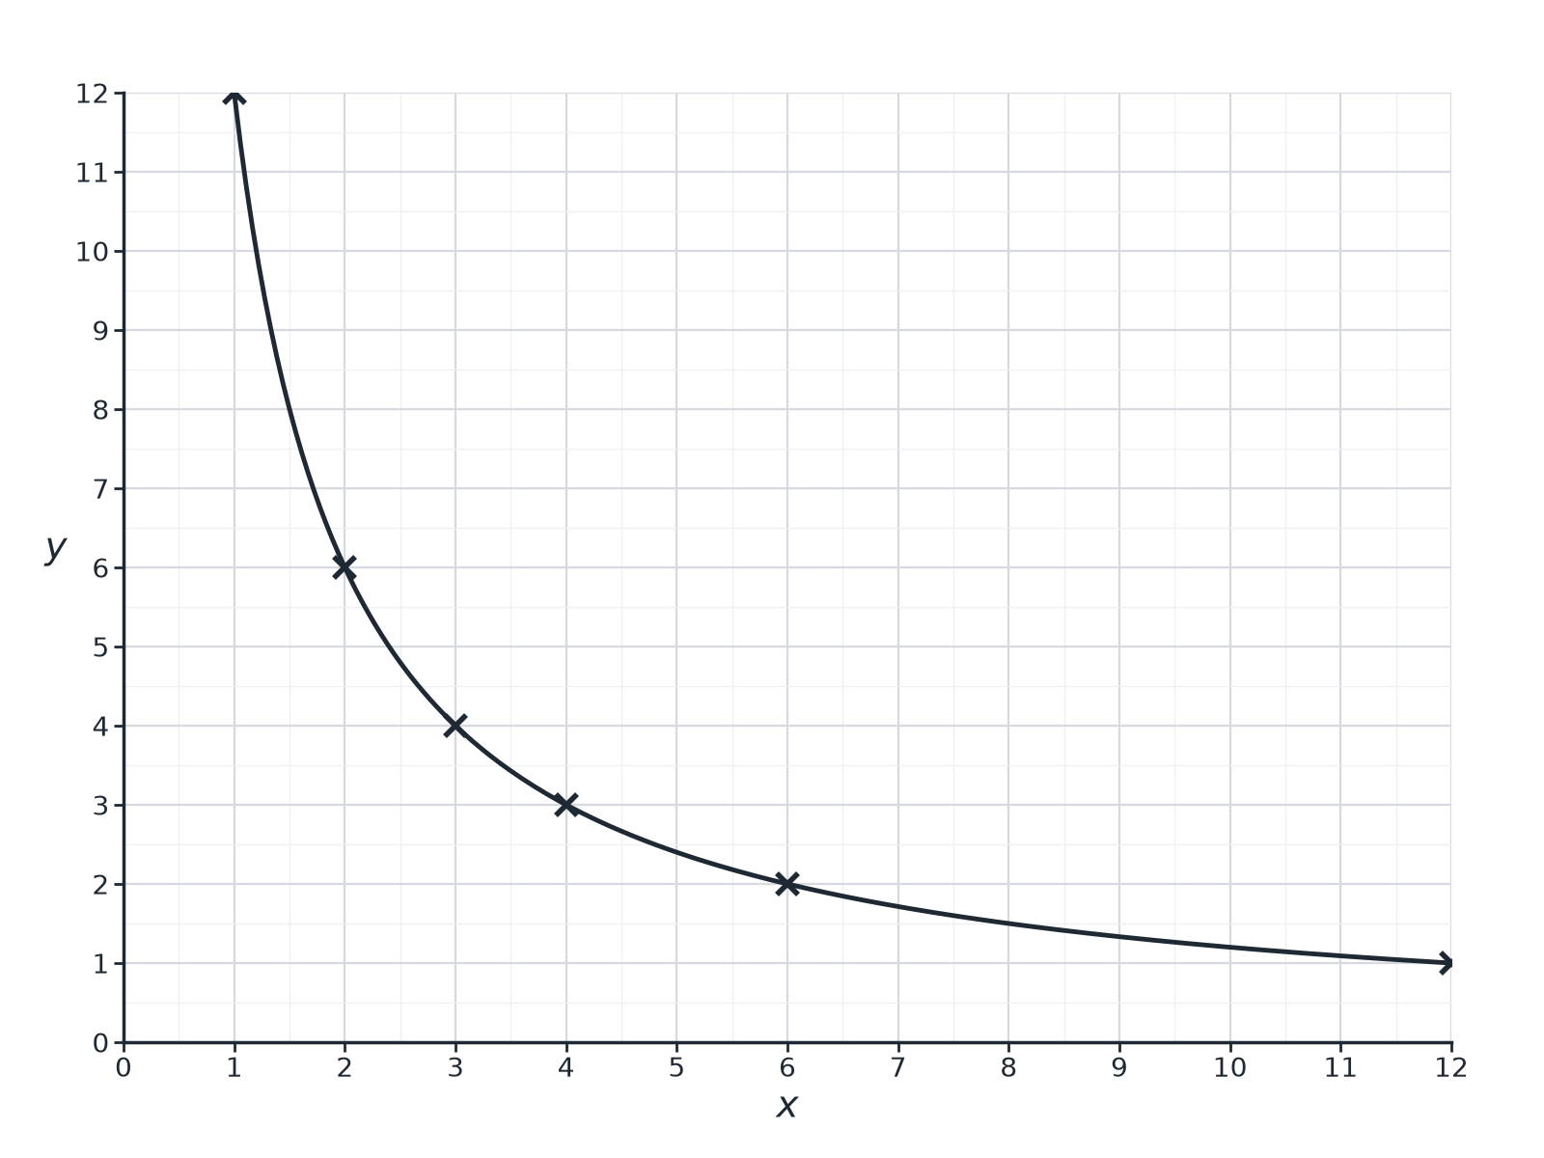
EDEXCEL GCSE MATHS · FOUNDATION & HIGHER
Question 4 · 3 marks · Non-calculator
The graph shows the relationship between x and y. Write down an equation connecting x and y. (3 marks)
Multiplicative reasoning
openrevise.com
Lesson 4 of 4

Slide 27
EDEXCEL GCSE MATHS · FOUNDATION & HIGHER
Question 4 · mark scheme
3 marks available. Award a mark for each point made.
Recognising inverse proportion
M1
k = 12
M1
y = 12/x
A1
Multiplicative reasoning
openrevise.com
Lesson 4 of 4

Slide 28
EDEXCEL GCSE MATHS · FOUNDATION & HIGHER
Question 5 · 3 marks · Non-calculator
“
y is directly proportional to x². When x = 2, y = 20. Find the value of y when x = 3.
HOW TO ANSWER IT
Command word: Non-calculator. Worth 3 marks, so plan before writing.
Multiplicative reasoning
openrevise.com
Lesson 4 of 4

Slide 29
EDEXCEL GCSE MATHS · FOUNDATION & HIGHER
Question 5 · mark scheme
3 marks available. Award a mark for each point made.
y = kx²
M1
k = 5
A1
45
A1
Multiplicative reasoning
openrevise.com
Lesson 4 of 4

Slide 30
EDEXCEL GCSE MATHS · FOUNDATION & HIGHER
Question 6 · 3 marks · Non-calculator
“
y is directly proportional to √x. When x = 4, y = 6. Find the value of y when x = 25.
HOW TO ANSWER IT
Command word: Non-calculator. Worth 3 marks, so plan before writing.
Multiplicative reasoning
openrevise.com
Lesson 4 of 4

Slide 31
EDEXCEL GCSE MATHS · FOUNDATION & HIGHER
Question 6 · mark scheme
3 marks available. Award a mark for each point made.
y = k√x
M1
k = 3
A1
15
A1
Multiplicative reasoning
openrevise.com
Lesson 4 of 4

