Slide 1

EDEXCEL GCSE MATHS · FOUNDATION & HIGHER
Congruence
Similarity and congruence
Lesson 1 of 5
openrevise.com

Slide 2

EDEXCEL GCSE MATHS · FOUNDATION & HIGHER
Warm-up
Answer each one, then check.
1
What do the angles in a triangle add up to?
2
What does isosceles mean?
3
What is a right-angled triangle's longest side called?
4
Do reflections keep the size of a shape?
5
What do the angles on a straight line add up to?
Similarity and congruence
openrevise.com
Lesson 1 of 5

Slide 3
EDEXCEL GCSE MATHS · FOUNDATION & HIGHER
Warm-up - Answers
What do the angles in a triangle add up to?
180°
1
What does isosceles mean?
Two equal sides
2
What is a right-angled triangle's longest side called?
The hypotenuse
3
Do reflections keep the size of a shape?
Yes
4
What do the angles on a straight line add up to?
180°
5
Similarity and congruence
openrevise.com
Lesson 1 of 5

Slide 4

EDEXCEL GCSE MATHS · FOUNDATION & HIGHER
Learning Objectives
Explain what congruent means.
1
Use SSS, SAS, ASA and RHS to show triangles are congruent.
2
Explain why AAA and SSA do not prove congruence.
3
Use congruence to find missing sides and angles.
4
Similarity and congruence
openrevise.com
Lesson 1 of 5

Slide 5

EDEXCEL GCSE MATHS · FOUNDATION & HIGHER
CONGRUENT
Two shapes are congruent if they are exactly the same shape and size.
One can be moved onto the other by a rotation, a reflection, a translation, or a combination.
Similarity and congruence
openrevise.com
Lesson 1 of 5

Slide 6
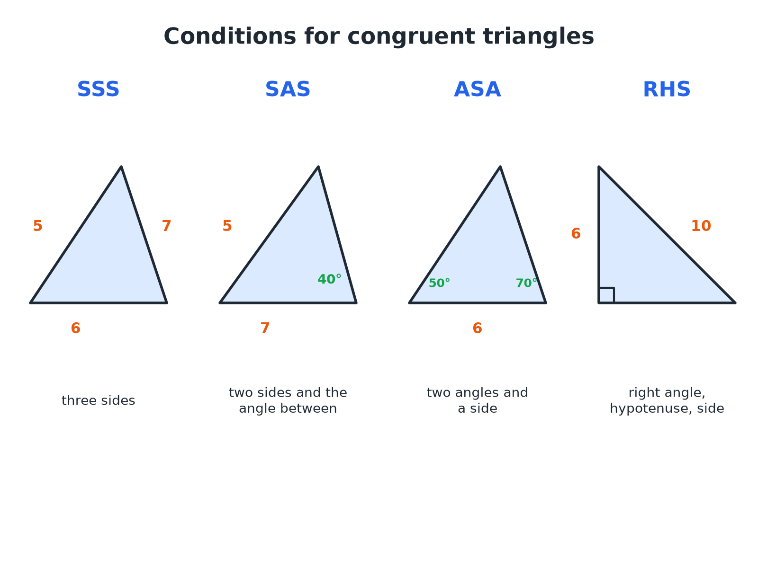

EDEXCEL GCSE MATHS · FOUNDATION & HIGHER
The Four Congruence Conditions
If two triangles satisfy any one of these, they are congruent.
Similarity and congruence
openrevise.com
Lesson 1 of 5

Slide 7

EDEXCEL GCSE MATHS · FOUNDATION & HIGHER
The Four Conditions
Learn the letters and what they mean.
Condition
Means
Example
SSS
All three sides equal
5, 6, 7 and 5, 6, 7
SAS
Two sides and the included angle equal
5, 40°, 7 and 5, 40°, 7
ASA
Two angles and a corresponding side equal
50°, 6, 70°
RHS
Right angle, hypotenuse and one other side equal
Right angle, 10, 6
Similarity and congruence
openrevise.com
Lesson 1 of 5

Slide 8

EDEXCEL GCSE MATHS · FOUNDATION & HIGHER
Proving Two Triangles Congruent
Triangle ABC has AB = 5 cm, BC = 7 cm and angle ABC = 50°. Triangle PQR has PQ = 5 cm, QR = 7 cm and angle PQR = 50°. Are the triangles congruent?
Two pairs of equal sides
AB = PQ and BC = QR
1
The angle between them is equal too
Angle B = angle Q = 50°
2
Two sides and the included angle
SAS
3
ANSWER
Yes, the triangles are congruent by SAS.
Similarity and congruence
openrevise.com
Lesson 1 of 5

Slide 9
EDEXCEL GCSE MATHS · FOUNDATION & HIGHER
Conditions That Do NOT Work
AAA
Three equal angles give similar triangles, but they can be different sizes.
SSA
Two sides and a non-included angle can give two different triangles.
Only sides
Two sides alone are not enough.
Angles not between the sides
If the angle is not between the two sides, it is not SAS.
Similarity and congruence
openrevise.com
Lesson 1 of 5

Slide 10
EDEXCEL GCSE MATHS · FOUNDATION & HIGHER
Using Congruence to Find a Length
Triangles ABC and DEF are congruent by SSS, with A matching D, B matching E and C matching F. AB = 6 cm, BC = 8 cm, DF = 10 cm. Find AC and DE.
Corresponding sides are equal
AB = DE, BC = EF, AC = DF
1
Find AC
AC = DF = 10 cm
2
Find DE
DE = AB = 6 cm
3
ANSWER
AC = 10 cm and DE = 6 cm.
Similarity and congruence
openrevise.com
Lesson 1 of 5

Slide 11

EDEXCEL GCSE MATHS · FOUNDATION & HIGHER
Writing the Reason
A congruence answer needs three things.
The equal parts
Write which sides or angles are equal, with the reason for each.
The condition
State SSS, SAS, ASA or RHS.
The conclusion
"So triangle ABC is congruent to triangle DEF."
Similarity and congruence
openrevise.com
Lesson 1 of 5

Slide 12

EDEXCEL GCSE MATHS · FOUNDATION & HIGHER
Key Terms
Congruent
Exactly the same shape and size.
Corresponding
In matching positions in two shapes.
Included angle
The angle between two given sides.
Hypotenuse
The longest side of a right-angled triangle.
SSS, SAS, ASA, RHS
The four conditions for congruent triangles.
Similar
The same shape but a different size.
Similarity and congruence
openrevise.com
Lesson 1 of 5

Slide 13

EDEXCEL GCSE MATHS · FOUNDATION & HIGHER
YOUR TASK
12 minutes
Congruent or Not?
Decide which pairs of triangles are congruent and name the condition. (a) 4, 5, 6 and 6, 4, 5 (b) sides 5 and 8 with an angle of 30° between them, and sides 5 and 8 with an angle of 40° between them (c) angles 40°, 60°, 80° in both triangles, but one has a side of 3 cm and the other a side of 6 cm.
Match the equal parts.
1
Name the condition.
2
WHAT A GOOD ANSWER SHOWS
(a) Congruent by SSS. (b) Not congruent: the included angles differ. (c) Not congruent: AAA does not prove congruence; the sides are different sizes, so the triangles are similar.
Similarity and congruence
openrevise.com
Lesson 1 of 5
Notes:
Ask what extra information would make (c) congruent.

Slide 14
EDEXCEL GCSE MATHS · FOUNDATION & HIGHER
Can I...?
Say what congruent means.
Explain why SSA is not enough.
Recall SSS, SAS, ASA and RHS.
Find corresponding sides and angles.
Decide whether two triangles are congruent.
Use congruence to find a length.
Explain why AAA is not enough.
Write a clear reason.
Similarity and congruence
openrevise.com
Lesson 1 of 5

Slide 15
EDEXCEL GCSE MATHS · FOUNDATION & HIGHER
Summary & Exam Focus
Congruent means identical in shape and size.
Conditions: SSS, SAS, ASA (or AAS), RHS.
AAA and SSA do not prove congruence.
Always give the condition as your reason.
EXAM FOCUS
Triangle ABC has AB = 6 cm, AC = 8 cm and angle A = 50°. Triangle PQR has PQ = 6 cm, PR = 8 cm and angle P = 50°. Show that the two triangles are congruent. (3 marks)
Name the pairs of equal parts and check the angle is between the two sides. Then state SAS.
openrevise.com

Slide 16
EDEXCEL GCSE MATHS · FOUNDATION & HIGHER
Exam Practice: Congruence
Answer all questions. Give reasons for your answers. · 25 minutes
Question 1 · 3 marks · Give a reason
The diagram shows three triangles A, B and C. Two of the triangles are congruent. Write down which two, and give a reason.
Question 2 · 3 marks · Show that
Triangle ABC has AB = 5 cm, BC = 7 cm and angle ABC = 50°. Triangle PQR has PQ = 5 cm, QR = 7 cm and angle PQR = 50°. Show that triangle…
Question 3 · 2 marks · Give a reason
Two triangles both have angles of 40°, 60° and 80°. Ben says they must be congruent. Explain why Ben is not necessarily correct.
Similarity and congruence
openrevise.com
Lesson 1 of 5

Slide 17
EDEXCEL GCSE MATHS · FOUNDATION & HIGHER
Exam Practice: Congruence (cont.)
Question 4 · 2 marks · Work out
Triangles ABC and DEF are congruent, with A matching D, B matching E and C matching F. AB = 6 cm, BC = 8 cm and DF = 10 cm. Write down the…
Question 5 · 3 marks · Explain
Triangle ABC is right-angled at B, with hypotenuse AC = 10 cm and AB = 6 cm. Triangle PQR is right-angled at Q, with hypotenuse PR = 10 cm…
Question 6 · 2 marks · Decide
Triangle ABC has sides 4 cm, 5 cm and 6 cm. Triangle DEF has sides 6 cm, 4 cm and 5 cm. Are the triangles congruent? Give a reason.
Similarity and congruence
openrevise.com
Lesson 1 of 5

Slide 18
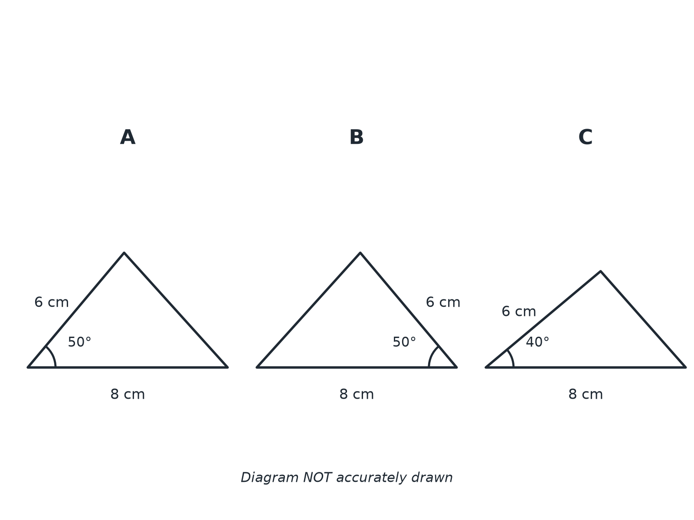
EDEXCEL GCSE MATHS · FOUNDATION & HIGHER
Question 1 · 3 marks · Give a reason
The diagram shows three triangles A, B and C. Two of the triangles are congruent. Write down which two, and give a reason. (3 marks)
Similarity and congruence
openrevise.com
Lesson 1 of 5

Slide 19
EDEXCEL GCSE MATHS · FOUNDATION & HIGHER
Question 1 · mark scheme
3 marks available. Award a mark for each point made.
A and B
B1
Two sides and the included angle equal
M1
SAS
A1
Similarity and congruence
openrevise.com
Lesson 1 of 5

Slide 20
EDEXCEL GCSE MATHS · FOUNDATION & HIGHER
Question 2 · 3 marks · Show that
“
Triangle ABC has AB = 5 cm, BC = 7 cm and angle ABC = 50°. Triangle PQR has PQ = 5 cm, QR = 7 cm and angle PQR = 50°. Show that triangle ABC is congruent to triangle PQR.
HOW TO ANSWER IT
Command word: Show that. Worth 3 marks, so plan before writing.
Similarity and congruence
openrevise.com
Lesson 1 of 5

Slide 21
EDEXCEL GCSE MATHS · FOUNDATION & HIGHER
Question 2 · mark scheme
3 marks available. Award a mark for each point made.
Equal sides stated
M1
Equal included angle stated
M1
SAS and conclusion
A1
Similarity and congruence
openrevise.com
Lesson 1 of 5

Slide 22
EDEXCEL GCSE MATHS · FOUNDATION & HIGHER
Question 3 · 2 marks · Give a reason
“
Two triangles both have angles of 40°, 60° and 80°. Ben says they must be congruent. Explain why Ben is not necessarily correct.
HOW TO ANSWER IT
Command word: Give a reason. Worth 2 marks, so plan before writing.
Similarity and congruence
openrevise.com
Lesson 1 of 5

Slide 23
EDEXCEL GCSE MATHS · FOUNDATION & HIGHER
Question 3 · mark scheme
2 marks available. Award a mark for each point made.
AAA is not a congruence condition
M1
The triangles could be different sizes
C1
Similarity and congruence
openrevise.com
Lesson 1 of 5

Slide 24
EDEXCEL GCSE MATHS · FOUNDATION & HIGHER
Question 4 · 2 marks · Work out
“
Triangles ABC and DEF are congruent, with A matching D, B matching E and C matching F. AB = 6 cm, BC = 8 cm and DF = 10 cm. Write down the length of AC.
HOW TO ANSWER IT
Command word: Work out. Worth 2 marks, so plan before writing.
Similarity and congruence
openrevise.com
Lesson 1 of 5

Slide 25
EDEXCEL GCSE MATHS · FOUNDATION & HIGHER
Question 4 · mark scheme
2 marks available. Award a mark for each point made.
Corresponding sides identified
M1
10
A1
Similarity and congruence
openrevise.com
Lesson 1 of 5

Slide 26
EDEXCEL GCSE MATHS · FOUNDATION & HIGHER
Question 5 · 3 marks · Explain
“
Triangle ABC is right-angled at B, with hypotenuse AC = 10 cm and AB = 6 cm. Triangle PQR is right-angled at Q, with hypotenuse PR = 10 cm and PQ = 6 cm. Explain why the triangles are congruent.
HOW TO ANSWER IT
Command word: Explain. Worth 3 marks, so plan before writing.
Similarity and congruence
openrevise.com
Lesson 1 of 5

Slide 27
EDEXCEL GCSE MATHS · FOUNDATION & HIGHER
Question 5 · mark scheme
3 marks available. Award a mark for each point made.
Right angle in each
B1
Hypotenuse and one other side equal
M1
RHS
A1
Similarity and congruence
openrevise.com
Lesson 1 of 5

Slide 28
EDEXCEL GCSE MATHS · FOUNDATION & HIGHER
Question 6 · 2 marks · Decide
“
Triangle ABC has sides 4 cm, 5 cm and 6 cm. Triangle DEF has sides 6 cm, 4 cm and 5 cm. Are the triangles congruent? Give a reason.
HOW TO ANSWER IT
Command word: Decide. Worth 2 marks, so plan before writing.
Similarity and congruence
openrevise.com
Lesson 1 of 5

Slide 29
EDEXCEL GCSE MATHS · FOUNDATION & HIGHER
Question 6 · mark scheme
2 marks available. Award a mark for each point made.
Yes
B1
SSS
B1
Similarity and congruence
openrevise.com
Lesson 1 of 5

