Slide 1

EDEXCEL GCSE MATHS · FOUNDATION & HIGHER
Geometric proof and congruence
Similarity and congruence
Lesson 2 of 5
openrevise.com

Slide 2

EDEXCEL GCSE MATHS · FOUNDATION & HIGHER
Warm-up
Answer each one, then check.
1
Name the four conditions for congruent triangles.
2
What are alternate angles?
3
What do the diagonals of a parallelogram do?
4
What is a proof?
5
Are vertically opposite angles equal?
Similarity and congruence
openrevise.com
Lesson 2 of 5

Slide 3
EDEXCEL GCSE MATHS · FOUNDATION & HIGHER
Warm-up - Answers
Name the four conditions for congruent triangles.
SSS, SAS, ASA, RHS
1
What are alternate angles?
Equal angles between parallel lines, in a Z shape
2
What do the diagonals of a parallelogram do?
Bisect each other
3
What is a proof?
A logical argument that shows a statement is always true
4
Are vertically opposite angles equal?
Yes
5
Similarity and congruence
openrevise.com
Lesson 2 of 5

Slide 4

EDEXCEL GCSE MATHS · FOUNDATION & HIGHER
Learning Objectives
Set out a geometric proof with statements and reasons.
1
Prove triangles congruent.
2
Use congruent triangles to prove other facts.
3
Use standard reasons for angles in parallel lines and triangles.
4
Similarity and congruence
openrevise.com
Lesson 2 of 5

Slide 5

EDEXCEL GCSE MATHS · FOUNDATION & HIGHER
Writing a Proof
A proof is a chain of statements, each with a reason.
1
2
3
4
5
State what you are given
Write down the facts from the question
Find equal sides and angles
Give a reason for each: "opposite sides of a parallelogram are equal"
Name the congruence condition
SSS, SAS, ASA or RHS
State the conclusion
"Therefore triangle ABC is congruent to triangle DEF"
Use it
Corresponding parts of congruent triangles are equal
Similarity and congruence
openrevise.com
Lesson 2 of 5

Slide 6
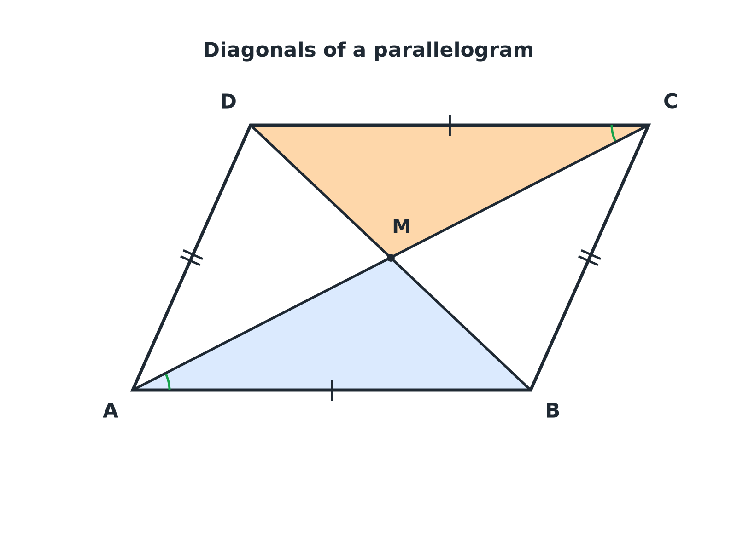

EDEXCEL GCSE MATHS · FOUNDATION & HIGHER
Diagonals of a Parallelogram
Triangles AMB and CMD are congruent, which shows the diagonals bisect each other.
Similarity and congruence
openrevise.com
Lesson 2 of 5

Slide 7

EDEXCEL GCSE MATHS · FOUNDATION & HIGHER
Proving Diagonals Bisect
ABCD is a parallelogram with diagonals AC and BD meeting at M. Prove that AM = MC and BM = MD.
1
AB = DC
Opposite sides of a parallelogram are equal
2
Angle BAM = angle DCM
Alternate angles (AB parallel to DC)
3
Angle ABM = angle CDM
Alternate angles (AB parallel to DC)
4
Triangles AMB and CMD are congruent
ASA (two angles and the corresponding side)
5
So AM = CM and BM = DM
Corresponding sides of congruent triangles
ANSWER
The diagonals of a parallelogram bisect each other, because triangles AMB and CMD are congruent (ASA).
Similarity and congruence
openrevise.com
Lesson 2 of 5

Slide 8
EDEXCEL GCSE MATHS · FOUNDATION & HIGHER
Base Angles of an Isosceles Triangle
In triangle ABC, AB = AC. D is the midpoint of BC. Prove that angle ABC = angle ACB.
1
AB = AC
Given
2
BD = DC
D is the midpoint of BC
3
AD = AD
Common side
4
Triangles ABD and ACD are congruent
SSS
5
So angle ABD = angle ACD
Corresponding angles of congruent triangles
ANSWER
The base angles are equal because triangles ABD and ACD are congruent (SSS).
Similarity and congruence
openrevise.com
Lesson 2 of 5

Slide 9

EDEXCEL GCSE MATHS · FOUNDATION & HIGHER
Good Proof, Weak Proof
A GOOD PROOF
A WEAK PROOF
• Every statement has a reason.
• Uses correct mathematical language.
• Names the congruence condition.
• Ends with a clear conclusion.
• Says "it is obvious" or "it looks equal".
• Uses measurements from a drawing.
• Misses out a step.
• Does not say why triangles are congruent.
Similarity and congruence
openrevise.com
Lesson 2 of 5

Slide 10

EDEXCEL GCSE MATHS · FOUNDATION & HIGHER
Reasons You Can Use
Choose the exact words the mark scheme expects.
Parallel lines
Alternate angles are equal; corresponding angles are equal; co-interior angles add to 180°.
Triangles
Angles in a triangle add to 180°; base angles of an isosceles triangle are equal.
Parallelograms
Opposite sides are equal and parallel; diagonals bisect each other.
Common side
Write "AD is common" when two triangles share a side.
Similarity and congruence
openrevise.com
Lesson 2 of 5

Slide 11
EDEXCEL GCSE MATHS · FOUNDATION & HIGHER
Key Terms
Proof
A logical argument showing a statement is always true.
Statement
A fact written in a proof.
Reason
The rule that justifies a statement.
Corresponding
In matching positions in congruent triangles.
Common side
A side shared by two triangles.
Bisect
Cut exactly in half.
Similarity and congruence
openrevise.com
Lesson 2 of 5

Slide 12

EDEXCEL GCSE MATHS · FOUNDATION & HIGHER
YOUR TASK
15 minutes
Complete the Proof
PQRS is a kite with PQ = PS and RQ = RS. Prove that triangles PQR and PSR are congruent, and hence that angle PQR = angle PSR.
1
List equal sides.
2
Name SSS.
3
Conclude.
WHAT A GOOD ANSWER SHOWS
PQ = PS (given), RQ = RS (given), PR = PR (common side). The triangles are congruent by SSS. Corresponding angles are equal, so angle PQR = angle PSR.
Similarity and congruence
openrevise.com
Lesson 2 of 5
Notes:
Ask students to underline the reason for each statement.

Slide 13

EDEXCEL GCSE MATHS · FOUNDATION & HIGHER
Can I...?
Set out statements and reasons.
Use corresponding parts of congruent triangles.
Use alternate angles in a proof.
Prove diagonals bisect.
Name a common side.
Prove base angles are equal.
Choose SSS, SAS, ASA or RHS.
Finish with a conclusion.
Similarity and congruence
openrevise.com
Lesson 2 of 5

Slide 14
EDEXCEL GCSE MATHS · FOUNDATION & HIGHER
Summary & Exam Focus
Every step needs a reason.
Give the congruence condition in words or letters.
Corresponding parts of congruent triangles are equal.
End with a conclusion that answers the question.
EXAM FOCUS
ABCD is a parallelogram. The diagonals AC and BD meet at M. Prove that triangles AMB and CMD are congruent. (4 marks)
Write each fact with its reason: opposite sides equal, alternate angles equal. Then name the condition (ASA here).
openrevise.com

Slide 15
EDEXCEL GCSE MATHS · FOUNDATION & HIGHER
Exam Practice: Geometric Proof and Congruence
Answer all questions. Give reasons for every step. · 30 minutes
Question 1 · 4 marks · Prove
ABCD is a parallelogram. The diagonals AC and BD meet at M. Prove that triangles AMB and CMD are congruent.
Question 2 · 2 marks · Prove
Using the congruent triangles from the last question, prove that AM = MC.
Question 3 · 4 marks · Prove
Triangle ABC is isosceles with AB = AC. D is the midpoint of BC. Prove that angle ABC = angle ACB.
Similarity and congruence
openrevise.com
Lesson 2 of 5

Slide 16
EDEXCEL GCSE MATHS · FOUNDATION & HIGHER
Exam Practice: Geometric Proof and Congruence (cont.)
Question 4 · 3 marks · Prove
PQRS is a kite with PQ = PS and RQ = RS. Prove that angle PQR = angle PSR.
Question 5 · 2 marks · Explain
Explain why "the triangles look the same" is not a good reason in a proof.
Question 6 · 3 marks · Prove
ABCD is a rectangle. The diagonals AC and BD are drawn. Prove that AC = BD.
Similarity and congruence
openrevise.com
Lesson 2 of 5

Slide 17
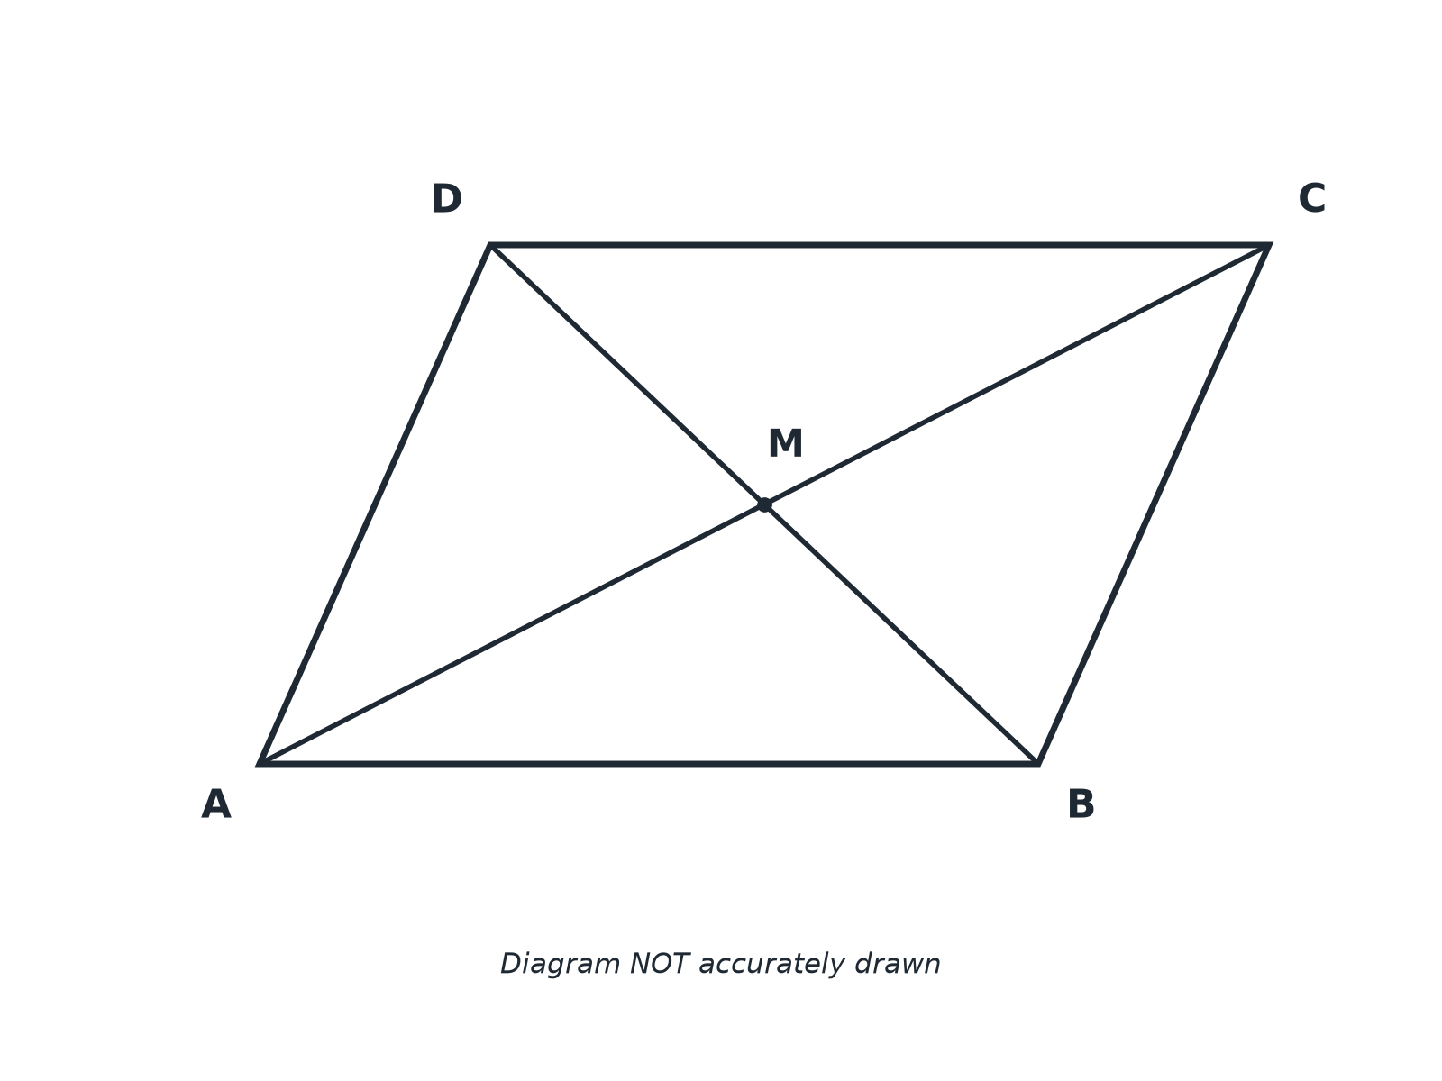
EDEXCEL GCSE MATHS · FOUNDATION & HIGHER
Question 1 · 4 marks · Prove
ABCD is a parallelogram. The diagonals AC and BD meet at M. Prove that triangles AMB and CMD are congruent. (4 marks)
Similarity and congruence
openrevise.com
Lesson 2 of 5

Slide 18
EDEXCEL GCSE MATHS · FOUNDATION & HIGHER
Question 1 · mark scheme
4 marks available. Award a mark for each point made.
AB = DC with a reason
B1
One pair of equal angles with a reason
M1
The second pair of equal angles with a reason
M1
Congruent by ASA
A1
Similarity and congruence
openrevise.com
Lesson 2 of 5

Slide 19
EDEXCEL GCSE MATHS · FOUNDATION & HIGHER
Question 2 · 2 marks · Prove
“
Using the congruent triangles from the last question, prove that AM = MC.
HOW TO ANSWER IT
Command word: Prove. Worth 2 marks, so plan before writing.
Similarity and congruence
openrevise.com
Lesson 2 of 5

Slide 20
EDEXCEL GCSE MATHS · FOUNDATION & HIGHER
Question 2 · mark scheme
2 marks available. Award a mark for each point made.
Corresponding sides of congruent triangles
M1
AM = MC
A1
Similarity and congruence
openrevise.com
Lesson 2 of 5

Slide 21
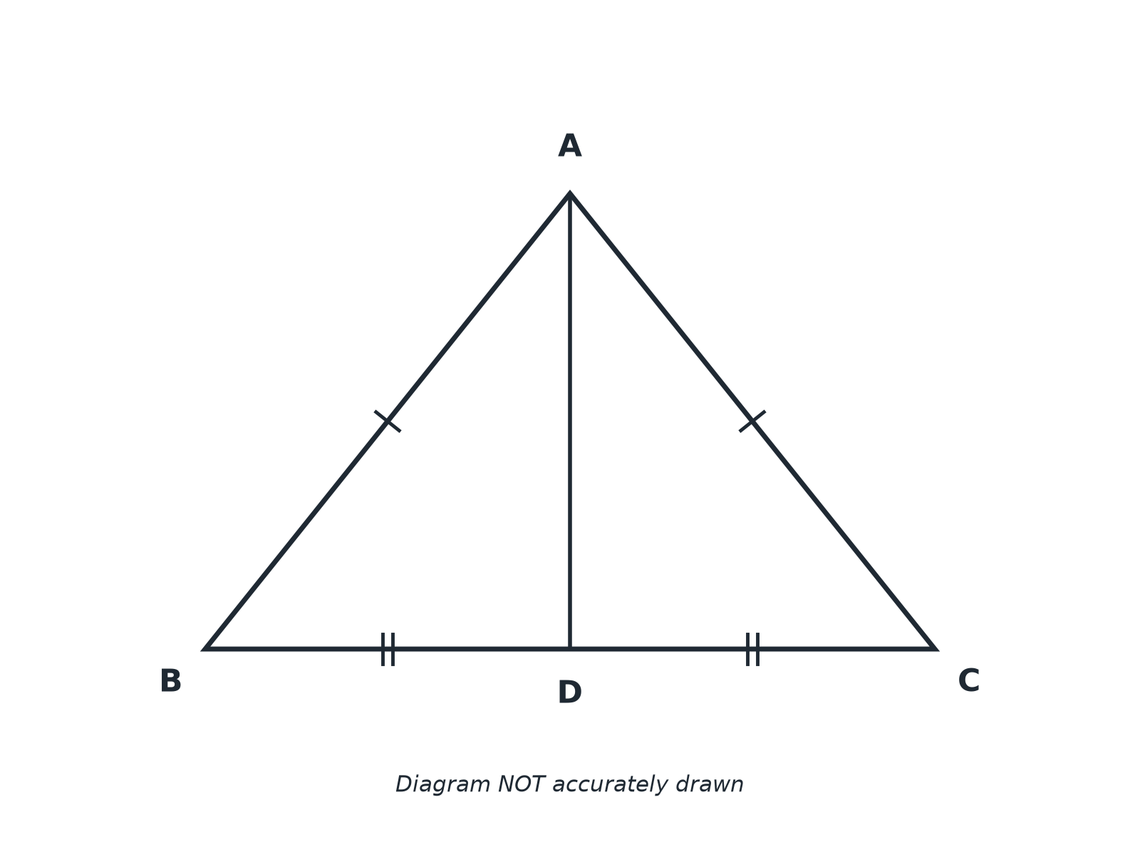
EDEXCEL GCSE MATHS · FOUNDATION & HIGHER
Question 3 · 4 marks · Prove
Triangle ABC is isosceles with AB = AC. D is the midpoint of BC. Prove that angle ABC = angle ACB. (4 marks)
Similarity and congruence
openrevise.com
Lesson 2 of 5

Slide 22
EDEXCEL GCSE MATHS · FOUNDATION & HIGHER
Question 3 · mark scheme
4 marks available. Award a mark for each point made.
AB = AC and BD = DC with reasons
M1
AD common
M1
SSS
A1
Conclusion about angles
C1
Similarity and congruence
openrevise.com
Lesson 2 of 5

Slide 23
EDEXCEL GCSE MATHS · FOUNDATION & HIGHER
Question 4 · 3 marks · Prove
“
PQRS is a kite with PQ = PS and RQ = RS. Prove that angle PQR = angle PSR.
HOW TO ANSWER IT
Command word: Prove. Worth 3 marks, so plan before writing.
Similarity and congruence
openrevise.com
Lesson 2 of 5

Slide 24
EDEXCEL GCSE MATHS · FOUNDATION & HIGHER
Question 4 · mark scheme
3 marks available. Award a mark for each point made.
Equal sides and common side
M1
SSS
M1
Conclusion
A1
Similarity and congruence
openrevise.com
Lesson 2 of 5

Slide 25
EDEXCEL GCSE MATHS · FOUNDATION & HIGHER
Question 5 · 2 marks · Explain
“
Explain why "the triangles look the same" is not a good reason in a proof.
HOW TO ANSWER IT
Command word: Explain. Worth 2 marks, so plan before writing.
Similarity and congruence
openrevise.com
Lesson 2 of 5

Slide 26
EDEXCEL GCSE MATHS · FOUNDATION & HIGHER
Question 5 · mark scheme
2 marks available. Award a mark for each point made.
Not appearances or measurements
M1
Each step needs a mathematical reason
C1
Similarity and congruence
openrevise.com
Lesson 2 of 5

Slide 27
EDEXCEL GCSE MATHS · FOUNDATION & HIGHER
Question 6 · 3 marks · Prove
“
ABCD is a rectangle. The diagonals AC and BD are drawn. Prove that AC = BD.
HOW TO ANSWER IT
Command word: Prove. Worth 3 marks, so plan before writing.
Similarity and congruence
openrevise.com
Lesson 2 of 5

Slide 28
EDEXCEL GCSE MATHS · FOUNDATION & HIGHER
Question 6 · mark scheme
3 marks available. Award a mark for each point made.
Equal sides and right angles
M1
SAS
M1
AC = BD
A1
Similarity and congruence
openrevise.com
Lesson 2 of 5

