Slide 1

EDEXCEL GCSE MATHS · HIGHER
More similarity
Similarity and congruence
Lesson 4 of 5
openrevise.com

Slide 2

EDEXCEL GCSE MATHS · HIGHER
Warm-up
Answer each one, then check.
1
What is the scale factor from 6 to 9?
2
Work out 1.5².
3
What do corresponding angles on parallel lines do?
4
Work out √(27/12).
5
If k = 3, what is k²?
Similarity and congruence
openrevise.com
Lesson 4 of 5

Slide 3
EDEXCEL GCSE MATHS · HIGHER
Warm-up - Answers
What is the scale factor from 6 to 9?
1.5
1
Work out 1.5².
2.25
2
What do corresponding angles on parallel lines do?
They are equal
3
Work out √(27/12).
1.5
4
If k = 3, what is k²?
9
5
Similarity and congruence
openrevise.com
Lesson 4 of 5

Slide 4

EDEXCEL GCSE MATHS · HIGHER
Learning Objectives
Find similar triangles created by parallel lines.
1
Find missing lengths using scale factors.
2
Use the area scale factor k².
3
Work backwards from an area ratio to a length ratio.
4
Similarity and congruence
openrevise.com
Lesson 4 of 5

Slide 5
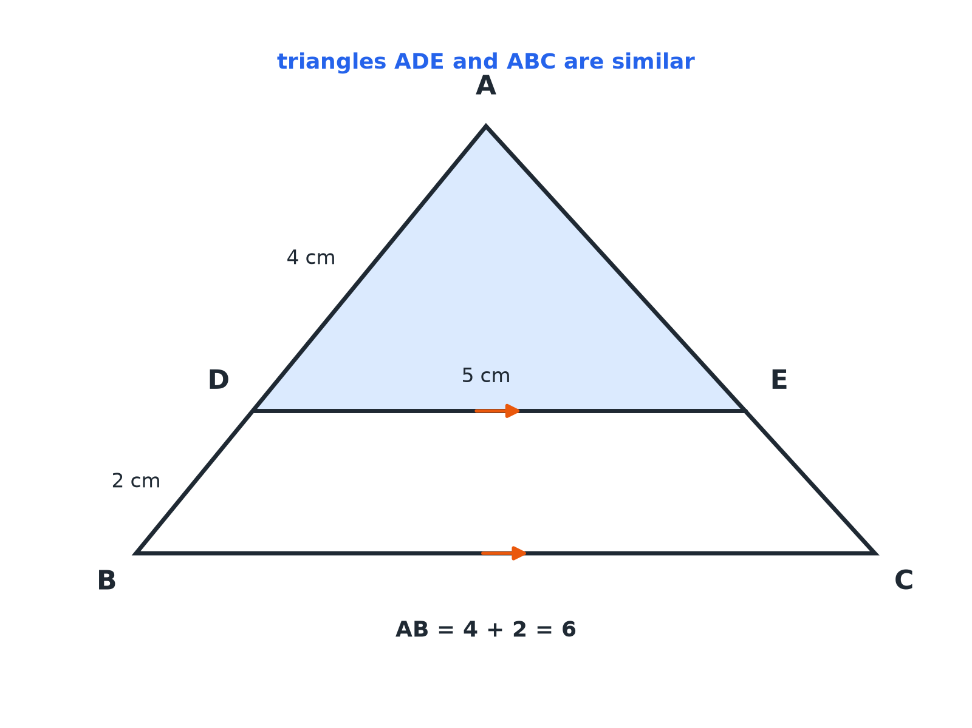

EDEXCEL GCSE MATHS · HIGHER
A Triangle Cut by a Parallel Line
A line parallel to one side of a triangle makes a smaller similar triangle.
Similarity and congruence
openrevise.com
Lesson 4 of 5

Slide 6

EDEXCEL GCSE MATHS · HIGHER
PARALLEL LINES
If DE is parallel to BC, then triangle ADE is similar to triangle ABC.
The corresponding angles are equal, and the angle at A is common.
Similarity and congruence
openrevise.com
Lesson 4 of 5

Slide 7

EDEXCEL GCSE MATHS · HIGHER
Finding a Length
In triangle ABC, DE is parallel to BC. AD = 4 cm, DB = 2 cm and DE = 5 cm. Find BC.
AB = AD + DB
4 + 2 = 6
1
Scale factor from ADE to ABC
6/4 = 1.5
2
BC = DE × 1.5
5 × 1.5
3
ANSWER
BC = 7.5 cm
Similarity and congruence
openrevise.com
Lesson 4 of 5

Slide 8

EDEXCEL GCSE MATHS · HIGHER
Watch the Sides
The whole side, not just the piece, is the corresponding length.
Use AB, not DB
The similar triangles are ADE and ABC, so AD corresponds to AB.
Add the parts
AB = AD + DB.
Label the two triangles
Write them in matching order: ADE and ABC.
Similarity and congruence
openrevise.com
Lesson 4 of 5

Slide 9
EDEXCEL GCSE MATHS · HIGHER
AREA SCALE FACTOR
If two shapes are similar with length scale factor k, their areas are in the ratio 1 : k².
Doubling all lengths multiplies the area by 4; tripling multiplies it by 9.
Similarity and congruence
openrevise.com
Lesson 4 of 5

Slide 10
EDEXCEL GCSE MATHS · HIGHER
Finding an Area
Two similar rectangles have lengths 12 cm and 18 cm. The area of the smaller is 40 cm². Find the area of the larger.
Length scale factor
18/12 = 1.5
1
Area scale factor
1.5² = 2.25
2
Area of the larger
40 × 2.25
3
ANSWER
90 cm²
Similarity and congruence
openrevise.com
Lesson 4 of 5

Slide 11
EDEXCEL GCSE MATHS · HIGHER
From Areas to Lengths
Two similar triangles have areas 12 cm² and 27 cm². Find the ratio of their lengths in its simplest form.
Ratio of areas
12 : 27 = 4 : 9
1
Take the square root
√4 : √9 = 2 : 3
2
ANSWER
The ratio of the lengths is 2 : 3.
Similarity and congruence
openrevise.com
Lesson 4 of 5

Slide 12

EDEXCEL GCSE MATHS · HIGHER
Scale Factors
For similar shapes with length scale factor k.
Measure
Scale factor
Example, k = 3
Lengths
k
3
Areas
k²
9
Volumes
k³
27
Similarity and congruence
openrevise.com
Lesson 4 of 5

Slide 13

EDEXCEL GCSE MATHS · HIGHER
Key Terms
Similar triangles
Triangles with equal angles and proportional sides.
Scale factor
The multiplier for lengths.
Area scale factor
The square of the length scale factor.
Parallel
Lines that never meet.
Corresponding angles
Equal angles in matching positions on parallel lines.
Ratio
A comparison of two quantities.
Similarity and congruence
openrevise.com
Lesson 4 of 5

Slide 14

EDEXCEL GCSE MATHS · HIGHER
YOUR TASK
12 minutes
Shadows and Similar Triangles
A 1.5 m post casts a shadow of 2 m at the same time as a tree casts a shadow of 12 m. Draw two similar right-angled triangles and find the height of the tree. If the post's triangle has area 1.5 m², find the area of the tree's triangle.
1
Draw both triangles.
2
Find the length scale factor.
3
Square it for area.
WHAT A GOOD ANSWER SHOWS
Scale factor 12 ÷ 2 = 6, so the tree is 1.5 × 6 = 9 m tall. The area scale factor is 6² = 36, so the area is 1.5 × 36 = 54 m².
Similarity and congruence
openrevise.com
Lesson 4 of 5
Notes:
Link to how surveyors measure heights.

Slide 15

EDEXCEL GCSE MATHS · HIGHER
Can I...?
Spot similar triangles from parallel lines.
Find an area from a length ratio.
Use the whole side, not part of it.
Find a length ratio from an area ratio.
Find a missing length.
Write the ratio in simplest form.
Use k² for areas.
Explain my reasoning.
Similarity and congruence
openrevise.com
Lesson 4 of 5

Slide 16
EDEXCEL GCSE MATHS · HIGHER
Summary & Exam Focus
A line parallel to a side makes a similar triangle.
Match corresponding sides in the same order.
Area scale factor = k².
Take a square root to go from area ratio to length ratio.
EXAM FOCUS
In triangle ABC, DE is parallel to BC. AD = 4 cm, DB = 2 cm and DE = 5 cm. Work out the length of BC. (3 marks)
The similar triangles are ADE and ABC. Use AB = AD + DB in the scale factor, not DB alone.
openrevise.com

Slide 17
EDEXCEL GCSE MATHS · HIGHER
Exam Practice: More Similarity
Answer all questions. Show your working. · 30 minutes
Question 1 · 3 marks · Work out
In triangle ABC, DE is parallel to BC. AD = 4 cm, DB = 2 cm and DE = 5 cm. Work out the length of BC.
Question 2 · 3 marks · Work out
Two similar rectangles have lengths of 12 cm and 18 cm. The area of the smaller rectangle is 40 cm². Work out the area of the larger…
Question 3 · 3 marks · Work out
Two similar triangles have areas of 12 cm² and 27 cm². Work out the ratio of the lengths of their corresponding sides. Give your answer in…
Similarity and congruence
openrevise.com
Lesson 4 of 5

Slide 18
EDEXCEL GCSE MATHS · HIGHER
Exam Practice: More Similarity (cont.)
Question 4 · 3 marks · Work out
Two similar shapes have corresponding lengths in the ratio 3 : 5. The area of the smaller shape is 36 cm². Work out the area of the larger…
Question 5 · 3 marks · Work out
A 1.5 m post casts a shadow 2 m long at the same time as a tree casts a shadow 12 m long. Work out the height of the tree.
Question 6 · 3 marks · Explain
Explain why triangle ADE is similar to triangle ABC when DE is parallel to BC.
Similarity and congruence
openrevise.com
Lesson 4 of 5

Slide 19
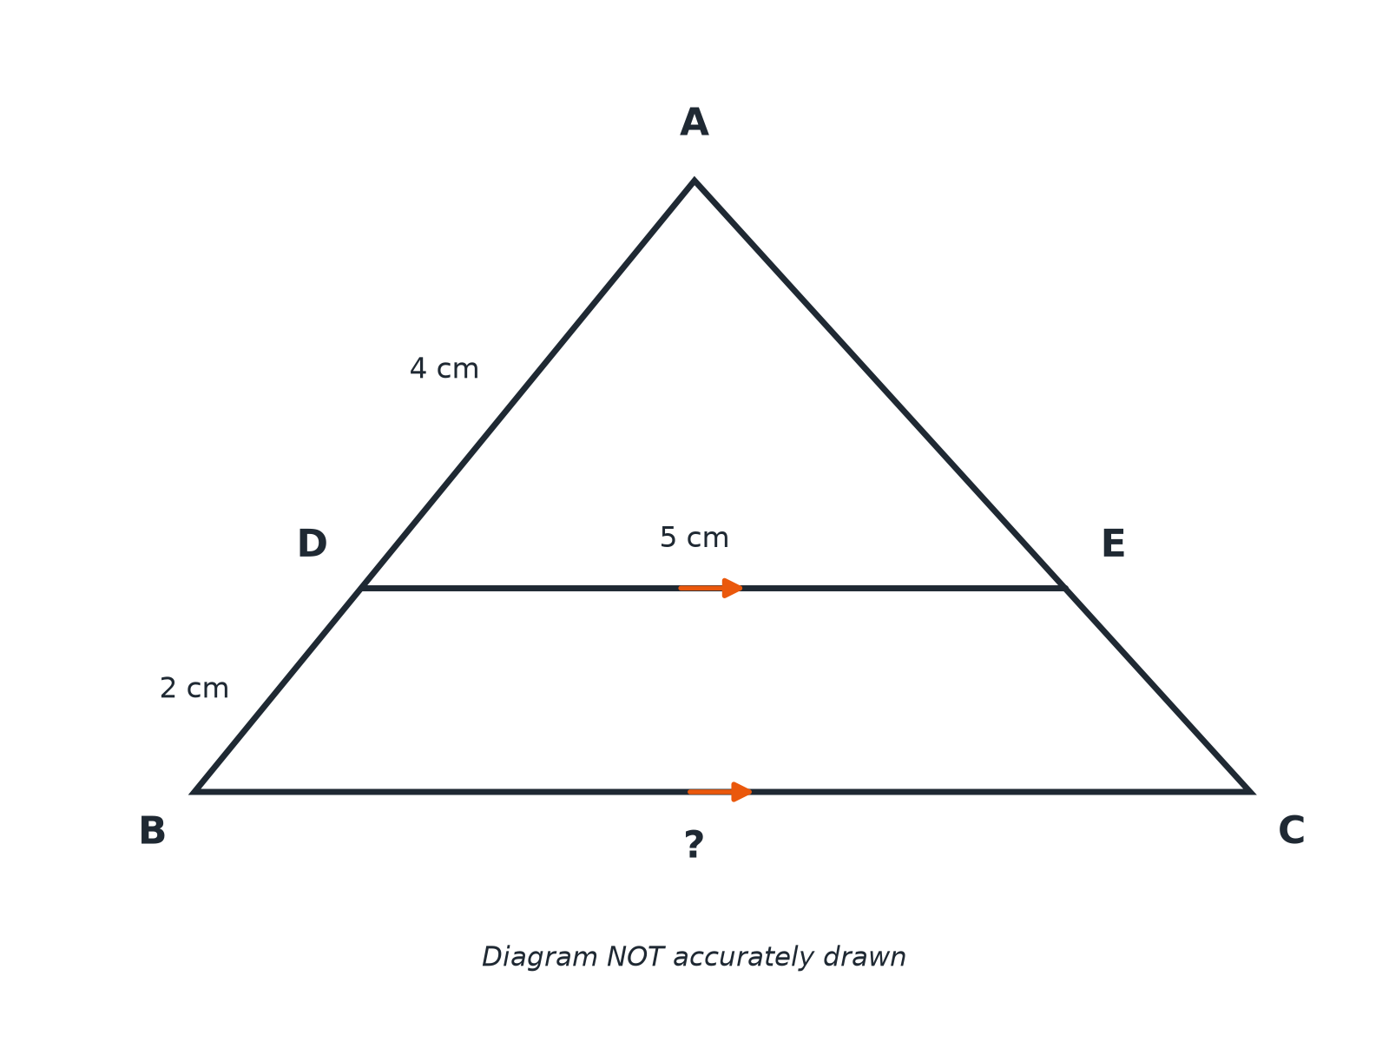
EDEXCEL GCSE MATHS · HIGHER
Question 1 · 3 marks · Work out
In triangle ABC, DE is parallel to BC. AD = 4 cm, DB = 2 cm and DE = 5 cm. Work out the length of BC. (3 marks)
Similarity and congruence
openrevise.com
Lesson 4 of 5

Slide 20
EDEXCEL GCSE MATHS · HIGHER
Question 1 · mark scheme
3 marks available. Award a mark for each point made.
Similar triangles ADE and ABC
M1
Scale factor 6/4
M1
7.5
A1
Similarity and congruence
openrevise.com
Lesson 4 of 5

Slide 21
EDEXCEL GCSE MATHS · HIGHER
Question 2 · 3 marks · Work out
“
Two similar rectangles have lengths of 12 cm and 18 cm. The area of the smaller rectangle is 40 cm². Work out the area of the larger rectangle.
HOW TO ANSWER IT
Command word: Work out. Worth 3 marks, so plan before writing.
Similarity and congruence
openrevise.com
Lesson 4 of 5

Slide 22
EDEXCEL GCSE MATHS · HIGHER
Question 2 · mark scheme
3 marks available. Award a mark for each point made.
Length scale factor 1.5
M1
1.5² = 2.25
M1
90
A1
Similarity and congruence
openrevise.com
Lesson 4 of 5

Slide 23
EDEXCEL GCSE MATHS · HIGHER
Question 3 · 3 marks · Work out
“
Two similar triangles have areas of 12 cm² and 27 cm². Work out the ratio of the lengths of their corresponding sides. Give your answer in the form 1 : n or in its simplest form.
HOW TO ANSWER IT
Command word: Work out. Worth 3 marks, so plan before writing.
Similarity and congruence
openrevise.com
Lesson 4 of 5

Slide 24
EDEXCEL GCSE MATHS · HIGHER
Question 3 · mark scheme
3 marks available. Award a mark for each point made.
4 : 9
M1
Square roots
M1
2 : 3
A1
Similarity and congruence
openrevise.com
Lesson 4 of 5

Slide 25
EDEXCEL GCSE MATHS · HIGHER
Question 4 · 3 marks · Work out
“
Two similar shapes have corresponding lengths in the ratio 3 : 5. The area of the smaller shape is 36 cm². Work out the area of the larger shape.
HOW TO ANSWER IT
Command word: Work out. Worth 3 marks, so plan before writing.
Similarity and congruence
openrevise.com
Lesson 4 of 5

Slide 26
EDEXCEL GCSE MATHS · HIGHER
Question 4 · mark scheme
3 marks available. Award a mark for each point made.
9 : 25
M1
36 × 25/9
M1
100
A1
Similarity and congruence
openrevise.com
Lesson 4 of 5

Slide 27
EDEXCEL GCSE MATHS · HIGHER
Question 5 · 3 marks · Work out
“
A 1.5 m post casts a shadow 2 m long at the same time as a tree casts a shadow 12 m long. Work out the height of the tree.
HOW TO ANSWER IT
Command word: Work out. Worth 3 marks, so plan before writing.
Similarity and congruence
openrevise.com
Lesson 4 of 5

Slide 28
EDEXCEL GCSE MATHS · HIGHER
Question 5 · mark scheme
3 marks available. Award a mark for each point made.
Scale factor 6
M1
1.5 × 6
M1
9
A1
Similarity and congruence
openrevise.com
Lesson 4 of 5

Slide 29
EDEXCEL GCSE MATHS · HIGHER
Question 6 · 3 marks · Explain
“
Explain why triangle ADE is similar to triangle ABC when DE is parallel to BC.
HOW TO ANSWER IT
Command word: Explain. Worth 3 marks, so plan before writing.
Similarity and congruence
openrevise.com
Lesson 4 of 5

Slide 30
EDEXCEL GCSE MATHS · HIGHER
Question 6 · mark scheme
3 marks available. Award a mark for each point made.
Corresponding angles on parallel lines
M1
Angle A common
M1
All angles equal, so similar
C1
Similarity and congruence
openrevise.com
Lesson 4 of 5

