Slide 1

EDEXCEL GCSE MATHS · HIGHER
Similarity in 3D solids
Similarity and congruence
Lesson 5 of 5
openrevise.com

Slide 2

EDEXCEL GCSE MATHS · HIGHER
Warm-up
Answer each one, then check.
1
Work out 2³.
2
Work out 1.5³.
3
What is the area scale factor if k = 3?
4
Work out ∛27.
5
What is the formula for the volume of a cone?
Similarity and congruence
openrevise.com
Lesson 5 of 5

Slide 3
EDEXCEL GCSE MATHS · HIGHER
Warm-up - Answers
Work out 2³.
8
1
Work out 1.5³.
3.375
2
What is the area scale factor if k = 3?
9
3
Work out ∛27.
3
4
What is the formula for the volume of a cone?
⅓πr² h
5
Similarity and congruence
openrevise.com
Lesson 5 of 5

Slide 4

EDEXCEL GCSE MATHS · HIGHER
Learning Objectives
Use length, area and volume scale factors.
1
Find a volume, capacity or mass of a similar solid.
2
Work out the length ratio from a volume ratio.
3
Solve problems with similar cones, cylinders and frustums.
4
Similarity and congruence
openrevise.com
Lesson 5 of 5

Slide 5
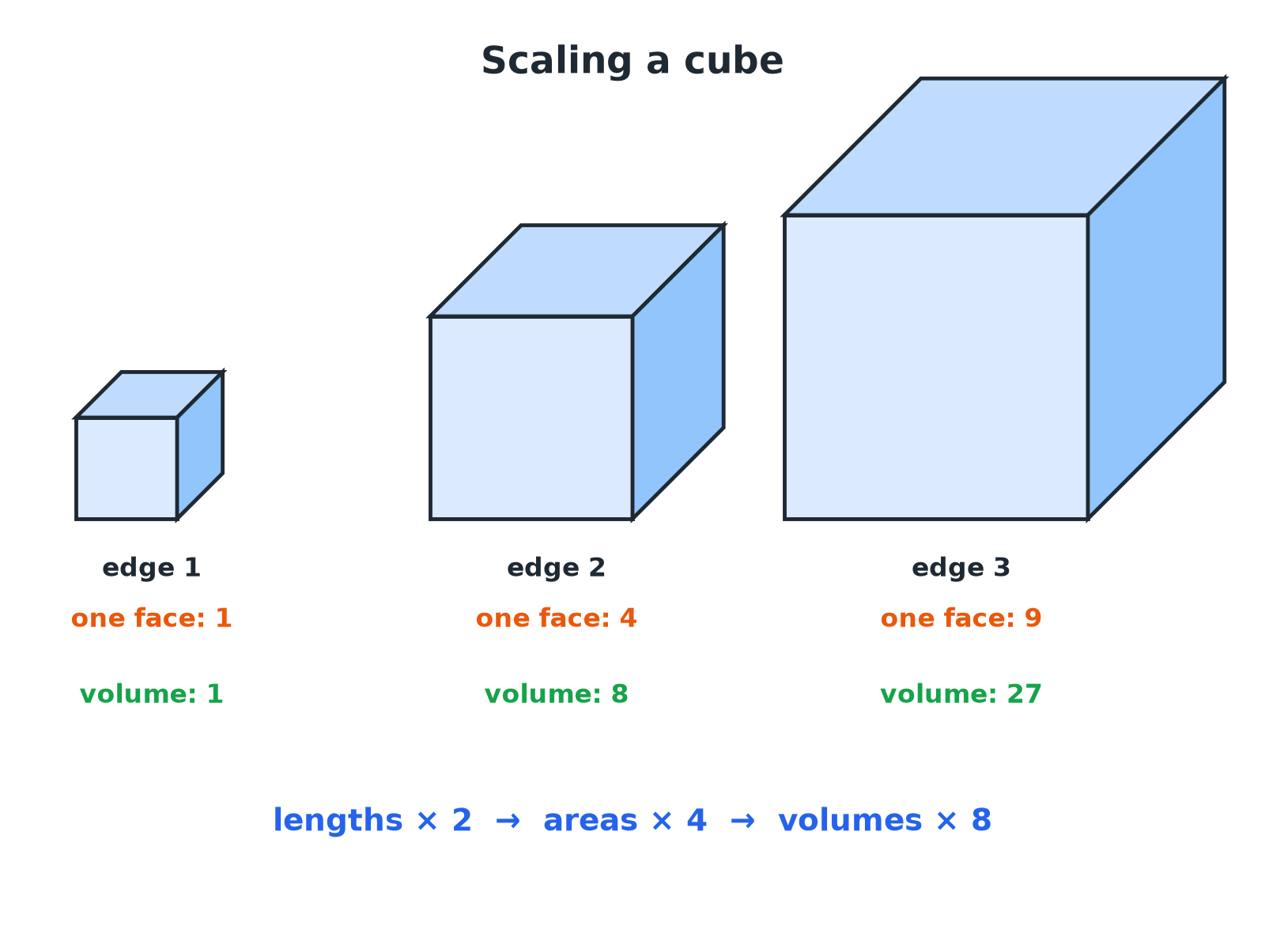

EDEXCEL GCSE MATHS · HIGHER
Similar Cubes
Doubling lengths multiplies areas by 4 and volumes by 8.
Similarity and congruence
openrevise.com
Lesson 5 of 5

Slide 6

EDEXCEL GCSE MATHS · HIGHER
Scale Factors for Similar Solids
If the length scale factor is k.
Measure
Scale factor
If k = 2
Lengths
k
2
Areas (including surface area)
k²
4
Volumes (and capacity, mass)
k³
8
Similarity and congruence
openrevise.com
Lesson 5 of 5

Slide 7

EDEXCEL GCSE MATHS · HIGHER
Volume of a Similar Cone
Cone A has height 6 cm and volume 40 cm³. Cone B is similar to A and has height 9 cm. Find the volume of cone B.
Length scale factor
9/6 = 1.5
1
Volume scale factor
1.5³ = 3.375
2
Volume of B
40 × 3.375
3
ANSWER
135 cm³
Similarity and congruence
openrevise.com
Lesson 5 of 5

Slide 8
EDEXCEL GCSE MATHS · HIGHER
A Model and the Real Thing
A model statue is 20 cm tall and has mass 2 kg. The real statue is 1.2 m tall and made of the same material. Find the mass of the real statue.
Length scale factor
120 ÷ 20 = 6
1
Volume (and mass) scale factor
6³ = 216
2
Mass
2 × 216
3
ANSWER
432 kg
Similarity and congruence
openrevise.com
Lesson 5 of 5

Slide 9
EDEXCEL GCSE MATHS · HIGHER
A Frustum
A cone of height 15 cm has volume 500 cm³. A small cone of height 6 cm is cut off the top, leaving a frustum. Find the volume of the frustum.
The small cone is similar to the large cone
Length scale factor 6/15 = 0.4
1
Volume scale factor
0.4³ = 0.064
2
Volume of the small cone
500 × 0.064 = 32
3
Frustum = large cone minus small cone
500 − 32
4
ANSWER
468 cm³
Similarity and congruence
openrevise.com
Lesson 5 of 5

Slide 10
EDEXCEL GCSE MATHS · HIGHER
From Volumes to Lengths
Two similar solids have volumes 8 cm³ and 125 cm³. Find the ratio of their lengths and of their surface areas.
Take the cube root of the volumes
∛8 : ∛125 = 2 : 5
1
Lengths
2 : 5
2
Surface areas: square the ratio
4 : 25
3
ANSWER
Lengths 2 : 5; surface areas 4 : 25.
Similarity and congruence
openrevise.com
Lesson 5 of 5

Slide 11

EDEXCEL GCSE MATHS · HIGHER
Which Scale Factor?
USE K (LENGTHS)
USE K² OR K³
• Heights, radii, edges, perimeters.
• Anything measured in a straight line.
• Read directly from the two shapes.
• k²: area, surface area, cross-section.
• k³: volume, capacity, mass (same material).
• Cube or square root to go backwards.
Similarity and congruence
openrevise.com
Lesson 5 of 5

Slide 12

EDEXCEL GCSE MATHS · HIGHER
Key Terms
Similar solids
Solids with the same shape and all lengths in the same ratio.
Volume scale factor
k³.
Surface area scale factor
k².
Frustum
A cone or pyramid with the top cut off parallel to the base.
Capacity
The volume a container holds.
Density
Mass per unit volume; the same in similar solids of the same material.
Similarity and congruence
openrevise.com
Lesson 5 of 5

Slide 13

EDEXCEL GCSE MATHS · HIGHER
YOUR TASK
12 minutes
Bottle Sizes
A small bottle is 10 cm tall and holds 250 ml. A similar large bottle is 15 cm tall. Find the capacity of the large bottle. A label on the small bottle has area 40 cm²; find the label area on the large bottle.
1
Find k.
2
Cube for volume.
3
Square for area.
WHAT A GOOD ANSWER SHOWS
Scale factor 1.5. Capacity 250 × 1.5³ = 843.75 ml, about 844 ml. Label 40 × 1.5² = 90 cm².
Similarity and congruence
openrevise.com
Lesson 5 of 5
Notes:
Ask why the large bottle holds more than 1.5 times as much.

Slide 14

EDEXCEL GCSE MATHS · HIGHER
Can I...?
State the scale factors k, k², k³.
Use a cube root to find a length ratio.
Find a volume of a similar solid.
Find the volume of a frustum.
Find a mass using a volume factor.
Choose the right scale factor.
Find the surface area of a similar solid.
Show clear working.
Similarity and congruence
openrevise.com
Lesson 5 of 5

Slide 15
EDEXCEL GCSE MATHS · HIGHER
Summary & Exam Focus
Lengths k, areas k², volumes k³.
For the same material, mass scales like volume.
From a volume ratio take the cube root for lengths.
A frustum is a large cone minus a similar small cone.
EXAM FOCUS
Cone A has height 6 cm and volume 40 cm³. Cone B is similar to A and has height 9 cm. Work out the volume of cone B. (3 marks)
Find the length scale factor first. Cube it for volume. Do not square it.
openrevise.com

Slide 16
EDEXCEL GCSE MATHS · HIGHER
Exam Practice: Similarity in 3D Solids
Answer all questions. Show your working. · 30 minutes
Question 1 · 3 marks · Work out
Cone A and cone B are mathematically similar. The height of cone A is 6 cm and its volume is 40 cm³. The height of cone B is 9 cm. Work out…
Question 2 · 3 marks · Work out
A model of a statue is 20 cm tall and has a mass of 2 kg. The real statue is 1.2 m tall and is made from the same material. Work out the…
Question 3 · 4 marks · Work out
A cone has a height of 15 cm and a volume of 500 cm³. A smaller cone of height 6 cm is cut off the top, leaving a frustum. The small cone…
Similarity and congruence
openrevise.com
Lesson 5 of 5

Slide 17
EDEXCEL GCSE MATHS · HIGHER
Exam Practice: Similarity in 3D Solids (cont.)
Question 4 · 3 marks · Work out
Two similar solids have surface areas in the ratio 4 : 9. Work out the ratio of their volumes.
Question 5 · 3 marks · Work out
A small bottle is 10 cm tall and holds 250 ml of juice. A similar large bottle is 15 cm tall. Work out the capacity of the large bottle…
Question 6 · 3 marks · Work out
Two similar solids have volumes of 8 cm³ and 125 cm³. The surface area of the smaller solid is 20 cm². Work out the surface area of the…
Similarity and congruence
openrevise.com
Lesson 5 of 5

Slide 18
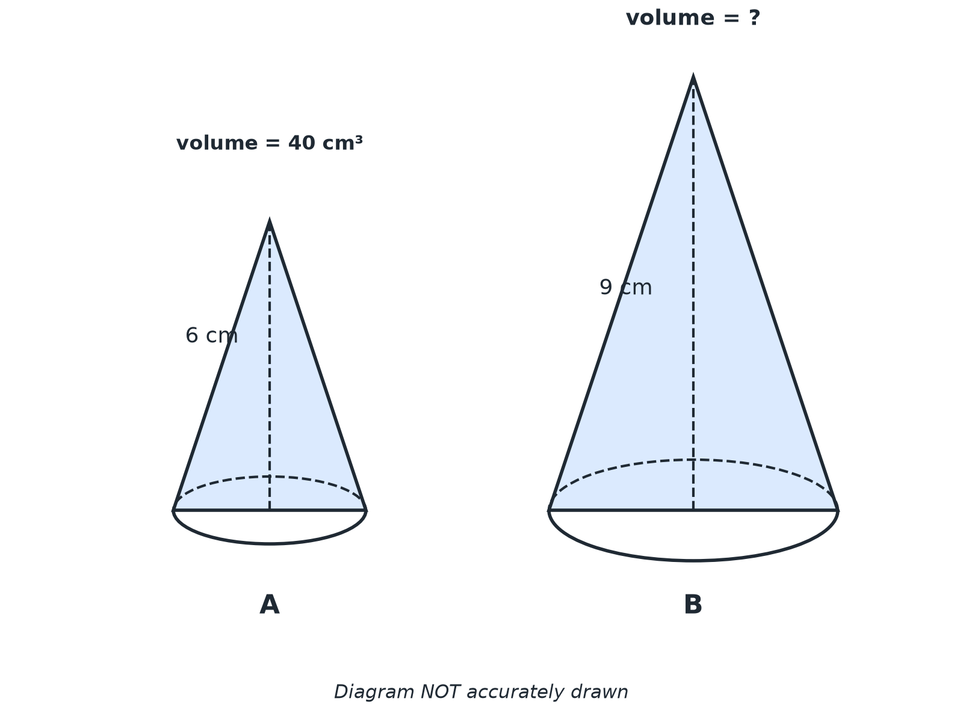
EDEXCEL GCSE MATHS · HIGHER
Question 1 · 3 marks · Work out
Cone A and cone B are mathematically similar. The height of cone A is 6 cm and its volume is 40 cm³. The height of cone B is 9 cm. Work out the volume of cone B. (3 marks)
Similarity and congruence
openrevise.com
Lesson 5 of 5

Slide 19
EDEXCEL GCSE MATHS · HIGHER
Question 1 · mark scheme
3 marks available. Award a mark for each point made.
Length scale factor 1.5
M1
1.5³ = 3.375
M1
135
A1
Similarity and congruence
openrevise.com
Lesson 5 of 5

Slide 20
EDEXCEL GCSE MATHS · HIGHER
Question 2 · 3 marks · Work out
“
A model of a statue is 20 cm tall and has a mass of 2 kg. The real statue is 1.2 m tall and is made from the same material. Work out the mass of the real statue.
HOW TO ANSWER IT
Command word: Work out. Worth 3 marks, so plan before writing.
Similarity and congruence
openrevise.com
Lesson 5 of 5

Slide 21
EDEXCEL GCSE MATHS · HIGHER
Question 2 · mark scheme
3 marks available. Award a mark for each point made.
Scale factor 6
M1
6³ = 216
M1
432
A1
Similarity and congruence
openrevise.com
Lesson 5 of 5

Slide 22
EDEXCEL GCSE MATHS · HIGHER
Question 3 · 4 marks · Work out
“
A cone has a height of 15 cm and a volume of 500 cm³. A smaller cone of height 6 cm is cut off the top, leaving a frustum. The small cone is similar to the large cone. Work out the volume of the frustum.
HOW TO ANSWER IT
Command word: Work out. Worth 4 marks, so plan before writing.
Similarity and congruence
openrevise.com
Lesson 5 of 5

Slide 23
EDEXCEL GCSE MATHS · HIGHER
Question 3 · mark scheme
4 marks available. Award a mark for each point made.
Scale factor 0.4
M1
0.4³ = 0.064
M1
Small cone 32
A1
468
A1
Similarity and congruence
openrevise.com
Lesson 5 of 5

Slide 24
EDEXCEL GCSE MATHS · HIGHER
Question 4 · 3 marks · Work out
“
Two similar solids have surface areas in the ratio 4 : 9. Work out the ratio of their volumes.
HOW TO ANSWER IT
Command word: Work out. Worth 3 marks, so plan before writing.
Similarity and congruence
openrevise.com
Lesson 5 of 5

Slide 25
EDEXCEL GCSE MATHS · HIGHER
Question 4 · mark scheme
3 marks available. Award a mark for each point made.
Length ratio 2 : 3
M1
Cubing
M1
8 : 27
A1
Similarity and congruence
openrevise.com
Lesson 5 of 5

Slide 26
EDEXCEL GCSE MATHS · HIGHER
Question 5 · 3 marks · Work out
“
A small bottle is 10 cm tall and holds 250 ml of juice. A similar large bottle is 15 cm tall. Work out the capacity of the large bottle. Give your answer to the nearest ml.
HOW TO ANSWER IT
Command word: Work out. Worth 3 marks, so plan before writing.
Similarity and congruence
openrevise.com
Lesson 5 of 5

Slide 27
EDEXCEL GCSE MATHS · HIGHER
Question 5 · mark scheme
3 marks available. Award a mark for each point made.
Scale factor 1.5
M1
250 × 1.5³
M1
844
A1
Similarity and congruence
openrevise.com
Lesson 5 of 5

Slide 28
EDEXCEL GCSE MATHS · HIGHER
Question 6 · 3 marks · Work out
“
Two similar solids have volumes of 8 cm³ and 125 cm³. The surface area of the smaller solid is 20 cm². Work out the surface area of the larger solid.
HOW TO ANSWER IT
Command word: Work out. Worth 3 marks, so plan before writing.
Similarity and congruence
openrevise.com
Lesson 5 of 5

Slide 29
EDEXCEL GCSE MATHS · HIGHER
Question 6 · mark scheme
3 marks available. Award a mark for each point made.
Length scale factor 5/2
M1
Area scale factor 6.25
M1
125
A1
Similarity and congruence
openrevise.com
Lesson 5 of 5

