Slide 1

EDEXCEL GCSE MATHS · HIGHER
Graph of the sine function
More trigonometry
Lesson 2 of 9
openrevise.com

Slide 2

EDEXCEL GCSE MATHS · HIGHER
Warm-up
Answer each one, then check.
1
What is sin 30°?
2
What is sin 90°?
3
What is the largest value sin x can take?
4
What does SOH mean?
5
Which mode must a calculator be in for degrees?
More trigonometry
openrevise.com
Lesson 2 of 9

Slide 3
EDEXCEL GCSE MATHS · HIGHER
Warm-up - Answers
What is sin 30°?
0.5
1
What is sin 90°?
1
2
What is the largest value sin x can take?
1
3
What does SOH mean?
sin = opposite ÷ hypotenuse
4
Which mode must a calculator be in for degrees?
DEG
5
More trigonometry
openrevise.com
Lesson 2 of 9

Slide 4

EDEXCEL GCSE MATHS · HIGHER
Learning Objectives
Sketch the graph of y = sin x for 0° ≤ x ≤ 360°.
1
Recall key values of sine.
2
Use symmetry to find a second solution of sin x = k.
3
Read solutions from the graph.
4
More trigonometry
openrevise.com
Lesson 2 of 9

Slide 5

EDEXCEL GCSE MATHS · HIGHER
SINE GRAPH
The graph of y = sin x is a smooth wave that repeats every 360°.
It starts at 0, rises to 1 at 90°, returns to 0 at 180°, falls to −1 at 270° and returns to 0 at 360°.
More trigonometry
openrevise.com
Lesson 2 of 9

Slide 6
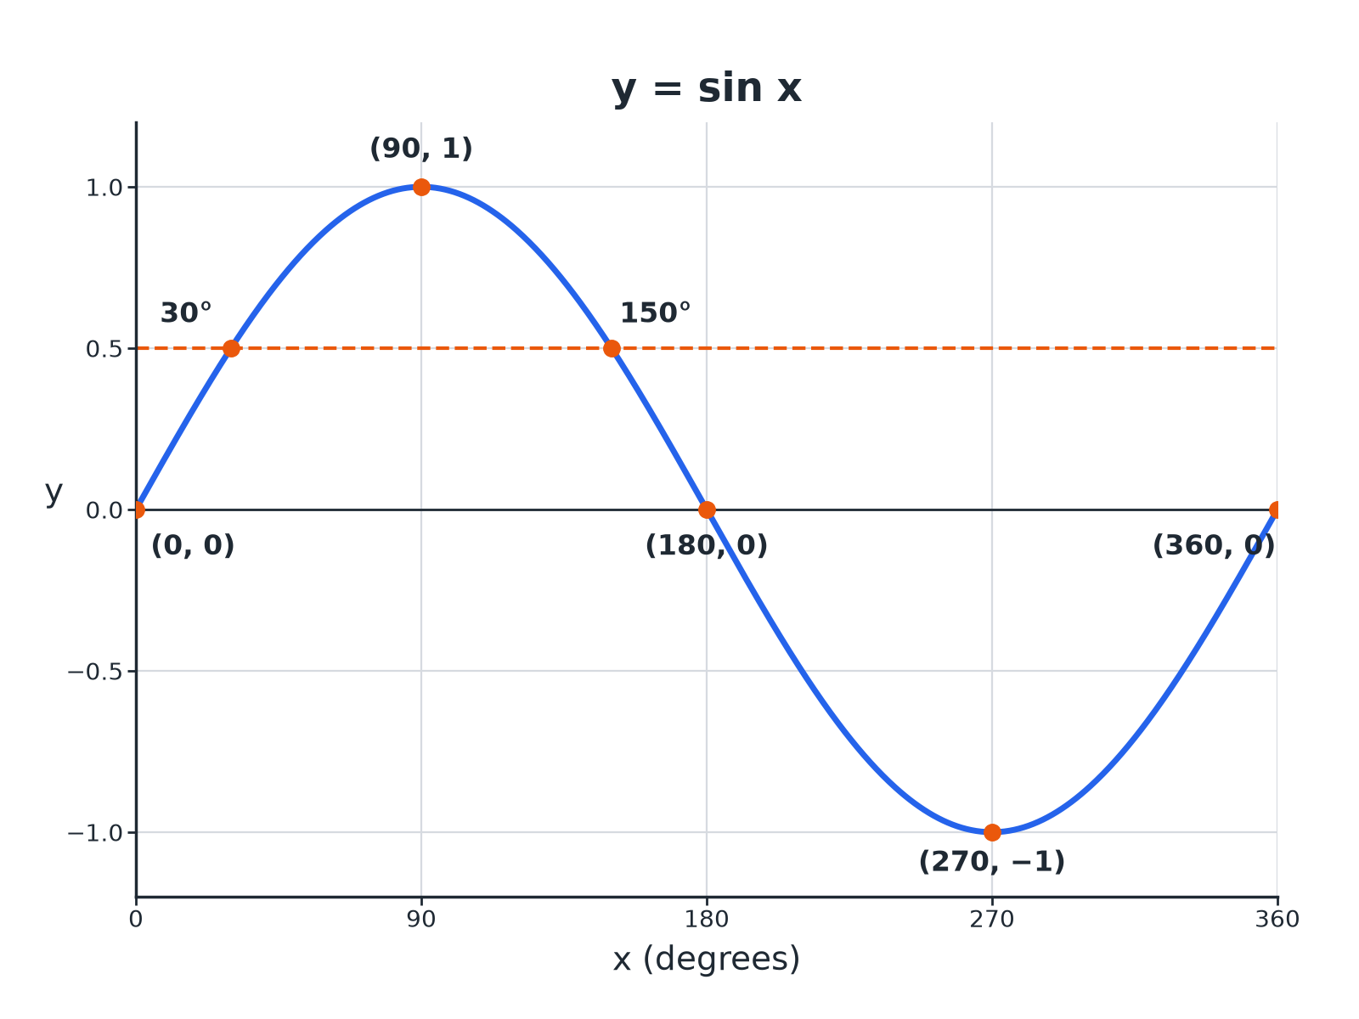

EDEXCEL GCSE MATHS · HIGHER
The Sine Graph
Sine x equals 0.5 has two solutions: 30 degrees and 150 degrees.
More trigonometry
openrevise.com
Lesson 2 of 9

Slide 7

EDEXCEL GCSE MATHS · HIGHER
Key Values of Sine
These are worth learning.
x
0°
30°
90°
150°
sin x
0
0.5
1
0.5 | 0 | −1 | 0
More trigonometry
openrevise.com
Lesson 2 of 9

Slide 8
EDEXCEL GCSE MATHS · HIGHER
Features of the Graph
Period
Repeats every 360°.
Maximum
1 at x = 90°.
Minimum
−1 at x = 270°.
Roots
x = 0°, 180°, 360°.
Symmetry
Symmetrical about x = 90° and x = 270°.
More trigonometry
openrevise.com
Lesson 2 of 9

Slide 9

EDEXCEL GCSE MATHS · HIGHER
Finding Two Solutions
Use symmetry about x = 90°.
1
2
3
4
Use the calculator
Find x = sin ⁻¹(k); this is the first solution
Reflect about 90
Second solution = 180°− x
Check the range
Both must be between 0° and 360°
Negative values
If k < 0, the solutions are between 180° and 360°
More trigonometry
openrevise.com
Lesson 2 of 9

Slide 10

EDEXCEL GCSE MATHS · HIGHER
Solving sin x = 0.5
Solve sin x = 0.5 for 0° ≤ x ≤ 360°.
Calculator
x = sin ⁻¹(0.5) = 30°
1
Reflect
x = 180°− 30°= 150°
2
ANSWER
x = 30° and x = 150°
More trigonometry
openrevise.com
Lesson 2 of 9

Slide 11
EDEXCEL GCSE MATHS · HIGHER
Solving a Negative Value
Solve sin x = −0.5 for 0° ≤ x ≤ 360°.
Calculator gives
sin ⁻¹(−0.5) = −30°, so use the positive 30° as a reference
1
Below the axis
Solutions are 180°+ 30° and 360°− 30°
2
Values
210° and 330°
3
ANSWER
x = 210° and x = 330°
More trigonometry
openrevise.com
Lesson 2 of 9

Slide 12

EDEXCEL GCSE MATHS · HIGHER
Key Terms
Period
The length after which the graph repeats.
Amplitude
The height from the middle line to the maximum.
Maximum
The highest value on the graph.
Minimum
The lowest value on the graph.
Inverse sine
sin ⁻¹, the calculator function that finds an angle.
Symmetry
The graph looks the same on both sides of a line.
More trigonometry
openrevise.com
Lesson 2 of 9

Slide 13

EDEXCEL GCSE MATHS · HIGHER
YOUR TASK
12 minutes
Sketch and Solve
(a) Sketch y = sin x for 0° to 360°. (b) Mark y = 0.8 and read the two solutions from your sketch. (c) Calculate them: sin ⁻¹(0.8) = 53.1°.
Draw the axes with 90° marks.
1
Use symmetry about 90°.
2
WHAT A GOOD ANSWER SHOWS
(b) About 53° and 127°. (c) x = 53.1° and 180°− 53.1°= 126.9°.
More trigonometry
openrevise.com
Lesson 2 of 9
Notes:
Check that the sketch solutions match the calculated ones.

Slide 14

EDEXCEL GCSE MATHS · HIGHER
Can I...?
Sketch the sine graph.
Use sin inverse.
State its maximum and minimum.
Find the second solution.
State its period.
Solve for negative values.
Recall sin 30 and sin 90.
Read solutions from a graph.
More trigonometry
openrevise.com
Lesson 2 of 9

Slide 15
EDEXCEL GCSE MATHS · HIGHER
Summary & Exam Focus
Sine repeats every 360°, max 1, min −1.
sin x = k has two solutions in 0° to 360° for −1 < k < 1.
Positive k: x and 180°− x.
Negative k: angles in the second half.
EXAM FOCUS
Solve sin x = 0.6 for 0° ≤ x ≤ 360°. Give answers correct to 1 decimal place. (3 marks)
Second solution is 180°− x. Check both are in range.
openrevise.com

Slide 16
EDEXCEL GCSE MATHS · HIGHER
Exam Practice: Graph of the sine function
Answer all questions. Show your working. · 25 minutes
Question 1 · 3 marks · Solve
Solve sin x = 0.6 for 0° ≤ x ≤ 360°. Give your answers correct to 1 decimal place.
Question 2 · 2 marks · Write down
Write down the value of (a) sin 90° (b) sin 270°
Question 3 · 3 marks · Use the graph
The graph shows y = sin x for 0° ≤ x ≤ 360°. Use the graph to solve sin x = 0.5 and to write down the maximum value of sin x.
More trigonometry
openrevise.com
Lesson 2 of 9

Slide 17
EDEXCEL GCSE MATHS · HIGHER
Exam Practice: Graph of the sine function (cont.)
Question 4 · 3 marks · Solve
Solve sin x = −0.3 for 0° ≤ x ≤ 360°. Give your answers correct to 1 decimal place.
Question 5 · 2 marks · Explain
Amir says that sin x = 1.4 has a solution. Explain why he is wrong.
Question 6 · 2 marks · Write down
sin 40°= 0.64 (to 2 decimal places). Write down another angle between 0° and 360° with sine 0.64.
More trigonometry
openrevise.com
Lesson 2 of 9

Slide 18
EDEXCEL GCSE MATHS · HIGHER
Question 1 · 3 marks · Solve
“
Solve sin x = 0.6 for 0° ≤ x ≤ 360°. Give your answers correct to 1 decimal place.
HOW TO ANSWER IT
Command word: Solve. Worth 3 marks, so plan before writing.
More trigonometry
openrevise.com
Lesson 2 of 9

Slide 19
EDEXCEL GCSE MATHS · HIGHER
Question 1 · mark scheme
3 marks available. Award a mark for each point made.
sin ⁻¹(0.6) = 36.9°
B1
180 − 36.9
M1
143.1
A1
More trigonometry
openrevise.com
Lesson 2 of 9

Slide 20
EDEXCEL GCSE MATHS · HIGHER
Question 2 · 2 marks · Write down
“
Write down the value of (a) sin 90° (b) sin 270°
HOW TO ANSWER IT
Command word: Write down. Worth 2 marks, so plan before writing.
More trigonometry
openrevise.com
Lesson 2 of 9

Slide 21
EDEXCEL GCSE MATHS · HIGHER
Question 2 · mark scheme
2 marks available. Award a mark for each point made.
1
B1
−1
B1
More trigonometry
openrevise.com
Lesson 2 of 9

Slide 22
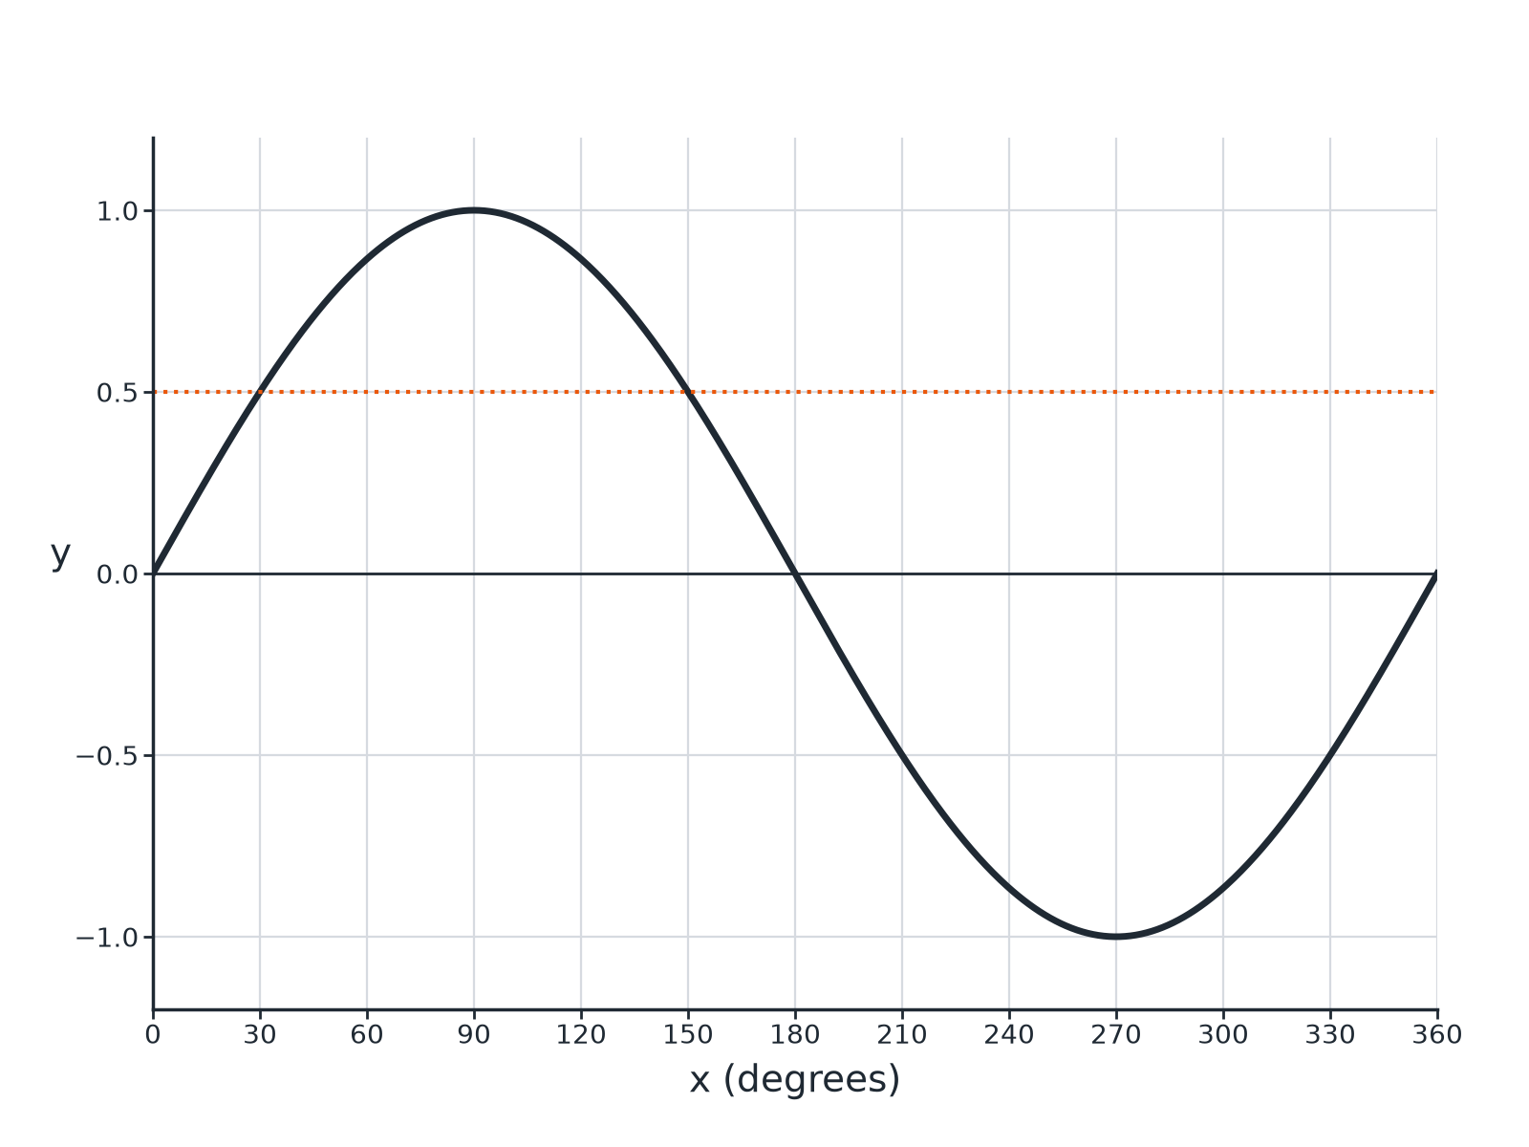
EDEXCEL GCSE MATHS · HIGHER
Question 3 · 3 marks · Use the graph
The graph shows y = sin x for 0° ≤ x ≤ 360°. Use the graph to solve sin x = 0.5 and to write down the maximum value of sin x. (3 marks)
More trigonometry
openrevise.com
Lesson 2 of 9

Slide 23
EDEXCEL GCSE MATHS · HIGHER
Question 3 · mark scheme
3 marks available. Award a mark for each point made.
30
B1
150
B1
1
B1
More trigonometry
openrevise.com
Lesson 2 of 9

Slide 24
EDEXCEL GCSE MATHS · HIGHER
Question 4 · 3 marks · Solve
“
Solve sin x = −0.3 for 0° ≤ x ≤ 360°. Give your answers correct to 1 decimal place.
HOW TO ANSWER IT
Command word: Solve. Worth 3 marks, so plan before writing.
More trigonometry
openrevise.com
Lesson 2 of 9

Slide 25
EDEXCEL GCSE MATHS · HIGHER
Question 4 · mark scheme
3 marks available. Award a mark for each point made.
Reference angle 17.5°
B1
180 + 17.5 or 360 − 17.5
M1
Both answers
A1
More trigonometry
openrevise.com
Lesson 2 of 9

Slide 26
EDEXCEL GCSE MATHS · HIGHER
Question 5 · 2 marks · Explain
“
Amir says that sin x = 1.4 has a solution. Explain why he is wrong.
HOW TO ANSWER IT
Command word: Explain. Worth 2 marks, so plan before writing.
More trigonometry
openrevise.com
Lesson 2 of 9

Slide 27
EDEXCEL GCSE MATHS · HIGHER
Question 5 · mark scheme
2 marks available. Award a mark for each point made.
Maximum of sine is 1
M1
Conclusion
C1
More trigonometry
openrevise.com
Lesson 2 of 9

Slide 28
EDEXCEL GCSE MATHS · HIGHER
Question 6 · 2 marks · Write down
“
sin 40°= 0.64 (to 2 decimal places). Write down another angle between 0° and 360° with sine 0.64.
HOW TO ANSWER IT
Command word: Write down. Worth 2 marks, so plan before writing.
More trigonometry
openrevise.com
Lesson 2 of 9

Slide 29
EDEXCEL GCSE MATHS · HIGHER
Question 6 · mark scheme
2 marks available. Award a mark for each point made.
180 − 40
M1
140
A1
More trigonometry
openrevise.com
Lesson 2 of 9

