Slide 1

EDEXCEL GCSE MATHS · HIGHER
Graph of the cosine function
More trigonometry
Lesson 3 of 9
openrevise.com

Slide 2

EDEXCEL GCSE MATHS · HIGHER
Warm-up
Answer each one, then check.
1
What is cos 60°?
2
What is cos 0°?
3
What does CAH mean?
4
What is the period of the sine graph?
5
What are the largest and smallest values of sine?
More trigonometry
openrevise.com
Lesson 3 of 9

Slide 3
EDEXCEL GCSE MATHS · HIGHER
Warm-up - Answers
What is cos 60°?
0.5
1
What is cos 0°?
1
2
What does CAH mean?
cos = adjacent ÷ hypotenuse
3
What is the period of the sine graph?
360°
4
What are the largest and smallest values of sine?
1 and −1
5
More trigonometry
openrevise.com
Lesson 3 of 9

Slide 4

EDEXCEL GCSE MATHS · HIGHER
Learning Objectives
Sketch the graph of y = cos x for 0° ≤ x ≤ 360°.
1
Recall key values of cosine.
2
Use symmetry to find a second solution of cos x = k.
3
Describe how the cosine and sine graphs are related.
4
More trigonometry
openrevise.com
Lesson 3 of 9

Slide 5

EDEXCEL GCSE MATHS · HIGHER
COSINE GRAPH
The graph of y = cos x is the sine wave shifted 90° to the left.
It starts at 1 when x = 0°, falls to 0 at 90°, reaches −1 at 180°, is 0 at 270° and back to 1 at 360°.
More trigonometry
openrevise.com
Lesson 3 of 9

Slide 6
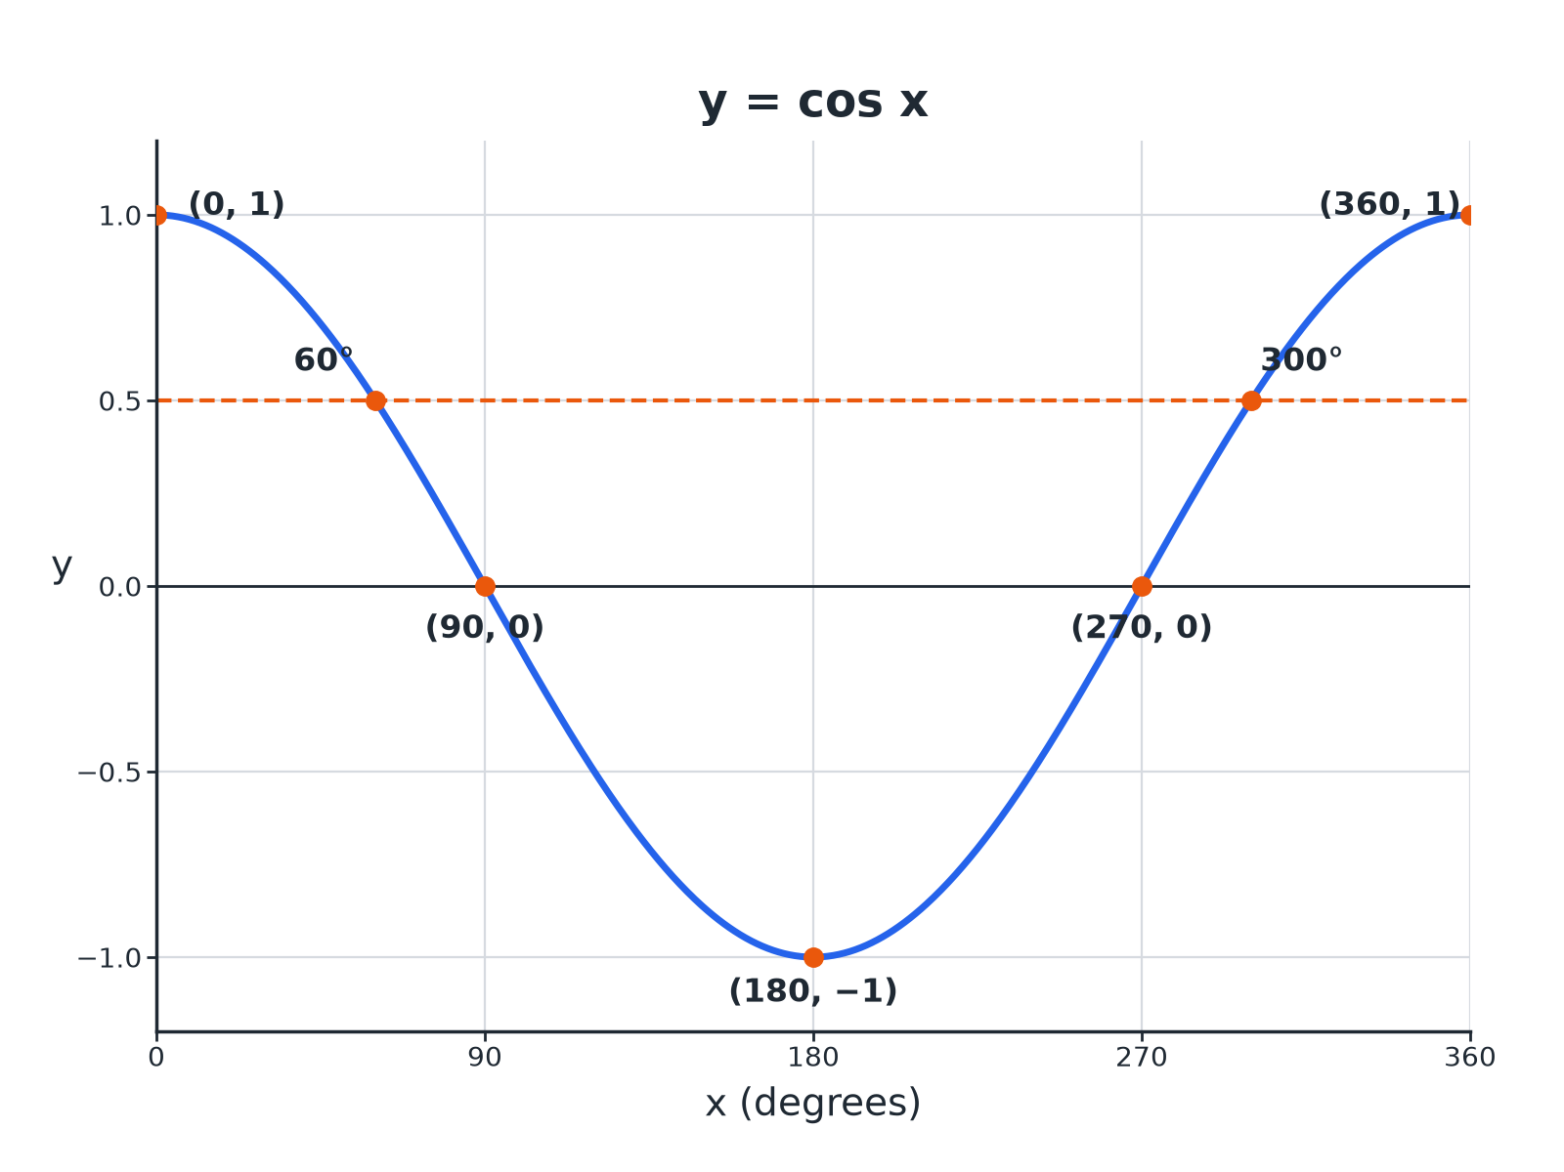

EDEXCEL GCSE MATHS · HIGHER
The Cosine Graph
Cosine x equals 0.5 has two solutions: 60 degrees and 300 degrees.
More trigonometry
openrevise.com
Lesson 3 of 9

Slide 7

EDEXCEL GCSE MATHS · HIGHER
Key Values of Cosine
These are worth learning.
x
0°
60°
90°
180°
cos x
1
0.5
0
−1 | 0 | 0.5 | 1
More trigonometry
openrevise.com
Lesson 3 of 9

Slide 8
EDEXCEL GCSE MATHS · HIGHER
Features of the Graph
Period
Repeats every 360°.
Maximum
1 at x = 0° and 360°.
Minimum
−1 at x = 180°.
Roots
x = 90° and 270°.
Symmetry
Symmetrical about x = 180°.
More trigonometry
openrevise.com
Lesson 3 of 9

Slide 9

EDEXCEL GCSE MATHS · HIGHER
Finding Two Solutions
Use symmetry about x = 180°.
1
2
3
4
Use the calculator
Find x = cos ⁻¹(k); this is the first solution
Reflect about 180
Second solution = 360°− x
Check the range
Both must be between 0° and 360°
Negative values
cos ⁻¹ of a negative gives an angle between 90° and 180°
More trigonometry
openrevise.com
Lesson 3 of 9

Slide 10

EDEXCEL GCSE MATHS · HIGHER
Solving cos x = 0.5
Solve cos x = 0.5 for 0° ≤ x ≤ 360°.
Calculator
x = cos ⁻¹(0.5) = 60°
1
Reflect
x = 360°− 60°= 300°
2
ANSWER
x = 60° and x = 300°
More trigonometry
openrevise.com
Lesson 3 of 9

Slide 11
EDEXCEL GCSE MATHS · HIGHER
Solving a Negative Value
Solve cos x = −0.7 for 0° ≤ x ≤ 360°, correct to 1 decimal place.
Calculator
x = cos ⁻¹(−0.7) = 134.4°
1
Reflect
360°− 134.4°= 225.6°
2
ANSWER
x = 134.4° and x = 225.6°
More trigonometry
openrevise.com
Lesson 3 of 9

Slide 12

EDEXCEL GCSE MATHS · HIGHER
Sine and Cosine Graphs
Y = SIN X
Y = COS X
• Starts at 0.
• Maximum at 90°, minimum at 270°.
• Second solution: 180°− x.
• Starts at 1.
• Maximum at 0° and 360°, minimum at 180°.
• Second solution: 360°− x.
More trigonometry
openrevise.com
Lesson 3 of 9

Slide 13

EDEXCEL GCSE MATHS · HIGHER
Key Terms
Cosine graph
The wave y = cos x.
Period
360° for both sine and cosine.
Inverse cosine
cos ⁻¹, the calculator function that finds an angle.
Translation
Sliding a graph without turning it.
Symmetry
The graph mirrors itself about a line.
Solution
A value of x that gives the required y.
More trigonometry
openrevise.com
Lesson 3 of 9

Slide 14

EDEXCEL GCSE MATHS · HIGHER
YOUR TASK
12 minutes
Sine Meets Cosine
Sketch y = sin x and y = cos x on the same axes for 0° to 360°. (a) Where do they cross? (b) What single translation maps sine onto cosine?
Draw both curves.
1
Read the crossing points.
2
WHAT A GOOD ANSWER SHOWS
(a) At x = 45° and 225°. (b) A translation of 90° to the left.
More trigonometry
openrevise.com
Lesson 3 of 9
Notes:
Check the crossings with a calculator: sin 45°= cos 45°.

Slide 15

EDEXCEL GCSE MATHS · HIGHER
Can I...?
Sketch the cosine graph.
Find the second solution.
State its maximum and minimum.
Solve for negative values.
Recall cos 0, cos 60 and cos 90.
Compare sine and cosine.
Use cos inverse.
Read solutions from a graph.
More trigonometry
openrevise.com
Lesson 3 of 9

Slide 16
EDEXCEL GCSE MATHS · HIGHER
Summary & Exam Focus
Cosine starts at 1, falls to −1 at 180°, returns to 1 at 360°.
cos x = k has two solutions in 0° to 360° for −1 < k < 1.
Solutions are x and 360°− x.
Cosine is sine shifted 90° left.
EXAM FOCUS
Solve cos x = 0.3 for 0° ≤ x ≤ 360°. Give answers correct to 1 decimal place. (3 marks)
Second solution is 360°− x.
openrevise.com

Slide 17
EDEXCEL GCSE MATHS · HIGHER
Exam Practice: Graph of the cosine function
Answer all questions. Show your working. · 25 minutes
Question 1 · 3 marks · Solve
Solve cos x = 0.3 for 0° ≤ x ≤ 360°. Give your answers correct to 1 decimal place.
Question 2 · 2 marks · Write down
Write down the value of (a) cos 0° (b) cos 180°
Question 3 · 3 marks · Use the graph
The graph shows y = cos x for 0° ≤ x ≤ 360°. Use the graph to solve cos x = −0.5 and to write down the minimum value of cos x.
More trigonometry
openrevise.com
Lesson 3 of 9

Slide 18
EDEXCEL GCSE MATHS · HIGHER
Exam Practice: Graph of the cosine function (cont.)
Question 4 · 3 marks · Solve
Solve cos x = −0.7 for 0° ≤ x ≤ 360°. Give your answers correct to 1 decimal place.
Question 5 · 2 marks · Write down
cos 50°= 0.64 (to 2 decimal places). Write down another angle between 0° and 360° with cosine 0.64.
Question 6 · 2 marks · Describe
Describe the single transformation that maps the graph of y = sin x onto the graph of y = cos x.
More trigonometry
openrevise.com
Lesson 3 of 9

Slide 19
EDEXCEL GCSE MATHS · HIGHER
Question 1 · 3 marks · Solve
“
Solve cos x = 0.3 for 0° ≤ x ≤ 360°. Give your answers correct to 1 decimal place.
HOW TO ANSWER IT
Command word: Solve. Worth 3 marks, so plan before writing.
More trigonometry
openrevise.com
Lesson 3 of 9

Slide 20
EDEXCEL GCSE MATHS · HIGHER
Question 1 · mark scheme
3 marks available. Award a mark for each point made.
cos ⁻¹(0.3) = 72.5°
B1
360 − 72.5
M1
287.5
A1
More trigonometry
openrevise.com
Lesson 3 of 9

Slide 21
EDEXCEL GCSE MATHS · HIGHER
Question 2 · 2 marks · Write down
“
Write down the value of (a) cos 0° (b) cos 180°
HOW TO ANSWER IT
Command word: Write down. Worth 2 marks, so plan before writing.
More trigonometry
openrevise.com
Lesson 3 of 9

Slide 22
EDEXCEL GCSE MATHS · HIGHER
Question 2 · mark scheme
2 marks available. Award a mark for each point made.
1
B1
−1
B1
More trigonometry
openrevise.com
Lesson 3 of 9

Slide 23
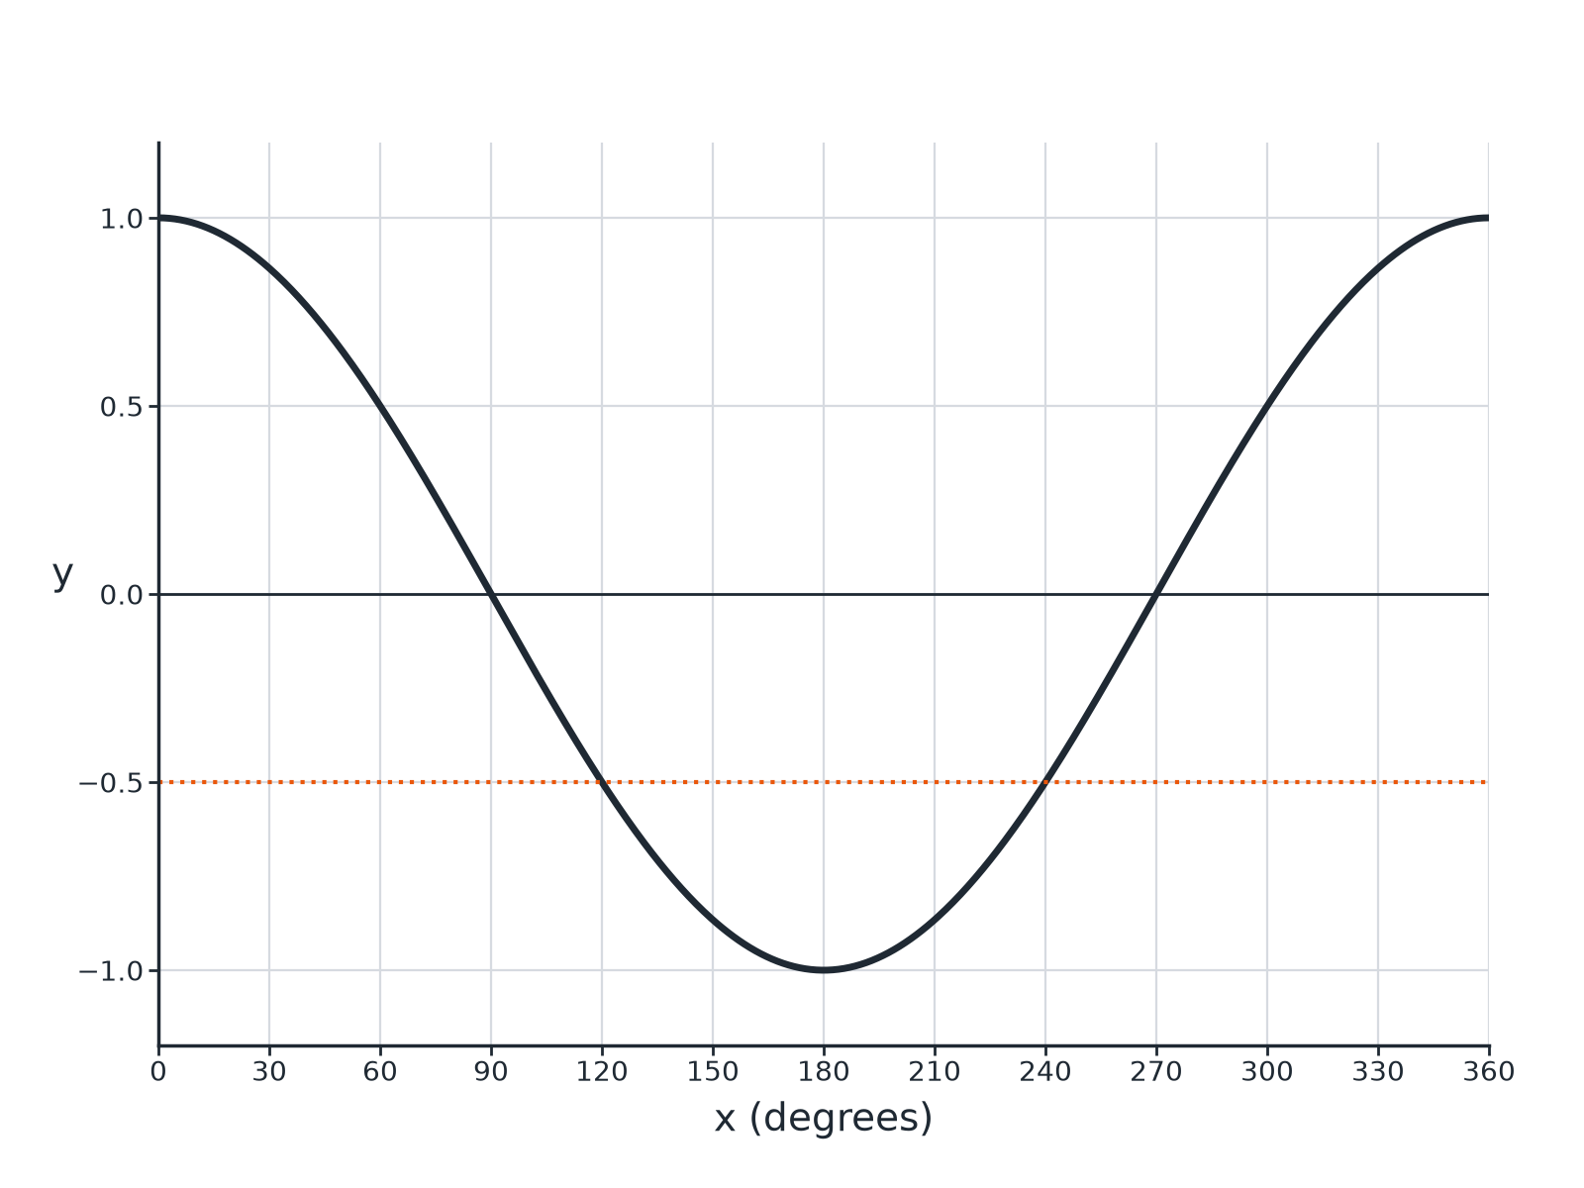
EDEXCEL GCSE MATHS · HIGHER
Question 3 · 3 marks · Use the graph
The graph shows y = cos x for 0° ≤ x ≤ 360°. Use the graph to solve cos x = −0.5 and to write down the minimum value of cos x. (3 marks)
More trigonometry
openrevise.com
Lesson 3 of 9

Slide 24
EDEXCEL GCSE MATHS · HIGHER
Question 3 · mark scheme
3 marks available. Award a mark for each point made.
120
B1
240
B1
−1
B1
More trigonometry
openrevise.com
Lesson 3 of 9

Slide 25
EDEXCEL GCSE MATHS · HIGHER
Question 4 · 3 marks · Solve
“
Solve cos x = −0.7 for 0° ≤ x ≤ 360°. Give your answers correct to 1 decimal place.
HOW TO ANSWER IT
Command word: Solve. Worth 3 marks, so plan before writing.
More trigonometry
openrevise.com
Lesson 3 of 9

Slide 26
EDEXCEL GCSE MATHS · HIGHER
Question 4 · mark scheme
3 marks available. Award a mark for each point made.
cos ⁻¹(−0.7) = 134.4°
B1
360 − 134.4
M1
225.6
A1
More trigonometry
openrevise.com
Lesson 3 of 9

Slide 27
EDEXCEL GCSE MATHS · HIGHER
Question 5 · 2 marks · Write down
“
cos 50°= 0.64 (to 2 decimal places). Write down another angle between 0° and 360° with cosine 0.64.
HOW TO ANSWER IT
Command word: Write down. Worth 2 marks, so plan before writing.
More trigonometry
openrevise.com
Lesson 3 of 9

Slide 28
EDEXCEL GCSE MATHS · HIGHER
Question 5 · mark scheme
2 marks available. Award a mark for each point made.
360 − 50
M1
310
A1
More trigonometry
openrevise.com
Lesson 3 of 9

Slide 29
EDEXCEL GCSE MATHS · HIGHER
Question 6 · 2 marks · Describe
“
Describe the single transformation that maps the graph of y = sin x onto the graph of y = cos x.
HOW TO ANSWER IT
Command word: Describe. Worth 2 marks, so plan before writing.
More trigonometry
openrevise.com
Lesson 3 of 9

Slide 30
EDEXCEL GCSE MATHS · HIGHER
Question 6 · mark scheme
2 marks available. Award a mark for each point made.
Translation
M1
90° to the left
A1
More trigonometry
openrevise.com
Lesson 3 of 9

