Slide 1

EDEXCEL GCSE MATHS · HIGHER
Graph of the tangent function
More trigonometry
Lesson 4 of 9
openrevise.com

Slide 2

EDEXCEL GCSE MATHS · HIGHER
Warm-up
Answer each one, then check.
1
What does TOA mean?
2
What is tan 45°?
3
What is tan 0°?
4
What is the period of sine and cosine?
5
Can you divide by zero?
More trigonometry
openrevise.com
Lesson 4 of 9

Slide 3
EDEXCEL GCSE MATHS · HIGHER
Warm-up - Answers
What does TOA mean?
tan = opposite ÷ adjacent
1
What is tan 45°?
1
2
What is tan 0°?
0
3
What is the period of sine and cosine?
360°
4
Can you divide by zero?
No
5
More trigonometry
openrevise.com
Lesson 4 of 9

Slide 4

EDEXCEL GCSE MATHS · HIGHER
Learning Objectives
Sketch the graph of y = tan x for 0° ≤ x ≤ 360°.
1
Recall key values and the position of the asymptotes.
2
Use the period of 180° to find a second solution.
3
Read solutions from the graph.
4
More trigonometry
openrevise.com
Lesson 4 of 9

Slide 5

EDEXCEL GCSE MATHS · HIGHER
TANGENT GRAPH
The graph of y = tan x repeats every 180° and has vertical asymptotes at x = 90° and x = 270°.
Unlike sine and cosine, tangent has no maximum or minimum: it goes up to infinity and down to minus infinity.
More trigonometry
openrevise.com
Lesson 4 of 9

Slide 6
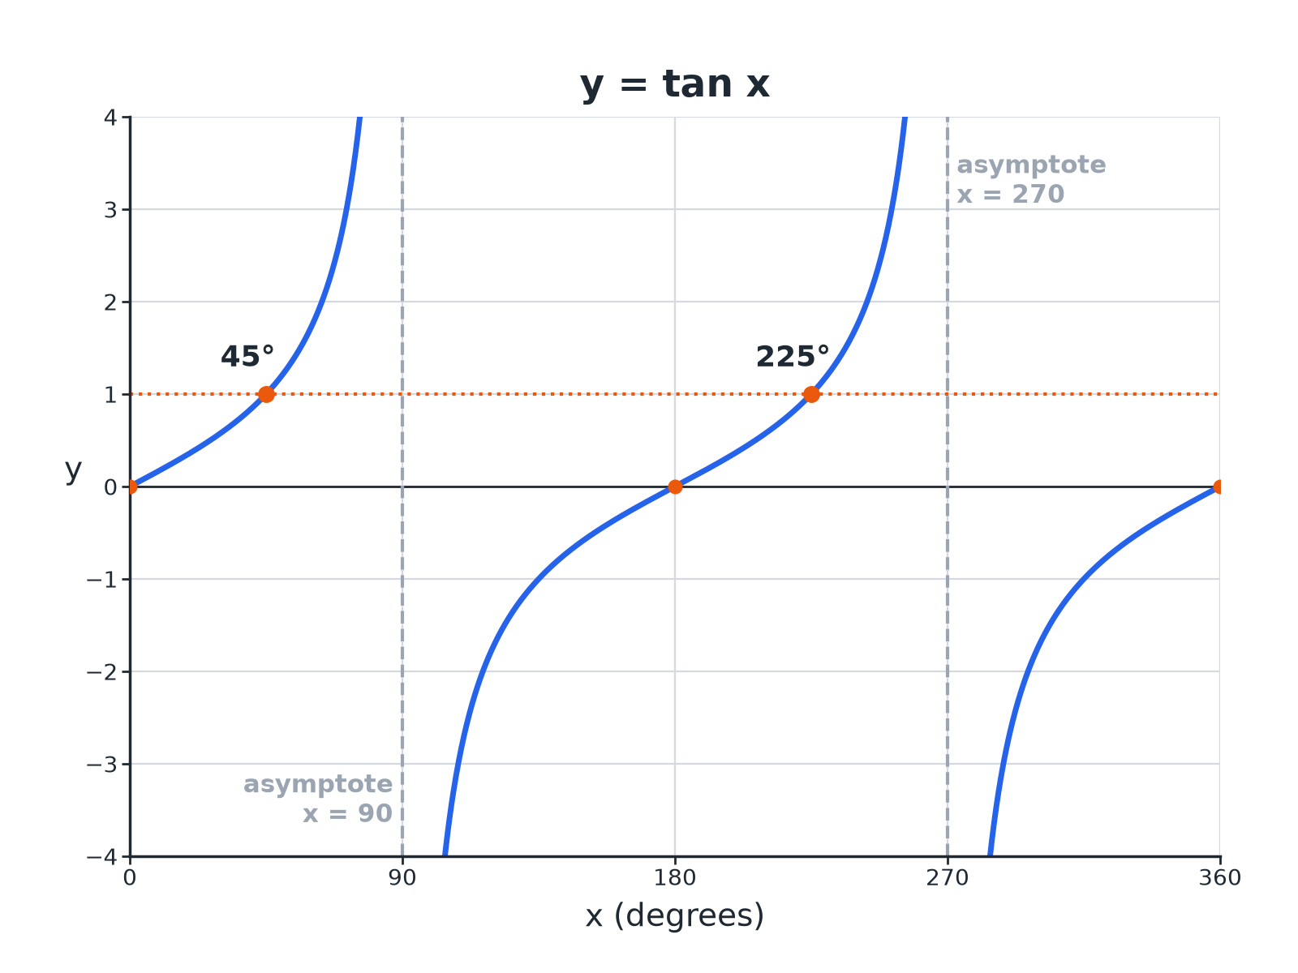

EDEXCEL GCSE MATHS · HIGHER
The Tangent Graph
Tan x = 1 has solutions at 45 degrees and 225 degrees.
More trigonometry
openrevise.com
Lesson 4 of 9

Slide 7

EDEXCEL GCSE MATHS · HIGHER
Key Values of Tangent
Learn these, and note the gaps.
x
0°
45°
90°
135°
tan x
0
1
undefined
−1 | 0 | 1 | undefined | −1 | 0
More trigonometry
openrevise.com
Lesson 4 of 9

Slide 8
EDEXCEL GCSE MATHS · HIGHER
Features of the Graph
Period
Repeats every 180°.
Asymptotes
Vertical lines at x = 90° and 270°; the graph never touches them.
Roots
x = 0°, 180°, 360°.
Range
Every value of y; no maximum or minimum.
Shape
Rises steeply through each root.
More trigonometry
openrevise.com
Lesson 4 of 9

Slide 9

EDEXCEL GCSE MATHS · HIGHER
Finding Two Solutions
The graph repeats every 180°.
1
2
3
4
Calculator
Find x = tan ⁻¹(k); this is the first solution
Add the period
Second solution = x + 180°
Negative values
If tan ⁻¹(k) is negative, add 180° and 360°
Check the range
Only keep answers between 0° and 360°
More trigonometry
openrevise.com
Lesson 4 of 9

Slide 10

EDEXCEL GCSE MATHS · HIGHER
Solving tan x = 2
Solve tan x = 2 for 0° ≤ x ≤ 360°, correct to 1 decimal place.
Calculator
x = tan ⁻¹(2) = 63.4°
1
Add 180°
63.4°+ 180°= 243.4°
2
ANSWER
x = 63.4° and x = 243.4°
More trigonometry
openrevise.com
Lesson 4 of 9

Slide 11
EDEXCEL GCSE MATHS · HIGHER
Solving a Negative Value
Solve tan x = −1 for 0° ≤ x ≤ 360°.
Calculator gives
tan ⁻¹(−1) = −45°
1
Add 180°
−45°+ 180°= 135°
2
Add 360°
−45°+ 360°= 315°
3
ANSWER
x = 135° and x = 315°
More trigonometry
openrevise.com
Lesson 4 of 9

Slide 12

EDEXCEL GCSE MATHS · HIGHER
Comparing the Three Graphs
SIN X AND COS X
TAN X
• Period 360°.
• Smooth waves between −1 and 1.
• No asymptotes.
• Solutions: x and 180°− x (sin), x and 360°− x (cos).
• Period 180°.
• Takes every value.
• Asymptotes at 90° and 270°.
• Solutions: x and x + 180°.
More trigonometry
openrevise.com
Lesson 4 of 9

Slide 13

EDEXCEL GCSE MATHS · HIGHER
Key Terms
Asymptote
A line that a graph gets closer to but never touches.
Period
The length after which the graph repeats.
Undefined
Has no value, e.g. tan 90°.
Inverse tangent
tan ⁻¹, the calculator function that finds an angle.
Root
A value of x where y = 0.
Range
The set of values y can take.
More trigonometry
openrevise.com
Lesson 4 of 9

Slide 14

EDEXCEL GCSE MATHS · HIGHER
YOUR TASK
12 minutes
Tangent Table
Use a calculator to fill in tan x for x = 60°, 80°, 85°, 89° (1 d.p.). Then describe what happens as x gets close to 90°.
Type each value into the calculator.
1
Describe the pattern.
2
WHAT A GOOD ANSWER SHOWS
1.7, 5.7, 11.4, 57.3. The values get bigger and bigger, which is why there is an asymptote at 90°.
More trigonometry
openrevise.com
Lesson 4 of 9
Notes:
Try 91°, 95° to see the values become large and negative.

Slide 15

EDEXCEL GCSE MATHS · HIGHER
Can I...?
Sketch the tangent graph.
Use tan inverse.
State the period.
Find the second solution.
Mark the asymptotes.
Solve for negative values.
Recall tan 45.
Read solutions from a graph.
More trigonometry
openrevise.com
Lesson 4 of 9

Slide 16
EDEXCEL GCSE MATHS · HIGHER
Summary & Exam Focus
Tangent repeats every 180°.
Vertical asymptotes at 90° and 270°.
Solutions are x and x + 180°.
Tangent takes every value, so tan x = k always has solutions.
EXAM FOCUS
Solve tan x = 0.5 for 0° ≤ x ≤ 360°. Give answers correct to 1 decimal place. (3 marks)
The period is 180°, so the second solution is x + 180°.
openrevise.com

Slide 17
EDEXCEL GCSE MATHS · HIGHER
Exam Practice: Graph of the tangent function
Answer all questions. Show your working. · 25 minutes
Question 1 · 3 marks · Solve
Solve tan x = 0.5 for 0° ≤ x ≤ 360°. Give your answers correct to 1 decimal place.
Question 2 · 2 marks · Write down
Write down the value of (a) tan 45° (b) tan 0°
Question 3 · 3 marks · Use the graph
The graph shows y = tan x for 0° ≤ x ≤ 180°. Use the graph to solve tan x = 1, and write down the equation of the asymptote.
More trigonometry
openrevise.com
Lesson 4 of 9

Slide 18
EDEXCEL GCSE MATHS · HIGHER
Exam Practice: Graph of the tangent function (cont.)
Question 4 · 3 marks · Solve
Solve tan x = −2 for 0° ≤ x ≤ 360°. Give your answers correct to 1 decimal place.
Question 5 · 2 marks · Explain
Explain why tan 90° has no value.
Question 6 · 2 marks · Write down
tan 30°= 0.58 (to 2 decimal places). Write down another angle between 0° and 360° with tangent 0.58.
More trigonometry
openrevise.com
Lesson 4 of 9

Slide 19
EDEXCEL GCSE MATHS · HIGHER
Question 1 · 3 marks · Solve
“
Solve tan x = 0.5 for 0° ≤ x ≤ 360°. Give your answers correct to 1 decimal place.
HOW TO ANSWER IT
Command word: Solve. Worth 3 marks, so plan before writing.
More trigonometry
openrevise.com
Lesson 4 of 9

Slide 20
EDEXCEL GCSE MATHS · HIGHER
Question 1 · mark scheme
3 marks available. Award a mark for each point made.
tan ⁻¹(0.5) = 26.6°
B1
Adds 180
M1
206.6
A1
More trigonometry
openrevise.com
Lesson 4 of 9

Slide 21
EDEXCEL GCSE MATHS · HIGHER
Question 2 · 2 marks · Write down
“
Write down the value of (a) tan 45° (b) tan 0°
HOW TO ANSWER IT
Command word: Write down. Worth 2 marks, so plan before writing.
More trigonometry
openrevise.com
Lesson 4 of 9

Slide 22
EDEXCEL GCSE MATHS · HIGHER
Question 2 · mark scheme
2 marks available. Award a mark for each point made.
1
B1
0
B1
More trigonometry
openrevise.com
Lesson 4 of 9

Slide 23
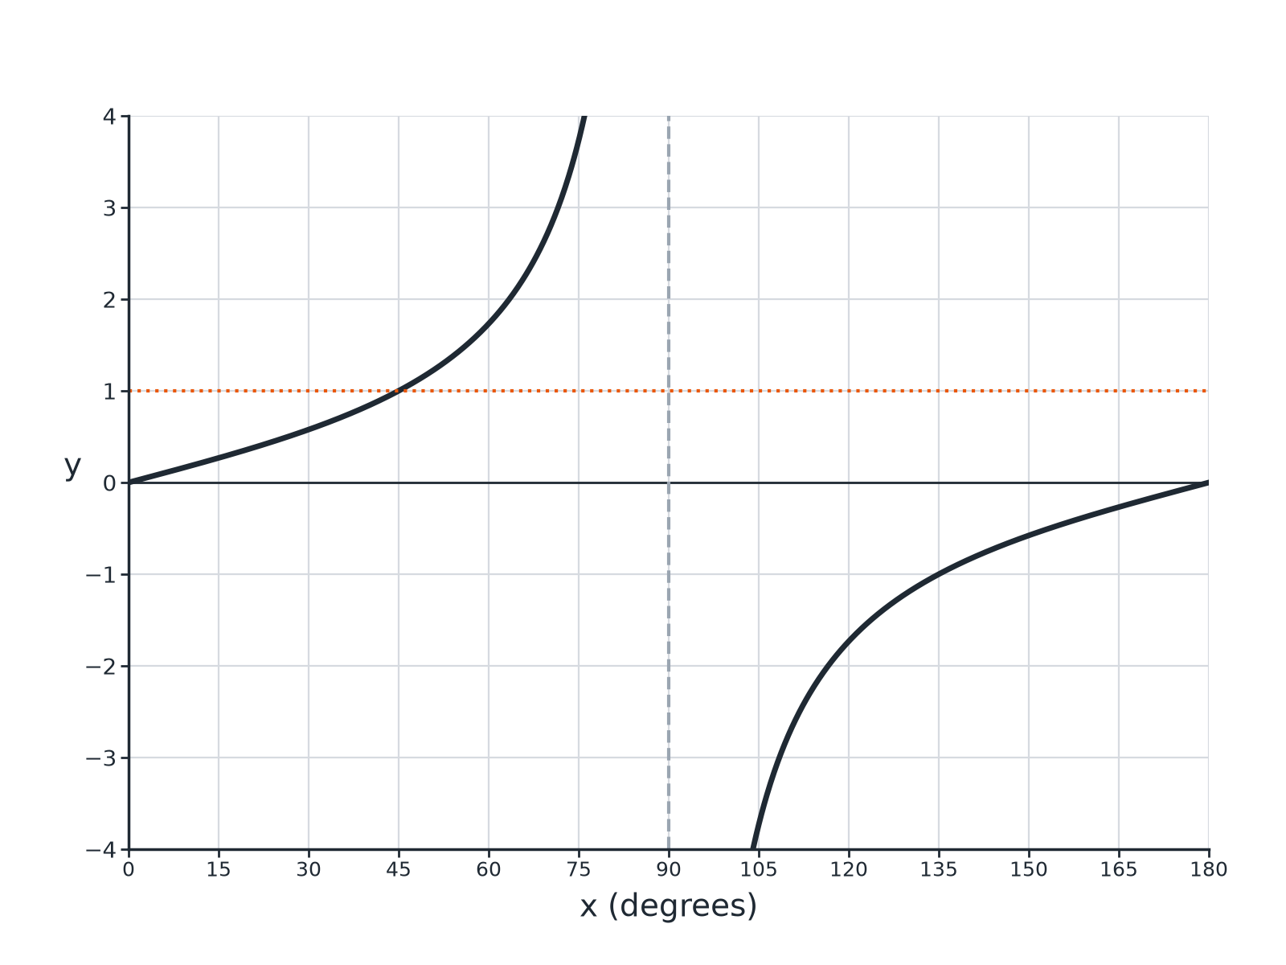
EDEXCEL GCSE MATHS · HIGHER
Question 3 · 3 marks · Use the graph
The graph shows y = tan x for 0° ≤ x ≤ 180°. Use the graph to solve tan x = 1, and write down the equation of the asymptote. (3 marks)
More trigonometry
openrevise.com
Lesson 4 of 9

Slide 24
EDEXCEL GCSE MATHS · HIGHER
Question 3 · mark scheme
3 marks available. Award a mark for each point made.
45
B1
x = 90
B1
Equation written in the form x = 90
B1
More trigonometry
openrevise.com
Lesson 4 of 9

Slide 25
EDEXCEL GCSE MATHS · HIGHER
Question 4 · 3 marks · Solve
“
Solve tan x = −2 for 0° ≤ x ≤ 360°. Give your answers correct to 1 decimal place.
HOW TO ANSWER IT
Command word: Solve. Worth 3 marks, so plan before writing.
More trigonometry
openrevise.com
Lesson 4 of 9

Slide 26
EDEXCEL GCSE MATHS · HIGHER
Question 4 · mark scheme
3 marks available. Award a mark for each point made.
tan ⁻¹(−2) = −63.4°
B1
−63.4 + 180 or −63.4 + 360
M1
Both answers
A1
More trigonometry
openrevise.com
Lesson 4 of 9

Slide 27
EDEXCEL GCSE MATHS · HIGHER
Question 5 · 2 marks · Explain
“
Explain why tan 90° has no value.
HOW TO ANSWER IT
Command word: Explain. Worth 2 marks, so plan before writing.
More trigonometry
openrevise.com
Lesson 4 of 9

Slide 28
EDEXCEL GCSE MATHS · HIGHER
Question 5 · mark scheme
2 marks available. Award a mark for each point made.
Refers to the asymptote or the graph
M1
Values grow without limit
C1
More trigonometry
openrevise.com
Lesson 4 of 9

Slide 29
EDEXCEL GCSE MATHS · HIGHER
Question 6 · 2 marks · Write down
“
tan 30°= 0.58 (to 2 decimal places). Write down another angle between 0° and 360° with tangent 0.58.
HOW TO ANSWER IT
Command word: Write down. Worth 2 marks, so plan before writing.
More trigonometry
openrevise.com
Lesson 4 of 9

Slide 30
EDEXCEL GCSE MATHS · HIGHER
Question 6 · mark scheme
2 marks available. Award a mark for each point made.
30 + 180
M1
210
A1
More trigonometry
openrevise.com
Lesson 4 of 9

