Slide 1
EDEXCEL GCSE MATHS · HIGHER
Calculating areas and the sine rule
More trigonometry
Lesson 5 of 9
openrevise.com

Slide 2

EDEXCEL GCSE MATHS · HIGHER
Warm-up
Answer each one, then check.
1
What is the area of a triangle?
2
What do the angles in a triangle add up to?
3
What is sin ⁻¹(0.5)?
4
Which side is opposite the right angle?
5
What does SOH CAH TOA help with?
More trigonometry
openrevise.com
Lesson 5 of 9

Slide 3
EDEXCEL GCSE MATHS · HIGHER
Warm-up - Answers
What is the area of a triangle?
½ × base × height
1
What do the angles in a triangle add up to?
180°
2
What is sin ⁻¹(0.5)?
30°
3
Which side is opposite the right angle?
The hypotenuse
4
What does SOH CAH TOA help with?
Right-angled triangles only
5
More trigonometry
openrevise.com
Lesson 5 of 9

Slide 4

EDEXCEL GCSE MATHS · HIGHER
Learning Objectives
Label a triangle with lower-case sides opposite capital angles.
1
Find the area of any triangle using ½absin C.
2
Use the sine rule to find a missing side.
3
Use the sine rule to find a missing angle.
4
More trigonometry
openrevise.com
Lesson 5 of 9

Slide 5

EDEXCEL GCSE MATHS · HIGHER
SINE RULE
In any triangle, the sides and the sines of their opposite angles are in proportion.
a/(sin A) = b/(sin B) = c/(sin C). Flip it to find an angle: (sin A)/a = (sin B)/b.
More trigonometry
openrevise.com
Lesson 5 of 9

Slide 6
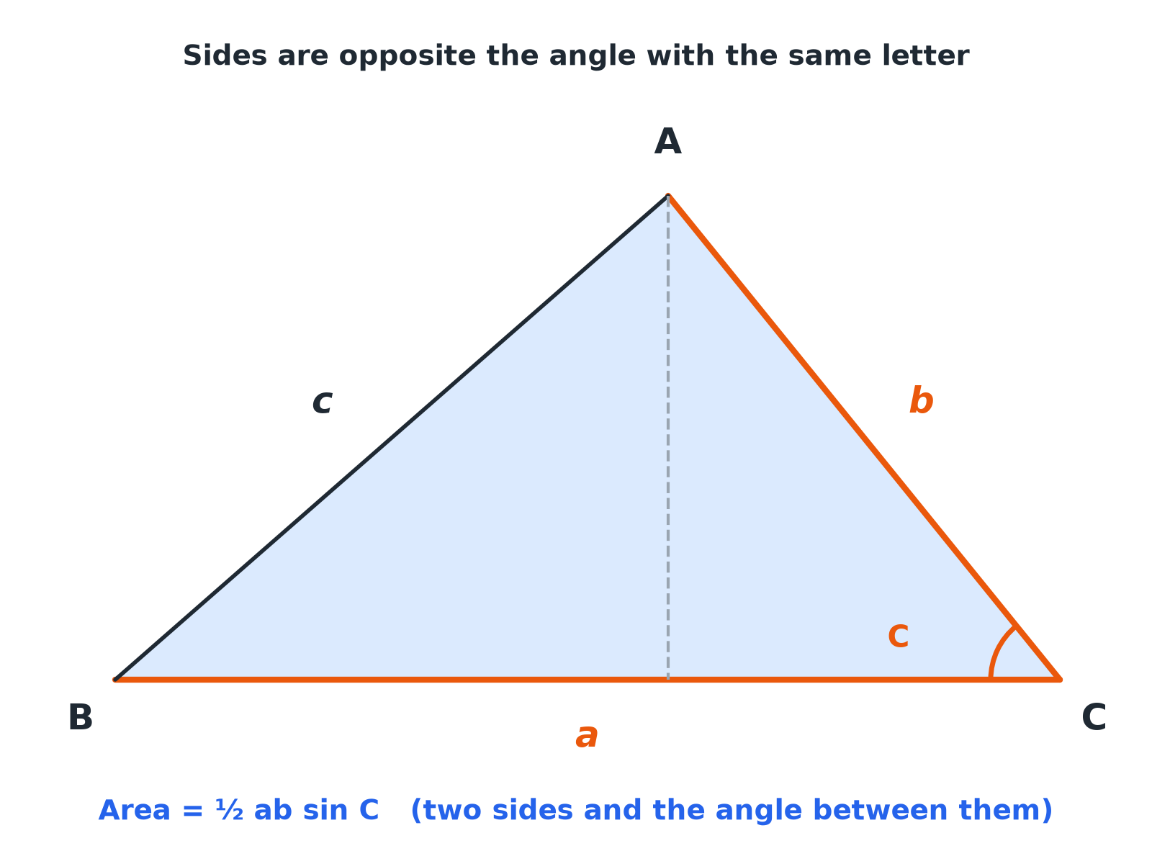

EDEXCEL GCSE MATHS · HIGHER
Labelling a Triangle
Side a is opposite angle A, and so on. Area uses two sides and the angle between them.
More trigonometry
openrevise.com
Lesson 5 of 9

Slide 7

EDEXCEL GCSE MATHS · HIGHER
Which Formula?
Area
½absin C: two sides and the angle between them.
Sine rule (side)
Two angles and a side, need another side.
Sine rule (angle)
Two sides and a non-included angle, need an angle.
Neither
Three sides, or two sides and the included angle: use the cosine rule (next lesson).
More trigonometry
openrevise.com
Lesson 5 of 9

Slide 8

EDEXCEL GCSE MATHS · HIGHER
Area of a Triangle
Find the area of a triangle with sides a = 8 cm and b = 11 cm and angle C = 50° between them. Give your answer to 3 significant figures.
Write the formula
Area = ½absin C
1
Substitute
½ × 8 × 11 × sin 50°
2
Work out
44 × 0.7660 = 33.7
3
ANSWER
Area = 33.7 cm²
More trigonometry
openrevise.com
Lesson 5 of 9

Slide 9
EDEXCEL GCSE MATHS · HIGHER
Sine Rule: Finding a Side
In triangle ABC, A = 40°, B = 65° and a = 8 cm. Find b.
Set up
b/(sin 65°) = 8/(sin 40°)
1
Rearrange
b = (8 × sin 65°)/(sin 40°)
2
Work out
b = 11.28
3
ANSWER
b = 11.3 cm (3 s.f.)
More trigonometry
openrevise.com
Lesson 5 of 9

Slide 10
EDEXCEL GCSE MATHS · HIGHER
Sine Rule: Finding an Angle
In triangle ABC, a = 7 cm, b = 9 cm and angle A = 35°. Find angle B.
Set up
(sin B)/9 = (sin 35°)/7
1
Rearrange
sin B = (9 × sin 35°)/7 = 0.7375
2
Inverse sine
B = sin ⁻¹(0.7375) = 47.5°
3
ANSWER
B = 47.5° (1 d.p.)
More trigonometry
openrevise.com
Lesson 5 of 9

Slide 11

EDEXCEL GCSE MATHS · HIGHER
Setting Out
Put the unknown on top.
Missing side
Write the rule with sides on top: a/(sin A) = b/(sin B).
Missing angle
Write the rule with sines on top: (sin A)/a = (sin B)/b.
Diagram
Mark which side is opposite which angle before you start.
Check
The biggest angle is opposite the longest side.
More trigonometry
openrevise.com
Lesson 5 of 9

Slide 12

EDEXCEL GCSE MATHS · HIGHER
Key Terms
Sine rule
a/(sin A) = b/(sin B) = c/(sin C).
Opposite
Across the triangle from an angle, not touching it.
Included angle
The angle between two given sides.
Scalene
A triangle with no equal sides.
Vertex
A corner of a shape.
Non-right-angled
A triangle with no 90° angle.
More trigonometry
openrevise.com
Lesson 5 of 9

Slide 13

EDEXCEL GCSE MATHS · HIGHER
YOUR TASK
12 minutes
Choose the Method
For each, say whether you would use the area formula, the sine rule, or neither yet, and why. (a) Two angles and one side, find another side. (b) Two sides and the angle between them, find the area. (c) Three sides, find an angle. (d) Two sides and an angle not between them, find another angle.
List what is given.
1
Choose the formula.
2
WHAT A GOOD ANSWER SHOWS
(a) Sine rule. (b) Area = ½absin C. (c) Neither yet: cosine rule. (d) Sine rule.
More trigonometry
openrevise.com
Lesson 5 of 9
Notes:
Encourage learners to write the known and unknown parts of the triangle first.

Slide 14
EDEXCEL GCSE MATHS · HIGHER
Can I...?
Label sides and angles.
Find a missing side.
Write the area formula.
Find a missing angle.
Find the area of a triangle.
Put the unknown on top.
Write the sine rule.
Check the answer is sensible.
More trigonometry
openrevise.com
Lesson 5 of 9

Slide 15
EDEXCEL GCSE MATHS · HIGHER
Summary & Exam Focus
Area = ½absin C.
Sine rule: a/(sin A) = b/(sin B).
Use the sine rule with two angles and a side, or two sides and a non-included angle.
Check side lengths against angles.
EXAM FOCUS
In triangle ABC, AB = 7 cm, angle B = 40° and angle C = 75°. Work out the length of AC. Give your answer correct to 3 significant figures. (3 marks)
Write the sine rule with the unknown side on top. Keep your calculator in degrees.
openrevise.com

Slide 16
EDEXCEL GCSE MATHS · HIGHER
Exam Practice: Areas and the sine rule
Answer all questions. Show your working. · 30 minutes
Question 1 · 3 marks · Work out
In triangle ABC, AB = 7 cm, angle ABC = 40° and angle ACB = 75°. Work out the length of AC. Give your answer correct to 3 significant…
Question 2 · 3 marks · Work out
In triangle ABC, angle A = 52°, angle B = 71° and BC = 9.4 cm. Work out the length of AC. Give your answer correct to 3 significant figures.
Question 3 · 3 marks · Work out
In triangle ABC, BC = 7 cm, AC = 9 cm and angle BAC = 35°. Work out the size of angle ABC. Give your answer correct to 1 decimal place…
More trigonometry
openrevise.com
Lesson 5 of 9

Slide 17
EDEXCEL GCSE MATHS · HIGHER
Exam Practice: Areas and the sine rule (cont.)
Question 4 · 2 marks · Work out
A triangle has two sides of length 9.5 cm and 6.2 cm with an angle of 112° between them. Work out the area of the triangle. Give your…
Question 5 · 4 marks · Work out
The area of a triangle is 25 cm². Two of its sides are 5 cm and 10 cm and the angle between them is acute. Work out the size of the angle…
Question 6 · 3 marks · Explain
In a triangle, angle A = 30°, a = 6 cm and b = 10 cm. Show that sin B = 5/6.
More trigonometry
openrevise.com
Lesson 5 of 9

Slide 18
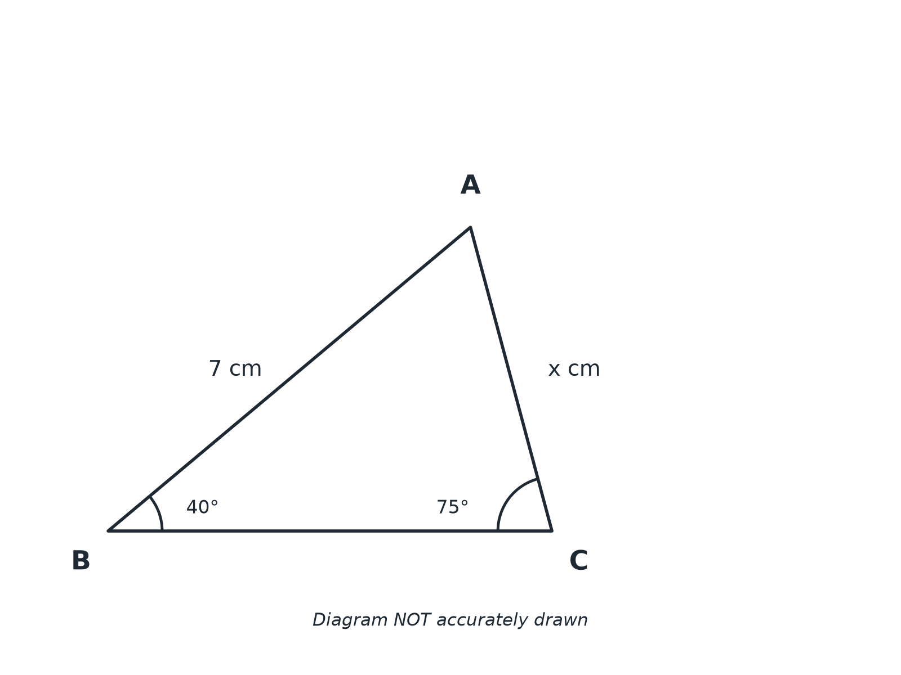
EDEXCEL GCSE MATHS · HIGHER
Question 1 · 3 marks · Work out
In triangle ABC, AB = 7 cm, angle ABC = 40° and angle ACB = 75°. Work out the length of AC. Give your answer correct to 3 significant figures. (3 marks)
More trigonometry
openrevise.com
Lesson 5 of 9

Slide 19
EDEXCEL GCSE MATHS · HIGHER
Question 1 · mark scheme
3 marks available. Award a mark for each point made.
AC/(sin 40°) = 7/(sin 75°)
M1
(7 × sin 40°)/(sin 75°)
M1
4.66
A1
More trigonometry
openrevise.com
Lesson 5 of 9

Slide 20
EDEXCEL GCSE MATHS · HIGHER
Question 2 · 3 marks · Work out
“
In triangle ABC, angle A = 52°, angle B = 71° and BC = 9.4 cm. Work out the length of AC. Give your answer correct to 3 significant figures.
HOW TO ANSWER IT
Command word: Work out. Worth 3 marks, so plan before writing.
More trigonometry
openrevise.com
Lesson 5 of 9

Slide 21
EDEXCEL GCSE MATHS · HIGHER
Question 2 · mark scheme
3 marks available. Award a mark for each point made.
AC/(sin 71°) = 9.4/(sin 52°)
M1
(9.4 × sin 71°)/(sin 52°)
M1
11.3
A1
More trigonometry
openrevise.com
Lesson 5 of 9

Slide 22
EDEXCEL GCSE MATHS · HIGHER
Question 3 · 3 marks · Work out
“
In triangle ABC, BC = 7 cm, AC = 9 cm and angle BAC = 35°. Work out the size of angle ABC. Give your answer correct to 1 decimal place. (Angle ABC is acute.)
HOW TO ANSWER IT
Command word: Work out. Worth 3 marks, so plan before writing.
More trigonometry
openrevise.com
Lesson 5 of 9

Slide 23
EDEXCEL GCSE MATHS · HIGHER
Question 3 · mark scheme
3 marks available. Award a mark for each point made.
(sin B)/9 = (sin 35°)/7
M1
sin B = 0.7375...
M1
47.5
A1
More trigonometry
openrevise.com
Lesson 5 of 9

Slide 24
EDEXCEL GCSE MATHS · HIGHER
Question 4 · 2 marks · Work out
“
A triangle has two sides of length 9.5 cm and 6.2 cm with an angle of 112° between them. Work out the area of the triangle. Give your answer correct to 3 significant figures.
HOW TO ANSWER IT
Command word: Work out. Worth 2 marks, so plan before writing.
More trigonometry
openrevise.com
Lesson 5 of 9

Slide 25
EDEXCEL GCSE MATHS · HIGHER
Question 4 · mark scheme
2 marks available. Award a mark for each point made.
½ × 9.5 × 6.2 × sin 112°
M1
27.3
A1
More trigonometry
openrevise.com
Lesson 5 of 9

Slide 26
EDEXCEL GCSE MATHS · HIGHER
Question 5 · 4 marks · Work out
“
The area of a triangle is 25 cm². Two of its sides are 5 cm and 10 cm and the angle between them is acute. Work out the size of the angle between these two sides. Give your answer correct to 1 decimal place.
HOW TO ANSWER IT
Command word: Work out. Worth 4 marks, so plan before writing.
More trigonometry
openrevise.com
Lesson 5 of 9

Slide 27
EDEXCEL GCSE MATHS · HIGHER
Question 5 · mark scheme
4 marks available. Award a mark for each point made.
½ × 5 × 10 × sin C = 25
M1
25 sin C = 25
M1
sin C = 1
A1
90.0
A1
More trigonometry
openrevise.com
Lesson 5 of 9

Slide 28
EDEXCEL GCSE MATHS · HIGHER
Question 6 · 3 marks · Explain
“
In a triangle, angle A = 30°, a = 6 cm and b = 10 cm. Show that sin B = 5/6.
HOW TO ANSWER IT
Command word: Explain. Worth 3 marks, so plan before writing.
More trigonometry
openrevise.com
Lesson 5 of 9

Slide 29
EDEXCEL GCSE MATHS · HIGHER
Question 6 · mark scheme
3 marks available. Award a mark for each point made.
Sine rule set up
M1
sin 30°= 0.5
M1
Completes the proof
A1
More trigonometry
openrevise.com
Lesson 5 of 9

