Slide 1
EDEXCEL GCSE MATHS · HIGHER
The cosine rule and 2D trigonometric problems
More trigonometry
Lesson 6 of 9
openrevise.com

Slide 2

EDEXCEL GCSE MATHS · HIGHER
Warm-up
Answer each one, then check.
1
What is cos 60°?
2
What is Pythagoras' theorem?
3
What is the sine rule?
4
What is a bearing?
5
What is cos ⁻¹(0.5)?
More trigonometry
openrevise.com
Lesson 6 of 9

Slide 3
EDEXCEL GCSE MATHS · HIGHER
Warm-up - Answers
What is cos 60°?
0.5
1
What is Pythagoras' theorem?
a² + b² = c²
2
What is the sine rule?
a/(sin A) = b/(sin B)
3
What is a bearing?
An angle measured clockwise from north, with three figures
4
What is cos ⁻¹(0.5)?
60°
5
More trigonometry
openrevise.com
Lesson 6 of 9

Slide 4

EDEXCEL GCSE MATHS · HIGHER
Learning Objectives
Use the cosine rule to find a missing side.
1
Rearrange the cosine rule to find a missing angle.
2
Decide between the sine rule, cosine rule and right-angled trigonometry.
3
Solve 2D problems, including bearings.
4
More trigonometry
openrevise.com
Lesson 6 of 9

Slide 5

EDEXCEL GCSE MATHS · HIGHER
COSINE RULE
The cosine rule links three sides and one angle: it is Pythagoras with a correction.
a² = b² + c² − 2bccos A. To find an angle: cos A = (b² + c² − a²)/2bc.
More trigonometry
openrevise.com
Lesson 6 of 9

Slide 6
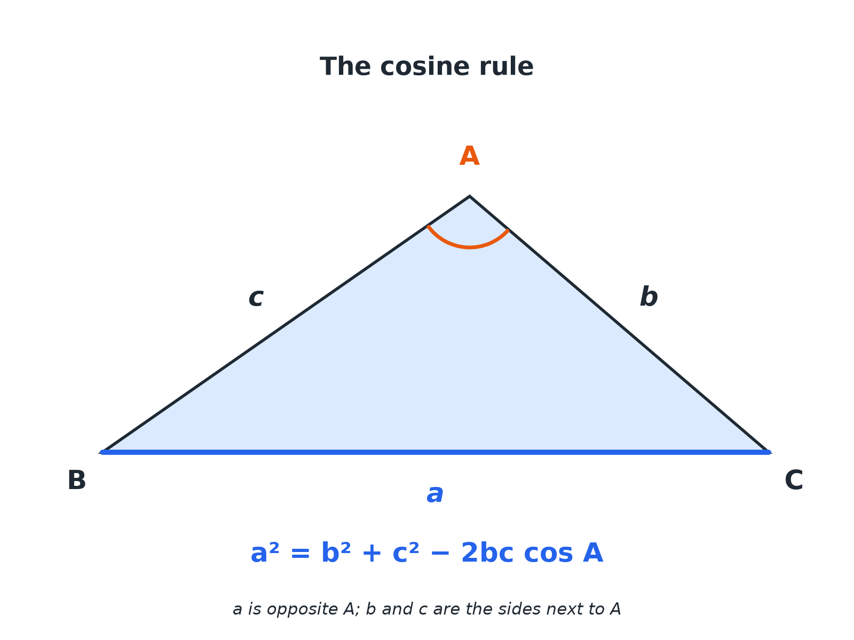

EDEXCEL GCSE MATHS · HIGHER
The Cosine Rule
The angle in the formula is opposite the side you are finding.
More trigonometry
openrevise.com
Lesson 6 of 9

Slide 7

EDEXCEL GCSE MATHS · HIGHER
Which Rule?
USE THE SINE RULE WHEN...
USE THE COSINE RULE WHEN...
• You have two angles and a side.
• You have two sides and an angle not between them.
• You have a matching pair (a side and its opposite angle).
• You have two sides and the angle between them.
• You have all three sides.
• You do not have a matching pair.
More trigonometry
openrevise.com
Lesson 6 of 9

Slide 8

EDEXCEL GCSE MATHS · HIGHER
Cosine Rule: Finding a Side
In triangle ABC, b = 7 cm, c = 9 cm and angle A = 60°. Find a.
Write the rule
a² = b² + c² − 2bccos A
1
Substitute
a² = 7² + 9² − 2 × 7 × 9 × cos 60°
2
Work out
a² = 49 + 81 − 63 = 67
3
Square root
a = 8.19
4
ANSWER
a = 8.19 cm (3 s.f.)
More trigonometry
openrevise.com
Lesson 6 of 9

Slide 9
EDEXCEL GCSE MATHS · HIGHER
Cosine Rule: Finding an Angle
A triangle has sides 5 cm, 7 cm and 9 cm. Find the largest angle.
Largest angle is opposite 9
a = 9, b = 5, c = 7
1
Rearranged rule
cos A = (5² + 7² − 9²)/(2 × 5 × 7)
2
Work out
cos A = (−7)/70 = −0.1
3
Inverse cosine
A = 95.7°
4
ANSWER
Largest angle = 95.7° (1 d.p.)
More trigonometry
openrevise.com
Lesson 6 of 9

Slide 10
EDEXCEL GCSE MATHS · HIGHER
A Bearings Problem
A ship sails 12 km on a bearing of 040° and then 9 km on a bearing of 130°. How far is it from its starting point?
Angle between the two legs
130°− 40°= 90°
1
Right-angled triangle
Use Pythagoras
2
Work out
12² + 9² = 144 + 81 = 225
3
Square root
√225 = 15
4
ANSWER
The ship is 15 km from its start.
More trigonometry
openrevise.com
Lesson 6 of 9

Slide 11

EDEXCEL GCSE MATHS · HIGHER
Common Slips
Avoid these.
Subtracting before multiplying
Work out 2bccos A as a whole first, then subtract.
Wrong angle
The angle in the formula is opposite the side on the left-hand side.
Rounding early
Keep the full value until the final step.
Angle over 90
A negative cosine means the angle is obtuse; this is fine.
More trigonometry
openrevise.com
Lesson 6 of 9

Slide 12

EDEXCEL GCSE MATHS · HIGHER
Key Terms
Cosine rule
a² = b² + c² − 2bccos A.
Bearing
A direction measured clockwise from north as three figures.
Included angle
The angle between two given sides.
Obtuse
An angle between 90° and 180°.
Largest angle
The angle opposite the longest side.
Rearrange
Change the subject of a formula.
More trigonometry
openrevise.com
Lesson 6 of 9

Slide 13

EDEXCEL GCSE MATHS · HIGHER
YOUR TASK
12 minutes
Which Rule and Why?
For each triangle, state which rule you would use first. (a) a = 6, b = 8, C = 50°, find c. (b) a = 5, b = 7, c = 9, find A. (c) A = 40°, B = 70°, a = 8, find b. (d) a = 9, b = 12, A = 30°, find B.
Check for a side with its opposite angle.
1
If there is none, use the cosine rule.
2
WHAT A GOOD ANSWER SHOWS
(a) Cosine rule (two sides and the included angle). (b) Cosine rule (three sides). (c) Sine rule. (d) Sine rule.
More trigonometry
openrevise.com
Lesson 6 of 9
Notes:
Discuss what makes a matching pair.

Slide 14
EDEXCEL GCSE MATHS · HIGHER
Can I...?
Write the cosine rule.
Choose sine or cosine rule.
Find a missing side.
Solve a bearings problem.
Rearrange to find an angle.
Avoid rounding too early.
Identify the largest angle.
Check with a sketch.
More trigonometry
openrevise.com
Lesson 6 of 9

Slide 15
EDEXCEL GCSE MATHS · HIGHER
Summary & Exam Focus
a² = b² + c² − 2bccos A.
cos A = (b² + c² − a²)/2bc.
Use cosine rule for SAS and SSS, sine rule when you have a matching pair.
Bearings: measure clockwise from north.
EXAM FOCUS
In triangle PQR, PQ = 8.4 cm, PR = 6.1 cm and angle QPR = 57°. Work out the length of QR. Give your answer correct to 3 significant figures. (3 marks)
Write the rule first, substitute, then use your calculator in one go.
openrevise.com

Slide 16
EDEXCEL GCSE MATHS · HIGHER
Exam Practice: The cosine rule
Answer all questions. Show your working. · 30 minutes
Question 1 · 3 marks · Work out
In triangle PQR, PQ = 8.4 cm, PR = 6.1 cm and angle QPR = 57°. Work out the length of QR. Give your answer correct to 3 significant figures.
Question 2 · 3 marks · Work out
In triangle ABC, AB = 8 cm, AC = 6 cm and angle BAC = 40°. Work out the length of BC. Give your answer correct to 3 significant figures.
Question 3 · 3 marks · Work out
A triangle has sides of length 6 cm, 8 cm and 11 cm. Work out the size of the largest angle. Give your answer correct to 1 decimal place.
More trigonometry
openrevise.com
Lesson 6 of 9

Slide 17
EDEXCEL GCSE MATHS · HIGHER
Exam Practice: The cosine rule (cont.)
Question 4 · 3 marks · Work out
A ship sails 12 km on a bearing of 040°. It then sails 9 km on a bearing of 130°. Work out the distance of the ship from its starting point.
Question 5 · 3 marks · Work out
A triangle has sides of length 7 cm, 8 cm and 9 cm. Work out the size of the smallest angle. Give your answer correct to 1 decimal place.
Question 6 · 2 marks · Explain
In triangle ABC, you are given a, c and angle B. Which rule would you use to find b, the sine rule or the cosine rule? Give a reason.
More trigonometry
openrevise.com
Lesson 6 of 9

Slide 18
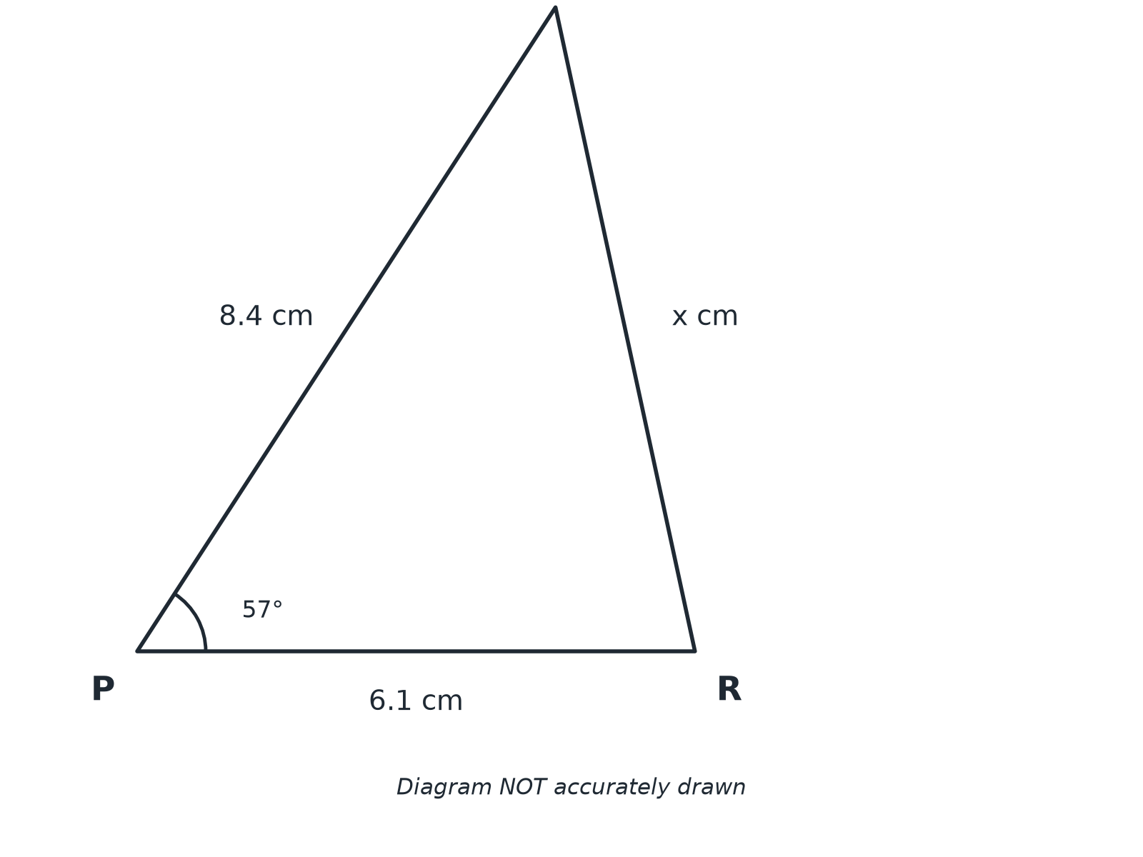
EDEXCEL GCSE MATHS · HIGHER
Question 1 · 3 marks · Work out
In triangle PQR, PQ = 8.4 cm, PR = 6.1 cm and angle QPR = 57°. Work out the length of QR. Give your answer correct to 3 significant figures. (3 marks)
More trigonometry
openrevise.com
Lesson 6 of 9

Slide 19
EDEXCEL GCSE MATHS · HIGHER
Question 1 · mark scheme
3 marks available. Award a mark for each point made.
8.4² + 6.1² − 2 × 8.4 × 6.1 × cos 57°
M1
51.9...
A1
7.21
A1
More trigonometry
openrevise.com
Lesson 6 of 9

Slide 20
EDEXCEL GCSE MATHS · HIGHER
Question 2 · 3 marks · Work out
“
In triangle ABC, AB = 8 cm, AC = 6 cm and angle BAC = 40°. Work out the length of BC. Give your answer correct to 3 significant figures.
HOW TO ANSWER IT
Command word: Work out. Worth 3 marks, so plan before writing.
More trigonometry
openrevise.com
Lesson 6 of 9

Slide 21
EDEXCEL GCSE MATHS · HIGHER
Question 2 · mark scheme
3 marks available. Award a mark for each point made.
6² + 8² − 2 × 6 × 8 × cos 40°
M1
26.4...
A1
5.14
A1
More trigonometry
openrevise.com
Lesson 6 of 9

Slide 22
EDEXCEL GCSE MATHS · HIGHER
Question 3 · 3 marks · Work out
“
A triangle has sides of length 6 cm, 8 cm and 11 cm. Work out the size of the largest angle. Give your answer correct to 1 decimal place.
HOW TO ANSWER IT
Command word: Work out. Worth 3 marks, so plan before writing.
More trigonometry
openrevise.com
Lesson 6 of 9

Slide 23
EDEXCEL GCSE MATHS · HIGHER
Question 3 · mark scheme
3 marks available. Award a mark for each point made.
(6² + 8² − 11²)/(2 × 6 × 8)
M1
−0.21875
A1
102.6
A1
More trigonometry
openrevise.com
Lesson 6 of 9

Slide 24
EDEXCEL GCSE MATHS · HIGHER
Question 4 · 3 marks · Work out
“
A ship sails 12 km on a bearing of 040°. It then sails 9 km on a bearing of 130°. Work out the distance of the ship from its starting point.
HOW TO ANSWER IT
Command word: Work out. Worth 3 marks, so plan before writing.
More trigonometry
openrevise.com
Lesson 6 of 9

Slide 25
EDEXCEL GCSE MATHS · HIGHER
Question 4 · mark scheme
3 marks available. Award a mark for each point made.
Right angle identified
M1
12² + 9² = 225
M1
15
A1
More trigonometry
openrevise.com
Lesson 6 of 9

Slide 26
EDEXCEL GCSE MATHS · HIGHER
Question 5 · 3 marks · Work out
“
A triangle has sides of length 7 cm, 8 cm and 9 cm. Work out the size of the smallest angle. Give your answer correct to 1 decimal place.
HOW TO ANSWER IT
Command word: Work out. Worth 3 marks, so plan before writing.
More trigonometry
openrevise.com
Lesson 6 of 9

Slide 27
EDEXCEL GCSE MATHS · HIGHER
Question 5 · mark scheme
3 marks available. Award a mark for each point made.
(8² + 9² − 7²)/(2 × 8 × 9)
M1
0.666...
A1
48.2
A1
More trigonometry
openrevise.com
Lesson 6 of 9

Slide 28
EDEXCEL GCSE MATHS · HIGHER
Question 6 · 2 marks · Explain
“
In triangle ABC, you are given a, c and angle B. Which rule would you use to find b, the sine rule or the cosine rule? Give a reason.
HOW TO ANSWER IT
Command word: Explain. Worth 2 marks, so plan before writing.
More trigonometry
openrevise.com
Lesson 6 of 9

Slide 29
EDEXCEL GCSE MATHS · HIGHER
Question 6 · mark scheme
2 marks available. Award a mark for each point made.
Cosine rule
B1
Two sides and the included angle
B1
More trigonometry
openrevise.com
Lesson 6 of 9

