Slide 1

EDEXCEL GCSE MATHS · HIGHER
Transforming trigonometric graphs 2
More trigonometry
Lesson 9 of 9
openrevise.com

Slide 2

EDEXCEL GCSE MATHS · HIGHER
Warm-up
Answer each one, then check.
1
What is the period of y = sin x?
2
Where is the first maximum of y = sin x?
3
What does y = sin x + 2 do to the graph?
4
What is the period of y = tan x?
5
What does y = 3sin x do to the graph?
More trigonometry
openrevise.com
Lesson 9 of 9

Slide 3
EDEXCEL GCSE MATHS · HIGHER
Warm-up - Answers
What is the period of y = sin x?
360°
1
Where is the first maximum of y = sin x?
x = 90°
2
What does y = sin x + 2 do to the graph?
Moves it up 2
3
What is the period of y = tan x?
180°
4
What does y = 3sin x do to the graph?
Stretches it vertically by 3
5
More trigonometry
openrevise.com
Lesson 9 of 9

Slide 4

EDEXCEL GCSE MATHS · HIGHER
Learning Objectives
Describe and sketch y = sin (x + a) and y = cos (x − a).
1
Describe and sketch y = sin ax and y = cos ax.
2
Find the period of y = sin ax.
3
Solve equations such as sin 2x = 0.5.
4
More trigonometry
openrevise.com
Lesson 9 of 9

Slide 5

EDEXCEL GCSE MATHS · HIGHER
HORIZONTAL TRANSFORMATIONS
Changes inside the brackets move or stretch the graph left and right, and often do the opposite of what you expect.
y = f(x + a) translates left by a. y = f(x − a) translates right by a. y = f(ax) stretches horizontally with scale factor 1/a.
More trigonometry
openrevise.com
Lesson 9 of 9

Slide 6
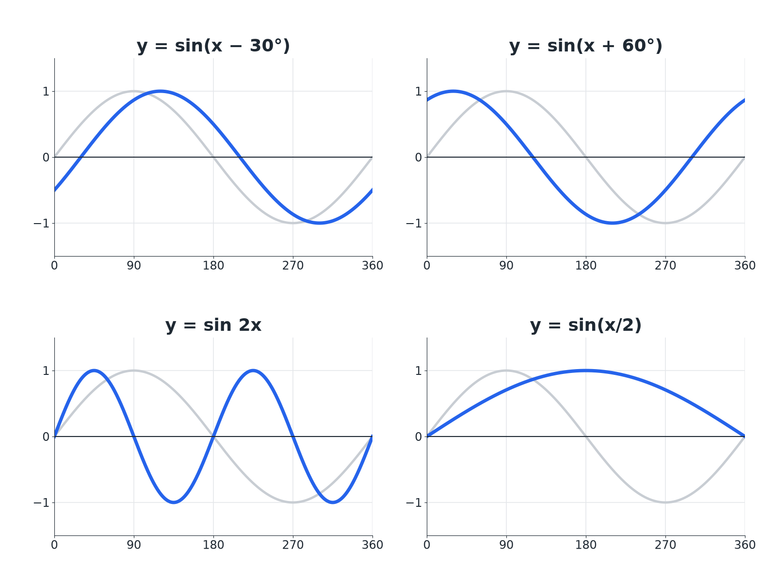

EDEXCEL GCSE MATHS · HIGHER
Four Horizontal Transformations
The faint curve is y equals sine x.
More trigonometry
openrevise.com
Lesson 9 of 9

Slide 7

EDEXCEL GCSE MATHS · HIGHER
Effects on the Graph
Read the change inside the brackets.
Equation
Transformation
Period
y = sin (x − 30°)
Translate right 30
360°
y = sin (x + 60°)
Translate left 60
360°
y = sin 2x
Horizontal stretch, scale factor ½
180°
y = cos 3x
Horizontal stretch, scale factor ⅓
120°
y = sin x/2
Horizontal stretch, scale factor 2
720°
More trigonometry
openrevise.com
Lesson 9 of 9

Slide 8

EDEXCEL GCSE MATHS · HIGHER
A Horizontal Translation
The graph of y = sin x is translated to give y = sin (x + 30°). Describe the translation and find the first maximum.
Plus inside the bracket
Moves left by 30°
1
Maximum was at
90°
2
Now at
90°− 30°= 60°
3
ANSWER
A translation of 30° to the left; the first maximum is at x = 60°.
More trigonometry
openrevise.com
Lesson 9 of 9

Slide 9
EDEXCEL GCSE MATHS · HIGHER
A Horizontal Stretch
State the period of y = cos 3x and how many full waves there are between 0° and 360°.
Period
360°/3 = 120°
1
Number of waves
360/120 = 3
2
ANSWER
The period is 120°, giving 3 full waves.
More trigonometry
openrevise.com
Lesson 9 of 9

Slide 10
EDEXCEL GCSE MATHS · HIGHER
Solving sin 2x = 0.5
Solve sin 2x = 0.5 for 0° ≤ x ≤ 360°.
Range for 2x
0° ≤ 2x ≤ 720°
1
Solve for 2x
2x = 30°, 150°, 390°, 510°
2
Halve
x = 15°, 75°, 195°, 255°
3
ANSWER
x = 15°, 75°, 195°, 255°
More trigonometry
openrevise.com
Lesson 9 of 9

Slide 11

EDEXCEL GCSE MATHS · HIGHER
Inside and Outside the Brackets
OUTSIDE THE BRACKETS: VERTICAL
INSIDE THE BRACKETS: HORIZONTAL
• y = asin x: stretch in y.
• y = sin x + a: translate up.
• Does what it looks like.
• y = sin (x + a): translate left.
• y = sin ax: stretch in x by 1/a.
• Does the opposite of what it looks like.
More trigonometry
openrevise.com
Lesson 9 of 9

Slide 12

EDEXCEL GCSE MATHS · HIGHER
Key Terms
Period
The length after which the graph repeats.
Horizontal stretch
A stretch that changes the x-values.
Translation
A slide left, right, up or down.
Scale factor
The number the x-values are multiplied by.
Full wave
One complete cycle of the graph.
Phase shift
A horizontal translation of a trig graph.
More trigonometry
openrevise.com
Lesson 9 of 9

Slide 13

EDEXCEL GCSE MATHS · HIGHER
YOUR TASK
12 minutes
Period Detective
State the period of each graph. (a) y = sin 4x (b) y = cos x/3 (c) y = tan 2x. Then say where the first maximum of (a) is.
Divide the normal period by the number.
1
Divide the first maximum position in the same way.
2
WHAT A GOOD ANSWER SHOWS
(a) 90°. (b) 1080°. (c) 90° (tangent's normal period is 180°, so divide by 2). First maximum of (a) at x = 22.5°.
More trigonometry
openrevise.com
Lesson 9 of 9
Notes:
The period is always the normal period divided by the number multiplying x.

Slide 14

EDEXCEL GCSE MATHS · HIGHER
Can I...?
Describe y = sin(x + a).
Find a first maximum.
Describe y = sin(x - a).
Sketch a transformed graph.
Describe y = sin ax.
Solve sin 2x = k.
Find the period.
Find a from a graph.
More trigonometry
openrevise.com
Lesson 9 of 9

Slide 15
EDEXCEL GCSE MATHS · HIGHER
Summary & Exam Focus
y = f(x + a): translate left by a. y = f(x − a): translate right.
y = f(ax): stretch in x by scale factor 1/a.
Period of sin ax or cos ax: 360°/a.
Solving sin ax = k: extend the range to 360a.
EXAM FOCUS
Solve sin 2x = 0.5 for 0° ≤ x ≤ 360°. (4 marks)
Find the range for the whole bracket first. Then solve, then divide.
openrevise.com

Slide 16
EDEXCEL GCSE MATHS · HIGHER
Exam Practice: Transforming trigonometric graphs 2
Answer all questions. Show your working. · 30 minutes
Question 1 · 2 marks · Find
The graph shows y = cos ax for 0° ≤ x ≤ 360°, where a is a positive whole number. Find the value of a.
Question 2 · 2 marks · Describe
Describe the single transformation that maps the graph of y = sin x onto the graph of y = sin (x − 40°).
Question 3 · 1 mark · Write down
Write down the period of y = sin 4x.
More trigonometry
openrevise.com
Lesson 9 of 9

Slide 17
EDEXCEL GCSE MATHS · HIGHER
Exam Practice: Transforming trigonometric graphs 2 (cont.)
Question 4 · 2 marks · Write down
Write down the coordinates of the first maximum point of y = sin (x − 30°) for x > 0.
Question 5 · 3 marks · Sketch
On a grid, sketch the graph of y = sin 2x for 0° ≤ x ≤ 360°.
Question 6 · 4 marks · Solve
Solve sin 2x = 0.5 for 0° ≤ x ≤ 360°.
More trigonometry
openrevise.com
Lesson 9 of 9

Slide 18
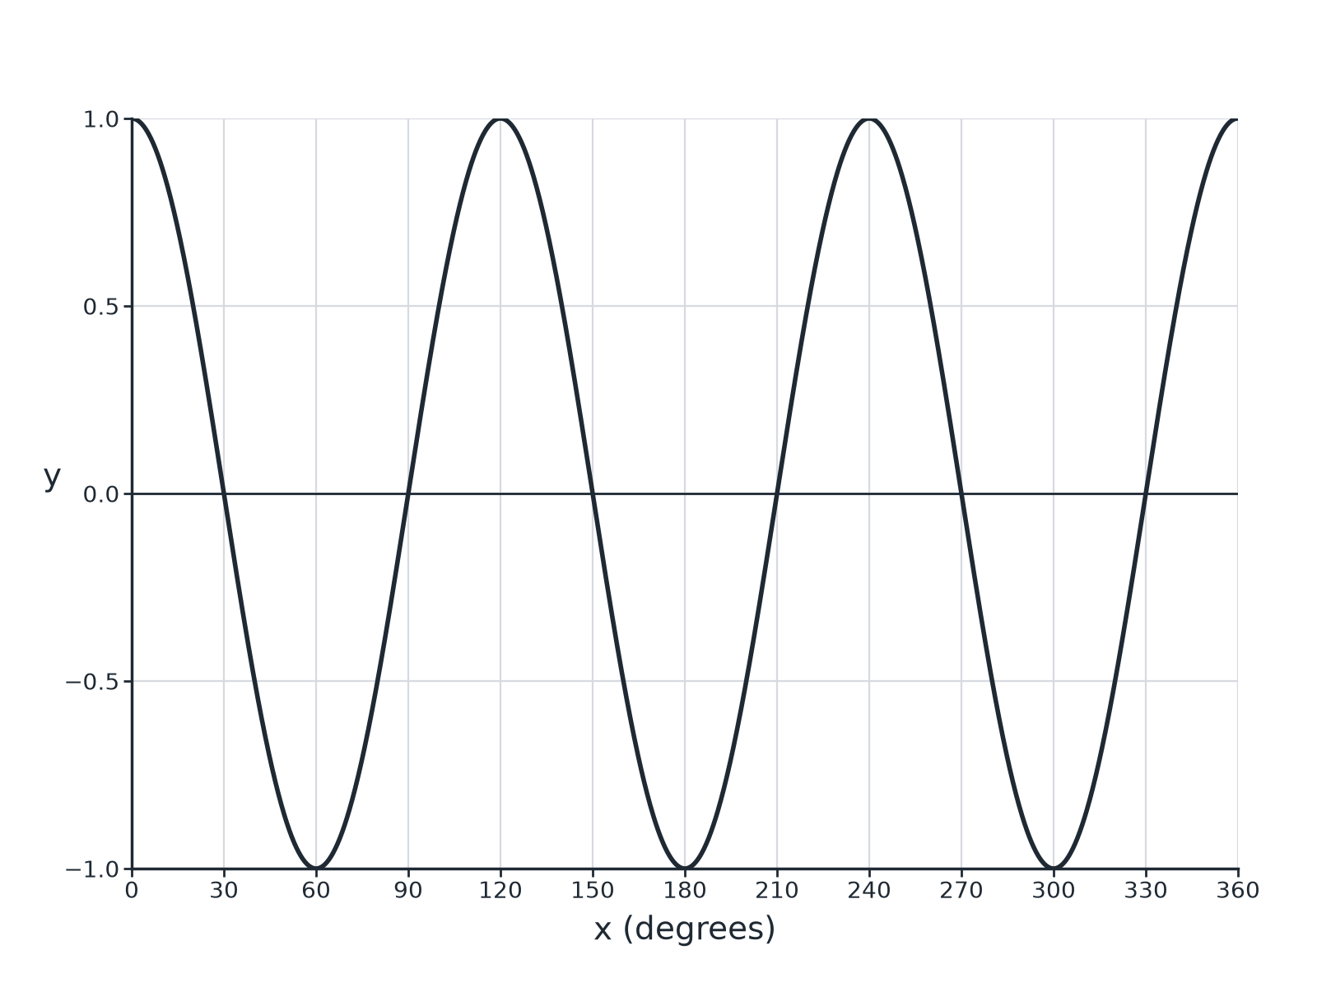
EDEXCEL GCSE MATHS · HIGHER
Question 1 · 2 marks · Find
The graph shows y = cos ax for 0° ≤ x ≤ 360°, where a is a positive whole number. Find the value of a. (2 marks)
More trigonometry
openrevise.com
Lesson 9 of 9

Slide 19
EDEXCEL GCSE MATHS · HIGHER
Question 1 · mark scheme
2 marks available. Award a mark for each point made.
Three waves or period 120°
M1
3
A1
More trigonometry
openrevise.com
Lesson 9 of 9

Slide 20
EDEXCEL GCSE MATHS · HIGHER
Question 2 · 2 marks · Describe
“
Describe the single transformation that maps the graph of y = sin x onto the graph of y = sin (x − 40°).
HOW TO ANSWER IT
Command word: Describe. Worth 2 marks, so plan before writing.
More trigonometry
openrevise.com
Lesson 9 of 9

Slide 21
EDEXCEL GCSE MATHS · HIGHER
Question 2 · mark scheme
2 marks available. Award a mark for each point made.
Translation
M1
40° to the right
A1
More trigonometry
openrevise.com
Lesson 9 of 9

Slide 22
EDEXCEL GCSE MATHS · HIGHER
Question 3 · 1 mark · Write down
“
Write down the period of y = sin 4x.
HOW TO ANSWER IT
Command word: Write down. Worth 1 mark, so plan before writing.
More trigonometry
openrevise.com
Lesson 9 of 9

Slide 23
EDEXCEL GCSE MATHS · HIGHER
Question 3 · mark scheme
1 mark available. Award a mark for each point made.
90
B1
More trigonometry
openrevise.com
Lesson 9 of 9

Slide 24
EDEXCEL GCSE MATHS · HIGHER
Question 4 · 2 marks · Write down
“
Write down the coordinates of the first maximum point of y = sin (x − 30°) for x > 0.
HOW TO ANSWER IT
Command word: Write down. Worth 2 marks, so plan before writing.
More trigonometry
openrevise.com
Lesson 9 of 9

Slide 25
EDEXCEL GCSE MATHS · HIGHER
Question 4 · mark scheme
2 marks available. Award a mark for each point made.
x = 120
B1
y = 1
B1
More trigonometry
openrevise.com
Lesson 9 of 9

Slide 26
EDEXCEL GCSE MATHS · HIGHER
Question 5 · 3 marks · Sketch
“
On a grid, sketch the graph of y = sin 2x for 0° ≤ x ≤ 360°.
HOW TO ANSWER IT
Command word: Sketch. Worth 3 marks, so plan before writing.
More trigonometry
openrevise.com
Lesson 9 of 9

Slide 27
EDEXCEL GCSE MATHS · HIGHER
Question 5 · mark scheme
3 marks available. Award a mark for each point made.
Two full waves
B1
Maximum 1 and minimum −1
B1
Correct roots or turning points
B1
More trigonometry
openrevise.com
Lesson 9 of 9

Slide 28
EDEXCEL GCSE MATHS · HIGHER
Question 6 · 4 marks · Solve
“
Solve sin 2x = 0.5 for 0° ≤ x ≤ 360°.
HOW TO ANSWER IT
Command word: Solve. Worth 4 marks, so plan before writing.
More trigonometry
openrevise.com
Lesson 9 of 9

Slide 29
EDEXCEL GCSE MATHS · HIGHER
Question 6 · mark scheme
4 marks available. Award a mark for each point made.
2x = 30
M1
2x = 150
M1
Extends to 390 and 510
M1
All four answers
A1
More trigonometry
openrevise.com
Lesson 9 of 9

