Slide 1

EDEXCEL GCSE MATHS · FOUNDATION & HIGHER
Box plots
Further statistics
Lesson 3 of 6
openrevise.com

Slide 2

EDEXCEL GCSE MATHS · FOUNDATION & HIGHER
Warm-up
Answer each one, then check.
1
What is the median of 3, 5, 9, 12, 20?
2
What is the range of 3, 5, 9, 12, 20?
3
What is the interquartile range?
4
What is a quartile?
5
Which measure of average is the middle value?
Further statistics
openrevise.com
Lesson 3 of 6

Slide 3
EDEXCEL GCSE MATHS · FOUNDATION & HIGHER
Warm-up - Answers
What is the median of 3, 5, 9, 12, 20?
9
1
What is the range of 3, 5, 9, 12, 20?
17
2
What is the interquartile range?
Upper quartile minus lower quartile
3
What is a quartile?
A value a quarter or three quarters of the way through the data
4
Which measure of average is the middle value?
Median
5
Further statistics
openrevise.com
Lesson 3 of 6

Slide 4

EDEXCEL GCSE MATHS · FOUNDATION & HIGHER
Learning Objectives
Find the minimum, lower quartile, median, upper quartile and maximum.
1
Draw a box plot.
2
Read a box plot.
3
Compare two data sets using a box plot.
4
Further statistics
openrevise.com
Lesson 3 of 6

Slide 5

EDEXCEL GCSE MATHS · FOUNDATION & HIGHER
BOX PLOT
A box plot shows the five-number summary: minimum, lower quartile, median, upper quartile, maximum.
The box shows the middle half of the data. The whiskers go out to the smallest and largest values.
Further statistics
openrevise.com
Lesson 3 of 6

Slide 6
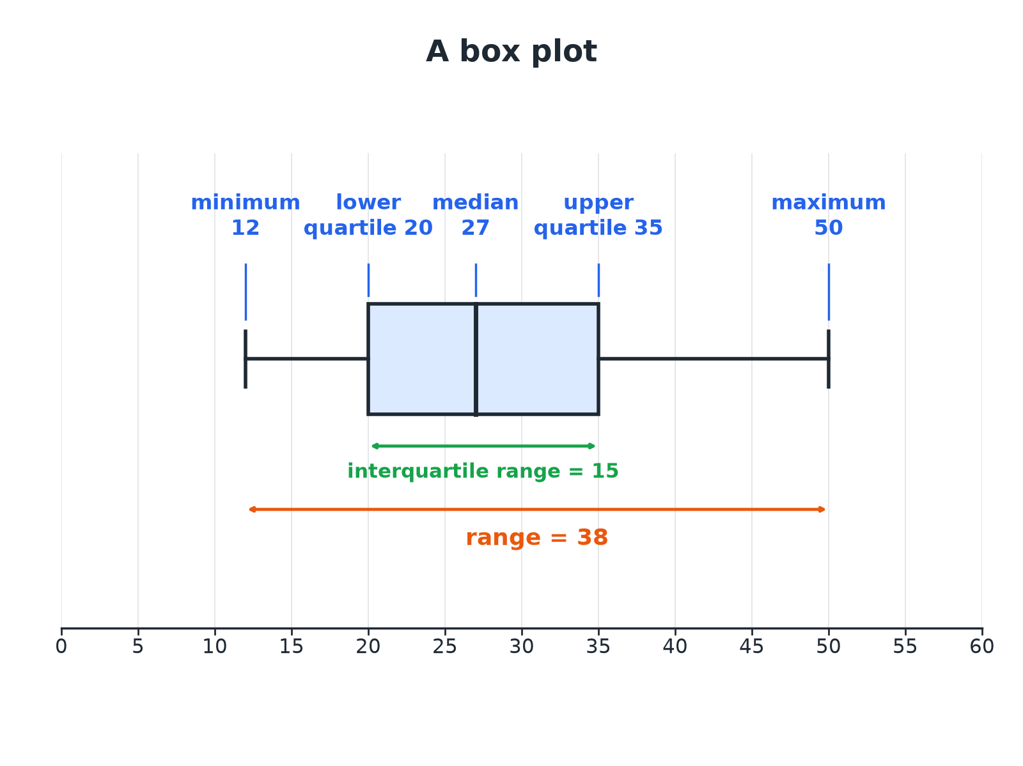

EDEXCEL GCSE MATHS · FOUNDATION & HIGHER
Anatomy of a Box Plot
Half of the data lie in the box.
Further statistics
openrevise.com
Lesson 3 of 6

Slide 7

EDEXCEL GCSE MATHS · FOUNDATION & HIGHER
Five-Number Summary
Find the five-number summary of 5, 8, 10, 12, 13, 15, 19, 22, 26.
Minimum and maximum
5 and 26
1
Median
13 (the 5th of 9 values)
2
Lower quartile
Middle of 5, 8, 10, 12: 9
3
Upper quartile
Middle of 15, 19, 22, 26: 20.5
4
ANSWER
Min 5, LQ 9, median 13, UQ 20.5, max 26.
Further statistics
openrevise.com
Lesson 3 of 6

Slide 8

EDEXCEL GCSE MATHS · FOUNDATION & HIGHER
Positions in Ordered Data
For n values in order.
Value
Position
Median
(n + 1)/2th value
Lower quartile
(n + 1)/4th value
Upper quartile
3(n + 1)/4th value
Interquartile range
UQ − LQ
Further statistics
openrevise.com
Lesson 3 of 6

Slide 9
EDEXCEL GCSE MATHS · FOUNDATION & HIGHER
Comparing Two Box Plots
Class A: min 10, LQ 22, median 30, UQ 40, max 55. Class B: min 15, LQ 25, median 32, UQ 38, max 48. Compare the two classes.
Averages
Median of B (32) is higher than A (30)
1
Spread: IQR
A: 40 − 22 = 18; B: 38 − 25 = 13
2
Range
A: 45; B: 33
3
Conclusion
B has a slightly higher median and is more consistent
4
ANSWER
On average class B did slightly better (median 32 against 30), and B's marks were more consistent (IQR 13 against 18).
Further statistics
openrevise.com
Lesson 3 of 6

Slide 10

EDEXCEL GCSE MATHS · FOUNDATION & HIGHER
Writing a Comparison
Always compare one average and one spread, in context.
An average
Compare the medians.
A spread
Compare the IQRs (or the ranges).
Use the context
"Class B scored higher on average" rather than "B is higher".
Use numbers
Quote the values you compared.
Further statistics
openrevise.com
Lesson 3 of 6

Slide 11

EDEXCEL GCSE MATHS · FOUNDATION & HIGHER
Key Terms
Box plot
A diagram showing the five-number summary.
Five-number summary
Minimum, LQ, median, UQ, maximum.
Whisker
The line from the box out to the minimum or maximum.
Interquartile range
The width of the box.
Range
Maximum minus minimum.
Consistent
Less spread out.
Further statistics
openrevise.com
Lesson 3 of 6

Slide 12

EDEXCEL GCSE MATHS · FOUNDATION & HIGHER
YOUR TASK
10 minutes
Read the Box
A box plot has minimum 4, LQ 10, median 15, UQ 22 and maximum 30. (a) Write down the range. (b) Write down the IQR. (c) The data set has 40 values. Roughly how many are between 10 and 22?
Read the five values.
1
Half of the data lie in the box.
2
WHAT A GOOD ANSWER SHOWS
(a) 30 − 4 = 26. (b) 22 − 10 = 12. (c) About 20, because half of the data are in the box.
Further statistics
openrevise.com
Lesson 3 of 6

Slide 13
EDEXCEL GCSE MATHS · FOUNDATION & HIGHER
Can I...?
Order the data.
Draw a box plot.
Find the median.
Find the range and IQR.
Find the quartiles.
Compare averages.
Write the five-number summary.
Compare spreads.
Further statistics
openrevise.com
Lesson 3 of 6

Slide 14
EDEXCEL GCSE MATHS · FOUNDATION & HIGHER
Summary & Exam Focus
Five values: min, LQ, median, UQ, max.
The box holds the middle 50%.
Compare medians (average) and IQRs (spread).
Give the numbers you use.
EXAM FOCUS
The box plots show the marks of two classes. Compare the distributions. (4 marks)
Compare one average and one spread, and refer to the context.
openrevise.com

