Slide 1

EDEXCEL GCSE MATHS · HIGHER
Drawing histograms
Further statistics
Lesson 4 of 6
openrevise.com

Slide 2

EDEXCEL GCSE MATHS · HIGHER
Warm-up
Answer each one, then check.
1
What is the width of the class 10 < t ≤ 30?
2
Work out 30 ÷ 20.
3
What is a frequency table?
4
How does a bar chart differ from a histogram?
5
Write 12 ÷ 10 as a decimal.
Further statistics
openrevise.com
Lesson 4 of 6

Slide 3
EDEXCEL GCSE MATHS · HIGHER
Warm-up - Answers
What is the width of the class 10 < t ≤ 30?
20
1
Work out 30 ÷ 20.
1.5
2
What is a frequency table?
A table of how often values occur
3
How does a bar chart differ from a histogram?
A histogram's bar area shows frequency; classes are continuous
4
Write 12 ÷ 10 as a decimal.
1.2
5
Further statistics
openrevise.com
Lesson 4 of 6

Slide 4

EDEXCEL GCSE MATHS · HIGHER
Learning Objectives
Explain why a histogram uses frequency density.
1
Work out the frequency density for each class.
2
Draw a histogram with unequal class widths.
3
Label the axes correctly.
4
Further statistics
openrevise.com
Lesson 4 of 6

Slide 5

EDEXCEL GCSE MATHS · HIGHER
HISTOGRAM
In a histogram the area of each bar shows the frequency. The height is the frequency density.
frequency density = frequency/(class width). The bars touch and there are no gaps.
Further statistics
openrevise.com
Lesson 4 of 6

Slide 6
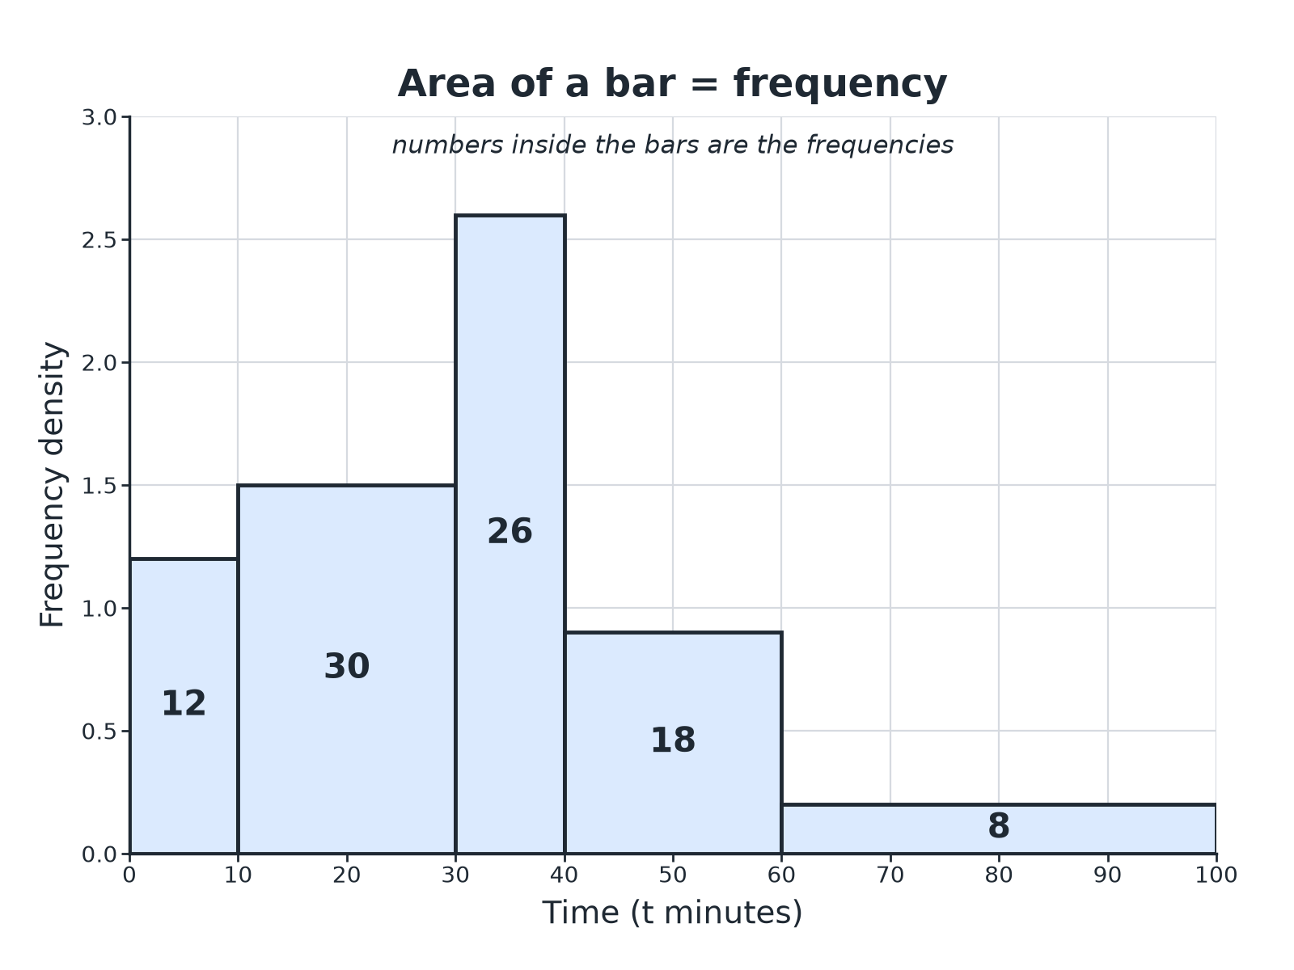

EDEXCEL GCSE MATHS · HIGHER
A Histogram
Wider bars are shorter for the same frequency.
Further statistics
openrevise.com
Lesson 4 of 6

Slide 7

EDEXCEL GCSE MATHS · HIGHER
Working Out Frequency Density
Times taken (t minutes) by 94 customers.
Time
Frequency
Class width
Frequency density
0 < t ≤ 10
12
10
1.2
10 < t ≤ 30
30
20
1.5
30 < t ≤ 40
26
10
2.6
40 < t ≤ 60
18
20
0.9
60 < t ≤ 100
8
40
0.2
Further statistics
openrevise.com
Lesson 4 of 6

Slide 8

EDEXCEL GCSE MATHS · HIGHER
Drawing a Histogram
Follow the steps.
1
2
3
4
5
Work out the class widths
Upper boundary minus lower boundary
Work out the frequency density
Frequency divided by class width
Draw the axes
Data on the horizontal axis, frequency density on the vertical axis
Draw the bars
Bars touch; the height is the frequency density
Label
Add a scale and a label for each axis
Further statistics
openrevise.com
Lesson 4 of 6

Slide 9

EDEXCEL GCSE MATHS · HIGHER
Frequency Density
A class 20 < x ≤ 50 has frequency 60. Work out the frequency density.
Class width
50 − 20 = 30
1
Divide
60/30 = 2
2
ANSWER
The frequency density is 2, so the bar has height 2.
Further statistics
openrevise.com
Lesson 4 of 6

Slide 10
EDEXCEL GCSE MATHS · HIGHER
Completing a Histogram
Age (a years): 0 < a ≤ 10: 8, 10 < a ≤ 20: 20, 20 < a ≤ 40: 36, 40 < a ≤ 60: 30. The first three bars are drawn. Work out the height of the last bar.
Class width
60 − 40 = 20
1
Frequency density
30/20 = 1.5
2
ANSWER
Draw a bar from 40 to 60 with height 1.5.
Further statistics
openrevise.com
Lesson 4 of 6

Slide 11

EDEXCEL GCSE MATHS · HIGHER
Common Mistakes
Watch for these.
Frequency as the height
Use frequency density.
Gaps between bars
The bars must touch.
Widths
Use the actual class width, not the number of classes.
Labels
The vertical axis is "Frequency density", not "Frequency".
Further statistics
openrevise.com
Lesson 4 of 6

Slide 12

EDEXCEL GCSE MATHS · HIGHER
Key Terms
Histogram
A chart where bar area shows frequency.
Frequency density
Frequency divided by class width.
Class width
The upper boundary minus the lower boundary.
Continuous data
Data measured, not counted.
Unequal class widths
Classes of different sizes.
Area
Height multiplied by width.
Further statistics
openrevise.com
Lesson 4 of 6

Slide 13

EDEXCEL GCSE MATHS · HIGHER
YOUR TASK
10 minutes
Find the Density
Work out the frequency density for each class. (a) 0 < w ≤ 5, frequency 15 (b) 5 < w ≤ 15, frequency 40 (c) 15 < w ≤ 35, frequency 30 (d) 35 < w ≤ 60, frequency 10.
Class width first.
1
Then divide.
2
WHAT A GOOD ANSWER SHOWS
(a) 3 (b) 4 (c) 1.5 (d) 0.4
Further statistics
openrevise.com
Lesson 4 of 6

Slide 14
EDEXCEL GCSE MATHS · HIGHER
Can I...?
Find the class widths.
Use unequal class widths.
Work out frequency density.
Complete a partly drawn histogram.
Draw and label axes.
Explain why frequency density is used.
Draw bars that touch.
Avoid common mistakes.
Further statistics
openrevise.com
Lesson 4 of 6

Slide 15
EDEXCEL GCSE MATHS · HIGHER
Summary & Exam Focus
Frequency density = frequency/(class width).
Area of bar = frequency.
Bars touch; classes may have different widths.
The vertical axis is frequency density.
EXAM FOCUS
A table shows the ages of 94 people in classes with different widths. Work out the frequency density for each class and draw the histogram. (4 marks)
Add a frequency density column to the table first.
openrevise.com

