Slide 1

EDEXCEL GCSE MATHS · HIGHER
Drawing histograms
Further statistics
Lesson 4 of 6
openrevise.com

Slide 2

EDEXCEL GCSE MATHS · HIGHER
Warm-up
Answer each one, then check.
1
What is the width of the class 10 < t ≤ 30?
2
Work out 30 ÷ 20.
3
What is a frequency table?
4
How does a bar chart differ from a histogram?
5
Write 12 ÷ 10 as a decimal.
Further statistics
openrevise.com
Lesson 4 of 6

Slide 3
EDEXCEL GCSE MATHS · HIGHER
Warm-up - Answers
What is the width of the class 10 < t ≤ 30?
20
1
Work out 30 ÷ 20.
1.5
2
What is a frequency table?
A table of how often values occur
3
How does a bar chart differ from a histogram?
A histogram's bar area shows frequency; classes are continuous
4
Write 12 ÷ 10 as a decimal.
1.2
5
Further statistics
openrevise.com
Lesson 4 of 6

Slide 4

EDEXCEL GCSE MATHS · HIGHER
Learning Objectives
Explain why a histogram uses frequency density.
1
Work out the frequency density for each class.
2
Draw a histogram with unequal class widths.
3
Label the axes correctly.
4
Further statistics
openrevise.com
Lesson 4 of 6

Slide 5

EDEXCEL GCSE MATHS · HIGHER
HISTOGRAM
In a histogram the area of each bar shows the frequency. The height is the frequency density.
frequency density = frequency/(class width). The bars touch and there are no gaps.
Further statistics
openrevise.com
Lesson 4 of 6

Slide 6
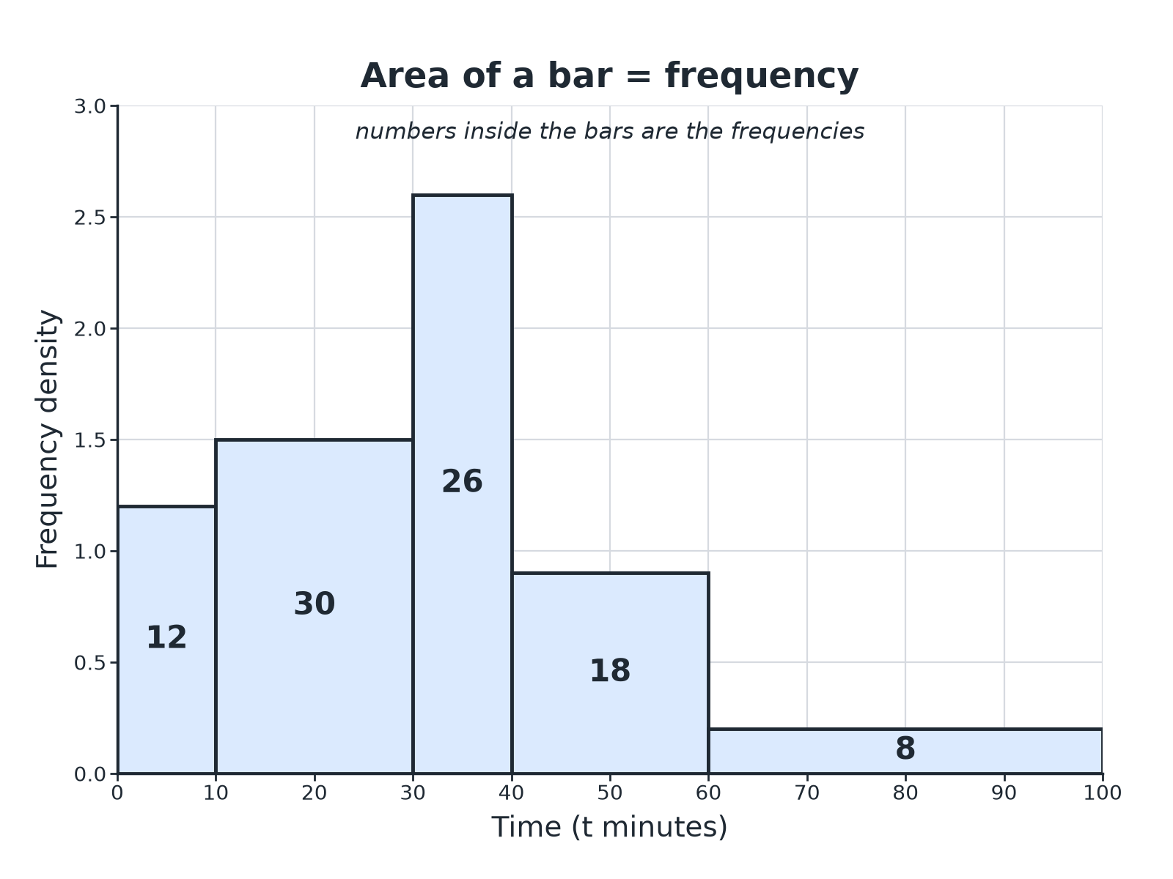

EDEXCEL GCSE MATHS · HIGHER
A Histogram
Wider bars are shorter for the same frequency.
Further statistics
openrevise.com
Lesson 4 of 6

Slide 7

EDEXCEL GCSE MATHS · HIGHER
Working Out Frequency Density
Times taken (t minutes) by 94 customers.
Time
Frequency
Class width
Frequency density
0 < t ≤ 10
12
10
1.2
10 < t ≤ 30
30
20
1.5
30 < t ≤ 40
26
10
2.6
40 < t ≤ 60
18
20
0.9
60 < t ≤ 100
8
40
0.2
Further statistics
openrevise.com
Lesson 4 of 6

Slide 8

EDEXCEL GCSE MATHS · HIGHER
Drawing a Histogram
Follow the steps.
1
2
3
4
5
Work out the class widths
Upper boundary minus lower boundary
Work out the frequency density
Frequency divided by class width
Draw the axes
Data on the horizontal axis, frequency density on the vertical axis
Draw the bars
Bars touch; the height is the frequency density
Label
Add a scale and a label for each axis
Further statistics
openrevise.com
Lesson 4 of 6

Slide 9

EDEXCEL GCSE MATHS · HIGHER
Frequency Density
A class 20 < x ≤ 50 has frequency 60. Work out the frequency density.
Class width
50 − 20 = 30
1
Divide
60/30 = 2
2
ANSWER
The frequency density is 2, so the bar has height 2.
Further statistics
openrevise.com
Lesson 4 of 6

Slide 10
EDEXCEL GCSE MATHS · HIGHER
Completing a Histogram
Age (a years): 0 < a ≤ 10: 8, 10 < a ≤ 20: 20, 20 < a ≤ 40: 36, 40 < a ≤ 60: 30. The first three bars are drawn. Work out the height of the last bar.
Class width
60 − 40 = 20
1
Frequency density
30/20 = 1.5
2
ANSWER
Draw a bar from 40 to 60 with height 1.5.
Further statistics
openrevise.com
Lesson 4 of 6

Slide 11

EDEXCEL GCSE MATHS · HIGHER
Common Mistakes
Watch for these.
Frequency as the height
Use frequency density.
Gaps between bars
The bars must touch.
Widths
Use the actual class width, not the number of classes.
Labels
The vertical axis is "Frequency density", not "Frequency".
Further statistics
openrevise.com
Lesson 4 of 6

Slide 12

EDEXCEL GCSE MATHS · HIGHER
Key Terms
Histogram
A chart where bar area shows frequency.
Frequency density
Frequency divided by class width.
Class width
The upper boundary minus the lower boundary.
Continuous data
Data measured, not counted.
Unequal class widths
Classes of different sizes.
Area
Height multiplied by width.
Further statistics
openrevise.com
Lesson 4 of 6

Slide 13

EDEXCEL GCSE MATHS · HIGHER
YOUR TASK
10 minutes
Find the Density
Work out the frequency density for each class. (a) 0 < w ≤ 5, frequency 15 (b) 5 < w ≤ 15, frequency 40 (c) 15 < w ≤ 35, frequency 30 (d) 35 < w ≤ 60, frequency 10.
Class width first.
1
Then divide.
2
WHAT A GOOD ANSWER SHOWS
(a) 3 (b) 4 (c) 1.5 (d) 0.4
Further statistics
openrevise.com
Lesson 4 of 6
Notes:
Ask which bar will be tallest and why.

Slide 14
EDEXCEL GCSE MATHS · HIGHER
Can I...?
Find the class widths.
Use unequal class widths.
Work out frequency density.
Complete a partly drawn histogram.
Draw and label axes.
Explain why frequency density is used.
Draw bars that touch.
Avoid common mistakes.
Further statistics
openrevise.com
Lesson 4 of 6

Slide 15
EDEXCEL GCSE MATHS · HIGHER
Summary & Exam Focus
Frequency density = frequency/(class width).
Area of bar = frequency.
Bars touch; classes may have different widths.
The vertical axis is frequency density.
EXAM FOCUS
A table shows the ages of 94 people in classes with different widths. Work out the frequency density for each class and draw the histogram. (4 marks)
Add a frequency density column to the table first.
openrevise.com

Slide 16
EDEXCEL GCSE MATHS · HIGHER
Exam Practice: Drawing histograms
Answer all questions. Show your working. · 30 minutes
Question 1 · 3 marks · Complete
The table shows the times, t minutes, taken by 94 customers. Frequencies: 0 < t ≤ 10: 12, 10 < t ≤ 30: 30, 30 < t ≤ 40: 26, 40 < t ≤ 60…
Question 2 · 3 marks · Complete the histogram
The table shows information about the ages, a years, of 94 people: 0 < a ≤ 10: 8, 10 < a ≤ 20: 20, 20 < a ≤ 40: 36, 40 < a ≤ 60: 30…
Question 3 · 2 marks · Work out
A class 5 < x ≤ 25 has frequency 40. Work out the frequency density.
Further statistics
openrevise.com
Lesson 4 of 6

Slide 17
EDEXCEL GCSE MATHS · HIGHER
Exam Practice: Drawing histograms (cont.)
Question 4 · 2 marks · Work out
A histogram bar for the class 10 < x ≤ 14 has a frequency density of 3. Work out the frequency of the class.
Question 5 · 2 marks · Explain
Explain why the height of a bar in a histogram is not the frequency when the class widths are unequal.
Question 6 · 3 marks · Draw
Describe how to draw a histogram from a grouped frequency table with unequal class widths.
Further statistics
openrevise.com
Lesson 4 of 6

Slide 18
EDEXCEL GCSE MATHS · HIGHER
Question 1 · 3 marks · Complete
“
The table shows the times, t minutes, taken by 94 customers. Frequencies: 0 < t ≤ 10: 12, 10 < t ≤ 30: 30, 30 < t ≤ 40: 26, 40 < t ≤ 60: 18, 60 < t ≤ 100: 8. Work out the frequency density for each class.
HOW TO ANSWER IT
Command word: Complete. Worth 3 marks, so plan before writing.
Further statistics
openrevise.com
Lesson 4 of 6

Slide 19
EDEXCEL GCSE MATHS · HIGHER
Question 1 · mark scheme
3 marks available. Award a mark for each point made.
Class widths
M1
At least three correct
M1
All correct
A1
Further statistics
openrevise.com
Lesson 4 of 6

Slide 20
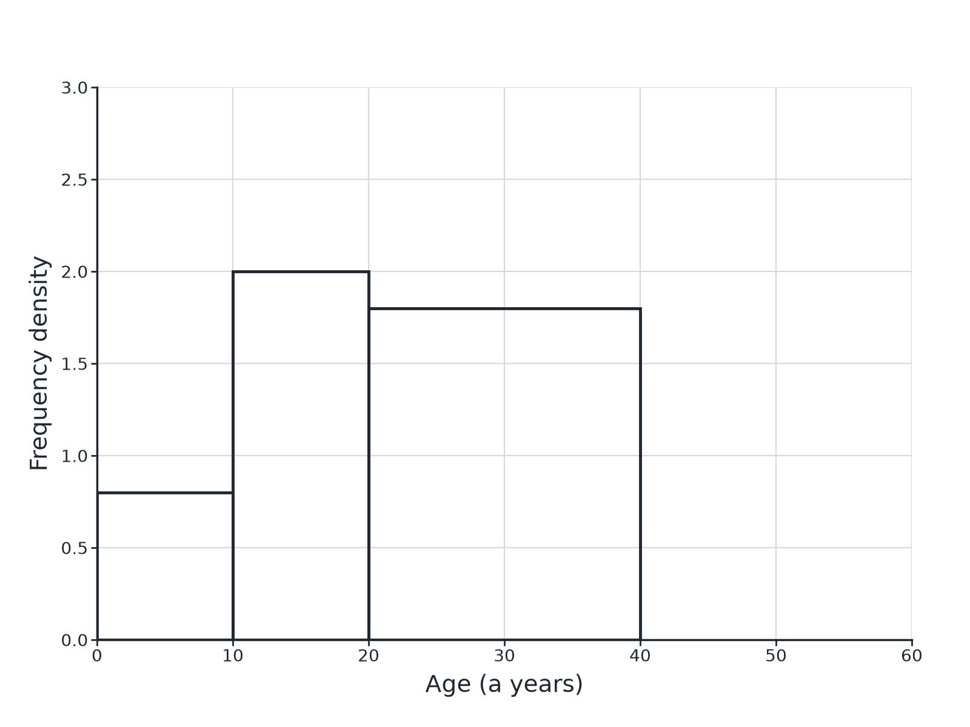
EDEXCEL GCSE MATHS · HIGHER
Question 2 · 3 marks · Complete the histogram
The table shows information about the ages, a years, of 94 people: 0 < a ≤ 10: 8, 10 < a ≤ 20: 20, 20 < a ≤ 40: 36, 40 < a ≤ 60: 30. Complete the histogram. (3 marks)
Further statistics
openrevise.com
Lesson 4 of 6

Slide 21
EDEXCEL GCSE MATHS · HIGHER
Question 2 · mark scheme
3 marks available. Award a mark for each point made.
Frequency density 1.5
M1
Bar from 40 to 60
A1
Height 1.5
A1
Further statistics
openrevise.com
Lesson 4 of 6

Slide 22
EDEXCEL GCSE MATHS · HIGHER
Question 3 · 2 marks · Work out
“
A class 5 < x ≤ 25 has frequency 40. Work out the frequency density.
HOW TO ANSWER IT
Command word: Work out. Worth 2 marks, so plan before writing.
Further statistics
openrevise.com
Lesson 4 of 6

Slide 23
EDEXCEL GCSE MATHS · HIGHER
Question 3 · mark scheme
2 marks available. Award a mark for each point made.
Class width 20
M1
2
A1
Further statistics
openrevise.com
Lesson 4 of 6

Slide 24
EDEXCEL GCSE MATHS · HIGHER
Question 4 · 2 marks · Work out
“
A histogram bar for the class 10 < x ≤ 14 has a frequency density of 3. Work out the frequency of the class.
HOW TO ANSWER IT
Command word: Work out. Worth 2 marks, so plan before writing.
Further statistics
openrevise.com
Lesson 4 of 6

Slide 25
EDEXCEL GCSE MATHS · HIGHER
Question 4 · mark scheme
2 marks available. Award a mark for each point made.
Uses 4 × 3
M1
12
A1
Further statistics
openrevise.com
Lesson 4 of 6

Slide 26
EDEXCEL GCSE MATHS · HIGHER
Question 5 · 2 marks · Explain
“
Explain why the height of a bar in a histogram is not the frequency when the class widths are unequal.
HOW TO ANSWER IT
Command word: Explain. Worth 2 marks, so plan before writing.
Further statistics
openrevise.com
Lesson 4 of 6

Slide 27
EDEXCEL GCSE MATHS · HIGHER
Question 5 · mark scheme
2 marks available. Award a mark for each point made.
Area shows frequency
M1
Frequency density used for the height
C1
Further statistics
openrevise.com
Lesson 4 of 6

Slide 28
EDEXCEL GCSE MATHS · HIGHER
Question 6 · 3 marks · Draw
“
Describe how to draw a histogram from a grouped frequency table with unequal class widths.
HOW TO ANSWER IT
Command word: Draw. Worth 3 marks, so plan before writing.
Further statistics
openrevise.com
Lesson 4 of 6

Slide 29
EDEXCEL GCSE MATHS · HIGHER
Question 6 · mark scheme
3 marks available. Award a mark for each point made.
Frequency density
B1
Axes correctly labelled
B1
Touching bars with correct heights
B1
Further statistics
openrevise.com
Lesson 4 of 6

