Slide 1

EDEXCEL GCSE MATHS · HIGHER
Interpreting histograms
Further statistics
Lesson 5 of 6
openrevise.com

Slide 2

EDEXCEL GCSE MATHS · HIGHER
Warm-up
Answer each one, then check.
1
What is frequency density?
2
Work out 20 × 1.5.
3
What is the midpoint of the class 20 < x ≤ 40?
4
How do you estimate a mean from grouped data?
5
What is the median position for 124 values?
Further statistics
openrevise.com
Lesson 5 of 6

Slide 3
EDEXCEL GCSE MATHS · HIGHER
Warm-up - Answers
What is frequency density?
Frequency divided by class width
1
Work out 20 × 1.5.
30
2
What is the midpoint of the class 20 < x ≤ 40?
30
3
How do you estimate a mean from grouped data?
Add up midpoint times frequency, divide by total frequency
4
What is the median position for 124 values?
The 62nd value
5
Further statistics
openrevise.com
Lesson 5 of 6

Slide 4

EDEXCEL GCSE MATHS · HIGHER
Learning Objectives
Find frequencies from a histogram using area.
1
Estimate the number in part of a class.
2
Estimate the median from a histogram.
3
Estimate the mean from a histogram.
4
Further statistics
openrevise.com
Lesson 5 of 6

Slide 5

EDEXCEL GCSE MATHS · HIGHER
READING A HISTOGRAM
Frequency = frequency density × class width. That is the area of the bar.
To estimate a frequency for part of a class, use the width of just that part.
Further statistics
openrevise.com
Lesson 5 of 6

Slide 6
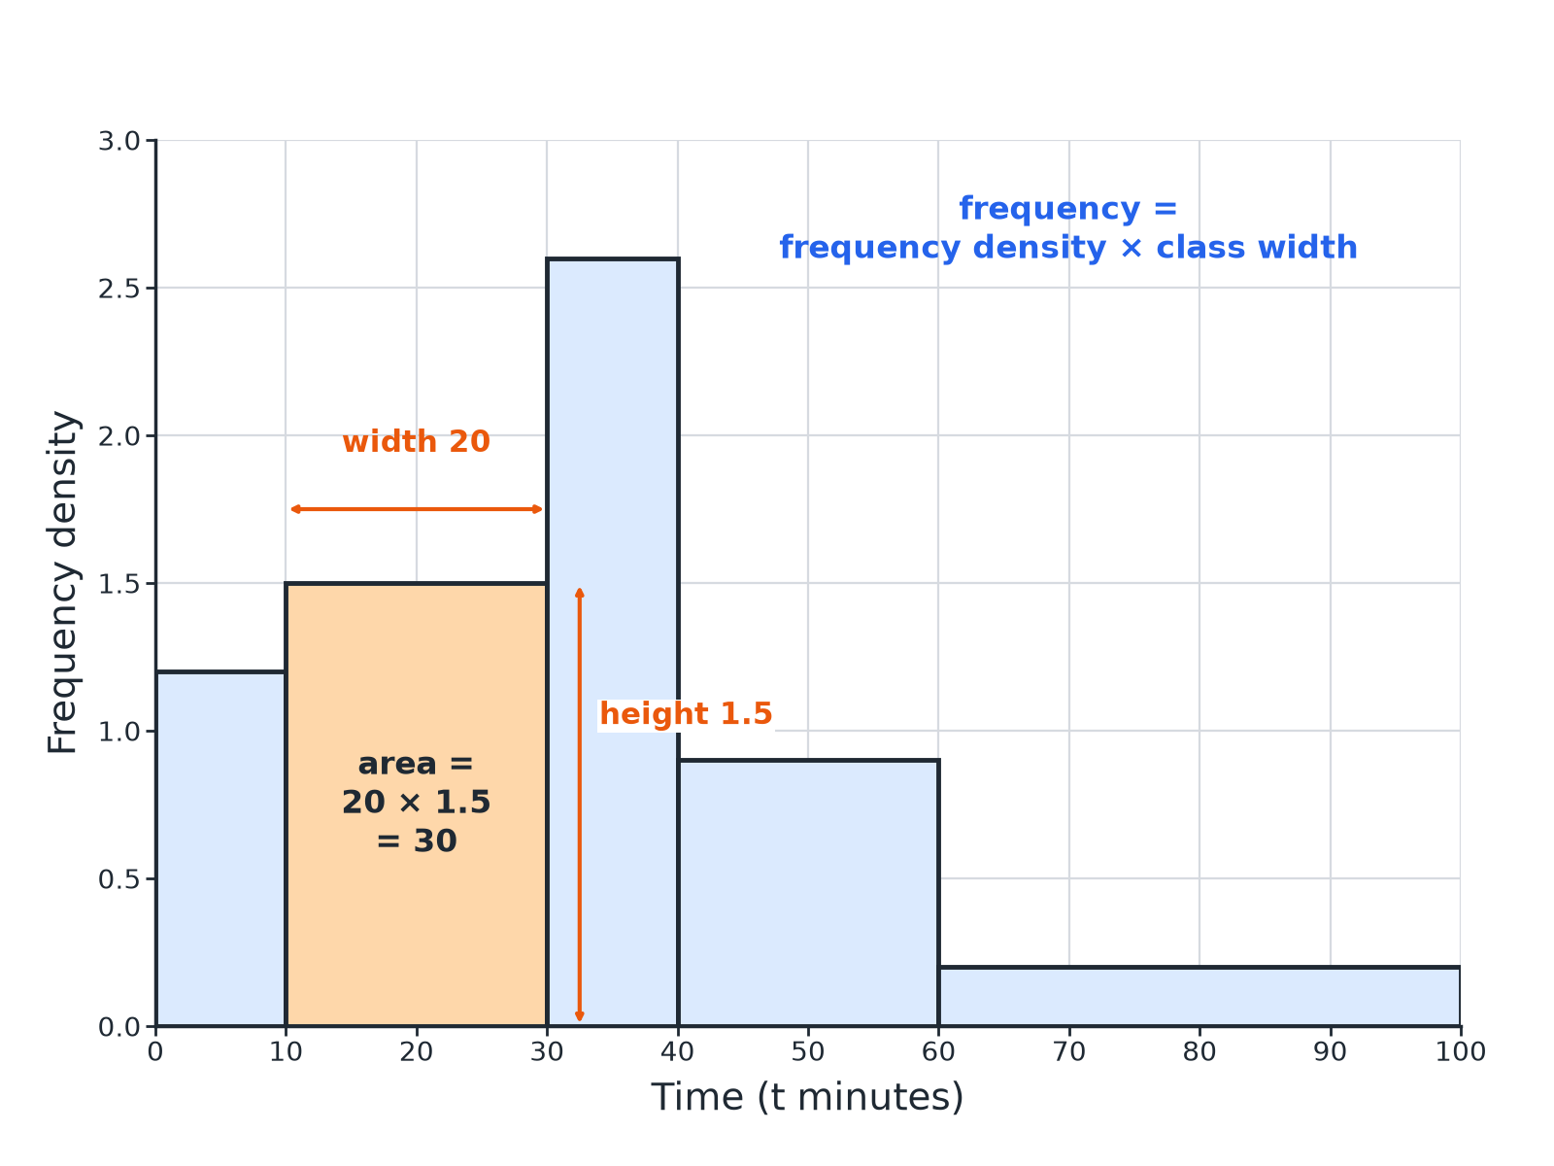

EDEXCEL GCSE MATHS · HIGHER
Area Shows Frequency
Area of the bar = frequency.
Further statistics
openrevise.com
Lesson 5 of 6

Slide 7

EDEXCEL GCSE MATHS · HIGHER
Frequency from a Bar
A histogram bar for the class 10 < t ≤ 30 has height 1.5. Find the frequency.
Class width
30 − 10 = 20
1
Multiply
20 × 1.5 = 30
2
ANSWER
The frequency is 30.
Further statistics
openrevise.com
Lesson 5 of 6

Slide 8
EDEXCEL GCSE MATHS · HIGHER
Part of a Class
In the class 20 < x ≤ 40 the frequency density is 2.2. Estimate the number of values between 25 and 40.
Width of the part
40 − 25 = 15
1
Multiply
15 × 2.2 = 33
2
ANSWER
About 33 values.
Further statistics
openrevise.com
Lesson 5 of 6

Slide 9
EDEXCEL GCSE MATHS · HIGHER
Estimating the Median
Frequencies of 16, 30, 44, 24 and 10 are in classes 0−10, 10−20, 20−40, 40−70, 70−90 (total 124). The frequency density of 20−40 is 2.2. Estimate the median.
1
Position
124 ÷ 2 = 62
2
Running total
16 + 30 = 46, so the median is in 20−40
3
Values needed in this class
62 − 46 = 16
4
Width needed
16 ÷ 2.2 = 7.27
5
Median
20 + 7.27 = 27.3
ANSWER
The median is about 27.3.
Further statistics
openrevise.com
Lesson 5 of 6

Slide 10
EDEXCEL GCSE MATHS · HIGHER
Estimating the Mean
Use the same data to estimate the mean.
Midpoints
5, 15, 30, 55, 80
1
Multiply
80 + 450 + 1320 + 1320 + 800 = 3970
2
Divide by 124
3970 ÷ 124 = 32.0
3
ANSWER
The mean is about 32.0.
Further statistics
openrevise.com
Lesson 5 of 6

Slide 11

EDEXCEL GCSE MATHS · HIGHER
Reading Tips
Keep the method tidy.
Add a frequency column
Work out each bar's frequency first.
Running totals
Use them to find the median class.
Median
Interpolate inside the median class.
Estimates
Values from grouped data are only estimates.
Further statistics
openrevise.com
Lesson 5 of 6

Slide 12

EDEXCEL GCSE MATHS · HIGHER
Key Terms
Frequency density
Height of a histogram bar.
Estimate
An approximate answer from grouped data.
Midpoint
The middle of a class.
Median class
The class that contains the median.
Interpolate
Find a value part of the way through a class.
Area
Width times height.
Further statistics
openrevise.com
Lesson 5 of 6

Slide 13

EDEXCEL GCSE MATHS · HIGHER
YOUR TASK
12 minutes
Read the Bars
A histogram has bars: 0−10 height 1.6, 10−20 height 3, 20−40 height 2.2, 40−70 height 0.8, 70−90 height 0.5. (a) Find each frequency. (b) Find the total. (c) Estimate the number aged 30 to 40.
Width times height.
1
Add them up.
2
WHAT A GOOD ANSWER SHOWS
(a) 16, 30, 44, 24, 10. (b) 124. (c) 10 × 2.2 = 22.
Further statistics
openrevise.com
Lesson 5 of 6
Notes:
Encourage learners to write the frequency above each bar.

Slide 14
EDEXCEL GCSE MATHS · HIGHER
Can I...?
Find frequency from area.
Interpolate the median.
Find the total frequency.
Work out midpoints.
Estimate part of a class.
Estimate the mean.
Find the median class.
Explain why answers are estimates.
Further statistics
openrevise.com
Lesson 5 of 6

Slide 15
EDEXCEL GCSE MATHS · HIGHER
Summary & Exam Focus
Frequency = frequency density × class width.
Median: find the class, then interpolate.
Mean: Σ(midpoint × frequency)/(total frequency).
Grouped answers are estimates.
EXAM FOCUS
The histogram shows the ages of visitors to a museum. Work out an estimate for the number of visitors aged 25 to 40. (3 marks)
Use the class width of only the part you need.
openrevise.com

Slide 16
EDEXCEL GCSE MATHS · HIGHER
Exam Practice: Interpreting histograms
Answer all questions. Show your working. · 30 minutes
Question 1 · 4 marks · Use the histogram
The histogram gives information about the ages of visitors to a museum. (a) Work out the number of visitors aged 10 to 20. (b) Work out an…
Question 2 · 2 marks · Work out
Use the same histogram to work out the total number of visitors.
Question 3 · 3 marks · Estimate
Use the same histogram to find an estimate for the median age.
Further statistics
openrevise.com
Lesson 5 of 6

Slide 17
EDEXCEL GCSE MATHS · HIGHER
Exam Practice: Interpreting histograms (cont.)
Question 4 · 3 marks · Estimate
Use the same histogram to find an estimate for the mean age of the visitors.
Question 5 · 2 marks · Work out
A histogram bar for a class of width 20 has height 1.4. Work out the frequency of the class.
Question 6 · 2 marks · Explain
Explain why the answer to part (b) of the first question is only an estimate.
Further statistics
openrevise.com
Lesson 5 of 6

Slide 18
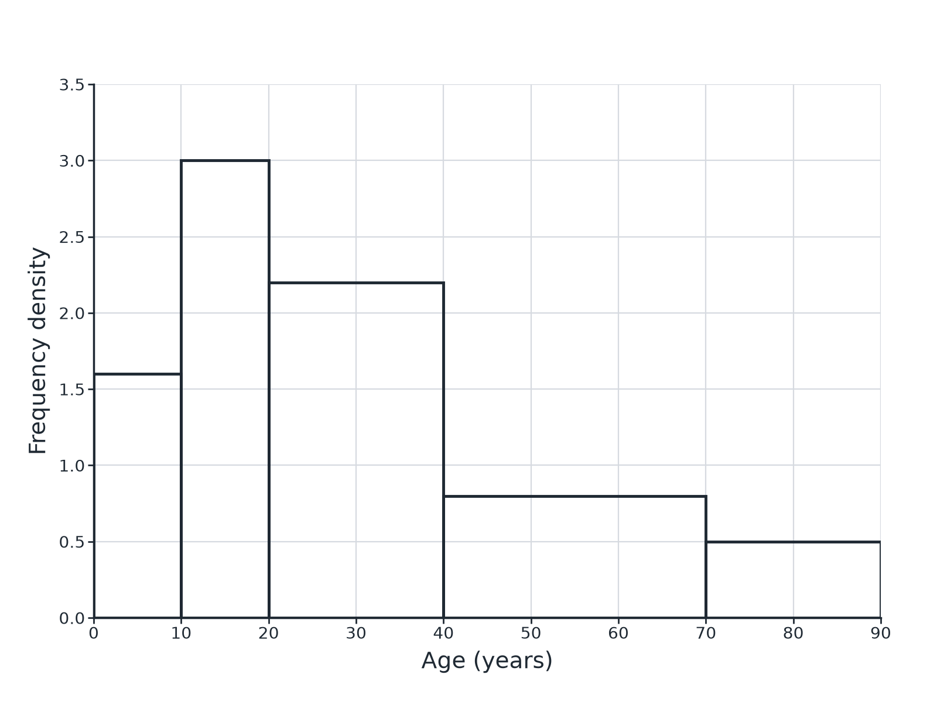
EDEXCEL GCSE MATHS · HIGHER
Question 1 · 4 marks · Use the histogram
The histogram gives information about the ages of visitors to a museum. (a) Work out the number of visitors aged 10 to 20. (b) Work out an estimate for the number of visitors aged 25 to 40. (4 marks)
Further statistics
openrevise.com
Lesson 5 of 6

Slide 19
EDEXCEL GCSE MATHS · HIGHER
Question 1 · mark scheme
4 marks available. Award a mark for each point made.
10 × 3
M1
30
A1
15 × 2.2
M1
33
A1
Further statistics
openrevise.com
Lesson 5 of 6

Slide 20
EDEXCEL GCSE MATHS · HIGHER
Question 2 · 2 marks · Work out
“
Use the same histogram to work out the total number of visitors.
HOW TO ANSWER IT
Command word: Work out. Worth 2 marks, so plan before writing.
Further statistics
openrevise.com
Lesson 5 of 6

Slide 21
EDEXCEL GCSE MATHS · HIGHER
Question 2 · mark scheme
2 marks available. Award a mark for each point made.
All five frequencies
M1
124
A1
Further statistics
openrevise.com
Lesson 5 of 6

Slide 22
EDEXCEL GCSE MATHS · HIGHER
Question 3 · 3 marks · Estimate
“
Use the same histogram to find an estimate for the median age.
HOW TO ANSWER IT
Command word: Estimate. Worth 3 marks, so plan before writing.
Further statistics
openrevise.com
Lesson 5 of 6

Slide 23
EDEXCEL GCSE MATHS · HIGHER
Question 3 · mark scheme
3 marks available. Award a mark for each point made.
Median position 62
B1
Interpolates in the class 20 to 40
M1
27.3 (accept 27 to 27.5)
A1
Further statistics
openrevise.com
Lesson 5 of 6

Slide 24
EDEXCEL GCSE MATHS · HIGHER
Question 4 · 3 marks · Estimate
“
Use the same histogram to find an estimate for the mean age of the visitors.
HOW TO ANSWER IT
Command word: Estimate. Worth 3 marks, so plan before writing.
Further statistics
openrevise.com
Lesson 5 of 6

Slide 25
EDEXCEL GCSE MATHS · HIGHER
Question 4 · mark scheme
3 marks available. Award a mark for each point made.
Midpoints times frequencies
M1
3970
A1
32.0
A1
Further statistics
openrevise.com
Lesson 5 of 6

Slide 26
EDEXCEL GCSE MATHS · HIGHER
Question 5 · 2 marks · Work out
“
A histogram bar for a class of width 20 has height 1.4. Work out the frequency of the class.
HOW TO ANSWER IT
Command word: Work out. Worth 2 marks, so plan before writing.
Further statistics
openrevise.com
Lesson 5 of 6

Slide 27
EDEXCEL GCSE MATHS · HIGHER
Question 5 · mark scheme
2 marks available. Award a mark for each point made.
Uses 20 × 1.4
M1
28
A1
Further statistics
openrevise.com
Lesson 5 of 6

Slide 28
EDEXCEL GCSE MATHS · HIGHER
Question 6 · 2 marks · Explain
“
Explain why the answer to part (b) of the first question is only an estimate.
HOW TO ANSWER IT
Command word: Explain. Worth 2 marks, so plan before writing.
Further statistics
openrevise.com
Lesson 5 of 6

Slide 29
EDEXCEL GCSE MATHS · HIGHER
Question 6 · mark scheme
2 marks available. Award a mark for each point made.
Data grouped
M1
Assumes even spread
C1
Further statistics
openrevise.com
Lesson 5 of 6

