Slide 1

EDEXCEL GCSE MATHS · FOUNDATION & HIGHER
Comparing and describing distributions
Further statistics
Lesson 6 of 6
openrevise.com

Slide 2

EDEXCEL GCSE MATHS · FOUNDATION & HIGHER
Warm-up
Answer each one, then check.
1
Name a measure of average.
2
Name a measure of spread.
3
What is an outlier?
4
Does an outlier affect the median much?
5
Does an outlier affect the mean much?
Further statistics
openrevise.com
Lesson 6 of 6

Slide 3
EDEXCEL GCSE MATHS · FOUNDATION & HIGHER
Warm-up - Answers
Name a measure of average.
Mean, median or mode
1
Name a measure of spread.
Range or interquartile range
2
What is an outlier?
A value far from the others
3
Does an outlier affect the median much?
No
4
Does an outlier affect the mean much?
Yes
5
Further statistics
openrevise.com
Lesson 6 of 6

Slide 4

EDEXCEL GCSE MATHS · FOUNDATION & HIGHER
Learning Objectives
Compare two distributions using an average and a measure of spread.
1
Choose the best average and spread.
2
Describe skew.
3
Write comparisons in context.
4
Further statistics
openrevise.com
Lesson 6 of 6

Slide 5

EDEXCEL GCSE MATHS · FOUNDATION & HIGHER
COMPARING
To compare distributions, compare one average and one measure of spread, using numbers and context.
A higher average means the values are generally bigger. A larger spread means the values are less consistent.
Further statistics
openrevise.com
Lesson 6 of 6

Slide 6
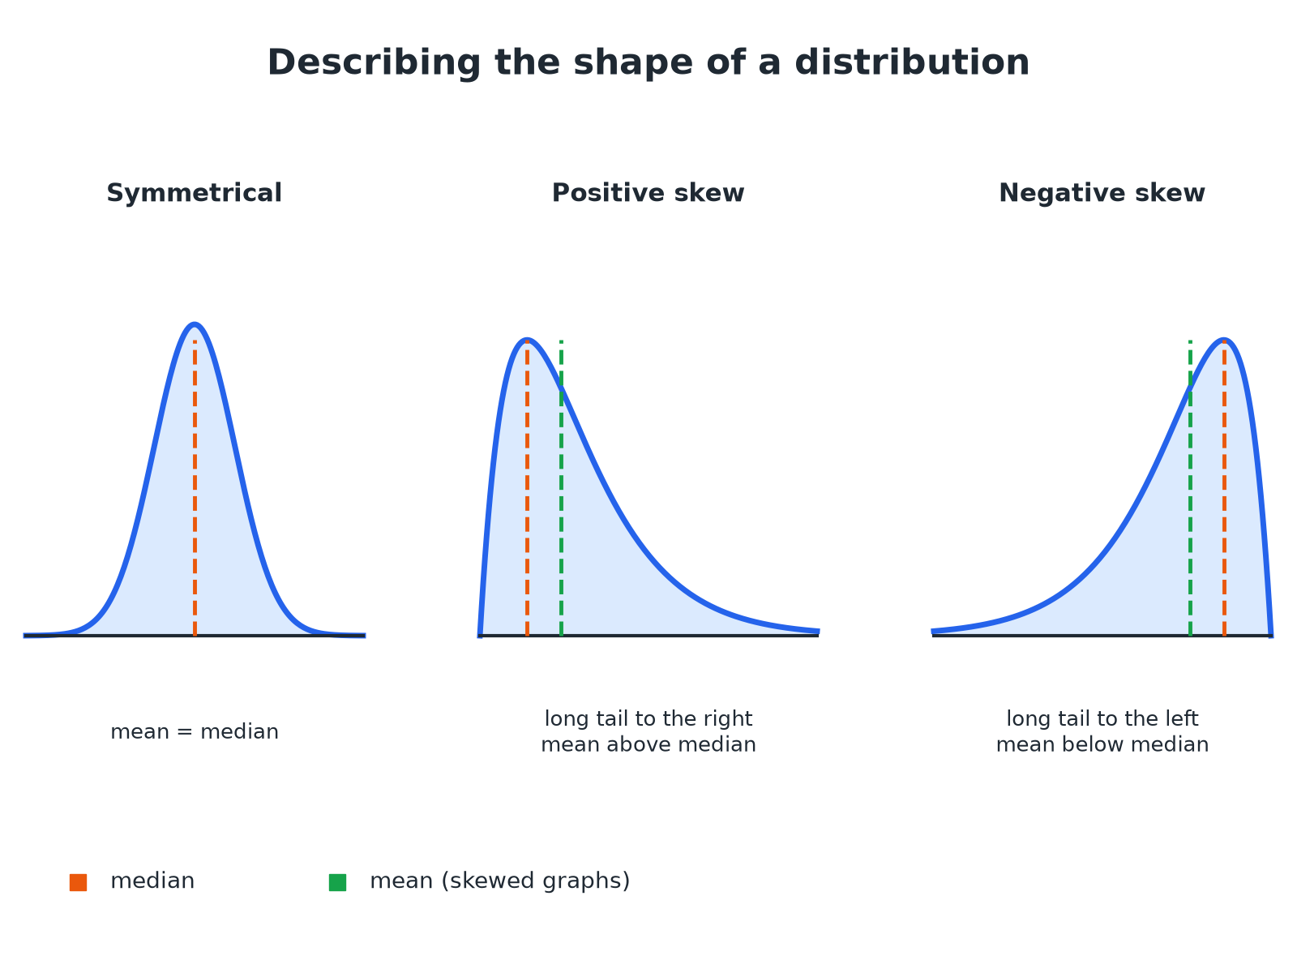

EDEXCEL GCSE MATHS · FOUNDATION & HIGHER
The Shape of a Distribution
The tail shows the direction of the skew.
Further statistics
openrevise.com
Lesson 6 of 6

Slide 7

EDEXCEL GCSE MATHS · FOUNDATION & HIGHER
Choosing Averages and Spreads
AVERAGES
SPREADS
• Mean uses every value, but is affected by outliers.
• Median is not affected by outliers.
• Mode is the most common value.
• Range uses the largest and smallest values only.
• IQR is the spread of the middle 50%.
• IQR is not affected by outliers.
Further statistics
openrevise.com
Lesson 6 of 6

Slide 8

EDEXCEL GCSE MATHS · FOUNDATION & HIGHER
Comparing Two Data Sets
Boys: median 12.4 s, IQR 1.2 s. Girls: median 13.1 s, IQR 2.0 s. Compare the times for the 100 m sprint.
Average
Boys' median 12.4 is lower than girls' 13.1
1
Meaning
On average the boys were faster
2
Spread
Boys' IQR 1.2 is smaller than girls' 2.0
3
Meaning
The boys' times were more consistent
4
ANSWER
On average the boys were faster (median 12.4 s against 13.1 s) and their times were more consistent (IQR 1.2 s against 2.0 s).
Further statistics
openrevise.com
Lesson 6 of 6

Slide 9
EDEXCEL GCSE MATHS · FOUNDATION & HIGHER
Comparing Cumulative Frequency Curves
Two cumulative frequency curves show the times of Group A and Group B (60 people each). Group A: median 28, IQR 16. Group B: median 22, IQR 17. Compare the groups.
Median
B's median is lower
1
Spread
The IQRs are very close
2
Conclusion
Group B were quicker on average, with a similar spread
3
ANSWER
Group B were quicker on average (median 22 against 28) and both groups had a similar spread (IQR 17 against 16).
Further statistics
openrevise.com
Lesson 6 of 6

Slide 10
EDEXCEL GCSE MATHS · FOUNDATION & HIGHER
Describing Skew
The mean is 30 and the median is 25. Describe the skew.
Compare
The mean is greater than the median
1
Shape
The tail is to the right
2
ANSWER
The distribution has positive skew.
Further statistics
openrevise.com
Lesson 6 of 6

Slide 11

EDEXCEL GCSE MATHS · FOUNDATION & HIGHER
Writing Good Comparisons
A full-mark answer has four parts.
An average
Compare medians or means, quoting numbers.
A spread
Compare IQRs or ranges, quoting numbers.
Context
Write in terms of the situation.
A conclusion
For example "so Group B were faster and more consistent".
Further statistics
openrevise.com
Lesson 6 of 6

Slide 12

EDEXCEL GCSE MATHS · FOUNDATION & HIGHER
Key Terms
Distribution
How values are spread across a data set.
Skew
A lack of symmetry; the tail shows the direction.
Symmetrical
The same on both sides of the middle.
Outlier
A value much larger or smaller than the rest.
Consistent
Little variation.
In context
Written using the real situation.
Further statistics
openrevise.com
Lesson 6 of 6

Slide 13

EDEXCEL GCSE MATHS · FOUNDATION & HIGHER
YOUR TASK
12 minutes
Write the Comparison
Set A: mean 24, range 10. Set B: mean 21, range 25. Write a comparison of the two sets.
Compare averages.
1
Compare spreads.
2
WHAT A GOOD ANSWER SHOWS
On average Set A has higher values (mean 24 against 21) and Set A is more consistent (range 10 against 25).
Further statistics
openrevise.com
Lesson 6 of 6
Notes:
Ask learners to check that they used a number for each statement.

Slide 14
EDEXCEL GCSE MATHS · FOUNDATION & HIGHER
Can I...?
Compare two medians.
Describe skew.
Compare two IQRs.
Write in context.
Compare means and ranges.
Use numbers.
Read a cumulative frequency graph.
Explain the choice of average.
Further statistics
openrevise.com
Lesson 6 of 6

Slide 15
EDEXCEL GCSE MATHS · FOUNDATION & HIGHER
Summary & Exam Focus
Compare one average and one spread.
Median and IQR are best if there are outliers.
Positive skew: long tail to the right, mean above median.
Give numbers and a conclusion.
EXAM FOCUS
The cumulative frequency graph shows the times taken by two groups. Compare the times. (4 marks)
Compare an average and a spread, and use the words of the question.
openrevise.com

Slide 16
EDEXCEL GCSE MATHS · FOUNDATION & HIGHER
Exam Practice: Comparing and describing distributions
Answer all questions. Show your working. · 30 minutes
Question 1 · 4 marks · Compare
The cumulative frequency graphs show the times taken by 60 people in Group A and 60 people in Group B to complete a puzzle. Compare the…
Question 2 · 2 marks · Compare
Boys: median 12.4 s, interquartile range 1.2 s. Girls: median 13.1 s, interquartile range 2.0 s. Write down two comparisons.
Question 3 · 2 marks · Compare
Set A has mean 24 and range 10. Set B has mean 21 and range 25. Compare the two sets.
Further statistics
openrevise.com
Lesson 6 of 6

Slide 17
EDEXCEL GCSE MATHS · FOUNDATION & HIGHER
Exam Practice: Comparing and describing distributions (cont.)
Question 4 · 2 marks · Describe
A distribution has a mean of 30 and a median of 25. Describe the skew of the distribution.
Question 5 · 2 marks · Explain
A data set has one very large outlier. Explain why the median is a better average than the mean.
Question 6 · 2 marks · Explain
The mean time for pupils in a London school is lower than in a school in Leeds. Ben says every pupil in the London school must be faster…
Further statistics
openrevise.com
Lesson 6 of 6

Slide 18
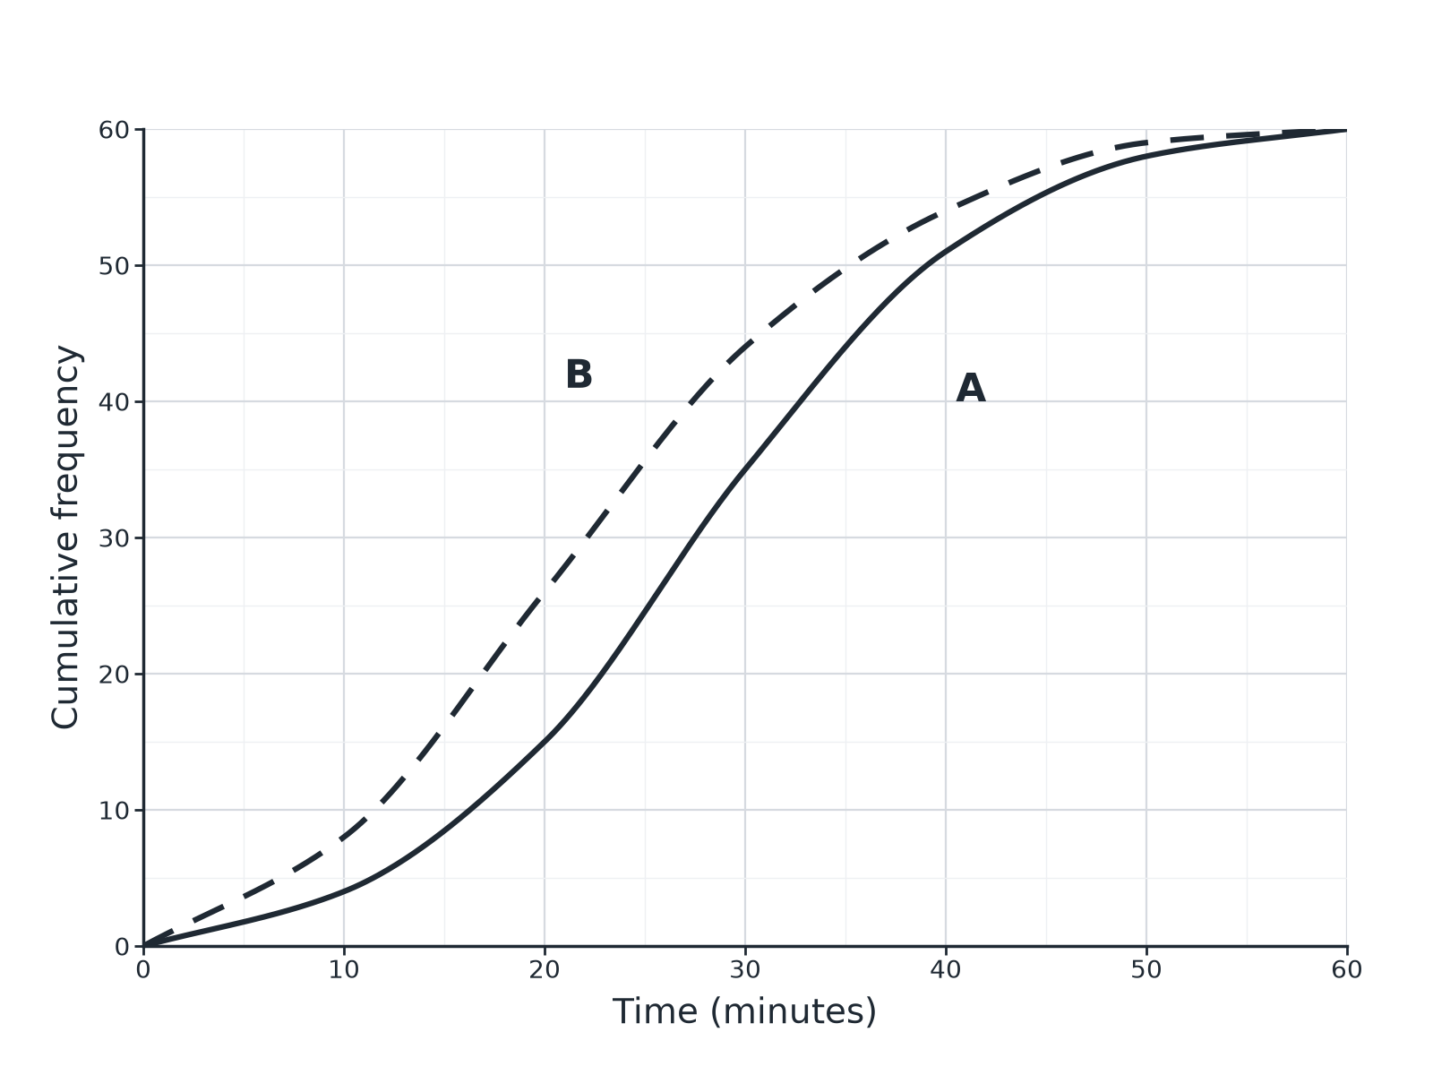
EDEXCEL GCSE MATHS · FOUNDATION & HIGHER
Question 1 · 4 marks · Compare
The cumulative frequency graphs show the times taken by 60 people in Group A and 60 people in Group B to complete a puzzle. Compare the times taken by the two groups. (4 marks)
Further statistics
openrevise.com
Lesson 6 of 6

Slide 19
EDEXCEL GCSE MATHS · FOUNDATION & HIGHER
Question 1 · mark scheme
4 marks available. Award a mark for each point made.
Median for each read from the graph
M1
Comment on average in context
A1
IQR for each read from the graph
M1
Comment on spread in context
A1
Further statistics
openrevise.com
Lesson 6 of 6

Slide 20
EDEXCEL GCSE MATHS · FOUNDATION & HIGHER
Question 2 · 2 marks · Compare
“
Boys: median 12.4 s, interquartile range 1.2 s. Girls: median 13.1 s, interquartile range 2.0 s. Write down two comparisons.
HOW TO ANSWER IT
Command word: Compare. Worth 2 marks, so plan before writing.
Further statistics
openrevise.com
Lesson 6 of 6

Slide 21
EDEXCEL GCSE MATHS · FOUNDATION & HIGHER
Question 2 · mark scheme
2 marks available. Award a mark for each point made.
Average compared in context
B1
Spread compared in context
B1
Further statistics
openrevise.com
Lesson 6 of 6

Slide 22
EDEXCEL GCSE MATHS · FOUNDATION & HIGHER
Question 3 · 2 marks · Compare
“
Set A has mean 24 and range 10. Set B has mean 21 and range 25. Compare the two sets.
HOW TO ANSWER IT
Command word: Compare. Worth 2 marks, so plan before writing.
Further statistics
openrevise.com
Lesson 6 of 6

Slide 23
EDEXCEL GCSE MATHS · FOUNDATION & HIGHER
Question 3 · mark scheme
2 marks available. Award a mark for each point made.
Compares means
B1
Compares ranges
B1
Further statistics
openrevise.com
Lesson 6 of 6

Slide 24
EDEXCEL GCSE MATHS · FOUNDATION & HIGHER
Question 4 · 2 marks · Describe
“
A distribution has a mean of 30 and a median of 25. Describe the skew of the distribution.
HOW TO ANSWER IT
Command word: Describe. Worth 2 marks, so plan before writing.
Further statistics
openrevise.com
Lesson 6 of 6

Slide 25
EDEXCEL GCSE MATHS · FOUNDATION & HIGHER
Question 4 · mark scheme
2 marks available. Award a mark for each point made.
Mean above median
M1
Positive skew
A1
Further statistics
openrevise.com
Lesson 6 of 6

Slide 26
EDEXCEL GCSE MATHS · FOUNDATION & HIGHER
Question 5 · 2 marks · Explain
“
A data set has one very large outlier. Explain why the median is a better average than the mean.
HOW TO ANSWER IT
Command word: Explain. Worth 2 marks, so plan before writing.
Further statistics
openrevise.com
Lesson 6 of 6

Slide 27
EDEXCEL GCSE MATHS · FOUNDATION & HIGHER
Question 5 · mark scheme
2 marks available. Award a mark for each point made.
Mean affected by outlier
M1
Median not affected
C1
Further statistics
openrevise.com
Lesson 6 of 6

Slide 28
EDEXCEL GCSE MATHS · FOUNDATION & HIGHER
Question 6 · 2 marks · Explain
“
The mean time for pupils in a London school is lower than in a school in Leeds. Ben says every pupil in the London school must be faster than every pupil in Leeds. Explain why Ben is wrong.
HOW TO ANSWER IT
Command word: Explain. Worth 2 marks, so plan before writing.
Further statistics
openrevise.com
Lesson 6 of 6

Slide 29
EDEXCEL GCSE MATHS · FOUNDATION & HIGHER
Question 6 · mark scheme
2 marks available. Award a mark for each point made.
Mean is an average only
M1
Individual values may overlap
C1
Further statistics
openrevise.com
Lesson 6 of 6

