Slide 1

EDEXCEL GCSE MATHS · FOUNDATION & HIGHER
Solving simultaneous equations graphically
Equations and graphs
Lesson 1 of 6
openrevise.com

Slide 2

EDEXCEL GCSE MATHS · FOUNDATION & HIGHER
Warm-up
Answer each one, then check.
1
What is the gradient of y = 3x + 2?
2
Where does y = 3x + 2 cross the y-axis?
3
Find y when x = 2 in y = 2x − 1.
4
What does "simultaneous" mean?
5
Rearrange x + y = 5 to make y the subject.
Equations and graphs
openrevise.com
Lesson 1 of 6

Slide 3
EDEXCEL GCSE MATHS · FOUNDATION & HIGHER
Warm-up - Answers
What is the gradient of y = 3x + 2?
3
1
Where does y = 3x + 2 cross the y-axis?
(0, 2)
2
Find y when x = 2 in y = 2x − 1.
3
3
What does "simultaneous" mean?
Both equations true at the same time
4
Rearrange x + y = 5 to make y the subject.
y = 5 − x
5
Equations and graphs
openrevise.com
Lesson 1 of 6

Slide 4

EDEXCEL GCSE MATHS · FOUNDATION & HIGHER
Learning Objectives
Draw straight lines from equations.
1
Find where two lines intersect.
2
Read the solution to a pair of simultaneous equations.
3
Check the solution by substituting.
4
Equations and graphs
openrevise.com
Lesson 1 of 6

Slide 5

EDEXCEL GCSE MATHS · FOUNDATION & HIGHER
GRAPHICAL SOLUTION
The coordinates of the point where two lines cross satisfy both equations at once.
The solution to y = 2x − 1 and x + y = 5 is the point (2, 3), so x = 2 and y = 3.
Equations and graphs
openrevise.com
Lesson 1 of 6

Slide 6
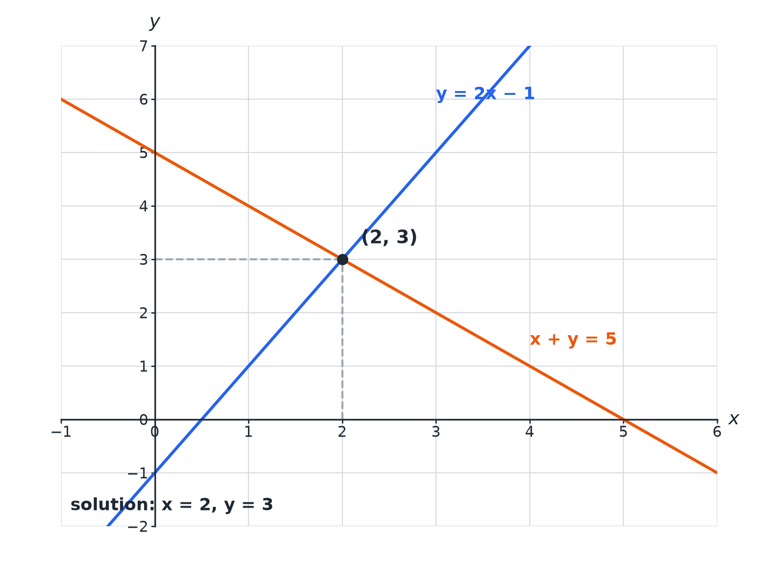

EDEXCEL GCSE MATHS · FOUNDATION & HIGHER
Where the Lines Cross
The intersection gives both x and y.
Equations and graphs
openrevise.com
Lesson 1 of 6

Slide 7

EDEXCEL GCSE MATHS · FOUNDATION & HIGHER
Solving Graphically
Draw both lines carefully.
1
2
3
4
5
Rearrange
Make each equation y = mx + c if you need to
Make a table or use the gradient and intercept
Find at least three points per line
Draw both lines
Use a ruler and extend across the grid
Read the crossing point
Write down x and y
Check
Substitute into both equations
Equations and graphs
openrevise.com
Lesson 1 of 6

Slide 8

EDEXCEL GCSE MATHS · FOUNDATION & HIGHER
Solve by Drawing
Solve y = 2x − 1 and x + y = 5 graphically.
1
Line 1 points
(0, −1), (2, 3), (4, 7)
2
Line 2: y = 5 − x
(0, 5), (2, 3), (5, 0)
3
Lines cross at
(2, 3)
4
Check line 1
2 × 2 − 1 = 3, correct
5
Check line 2
2 + 3 = 5, correct
ANSWER
x = 2 and y = 3
Equations and graphs
openrevise.com
Lesson 1 of 6

Slide 9
EDEXCEL GCSE MATHS · FOUNDATION & HIGHER
No Solutions
Explain why y = 2x + 1 and y = 2x + 5 have no solutions.
Gradients
Both are 2
1
Parallel lines
They never meet
2
ANSWER
The lines are parallel, so there is no point that satisfies both equations.
Equations and graphs
openrevise.com
Lesson 1 of 6

Slide 10

EDEXCEL GCSE MATHS · FOUNDATION & HIGHER
Tips
Get an accurate answer.
Ruler
Use a sharp pencil and a ruler.
Check
Always substitute back to check.
Rearranging
Get both equations into y = mx + c form before drawing.
Estimates
A graph gives an approximate answer unless the point is on a grid crossing.
Equations and graphs
openrevise.com
Lesson 1 of 6

Slide 11

EDEXCEL GCSE MATHS · FOUNDATION & HIGHER
Key Terms
Simultaneous equations
Equations that are both true for the same values.
Intersection
The point where two lines cross.
Gradient
How steep a line is.
Intercept
Where a line crosses an axis.
Parallel
Lines with the same gradient.
Solution
The values of x and y that satisfy both equations.
Equations and graphs
openrevise.com
Lesson 1 of 6

Slide 12

EDEXCEL GCSE MATHS · FOUNDATION & HIGHER
YOUR TASK
12 minutes
Find the Crossing Point
Draw y = x − 1 and y = 5 − x on the same axes for x from 0 to 5. Read the solution.
Make a table of values for each line.
1
Read where they cross.
2
WHAT A GOOD ANSWER SHOWS
The lines cross at (3, 2), so x = 3 and y = 2.
Equations and graphs
openrevise.com
Lesson 1 of 6

Slide 13
EDEXCEL GCSE MATHS · FOUNDATION & HIGHER
Can I...?
Draw a line from its equation.
Write x and y values.
Rearrange to y = mx + c.
Check by substitution.
Draw two lines on one grid.
Explain why parallel lines have no solution.
Read the intersection.
Draw accurately.
Equations and graphs
openrevise.com
Lesson 1 of 6

Slide 14
EDEXCEL GCSE MATHS · FOUNDATION & HIGHER
Summary & Exam Focus
Solution = coordinates of the intersection.
Check in both equations.
Parallel lines have no solution.
Rearrange first to help you draw.
EXAM FOCUS
On the grid, draw the graph of x + y = 5. Hence solve y = 2x − 1 and x + y = 5. (4 marks)
Plot at least three points for each line. Circle the intersection.
openrevise.com

