Slide 1

EDEXCEL GCSE MATHS · FOUNDATION & HIGHER
Representing inequalities graphically
Equations and graphs
Lesson 2 of 6
openrevise.com

Slide 2

EDEXCEL GCSE MATHS · FOUNDATION & HIGHER
Warm-up
Answer each one, then check.
1
What does x > 3 mean?
2
What does y ≤ 2 mean?
3
What is the line x = 4?
4
What is the line y = 2?
5
Draw the line y = x: what is its gradient?
Equations and graphs
openrevise.com
Lesson 2 of 6

Slide 3
EDEXCEL GCSE MATHS · FOUNDATION & HIGHER
Warm-up - Answers
What does x > 3 mean?
x is greater than 3
1
What does y ≤ 2 mean?
y is less than or equal to 2
2
What is the line x = 4?
A vertical line through 4 on the x-axis
3
What is the line y = 2?
A horizontal line through 2 on the y-axis
4
Draw the line y = x: what is its gradient?
1
5
Equations and graphs
openrevise.com
Lesson 2 of 6

Slide 4

EDEXCEL GCSE MATHS · FOUNDATION & HIGHER
Learning Objectives
Draw a boundary line for an inequality.
1
Choose a solid or dashed line.
2
Shade the correct region.
3
Write inequalities for a region and list integer points.
4
Equations and graphs
openrevise.com
Lesson 2 of 6

Slide 5

EDEXCEL GCSE MATHS · FOUNDATION & HIGHER
INEQUALITY REGIONS
An inequality describes a region. Draw the boundary line, then shade the side where the inequality is true.
Solid line for ≤ or ≥. Dashed line for < or >.
Equations and graphs
openrevise.com
Lesson 2 of 6

Slide 6
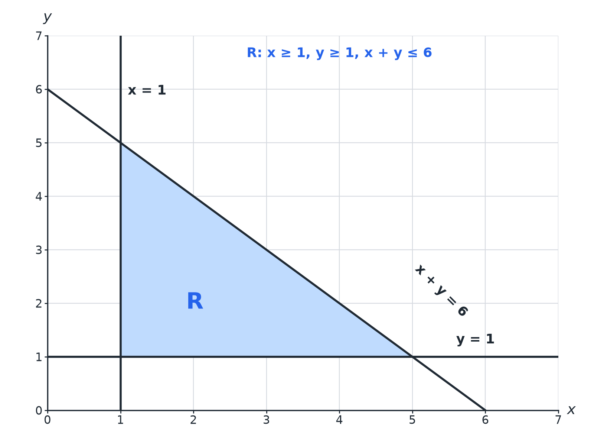

EDEXCEL GCSE MATHS · FOUNDATION & HIGHER
A Region from Three Inequalities
The region R satisfies all three inequalities.
Equations and graphs
openrevise.com
Lesson 2 of 6

Slide 7

EDEXCEL GCSE MATHS · FOUNDATION & HIGHER
Solid or Dashed?
The boundary is part of the region only for ≤ and ≥.
Inequality
Boundary line
Points on the line
y ≥ 2
Solid
Included
y > 2
Dashed
Not included
x + y ≤ 6
Solid
Included
y < x
Dashed
Not included
Equations and graphs
openrevise.com
Lesson 2 of 6

Slide 8

EDEXCEL GCSE MATHS · FOUNDATION & HIGHER
Test a Point
Show which side of the line x + y = 6 satisfies x + y ≤ 6.
Test the origin
0 + 0 = 0
1
Compare
0 ≤ 6 is true
2
So shade
The side of the line containing the origin
3
ANSWER
Shade the region below the line x + y = 6, including the line.
Equations and graphs
openrevise.com
Lesson 2 of 6

Slide 9
EDEXCEL GCSE MATHS · FOUNDATION & HIGHER
Integer Points in a Region
List the integer points in x ≥ 1, y ≥ 1, x + y ≤ 4.
Try x = 1
y = 1, 2, 3
1
Try x = 2
y = 1, 2
2
Try x = 3
y = 1
3
ANSWER
(1,1), (1,2), (1,3), (2,1), (2,2), (3,1)
Equations and graphs
openrevise.com
Lesson 2 of 6

Slide 10
EDEXCEL GCSE MATHS · FOUNDATION & HIGHER
Writing Inequalities
A region is bounded by y = 1, x = 4 and y = x, and lies above y = 1, to the left of x = 4 and below y = x. Write the inequalities.
Above y = 1
y ≥ 1
1
Left of x = 4
x ≤ 4
2
Below y = x
y ≤ x
3
ANSWER
y ≥ 1, x ≤ 4, y ≤ x
Equations and graphs
openrevise.com
Lesson 2 of 6

Slide 11

EDEXCEL GCSE MATHS · FOUNDATION & HIGHER
Tips
Keep it clear.
Label R
Mark the required region clearly.
Check with a point
Test one point in the region in every inequality.
Boundary lines
Draw all lines even if only part of them bounds the region.
Read the instruction
Some questions ask you to shade the region that is NOT wanted.
Equations and graphs
openrevise.com
Lesson 2 of 6

Slide 12

EDEXCEL GCSE MATHS · FOUNDATION & HIGHER
Key Terms
Inequality
A statement using <, >, ≤ or ≥.
Boundary
The line separating the region from the rest.
Region
The set of points that satisfy the inequalities.
Integer
A whole number.
Test point
A point used to decide which side to shade.
Solid line
Boundary included.
Equations and graphs
openrevise.com
Lesson 2 of 6

Slide 13

EDEXCEL GCSE MATHS · FOUNDATION & HIGHER
YOUR TASK
12 minutes
Sketch the Region
Draw the region satisfying x ≥ 2, y ≥ 1 and x + y ≤ 6. List the integer points that lie in it.
Draw each boundary line.
1
Count integer points column by column.
2
WHAT A GOOD ANSWER SHOWS
The region is a triangle with corners (2, 1), (5, 1) and (2, 4). Integer points: (2,1),(2,2),(2,3),(2,4),(3,1),(3,2),(3,3),(4,1),(4,2),(5,1).
Equations and graphs
openrevise.com
Lesson 2 of 6
Notes:
Ask learners to check points on the boundary.

Slide 14
EDEXCEL GCSE MATHS · FOUNDATION & HIGHER
Can I...?
Draw x = a and y = b lines.
Shade the correct region.
Draw sloping boundary lines.
Write inequalities for a region.
Use solid and dashed lines.
List integer points.
Test a point.
Label R clearly.
Equations and graphs
openrevise.com
Lesson 2 of 6

Slide 15
EDEXCEL GCSE MATHS · FOUNDATION & HIGHER
Summary & Exam Focus
≤ and ≥: solid line. < and >: dashed.
Test a point to decide which side to shade.
The region satisfies all inequalities at once.
Integer points on a solid boundary are included.
EXAM FOCUS
The diagram shows a region R. Write down the three inequalities that define R. (3 marks)
Name each boundary line first, then decide which side is R.
openrevise.com

Slide 16
EDEXCEL GCSE MATHS · FOUNDATION & HIGHER
Exam Practice: Representing inequalities graphically
Answer all questions. Show your working. · 25 minutes
Question 1 · 3 marks · Write down
The region R is shown shaded on the grid. Write down the three inequalities that define R.
Question 2 · 3 marks · Write down
x and y are integers with x ≥ 1, y ≥ 1 and x + y ≤ 4. Write down all the possible pairs (x, y).
Question 3 · 3 marks · Write down
A region on a grid is bounded by the lines x = 1, y = 1 and x + y = 6, and lies above y = 1, to the right of x = 1 and below x + y = 6…
Equations and graphs
openrevise.com
Lesson 2 of 6

Slide 17
EDEXCEL GCSE MATHS · FOUNDATION & HIGHER
Exam Practice: Representing inequalities graphically (cont.)
Question 4 · 2 marks · Explain
Explain when you would draw a dashed line rather than a solid line for the boundary of an inequality.
Question 5 · 2 marks · Decide
Is the point (2, 3) in the region y > 2x − 1? Give a reason.
Question 6 · 3 marks · Shade
On a grid, show by shading the region defined by x ≥ 2, y < 3 and y ≥ 0. Describe the shape you have shaded.
Equations and graphs
openrevise.com
Lesson 2 of 6

Slide 18
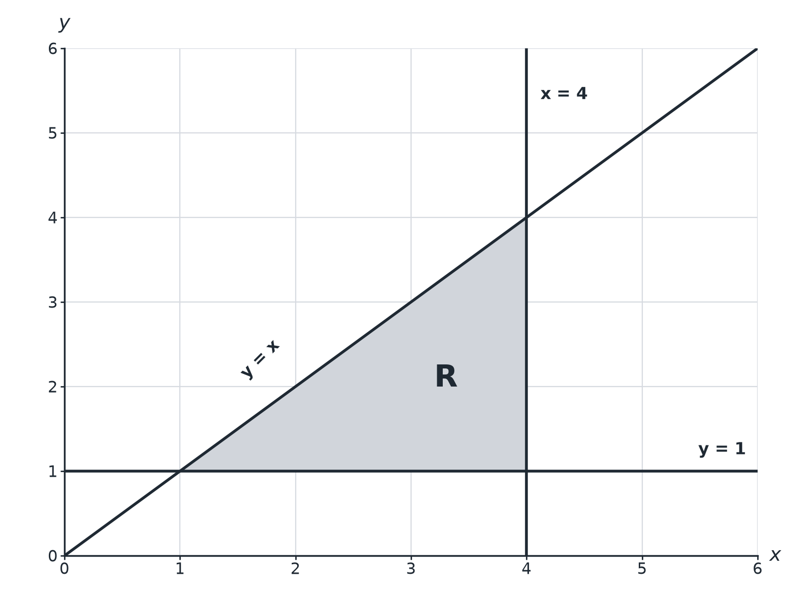
EDEXCEL GCSE MATHS · FOUNDATION & HIGHER
Question 1 · 3 marks · Write down
The region R is shown shaded on the grid. Write down the three inequalities that define R. (3 marks)
Equations and graphs
openrevise.com
Lesson 2 of 6

Slide 19
EDEXCEL GCSE MATHS · FOUNDATION & HIGHER
Question 1 · mark scheme
3 marks available. Award a mark for each point made.
One correct inequality
B1
Two correct
B1
All three correct
B1
Equations and graphs
openrevise.com
Lesson 2 of 6

Slide 20
EDEXCEL GCSE MATHS · FOUNDATION & HIGHER
Question 2 · 3 marks · Write down
“
x and y are integers with x ≥ 1, y ≥ 1 and x + y ≤ 4. Write down all the possible pairs (x, y).
HOW TO ANSWER IT
Command word: Write down. Worth 3 marks, so plan before writing.
Equations and graphs
openrevise.com
Lesson 2 of 6

Slide 21
EDEXCEL GCSE MATHS · FOUNDATION & HIGHER
Question 2 · mark scheme
3 marks available. Award a mark for each point made.
At least 3 correct pairs and none wrong
M1
5 correct
A1
All 6 correct
A1
Equations and graphs
openrevise.com
Lesson 2 of 6

Slide 22
EDEXCEL GCSE MATHS · FOUNDATION & HIGHER
Question 3 · 3 marks · Write down
“
A region on a grid is bounded by the lines x = 1, y = 1 and x + y = 6, and lies above y = 1, to the right of x = 1 and below x + y = 6. Write down the three inequalities that define the region.
HOW TO ANSWER IT
Command word: Write down. Worth 3 marks, so plan before writing.
Equations and graphs
openrevise.com
Lesson 2 of 6

Slide 23
EDEXCEL GCSE MATHS · FOUNDATION & HIGHER
Question 3 · mark scheme
3 marks available. Award a mark for each point made.
One correct
B1
Two correct
B1
All three
B1
Equations and graphs
openrevise.com
Lesson 2 of 6

Slide 24
EDEXCEL GCSE MATHS · FOUNDATION & HIGHER
Question 4 · 2 marks · Explain
“
Explain when you would draw a dashed line rather than a solid line for the boundary of an inequality.
HOW TO ANSWER IT
Command word: Explain. Worth 2 marks, so plan before writing.
Equations and graphs
openrevise.com
Lesson 2 of 6

Slide 25
EDEXCEL GCSE MATHS · FOUNDATION & HIGHER
Question 4 · mark scheme
2 marks available. Award a mark for each point made.
Dashed for < or >
M1
Points on the line not included
C1
Equations and graphs
openrevise.com
Lesson 2 of 6

Slide 26
EDEXCEL GCSE MATHS · FOUNDATION & HIGHER
Question 5 · 2 marks · Decide
“
Is the point (2, 3) in the region y > 2x − 1? Give a reason.
HOW TO ANSWER IT
Command word: Decide. Worth 2 marks, so plan before writing.
Equations and graphs
openrevise.com
Lesson 2 of 6

Slide 27
EDEXCEL GCSE MATHS · FOUNDATION & HIGHER
Question 5 · mark scheme
2 marks available. Award a mark for each point made.
Substitutes
M1
No, with reason
A1
Equations and graphs
openrevise.com
Lesson 2 of 6

Slide 28
EDEXCEL GCSE MATHS · FOUNDATION & HIGHER
Question 6 · 3 marks · Shade
“
On a grid, show by shading the region defined by x ≥ 2, y < 3 and y ≥ 0. Describe the shape you have shaded.
HOW TO ANSWER IT
Command word: Shade. Worth 3 marks, so plan before writing.
Equations and graphs
openrevise.com
Lesson 2 of 6

Slide 29
EDEXCEL GCSE MATHS · FOUNDATION & HIGHER
Question 6 · mark scheme
3 marks available. Award a mark for each point made.
x = 2 solid
B1
y = 3 dashed
B1
Correct region
B1
Equations and graphs
openrevise.com
Lesson 2 of 6

