Slide 1
EDEXCEL GCSE MATHS · FOUNDATION & HIGHER
Quadratic equations
Equations and graphs
Lesson 3 of 6
openrevise.com

Slide 2

EDEXCEL GCSE MATHS · FOUNDATION & HIGHER
Warm-up
Answer each one, then check.
1
Factorise x² + 5x + 6.
2
Expand (x + 3)(x − 1).
3
What is √49?
4
If ab = 0, what do you know?
5
What is the value of 3²?
Equations and graphs
openrevise.com
Lesson 3 of 6

Slide 3
EDEXCEL GCSE MATHS · FOUNDATION & HIGHER
Warm-up - Answers
Factorise x² + 5x + 6.
(x + 2)(x + 3)
1
Expand (x + 3)(x − 1).
x² + 2x − 3
2
What is √49?
7
3
If ab = 0, what do you know?
a = 0 or b = 0
4
What is the value of 3²?
9
5
Equations and graphs
openrevise.com
Lesson 3 of 6

Slide 4

EDEXCEL GCSE MATHS · FOUNDATION & HIGHER
Learning Objectives
Solve a quadratic by factorising.
1
Solve a quadratic with the quadratic formula.
2
Complete the square and use it to solve.
3
Choose the most efficient method.
4
Equations and graphs
openrevise.com
Lesson 3 of 6

Slide 5

EDEXCEL GCSE MATHS · FOUNDATION & HIGHER
QUADRATIC EQUATIONS
A quadratic equation can be written ax² + bx + c = 0 and usually has two solutions.
Rearrange so that one side is 0 before you use any method.
Equations and graphs
openrevise.com
Lesson 3 of 6

Slide 6
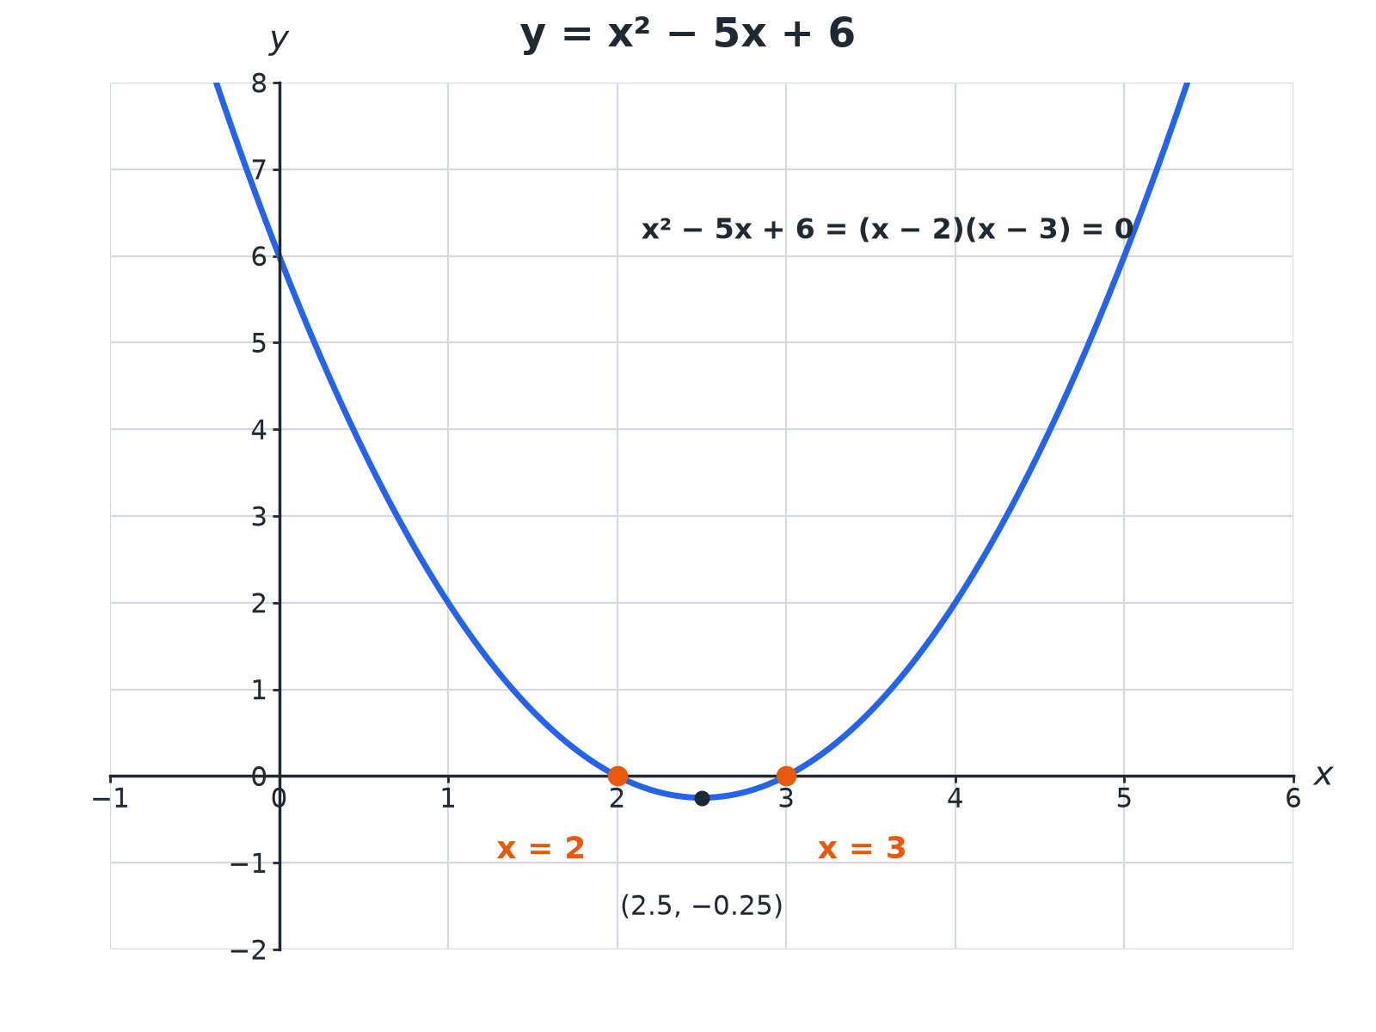

EDEXCEL GCSE MATHS · FOUNDATION & HIGHER
Two Solutions
The solutions are where the graph crosses the x-axis.
Equations and graphs
openrevise.com
Lesson 3 of 6

Slide 7

EDEXCEL GCSE MATHS · FOUNDATION & HIGHER
Choosing a Method
Use the quickest one that works.
Method
Use it when
Example
Factorising
The quadratic factorises easily
x² − 5x + 6 = 0
Formula
It does not factorise, or the answer is needed as a decimal
x² + 4x − 7 = 0
Completing the square
You need exact surds or the turning point
x² + 6x − 2 = 0
Equations and graphs
openrevise.com
Lesson 3 of 6

Slide 8

EDEXCEL GCSE MATHS · FOUNDATION & HIGHER
Factorising
Solve 2x² + 5x − 3 = 0.
Factorise
(2x − 1)(x + 3) = 0
1
Each bracket is 0
2x − 1 = 0 or x + 3 = 0
2
Solve
x = ½ or x = −3
3
ANSWER
x = ½ or x = −3
Equations and graphs
openrevise.com
Lesson 3 of 6

Slide 9
EDEXCEL GCSE MATHS · FOUNDATION & HIGHER
The Quadratic Formula
Solve x² + 4x − 7 = 0. Give your answers to 2 decimal places.
Formula
x = (−b ± √(b² − 4ac))/2a
1
Substitute a = 1, b = 4, c = −7
x = (−4 ± √(16 + 28))/2
2
Simplify
x = (−4 ± √44)/2
3
Evaluate
x = 1.32 or x = −5.32
4
ANSWER
x = 1.32 or x = −5.32
Equations and graphs
openrevise.com
Lesson 3 of 6

Slide 10
EDEXCEL GCSE MATHS · FOUNDATION & HIGHER
Completing the Square
Solve x² + 6x − 2 = 0 by completing the square. Give your answers to 2 decimal places.
Complete the square
(x + 3)² − 9 − 2 = 0
1
Simplify
(x + 3)² = 11
2
Square root
x + 3 = ± √11
3
Solve
x = −3 ± √11 = 0.32 or −6.32
4
ANSWER
x = 0.32 or x = −6.32
Equations and graphs
openrevise.com
Lesson 3 of 6

Slide 11

EDEXCEL GCSE MATHS · FOUNDATION & HIGHER
Common Mistakes
Avoid these.
Not rearranging to 0
Move everything to one side first.
Dividing by x
Solving x² = 7x by dividing loses the solution x = 0; factorise instead.
Signs in the formula
Take care with −b and b² − 4ac when b or c is negative.
Only one solution
Give both solutions.
Equations and graphs
openrevise.com
Lesson 3 of 6

Slide 12

EDEXCEL GCSE MATHS · FOUNDATION & HIGHER
Key Terms
Quadratic
An equation with a highest power of x².
Factorise
Write as a product of brackets.
Root
A solution of an equation.
Discriminant
b² − 4ac.
Completing the square
Writing x² + bx + c as (x + p)² + q.
Surd
A root that cannot be simplified to a whole number, e.g. √11.
Equations and graphs
openrevise.com
Lesson 3 of 6

Slide 13

EDEXCEL GCSE MATHS · FOUNDATION & HIGHER
YOUR TASK
12 minutes
Choose Your Method
Solve each and say which method you used. (a) x² − 7x + 10 = 0 (b) x² + 2x − 5 = 0 (2 d.p.) (c) x² = 9x.
Look for factors first.
1
Otherwise use the formula.
2
WHAT A GOOD ANSWER SHOWS
(a) x = 2 or 5 (factorising). (b) x = −1 ± √6 = 1.45 or −3.45 (formula or completing the square). (c) x(x − 9) = 0, so x = 0 or 9.
Equations and graphs
openrevise.com
Lesson 3 of 6
Notes:
Point out that (c) must not be divided by x.

Slide 14
EDEXCEL GCSE MATHS · FOUNDATION & HIGHER
Can I...?
Rearrange to equal zero.
Give answers to a given accuracy.
Factorise and solve.
Give both solutions.
Use the quadratic formula.
Avoid dividing by x.
Complete the square.
Choose a method.
Equations and graphs
openrevise.com
Lesson 3 of 6

Slide 15
EDEXCEL GCSE MATHS · FOUNDATION & HIGHER
Summary & Exam Focus
Factorise if you can.
Formula: x = (−b ± √(b² − 4ac))/2a.
Complete the square: (x + p)² + q.
Every quadratic has up to two solutions.
EXAM FOCUS
Solve x² + 4x − 7 = 0. Give your solutions correct to 2 decimal places. (3 marks)
Write the formula first, then substitute carefully, using brackets for negatives.
openrevise.com

Slide 16
EDEXCEL GCSE MATHS · FOUNDATION & HIGHER
Exam Practice: Quadratic equations
Answer all questions. Show your working. · 30 minutes
Question 1 · 2 marks · Solve
Solve x² − 5x + 6 = 0.
Question 2 · 3 marks · Solve
Solve 2x² + 5x − 3 = 0.
Question 3 · 3 marks · Solve
Solve x² + 4x − 7 = 0. Give your solutions correct to 2 decimal places.
Equations and graphs
openrevise.com
Lesson 3 of 6

Slide 17
EDEXCEL GCSE MATHS · FOUNDATION & HIGHER
Exam Practice: Quadratic equations (cont.)
Question 4 · 4 marks · Solve
(a) Write x² + 6x − 2 in the form (x + a)² + b. (b) Hence solve x² + 6x − 2 = 0. Give your answers correct to 2 decimal places.
Question 5 · 2 marks · Use the graph
The graph of y = x² − 4x + 1 is shown. Use the graph to find estimates for the solutions of x² − 4x + 1 = 0.
Question 6 · 2 marks · Solve
Solve x² = 7x.
Equations and graphs
openrevise.com
Lesson 3 of 6

Slide 18
EDEXCEL GCSE MATHS · FOUNDATION & HIGHER
Question 1 · 2 marks · Solve
“
Solve x² − 5x + 6 = 0.
HOW TO ANSWER IT
Command word: Solve. Worth 2 marks, so plan before writing.
Equations and graphs
openrevise.com
Lesson 3 of 6

Slide 19
EDEXCEL GCSE MATHS · FOUNDATION & HIGHER
Question 1 · mark scheme
2 marks available. Award a mark for each point made.
(x − 2)(x − 3)
M1
2 and 3
A1
Equations and graphs
openrevise.com
Lesson 3 of 6

Slide 20
EDEXCEL GCSE MATHS · FOUNDATION & HIGHER
Question 2 · 3 marks · Solve
“
Solve 2x² + 5x − 3 = 0.
HOW TO ANSWER IT
Command word: Solve. Worth 3 marks, so plan before writing.
Equations and graphs
openrevise.com
Lesson 3 of 6

Slide 21
EDEXCEL GCSE MATHS · FOUNDATION & HIGHER
Question 2 · mark scheme
3 marks available. Award a mark for each point made.
Factorises
M1
One correct solution
A1
Both correct
A1
Equations and graphs
openrevise.com
Lesson 3 of 6

Slide 22
EDEXCEL GCSE MATHS · FOUNDATION & HIGHER
Question 3 · 3 marks · Solve
“
Solve x² + 4x − 7 = 0. Give your solutions correct to 2 decimal places.
HOW TO ANSWER IT
Command word: Solve. Worth 3 marks, so plan before writing.
Equations and graphs
openrevise.com
Lesson 3 of 6

Slide 23
EDEXCEL GCSE MATHS · FOUNDATION & HIGHER
Question 3 · mark scheme
3 marks available. Award a mark for each point made.
Substitutes into the formula
M1
(−4 ± √44)/2
A1
1.32 and −5.32
A1
Equations and graphs
openrevise.com
Lesson 3 of 6

Slide 24
EDEXCEL GCSE MATHS · FOUNDATION & HIGHER
Question 4 · 4 marks · Solve
“
(a) Write x² + 6x − 2 in the form (x + a)² + b. (b) Hence solve x² + 6x − 2 = 0. Give your answers correct to 2 decimal places.
HOW TO ANSWER IT
Command word: Solve. Worth 4 marks, so plan before writing.
Equations and graphs
openrevise.com
Lesson 3 of 6

Slide 25
EDEXCEL GCSE MATHS · FOUNDATION & HIGHER
Question 4 · mark scheme
4 marks available. Award a mark for each point made.
a = 3
B1
b = −11
B1
x = −3 ± √11
M1
0.32 and −6.32
A1
Equations and graphs
openrevise.com
Lesson 3 of 6

Slide 26
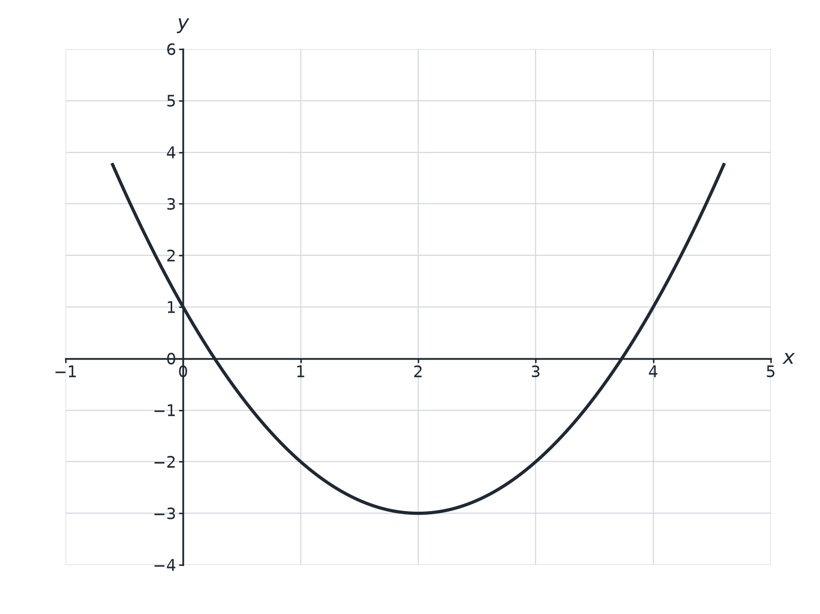
EDEXCEL GCSE MATHS · FOUNDATION & HIGHER
Question 5 · 2 marks · Use the graph
The graph of y = x² − 4x + 1 is shown. Use the graph to find estimates for the solutions of x² − 4x + 1 = 0. (2 marks)
Equations and graphs
openrevise.com
Lesson 3 of 6

Slide 27
EDEXCEL GCSE MATHS · FOUNDATION & HIGHER
Question 5 · mark scheme
2 marks available. Award a mark for each point made.
One correct estimate
B1
Both correct
B1
Equations and graphs
openrevise.com
Lesson 3 of 6

Slide 28
EDEXCEL GCSE MATHS · FOUNDATION & HIGHER
Question 6 · 2 marks · Solve
“
Solve x² = 7x.
HOW TO ANSWER IT
Command word: Solve. Worth 2 marks, so plan before writing.
Equations and graphs
openrevise.com
Lesson 3 of 6

Slide 29
EDEXCEL GCSE MATHS · FOUNDATION & HIGHER
Question 6 · mark scheme
2 marks available. Award a mark for each point made.
x(x − 7) = 0
M1
0 and 7
A1
Equations and graphs
openrevise.com
Lesson 3 of 6

