Slide 1

EDEXCEL GCSE MATHS · FOUNDATION & HIGHER
Using quadratic graphs
Equations and graphs
Lesson 4 of 6
openrevise.com

Slide 2

EDEXCEL GCSE MATHS · FOUNDATION & HIGHER
Warm-up
Answer each one, then check.
1
Work out x² − 2x − 3 when x = 2.
2
What shape is a graph of y = x²?
3
What is a root of a graph?
4
What is a line of symmetry?
5
What is y on the y-axis?
Equations and graphs
openrevise.com
Lesson 4 of 6

Slide 3
EDEXCEL GCSE MATHS · FOUNDATION & HIGHER
Warm-up - Answers
Work out x² − 2x − 3 when x = 2.
−3
1
What shape is a graph of y = x²?
A U-shaped parabola
2
What is a root of a graph?
Where it crosses the x-axis
3
What is a line of symmetry?
A line the graph reflects onto itself in
4
What is y on the y-axis?
The vertical coordinate
5
Equations and graphs
openrevise.com
Lesson 4 of 6

Slide 4

EDEXCEL GCSE MATHS · FOUNDATION & HIGHER
Learning Objectives
Complete a table of values and draw a quadratic graph.
1
Find roots, the y-intercept, the turning point and the line of symmetry.
2
Solve ax² + bx + c = 0 using a graph.
3
Solve related equations such as x² − 2x − 3 = 2 by drawing a line.
4
Equations and graphs
openrevise.com
Lesson 4 of 6

Slide 5

EDEXCEL GCSE MATHS · FOUNDATION & HIGHER
QUADRATIC GRAPH
A quadratic graph is a smooth curve called a parabola. It is symmetrical about a vertical line through its turning point.
The roots are where y = 0. To solve f(x) = k, draw the line y = k and read the x-values where it meets the curve.
Equations and graphs
openrevise.com
Lesson 4 of 6

Slide 6
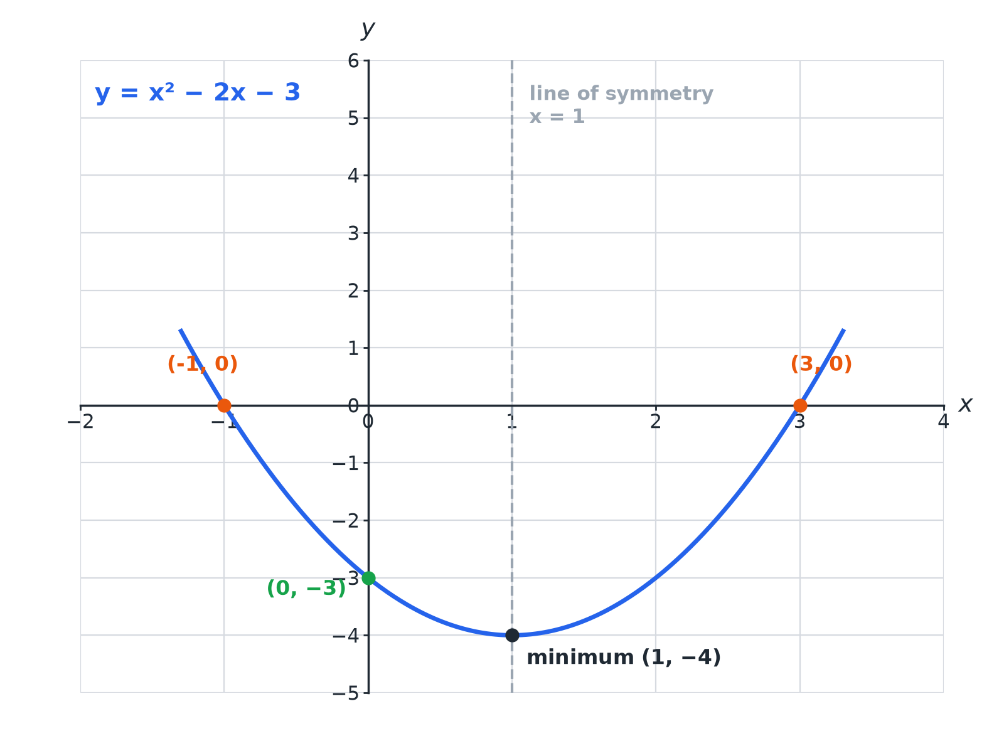

EDEXCEL GCSE MATHS · FOUNDATION & HIGHER
Key Features of a Parabola
Roots, minimum point, y-intercept and axis of symmetry.
Equations and graphs
openrevise.com
Lesson 4 of 6

Slide 7

EDEXCEL GCSE MATHS · FOUNDATION & HIGHER
Table of Values
y = x² − 2x − 3.
x
−2
−1
1
2
y
5
0
−3
−4 | −3 | 0 | 5
Equations and graphs
openrevise.com
Lesson 4 of 6

Slide 8

EDEXCEL GCSE MATHS · FOUNDATION & HIGHER
Roots and Turning Point
For y = x² − 2x − 3, find the roots, the turning point and the line of symmetry.
Roots
y = 0: (x − 3)(x + 1) = 0, so x = 3 or −1
1
Line of symmetry
Halfway between the roots: x = 1
2
Turning point
y = 1 − 2 − 3 = −4, so (1, −4)
3
ANSWER
Roots −1 and 3; line of symmetry x = 1; minimum point (1, −4).
Equations and graphs
openrevise.com
Lesson 4 of 6

Slide 9
EDEXCEL GCSE MATHS · FOUNDATION & HIGHER
Solving a Related Equation
Use the graph of y = x² − 2x − 3 to solve x² − 2x − 3 = 2.
Draw the line
y = 2 across the graph
1
Read the x-values where it meets the curve
x ≈ −1.4 and x ≈ 3.4
2
Check
1 ± √6 = −1.45, 3.45
3
ANSWER
x ≈ −1.4 or x ≈ 3.4
Equations and graphs
openrevise.com
Lesson 4 of 6

Slide 10
EDEXCEL GCSE MATHS · FOUNDATION & HIGHER
Completed Square Form
Write y = x² − 2x − 3 in the form (x − a)² + b and write down the turning point.
Complete the square
(x − 1)² − 1 − 3
1
Simplify
y = (x − 1)² − 4
2
Turning point
(1, −4)
3
ANSWER
y = (x − 1)² − 4; the turning point is (1, −4).
Equations and graphs
openrevise.com
Lesson 4 of 6

Slide 11

EDEXCEL GCSE MATHS · FOUNDATION & HIGHER
Drawing Tips
Get a smooth curve.
Plot every point
Then join with a smooth curve, not straight segments.
No flat bottom
Near the turning point the curve rounds gently.
Check symmetry
Values on each side of the turning point should match.
Use a ruler for lines
Use a pencil for the curve.
Equations and graphs
openrevise.com
Lesson 4 of 6

Slide 12

EDEXCEL GCSE MATHS · FOUNDATION & HIGHER
Key Terms
Parabola
The U-shaped graph of a quadratic.
Root
A value of x where y = 0.
Turning point
The lowest or highest point of the curve.
Line of symmetry
The vertical line through the turning point.
y-intercept
Where the graph crosses the y-axis.
Minimum
The lowest point of a U-shaped curve.
Equations and graphs
openrevise.com
Lesson 4 of 6

Slide 13

EDEXCEL GCSE MATHS · FOUNDATION & HIGHER
YOUR TASK
12 minutes
Sketch and Solve
Complete the table for y = x² − 4x for x = 0 to 4 and sketch the graph. Write down the roots and the turning point.
Substitute each x value.
1
Join with a smooth curve.
2
WHAT A GOOD ANSWER SHOWS
y = 0, −3, −4, −3, 0. Roots x = 0 and x = 4; turning point (2, −4).
Equations and graphs
openrevise.com
Lesson 4 of 6

Slide 14
EDEXCEL GCSE MATHS · FOUNDATION & HIGHER
Can I...?
Complete a table.
Find the turning point.
Plot the points.
Give the line of symmetry.
Draw a smooth curve.
Solve a related equation.
Find the roots.
Use the completed square form.
Equations and graphs
openrevise.com
Lesson 4 of 6

Slide 15
EDEXCEL GCSE MATHS · FOUNDATION & HIGHER
Summary & Exam Focus
Roots are where y = 0.
The turning point lies on the line of symmetry.
Solve f(x) = k with the line y = k.
Completed square form gives the turning point directly.
EXAM FOCUS
The graph of y = x² − 2x − 3 is drawn. Use it to solve x² − 2x − 3 = 0 and to find the coordinates of the turning point. (3 marks)
Draw your line across the graph and mark the intersections.
openrevise.com

