Slide 1

EDEXCEL GCSE MATHS · HIGHER
Cubic equations
Equations and graphs
Lesson 5 of 6
openrevise.com

Slide 2

EDEXCEL GCSE MATHS · HIGHER
Warm-up
Answer each one, then check.
1
Work out (−2)³.
2
Factorise x² − 4.
3
Work out 2³ − 4 × 2.
4
What is a root of a graph?
5
What shape is y = x²?
Equations and graphs
openrevise.com
Lesson 5 of 6

Slide 3
EDEXCEL GCSE MATHS · HIGHER
Warm-up - Answers
Work out (−2)³.
−8
1
Factorise x² − 4.
(x − 2)(x + 2)
2
Work out 2³ − 4 × 2.
0
3
What is a root of a graph?
Where y = 0
4
What shape is y = x²?
A parabola
5
Equations and graphs
openrevise.com
Lesson 5 of 6

Slide 4

EDEXCEL GCSE MATHS · HIGHER
Learning Objectives
Recognise the shape of a cubic graph.
1
Complete a table and draw a cubic graph.
2
Find roots by factorising or from the graph.
3
Solve f(x) = k by drawing a horizontal line.
4
Equations and graphs
openrevise.com
Lesson 5 of 6

Slide 5

EDEXCEL GCSE MATHS · HIGHER
CUBIC GRAPH
A cubic graph has an x³ term and a smooth S-shaped curve. It can cross the x-axis up to three times.
With a positive x³ term the curve rises from bottom left to top right.
Equations and graphs
openrevise.com
Lesson 5 of 6

Slide 6
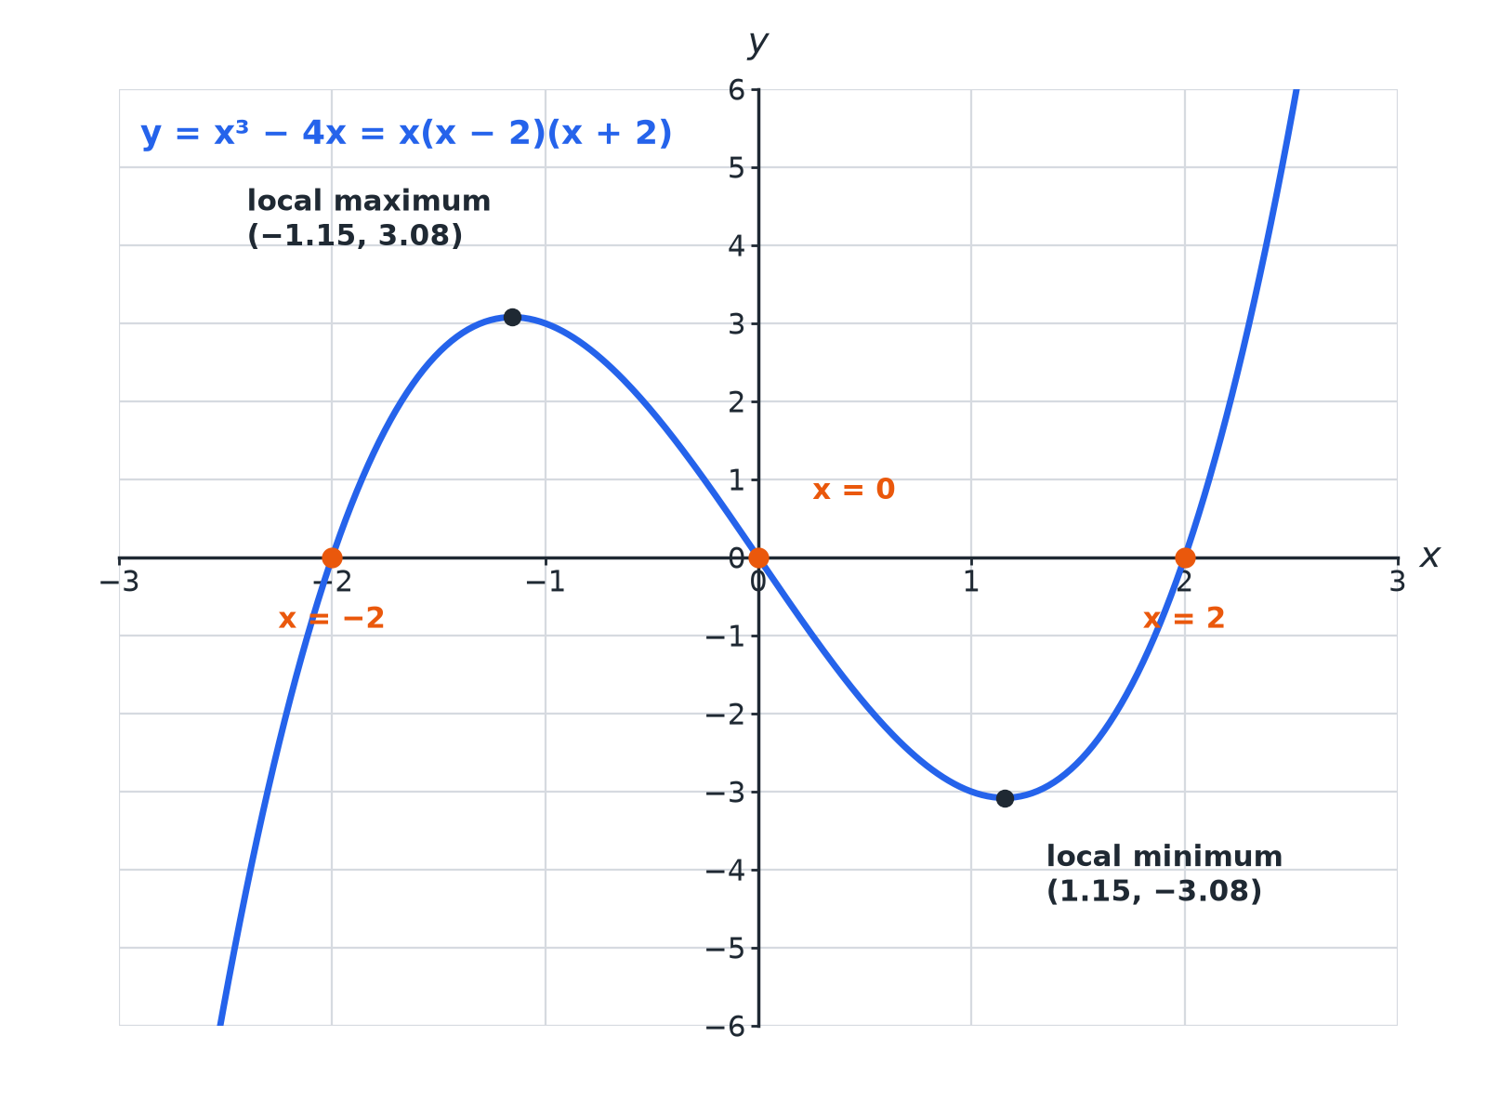

EDEXCEL GCSE MATHS · HIGHER
A Cubic Graph
Three roots, one maximum and one minimum.
Equations and graphs
openrevise.com
Lesson 5 of 6

Slide 7

EDEXCEL GCSE MATHS · HIGHER
Table of Values
y = x³ − 4x.
x
−3
−2
−1
1
y
−15
0
3
0 | −3 | 0 | 15
Equations and graphs
openrevise.com
Lesson 5 of 6

Slide 8

EDEXCEL GCSE MATHS · HIGHER
Roots of a Cubic
Find the roots of y = x³ − 4x.
Set y = 0
x³ − 4x = 0
1
Factorise
x(x² − 4) = x(x − 2)(x + 2)
2
Solve
x = 0, 2, −2
3
ANSWER
The roots are x = −2, 0 and 2.
Equations and graphs
openrevise.com
Lesson 5 of 6

Slide 9
EDEXCEL GCSE MATHS · HIGHER
Solving a Cubic from the Graph
Use the graph of y = x³ − 4x to solve x³ − 4x = 1.
Draw
The line y = 1
1
Read the three intersections
x ≈ −1.9, −0.3 and 2.1
2
Check
2.1³ − 4 × 2.1 = 0.861, close to 1
3
ANSWER
x ≈ −1.9, x ≈ −0.3 and x ≈ 2.1
Equations and graphs
openrevise.com
Lesson 5 of 6

Slide 10
EDEXCEL GCSE MATHS · HIGHER
How Many Solutions?
How many solutions does x³ − 4x = 5 have?
Local maximum
About 3.1, below 5
1
The line y = 5
Meets the curve once, on the right
2
ANSWER
One solution.
Equations and graphs
openrevise.com
Lesson 5 of 6

Slide 11

EDEXCEL GCSE MATHS · HIGHER
Common Mistakes
Draw carefully.
Sharp corners
The curve is smooth: no straight segments or points.
Negative values
Cube negatives carefully: (−2)³ = −8.
Missing solutions
A cubic can have up to three solutions.
Turning point values
Read them from the graph or a fine table.
Equations and graphs
openrevise.com
Lesson 5 of 6

Slide 12

EDEXCEL GCSE MATHS · HIGHER
Key Terms
Cubic
An expression or equation with a highest power of x³.
Root
A solution of f(x) = 0.
Local maximum
A turning point at the top of a hill.
Local minimum
A turning point at the bottom of a valley.
Intersection
Where two graphs meet.
Estimate
An approximate value from a graph.
Equations and graphs
openrevise.com
Lesson 5 of 6

Slide 13

EDEXCEL GCSE MATHS · HIGHER
YOUR TASK
12 minutes
Cubic Table
Complete a table for y = x³ − 3x for x = −2 to 2. Sketch the graph. How many roots does it have?
Cube each x carefully.
1
Join with a smooth curve.
2
WHAT A GOOD ANSWER SHOWS
y = −2, 2, 0, −2, 2. The curve crosses the x-axis at x = −√3, 0, √3: three roots.
Equations and graphs
openrevise.com
Lesson 5 of 6
Notes:
Ask learners to describe where the turning points are.

Slide 14
EDEXCEL GCSE MATHS · HIGHER
Can I...?
Recognise a cubic graph.
Identify turning points.
Complete a table.
Draw a line to solve an equation.
Draw a smooth curve.
Count the solutions.
Find roots.
Avoid common mistakes.
Equations and graphs
openrevise.com
Lesson 5 of 6

Slide 15
EDEXCEL GCSE MATHS · HIGHER
Summary & Exam Focus
A cubic has an x³ term.
It can have up to three roots and two turning points.
Solve f(x) = k with the line y = k.
Factorise to find exact roots.
EXAM FOCUS
Use the graph of y = x³ − 4x to find estimates for the solutions of x³ − 4x = 1. (3 marks)
Draw the horizontal line y = 1 and read all three intersections.
openrevise.com

Slide 16
EDEXCEL GCSE MATHS · HIGHER
Exam Practice: Cubic equations
Answer all questions. Show your working. · 30 minutes
Question 1 · 2 marks · Complete the table
Complete the table of values for y = x³ − 4x for x = −3, −2, −1, 0, 1, 2, 3.
Question 2 · 3 marks · Use the graph
The graph of y = x³ − 4x is drawn on the grid. Use the graph to find estimates for the solutions of x³ − 4x = 1.
Question 3 · 3 marks · Solve
Factorise x³ − 4x and hence solve x³ − 4x = 0.
Equations and graphs
openrevise.com
Lesson 5 of 6

Slide 17
EDEXCEL GCSE MATHS · HIGHER
Exam Practice: Cubic equations (cont.)
Question 4 · 2 marks · Explain
Use the graph to explain why x³ − 4x = 5 has only one solution.
Question 5 · 2 marks · Work out
Work out the value of x³ − 4x when x = 1.2.
Question 6 · 2 marks · Describe
Describe the shape of the graph of y = x³ and write down its root.
Equations and graphs
openrevise.com
Lesson 5 of 6

Slide 18
EDEXCEL GCSE MATHS · HIGHER
Question 1 · 2 marks · Complete the table
“
Complete the table of values for y = x³ − 4x for x = −3, −2, −1, 0, 1, 2, 3.
HOW TO ANSWER IT
Command word: Complete the table. Worth 2 marks, so plan before writing.
Equations and graphs
openrevise.com
Lesson 5 of 6

Slide 19
EDEXCEL GCSE MATHS · HIGHER
Question 1 · mark scheme
2 marks available. Award a mark for each point made.
At least 4 correct
M1
All correct
A1
Equations and graphs
openrevise.com
Lesson 5 of 6

Slide 20
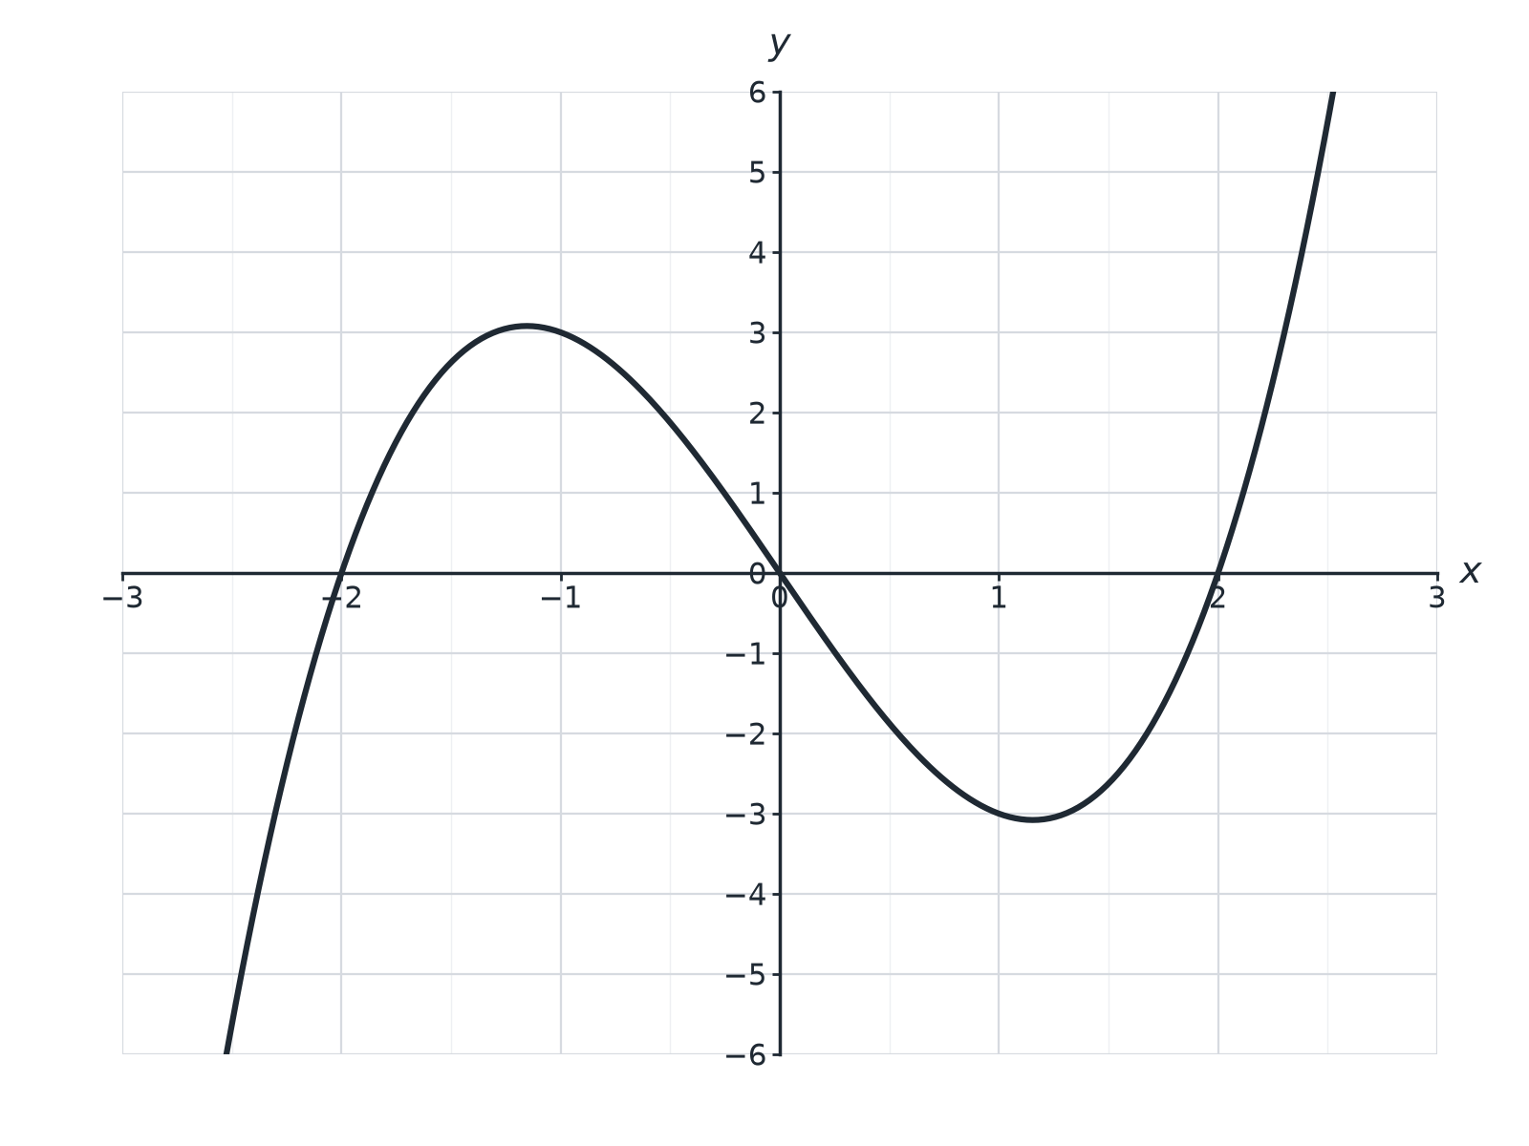
EDEXCEL GCSE MATHS · HIGHER
Question 2 · 3 marks · Use the graph
The graph of y = x³ − 4x is drawn on the grid. Use the graph to find estimates for the solutions of x³ − 4x = 1. (3 marks)
Equations and graphs
openrevise.com
Lesson 5 of 6

Slide 21
EDEXCEL GCSE MATHS · HIGHER
Question 2 · mark scheme
3 marks available. Award a mark for each point made.
Draws y = 1
M1
Two correct estimates
A1
All three
A1
Equations and graphs
openrevise.com
Lesson 5 of 6

Slide 22
EDEXCEL GCSE MATHS · HIGHER
Question 3 · 3 marks · Solve
“
Factorise x³ − 4x and hence solve x³ − 4x = 0.
HOW TO ANSWER IT
Command word: Solve. Worth 3 marks, so plan before writing.
Equations and graphs
openrevise.com
Lesson 5 of 6

Slide 23
EDEXCEL GCSE MATHS · HIGHER
Question 3 · mark scheme
3 marks available. Award a mark for each point made.
x(x² − 4)
M1
x(x − 2)(x + 2)
A1
Three solutions
A1
Equations and graphs
openrevise.com
Lesson 5 of 6

Slide 24
EDEXCEL GCSE MATHS · HIGHER
Question 4 · 2 marks · Explain
“
Use the graph to explain why x³ − 4x = 5 has only one solution.
HOW TO ANSWER IT
Command word: Explain. Worth 2 marks, so plan before writing.
Equations and graphs
openrevise.com
Lesson 5 of 6

Slide 25
EDEXCEL GCSE MATHS · HIGHER
Question 4 · mark scheme
2 marks available. Award a mark for each point made.
Line y = 5 is above the maximum
M1
Only one intersection
C1
Equations and graphs
openrevise.com
Lesson 5 of 6

Slide 26
EDEXCEL GCSE MATHS · HIGHER
Question 5 · 2 marks · Work out
“
Work out the value of x³ − 4x when x = 1.2.
HOW TO ANSWER IT
Command word: Work out. Worth 2 marks, so plan before writing.
Equations and graphs
openrevise.com
Lesson 5 of 6

Slide 27
EDEXCEL GCSE MATHS · HIGHER
Question 5 · mark scheme
2 marks available. Award a mark for each point made.
1.2³ = 1.728
M1
−3.072
A1
Equations and graphs
openrevise.com
Lesson 5 of 6

Slide 28
EDEXCEL GCSE MATHS · HIGHER
Question 6 · 2 marks · Describe
“
Describe the shape of the graph of y = x³ and write down its root.
HOW TO ANSWER IT
Command word: Describe. Worth 2 marks, so plan before writing.
Equations and graphs
openrevise.com
Lesson 5 of 6

Slide 29
EDEXCEL GCSE MATHS · HIGHER
Question 6 · mark scheme
2 marks available. Award a mark for each point made.
S-shaped curve
B1
x = 0
B1
Equations and graphs
openrevise.com
Lesson 5 of 6

