Slide 1
EDEXCEL GCSE MATHS · HIGHER
Using iteration to solve equations
Equations and graphs
Lesson 6 of 6
openrevise.com

Slide 2

EDEXCEL GCSE MATHS · HIGHER
Warm-up
Answer each one, then check.
1
Work out 1³ − 1 − 1.
2
Work out 2³ − 2 − 1.
3
What is ∛8?
4
What does ANS do on a calculator?
5
What does "to 2 decimal places" mean?
Equations and graphs
openrevise.com
Lesson 6 of 6

Slide 3
EDEXCEL GCSE MATHS · HIGHER
Warm-up - Answers
Work out 1³ − 1 − 1.
−1
1
Work out 2³ − 2 − 1.
5
2
What is ∛8?
2
3
What does ANS do on a calculator?
Uses the previous answer
4
What does "to 2 decimal places" mean?
Rounded to two digits after the point
5
Equations and graphs
openrevise.com
Lesson 6 of 6

Slide 4

EDEXCEL GCSE MATHS · HIGHER
Learning Objectives
Show that a root lies between two values.
1
Use decimal search to narrow down a root.
2
Use an iteration formula x_(n+1) = f(x_n).
3
Rearrange an equation into an iteration formula.
4
Equations and graphs
openrevise.com
Lesson 6 of 6

Slide 5

EDEXCEL GCSE MATHS · HIGHER
CHANGE OF SIGN
If f(a) and f(b) have opposite signs, the graph crosses the x-axis between a and b, so there is a root in that interval.
This works when f is continuous, with no breaks in the curve.
Equations and graphs
openrevise.com
Lesson 6 of 6

Slide 6
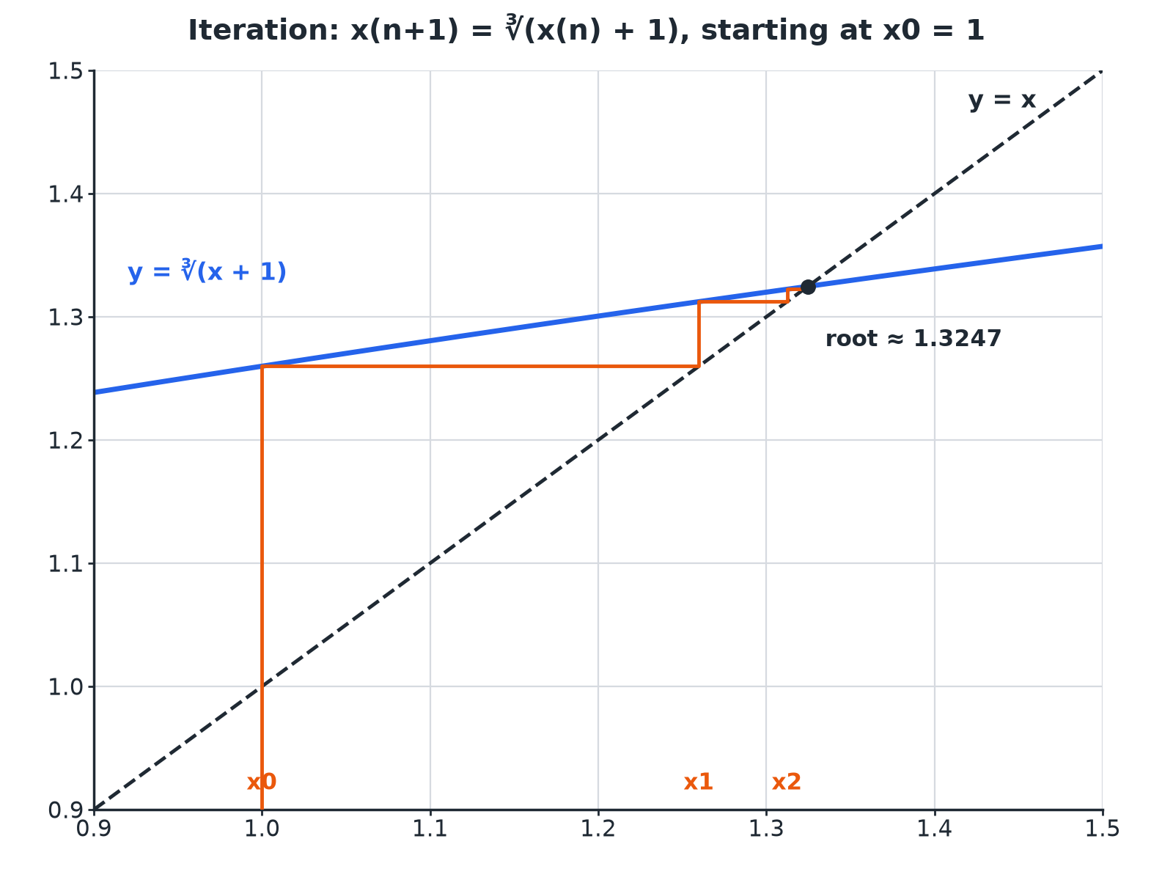

EDEXCEL GCSE MATHS · HIGHER
Iteration Staircase
Each step feeds the last answer back in, moving towards the root.
Equations and graphs
openrevise.com
Lesson 6 of 6

Slide 7

EDEXCEL GCSE MATHS · HIGHER
Change of Sign
Show that x³ − x − 1 = 0 has a root between 1 and 2.
Write the function
f(x) = x³ − x − 1
1
f(1)
1 − 1 − 1 = −1
2
f(2)
8 − 2 − 1 = 5
3
Sign change
Negative to positive
4
ANSWER
f(1) < 0 and f(2) > 0, so there is a root between 1 and 2.
Equations and graphs
openrevise.com
Lesson 6 of 6

Slide 8
EDEXCEL GCSE MATHS · HIGHER
Decimal Search
Find the root of x³ − x − 1 = 0 to 2 decimal places.
1
f(1.3)
−0.103 (negative)
2
f(1.4)
0.344 (positive)
3
f(1.32)
−0.020 (negative)
4
f(1.33)
0.023 (positive)
5
Midpoint f(1.325)
0.001 (positive), so the root is below 1.325
ANSWER
The root is 1.32 to 2 decimal places.
Equations and graphs
openrevise.com
Lesson 6 of 6

Slide 9
EDEXCEL GCSE MATHS · HIGHER
Iteration
x_(n+1) = ∛(x_n + 1) with x₀ = 1. Work out x₁, x₂ and x₃.
x₁
∛2 = 1.2599
1
x₂
∛(1.2599 + 1) = 1.3123
2
x₃
∛(1.3123 + 1) = 1.3224
3
ANSWER
x₁ = 1.2599, x₂ = 1.3123, x₃ = 1.3224; the values are approaching the root 1.3247.
Equations and graphs
openrevise.com
Lesson 6 of 6

Slide 10
EDEXCEL GCSE MATHS · HIGHER
Rearranging to an Iteration Formula
Show that x³ − x − 1 = 0 can be rearranged to x = ∛(x + 1).
Add x + 1
x³ = x + 1
1
Cube root
x = ∛(x + 1)
2
ANSWER
x³ − x − 1 = 0 gives x³ = x + 1, so x = ∛(x + 1).
Equations and graphs
openrevise.com
Lesson 6 of 6

Slide 11

EDEXCEL GCSE MATHS · HIGHER
Calculator Tips
Use your calculator efficiently.
Type the starting value
Press =, then type the formula using ANS.
Keep pressing =
Each press gives the next term.
Do not round in between
Use the full value from ANS.
Compare
When two terms agree to the accuracy needed, stop.
Equations and graphs
openrevise.com
Lesson 6 of 6

Slide 12

EDEXCEL GCSE MATHS · HIGHER
Key Terms
Iteration
Repeating a calculation using the previous answer.
Iteration formula
A rule x_(n+1) = f(x_n).
Starting value
The first value, x₀.
Change of sign
f(a) and f(b) have opposite signs.
Root
A value of x where f(x) = 0.
Convergence
The values getting closer to a limit.
Equations and graphs
openrevise.com
Lesson 6 of 6

Slide 13

EDEXCEL GCSE MATHS · HIGHER
YOUR TASK
12 minutes
Close In on a Root
(a) Show that x³ + 2x − 7 = 0 has a root between 1 and 2. (b) Use decimal search to find the root to 1 decimal place.
Test the midpoint of the last interval.
1
Decide which way to round.
2
WHAT A GOOD ANSWER SHOWS
(a) f(1) = −4, f(2) = 5. (b) f(1.5) = −0.625, f(1.6) = 0.296, f(1.55) = −0.176; the root is between 1.55 and 1.6, so it is 1.6 to 1 d.p.
Equations and graphs
openrevise.com
Lesson 6 of 6
Notes:
Discuss why testing the midpoint 1.55 settles the rounding.

Slide 14
EDEXCEL GCSE MATHS · HIGHER
Can I...?
Evaluate f(a) and f(b).
Use ANS on a calculator.
Explain a change of sign.
Use an iteration formula.
Use decimal search.
Rearrange to an iteration formula.
Use a starting value.
Stop at the required accuracy.
Equations and graphs
openrevise.com
Lesson 6 of 6

Slide 15
EDEXCEL GCSE MATHS · HIGHER
Summary & Exam Focus
Change of sign shows a root in an interval.
Decimal search narrows the interval.
Iteration: feed each answer back into the formula.
Stop when values agree to the required accuracy.
EXAM FOCUS
Show that x³ − x − 1 = 0 has a root between 1 and 2. (2 marks)
Show both values of f and state that the sign changes.
openrevise.com

Slide 16
EDEXCEL GCSE MATHS · HIGHER
Exam Practice: Using iteration to solve equations
Answer all questions. Show your working. · 30 minutes
Question 1 · 2 marks · Show that
Show that the equation x³ − x − 1 = 0 has a root between 1 and 2.
Question 2 · 3 marks · Work out
x_(n+1) = ∛(x_n + 1) and x₀ = 1. Work out the values of x₁, x₂ and x₃.
Question 3 · 2 marks · Show that
Show that x³ − x − 1 = 0 can be rearranged to give x = ∛(x + 1).
Equations and graphs
openrevise.com
Lesson 6 of 6

Slide 17
EDEXCEL GCSE MATHS · HIGHER
Exam Practice: Using iteration to solve equations (cont.)
Question 4 · 4 marks · Find
The graph of y = x³ − x − 1 is shown. It crosses the x-axis between x = 1 and x = 2. Use a trial and improvement method to find this root…
Question 5 · 4 marks · Find
(a) Show that x³ + 2x − 7 = 0 has a root between 1 and 2. (b) Find this root correct to 1 decimal place.
Question 6 · 2 marks · Explain
Using x_(n+1) = ∛(x_n + 1) with x₀ = 1, the values are x₅ = 1.32463 and x₆ = 1.32470. Write down the root of x³ − x − 1 = 0 to 3 decimal…
Equations and graphs
openrevise.com
Lesson 6 of 6

Slide 18
EDEXCEL GCSE MATHS · HIGHER
Question 1 · 2 marks · Show that
“
Show that the equation x³ − x − 1 = 0 has a root between 1 and 2.
HOW TO ANSWER IT
Command word: Show that. Worth 2 marks, so plan before writing.
Equations and graphs
openrevise.com
Lesson 6 of 6

Slide 19
EDEXCEL GCSE MATHS · HIGHER
Question 1 · mark scheme
2 marks available. Award a mark for each point made.
f(1) = −1 and f(2) = 5
M1
Change of sign conclusion
C1
Equations and graphs
openrevise.com
Lesson 6 of 6

Slide 20
EDEXCEL GCSE MATHS · HIGHER
Question 2 · 3 marks · Work out
“
x_(n+1) = ∛(x_n + 1) and x₀ = 1. Work out the values of x₁, x₂ and x₃.
HOW TO ANSWER IT
Command word: Work out. Worth 3 marks, so plan before writing.
Equations and graphs
openrevise.com
Lesson 6 of 6

Slide 21
EDEXCEL GCSE MATHS · HIGHER
Question 2 · mark scheme
3 marks available. Award a mark for each point made.
x₁ = 1.26
B1
x₂ = 1.31
B1
x₃ = 1.32
B1
Equations and graphs
openrevise.com
Lesson 6 of 6

Slide 22
EDEXCEL GCSE MATHS · HIGHER
Question 3 · 2 marks · Show that
“
Show that x³ − x − 1 = 0 can be rearranged to give x = ∛(x + 1).
HOW TO ANSWER IT
Command word: Show that. Worth 2 marks, so plan before writing.
Equations and graphs
openrevise.com
Lesson 6 of 6

Slide 23
EDEXCEL GCSE MATHS · HIGHER
Question 3 · mark scheme
2 marks available. Award a mark for each point made.
x³ = x + 1
M1
Cube root both sides
A1
Equations and graphs
openrevise.com
Lesson 6 of 6

Slide 24
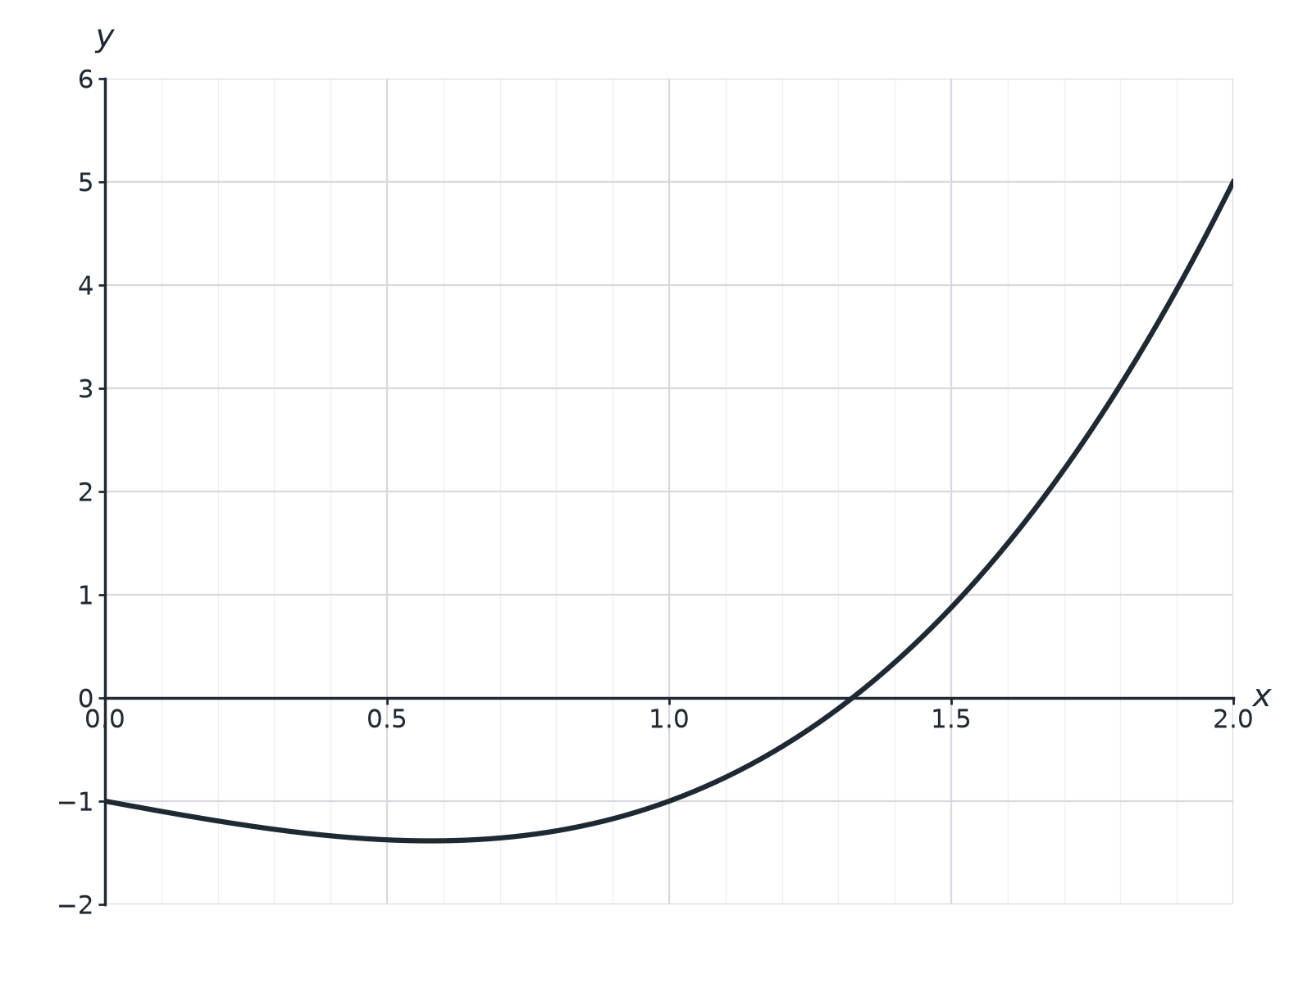
EDEXCEL GCSE MATHS · HIGHER
Question 4 · 4 marks · Find
The graph of y = x³ − x − 1 is shown. It crosses the x-axis between x = 1 and x = 2. Use a trial and improvement method to find this root correct to 1 decimal place. You must show all your working. (4 marks)
Equations and graphs
openrevise.com
Lesson 6 of 6

Slide 25
EDEXCEL GCSE MATHS · HIGHER
Question 4 · mark scheme
4 marks available. Award a mark for each point made.
Tests values in the interval
M1
f(1.3) < 0 and f(1.4) > 0
A1
Tests 1.35
M1
1.3
A1
Equations and graphs
openrevise.com
Lesson 6 of 6

Slide 26
EDEXCEL GCSE MATHS · HIGHER
Question 5 · 4 marks · Find
“
(a) Show that x³ + 2x − 7 = 0 has a root between 1 and 2. (b) Find this root correct to 1 decimal place.
HOW TO ANSWER IT
Command word: Find. Worth 4 marks, so plan before writing.
Equations and graphs
openrevise.com
Lesson 6 of 6

Slide 27
EDEXCEL GCSE MATHS · HIGHER
Question 5 · mark scheme
4 marks available. Award a mark for each point made.
f(1) = −4 and f(2) = 5
B1
Tests 1.5 or 1.6
M1
Tests 1.55
M1
1.6
A1
Equations and graphs
openrevise.com
Lesson 6 of 6

Slide 28
EDEXCEL GCSE MATHS · HIGHER
Question 6 · 2 marks · Explain
“
Using x_(n+1) = ∛(x_n + 1) with x₀ = 1, the values are x₅ = 1.32463 and x₆ = 1.32470. Write down the root of x³ − x − 1 = 0 to 3 decimal places and explain how you know.
HOW TO ANSWER IT
Command word: Explain. Worth 2 marks, so plan before writing.
Equations and graphs
openrevise.com
Lesson 6 of 6

Slide 29
EDEXCEL GCSE MATHS · HIGHER
Question 6 · mark scheme
2 marks available. Award a mark for each point made.
1.325
B1
Successive values agree to 3 d.p.
C1
Equations and graphs
openrevise.com
Lesson 6 of 6

