Slide 1

AQA GCSE PHYSICS · PAPER 1 · FOUNDATION & HIGHER
Energy stores and systems
Energy
Lesson 1 of 7
openrevise.com

Slide 2

AQA GCSE PHYSICS · PAPER 1 · FOUNDATION & HIGHER
Warm-up
Answer each one, then check.
1
What is the unit of energy?
2
What is a system?
3
Name the energy store in a stretched spring.
4
Name the energy store in food and fuels.
5
Can energy be created or destroyed?
Energy
openrevise.com
Lesson 1 of 7

Slide 3
AQA GCSE PHYSICS · PAPER 1 · FOUNDATION & HIGHER
Warm-up - Answers
What is the unit of energy?
The joule (J)
1
What is a system?
An object or group of objects
2
Name the energy store in a stretched spring.
Elastic potential
3
Name the energy store in food and fuels.
Chemical
4
Can energy be created or destroyed?
No, it can only be transferred, stored or dissipated
5
Energy
openrevise.com
Lesson 1 of 7

Slide 4

AQA GCSE PHYSICS · PAPER 1 · FOUNDATION & HIGHER
Learning Objectives
Define a system and describe changes in the way energy is stored when a system changes.
1
Name the main energy stores and the four transfer pathways.
2
Describe the energy changes in common situations, such as an object projected upwards or a kettle boiling water.
3
Write clear statements using the phrase 'energy is transferred from ... to ...'.
4
Energy
openrevise.com
Lesson 1 of 7

Slide 5

AQA GCSE PHYSICS · PAPER 1 · FOUNDATION & HIGHER
CONSERVATION OF ENERGY
Energy cannot be created or destroyed. It can be transferred usefully, stored or dissipated.
A system is an object or group of objects. When a system changes, there are changes in the way energy is stored.
Energy
openrevise.com
Lesson 1 of 7

Slide 6
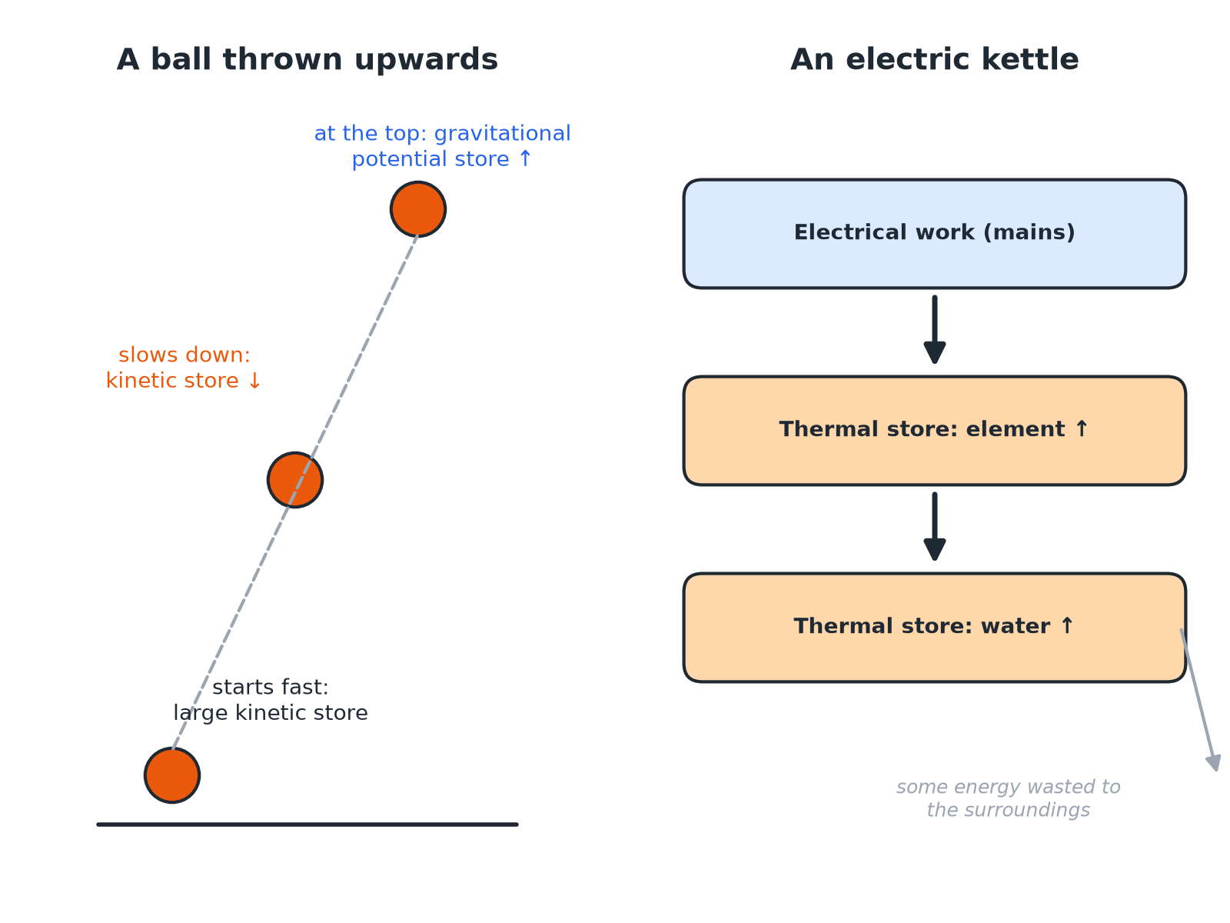

AQA GCSE PHYSICS · PAPER 1 · FOUNDATION & HIGHER
Energy Changes in Two Systems
Ask 'which store goes down and which goes up?' for every change.
Energy
openrevise.com
Lesson 1 of 7

Slide 7

AQA GCSE PHYSICS · PAPER 1 · FOUNDATION & HIGHER
The Energy Stores
Learn the main stores and an example of each.
Energy store
Examples
Kinetic
Any moving object
Gravitational potential
An object above the ground
Elastic potential
A stretched or compressed spring, an elastic band
Thermal
A hot object; the particles have more energy
Chemical
Fuels, food, batteries
Nuclear
The nucleus of an atom
Magnetic
Magnets and electromagnets
Electrostatic
Charged objects, such as a charged balloon
Energy
openrevise.com
Lesson 1 of 7

Slide 8
AQA GCSE PHYSICS · PAPER 1 · FOUNDATION & HIGHER
Ways Energy Is Transferred
Mechanically
A force moves an object through a distance (work done).
Electrically
Charge flows in a circuit (work done by the current).
By heating
Energy flows from a hotter object to a cooler one.
By radiation
Energy is carried by waves, such as light and sound.
Energy
openrevise.com
Lesson 1 of 7

Slide 9

AQA GCSE PHYSICS · PAPER 1 · FOUNDATION & HIGHER
A Ball Thrown Upwards
Describe the changes in the way energy is stored when a ball is thrown upwards, until it reaches its highest point.
Just after leaving the hand
The ball has a large kinetic energy store
1
As it rises
It slows down, so the kinetic energy store decreases
2
At the same time
Its height increases, so the gravitational potential energy store increases
3
Small effect
Some energy is transferred to the thermal store of the air by friction
4
ANSWER
Energy is transferred mechanically from the kinetic store to the gravitational potential store, with a little dissipated to the thermal store of the air.
Energy
openrevise.com
Lesson 1 of 7

Slide 10
AQA GCSE PHYSICS · PAPER 1 · FOUNDATION & HIGHER
Boiling Water in a Kettle
Describe the changes in the way energy is stored when a kettle boils water.
Electrical work
Charge flowing through the heating element transfers energy from the mains
1
Heating element
The thermal energy store of the element increases
2
By heating
Energy is transferred to the thermal energy store of the water, which increases
3
Wasted
Some energy heats the kettle and the surroundings
4
ANSWER
Energy is transferred electrically and then by heating to the thermal store of the water; some is dissipated to the surroundings.
Energy
openrevise.com
Lesson 1 of 7

Slide 11

AQA GCSE PHYSICS · PAPER 1 · FOUNDATION & HIGHER
Writing Good Answers
Use the language of stores and transfers.
Name the stores
Say 'the kinetic energy store decreases', not 'kinetic energy is lost'.
Say how
Give the pathway: mechanically, electrically, by heating or by radiation.
Say where the rest goes
Mention dissipation to the surroundings if the system is not perfectly efficient.
Total energy
The total energy after the change is the same as before.
Energy
openrevise.com
Lesson 1 of 7

Slide 12

AQA GCSE PHYSICS · PAPER 1 · FOUNDATION & HIGHER
Key Terms
System
An object or group of objects.
Energy store
A way energy is held, such as kinetic or thermal.
Transfer
Energy moving from one store to another.
Dissipated
Spread out to the surroundings in less useful stores.
Closed system
A system where no energy enters or leaves.
Work done
Energy transferred by a force or a current.
Energy
openrevise.com
Lesson 1 of 7

Slide 13

AQA GCSE PHYSICS · PAPER 1 · FOUNDATION & HIGHER
YOUR TASK
10 minutes
Store to Store
For each situation, name the store that decreases and the store that increases. (a) A car braking. (b) A book falling off a shelf. (c) A battery powering a motor lifting a weight. (d) A bow being drawn and released.
Name the store before.
1
Name the store after.
2
WHAT A GOOD ANSWER SHOWS
(a) Kinetic decreases; thermal (brakes) increases. (b) Gravitational potential decreases; kinetic increases. (c) Chemical decreases; gravitational potential increases (plus some thermal). (d) Chemical (archer) to elastic potential, then elastic decreases; kinetic of the arrow increases.
Energy
openrevise.com
Lesson 1 of 7

Slide 14
AQA GCSE PHYSICS · PAPER 1 · FOUNDATION & HIGHER
Can I...?
Name the main energy stores.
Describe energy changes when a vehicle slows down.
Name the four transfer pathways.
Describe how a kettle heats water.
Define a system.
Use 'increases' and 'decreases' correctly.
Describe energy changes for an object projected upwards.
State that total energy is conserved.
Energy
openrevise.com
Lesson 1 of 7

Slide 15
AQA GCSE PHYSICS · PAPER 1 · FOUNDATION & HIGHER
Summary & Exam Focus
Energy can be transferred, stored or dissipated but not created or destroyed.
Describe changes with 'store decreases' and 'store increases'.
Pathways: mechanically, electrically, by heating, by radiation.
In a closed system the total energy does not change.
EXAM FOCUS
A car slows down to a stop using its brakes. Describe the changes in the way energy is stored. (2 marks)
Say which store decreases and which increases.
openrevise.com

