Slide 1

AQA GCSE PHYSICS · PAPER 1 · FOUNDATION & HIGHER
Kinetic, elastic and gravitational potential energy
Energy
Lesson 2 of 7
openrevise.com

Slide 2

AQA GCSE PHYSICS · PAPER 1 · FOUNDATION & HIGHER
Warm-up
Answer each one, then check.
1
Write the unit for mass.
2
Convert 6.0 cm to metres.
3
Work out 4².
4
What does g stand for in E_p = mgh?
5
What is the unit of speed?
Energy
openrevise.com
Lesson 2 of 7

Slide 3
AQA GCSE PHYSICS · PAPER 1 · FOUNDATION & HIGHER
Warm-up - Answers
Write the unit for mass.
Kilograms (kg)
1
Convert 6.0 cm to metres.
0.060 m
2
Work out 4².
16
3
What does g stand for in E_p = mgh?
Gravitational field strength
4
What is the unit of speed?
Metres per second (m/s)
5
Energy
openrevise.com
Lesson 2 of 7

Slide 4

AQA GCSE PHYSICS · PAPER 1 · FOUNDATION & HIGHER
Learning Objectives
Recall and apply the equation for kinetic energy.
1
Recall and apply the equation for elastic potential energy.
2
Apply the equation for gravitational potential energy.
3
Use energy conservation to find speeds and heights.
4
Convert units and give answers to an appropriate number of significant figures.
5
Energy
openrevise.com
Lesson 2 of 7

Slide 5

AQA GCSE PHYSICS · PAPER 1 · FOUNDATION & HIGHER
THREE ENERGY EQUATIONS
E_k = ½mv² E_e = ½ke² E_p = mgh
Learn the first two. E_p = mgh is on the equation sheet, and the value of g (9.8 N/kg) is always given in the question.
Energy
openrevise.com
Lesson 2 of 7

Slide 6
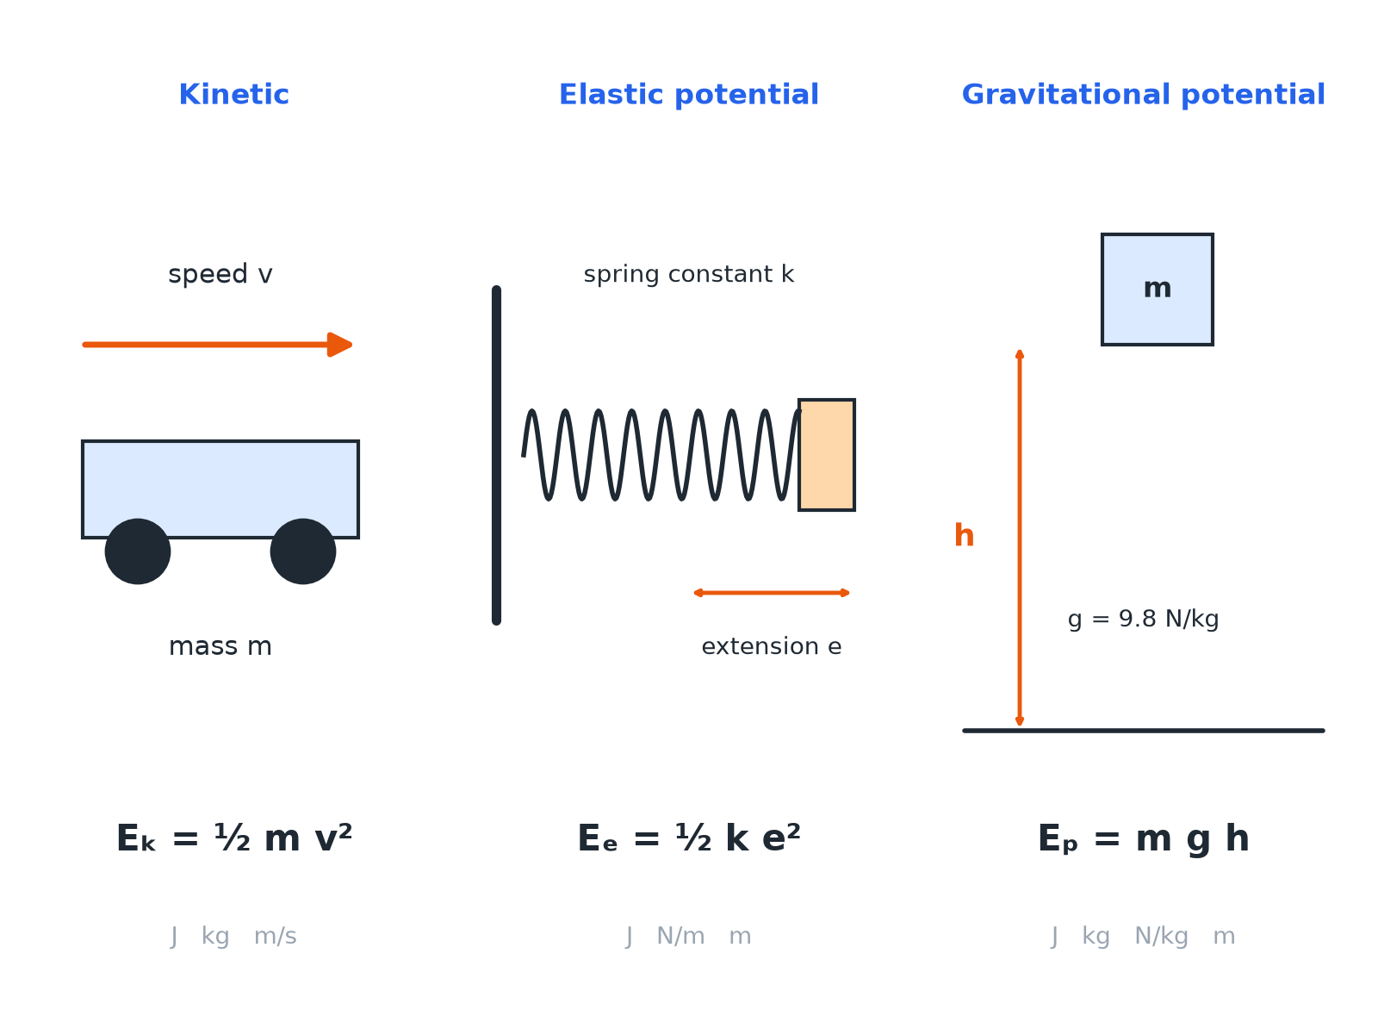

AQA GCSE PHYSICS · PAPER 1 · FOUNDATION & HIGHER
Three Stores, Three Equations
Check the units before you substitute.
Energy
openrevise.com
Lesson 2 of 7

Slide 7

AQA GCSE PHYSICS · PAPER 1 · FOUNDATION & HIGHER
Quantities and Units
Always use these units.
Quantity
Symbol
Unit
Kinetic energy
E_k
joules (J)
Elastic potential energy
E_e
joules (J)
Gravitational potential energy
E_p
joules (J)
Mass
m
kilograms (kg)
Speed
v
metres per second (m/s)
Spring constant
k
newtons per metre (N/m)
Extension
e
metres (m)
Gravitational field strength
g
newtons per kilogram (N/kg)
Height
h
metres (m)
Energy
openrevise.com
Lesson 2 of 7

Slide 8

AQA GCSE PHYSICS · PAPER 1 · FOUNDATION & HIGHER
Kinetic Energy
A car of mass 1200 kg travels at 15 m/s. Calculate its kinetic energy.
Write the equation
E_k = ½mv²
1
Substitute
E_k = 0.5 × 1200 × 15²
2
Square first
15² = 225
3
Answer
E_k = 135 000 J
4
ANSWER
Kinetic energy = 135 000 J (or 135 kJ).
Energy
openrevise.com
Lesson 2 of 7

Slide 9
AQA GCSE PHYSICS · PAPER 1 · FOUNDATION & HIGHER
Elastic Potential Energy
A spring has a spring constant of 40 N/m. It is stretched by 25 cm. Calculate the elastic potential energy stored.
Convert the extension
25 cm = 0.25 m
1
Substitute
E_e = 0.5 × 40 × 0.25²
2
Answer
E_e = 1.25 J
3
ANSWER
1.25 J
Energy
openrevise.com
Lesson 2 of 7

Slide 10
AQA GCSE PHYSICS · PAPER 1 · FOUNDATION & HIGHER
Gravitational Potential Energy
A 2.0 kg book is lifted 3.0 m onto a shelf. g = 9.8 N/kg. Calculate the gain in gravitational potential energy.
Write the equation
E_p = mgh
1
Substitute
E_p = 2.0 × 9.8 × 3.0
2
Answer
E_p = 58.8 J
3
ANSWER
58.8 J (about 59 J)
Energy
openrevise.com
Lesson 2 of 7

Slide 11
AQA GCSE PHYSICS · PAPER 1 · FOUNDATION & HIGHER
Using Energy Conservation
A roller coaster car starts from rest at a height of 20 m. Ignoring friction, find its speed at the bottom. g = 9.8 N/kg.
Gravitational potential lost equals kinetic gained
mgh = ½mv²
1
The mass cancels
v² = 2gh = 2 × 9.8 × 20 = 392
2
Square root
v = 19.8 m/s
3
ANSWER
19.8 m/s
Energy
openrevise.com
Lesson 2 of 7

Slide 12

AQA GCSE PHYSICS · PAPER 1 · FOUNDATION & HIGHER
Common Mistakes
Marks are often lost here.
Squaring
Square only the speed or extension, not the whole of ½mv.
Units
Convert cm to m and g to kg before substituting.
Halving
Do not forget the 0.5 in the kinetic and elastic equations.
Significant figures
Give the answer to the same number of s.f. as the least accurate data, usually 2 or 3.
Energy
openrevise.com
Lesson 2 of 7

Slide 13

AQA GCSE PHYSICS · PAPER 1 · FOUNDATION & HIGHER
Key Terms
Kinetic energy
Energy stored in the movement of an object.
Elastic potential energy
Energy stored in a stretched or compressed object.
Gravitational potential energy
Energy stored in an object raised above the ground.
Spring constant
How stiff a spring is; force needed per metre of extension.
Extension
The increase in length of a spring.
Gravitational field strength
The force on each kilogram; 9.8 N/kg on Earth.
Energy
openrevise.com
Lesson 2 of 7

Slide 14

AQA GCSE PHYSICS · PAPER 1 · FOUNDATION & HIGHER
YOUR TASK
12 minutes
Energy Race
Calculate each. (a) A 0.50 kg ball moving at 8.0 m/s. (b) A spring with k = 100 N/m stretched by 0.10 m. (c) A 60 kg climber 15 m up a cliff (g = 9.8 N/kg).
1
Write the equation.
2
Substitute and calculate.
3
Add the unit.
WHAT A GOOD ANSWER SHOWS
(a) 16 J (b) 0.50 J (c) 8820 J (about 8800 J).
Energy
openrevise.com
Lesson 2 of 7

Slide 15
AQA GCSE PHYSICS · PAPER 1 · FOUNDATION & HIGHER
Can I...?
Recall the kinetic energy equation.
Square the correct quantity.
Recall the elastic potential energy equation.
Use conservation of energy to find a speed.
Use the gravitational potential energy equation.
Give units and sensible significant figures.
Convert cm to m.
Rearrange an equation.
Energy
openrevise.com
Lesson 2 of 7

Slide 16
AQA GCSE PHYSICS · PAPER 1 · FOUNDATION & HIGHER
Summary & Exam Focus
E_k = ½mv².
E_e = ½ke², with e in metres.
E_p = mgh, with g given.
Energy lost from one store is gained by another if no energy is dissipated.
EXAM FOCUS
A 0.40 kg ball moves at 12 m/s. Calculate its kinetic energy. (2 marks)
Write the equation, substitute, then give the unit.
openrevise.com

