Slide 1

AQA GCSE PHYSICS · PAPER 1 · FOUNDATION & HIGHER
Kinetic, elastic and gravitational potential energy
Energy
Lesson 2 of 7
openrevise.com

Slide 2

AQA GCSE PHYSICS · PAPER 1 · FOUNDATION & HIGHER
Warm-up
Answer each one, then check.
1
Write the unit for mass.
2
Convert 6.0 cm to metres.
3
Work out 4².
4
What does g stand for in E_p = mgh?
5
What is the unit of speed?
Energy
openrevise.com
Lesson 2 of 7

Slide 3
AQA GCSE PHYSICS · PAPER 1 · FOUNDATION & HIGHER
Warm-up - Answers
Write the unit for mass.
Kilograms (kg)
1
Convert 6.0 cm to metres.
0.060 m
2
Work out 4².
16
3
What does g stand for in E_p = mgh?
Gravitational field strength
4
What is the unit of speed?
Metres per second (m/s)
5
Energy
openrevise.com
Lesson 2 of 7

Slide 4

AQA GCSE PHYSICS · PAPER 1 · FOUNDATION & HIGHER
Learning Objectives
Recall and apply the equation for kinetic energy.
1
Recall and apply the equation for elastic potential energy.
2
Apply the equation for gravitational potential energy.
3
Use energy conservation to find speeds and heights.
4
Convert units and give answers to an appropriate number of significant figures.
5
Energy
openrevise.com
Lesson 2 of 7

Slide 5

AQA GCSE PHYSICS · PAPER 1 · FOUNDATION & HIGHER
THREE ENERGY EQUATIONS
E_k = ½mv² E_e = ½ke² E_p = mgh
Learn the first two. E_p = mgh is on the equation sheet, and the value of g (9.8 N/kg) is always given in the question.
Energy
openrevise.com
Lesson 2 of 7

Slide 6
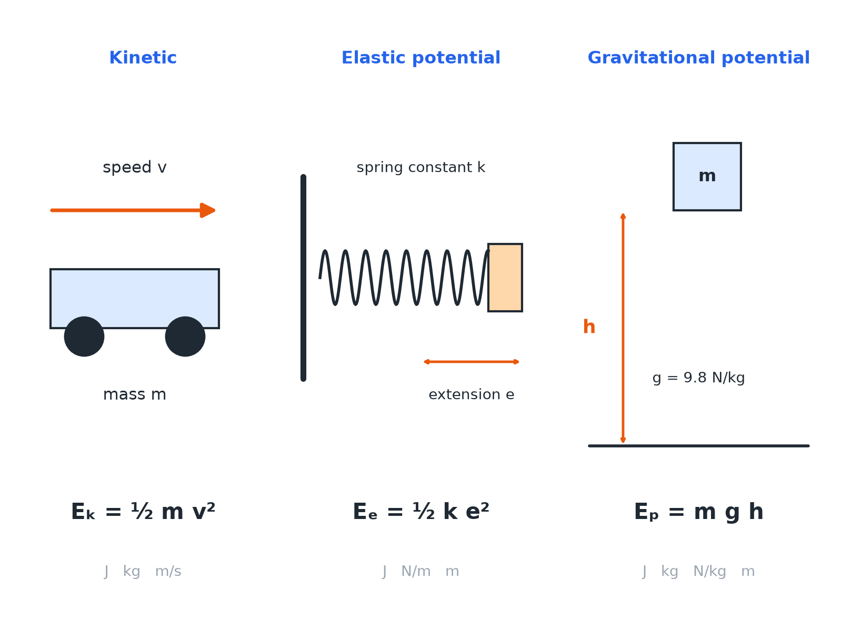

AQA GCSE PHYSICS · PAPER 1 · FOUNDATION & HIGHER
Three Stores, Three Equations
Check the units before you substitute.
Energy
openrevise.com
Lesson 2 of 7

Slide 7

AQA GCSE PHYSICS · PAPER 1 · FOUNDATION & HIGHER
Quantities and Units
Always use these units.
Quantity
Symbol
Unit
Kinetic energy
E_k
joules (J)
Elastic potential energy
E_e
joules (J)
Gravitational potential energy
E_p
joules (J)
Mass
m
kilograms (kg)
Speed
v
metres per second (m/s)
Spring constant
k
newtons per metre (N/m)
Extension
e
metres (m)
Gravitational field strength
g
newtons per kilogram (N/kg)
Height
h
metres (m)
Energy
openrevise.com
Lesson 2 of 7

Slide 8

AQA GCSE PHYSICS · PAPER 1 · FOUNDATION & HIGHER
Kinetic Energy
A car of mass 1200 kg travels at 15 m/s. Calculate its kinetic energy.
Write the equation
E_k = ½mv²
1
Substitute
E_k = 0.5 × 1200 × 15²
2
Square first
15² = 225
3
Answer
E_k = 135 000 J
4
ANSWER
Kinetic energy = 135 000 J (or 135 kJ).
Energy
openrevise.com
Lesson 2 of 7

Slide 9
AQA GCSE PHYSICS · PAPER 1 · FOUNDATION & HIGHER
Elastic Potential Energy
A spring has a spring constant of 40 N/m. It is stretched by 25 cm. Calculate the elastic potential energy stored.
Convert the extension
25 cm = 0.25 m
1
Substitute
E_e = 0.5 × 40 × 0.25²
2
Answer
E_e = 1.25 J
3
ANSWER
1.25 J
Energy
openrevise.com
Lesson 2 of 7

Slide 10
AQA GCSE PHYSICS · PAPER 1 · FOUNDATION & HIGHER
Gravitational Potential Energy
A 2.0 kg book is lifted 3.0 m onto a shelf. g = 9.8 N/kg. Calculate the gain in gravitational potential energy.
Write the equation
E_p = mgh
1
Substitute
E_p = 2.0 × 9.8 × 3.0
2
Answer
E_p = 58.8 J
3
ANSWER
58.8 J (about 59 J)
Energy
openrevise.com
Lesson 2 of 7

Slide 11
AQA GCSE PHYSICS · PAPER 1 · FOUNDATION & HIGHER
Using Energy Conservation
A roller coaster car starts from rest at a height of 20 m. Ignoring friction, find its speed at the bottom. g = 9.8 N/kg.
Gravitational potential lost equals kinetic gained
mgh = ½mv²
1
The mass cancels
v² = 2gh = 2 × 9.8 × 20 = 392
2
Square root
v = 19.8 m/s
3
ANSWER
19.8 m/s
Energy
openrevise.com
Lesson 2 of 7

Slide 12

AQA GCSE PHYSICS · PAPER 1 · FOUNDATION & HIGHER
Common Mistakes
Marks are often lost here.
Squaring
Square only the speed or extension, not the whole of ½mv.
Units
Convert cm to m and g to kg before substituting.
Halving
Do not forget the 0.5 in the kinetic and elastic equations.
Significant figures
Give the answer to the same number of s.f. as the least accurate data, usually 2 or 3.
Energy
openrevise.com
Lesson 2 of 7

Slide 13

AQA GCSE PHYSICS · PAPER 1 · FOUNDATION & HIGHER
Key Terms
Kinetic energy
Energy stored in the movement of an object.
Elastic potential energy
Energy stored in a stretched or compressed object.
Gravitational potential energy
Energy stored in an object raised above the ground.
Spring constant
How stiff a spring is; force needed per metre of extension.
Extension
The increase in length of a spring.
Gravitational field strength
The force on each kilogram; 9.8 N/kg on Earth.
Energy
openrevise.com
Lesson 2 of 7

Slide 14

AQA GCSE PHYSICS · PAPER 1 · FOUNDATION & HIGHER
YOUR TASK
12 minutes
Energy Race
Calculate each. (a) A 0.50 kg ball moving at 8.0 m/s. (b) A spring with k = 100 N/m stretched by 0.10 m. (c) A 60 kg climber 15 m up a cliff (g = 9.8 N/kg).
1
Write the equation.
2
Substitute and calculate.
3
Add the unit.
WHAT A GOOD ANSWER SHOWS
(a) 16 J (b) 0.50 J (c) 8820 J (about 8800 J).
Energy
openrevise.com
Lesson 2 of 7
Notes:
Ask learners which store each answer is in.

Slide 15
AQA GCSE PHYSICS · PAPER 1 · FOUNDATION & HIGHER
Can I...?
Recall the kinetic energy equation.
Square the correct quantity.
Recall the elastic potential energy equation.
Use conservation of energy to find a speed.
Use the gravitational potential energy equation.
Give units and sensible significant figures.
Convert cm to m.
Rearrange an equation.
Energy
openrevise.com
Lesson 2 of 7

Slide 16
AQA GCSE PHYSICS · PAPER 1 · FOUNDATION & HIGHER
Summary & Exam Focus
E_k = ½mv².
E_e = ½ke², with e in metres.
E_p = mgh, with g given.
Energy lost from one store is gained by another if no energy is dissipated.
EXAM FOCUS
A 0.40 kg ball moves at 12 m/s. Calculate its kinetic energy. (2 marks)
Write the equation, substitute, then give the unit.
openrevise.com

Slide 17
AQA GCSE PHYSICS · PAPER 1 · FOUNDATION & HIGHER
Exam Practice: Kinetic, elastic and gravitational potential energy
Answer all questions. Use the mark allocation as a guide to how much to write. · 17 minutes
Question 1 · 2 marks · Calculate
A ball of mass 0.40 kg moves at 12 m/s. Calculate the kinetic energy of the ball. Use the equation: kinetic energy = 0.5 × mass × (speed)²
Question 2 · 3 marks · Calculate
A person of mass 55 kg climbs a ladder to a height of 4.0 m. Calculate the increase in gravitational potential energy. Gravitational field…
Question 3 · 3 marks · Calculate
A spring has a spring constant of 25 N/m. It is stretched by 6.0 cm. Calculate the elastic potential energy stored in the spring. Assume…
Energy
openrevise.com
Lesson 2 of 7

Slide 18
AQA GCSE PHYSICS · PAPER 1 · FOUNDATION & HIGHER
Exam Practice: Kinetic, elastic and gravitational potential energy (cont.)
Question 4 · 4 marks · Calculate
The diagram shows a roller coaster car of mass 400 kg. It is released from rest at A. Gravitational field strength = 9.8 N/kg. (a)…
Question 5 · 4 marks · Calculate
A ball of mass 0.050 kg is thrown vertically upwards at 20 m/s. Assume there is no air resistance. Calculate the maximum height reached by…
Energy
openrevise.com
Lesson 2 of 7

Slide 19
AQA GCSE PHYSICS · PAPER 1 · FOUNDATION & HIGHER
Question 1 · 2 marks · Calculate
“
A ball of mass 0.40 kg moves at 12 m/s. Calculate the kinetic energy of the ball. Use the equation: kinetic energy = 0.5 × mass × (speed)²
HOW TO ANSWER IT
Command word: Calculate. Worth 2 marks, so plan before writing.
Energy
openrevise.com
Lesson 2 of 7

Slide 20
AQA GCSE PHYSICS · PAPER 1 · FOUNDATION & HIGHER
Question 1 · mark scheme
2 marks available. Award a mark for each point made.
Correct substitution
1 mark
28.8 J
1 mark
Energy
openrevise.com
Lesson 2 of 7

Slide 21
AQA GCSE PHYSICS · PAPER 1 · FOUNDATION & HIGHER
Question 2 · 3 marks · Calculate
“
A person of mass 55 kg climbs a ladder to a height of 4.0 m. Calculate the increase in gravitational potential energy. Gravitational field strength = 9.8 N/kg. Give your answer to 2 significant figures.
HOW TO ANSWER IT
Command word: Calculate. Worth 3 marks, so plan before writing.
Energy
openrevise.com
Lesson 2 of 7

Slide 22
AQA GCSE PHYSICS · PAPER 1 · FOUNDATION & HIGHER
Question 2 · mark scheme
3 marks available. Award a mark for each point made.
Correct substitution
1 mark
2156 J
1 mark
2200 J
1 mark
Energy
openrevise.com
Lesson 2 of 7

Slide 23
AQA GCSE PHYSICS · PAPER 1 · FOUNDATION & HIGHER
Question 3 · 3 marks · Calculate
“
A spring has a spring constant of 25 N/m. It is stretched by 6.0 cm. Calculate the elastic potential energy stored in the spring. Assume the limit of proportionality has not been exceeded.
HOW TO ANSWER IT
Command word: Calculate. Worth 3 marks, so plan before writing.
Energy
openrevise.com
Lesson 2 of 7

Slide 24
AQA GCSE PHYSICS · PAPER 1 · FOUNDATION & HIGHER
Question 3 · mark scheme
3 marks available. Award a mark for each point made.
Converts 6.0 cm to 0.060 m
1 mark
Correct substitution
1 mark
0.045 J
1 mark
Energy
openrevise.com
Lesson 2 of 7

Slide 25
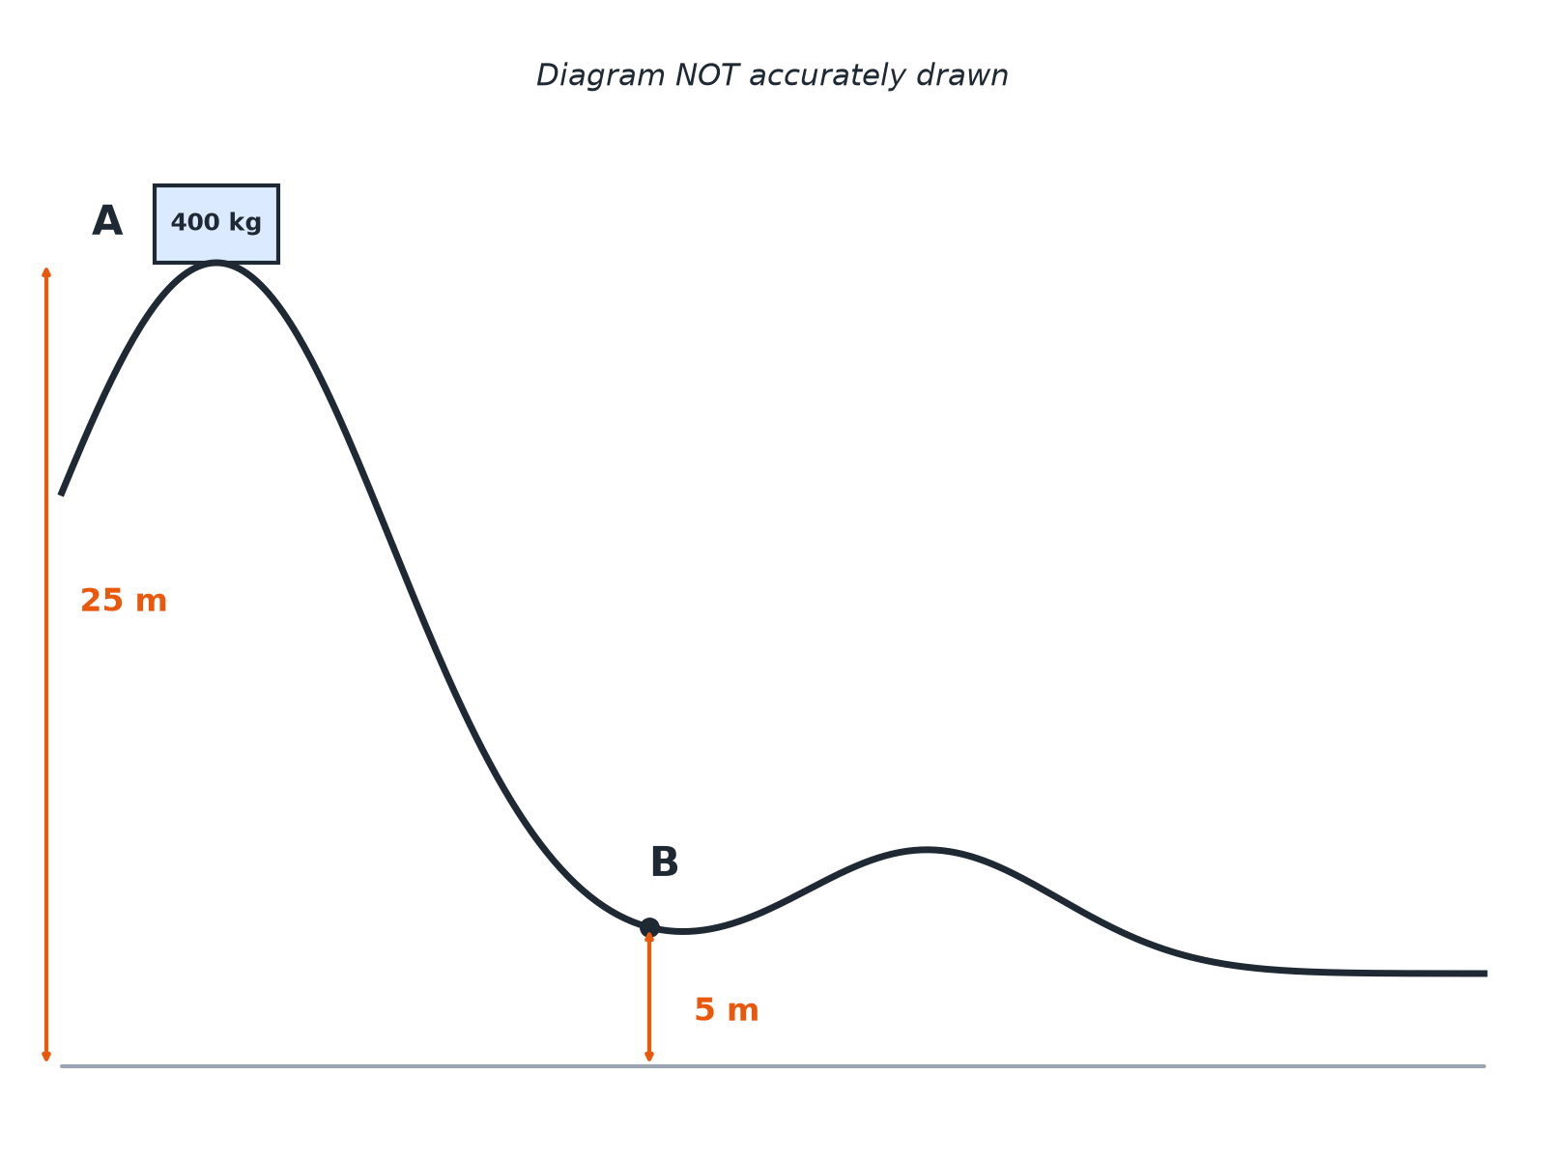
AQA GCSE PHYSICS · PAPER 1 · FOUNDATION & HIGHER
Question 4 · 4 marks · Calculate
The diagram shows a roller coaster car of mass 400 kg. It is released from rest at A. Gravitational field strength = 9.8 N/kg. (a) Calculate the gravitational potential energy stored when the car is at A. (b) Assume no energy is dissipated. Calculate the speed of the car at B. (4 marks)
Energy
openrevise.com
Lesson 2 of 7

Slide 26
AQA GCSE PHYSICS · PAPER 1 · FOUNDATION & HIGHER
Question 4 · mark scheme
4 marks available. Award a mark for each point made.
98 000 J
1 mark
Kinetic energy gained = 78 400 J
1 mark
v² = 2E_k ÷ m
1 mark
19.8 m/s (accept 20 m/s)
1 mark
Energy
openrevise.com
Lesson 2 of 7

Slide 27
AQA GCSE PHYSICS · PAPER 1 · FOUNDATION & HIGHER
Question 5 · 4 marks · Calculate
“
A ball of mass 0.050 kg is thrown vertically upwards at 20 m/s. Assume there is no air resistance. Calculate the maximum height reached by the ball. Gravitational field strength = 9.8 N/kg.
HOW TO ANSWER IT
Command word: Calculate. Worth 4 marks, so plan before writing.
Energy
openrevise.com
Lesson 2 of 7

Slide 28
AQA GCSE PHYSICS · PAPER 1 · FOUNDATION & HIGHER
Question 5 · mark scheme
4 marks available. Award a mark for each point made.
Kinetic energy = 10 J
1 mark
Kinetic energy equals gravitational potential energy at the top
1 mark
h = E_p ÷ (mg)
1 mark
20 m (accept 20.4 m)
1 mark
Energy
openrevise.com
Lesson 2 of 7

