Slide 1

AQA GCSE PHYSICS · PAPER 1 · FOUNDATION & HIGHER
Power
Energy
Lesson 4 of 7
openrevise.com

Slide 2

AQA GCSE PHYSICS · PAPER 1 · FOUNDATION & HIGHER
Warm-up
Answer each one, then check.
1
What is the unit of energy?
2
What is the unit of time used in power calculations?
3
Convert 2 minutes to seconds.
4
What is work done?
5
Write 1.5 kW in watts.
Energy
openrevise.com
Lesson 4 of 7

Slide 3
AQA GCSE PHYSICS · PAPER 1 · FOUNDATION & HIGHER
Warm-up - Answers
What is the unit of energy?
Joule
1
What is the unit of time used in power calculations?
Seconds
2
Convert 2 minutes to seconds.
120 s
3
What is work done?
Energy transferred by a force
4
Write 1.5 kW in watts.
1500 W
5
Energy
openrevise.com
Lesson 4 of 7

Slide 4

AQA GCSE PHYSICS · PAPER 1 · FOUNDATION & HIGHER
Learning Objectives
Define power.
1
Recall and apply both power equations.
2
Explain that 1 W is 1 J/s.
3
Compare two devices doing the same work at different rates.
4
Energy
openrevise.com
Lesson 4 of 7

Slide 5

AQA GCSE PHYSICS · PAPER 1 · FOUNDATION & HIGHER
POWER
Power is the rate at which energy is transferred or the rate at which work is done.
P = E/t and P = W/t. Power is in watts (W), energy and work in joules (J), time in seconds (s). 1 W = 1 J/s.
Energy
openrevise.com
Lesson 4 of 7

Slide 6
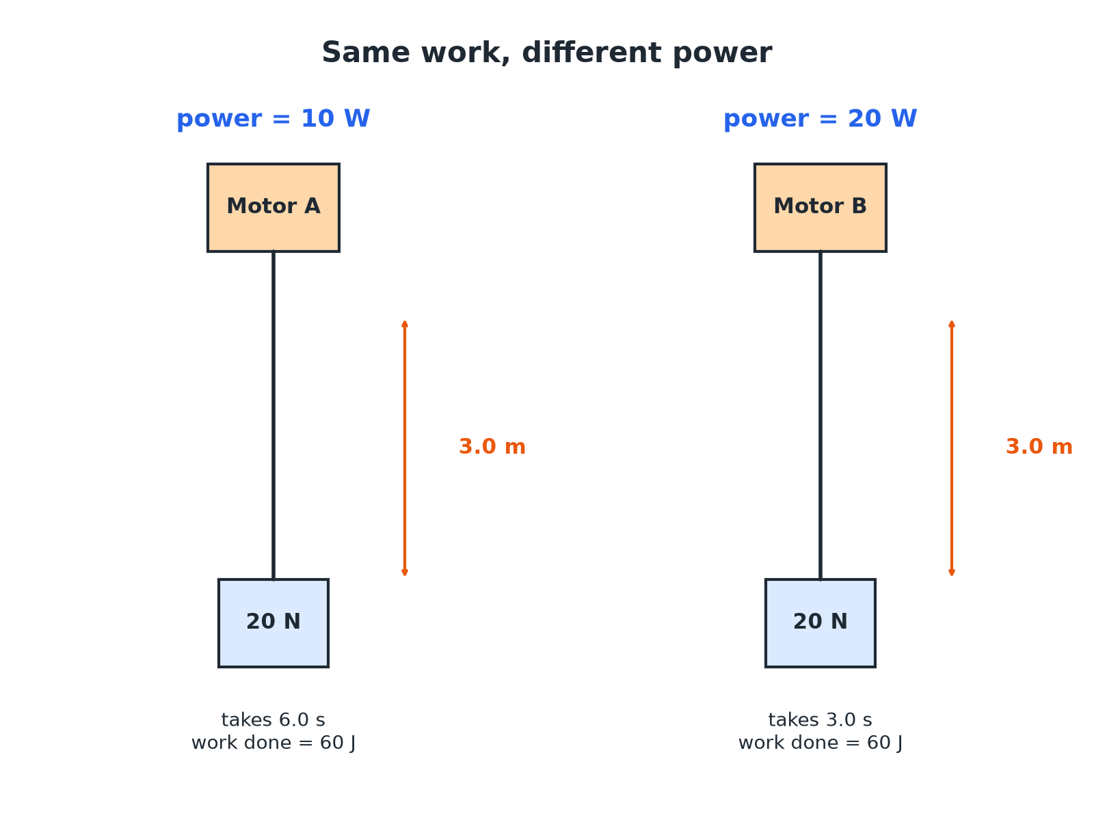

AQA GCSE PHYSICS · PAPER 1 · FOUNDATION & HIGHER
Same Work, Different Power
Same work, half the time means twice the power.
Energy
openrevise.com
Lesson 4 of 7

Slide 7

AQA GCSE PHYSICS · PAPER 1 · FOUNDATION & HIGHER
Power Equations
Learn both and the units.
Equation
Meaning
Units
P = E/t
Power is energy transferred divided by time
W, J, s
P = W/t
Power is work done divided by time
W, J, s
Energy
openrevise.com
Lesson 4 of 7

Slide 8

AQA GCSE PHYSICS · PAPER 1 · FOUNDATION & HIGHER
Energy Transferred by a Kettle
A kettle transfers 360 000 J of energy in 2.0 minutes. Calculate its power.
Convert time
2.0 min = 120 s
1
Substitute
P = 360 000 ÷ 120
2
Answer
P = 3000 W
3
ANSWER
3000 W (3 kW)
Energy
openrevise.com
Lesson 4 of 7

Slide 9
AQA GCSE PHYSICS · PAPER 1 · FOUNDATION & HIGHER
Work and Power of a Climber
A person of mass 60 kg climbs 3.0 m in 5.0 s. g = 9.8 N/kg. Calculate the power.
Work done = energy gained
W = mgh = 60 × 9.8 × 3.0 = 1764 J
1
Power
P = W ÷ t = 1764 ÷ 5.0
2
Answer
P = 352.8 W
3
ANSWER
About 350 W (2 s.f.)
Energy
openrevise.com
Lesson 4 of 7

Slide 10
AQA GCSE PHYSICS · PAPER 1 · FOUNDATION & HIGHER
Rearranging
A 1500 W heater is switched on. How long does it take to transfer 450 000 J?
Rearrange
t = E ÷ P
1
Substitute
t = 450 000 ÷ 1500
2
Answer
t = 300 s
3
ANSWER
300 s (5 minutes)
Energy
openrevise.com
Lesson 4 of 7

Slide 11

AQA GCSE PHYSICS · PAPER 1 · FOUNDATION & HIGHER
Watch Out
Common ways to lose marks.
Time in seconds
Always convert minutes and hours to seconds.
Power, not energy
Power is a rate: it tells you how quickly, not how much.
Unit
1 W is 1 joule per second, not 1 joule.
Energy
openrevise.com
Lesson 4 of 7

Slide 12

AQA GCSE PHYSICS · PAPER 1 · FOUNDATION & HIGHER
Key Terms
Power
The rate at which energy is transferred or work is done.
Watt
The unit of power; one joule per second.
Work done
Energy transferred by a force moving an object.
Rate
How much something changes in each unit of time.
Kilowatt
1000 watts.
Energy transferred
The amount of energy moved from one store to another.
Energy
openrevise.com
Lesson 4 of 7

Slide 13

AQA GCSE PHYSICS · PAPER 1 · FOUNDATION & HIGHER
YOUR TASK
10 minutes
Fair Race
Two students run up the same flight of stairs. Student A takes 8.0 s and student B takes 5.0 s. Both have a weight of 600 N and the stairs are 3.0 m high. Calculate the work done and the power of each student.
Work done first.
1
Then divide by each time.
2
WHAT A GOOD ANSWER SHOWS
Work done by each = 600 × 3.0 = 1800 J. Power A = 225 W. Power B = 360 W.
Energy
openrevise.com
Lesson 4 of 7
Notes:
Ask why both do the same work but B has a greater power.

Slide 14
AQA GCSE PHYSICS · PAPER 1 · FOUNDATION & HIGHER
Can I...?
Define power.
Explain what a watt is.
Use P = E ÷ t.
Rearrange for time.
Use P = W ÷ t.
Compare two devices with the same work.
Convert minutes to seconds.
Give the unit.
Energy
openrevise.com
Lesson 4 of 7

Slide 15
AQA GCSE PHYSICS · PAPER 1 · FOUNDATION & HIGHER
Summary & Exam Focus
P = E ÷ t or P = W ÷ t.
1 W = 1 J/s.
Higher power means energy transferred faster.
Time must be in seconds.
EXAM FOCUS
A motor transfers 6000 J of energy in 30 s. Calculate its power. (2 marks)
Write the equation, substitute, and give the unit W.
openrevise.com

Slide 16
AQA GCSE PHYSICS · PAPER 1 · FOUNDATION & HIGHER
Exam Practice: Power
Answer all questions. Use the mark allocation as a guide to how much to write. · 15 minutes
Question 1 · 2 marks · Calculate
A motor transfers 6000 J of energy in 30 s. Calculate the power of the motor. Use the equation: power = energy transferred ÷ time
Question 2 · 2 marks · Calculate
A machine does 900 J of work in 12 s. Calculate the power.
Question 3 · 3 marks · Compare
Motor A lifts a 20 N weight through 3.0 m in 6.0 s. Motor B lifts the same weight through the same height in 3.0 s. Compare the power of…
Energy
openrevise.com
Lesson 4 of 7

Slide 17
AQA GCSE PHYSICS · PAPER 1 · FOUNDATION & HIGHER
Exam Practice: Power (cont.)
Question 4 · 1 mark · State
State what is meant by a power of 1 watt.
Question 5 · 4 marks · Calculate
A person of mass 60 kg climbs stairs of height 3.0 m in 5.0 s. Calculate the power developed by the person. Gravitational field strength =…
Question 6 · 2 marks · Calculate
A 1500 W heater is switched on until it has transferred 450 000 J. Calculate the time it is switched on for.
Energy
openrevise.com
Lesson 4 of 7

Slide 18
AQA GCSE PHYSICS · PAPER 1 · FOUNDATION & HIGHER
Question 1 · 2 marks · Calculate
“
A motor transfers 6000 J of energy in 30 s. Calculate the power of the motor. Use the equation: power = energy transferred ÷ time
HOW TO ANSWER IT
Command word: Calculate. Worth 2 marks, so plan before writing.
Energy
openrevise.com
Lesson 4 of 7

Slide 19
AQA GCSE PHYSICS · PAPER 1 · FOUNDATION & HIGHER
Question 1 · mark scheme
2 marks available. Award a mark for each point made.
Correct substitution
1 mark
200 W
1 mark
Energy
openrevise.com
Lesson 4 of 7

Slide 20
AQA GCSE PHYSICS · PAPER 1 · FOUNDATION & HIGHER
Question 2 · 2 marks · Calculate
“
A machine does 900 J of work in 12 s. Calculate the power.
HOW TO ANSWER IT
Command word: Calculate. Worth 2 marks, so plan before writing.
Energy
openrevise.com
Lesson 4 of 7

Slide 21
AQA GCSE PHYSICS · PAPER 1 · FOUNDATION & HIGHER
Question 2 · mark scheme
2 marks available. Award a mark for each point made.
Correct substitution
1 mark
75 W
1 mark
Energy
openrevise.com
Lesson 4 of 7

Slide 22
AQA GCSE PHYSICS · PAPER 1 · FOUNDATION & HIGHER
Question 3 · 3 marks · Compare
“
Motor A lifts a 20 N weight through 3.0 m in 6.0 s. Motor B lifts the same weight through the same height in 3.0 s. Compare the power of the two motors. Show your calculations.
HOW TO ANSWER IT
Command word: Compare. Worth 3 marks, so plan before writing.
Energy
openrevise.com
Lesson 4 of 7

Slide 23
AQA GCSE PHYSICS · PAPER 1 · FOUNDATION & HIGHER
Question 3 · mark scheme
3 marks available. Award a mark for each point made.
Work done = 60 J
1 mark
A = 10 W and B = 20 W
1 mark
B has twice the power
1 mark
Energy
openrevise.com
Lesson 4 of 7

Slide 24
AQA GCSE PHYSICS · PAPER 1 · FOUNDATION & HIGHER
Question 4 · 1 mark · State
“
State what is meant by a power of 1 watt.
HOW TO ANSWER IT
Command word: State. Worth 1 mark, so plan before writing.
Energy
openrevise.com
Lesson 4 of 7

Slide 25
AQA GCSE PHYSICS · PAPER 1 · FOUNDATION & HIGHER
Question 4 · mark scheme
1 mark available. Award a mark for each point made.
1 joule per second
1 mark
Energy
openrevise.com
Lesson 4 of 7

Slide 26
AQA GCSE PHYSICS · PAPER 1 · FOUNDATION & HIGHER
Question 5 · 4 marks · Calculate
“
A person of mass 60 kg climbs stairs of height 3.0 m in 5.0 s. Calculate the power developed by the person. Gravitational field strength = 9.8 N/kg. Give your answer to 2 significant figures.
HOW TO ANSWER IT
Command word: Calculate. Worth 4 marks, so plan before writing.
Energy
openrevise.com
Lesson 4 of 7

Slide 27
AQA GCSE PHYSICS · PAPER 1 · FOUNDATION & HIGHER
Question 5 · mark scheme
4 marks available. Award a mark for each point made.
Work done = mgh
1 mark
1764 J
1 mark
352.8 W
1 mark
350 W
1 mark
Energy
openrevise.com
Lesson 4 of 7

Slide 28
AQA GCSE PHYSICS · PAPER 1 · FOUNDATION & HIGHER
Question 6 · 2 marks · Calculate
“
A 1500 W heater is switched on until it has transferred 450 000 J. Calculate the time it is switched on for.
HOW TO ANSWER IT
Command word: Calculate. Worth 2 marks, so plan before writing.
Energy
openrevise.com
Lesson 4 of 7

Slide 29
AQA GCSE PHYSICS · PAPER 1 · FOUNDATION & HIGHER
Question 6 · mark scheme
2 marks available. Award a mark for each point made.
Rearranges to t = E ÷ P
1 mark
300 s
1 mark
Energy
openrevise.com
Lesson 4 of 7

