Slide 1

AQA GCSE PHYSICS · PAPER 1 · FOUNDATION & HIGHER
Efficiency
Energy
Lesson 6 of 7
openrevise.com

Slide 2

AQA GCSE PHYSICS · PAPER 1 · FOUNDATION & HIGHER
Warm-up
Answer each one, then check.
1
What is dissipated energy?
2
What is 0.35 as a percentage?
3
Write 60% as a decimal.
4
Give the unit of power.
5
What does 'useful' energy mean?
Energy
openrevise.com
Lesson 6 of 7

Slide 3
AQA GCSE PHYSICS · PAPER 1 · FOUNDATION & HIGHER
Warm-up - Answers
What is dissipated energy?
Energy spread to the surroundings in less useful stores
1
What is 0.35 as a percentage?
35%
2
Write 60% as a decimal.
0.60
3
Give the unit of power.
Watt
4
What does 'useful' energy mean?
Energy transferred in the way we want
5
Energy
openrevise.com
Lesson 6 of 7

Slide 4

AQA GCSE PHYSICS · PAPER 1 · FOUNDATION & HIGHER
Learning Objectives
Recall and apply the efficiency equations.
1
Give efficiency as a decimal or a percentage.
2
Interpret Sankey diagrams.
3
Describe ways to increase the efficiency of an energy transfer (Higher tier).
4
Energy
openrevise.com
Lesson 6 of 7

Slide 5

AQA GCSE PHYSICS · PAPER 1 · FOUNDATION & HIGHER
EFFICIENCY
efficiency = (useful output energy transfer)/(total input energy transfer)
Also: efficiency = (useful power output)/(total power input). Efficiency has no units and is never more than 1 (100%).
Energy
openrevise.com
Lesson 6 of 7

Slide 6
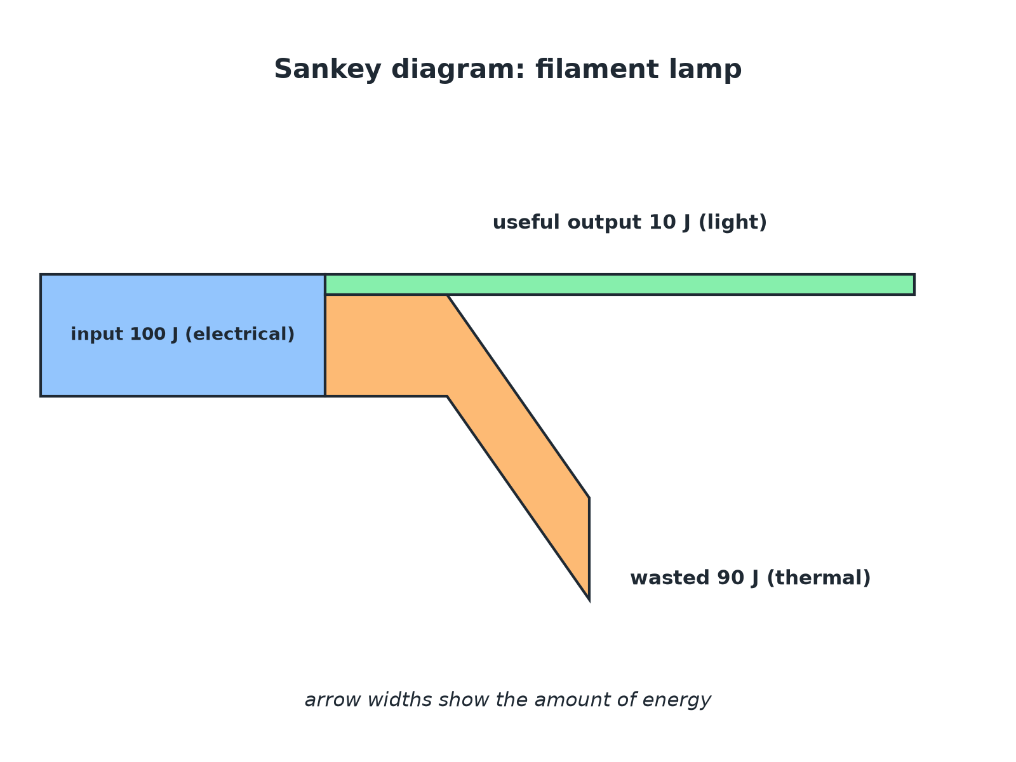

AQA GCSE PHYSICS · PAPER 1 · FOUNDATION & HIGHER
A Sankey Diagram
The width of each arrow shows the amount of energy.
Energy
openrevise.com
Lesson 6 of 7

Slide 7

AQA GCSE PHYSICS · PAPER 1 · FOUNDATION & HIGHER
Efficiency of a Lamp
A lamp transfers 100 J of electrical energy and 8 J of it is transferred as light. Calculate its efficiency.
Write the equation
efficiency = (useful output)/(total input)
1
Substitute
8/100
2
Decimal
0.08
3
Percentage
0.08 × 100 = 8%
4
ANSWER
Efficiency = 0.08 or 8%.
Energy
openrevise.com
Lesson 6 of 7

Slide 8
AQA GCSE PHYSICS · PAPER 1 · FOUNDATION & HIGHER
Using Power
A motor has a total power input of 500 W and a useful power output of 350 W. Calculate its efficiency as a percentage.
Substitute
350/500
1
Decimal
0.70
2
Percentage
70%
3
ANSWER
70%
Energy
openrevise.com
Lesson 6 of 7

Slide 9
AQA GCSE PHYSICS · PAPER 1 · FOUNDATION & HIGHER
Finding the Useful Output
A machine is 85% efficient. How much useful energy does it transfer from a 400 J input?
Efficiency as a decimal
0.85
1
Multiply
0.85 × 400 = 340 J
2
ANSWER
340 J
Energy
openrevise.com
Lesson 6 of 7

Slide 10

AQA GCSE PHYSICS · PAPER 1 · FOUNDATION & HIGHER
Ways to Increase Efficiency (Higher Tier)
Reduce the energy that is dissipated.
Lubrication
Reduces friction between moving parts.
Thermal insulation
Reduces energy lost by heating, for example around a boiler or a house.
Streamlining
Reduces air resistance so less energy is wasted.
Energy
openrevise.com
Lesson 6 of 7

Slide 11
AQA GCSE PHYSICS · PAPER 1 · FOUNDATION & HIGHER
Ways to Increase Efficiency (Higher Tier) (cont.)
Better design
For example LED lamps transfer more input energy as light.
Higher tier
The question may ask you to suggest a way suitable for a described machine.
Energy
openrevise.com
Lesson 6 of 7

Slide 12
AQA GCSE PHYSICS · PAPER 1 · FOUNDATION & HIGHER
Common Mistakes
Check your answer.
Efficiency above 1
It cannot be greater than 1 (100%): useful output cannot be more than the input.
Wrong way up
Useful output goes on top.
Units
Do not write J or W after an efficiency.
Percent or decimal
Read the question for the form required.
Energy
openrevise.com
Lesson 6 of 7

Slide 13

AQA GCSE PHYSICS · PAPER 1 · FOUNDATION & HIGHER
Key Terms
Efficiency
The fraction of the input energy that is transferred usefully.
Useful output
Energy transferred in the way that is wanted.
Wasted energy
Energy transferred to stores that are not useful.
Sankey diagram
A diagram with arrow widths that show energy amounts.
Streamlining
Shaping an object to reduce air resistance.
Input
The energy or power supplied to a device.
Energy
openrevise.com
Lesson 6 of 7

Slide 14

AQA GCSE PHYSICS · PAPER 1 · FOUNDATION & HIGHER
YOUR TASK
12 minutes
Compare the Lamps
LED lamp: efficiency 0.85, input power 8 W. Filament lamp: efficiency 0.10, input power 60 W. Calculate the useful power output of each and say which lamp is better.
Rearrange the equation for useful power.
1
Compare the two answers.
2
WHAT A GOOD ANSWER SHOWS
LED: 0.85 × 8 = 6.8 W. Filament: 0.10 × 60 = 6.0 W. The LED gives more useful output from far less input, so it is better.
Energy
openrevise.com
Lesson 6 of 7
Notes:
Ask learners about cost.

Slide 15
AQA GCSE PHYSICS · PAPER 1 · FOUNDATION & HIGHER
Can I...?
Recall both efficiency equations.
Explain efficiency cannot exceed 1.
Calculate efficiency.
Find useful output from an efficiency.
Convert decimal and percentage.
Describe ways to increase efficiency.
Interpret a Sankey diagram.
Compare devices.
Energy
openrevise.com
Lesson 6 of 7

Slide 16
AQA GCSE PHYSICS · PAPER 1 · FOUNDATION & HIGHER
Summary & Exam Focus
Efficiency = useful output ÷ total input.
Also useful power ÷ total power.
Multiply by 100 for a percentage.
Efficiency is never more than 1.
EXAM FOCUS
A device has an input of 400 J and a useful output of 100 J. Calculate the efficiency. (2 marks)
Put useful over total.
openrevise.com

Slide 17
AQA GCSE PHYSICS · PAPER 1 · FOUNDATION & HIGHER
Exam Practice: Efficiency
Answer all questions. Use the mark allocation as a guide to how much to write. · 17 minutes
Question 1 · 2 marks · Calculate
A device transfers 400 J of energy as input and 100 J of useful energy. Calculate the efficiency of the device. Use the equation…
Question 2 · 3 marks · Use the diagram
The Sankey diagram shows the energy transfers in an electric motor. (a) Calculate the energy wasted every second. (b) Calculate the…
Question 3 · 3 marks · Calculate
A lamp has an efficiency of 0.20 and a total power input of 60 W. Calculate the useful power output of the lamp.
Energy
openrevise.com
Lesson 6 of 7

Slide 18
AQA GCSE PHYSICS · PAPER 1 · FOUNDATION & HIGHER
Exam Practice: Efficiency (cont.)
Question 4 · 2 marks · Suggest
A car engine wastes a lot of energy. Suggest two ways to increase the efficiency of the car.
Question 5 · 4 marks · Compare
An LED lamp has an efficiency of 0.85 and an input power of 8 W. A filament lamp has an efficiency of 0.10 and an input power of 60 W…
Question 6 · 2 marks · Explain
A student says that a machine has an efficiency of 120%. Explain why this cannot be correct.
Energy
openrevise.com
Lesson 6 of 7

Slide 19
AQA GCSE PHYSICS · PAPER 1 · FOUNDATION & HIGHER
Question 1 · 2 marks · Calculate
“
A device transfers 400 J of energy as input and 100 J of useful energy. Calculate the efficiency of the device. Use the equation: efficiency = useful output energy transfer ÷ total input energy transfer
HOW TO ANSWER IT
Command word: Calculate. Worth 2 marks, so plan before writing.
Energy
openrevise.com
Lesson 6 of 7

Slide 20
AQA GCSE PHYSICS · PAPER 1 · FOUNDATION & HIGHER
Question 1 · mark scheme
2 marks available. Award a mark for each point made.
Correct substitution
1 mark
0.25 or 25%
1 mark
Energy
openrevise.com
Lesson 6 of 7

Slide 21
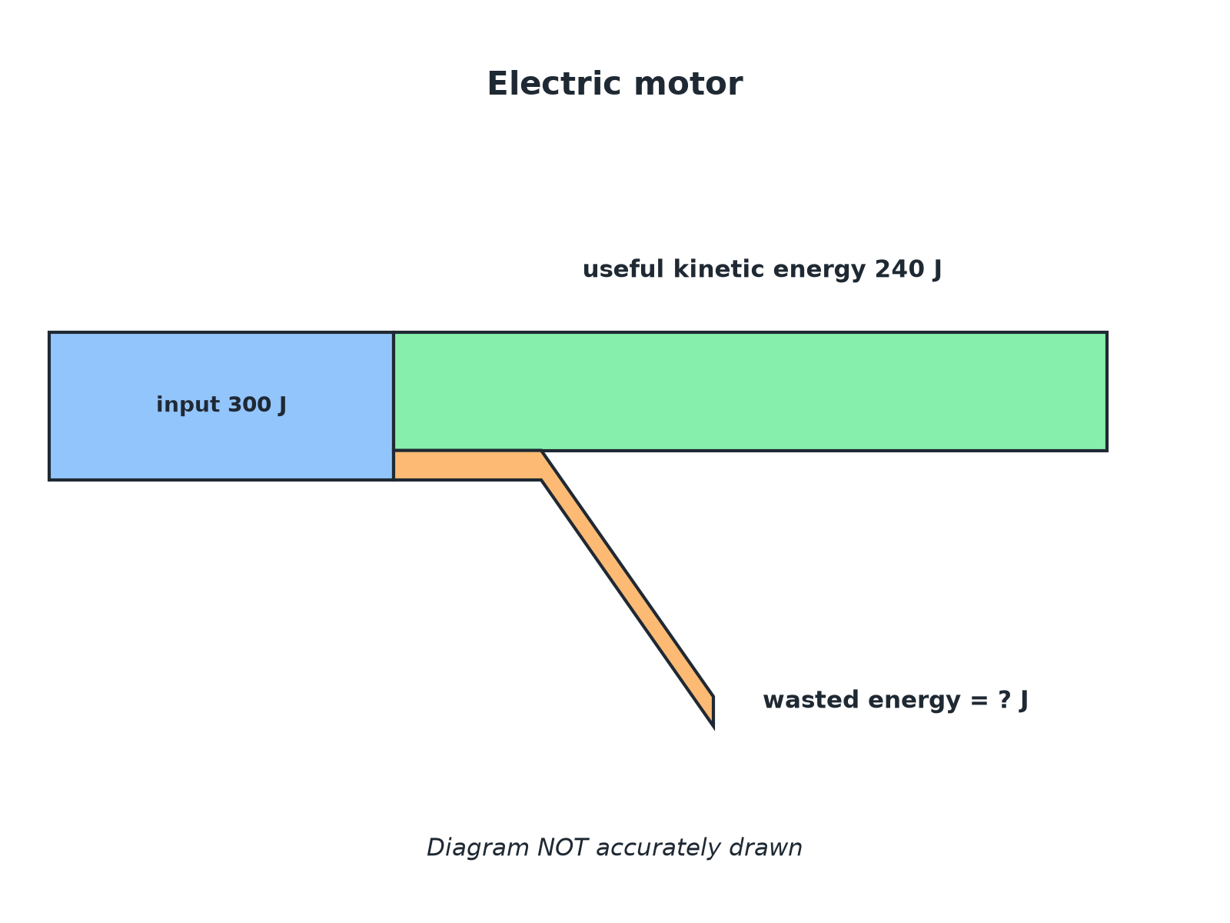
AQA GCSE PHYSICS · PAPER 1 · FOUNDATION & HIGHER
Question 2 · 3 marks · Use the diagram
The Sankey diagram shows the energy transfers in an electric motor. (a) Calculate the energy wasted every second. (b) Calculate the efficiency of the motor. (3 marks)
Energy
openrevise.com
Lesson 6 of 7

Slide 22
AQA GCSE PHYSICS · PAPER 1 · FOUNDATION & HIGHER
Question 2 · mark scheme
3 marks available. Award a mark for each point made.
60 J
1 mark
Correct substitution
1 mark
0.80 or 80%
1 mark
Energy
openrevise.com
Lesson 6 of 7

Slide 23
AQA GCSE PHYSICS · PAPER 1 · FOUNDATION & HIGHER
Question 3 · 3 marks · Calculate
“
A lamp has an efficiency of 0.20 and a total power input of 60 W. Calculate the useful power output of the lamp.
HOW TO ANSWER IT
Command word: Calculate. Worth 3 marks, so plan before writing.
Energy
openrevise.com
Lesson 6 of 7

Slide 24
AQA GCSE PHYSICS · PAPER 1 · FOUNDATION & HIGHER
Question 3 · mark scheme
3 marks available. Award a mark for each point made.
Rearranges to power output = efficiency × input
1 mark
Correct substitution
1 mark
12 W
1 mark
Energy
openrevise.com
Lesson 6 of 7

Slide 25
AQA GCSE PHYSICS · PAPER 1 · FOUNDATION & HIGHER
Question 4 · 2 marks · Suggest
“
A car engine wastes a lot of energy. Suggest two ways to increase the efficiency of the car.
HOW TO ANSWER IT
Command word: Suggest. Worth 2 marks, so plan before writing.
Energy
openrevise.com
Lesson 6 of 7

Slide 26
AQA GCSE PHYSICS · PAPER 1 · FOUNDATION & HIGHER
Question 4 · mark scheme
2 marks available. Award a mark for each point made.
First way
1 mark
Second way
1 mark
Energy
openrevise.com
Lesson 6 of 7

Slide 27
AQA GCSE PHYSICS · PAPER 1 · FOUNDATION & HIGHER
Question 5 · 4 marks · Compare
“
An LED lamp has an efficiency of 0.85 and an input power of 8 W. A filament lamp has an efficiency of 0.10 and an input power of 60 W. Compare the useful power output of the two lamps. Which is the better lamp? Show your calculations.
HOW TO ANSWER IT
Command word: Compare. Worth 4 marks, so plan before writing.
Energy
openrevise.com
Lesson 6 of 7

Slide 28
AQA GCSE PHYSICS · PAPER 1 · FOUNDATION & HIGHER
Question 5 · mark scheme
4 marks available. Award a mark for each point made.
6.8 W
1 mark
6.0 W
1 mark
LED gives more useful power
1 mark
With much less input power
1 mark
Energy
openrevise.com
Lesson 6 of 7

Slide 29
AQA GCSE PHYSICS · PAPER 1 · FOUNDATION & HIGHER
Question 6 · 2 marks · Explain
“
A student says that a machine has an efficiency of 120%. Explain why this cannot be correct.
HOW TO ANSWER IT
Command word: Explain. Worth 2 marks, so plan before writing.
Energy
openrevise.com
Lesson 6 of 7

Slide 30
AQA GCSE PHYSICS · PAPER 1 · FOUNDATION & HIGHER
Question 6 · mark scheme
2 marks available. Award a mark for each point made.
Energy cannot be created
1 mark
Useful output cannot exceed the total input
1 mark
Energy
openrevise.com
Lesson 6 of 7

