Slide 1

AQA GCSE PHYSICS · PAPER 1 · FOUNDATION & HIGHER
National and global energy resources
Energy
Lesson 7 of 7
openrevise.com

Slide 2

AQA GCSE PHYSICS · PAPER 1 · FOUNDATION & HIGHER
Warm-up
Answer each one, then check.
1
Name a fossil fuel.
2
What does renewable mean?
3
What gas do fossil fuels release when burned?
4
What is generated in a power station?
5
Name a use of energy resources other than electricity.
Energy
openrevise.com
Lesson 7 of 7

Slide 3
AQA GCSE PHYSICS · PAPER 1 · FOUNDATION & HIGHER
Warm-up - Answers
Name a fossil fuel.
Coal, oil or natural gas
1
What does renewable mean?
Can be replenished as it is used
2
What gas do fossil fuels release when burned?
Carbon dioxide
3
What is generated in a power station?
Electricity
4
Name a use of energy resources other than electricity.
Transport or heating
5
Energy
openrevise.com
Lesson 7 of 7

Slide 4

AQA GCSE PHYSICS · PAPER 1 · FOUNDATION & HIGHER
Learning Objectives
Name the main energy resources.
1
Distinguish renewable and non-renewable resources.
2
Compare their uses: transport, electricity generation, heating.
3
Explain why some resources are more reliable than others.
4
Describe environmental impacts and explain trends in resource use.
5
Energy
openrevise.com
Lesson 7 of 7

Slide 5

AQA GCSE PHYSICS · PAPER 1 · FOUNDATION & HIGHER
RENEWABLE
A renewable energy resource is one that is being, or can be, replenished as it is used.
Non-renewable resources will run out: fossil fuels (coal, oil, gas) and nuclear fuel. Renewable: bio-fuel, wind, hydro-electricity, geothermal, tides, the Sun and water waves.
Energy
openrevise.com
Lesson 7 of 7

Slide 6
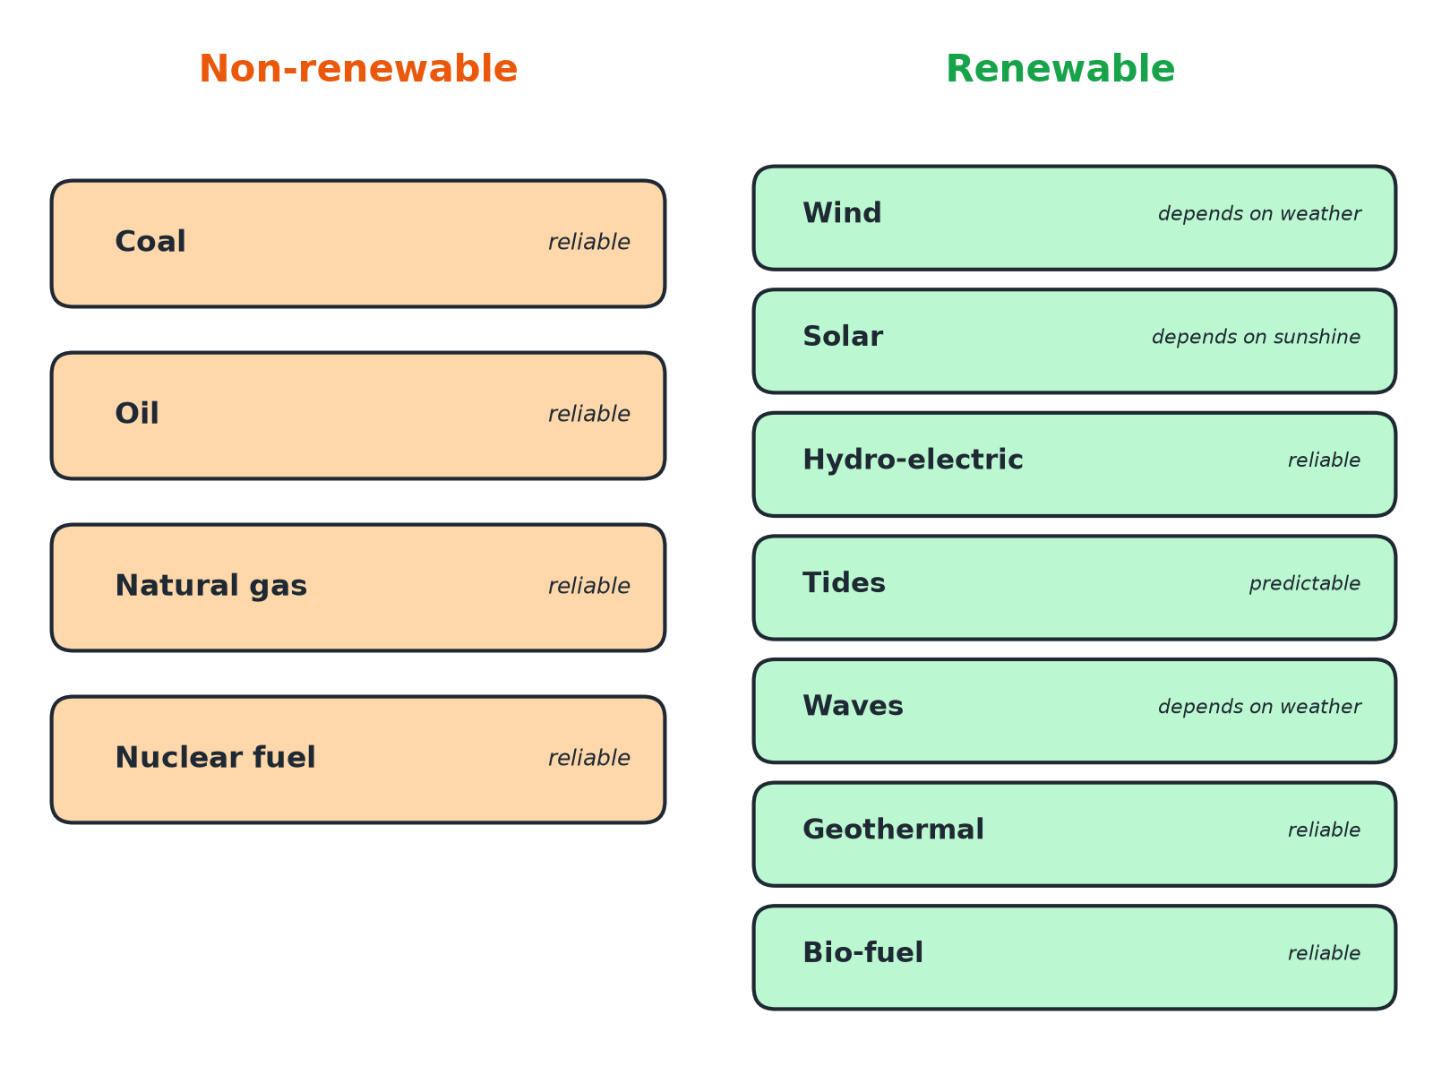

AQA GCSE PHYSICS · PAPER 1 · FOUNDATION & HIGHER
Renewable and Non-renewable Resources
Reliable means it can produce power when needed.
Energy
openrevise.com
Lesson 7 of 7

Slide 7

AQA GCSE PHYSICS · PAPER 1 · FOUNDATION & HIGHER
Comparing Energy Resources
Use this to compare for evaluation questions.
Resource
Renewable?
Reliable?
Main environmental issue
Coal, oil, gas
No
Yes
Release carbon dioxide (global warming); coal and oil also cause acid rain or pollution
Nuclear fuel
No
Yes
Radioactive waste; risk of accidents; very low carbon dioxide
Wind
Yes
No: depends on wind speed
Visual and noise impact; can affect birds
Solar
Yes
No: only in daylight and sunshine
Land use for large solar farms
Hydro-electric
Yes
Mostly, if water is stored
Flooding valleys destroys habitats
Tides and waves
Yes
Tides are predictable; waves vary
Can affect marine life and sea views
Bio-fuel
Yes
Yes, can be stored
Land used for crops; carbon dioxide released when burned
Geothermal
Yes
Yes
Only possible in some places
Energy
openrevise.com
Lesson 7 of 7

Slide 8
AQA GCSE PHYSICS · PAPER 1 · FOUNDATION & HIGHER
Uses of Energy Resources
Transport
Petrol, diesel and bio-fuels power vehicles.
Electricity generation
Fossil fuels, nuclear fuel, wind, solar, hydro, tides, waves and geothermal turn generators or solar cells.
Heating
Gas and bio-fuels heat homes; geothermal and solar can heat water directly.
Descriptions of the power station process
are not required for this specification.
Energy
openrevise.com
Lesson 7 of 7

Slide 9

AQA GCSE PHYSICS · PAPER 1 · FOUNDATION & HIGHER
Why Are Some More Reliable?
Reliability means the resource can supply energy on demand.
Fuels
Coal, oil, gas, nuclear fuel and bio-fuel can be stored and used when needed.
Weather
Wind and solar depend on weather and time of day.
Predictable
Tides are predictable because they depend on the Moon and Sun.
Energy
openrevise.com
Lesson 7 of 7

Slide 10
AQA GCSE PHYSICS · PAPER 1 · FOUNDATION & HIGHER
Patterns and Trends
Use of renewables has grown.
Reasons for growth
To reduce carbon dioxide emissions, government targets, falling costs of wind and solar.
Slow change
Building new power stations is expensive and takes time.
Science and society
Science can identify environmental problems but political, social, ethical and economic factors decide how they are tackled.
Energy
openrevise.com
Lesson 7 of 7

Slide 11

AQA GCSE PHYSICS · PAPER 1 · FOUNDATION & HIGHER
Key Terms
Renewable
A resource that is replenished as it is used.
Non-renewable
A resource that will run out.
Fossil fuel
Coal, oil or natural gas formed from ancient organisms.
Reliable
Able to supply energy whenever it is needed.
Bio-fuel
A fuel made from plant or animal matter.
Global warming
Rise in the Earth's average temperature linked to greenhouse gases.
Energy
openrevise.com
Lesson 7 of 7

Slide 12

AQA GCSE PHYSICS · PAPER 1 · FOUNDATION & HIGHER
YOUR TASK
15 minutes
Evaluate the Options
A town needs a new power source. In groups, choose between a wind farm, a gas power station and a nuclear power station, giving two advantages and two disadvantages of each.
1
List advantages.
2
List disadvantages.
3
Decide and justify.
WHAT A GOOD ANSWER SHOWS
Wind: no fuel or CO2 in use but not reliable, visual impact. Gas: reliable but produces CO2 and uses a finite fuel. Nuclear: reliable and low CO2 but produces radioactive waste and is costly to build and decommission.
Energy
openrevise.com
Lesson 7 of 7
Notes:
Ask which factors carry most weight and why.

Slide 13
AQA GCSE PHYSICS · PAPER 1 · FOUNDATION & HIGHER
Can I...?
Name the main energy resources.
Describe environmental impacts.
Say which are renewable.
Describe trends in use.
Compare uses of resources.
Evaluate two resources.
Explain reliability.
Use data to justify a conclusion.
Energy
openrevise.com
Lesson 7 of 7

Slide 14
AQA GCSE PHYSICS · PAPER 1 · FOUNDATION & HIGHER
Summary & Exam Focus
Renewable resources are replenished as they are used.
Fossil fuels and nuclear fuel are non-renewable.
Wind and solar are not reliable; fuels are reliable.
Each resource has environmental impacts.
EXAM FOCUS
State two renewable energy resources. (2 marks)
Give complete, specific resources such as wind or hydro-electricity.
openrevise.com

Slide 15
AQA GCSE PHYSICS · PAPER 1 · FOUNDATION & HIGHER
Exam Practice: National and global energy resources
Answer all questions. Use the mark allocation as a guide to how much to write. · 20 minutes
Question 1 · 2 marks · State
Give two examples of non-renewable energy resources.
Question 2 · 2 marks · State
What is meant by a renewable energy resource?
Question 3 · 4 marks · Use the data
The bar chart shows the percentage of a country's electricity generated by different resources in 2000 and in 2020. (a) Describe two…
Energy
openrevise.com
Lesson 7 of 7

Slide 16
AQA GCSE PHYSICS · PAPER 1 · FOUNDATION & HIGHER
Exam Practice: National and global energy resources (cont.)
Question 4 · 3 marks · Explain
Wind turbines and gas power stations can both generate electricity. Compare the reliability of the two and explain the difference.
Question 5 · 6 marks · Evaluate
Evaluate the use of nuclear fuel and wind to generate electricity. Include environmental effects and reliability in your answer.
Question 6 · 2 marks · Suggest
Some countries still use fossil fuels even though they know about the environmental problems. Suggest two reasons for this.
Energy
openrevise.com
Lesson 7 of 7

Slide 17
AQA GCSE PHYSICS · PAPER 1 · FOUNDATION & HIGHER
Question 1 · 2 marks · State
“
Give two examples of non-renewable energy resources.
HOW TO ANSWER IT
Command word: State. Worth 2 marks, so plan before writing.
Energy
openrevise.com
Lesson 7 of 7

Slide 18
AQA GCSE PHYSICS · PAPER 1 · FOUNDATION & HIGHER
Question 1 · mark scheme
2 marks available. Award a mark for each point made.
First example
1 mark
Second example
1 mark
Energy
openrevise.com
Lesson 7 of 7

Slide 19
AQA GCSE PHYSICS · PAPER 1 · FOUNDATION & HIGHER
Question 2 · 2 marks · State
“
What is meant by a renewable energy resource?
HOW TO ANSWER IT
Command word: State. Worth 2 marks, so plan before writing.
Energy
openrevise.com
Lesson 7 of 7

Slide 20
AQA GCSE PHYSICS · PAPER 1 · FOUNDATION & HIGHER
Question 2 · mark scheme
2 marks available. Award a mark for each point made.
Replenished
1 mark
As it is used
1 mark
Energy
openrevise.com
Lesson 7 of 7

Slide 21
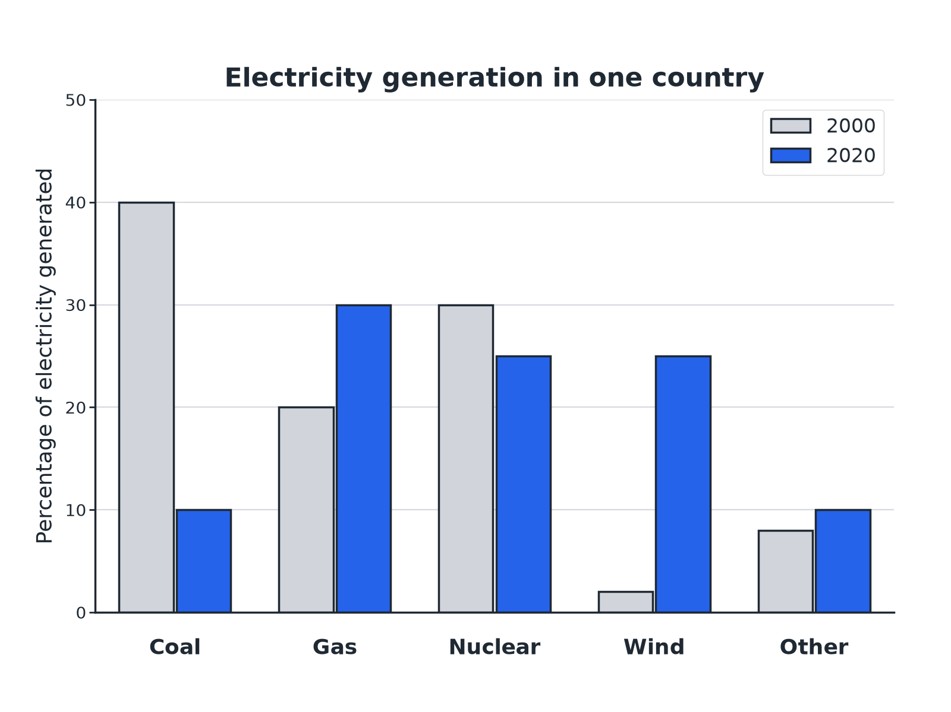
AQA GCSE PHYSICS · PAPER 1 · FOUNDATION & HIGHER
Question 3 · 4 marks · Use the data
The bar chart shows the percentage of a country's electricity generated by different resources in 2000 and in 2020. (a) Describe two changes between 2000 and 2020. (b) Suggest one reason for one of these changes. (4 marks)
Energy
openrevise.com
Lesson 7 of 7

Slide 22
AQA GCSE PHYSICS · PAPER 1 · FOUNDATION & HIGHER
Question 3 · mark scheme
4 marks available. Award a mark for each point made.
First change with data
1 mark
Second change with data
1 mark
Reason
1 mark
Linked to the change chosen
1 mark
Energy
openrevise.com
Lesson 7 of 7

Slide 23
AQA GCSE PHYSICS · PAPER 1 · FOUNDATION & HIGHER
Question 4 · 3 marks · Explain
“
Wind turbines and gas power stations can both generate electricity. Compare the reliability of the two and explain the difference.
HOW TO ANSWER IT
Command word: Explain. Worth 3 marks, so plan before writing.
Energy
openrevise.com
Lesson 7 of 7

Slide 24
AQA GCSE PHYSICS · PAPER 1 · FOUNDATION & HIGHER
Question 4 · mark scheme
3 marks available. Award a mark for each point made.
Gas is more reliable
1 mark
Gas can be stored or supplied on demand
1 mark
Wind depends on the weather
1 mark
Energy
openrevise.com
Lesson 7 of 7

Slide 25
AQA GCSE PHYSICS · PAPER 1 · FOUNDATION & HIGHER
Question 5 · 6 marks · Evaluate
“
Evaluate the use of nuclear fuel and wind to generate electricity. Include environmental effects and reliability in your answer.
HOW TO ANSWER IT
Command word: Evaluate. Worth 6 marks, so plan before writing.
Energy
openrevise.com
Lesson 7 of 7

Slide 26
AQA GCSE PHYSICS · PAPER 1 · FOUNDATION & HIGHER
Question 5 · mark scheme
6 marks available. Award a mark for each point made.
Level 3 (5 to 6 marks): a balanced comparison covering reliability, environmental impact and at least one of cost, carbon dioxide or waste, and a justified conclusion
5 to 6 marks
Level 2 (3 to 4 marks): several valid points for both, with some comparison
3 to 4 marks
Level 1 (1 to 2 marks): simple statements about one or both
1 to 2 marks
Energy
openrevise.com
Lesson 7 of 7

Slide 27
AQA GCSE PHYSICS · PAPER 1 · FOUNDATION & HIGHER
Question 6 · 2 marks · Suggest
“
Some countries still use fossil fuels even though they know about the environmental problems. Suggest two reasons for this.
HOW TO ANSWER IT
Command word: Suggest. Worth 2 marks, so plan before writing.
Energy
openrevise.com
Lesson 7 of 7

Slide 28
AQA GCSE PHYSICS · PAPER 1 · FOUNDATION & HIGHER
Question 6 · mark scheme
2 marks available. Award a mark for each point made.
First reason
1 mark
Second reason
1 mark
Energy
openrevise.com
Lesson 7 of 7

