Slide 1

AQA GCSE PHYSICS · PAPER 1 · FOUNDATION & HIGHER
Circuit symbols, charge and current
Electricity
Lesson 1 of 10
openrevise.com

Slide 2

AQA GCSE PHYSICS · PAPER 1 · FOUNDATION & HIGHER
Warm-up
Answer each one, then check.
1
What is the unit of current?
2
What is the unit of time in physics calculations?
3
Which particles carry current in a metal wire?
4
What does a battery provide?
5
Convert 2 minutes to seconds.
Electricity
openrevise.com
Lesson 1 of 10

Slide 3
AQA GCSE PHYSICS · PAPER 1 · FOUNDATION & HIGHER
Warm-up - Answers
What is the unit of current?
The ampere (A)
1
What is the unit of time in physics calculations?
The second (s)
2
Which particles carry current in a metal wire?
Electrons
3
What does a battery provide?
A potential difference (a push for charge)
4
Convert 2 minutes to seconds.
120 s
5
Electricity
openrevise.com
Lesson 1 of 10

Slide 4

AQA GCSE PHYSICS · PAPER 1 · FOUNDATION & HIGHER
Learning Objectives
Draw and interpret circuit diagrams using standard symbols.
1
State that a source of potential difference is needed to make charge flow in a closed circuit.
2
Recall and apply Q = It.
3
State that the current has the same value at any point in a single closed loop.
4
Electricity
openrevise.com
Lesson 1 of 10

Slide 5

AQA GCSE PHYSICS · PAPER 1 · FOUNDATION & HIGHER
CHARGE AND CURRENT
charge flow = current × time Q = It
Electric current is a flow of electrical charge. The size of the current is the rate of flow of charge. Charge is in coulombs (C), current in amperes (A) and time in seconds (s).
Electricity
openrevise.com
Lesson 1 of 10

Slide 6
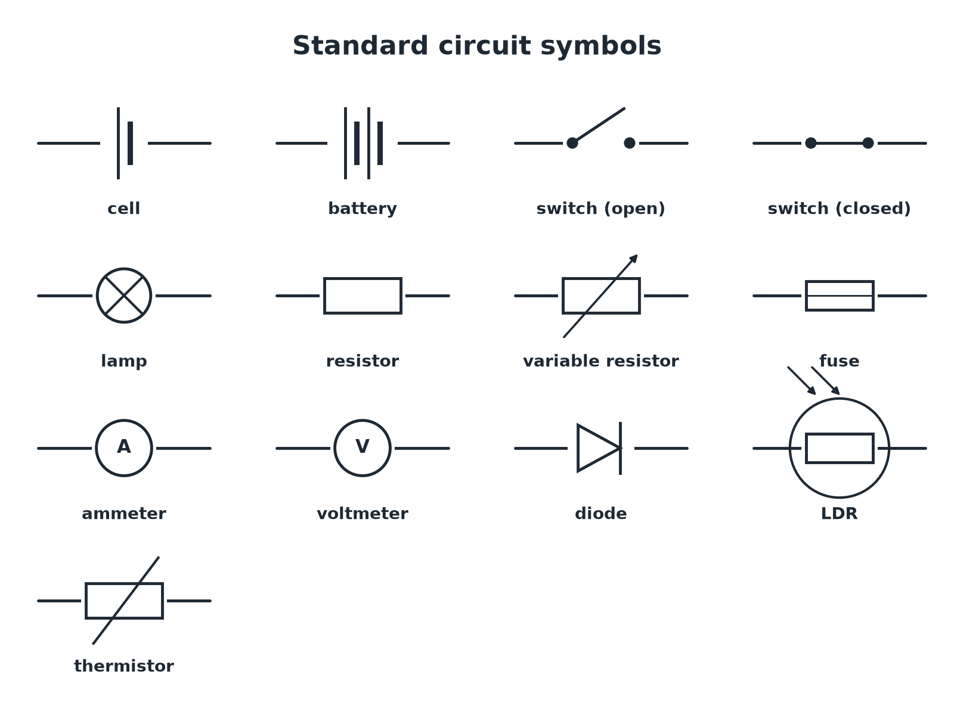

AQA GCSE PHYSICS · PAPER 1 · FOUNDATION & HIGHER
Standard Circuit Symbols
Learn to draw these quickly and neatly.
Electricity
openrevise.com
Lesson 1 of 10

Slide 7

AQA GCSE PHYSICS · PAPER 1 · FOUNDATION & HIGHER
Drawing a Circuit Diagram
Use a ruler and standard symbols.
1
2
3
4
5
Start with the power supply
Draw a cell or battery.
Add components in series
Draw straight lines with square corners; no gaps.
Add the ammeter in series
It goes in the main loop where you want to measure current.
Add the voltmeter in parallel
It goes across the component you are measuring.
Check
Every component is joined by lines and the loop is closed.
Electricity
openrevise.com
Lesson 1 of 10

Slide 8

AQA GCSE PHYSICS · PAPER 1 · FOUNDATION & HIGHER
Charge Flow
A current of 3.0 A flows through a lamp for 20 s. Calculate the charge that flows.
Write the equation
Q = It
1
Substitute
Q = 3.0 × 20
2
Answer
Q = 60 C
3
ANSWER
60 coulombs
Electricity
openrevise.com
Lesson 1 of 10

Slide 9
AQA GCSE PHYSICS · PAPER 1 · FOUNDATION & HIGHER
Finding the Current
240 C of charge flows through a heater in 2 minutes. Calculate the current.
Convert the time
2 min = 120 s
1
Rearrange
I = Q ÷ t
2
Substitute
I = 240 ÷ 120
3
Answer
I = 2.0 A
4
ANSWER
2.0 A
Electricity
openrevise.com
Lesson 1 of 10

Slide 10

AQA GCSE PHYSICS · PAPER 1 · FOUNDATION & HIGHER
Key Ideas
Learn these.
A source of pd is needed
For charge to flow round a closed circuit there must be a source of potential difference, such as a cell.
Current in a series loop
The current has the same value at every point in a single closed loop.
Current is not used up
Charge keeps flowing round the loop; the components transfer energy from the charge.
Ammeter and voltmeter
Ammeter in series measures current. Voltmeter in parallel measures pd.
Electricity
openrevise.com
Lesson 1 of 10

Slide 11

AQA GCSE PHYSICS · PAPER 1 · FOUNDATION & HIGHER
Key Terms
Electric current
The rate of flow of electrical charge.
Charge
A property of matter that can be positive or negative; measured in coulombs.
Ampere
The unit of current; one coulomb per second.
Coulomb
The unit of charge.
Ammeter
Measures current; connected in series.
Potential difference
The energy transferred per unit of charge; measured in volts.
Electricity
openrevise.com
Lesson 1 of 10

Slide 12

AQA GCSE PHYSICS · PAPER 1 · FOUNDATION & HIGHER
YOUR TASK
12 minutes
Circuit Doodles
Draw circuit diagrams for: (a) a cell, a switch and a lamp in series; (b) the same circuit with an ammeter to measure the current in the lamp and a voltmeter to measure the pd across it.
Draw the loop with a ruler.
1
Add the meters in the right way.
2
WHAT A GOOD ANSWER SHOWS
(a) A loop containing a cell, closed switch and lamp. (b) The ammeter is in the loop (series); the voltmeter is drawn in parallel with the lamp only.
Electricity
openrevise.com
Lesson 1 of 10
Notes:
Check that voltmeters are never in series.

Slide 13
AQA GCSE PHYSICS · PAPER 1 · FOUNDATION & HIGHER
Can I...?
Recognise standard circuit symbols.
Rearrange for current or time.
Draw a series circuit.
Convert minutes to seconds.
Place an ammeter and voltmeter correctly.
Explain why current is the same round a series loop.
Use Q = It.
State what is needed for charge to flow.
Electricity
openrevise.com
Lesson 1 of 10

Slide 14
AQA GCSE PHYSICS · PAPER 1 · FOUNDATION & HIGHER
Summary & Exam Focus
Q = It.
Symbols: cell, lamp, ammeter (A), voltmeter (V), and so on.
Ammeters in series, voltmeters in parallel.
Current is the same at every point in a series loop.
EXAM FOCUS
A current of 0.40 A flows for 30 s. Calculate the charge that flows. (2 marks)
Write the equation, substitute, and include the unit C.
openrevise.com

Slide 15
AQA GCSE PHYSICS · PAPER 1 · FOUNDATION & HIGHER
Exam Practice: Circuit symbols, charge and current
Answer all questions. Use the mark allocation as a guide to how much to write. · 15 minutes
Question 1 · 2 marks · Calculate
A current of 0.40 A flows through a lamp for 30 s. Calculate the charge that flows through the lamp. Use the equation: charge flow =…
Question 2 · 4 marks · Draw
Draw a circuit diagram to show a cell, a switch and a lamp connected in series, with an ammeter to measure the current through the lamp and…
Question 3 · 3 marks · Calculate
180 C of charge flows through a heater in 1.0 minute. Calculate the current in the heater.
Electricity
openrevise.com
Lesson 1 of 10

Slide 16
AQA GCSE PHYSICS · PAPER 1 · FOUNDATION & HIGHER
Exam Practice: Circuit symbols, charge and current (cont.)
Question 4 · 2 marks · Explain
In a series circuit, ammeter A1 reads 0.50 A. A second ammeter, A2, is on the other side of a lamp. What does A2 read? Explain your answer.
Question 5 · 3 marks · Calculate
A charge of 12 C flows through a resistor when the current is 0.50 A. Calculate the time for which the current flows.
Electricity
openrevise.com
Lesson 1 of 10

Slide 17
AQA GCSE PHYSICS · PAPER 1 · FOUNDATION & HIGHER
Question 1 · 2 marks · Calculate
“
A current of 0.40 A flows through a lamp for 30 s. Calculate the charge that flows through the lamp. Use the equation: charge flow = current × time
HOW TO ANSWER IT
Command word: Calculate. Worth 2 marks, so plan before writing.
Electricity
openrevise.com
Lesson 1 of 10

Slide 18
AQA GCSE PHYSICS · PAPER 1 · FOUNDATION & HIGHER
Question 1 · mark scheme
2 marks available. Award a mark for each point made.
Correct substitution
1 mark
12 C
1 mark
Electricity
openrevise.com
Lesson 1 of 10

Slide 19
AQA GCSE PHYSICS · PAPER 1 · FOUNDATION & HIGHER
Question 2 · 4 marks · Draw
“
Draw a circuit diagram to show a cell, a switch and a lamp connected in series, with an ammeter to measure the current through the lamp and a voltmeter to measure the potential difference across the lamp. Use the correct circuit symbols.
HOW TO ANSWER IT
Command word: Draw. Worth 4 marks, so plan before writing.
Electricity
openrevise.com
Lesson 1 of 10

Slide 20
AQA GCSE PHYSICS · PAPER 1 · FOUNDATION & HIGHER
Question 2 · mark scheme
4 marks available. Award a mark for each point made.
Cell, switch and lamp in a closed series loop
1 mark
Ammeter in series
1 mark
Voltmeter in parallel with the lamp
1 mark
All symbols correct
1 mark
Electricity
openrevise.com
Lesson 1 of 10

Slide 21
AQA GCSE PHYSICS · PAPER 1 · FOUNDATION & HIGHER
Question 3 · 3 marks · Calculate
“
180 C of charge flows through a heater in 1.0 minute. Calculate the current in the heater.
HOW TO ANSWER IT
Command word: Calculate. Worth 3 marks, so plan before writing.
Electricity
openrevise.com
Lesson 1 of 10

Slide 22
AQA GCSE PHYSICS · PAPER 1 · FOUNDATION & HIGHER
Question 3 · mark scheme
3 marks available. Award a mark for each point made.
Converts 1.0 minute to 60 s
1 mark
Correct substitution
1 mark
3.0 A
1 mark
Electricity
openrevise.com
Lesson 1 of 10

Slide 23
AQA GCSE PHYSICS · PAPER 1 · FOUNDATION & HIGHER
Question 4 · 2 marks · Explain
“
In a series circuit, ammeter A1 reads 0.50 A. A second ammeter, A2, is on the other side of a lamp. What does A2 read? Explain your answer.
HOW TO ANSWER IT
Command word: Explain. Worth 2 marks, so plan before writing.
Electricity
openrevise.com
Lesson 1 of 10

Slide 24
AQA GCSE PHYSICS · PAPER 1 · FOUNDATION & HIGHER
Question 4 · mark scheme
2 marks available. Award a mark for each point made.
0.50 A
1 mark
Current is the same at every point in a series loop
1 mark
Electricity
openrevise.com
Lesson 1 of 10

Slide 25
AQA GCSE PHYSICS · PAPER 1 · FOUNDATION & HIGHER
Question 5 · 3 marks · Calculate
“
A charge of 12 C flows through a resistor when the current is 0.50 A. Calculate the time for which the current flows.
HOW TO ANSWER IT
Command word: Calculate. Worth 3 marks, so plan before writing.
Electricity
openrevise.com
Lesson 1 of 10

Slide 26
AQA GCSE PHYSICS · PAPER 1 · FOUNDATION & HIGHER
Question 5 · mark scheme
3 marks available. Award a mark for each point made.
Rearranges to t = Q ÷ I
1 mark
Correct substitution
1 mark
24 s
1 mark
Electricity
openrevise.com
Lesson 1 of 10

