Slide 1

AQA GCSE PHYSICS · PAPER 1 · FOUNDATION & HIGHER
Series and parallel circuits
Electricity
Lesson 4 of 10
openrevise.com

Slide 2

AQA GCSE PHYSICS · PAPER 1 · FOUNDATION & HIGHER
Warm-up
Answer each one, then check.
1
What is the same everywhere in a series loop?
2
What does an ammeter measure?
3
How is a voltmeter connected?
4
What is the equation linking V, I and R?
5
Add 4 + 8.
Electricity
openrevise.com
Lesson 4 of 10

Slide 3
AQA GCSE PHYSICS · PAPER 1 · FOUNDATION & HIGHER
Warm-up - Answers
What is the same everywhere in a series loop?
The current
1
What does an ammeter measure?
Current
2
How is a voltmeter connected?
In parallel
3
What is the equation linking V, I and R?
V = IR
4
Add 4 + 8.
12
5
Electricity
openrevise.com
Lesson 4 of 10

Slide 4

AQA GCSE PHYSICS · PAPER 1 · FOUNDATION & HIGHER
Learning Objectives
Describe the differences between series and parallel circuits.
1
Use R_(total) = R₁ + R₂ for resistors in series.
2
Calculate currents, pds and resistances in series circuits.
3
Explain why adding resistors in series increases and in parallel decreases the total resistance.
4
Electricity
openrevise.com
Lesson 4 of 10

Slide 5

AQA GCSE PHYSICS · PAPER 1 · FOUNDATION & HIGHER
SERIES AND PARALLEL
Series: same current, pd shared, R_(total) = R₁ + R₂. Parallel: same pd, currents add, R_(total) is less than the smallest resistor.
You are not required to calculate the total resistance of two resistors in parallel.
Electricity
openrevise.com
Lesson 4 of 10

Slide 6
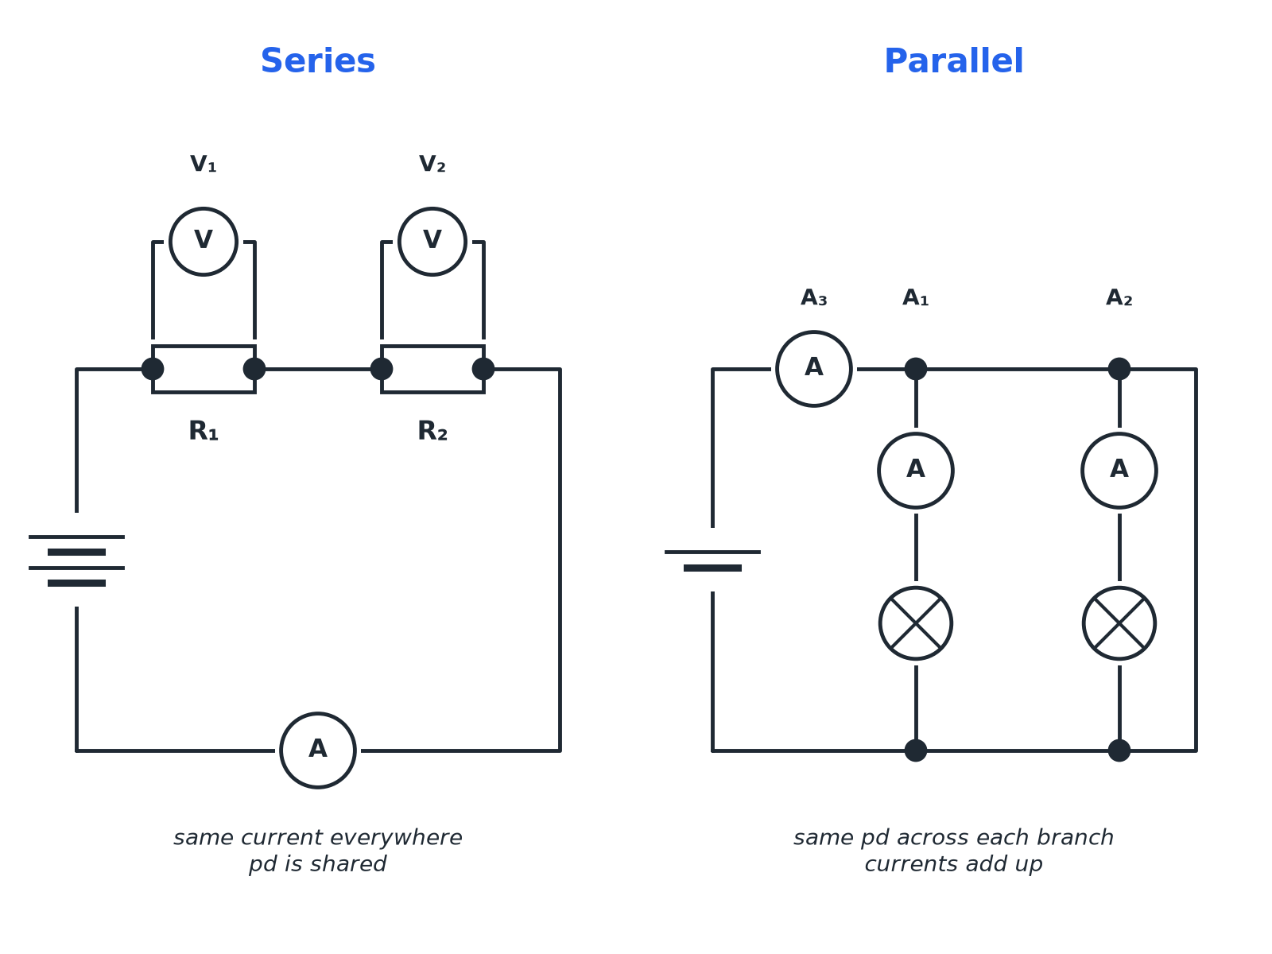

AQA GCSE PHYSICS · PAPER 1 · FOUNDATION & HIGHER
Series and Parallel
One path or several paths for the current.
Electricity
openrevise.com
Lesson 4 of 10

Slide 7

AQA GCSE PHYSICS · PAPER 1 · FOUNDATION & HIGHER
Series or Parallel?
SERIES
PARALLEL
• One loop for the current.
• The same current through each component.
• The supply pd is shared between components.
• Total resistance = R1 + R2.
• More than one loop.
• The same pd across each branch.
• The currents in the branches add to the total current.
• Total resistance is less than the smallest resistor.
Electricity
openrevise.com
Lesson 4 of 10

Slide 8

AQA GCSE PHYSICS · PAPER 1 · FOUNDATION & HIGHER
Series Circuit
A 12 V battery is connected in series with resistors of 4.0 Ω and 8.0 Ω. Calculate the current and the pd across each resistor.
1
Total resistance
R = 4.0 + 8.0 = 12 Ω
2
Current
I = V ÷ R = 12 ÷ 12 = 1.0 A
3
Pd across 4.0 Ω
V = IR = 1.0 × 4.0 = 4.0 V
4
Pd across 8.0 Ω
V = 1.0 × 8.0 = 8.0 V
5
Check
4.0 + 8.0 = 12 V
ANSWER
Current 1.0 A; pds 4.0 V and 8.0 V.
Electricity
openrevise.com
Lesson 4 of 10

Slide 9
AQA GCSE PHYSICS · PAPER 1 · FOUNDATION & HIGHER
Parallel Circuit
Two lamps are connected in parallel to a 6.0 V supply. A1 reads 1.2 A and A2 reads 0.80 A. What does A3 in the main wire read?
Currents in the branches add
I_(total) = 1.2 + 0.80
1
Answer
I_(total) = 2.0 A
2
ANSWER
2.0 A; each lamp has 6.0 V across it.
Electricity
openrevise.com
Lesson 4 of 10

Slide 10

AQA GCSE PHYSICS · PAPER 1 · FOUNDATION & HIGHER
Why Resistance Changes
Explain it in words.
In series
The current has to pass through each resistor one after another, so the total opposition is greater.
In parallel
There are more paths for the current, so more charge can flow: the total resistance is less than any single resistor.
Uses of series circuits
Measurement and testing, for example a circuit with a thermistor and an ammeter.
Uses of parallel circuits
House lighting: each lamp has the full supply pd and can be switched on separately.
Electricity
openrevise.com
Lesson 4 of 10

Slide 11

AQA GCSE PHYSICS · PAPER 1 · FOUNDATION & HIGHER
Key Terms
Series
Components connected one after another in a single loop.
Parallel
Components connected on separate branches.
Equivalent resistance
The single resistance that could replace the combination.
Branch
One of the paths in a parallel circuit.
Total resistance
The resistance of the whole circuit.
Shared pd
The supply pd divides between series components.
Electricity
openrevise.com
Lesson 4 of 10

Slide 12

AQA GCSE PHYSICS · PAPER 1 · FOUNDATION & HIGHER
YOUR TASK
12 minutes
Circuit Puzzle
A 9.0 V cell is connected to two resistors in series, 6.0 Ω and 12 Ω. (a) Find the total resistance. (b) Find the current. (c) Find the pd across the 12 Ω resistor.
Add the resistances.
1
Find I, then V across each.
2
WHAT A GOOD ANSWER SHOWS
(a) 18 Ω (b) 9.0 ÷ 18 = 0.50 A (c) 0.50 × 12 = 6.0 V
Electricity
openrevise.com
Lesson 4 of 10
Notes:
Check that the pds add up to 9.0 V.

Slide 13
AQA GCSE PHYSICS · PAPER 1 · FOUNDATION & HIGHER
Can I...?
Describe series and parallel circuits.
Add branch currents in parallel.
Add resistors in series.
State that pd is the same across parallel branches.
Find the current in a series circuit.
Explain why total resistance changes.
Find the pd across each resistor.
Draw a circuit diagram.
Electricity
openrevise.com
Lesson 4 of 10

Slide 14
AQA GCSE PHYSICS · PAPER 1 · FOUNDATION & HIGHER
Summary & Exam Focus
Series: R_(total) = R₁ + R₂, same current, shared pd.
Parallel: same pd, currents add, total resistance less than the smallest.
Ammeters in series, voltmeters in parallel.
Household circuits use parallel wiring.
EXAM FOCUS
A 12 V battery is connected in series to resistors of 4.0 Ω and 8.0 Ω. Calculate the current. (3 marks)
Add the resistances first, then use V = IR.
openrevise.com

Slide 15
AQA GCSE PHYSICS · PAPER 1 · FOUNDATION & HIGHER
Exam Practice: Series and parallel circuits
Answer all questions. Use the mark allocation as a guide to how much to write. · 19 minutes
Question 1 · 3 marks · Calculate
The diagram shows a 12 V battery connected to two resistors in series. Calculate (a) the total resistance and (b) the current in the…
Question 2 · 3 marks · Calculate
Use your answer to the previous question to calculate the potential difference across the 8.0 Ω resistor. The current is 1.0 A.
Question 3 · 3 marks · Use the diagram
The diagram shows two lamps connected in parallel to a 6.0 V supply. Ammeter A1 reads 1.2 A and A2 reads 0.80 A. (a) Calculate the reading…
Electricity
openrevise.com
Lesson 4 of 10

Slide 16
AQA GCSE PHYSICS · PAPER 1 · FOUNDATION & HIGHER
Exam Practice: Series and parallel circuits (cont.)
Question 4 · 2 marks · Explain
Explain why the lights in a house are connected in parallel rather than in series.
Question 5 · 3 marks · Explain
Explain, in terms of the flow of current, why adding a second resistor in series increases the total resistance but adding a second…
Question 6 · 4 marks · Calculate
A 9.0 V cell is connected to a 6.0 Ω resistor and a 12 Ω resistor in series. Calculate the potential difference across the 12 Ω resistor.
Electricity
openrevise.com
Lesson 4 of 10

Slide 17
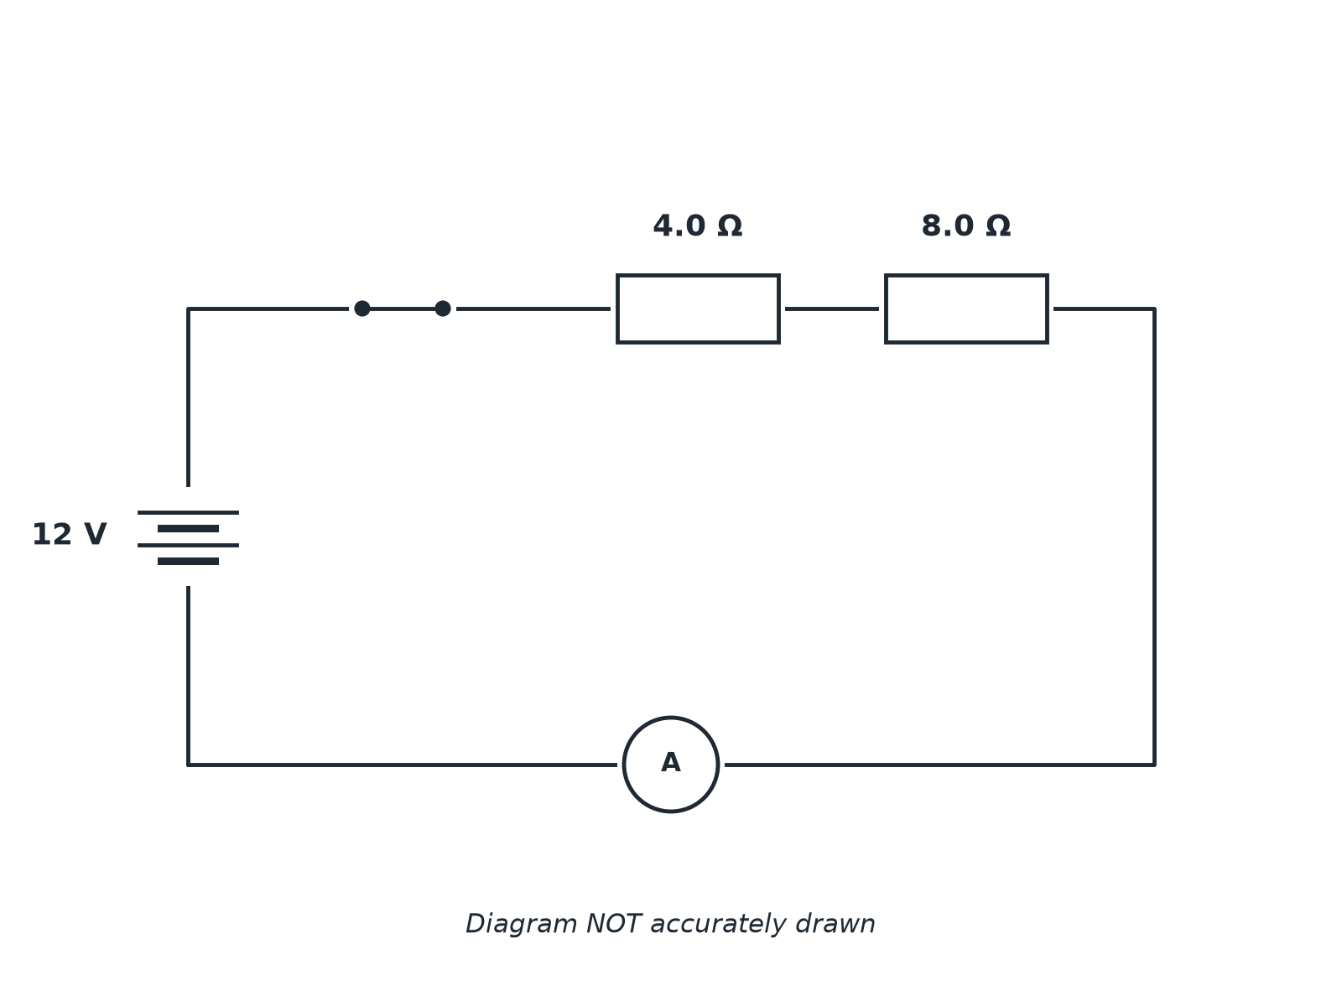
AQA GCSE PHYSICS · PAPER 1 · FOUNDATION & HIGHER
Question 1 · 3 marks · Calculate
The diagram shows a 12 V battery connected to two resistors in series. Calculate (a) the total resistance and (b) the current in the circuit. (3 marks)
Electricity
openrevise.com
Lesson 4 of 10

Slide 18
AQA GCSE PHYSICS · PAPER 1 · FOUNDATION & HIGHER
Question 1 · mark scheme
3 marks available. Award a mark for each point made.
Adds resistances
1 mark
12 Ω
1 mark
1.0 A
1 mark
Electricity
openrevise.com
Lesson 4 of 10

Slide 19
AQA GCSE PHYSICS · PAPER 1 · FOUNDATION & HIGHER
Question 2 · 3 marks · Calculate
“
Use your answer to the previous question to calculate the potential difference across the 8.0 Ω resistor. The current is 1.0 A.
HOW TO ANSWER IT
Command word: Calculate. Worth 3 marks, so plan before writing.
Electricity
openrevise.com
Lesson 4 of 10

Slide 20
AQA GCSE PHYSICS · PAPER 1 · FOUNDATION & HIGHER
Question 2 · mark scheme
3 marks available. Award a mark for each point made.
Correct equation
1 mark
Correct substitution
1 mark
8.0 V
1 mark
Electricity
openrevise.com
Lesson 4 of 10

Slide 21
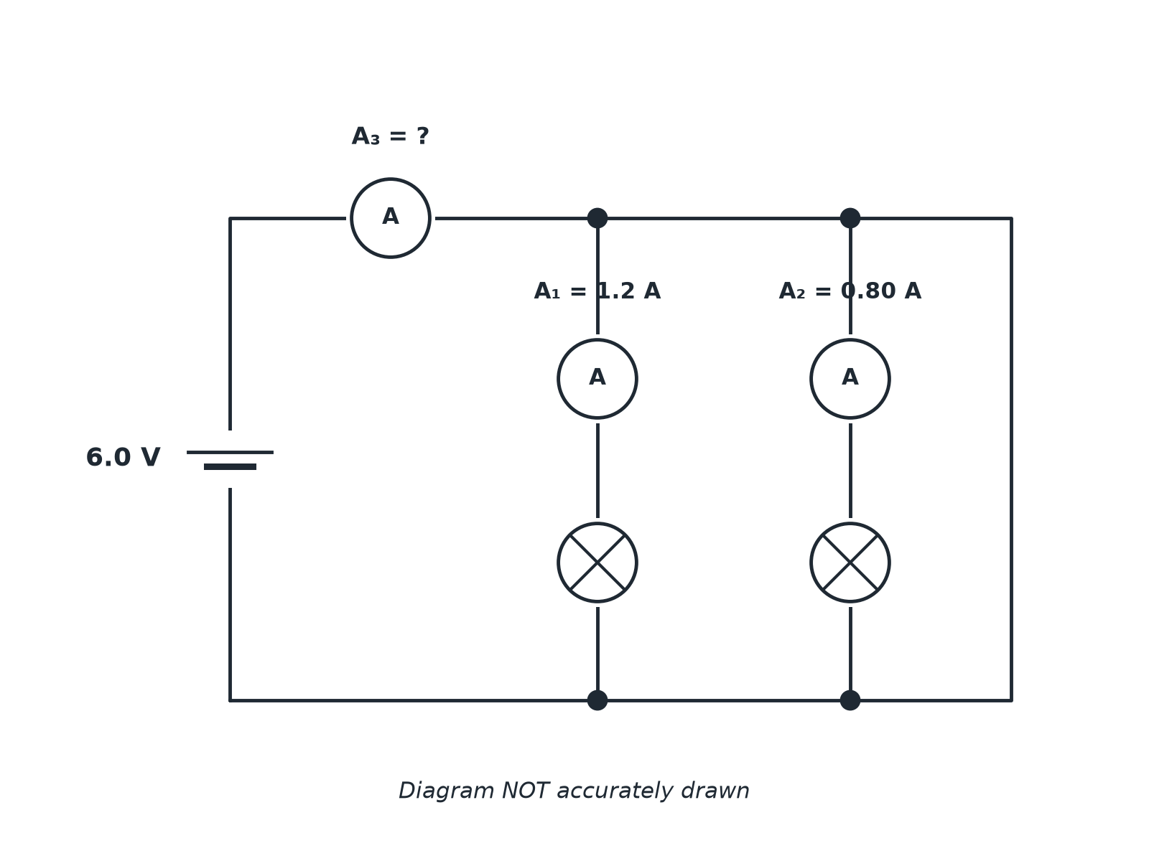
AQA GCSE PHYSICS · PAPER 1 · FOUNDATION & HIGHER
Question 3 · 3 marks · Use the diagram
The diagram shows two lamps connected in parallel to a 6.0 V supply. Ammeter A1 reads 1.2 A and A2 reads 0.80 A. (a) Calculate the reading on A3. (b) State the pd across each lamp. (3 marks)
Electricity
openrevise.com
Lesson 4 of 10

Slide 22
AQA GCSE PHYSICS · PAPER 1 · FOUNDATION & HIGHER
Question 3 · mark scheme
3 marks available. Award a mark for each point made.
Adds the branch currents
1 mark
2.0 A
1 mark
6.0 V
1 mark
Electricity
openrevise.com
Lesson 4 of 10

Slide 23
AQA GCSE PHYSICS · PAPER 1 · FOUNDATION & HIGHER
Question 4 · 2 marks · Explain
“
Explain why the lights in a house are connected in parallel rather than in series.
HOW TO ANSWER IT
Command word: Explain. Worth 2 marks, so plan before writing.
Electricity
openrevise.com
Lesson 4 of 10

Slide 24
AQA GCSE PHYSICS · PAPER 1 · FOUNDATION & HIGHER
Question 4 · mark scheme
2 marks available. Award a mark for each point made.
Each lamp gets the full supply pd
1 mark
Lamps can be switched independently or one failing does not stop the others
1 mark
Electricity
openrevise.com
Lesson 4 of 10

Slide 25
AQA GCSE PHYSICS · PAPER 1 · FOUNDATION & HIGHER
Question 5 · 3 marks · Explain
“
Explain, in terms of the flow of current, why adding a second resistor in series increases the total resistance but adding a second resistor in parallel decreases the total resistance.
HOW TO ANSWER IT
Command word: Explain. Worth 3 marks, so plan before writing.
Electricity
openrevise.com
Lesson 4 of 10

Slide 26
AQA GCSE PHYSICS · PAPER 1 · FOUNDATION & HIGHER
Question 5 · mark scheme
3 marks available. Award a mark for each point made.
Series: current passes through both, so resistance is greater
1 mark
Parallel: two paths
1 mark
More current for the same pd, so total resistance is less
1 mark
Electricity
openrevise.com
Lesson 4 of 10

Slide 27
AQA GCSE PHYSICS · PAPER 1 · FOUNDATION & HIGHER
Question 6 · 4 marks · Calculate
“
A 9.0 V cell is connected to a 6.0 Ω resistor and a 12 Ω resistor in series. Calculate the potential difference across the 12 Ω resistor.
HOW TO ANSWER IT
Command word: Calculate. Worth 4 marks, so plan before writing.
Electricity
openrevise.com
Lesson 4 of 10

Slide 28
AQA GCSE PHYSICS · PAPER 1 · FOUNDATION & HIGHER
Question 6 · mark scheme
4 marks available. Award a mark for each point made.
Total resistance 18 Ω
1 mark
Current 0.50 A
1 mark
Correct substitution
1 mark
6.0 V
1 mark
Electricity
openrevise.com
Lesson 4 of 10

