Slide 1

AQA GCSE PHYSICS · PAPER 1 · FOUNDATION & HIGHER
Mains electricity and safety
Electricity
Lesson 5 of 10
openrevise.com

Slide 2

AQA GCSE PHYSICS · PAPER 1 · FOUNDATION & HIGHER
Warm-up
Answer each one, then check.
1
What is the unit of frequency?
2
What colour is the earth wire?
3
What does a fuse do?
4
What does AC stand for?
5
What is the potential difference of the mains?
Electricity
openrevise.com
Lesson 5 of 10

Slide 3
AQA GCSE PHYSICS · PAPER 1 · FOUNDATION & HIGHER
Warm-up - Answers
What is the unit of frequency?
Hertz (Hz)
1
What colour is the earth wire?
Green and yellow stripes
2
What does a fuse do?
Melts and breaks the circuit if the current is too large
3
What does AC stand for?
Alternating current
4
What is the potential difference of the mains?
About 230 V
5
Electricity
openrevise.com
Lesson 5 of 10

Slide 4

AQA GCSE PHYSICS · PAPER 1 · FOUNDATION & HIGHER
Learning Objectives
State the frequency and potential difference of UK mains.
1
Explain the difference between dc and ac.
2
Identify the live, neutral and earth wires by colour and function.
3
Explain why a live wire can be dangerous even when a switch is open, and the dangers of connecting live to earth.
4
Electricity
openrevise.com
Lesson 5 of 10

Slide 5

AQA GCSE PHYSICS · PAPER 1 · FOUNDATION & HIGHER
MAINS ELECTRICITY
Mains electricity in the UK is an alternating supply of about 230 V with a frequency of 50 Hz.
Direct pd (dc) always pushes charge in the same direction. Alternating pd (ac) repeatedly changes direction.
Electricity
openrevise.com
Lesson 5 of 10

Slide 6
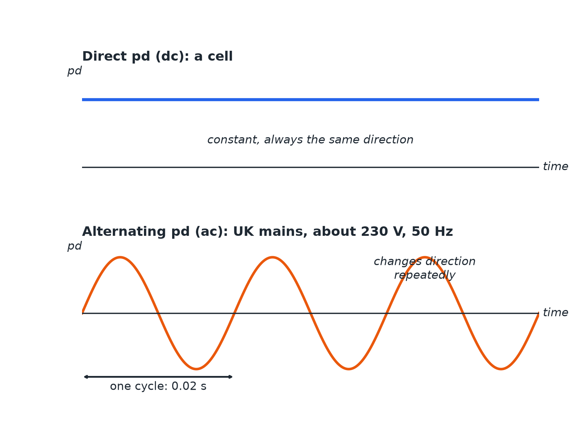

AQA GCSE PHYSICS · PAPER 1 · FOUNDATION & HIGHER
Direct and Alternating pd
Alternating pd changes direction 50 times each second.
Electricity
openrevise.com
Lesson 5 of 10

Slide 7
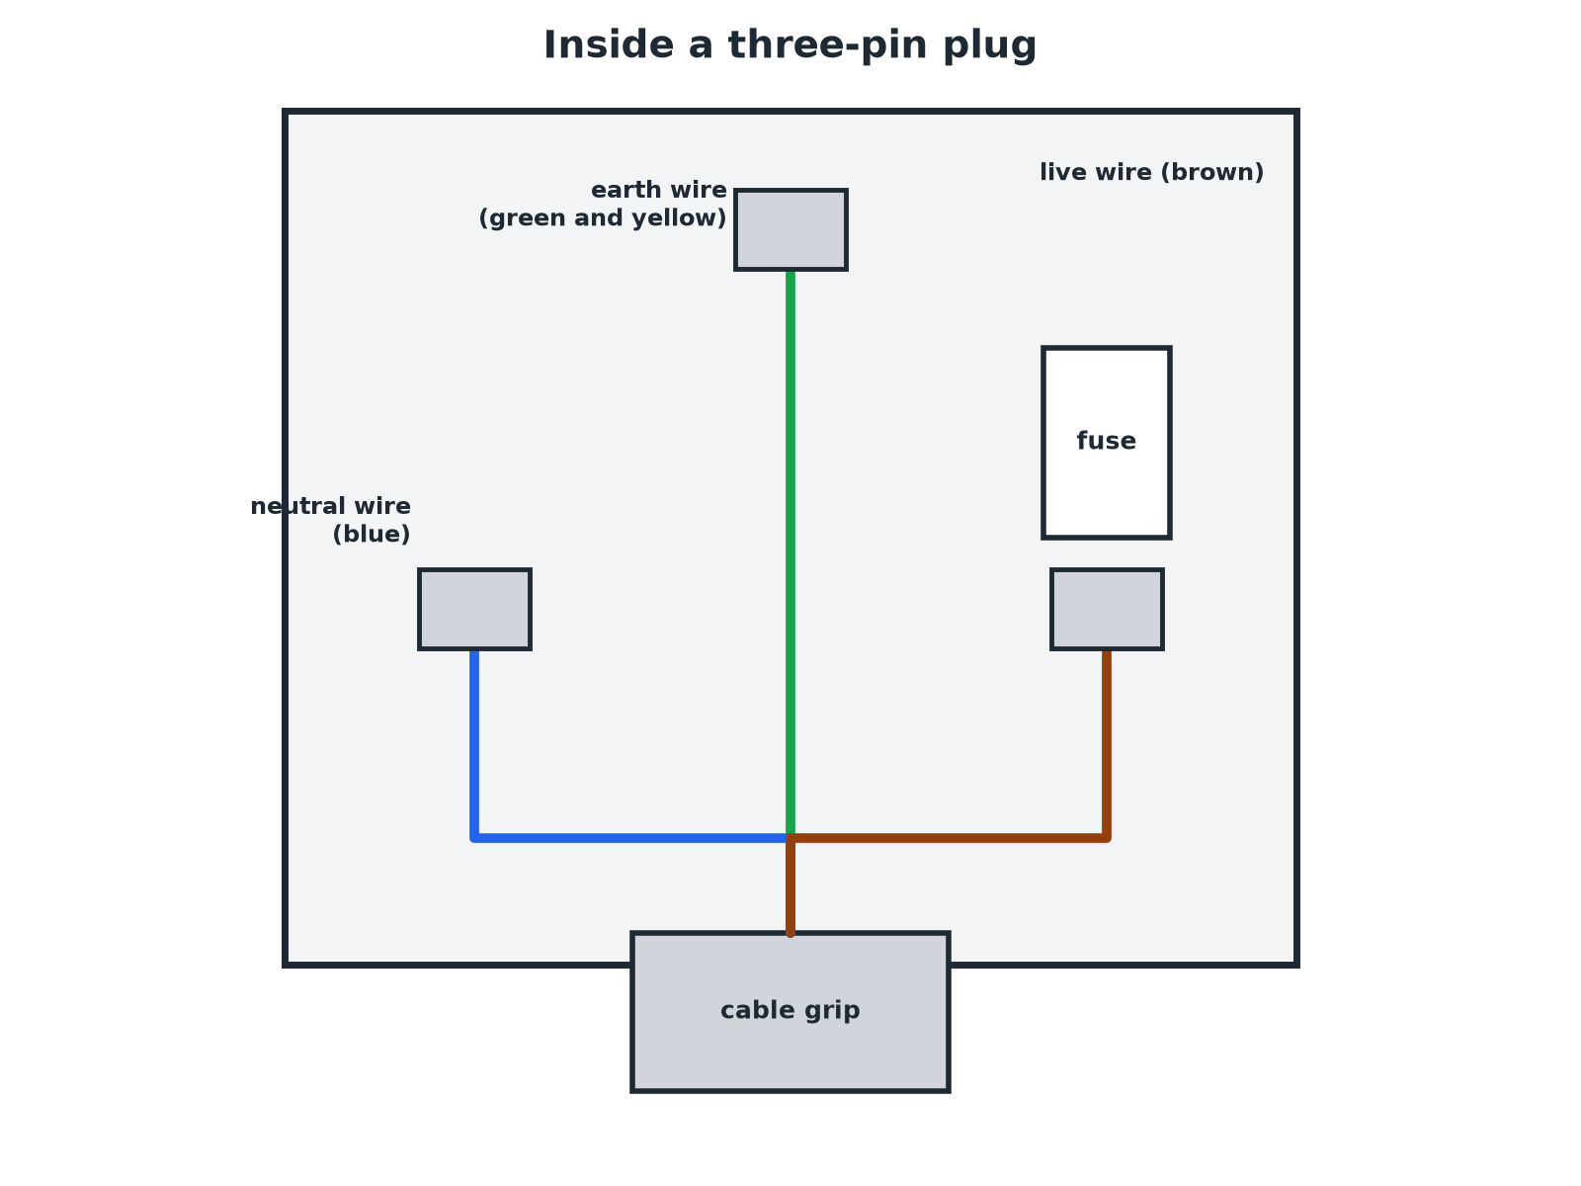
AQA GCSE PHYSICS · PAPER 1 · FOUNDATION & HIGHER
A Three-pin Plug
Colour coding makes the wires easy to identify.
Electricity
openrevise.com
Lesson 5 of 10

Slide 8

AQA GCSE PHYSICS · PAPER 1 · FOUNDATION & HIGHER
The Three-Core Cable
Learn the colour, name and job of each wire.
Wire
Colour
Job
Potential difference
Live
Brown
Carries the alternating pd from the supply
About 230 V
Neutral
Blue
Completes the circuit
At or close to 0 V
Earth
Green and yellow stripes
Safety wire: stops the appliance becoming live
0 V; only carries a current if there is a fault
Electricity
openrevise.com
Lesson 5 of 10

Slide 9

AQA GCSE PHYSICS · PAPER 1 · FOUNDATION & HIGHER
Why the Live Wire Is Dangerous
Explain why touching a live wire can be dangerous even when the switch in the appliance is open.
Switch position
If the switch is in the neutral wire, the live wire stays connected to the appliance
1
Potential difference
The live wire is at about 230 V compared with earth
2
Danger
A person touching it can provide a path to earth, and a current flows through the person
3
ANSWER
The live wire is at 230 V even when the switch is open (if the switch is in the neutral); touching it can give a dangerous current.
Electricity
openrevise.com
Lesson 5 of 10

Slide 10
AQA GCSE PHYSICS · PAPER 1 · FOUNDATION & HIGHER
Live and Earth
Explain the dangers of a connection between the live wire and earth.
Low resistance path
A very large current can flow to earth
1
Effects
The wires heat up, which can cause a fire; a person may be electrocuted
2
Earth wire
It gives a safe path so a fuse blows or the trip operates
3
ANSWER
A connection between live and earth can cause a large current, overheating, fires or electric shock.
Electricity
openrevise.com
Lesson 5 of 10

Slide 11

AQA GCSE PHYSICS · PAPER 1 · FOUNDATION & HIGHER
Safety Tips
Exam-ready reasons.
Fuse and switch
They go in the live wire so the appliance is disconnected from 230 V.
Earth wire
Connected to the metal case so that if the live wire touches it, a large current flows and the fuse melts.
Double-insulated appliances
Have no earth wire because they have a plastic case.
Electricity
openrevise.com
Lesson 5 of 10

Slide 12

AQA GCSE PHYSICS · PAPER 1 · FOUNDATION & HIGHER
Key Terms
Direct pd (dc)
A pd that always pushes charge in the same direction.
Alternating pd (ac)
A pd that repeatedly changes direction.
Frequency
The number of cycles per second, in hertz.
Live wire
The wire carrying the alternating pd, at about 230 V.
Neutral wire
The wire that completes the circuit, at about 0 V.
Earth wire
The safety wire, at 0 V, connected to the metal case.
Electricity
openrevise.com
Lesson 5 of 10

Slide 13

AQA GCSE PHYSICS · PAPER 1 · FOUNDATION & HIGHER
YOUR TASK
10 minutes
Plug Detective
A plug's wires are brown, blue and green and yellow. State the name of each wire and its job. Then say why a switch should go in the live wire.
Name each wire.
1
Say what it does.
2
WHAT A GOOD ANSWER SHOWS
Brown: live, carries 230 V. Blue: neutral, completes the circuit. Green and yellow: earth, safety wire. A switch in the live wire disconnects the appliance from the 230 V supply.
Electricity
openrevise.com
Lesson 5 of 10
Notes:
Ask what could happen if a switch were in the neutral wire.

Slide 14
AQA GCSE PHYSICS · PAPER 1 · FOUNDATION & HIGHER
Can I...?
State the frequency and pd of UK mains.
Say the live wire is at 230 V.
Explain dc and ac.
Explain why a live wire is dangerous with the switch open.
Name the three wires and their colours.
Explain the dangers of live-to-earth connections.
State the job of each wire.
Explain the purpose of the earth wire.
Electricity
openrevise.com
Lesson 5 of 10

Slide 15
AQA GCSE PHYSICS · PAPER 1 · FOUNDATION & HIGHER
Summary & Exam Focus
UK mains: 230 V, 50 Hz, ac.
Live: brown; neutral: blue; earth: green and yellow.
Earth wire only carries current if there is a fault.
Switches go in the live wire.
EXAM FOCUS
Give the colour of the live wire and state its potential difference compared with earth. (2 marks)
Brown, and about 230 V.
openrevise.com

Slide 16
AQA GCSE PHYSICS · PAPER 1 · FOUNDATION & HIGHER
Exam Practice: Mains electricity and safety
Answer all questions. Use the mark allocation as a guide to how much to write. · 15 minutes
Question 1 · 2 marks · State
State the frequency and the approximate potential difference of the UK mains supply.
Question 2 · 3 marks · Complete
The diagram shows the wires in a three-pin plug labelled A, B and C. Give the name of each wire.
Question 3 · 2 marks · Explain
Explain the difference between direct potential difference and alternating potential difference.
Electricity
openrevise.com
Lesson 5 of 10

Slide 17
AQA GCSE PHYSICS · PAPER 1 · FOUNDATION & HIGHER
Exam Practice: Mains electricity and safety (cont.)
Question 4 · 3 marks · Explain
The earth wire in a kettle is connected to its metal case. Explain the purpose of the earth wire.
Question 5 · 4 marks · Explain
A person touches the live wire in a broken appliance, but the switch in the appliance was off. Explain why the person could still receive…
Electricity
openrevise.com
Lesson 5 of 10

Slide 18
AQA GCSE PHYSICS · PAPER 1 · FOUNDATION & HIGHER
Question 1 · 2 marks · State
“
State the frequency and the approximate potential difference of the UK mains supply.
HOW TO ANSWER IT
Command word: State. Worth 2 marks, so plan before writing.
Electricity
openrevise.com
Lesson 5 of 10

Slide 19
AQA GCSE PHYSICS · PAPER 1 · FOUNDATION & HIGHER
Question 1 · mark scheme
2 marks available. Award a mark for each point made.
50 Hz
1 mark
230 V
1 mark
Electricity
openrevise.com
Lesson 5 of 10

Slide 20
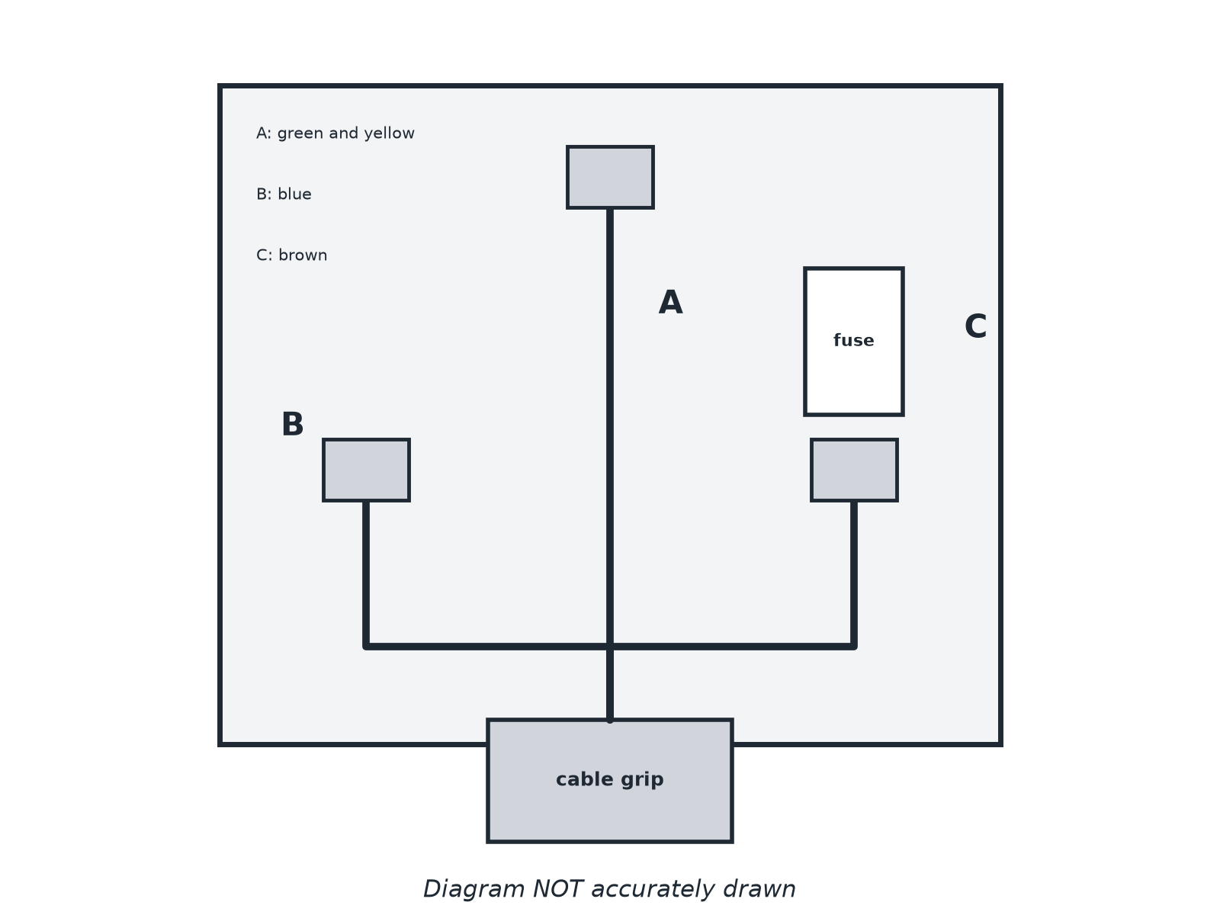
AQA GCSE PHYSICS · PAPER 1 · FOUNDATION & HIGHER
Question 2 · 3 marks · Complete
The diagram shows the wires in a three-pin plug labelled A, B and C. Give the name of each wire. (3 marks)
Electricity
openrevise.com
Lesson 5 of 10

Slide 21
AQA GCSE PHYSICS · PAPER 1 · FOUNDATION & HIGHER
Question 2 · mark scheme
3 marks available. Award a mark for each point made.
Earth
1 mark
Neutral
1 mark
Live
1 mark
Electricity
openrevise.com
Lesson 5 of 10

Slide 22
AQA GCSE PHYSICS · PAPER 1 · FOUNDATION & HIGHER
Question 3 · 2 marks · Explain
“
Explain the difference between direct potential difference and alternating potential difference.
HOW TO ANSWER IT
Command word: Explain. Worth 2 marks, so plan before writing.
Electricity
openrevise.com
Lesson 5 of 10

Slide 23
AQA GCSE PHYSICS · PAPER 1 · FOUNDATION & HIGHER
Question 3 · mark scheme
2 marks available. Award a mark for each point made.
Direct: one direction
1 mark
Alternating: changes direction repeatedly
1 mark
Electricity
openrevise.com
Lesson 5 of 10

Slide 24
AQA GCSE PHYSICS · PAPER 1 · FOUNDATION & HIGHER
Question 4 · 3 marks · Explain
“
The earth wire in a kettle is connected to its metal case. Explain the purpose of the earth wire.
HOW TO ANSWER IT
Command word: Explain. Worth 3 marks, so plan before writing.
Electricity
openrevise.com
Lesson 5 of 10

Slide 25
AQA GCSE PHYSICS · PAPER 1 · FOUNDATION & HIGHER
Question 4 · mark scheme
3 marks available. Award a mark for each point made.
Safety wire
1 mark
Stops the case becoming live
1 mark
Only carries current if there is a fault, so the fuse melts
1 mark
Electricity
openrevise.com
Lesson 5 of 10

Slide 26
AQA GCSE PHYSICS · PAPER 1 · FOUNDATION & HIGHER
Question 5 · 4 marks · Explain
“
A person touches the live wire in a broken appliance, but the switch in the appliance was off. Explain why the person could still receive an electric shock, and why connecting the live wire to earth is dangerous.
HOW TO ANSWER IT
Command word: Explain. Worth 4 marks, so plan before writing.
Electricity
openrevise.com
Lesson 5 of 10

Slide 27
AQA GCSE PHYSICS · PAPER 1 · FOUNDATION & HIGHER
Question 5 · mark scheme
4 marks available. Award a mark for each point made.
Live wire is at about 230 V
1 mark
Switch may be in the neutral wire, so live remains connected
1 mark
Current flows through the person to earth
1 mark
Live to earth: very large current causing heating, fire or shock
1 mark
Electricity
openrevise.com
Lesson 5 of 10

