Slide 1

AQA GCSE PHYSICS · PAPER 1 · FOUNDATION & HIGHER
Electrical power
Electricity
Lesson 6 of 10
openrevise.com

Slide 2

AQA GCSE PHYSICS · PAPER 1 · FOUNDATION & HIGHER
Warm-up
Answer each one, then check.
1
What is the unit of power?
2
Write the equation linking energy and time for power.
3
What is V = IR used for?
4
Convert 2.3 kW to watts.
5
Work out 3².
Electricity
openrevise.com
Lesson 6 of 10

Slide 3
AQA GCSE PHYSICS · PAPER 1 · FOUNDATION & HIGHER
Warm-up - Answers
What is the unit of power?
Watt (W)
1
Write the equation linking energy and time for power.
P = E ÷ t
2
What is V = IR used for?
Linking pd, current and resistance
3
Convert 2.3 kW to watts.
2300 W
4
Work out 3².
9
5
Electricity
openrevise.com
Lesson 6 of 10

Slide 4

AQA GCSE PHYSICS · PAPER 1 · FOUNDATION & HIGHER
Learning Objectives
Explain how the power transfer in a device is related to the pd across it and the current through it.
1
Recall and apply P = VI.
2
Recall and apply P = I²R.
3
Rearrange to find current, pd or resistance.
4
Electricity
openrevise.com
Lesson 6 of 10

Slide 5

AQA GCSE PHYSICS · PAPER 1 · FOUNDATION & HIGHER
ELECTRICAL POWER
power = potential difference × current P = VI
Also P = I²R (power = current squared × resistance). Power is in watts (W), pd in volts (V), current in amperes (A) and resistance in ohms (Ω).
Electricity
openrevise.com
Lesson 6 of 10

Slide 6
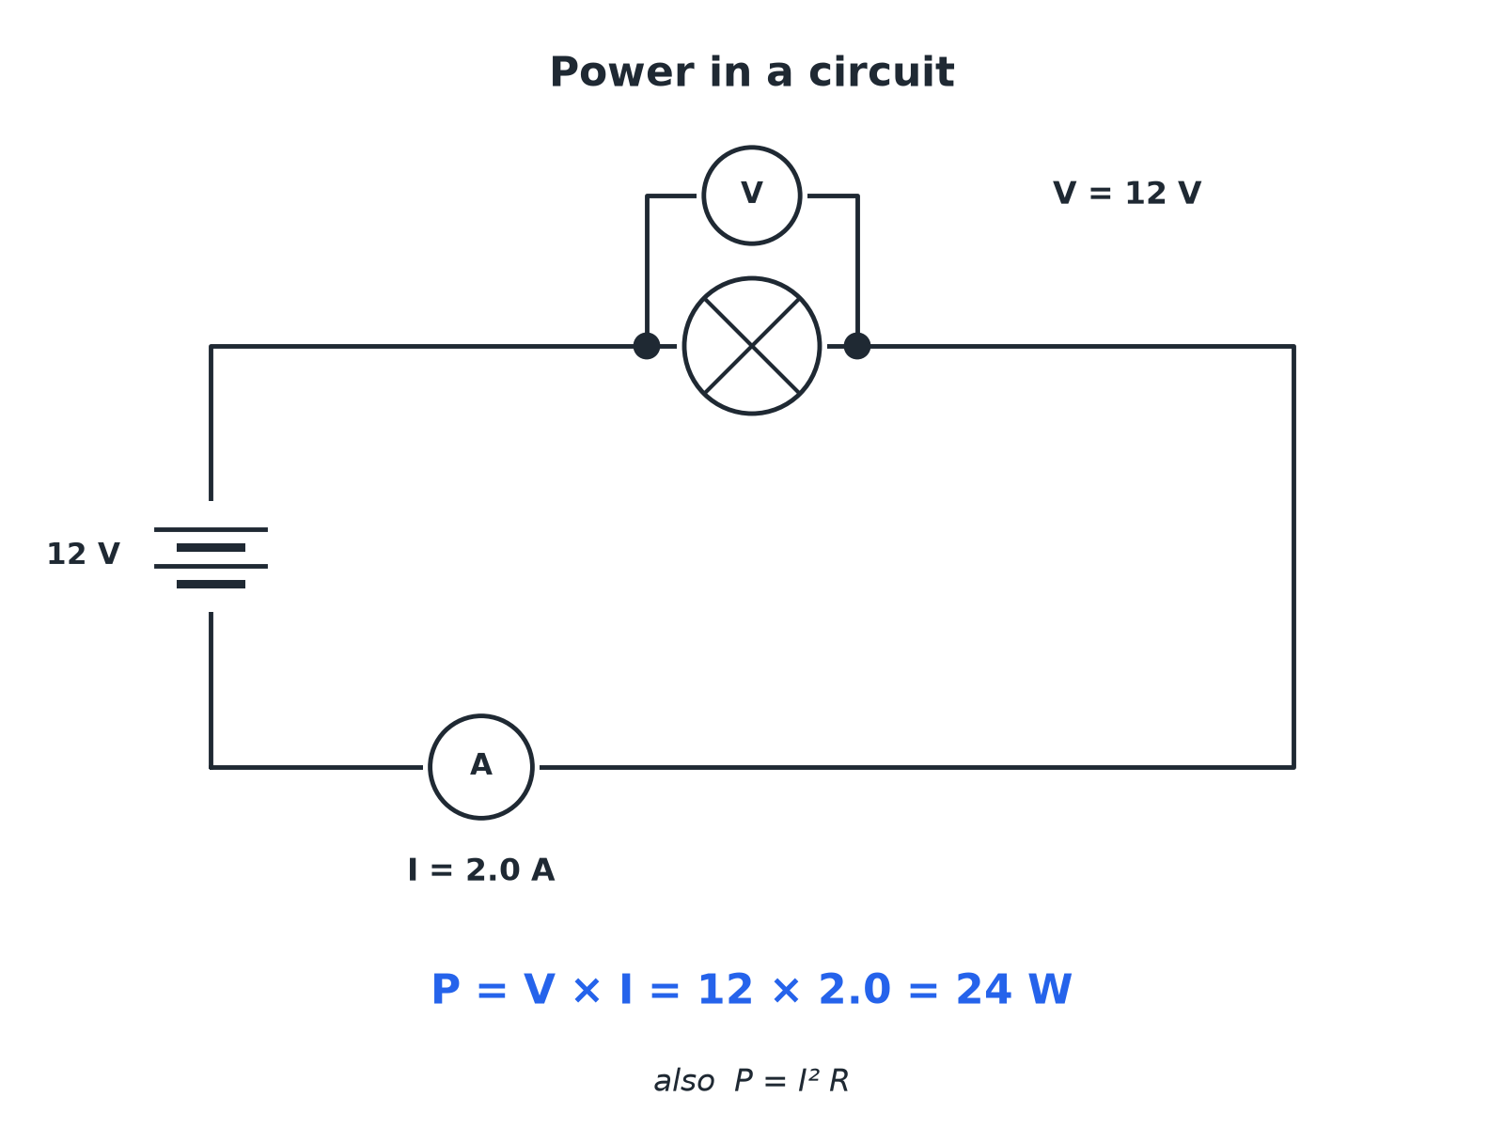

AQA GCSE PHYSICS · PAPER 1 · FOUNDATION & HIGHER
Power in a Circuit
A device with a bigger pd or current has a greater power.
Electricity
openrevise.com
Lesson 6 of 10

Slide 7

AQA GCSE PHYSICS · PAPER 1 · FOUNDATION & HIGHER
Using P = VI
A kettle has a current of 10 A when connected to the 230 V mains. Calculate its power.
Write the equation
P = VI
1
Substitute
P = 230 × 10
2
Answer
P = 2300 W
3
ANSWER
2300 W (2.3 kW)
Electricity
openrevise.com
Lesson 6 of 10

Slide 8
AQA GCSE PHYSICS · PAPER 1 · FOUNDATION & HIGHER
Using P = I²R
A current of 6.0 A flows through a 5.0 Ω resistor. Calculate the power.
Write the equation
P = I²R
1
Square the current first
6.0² = 36
2
Substitute
P = 36 × 5.0
3
Answer
P = 180 W
4
ANSWER
180 W
Electricity
openrevise.com
Lesson 6 of 10

Slide 9
AQA GCSE PHYSICS · PAPER 1 · FOUNDATION & HIGHER
Finding the Current
A 60 W lamp is connected to the 230 V mains. Calculate the current.
Rearrange
I = P ÷ V
1
Substitute
I = 60 ÷ 230
2
Answer
I = 0.26 A
3
ANSWER
0.26 A
Electricity
openrevise.com
Lesson 6 of 10

Slide 10

AQA GCSE PHYSICS · PAPER 1 · FOUNDATION & HIGHER
Which Equation?
Look at what you are given.
You have
Use
V and I
P = VI
I and R
P = I²R
V and R
Find I first with I = V ÷ R, then P = VI
E and t
P = E ÷ t
Electricity
openrevise.com
Lesson 6 of 10

Slide 11

AQA GCSE PHYSICS · PAPER 1 · FOUNDATION & HIGHER
Common Mistakes
Take care with squares.
Squaring
Square only the current, then multiply by the resistance.
Units
Convert mA to A and kW to W first.
Rating labels
The power rating of an appliance is at its normal pd.
Electricity
openrevise.com
Lesson 6 of 10

Slide 12

AQA GCSE PHYSICS · PAPER 1 · FOUNDATION & HIGHER
Key Terms
Power
The rate at which energy is transferred.
Watt
One joule per second.
Power rating
The power an appliance transfers in normal use.
Kilowatt
1000 watts.
Potential difference
Energy transferred per coulomb of charge.
Current
The rate of flow of charge.
Electricity
openrevise.com
Lesson 6 of 10

Slide 13

AQA GCSE PHYSICS · PAPER 1 · FOUNDATION & HIGHER
YOUR TASK
10 minutes
Rating Plate
A hair dryer is rated 1500 W at 230 V. Calculate the current. A toaster takes 4.0 A at 230 V; find its power.
Rearrange P = VI for current.
1
Then calculate the toaster power.
2
WHAT A GOOD ANSWER SHOWS
Hair dryer: 1500 ÷ 230 = 6.5 A. Toaster: 230 × 4.0 = 920 W.
Electricity
openrevise.com
Lesson 6 of 10
Notes:
Ask which draws more current and what this means for the fuse.

Slide 14
AQA GCSE PHYSICS · PAPER 1 · FOUNDATION & HIGHER
Can I...?
Recall P = VI.
Square the current correctly.
Recall P = I²R.
Convert units to W and A.
Choose the right equation.
Explain what power means.
Rearrange for current.
Give the unit.
Electricity
openrevise.com
Lesson 6 of 10

Slide 15
AQA GCSE PHYSICS · PAPER 1 · FOUNDATION & HIGHER
Summary & Exam Focus
P = VI.
P = I²R.
Power is in watts.
Higher power means faster energy transfer.
EXAM FOCUS
A kettle draws 10 A from the 230 V mains. Calculate its power. (2 marks)
Choose P = VI, substitute and give W.
openrevise.com

Slide 16
AQA GCSE PHYSICS · PAPER 1 · FOUNDATION & HIGHER
Exam Practice: Electrical power
Answer all questions. Use the mark allocation as a guide to how much to write. · 15 minutes
Question 1 · 2 marks · Calculate
A kettle is connected to the 230 V mains and the current is 10 A. Calculate the power of the kettle. Use the equation: power = potential…
Question 2 · 3 marks · Calculate
A current of 6.0 A flows through a resistor of resistance 5.0 Ω. Calculate the power. Use the equation: power = (current)² × resistance
Question 3 · 3 marks · Calculate
A lamp has a power of 60 W and works at 230 V. Calculate the current in the lamp.
Electricity
openrevise.com
Lesson 6 of 10

Slide 17
AQA GCSE PHYSICS · PAPER 1 · FOUNDATION & HIGHER
Exam Practice: Electrical power (cont.)
Question 4 · 2 marks · Explain
A student says that the power of a device only depends on the current. Explain why the student is not correct.
Question 5 · 4 marks · Calculate
An electric heater has a resistance of 46 Ω and is connected to a 230 V supply. Calculate the power of the heater.
Electricity
openrevise.com
Lesson 6 of 10

Slide 18
AQA GCSE PHYSICS · PAPER 1 · FOUNDATION & HIGHER
Question 1 · 2 marks · Calculate
“
A kettle is connected to the 230 V mains and the current is 10 A. Calculate the power of the kettle. Use the equation: power = potential difference × current
HOW TO ANSWER IT
Command word: Calculate. Worth 2 marks, so plan before writing.
Electricity
openrevise.com
Lesson 6 of 10

Slide 19
AQA GCSE PHYSICS · PAPER 1 · FOUNDATION & HIGHER
Question 1 · mark scheme
2 marks available. Award a mark for each point made.
Correct substitution
1 mark
2300 W
1 mark
Electricity
openrevise.com
Lesson 6 of 10

Slide 20
AQA GCSE PHYSICS · PAPER 1 · FOUNDATION & HIGHER
Question 2 · 3 marks · Calculate
“
A current of 6.0 A flows through a resistor of resistance 5.0 Ω. Calculate the power. Use the equation: power = (current)² × resistance
HOW TO ANSWER IT
Command word: Calculate. Worth 3 marks, so plan before writing.
Electricity
openrevise.com
Lesson 6 of 10

Slide 21
AQA GCSE PHYSICS · PAPER 1 · FOUNDATION & HIGHER
Question 2 · mark scheme
3 marks available. Award a mark for each point made.
Squares the current
1 mark
Correct substitution
1 mark
180 W
1 mark
Electricity
openrevise.com
Lesson 6 of 10

Slide 22
AQA GCSE PHYSICS · PAPER 1 · FOUNDATION & HIGHER
Question 3 · 3 marks · Calculate
“
A lamp has a power of 60 W and works at 230 V. Calculate the current in the lamp.
HOW TO ANSWER IT
Command word: Calculate. Worth 3 marks, so plan before writing.
Electricity
openrevise.com
Lesson 6 of 10

Slide 23
AQA GCSE PHYSICS · PAPER 1 · FOUNDATION & HIGHER
Question 3 · mark scheme
3 marks available. Award a mark for each point made.
Rearranges to I = P ÷ V
1 mark
Correct substitution
1 mark
0.26 A
1 mark
Electricity
openrevise.com
Lesson 6 of 10

Slide 24
AQA GCSE PHYSICS · PAPER 1 · FOUNDATION & HIGHER
Question 4 · 2 marks · Explain
“
A student says that the power of a device only depends on the current. Explain why the student is not correct.
HOW TO ANSWER IT
Command word: Explain. Worth 2 marks, so plan before writing.
Electricity
openrevise.com
Lesson 6 of 10

Slide 25
AQA GCSE PHYSICS · PAPER 1 · FOUNDATION & HIGHER
Question 4 · mark scheme
2 marks available. Award a mark for each point made.
Power = V × I
1 mark
Depends on pd (or resistance) as well as current
1 mark
Electricity
openrevise.com
Lesson 6 of 10

Slide 26
AQA GCSE PHYSICS · PAPER 1 · FOUNDATION & HIGHER
Question 5 · 4 marks · Calculate
“
An electric heater has a resistance of 46 Ω and is connected to a 230 V supply. Calculate the power of the heater.
HOW TO ANSWER IT
Command word: Calculate. Worth 4 marks, so plan before writing.
Electricity
openrevise.com
Lesson 6 of 10

Slide 27
AQA GCSE PHYSICS · PAPER 1 · FOUNDATION & HIGHER
Question 5 · mark scheme
4 marks available. Award a mark for each point made.
Rearranges V = IR
1 mark
5.0 A
1 mark
Correct substitution into P = VI
1 mark
1150 W
1 mark
Electricity
openrevise.com
Lesson 6 of 10

