Slide 1

AQA GCSE PHYSICS · PAPER 1 · FOUNDATION & HIGHER
The National Grid
Electricity
Lesson 8 of 10
openrevise.com

Slide 2

AQA GCSE PHYSICS · PAPER 1 · FOUNDATION & HIGHER
Warm-up
Answer each one, then check.
1
What does a power station generate?
2
What happens to a wire when a current flows?
3
Write the equation for power using current and resistance.
4
What does step-up mean?
5
What is a cable?
Electricity
openrevise.com
Lesson 8 of 10

Slide 3
AQA GCSE PHYSICS · PAPER 1 · FOUNDATION & HIGHER
Warm-up - Answers
What does a power station generate?
Electricity
1
What happens to a wire when a current flows?
It heats up
2
Write the equation for power using current and resistance.
P = I²R
3
What does step-up mean?
Increases the potential difference
4
What is a cable?
A wire used to carry current
5
Electricity
openrevise.com
Lesson 8 of 10

Slide 4

AQA GCSE PHYSICS · PAPER 1 · FOUNDATION & HIGHER
Learning Objectives
Describe the National Grid as a system of cables and transformers.
1
State the roles of step-up and step-down transformers.
2
Explain why the National Grid is an efficient way to transfer energy.
3
Electricity
openrevise.com
Lesson 8 of 10

Slide 5

AQA GCSE PHYSICS · PAPER 1 · FOUNDATION & HIGHER
THE NATIONAL GRID
Step-up transformers increase the potential difference for transmission, which reduces the current and so the energy wasted as heat in the cables.
The National Grid is a system of cables and transformers linking power stations to consumers.
Electricity
openrevise.com
Lesson 8 of 10

Slide 6
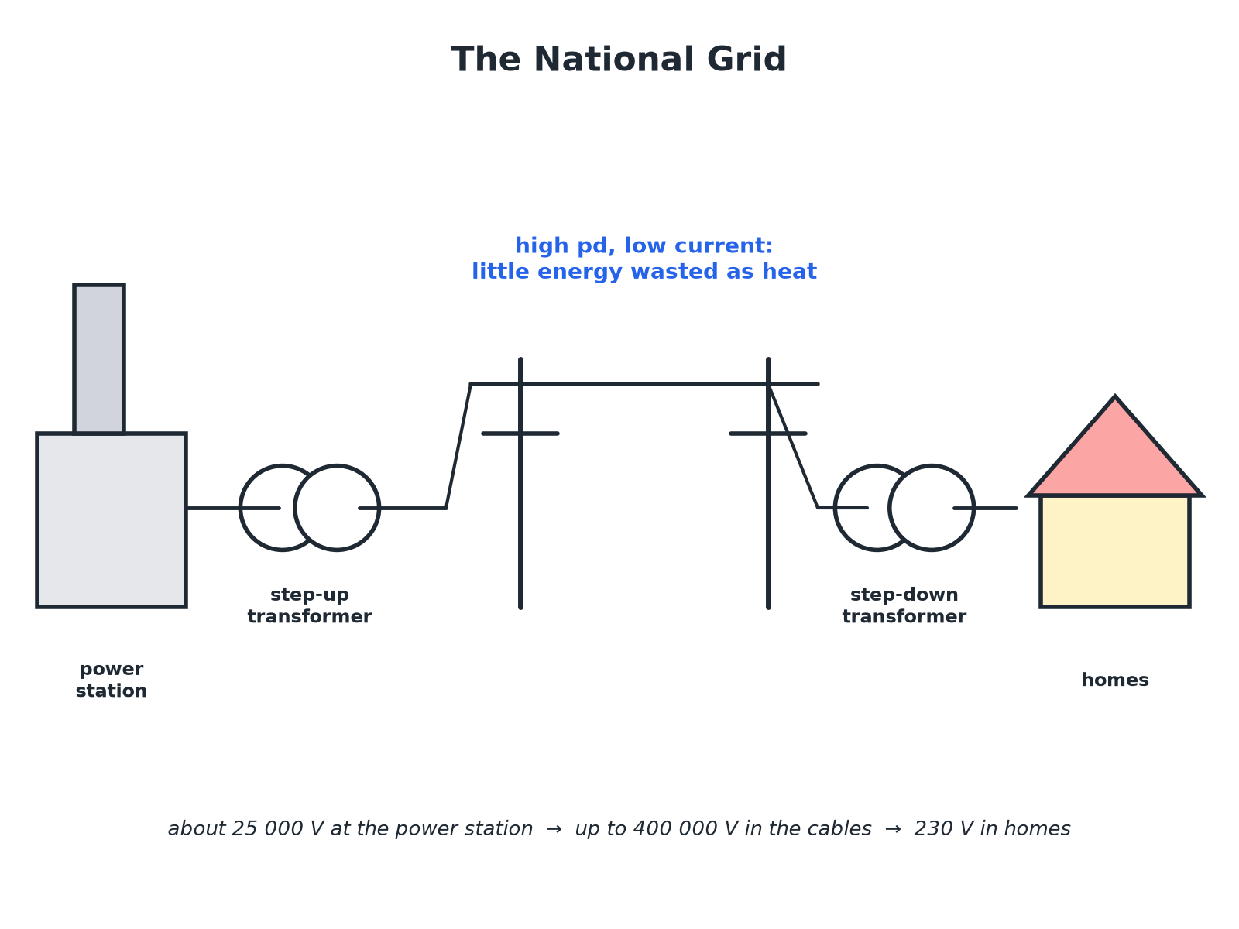

AQA GCSE PHYSICS · PAPER 1 · FOUNDATION & HIGHER
From Power Station to Home
High pd means low current.
Electricity
openrevise.com
Lesson 8 of 10

Slide 7

AQA GCSE PHYSICS · PAPER 1 · FOUNDATION & HIGHER
Why High pd Means Efficient
Follow the logic.
1
2
3
4
5
Power = pd × current
For the same power, a higher pd means a smaller current.
Less current
A smaller current means less heating in the cables.
Energy wasted
Power loss in the cable is P = I²R, so halving the current cuts the loss to a quarter.
Step-up transformers
Increase the pd before the cables.
Step-down transformers
Decrease the pd to a safe value for homes (230 V).
Electricity
openrevise.com
Lesson 8 of 10

Slide 8

AQA GCSE PHYSICS · PAPER 1 · FOUNDATION & HIGHER
Comparing Losses
100 kW is transmitted through cables of total resistance 2.0 Ω. Compare the power lost at 1000 V with the power lost at 10 000 V.
Current at 1000 V
I = P ÷ V = 100 000 ÷ 1000 = 100 A
1
Power lost
P = I²R = 100² × 2.0 = 20 000 W
2
Current at 10 000 V
I = 100 000 ÷ 10 000 = 10 A
3
Power lost
10² × 2.0 = 200 W
4
ANSWER
20 kW lost at 1000 V but only 200 W lost at 10 000 V: high pd wastes far less energy.
Electricity
openrevise.com
Lesson 8 of 10

Slide 9

AQA GCSE PHYSICS · PAPER 1 · FOUNDATION & HIGHER
Key Points
For an exam answer.
Efficient
High pd, low current means little energy wasted as heat in the cables.
Step-up
Used at the power station end.
Step-down
Used near homes and factories.
Safety
The high pd is reduced to 230 V before homes.
Electricity
openrevise.com
Lesson 8 of 10

Slide 10

AQA GCSE PHYSICS · PAPER 1 · FOUNDATION & HIGHER
Key Terms
National Grid
A system of cables and transformers linking power stations to consumers.
Transformer
A device that changes the size of an alternating pd.
Step-up transformer
Increases the pd.
Step-down transformer
Decreases the pd.
Transmission cables
Cables that carry electricity over long distances.
Efficient
Wasting little energy.
Electricity
openrevise.com
Lesson 8 of 10

Slide 11

AQA GCSE PHYSICS · PAPER 1 · FOUNDATION & HIGHER
YOUR TASK
10 minutes
Follow the Grid
Put these in the correct order: homes, step-up transformer, power station, step-down transformer, transmission cables.
Start at the power station.
1
End at homes.
2
WHAT A GOOD ANSWER SHOWS
Power station, step-up transformer, transmission cables, step-down transformer, homes.
Electricity
openrevise.com
Lesson 8 of 10
Notes:
Ask why the pd is increased before the cables.

Slide 12
AQA GCSE PHYSICS · PAPER 1 · FOUNDATION & HIGHER
Can I...?
Describe the National Grid.
Link current to energy wasted.
State what a step-up transformer does.
Compare power losses.
State what a step-down transformer does.
Draw or complete a grid diagram.
Explain why high pd is used.
Explain why 230 V is needed in homes.
Electricity
openrevise.com
Lesson 8 of 10

Slide 13
AQA GCSE PHYSICS · PAPER 1 · FOUNDATION & HIGHER
Summary & Exam Focus
Step-up transformers increase pd, step-down decrease it.
High pd means low current for the same power.
Low current means less energy wasted as heat in the cables.
The National Grid is efficient.
EXAM FOCUS
Explain why the National Grid transmits electricity at a high potential difference. (3 marks)
Say higher pd means lower current, so less heating.
openrevise.com

Slide 14
AQA GCSE PHYSICS · PAPER 1 · FOUNDATION & HIGHER
Exam Practice: The National Grid
Answer all questions. Use the mark allocation as a guide to how much to write. · 15 minutes
Question 1 · 2 marks · Complete
Name the two types of transformer used in the National Grid and state what each does.
Question 2 · 3 marks · Use the diagram
The diagram shows part of the National Grid. (a) Name the parts labelled A and B. (b) State why B is needed near homes.
Question 3 · 3 marks · Explain
Explain why using a high potential difference to transmit electricity is efficient.
Electricity
openrevise.com
Lesson 8 of 10

Slide 15
AQA GCSE PHYSICS · PAPER 1 · FOUNDATION & HIGHER
Exam Practice: The National Grid (cont.)
Question 4 · 4 marks · Calculate
A power of 100 kW is transmitted at 10 000 V through cables of total resistance 2.0 Ω. Calculate the power wasted as heat in the cables.
Question 5 · 2 marks · Explain
The potential difference in the transmission cables is much higher than in homes. Explain why the potential difference in homes is reduced.
Electricity
openrevise.com
Lesson 8 of 10

Slide 16
AQA GCSE PHYSICS · PAPER 1 · FOUNDATION & HIGHER
Question 1 · 2 marks · Complete
“
Name the two types of transformer used in the National Grid and state what each does.
HOW TO ANSWER IT
Command word: Complete. Worth 2 marks, so plan before writing.
Electricity
openrevise.com
Lesson 8 of 10

Slide 17
AQA GCSE PHYSICS · PAPER 1 · FOUNDATION & HIGHER
Question 1 · mark scheme
2 marks available. Award a mark for each point made.
Step-up increases pd
1 mark
Step-down decreases pd
1 mark
Electricity
openrevise.com
Lesson 8 of 10

Slide 18
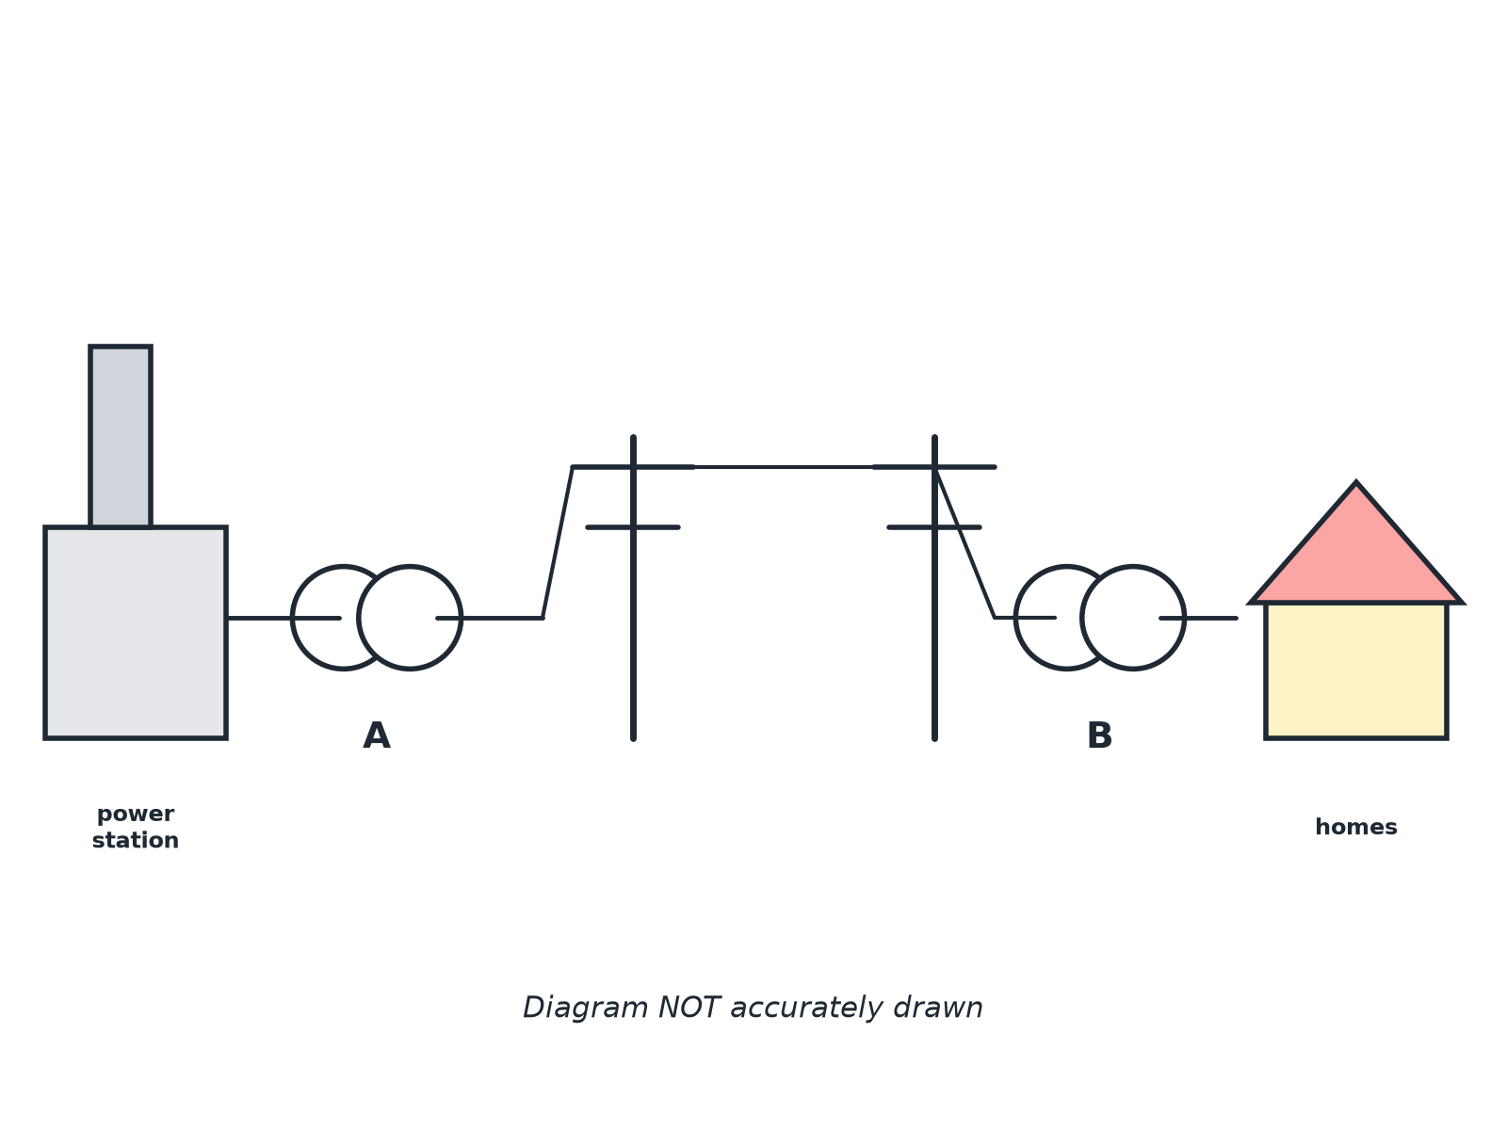
AQA GCSE PHYSICS · PAPER 1 · FOUNDATION & HIGHER
Question 2 · 3 marks · Use the diagram
The diagram shows part of the National Grid. (a) Name the parts labelled A and B. (b) State why B is needed near homes. (3 marks)
Electricity
openrevise.com
Lesson 8 of 10

Slide 19
AQA GCSE PHYSICS · PAPER 1 · FOUNDATION & HIGHER
Question 2 · mark scheme
3 marks available. Award a mark for each point made.
A: step-up transformer
1 mark
B: step-down transformer
1 mark
Reduces the pd to a safe value for homes
1 mark
Electricity
openrevise.com
Lesson 8 of 10

Slide 20
AQA GCSE PHYSICS · PAPER 1 · FOUNDATION & HIGHER
Question 3 · 3 marks · Explain
“
Explain why using a high potential difference to transmit electricity is efficient.
HOW TO ANSWER IT
Command word: Explain. Worth 3 marks, so plan before writing.
Electricity
openrevise.com
Lesson 8 of 10

Slide 21
AQA GCSE PHYSICS · PAPER 1 · FOUNDATION & HIGHER
Question 3 · mark scheme
3 marks available. Award a mark for each point made.
High pd means lower current for the same power
1 mark
Lower current means less heating of the cables
1 mark
So less energy wasted
1 mark
Electricity
openrevise.com
Lesson 8 of 10

Slide 22
AQA GCSE PHYSICS · PAPER 1 · FOUNDATION & HIGHER
Question 4 · 4 marks · Calculate
“
A power of 100 kW is transmitted at 10 000 V through cables of total resistance 2.0 Ω. Calculate the power wasted as heat in the cables.
HOW TO ANSWER IT
Command word: Calculate. Worth 4 marks, so plan before writing.
Electricity
openrevise.com
Lesson 8 of 10

Slide 23
AQA GCSE PHYSICS · PAPER 1 · FOUNDATION & HIGHER
Question 4 · mark scheme
4 marks available. Award a mark for each point made.
Rearranges to I = P ÷ V
1 mark
10 A
1 mark
Correct substitution into I²R
1 mark
200 W
1 mark
Electricity
openrevise.com
Lesson 8 of 10

Slide 24
AQA GCSE PHYSICS · PAPER 1 · FOUNDATION & HIGHER
Question 5 · 2 marks · Explain
“
The potential difference in the transmission cables is much higher than in homes. Explain why the potential difference in homes is reduced.
HOW TO ANSWER IT
Command word: Explain. Worth 2 marks, so plan before writing.
Electricity
openrevise.com
Lesson 8 of 10

Slide 25
AQA GCSE PHYSICS · PAPER 1 · FOUNDATION & HIGHER
Question 5 · mark scheme
2 marks available. Award a mark for each point made.
Safe for homes or appliances designed for 230 V
1 mark
Step-down transformer decreases the pd
1 mark
Electricity
openrevise.com
Lesson 8 of 10

