Slide 1

AQA GCSE PHYSICS · PAPER 1 · FOUNDATION & HIGHER
Static charge
Electricity
Lesson 9 of 10
openrevise.com

Slide 2

AQA GCSE PHYSICS · PAPER 1 · FOUNDATION & HIGHER
Warm-up
Answer each one, then check.
1
What charge do electrons have?
2
What is an insulator?
3
What is a non-contact force?
4
What charge does a proton have?
5
Like charges...
Electricity
openrevise.com
Lesson 9 of 10

Slide 3
AQA GCSE PHYSICS · PAPER 1 · FOUNDATION & HIGHER
Warm-up - Answers
What charge do electrons have?
Negative
1
What is an insulator?
A material that does not conduct electricity
2
What is a non-contact force?
A force between objects that are not touching
3
What charge does a proton have?
Positive
4
Like charges...
Repel
5
Electricity
openrevise.com
Lesson 9 of 10

Slide 4

AQA GCSE PHYSICS · PAPER 1 · FOUNDATION & HIGHER
Learning Objectives
Describe the production of static electricity by rubbing.
1
Explain charging in terms of the transfer of electrons.
2
Describe evidence that charged objects exert non-contact forces.
3
Explain sparking.
4
Electricity
openrevise.com
Lesson 9 of 10

Slide 5

AQA GCSE PHYSICS · PAPER 1 · FOUNDATION & HIGHER
STATIC ELECTRICITY
When insulating materials are rubbed together, electrons are transferred: the material that gains electrons becomes negatively charged and the one that loses them is left with an equal positive charge.
Objects with the same type of charge repel; objects with different types of charge attract.
Electricity
openrevise.com
Lesson 9 of 10

Slide 6
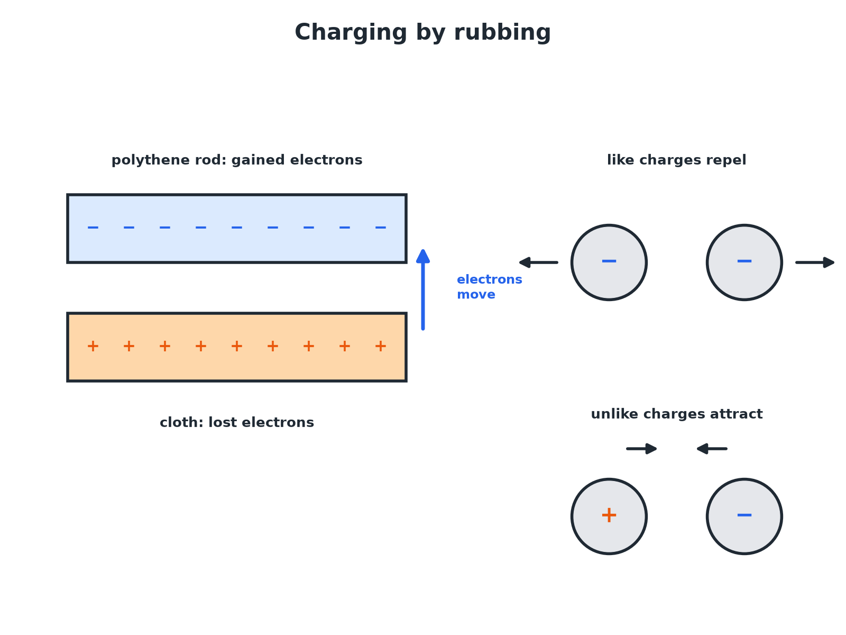

AQA GCSE PHYSICS · PAPER 1 · FOUNDATION & HIGHER
Charging by Rubbing
Only electrons move; protons stay in the nuclei.
Electricity
openrevise.com
Lesson 9 of 10

Slide 7

AQA GCSE PHYSICS · PAPER 1 · FOUNDATION & HIGHER
Explaining Charging
Explain why a polythene rod becomes negatively charged when rubbed with a cloth.
Friction
Rubbing transfers energy so electrons can move
1
Electrons move
Negatively charged electrons are rubbed off the cloth and on to the rod
2
The rod
Gains electrons, so it becomes negatively charged
3
The cloth
Loses electrons and is left with an equal positive charge
4
ANSWER
Electrons transfer from the cloth to the rod; the rod becomes negative and the cloth positive.
Electricity
openrevise.com
Lesson 9 of 10

Slide 8
AQA GCSE PHYSICS · PAPER 1 · FOUNDATION & HIGHER
Sparking
Explain how a spark can jump from a charged object to an earthed conductor.
Charge builds
A large amount of charge collects on the object
1
Strong field
The electric field between the object and the conductor becomes very strong
2
Air ionises
The air becomes ionised and conducts, so charge flows as a spark
3
ANSWER
Charge builds up until the field is strong enough to make air conduct, and the charge flows as a spark.
Electricity
openrevise.com
Lesson 9 of 10

Slide 9

AQA GCSE PHYSICS · PAPER 1 · FOUNDATION & HIGHER
Evidence of Non-Contact Forces
Repulsion
Two charged rods of the same charge push each other apart.
Attraction
A charged rod attracts small pieces of paper or a stream of water.
Hanging balls
Suspended charged balls move apart or together without touching.
Balloon on a wall
A rubbed balloon can stick to a wall.
Electricity
openrevise.com
Lesson 9 of 10

Slide 10

AQA GCSE PHYSICS · PAPER 1 · FOUNDATION & HIGHER
Common Mistakes
Be precise.
Only electrons move
Positive charges (protons) are fixed in the nucleus and do not move when rubbed.
Insulators
Only insulators keep the charge; a metal rod held in the hand loses its charge.
Say gained or lost
Say 'gained electrons', not 'gained negative charge'.
Electricity
openrevise.com
Lesson 9 of 10

Slide 11

AQA GCSE PHYSICS · PAPER 1 · FOUNDATION & HIGHER
Key Terms
Static electricity
Charge that builds up on an insulator.
Electron
A negatively charged particle.
Non-contact force
A force between objects that are not touching.
Earthing
Connecting to the ground so charge can flow away.
Repel
Push apart.
Attract
Pull together.
Electricity
openrevise.com
Lesson 9 of 10

Slide 12

AQA GCSE PHYSICS · PAPER 1 · FOUNDATION & HIGHER
YOUR TASK
10 minutes
Rub and Predict
A student rubs a cloth on a balloon. The balloon is then attracted to the wall. Explain what has happened to the electrons and what type of charge the balloon has.
Say which way electrons moved.
1
State the charge on each object.
2
WHAT A GOOD ANSWER SHOWS
Electrons are transferred from the cloth to the balloon. The balloon gains electrons and becomes negatively charged; it attracts the wall.
Electricity
openrevise.com
Lesson 9 of 10
Notes:
Ask what would happen if two rubbed balloons were held close together.

Slide 13
AQA GCSE PHYSICS · PAPER 1 · FOUNDATION & HIGHER
Can I...?
Explain how rubbing makes charge.
Describe evidence for non-contact forces.
Say which particles move.
Explain sparking.
State the charge on each object.
Explain why insulators keep charge.
Describe attraction and repulsion.
Use the terms gained and lost electrons.
Electricity
openrevise.com
Lesson 9 of 10

Slide 14
AQA GCSE PHYSICS · PAPER 1 · FOUNDATION & HIGHER
Summary & Exam Focus
Rubbing insulators transfers electrons.
The material that gains electrons is negative; the one that loses electrons is positive.
Like charges repel, unlike attract.
Sparks occur when the field is strong enough to ionise air.
EXAM FOCUS
Explain how a polythene rod becomes negatively charged when rubbed with a cloth. (3 marks)
Say which way the electrons move.
openrevise.com

Slide 15
AQA GCSE PHYSICS · PAPER 1 · FOUNDATION & HIGHER
Exam Practice: Static charge
Answer all questions. Use the mark allocation as a guide to how much to write. · 16 minutes
Question 1 · 3 marks · Explain
A polythene rod is rubbed with a cloth and becomes negatively charged. Explain how the rod becomes negatively charged.
Question 2 · 3 marks · Use the diagram
The diagram shows two charged balls hanging from threads. Ball A is negatively charged. (a) State the type of charge on ball B. (b) Name…
Question 3 · 3 marks · Explain
A student walks across a nylon carpet and then gets a small electric shock when touching a metal door handle. Explain why.
Electricity
openrevise.com
Lesson 9 of 10

Slide 16
AQA GCSE PHYSICS · PAPER 1 · FOUNDATION & HIGHER
Exam Practice: Static charge (cont.)
Question 4 · 2 marks · Explain
Explain why a charged balloon can stick to a wall even though the balloon and wall do not touch.
Question 5 · 4 marks · Explain
Lightning is a very large spark. Explain how charge builds up in a cloud and what causes the lightning.
Electricity
openrevise.com
Lesson 9 of 10

Slide 17
AQA GCSE PHYSICS · PAPER 1 · FOUNDATION & HIGHER
Question 1 · 3 marks · Explain
“
A polythene rod is rubbed with a cloth and becomes negatively charged. Explain how the rod becomes negatively charged.
HOW TO ANSWER IT
Command word: Explain. Worth 3 marks, so plan before writing.
Electricity
openrevise.com
Lesson 9 of 10

Slide 18
AQA GCSE PHYSICS · PAPER 1 · FOUNDATION & HIGHER
Question 1 · mark scheme
3 marks available. Award a mark for each point made.
Electrons transferred
1 mark
From the cloth to the rod
1 mark
Rod gains electrons so it is negative
1 mark
Electricity
openrevise.com
Lesson 9 of 10

Slide 19
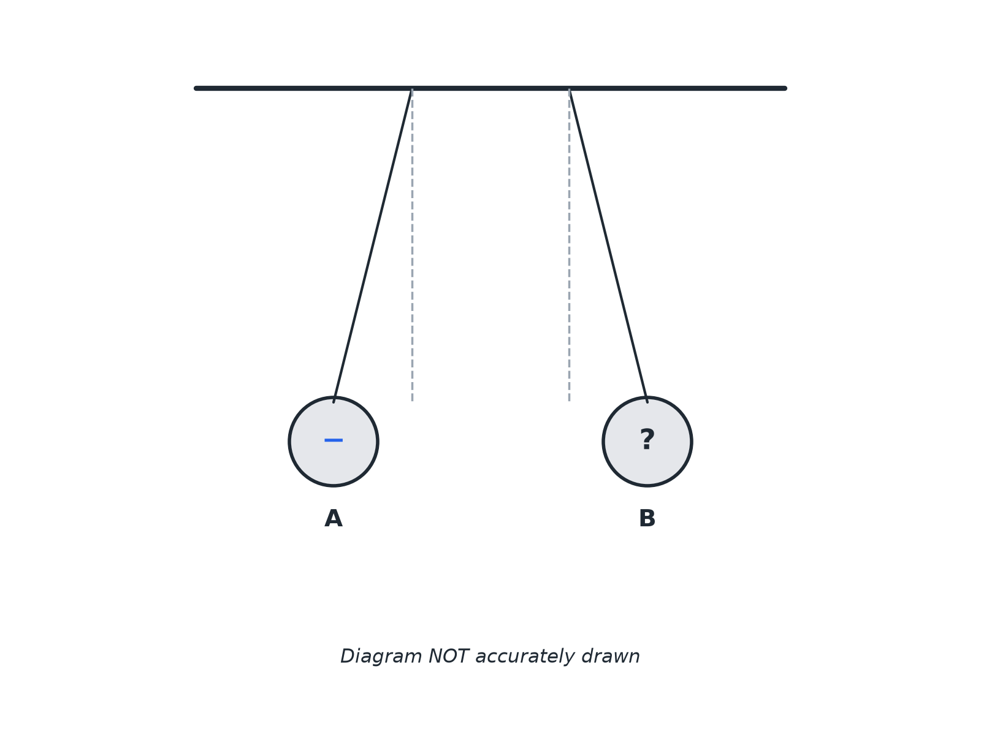
AQA GCSE PHYSICS · PAPER 1 · FOUNDATION & HIGHER
Question 2 · 3 marks · Use the diagram
The diagram shows two charged balls hanging from threads. Ball A is negatively charged. (a) State the type of charge on ball B. (b) Name the type of force acting between the balls. (3 marks)
Electricity
openrevise.com
Lesson 9 of 10

Slide 20
AQA GCSE PHYSICS · PAPER 1 · FOUNDATION & HIGHER
Question 2 · mark scheme
3 marks available. Award a mark for each point made.
Negative
1 mark
Because they repel (like charges)
1 mark
Non-contact force
1 mark
Electricity
openrevise.com
Lesson 9 of 10

Slide 21
AQA GCSE PHYSICS · PAPER 1 · FOUNDATION & HIGHER
Question 3 · 3 marks · Explain
“
A student walks across a nylon carpet and then gets a small electric shock when touching a metal door handle. Explain why.
HOW TO ANSWER IT
Command word: Explain. Worth 3 marks, so plan before writing.
Electricity
openrevise.com
Lesson 9 of 10

Slide 22
AQA GCSE PHYSICS · PAPER 1 · FOUNDATION & HIGHER
Question 3 · mark scheme
3 marks available. Award a mark for each point made.
Rubbing transfers electrons
1 mark
The student becomes charged
1 mark
Charge flows to earth through the handle
1 mark
Electricity
openrevise.com
Lesson 9 of 10

Slide 23
AQA GCSE PHYSICS · PAPER 1 · FOUNDATION & HIGHER
Question 4 · 2 marks · Explain
“
Explain why a charged balloon can stick to a wall even though the balloon and wall do not touch.
HOW TO ANSWER IT
Command word: Explain. Worth 2 marks, so plan before writing.
Electricity
openrevise.com
Lesson 9 of 10

Slide 24
AQA GCSE PHYSICS · PAPER 1 · FOUNDATION & HIGHER
Question 4 · mark scheme
2 marks available. Award a mark for each point made.
Non-contact force
1 mark
Attraction between charged balloon and wall
1 mark
Electricity
openrevise.com
Lesson 9 of 10

Slide 25
AQA GCSE PHYSICS · PAPER 1 · FOUNDATION & HIGHER
Question 5 · 4 marks · Explain
“
Lightning is a very large spark. Explain how charge builds up in a cloud and what causes the lightning.
HOW TO ANSWER IT
Command word: Explain. Worth 4 marks, so plan before writing.
Electricity
openrevise.com
Lesson 9 of 10

Slide 26
AQA GCSE PHYSICS · PAPER 1 · FOUNDATION & HIGHER
Question 5 · mark scheme
4 marks available. Award a mark for each point made.
Electrons transferred by collisions or friction
1 mark
Cloud charged, large pd between cloud and ground
1 mark
Strong electric field ionises the air
1 mark
Charge flows as a spark
1 mark
Electricity
openrevise.com
Lesson 9 of 10

