Slide 1

AQA GCSE PHYSICS · PAPER 1 · FOUNDATION & HIGHER
Electric fields
Electricity
Lesson 10 of 10
openrevise.com

Slide 2

AQA GCSE PHYSICS · PAPER 1 · FOUNDATION & HIGHER
Warm-up
Answer each one, then check.
1
What is a field?
2
Which charges attract?
3
What is a non-contact force?
4
What charge does an electron have?
5
What is a spark?
Electricity
openrevise.com
Lesson 10 of 10

Slide 3
AQA GCSE PHYSICS · PAPER 1 · FOUNDATION & HIGHER
Warm-up - Answers
What is a field?
A region where a force acts on certain objects
1
Which charges attract?
Unlike charges
2
What is a non-contact force?
A force between objects that are not touching
3
What charge does an electron have?
Negative
4
What is a spark?
A sudden flow of charge through air
5
Electricity
openrevise.com
Lesson 10 of 10

Slide 4

AQA GCSE PHYSICS · PAPER 1 · FOUNDATION & HIGHER
Learning Objectives
Explain the concept of an electric field.
1
Draw the electric field pattern for an isolated charged sphere.
2
Describe how the strength of the field changes with distance.
3
Explain non-contact forces and sparking using the idea of a field.
4
Electricity
openrevise.com
Lesson 10 of 10

Slide 5

AQA GCSE PHYSICS · PAPER 1 · FOUNDATION & HIGHER
ELECTRIC FIELDS
A charged object creates an electric field around itself. A second charged object placed in the field experiences a force.
The field is strongest close to the charged object and gets weaker with distance. The force gets stronger as the distance between the objects decreases.
Electricity
openrevise.com
Lesson 10 of 10

Slide 6
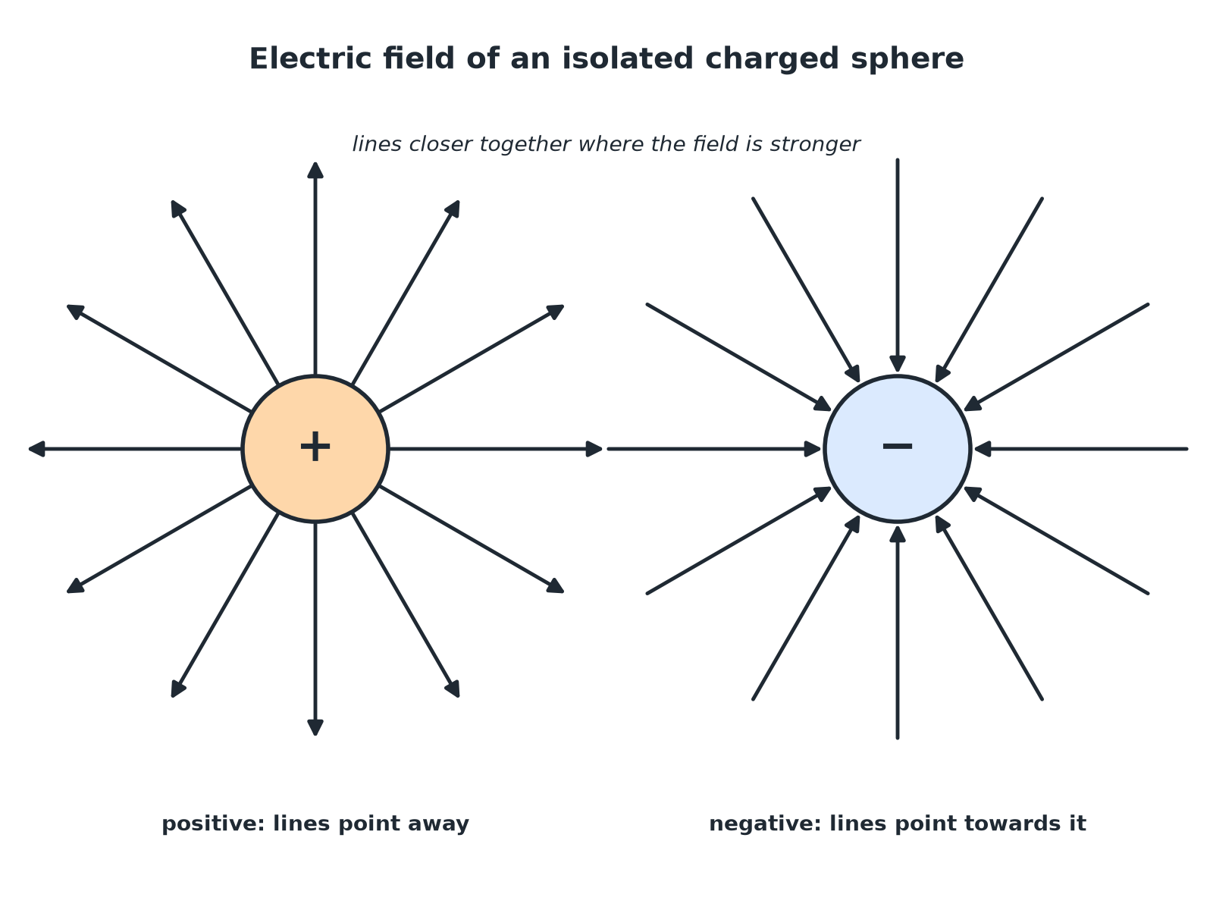

AQA GCSE PHYSICS · PAPER 1 · FOUNDATION & HIGHER
Field Around a Charged Sphere
Arrows show the direction of the force on a positive charge.
Electricity
openrevise.com
Lesson 10 of 10

Slide 7

AQA GCSE PHYSICS · PAPER 1 · FOUNDATION & HIGHER
Drawing the Field of an Isolated Sphere
Follow the rules.
1
2
3
4
Draw the sphere
A circle with plus or minus signs.
Draw straight lines
At least 8 lines, evenly spaced, starting at the surface and going radially.
Add arrows
Away from a positive sphere; towards a negative sphere.
Show the strength
Lines are closer together near the sphere, where the field is stronger.
Electricity
openrevise.com
Lesson 10 of 10

Slide 8

AQA GCSE PHYSICS · PAPER 1 · FOUNDATION & HIGHER
Force in a Field
A small positive charge is placed near a positively charged sphere. Describe the force on it and how it changes as the charge is moved closer.
Direction
The charge is repelled: the force is away from the sphere
1
As it moves closer
The field is stronger, so the force gets stronger
2
ANSWER
The force is repulsive and increases as the distance decreases.
Electricity
openrevise.com
Lesson 10 of 10

Slide 9
AQA GCSE PHYSICS · PAPER 1 · FOUNDATION & HIGHER
Explaining a Spark
Explain how the idea of an electric field helps to explain sparking.
Charged object
Creates a strong electric field around itself
1
Air
The strong field can make air molecules lose electrons (ionise)
2
Charge flows
The ionised air conducts, so charge flows as a spark
3
ANSWER
A strong electric field ionises the air so charge can flow: a spark.
Electricity
openrevise.com
Lesson 10 of 10

Slide 10

AQA GCSE PHYSICS · PAPER 1 · FOUNDATION & HIGHER
Non-Contact Forces
Fields explain forces at a distance.
Field
A charged object does not touch the other object, but its field acts on it.
Distance
The further away, the weaker the field and the force.
Direction
Field lines show the direction of the force on a positive charge.
Electricity
openrevise.com
Lesson 10 of 10

Slide 11

AQA GCSE PHYSICS · PAPER 1 · FOUNDATION & HIGHER
Key Terms
Electric field
The region around a charged object where another charge feels a force.
Field lines
Lines showing the direction of the force on a positive charge.
Isolated sphere
A charged sphere far from any other charges.
Ionise
Remove or add electrons to make ions.
Non-contact force
A force between objects that are not touching.
Field strength
How large the force on a charge is at a point.
Electricity
openrevise.com
Lesson 10 of 10

Slide 12

AQA GCSE PHYSICS · PAPER 1 · FOUNDATION & HIGHER
YOUR TASK
12 minutes
Draw the Field
Draw the electric field around (a) a positively charged sphere and (b) a negatively charged sphere. Show the arrows and how the strength varies.
Draw at least eight lines.
1
Add arrows in the right direction.
2
WHAT A GOOD ANSWER SHOWS
(a) Radial lines with arrows pointing away, closer together at the sphere. (b) Radial lines with arrows pointing towards the sphere.
Electricity
openrevise.com
Lesson 10 of 10
Notes:
Check that the lines do not cross and are straight.

Slide 13
AQA GCSE PHYSICS · PAPER 1 · FOUNDATION & HIGHER
Can I...?
Define an electric field.
Explain non-contact force with fields.
Draw the field around a positive sphere.
Explain sparking with fields.
Draw the field around a negative sphere.
Use arrows correctly.
Say how strength changes with distance.
Draw evenly spaced lines.
Electricity
openrevise.com
Lesson 10 of 10

Slide 14
AQA GCSE PHYSICS · PAPER 1 · FOUNDATION & HIGHER
Summary & Exam Focus
An electric field surrounds a charged object.
Field lines point away from positive and towards negative.
The field is strongest close to the object.
A strong field can ionise air and cause a spark.
EXAM FOCUS
Draw the electric field pattern around an isolated negatively charged sphere. (2 marks)
Straight lines, arrows pointing towards the sphere.
openrevise.com

Slide 15
AQA GCSE PHYSICS · PAPER 1 · FOUNDATION & HIGHER
Exam Practice: Electric fields
Answer all questions. Use the mark allocation as a guide to how much to write. · 14 minutes
Question 1 · 2 marks · Draw
Draw the electric field pattern of an isolated negatively charged sphere.
Question 2 · 3 marks · Complete the diagram
The diagram shows a positively charged sphere with two field lines drawn. Complete the diagram to show the electric field. Explain what the…
Question 3 · 2 marks · Explain
A small positive charge is moved towards a positively charged sphere. Explain how the force on the small charge changes.
Electricity
openrevise.com
Lesson 10 of 10

Slide 16
AQA GCSE PHYSICS · PAPER 1 · FOUNDATION & HIGHER
Exam Practice: Electric fields (cont.)
Question 4 · 3 marks · Explain
Explain how the idea of an electric field helps to explain how a charged comb can pick up small pieces of paper without touching them.
Question 5 · 3 marks · Explain
Explain, using the idea of an electric field, how a spark can jump between a charged sphere and a metal rod.
Electricity
openrevise.com
Lesson 10 of 10

Slide 17
AQA GCSE PHYSICS · PAPER 1 · FOUNDATION & HIGHER
Question 1 · 2 marks · Draw
“
Draw the electric field pattern of an isolated negatively charged sphere.
HOW TO ANSWER IT
Command word: Draw. Worth 2 marks, so plan before writing.
Electricity
openrevise.com
Lesson 10 of 10

Slide 18
AQA GCSE PHYSICS · PAPER 1 · FOUNDATION & HIGHER
Question 1 · mark scheme
2 marks available. Award a mark for each point made.
Straight radial lines
1 mark
Arrows pointing towards the sphere
1 mark
Electricity
openrevise.com
Lesson 10 of 10

Slide 19
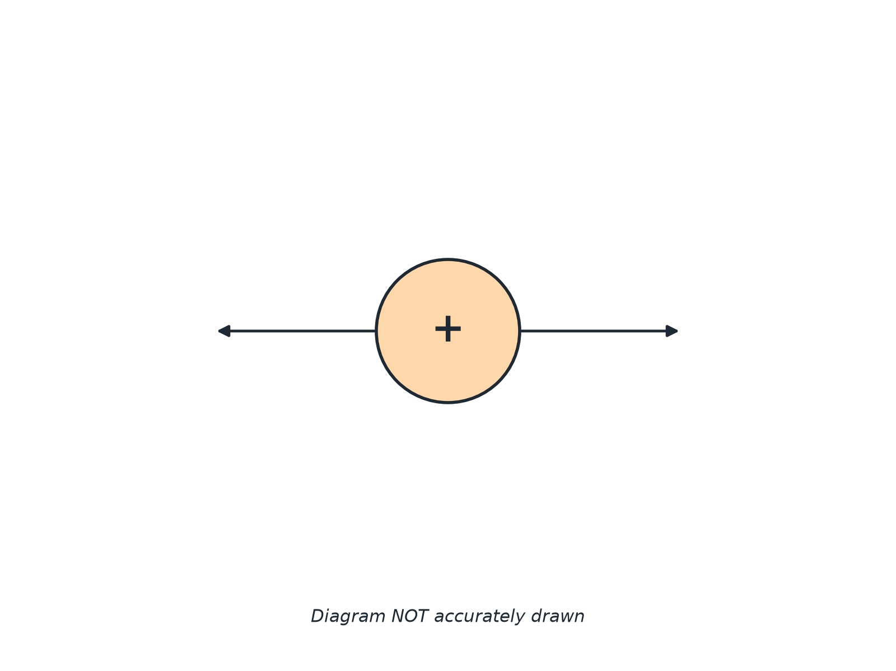
AQA GCSE PHYSICS · PAPER 1 · FOUNDATION & HIGHER
Question 2 · 3 marks · Complete the diagram
The diagram shows a positively charged sphere with two field lines drawn. Complete the diagram to show the electric field. Explain what the diagram shows about the field strength. (3 marks)
Electricity
openrevise.com
Lesson 10 of 10

Slide 20
AQA GCSE PHYSICS · PAPER 1 · FOUNDATION & HIGHER
Question 2 · mark scheme
3 marks available. Award a mark for each point made.
Additional radial straight lines evenly spaced
1 mark
Arrows pointing away
1 mark
Field strongest close to the sphere
1 mark
Electricity
openrevise.com
Lesson 10 of 10

Slide 21
AQA GCSE PHYSICS · PAPER 1 · FOUNDATION & HIGHER
Question 3 · 2 marks · Explain
“
A small positive charge is moved towards a positively charged sphere. Explain how the force on the small charge changes.
HOW TO ANSWER IT
Command word: Explain. Worth 2 marks, so plan before writing.
Electricity
openrevise.com
Lesson 10 of 10

Slide 22
AQA GCSE PHYSICS · PAPER 1 · FOUNDATION & HIGHER
Question 3 · mark scheme
2 marks available. Award a mark for each point made.
Force increases as the distance decreases
1 mark
The field is stronger closer to the sphere
1 mark
Electricity
openrevise.com
Lesson 10 of 10

Slide 23
AQA GCSE PHYSICS · PAPER 1 · FOUNDATION & HIGHER
Question 4 · 3 marks · Explain
“
Explain how the idea of an electric field helps to explain how a charged comb can pick up small pieces of paper without touching them.
HOW TO ANSWER IT
Command word: Explain. Worth 3 marks, so plan before writing.
Electricity
openrevise.com
Lesson 10 of 10

Slide 24
AQA GCSE PHYSICS · PAPER 1 · FOUNDATION & HIGHER
Question 4 · mark scheme
3 marks available. Award a mark for each point made.
Charged object has an electric field
1 mark
The field exerts a force on other objects
1 mark
Non-contact force of attraction
1 mark
Electricity
openrevise.com
Lesson 10 of 10

Slide 25
AQA GCSE PHYSICS · PAPER 1 · FOUNDATION & HIGHER
Question 5 · 3 marks · Explain
“
Explain, using the idea of an electric field, how a spark can jump between a charged sphere and a metal rod.
HOW TO ANSWER IT
Command word: Explain. Worth 3 marks, so plan before writing.
Electricity
openrevise.com
Lesson 10 of 10

Slide 26
AQA GCSE PHYSICS · PAPER 1 · FOUNDATION & HIGHER
Question 5 · mark scheme
3 marks available. Award a mark for each point made.
Strong field near the sphere
1 mark
Ionises the air
1 mark
Charge flows through the air as a spark
1 mark
Electricity
openrevise.com
Lesson 10 of 10

