Slide 1

AQA GCSE PHYSICS · PAPER 1 · FOUNDATION & HIGHER
Current, resistance and potential difference
Electricity
Lesson 2 of 10
openrevise.com

Slide 2

AQA GCSE PHYSICS · PAPER 1 · FOUNDATION & HIGHER
Warm-up
Answer each one, then check.
1
Write the unit of resistance.
2
What is the unit of potential difference?
3
Where is a voltmeter connected?
4
What does a longer wire do to resistance?
5
What is a current?
Electricity
openrevise.com
Lesson 2 of 10

Slide 3
AQA GCSE PHYSICS · PAPER 1 · FOUNDATION & HIGHER
Warm-up - Answers
Write the unit of resistance.
Ohm (Ω)
1
What is the unit of potential difference?
Volt (V)
2
Where is a voltmeter connected?
In parallel across the component
3
What does a longer wire do to resistance?
Increases it
4
What is a current?
A flow of charge
5
Electricity
openrevise.com
Lesson 2 of 10

Slide 4

AQA GCSE PHYSICS · PAPER 1 · FOUNDATION & HIGHER
Learning Objectives
Explain that current depends on resistance and potential difference.
1
Recall and apply V = IR.
2
Describe how to investigate the resistance of a wire and of combinations of resistors (Required Practical 3).
3
Interpret graphs of resistance against length.
4
Electricity
openrevise.com
Lesson 2 of 10

Slide 5

AQA GCSE PHYSICS · PAPER 1 · FOUNDATION & HIGHER
V = IR
potential difference = current × resistance V = IR
The greater the resistance of a component, the smaller the current for a given potential difference across it. Questions use the term potential difference; voltage also gains credit.
Electricity
openrevise.com
Lesson 2 of 10

Slide 6

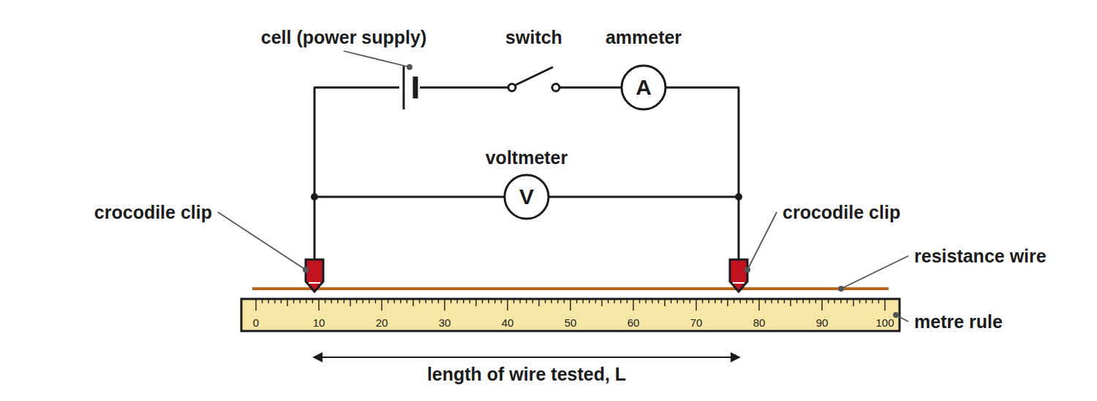
AQA GCSE PHYSICS · PAPER 1 · FOUNDATION & HIGHER
Required Practical 3: Resistance of a Wire
Change only the length of wire between the clips.
Electricity
openrevise.com
Lesson 2 of 10

Slide 7

AQA GCSE PHYSICS · PAPER 1 · FOUNDATION & HIGHER
Method: Resistance and Length of a Wire
Required Practical 3, part 1.
1
2
3
4
5
6
Set up
Connect the circuit with the ammeter in series and the voltmeter across the wire.
Set the length
Clip the crocodile clips at 0.20 m, and record the pd and current.
Switch off between readings
This keeps the wire at a constant temperature.
Repeat
Take readings at 0.40 m, 0.60 m, 0.80 m and 1.00 m.
Calculate
For each length R = V ÷ I.
Plot
Draw a graph of resistance against length: a straight line through the origin.
Electricity
openrevise.com
Lesson 2 of 10

Slide 8
AQA GCSE PHYSICS · PAPER 1 · FOUNDATION & HIGHER
Method: Resistors in Series and Parallel
Required Practical 3, part 2.
1
2
3
Series
Connect known resistors in series, measure V and I, calculate R = V ÷ I.
Parallel
Repeat with the same resistors in parallel.
Compare
The series combination has a larger resistance than either resistor; the parallel combination has a smaller one.
Electricity
openrevise.com
Lesson 2 of 10

Slide 9

AQA GCSE PHYSICS · PAPER 1 · FOUNDATION & HIGHER
Calculating Current
A 12 V battery is connected across a 4.0 Ω resistor. Calculate the current.
Rearrange
I = V ÷ R
1
Substitute
I = 12 ÷ 4.0
2
Answer
I = 3.0 A
3
ANSWER
3.0 A
Electricity
openrevise.com
Lesson 2 of 10

Slide 10
AQA GCSE PHYSICS · PAPER 1 · FOUNDATION & HIGHER
Calculating Potential Difference
A current of 0.50 A flows through a 20 Ω resistor. Calculate the potential difference across it.
Write the equation
V = IR
1
Substitute
V = 0.50 × 20
2
Answer
V = 10 V
3
ANSWER
10 V
Electricity
openrevise.com
Lesson 2 of 10

Slide 11
AQA GCSE PHYSICS · PAPER 1 · FOUNDATION & HIGHER
Calculating Resistance
A voltmeter reads 6.0 V and an ammeter reads 20 mA. Calculate the resistance.
Convert the current
20 mA = 0.020 A
1
Rearrange
R = V ÷ I
2
Substitute
R = 6.0 ÷ 0.020
3
Answer
R = 300 Ω
4
ANSWER
300 Ω
Electricity
openrevise.com
Lesson 2 of 10

Slide 12

AQA GCSE PHYSICS · PAPER 1 · FOUNDATION & HIGHER
Getting Good Results
Why we switch off between readings.
Heating
A current makes the wire hotter, and a hotter metal wire has a higher resistance.
Constant temperature
Use a low current and switch off between readings.
Zero errors
Check the meters read zero before starting.
Repeat
Repeat and average to reduce random errors.
Electricity
openrevise.com
Lesson 2 of 10

Slide 13

AQA GCSE PHYSICS · PAPER 1 · FOUNDATION & HIGHER
Key Terms
Resistance
How much a component opposes the flow of current.
Ohm
The unit of resistance (Ω).
Potential difference
The energy transferred per coulomb; measured in volts.
Voltmeter
Measures pd; connected in parallel.
Constant temperature
Kept the same so the resistance does not change for other reasons.
Directly proportional
Doubling one quantity doubles the other.
Electricity
openrevise.com
Lesson 2 of 10

Slide 14

AQA GCSE PHYSICS · PAPER 1 · FOUNDATION & HIGHER
YOUR TASK
10 minutes
Predict the Graph
A student measures the resistance of 20 cm, 40 cm, 60 cm, 80 cm and 100 cm of a wire. What does the graph of resistance against length look like? A 30 cm length has a resistance of 1.8 Ω; what is the resistance of 90 cm?
Sketch the axes.
1
Use the ratio of lengths.
2
WHAT A GOOD ANSWER SHOWS
A straight line through the origin: resistance is directly proportional to length. 90 cm is three times as long, so R = 5.4 Ω.
Electricity
openrevise.com
Lesson 2 of 10
Notes:
Ask what happens if the wire heats up.

Slide 15
AQA GCSE PHYSICS · PAPER 1 · FOUNDATION & HIGHER
Can I...?
Recall V = IR.
Explain why the wire is switched off between readings.
Rearrange for I or R.
Draw a graph of R against length.
Convert mA to A.
Say what happens to resistance in series and parallel.
Describe the resistance of wire method.
Use the correct units.
Electricity
openrevise.com
Lesson 2 of 10

Slide 16
AQA GCSE PHYSICS · PAPER 1 · FOUNDATION & HIGHER
Summary & Exam Focus
V = IR.
Ammeter in series, voltmeter in parallel.
Longer wire means greater resistance.
Switch off between readings to keep the temperature constant.
EXAM FOCUS
A potential difference of 9.0 V is applied across a resistor and the current is 0.30 A. Calculate the resistance. (2 marks)
State the equation, substitute and give the unit Ω.
openrevise.com

Slide 17
AQA GCSE PHYSICS · PAPER 1 · FOUNDATION & HIGHER
Exam Practice: Current, resistance and potential difference
Answer all questions. Use the mark allocation as a guide to how much to write. · 21 minutes
Question 1 · 2 marks · Calculate
The potential difference across a resistor is 9.0 V and the current through it is 0.30 A. Calculate the resistance of the resistor. Use the…
Question 2 · 2 marks · Calculate
A current of 0.15 A flows through a 40 Ω resistor. Calculate the potential difference across the resistor.
Question 3 · 4 marks · Use the graph
A student investigates how the resistance of a wire depends on its length. The graph shows the results. (a) Describe the relationship shown…
Electricity
openrevise.com
Lesson 2 of 10

Slide 18
AQA GCSE PHYSICS · PAPER 1 · FOUNDATION & HIGHER
Exam Practice: Current, resistance and potential difference (cont.)
Question 4 · 6 marks · Describe
Describe an investigation to show how the resistance of a wire depends on its length. Your answer should include a circuit diagram…
Question 5 · 3 marks · Explain
Two identical resistors are connected first in series and then in parallel. Explain, without calculation, how the total resistance of each…
Question 6 · 3 marks · Calculate
A voltmeter reads 6.0 V and an ammeter reads 20 mA. Calculate the resistance of the component.
Electricity
openrevise.com
Lesson 2 of 10

Slide 19
AQA GCSE PHYSICS · PAPER 1 · FOUNDATION & HIGHER
Question 1 · 2 marks · Calculate
“
The potential difference across a resistor is 9.0 V and the current through it is 0.30 A. Calculate the resistance of the resistor. Use the equation: potential difference = current × resistance
HOW TO ANSWER IT
Command word: Calculate. Worth 2 marks, so plan before writing.
Electricity
openrevise.com
Lesson 2 of 10

Slide 20
AQA GCSE PHYSICS · PAPER 1 · FOUNDATION & HIGHER
Question 1 · mark scheme
2 marks available. Award a mark for each point made.
Correct substitution
1 mark
30 Ω
1 mark
Electricity
openrevise.com
Lesson 2 of 10

Slide 21
AQA GCSE PHYSICS · PAPER 1 · FOUNDATION & HIGHER
Question 2 · 2 marks · Calculate
“
A current of 0.15 A flows through a 40 Ω resistor. Calculate the potential difference across the resistor.
HOW TO ANSWER IT
Command word: Calculate. Worth 2 marks, so plan before writing.
Electricity
openrevise.com
Lesson 2 of 10

Slide 22
AQA GCSE PHYSICS · PAPER 1 · FOUNDATION & HIGHER
Question 2 · mark scheme
2 marks available. Award a mark for each point made.
Correct substitution
1 mark
6.0 V
1 mark
Electricity
openrevise.com
Lesson 2 of 10

Slide 23
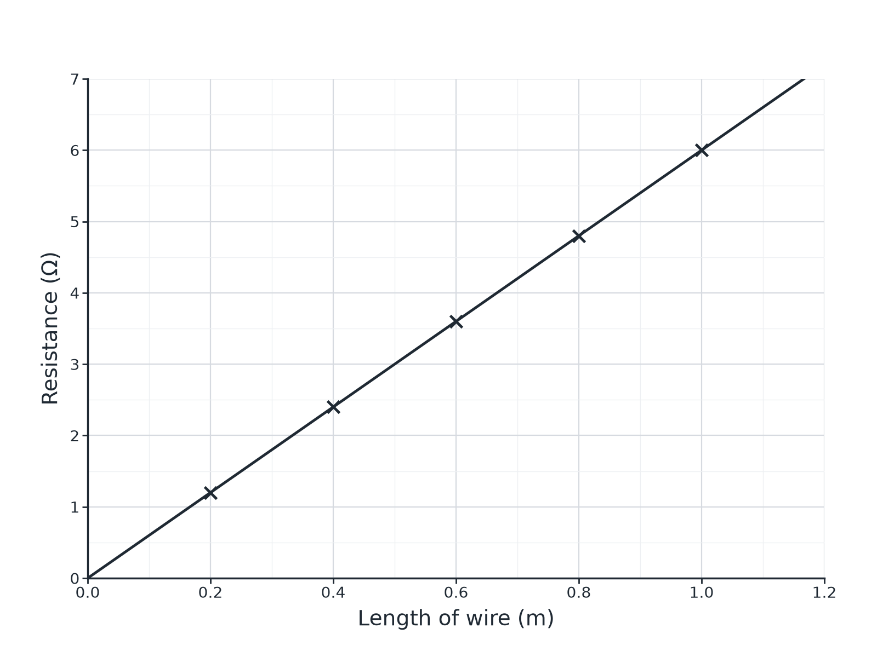
AQA GCSE PHYSICS · PAPER 1 · FOUNDATION & HIGHER
Question 3 · 4 marks · Use the graph
A student investigates how the resistance of a wire depends on its length. The graph shows the results. (a) Describe the relationship shown by the graph. (b) Use the graph to find the resistance of 70 cm of the wire. (c) Suggest why the student switched off the current between readings. (4 marks)
Electricity
openrevise.com
Lesson 2 of 10

Slide 24
AQA GCSE PHYSICS · PAPER 1 · FOUNDATION & HIGHER
Question 3 · mark scheme
4 marks available. Award a mark for each point made.
Straight line through the origin, or directly proportional
1 mark
4.2 Ω (accept 4.1 to 4.3)
1 mark
To keep the temperature constant or stop the wire heating
1 mark
Because temperature affects resistance
1 mark
Electricity
openrevise.com
Lesson 2 of 10

Slide 25
AQA GCSE PHYSICS · PAPER 1 · FOUNDATION & HIGHER
Question 4 · 6 marks · Describe
“
Describe an investigation to show how the resistance of a wire depends on its length. Your answer should include a circuit diagram description, the measurements you would take, and how you would keep the test fair and safe.
HOW TO ANSWER IT
Command word: Describe. Worth 6 marks, so plan before writing.
Electricity
openrevise.com
Lesson 2 of 10

Slide 26
AQA GCSE PHYSICS · PAPER 1 · FOUNDATION & HIGHER
Question 4 · mark scheme
6 marks available. Award a mark for each point made.
Level 3 (5 to 6 marks): a complete method with a correct circuit (ammeter in series, voltmeter across the wire), several lengths, calculation of R = V ÷ I for each, a graph, and control of temperature or safety
5 to 6 marks
Level 2 (3 to 4 marks): a method with most of the equipment and measurements, but with gaps in the detail or control
3 to 4 marks
Level 1 (1 to 2 marks): simple statements about measuring current and pd for wires
1 to 2 marks
Electricity
openrevise.com
Lesson 2 of 10

Slide 27
AQA GCSE PHYSICS · PAPER 1 · FOUNDATION & HIGHER
Question 5 · 3 marks · Explain
“
Two identical resistors are connected first in series and then in parallel. Explain, without calculation, how the total resistance of each arrangement compares with the resistance of one resistor.
HOW TO ANSWER IT
Command word: Explain. Worth 3 marks, so plan before writing.
Electricity
openrevise.com
Lesson 2 of 10

Slide 28
AQA GCSE PHYSICS · PAPER 1 · FOUNDATION & HIGHER
Question 5 · mark scheme
3 marks available. Award a mark for each point made.
Series greater
1 mark
Parallel less
1 mark
A reason for either
1 mark
Electricity
openrevise.com
Lesson 2 of 10

Slide 29
AQA GCSE PHYSICS · PAPER 1 · FOUNDATION & HIGHER
Question 6 · 3 marks · Calculate
“
A voltmeter reads 6.0 V and an ammeter reads 20 mA. Calculate the resistance of the component.
HOW TO ANSWER IT
Command word: Calculate. Worth 3 marks, so plan before writing.
Electricity
openrevise.com
Lesson 2 of 10

Slide 30
AQA GCSE PHYSICS · PAPER 1 · FOUNDATION & HIGHER
Question 6 · mark scheme
3 marks available. Award a mark for each point made.
Converts 20 mA to 0.020 A
1 mark
Correct substitution
1 mark
300 Ω
1 mark
Electricity
openrevise.com
Lesson 2 of 10

