Slide 1

AQA GCSE PHYSICS · PAPER 1 · FOUNDATION & HIGHER
Resistors and I–V characteristics
Electricity
Lesson 3 of 10
openrevise.com

Slide 2

AQA GCSE PHYSICS · PAPER 1 · FOUNDATION & HIGHER
Warm-up
Answer each one, then check.
1
What is an ohmic conductor?
2
What does I–V stand for?
3
What is a straight line graph through the origin?
4
What happens to a metal when its temperature rises?
5
What does LDR stand for?
Electricity
openrevise.com
Lesson 3 of 10

Slide 3
AQA GCSE PHYSICS · PAPER 1 · FOUNDATION & HIGHER
Warm-up - Answers
What is an ohmic conductor?
A conductor with constant resistance at constant temperature
1
What does I–V stand for?
Current against potential difference
2
What is a straight line graph through the origin?
Directly proportional
3
What happens to a metal when its temperature rises?
Its resistance rises
4
What does LDR stand for?
Light-dependent resistor
5
Electricity
openrevise.com
Lesson 3 of 10

Slide 4

AQA GCSE PHYSICS · PAPER 1 · FOUNDATION & HIGHER
Learning Objectives
Describe the I–V graphs of a resistor, filament lamp and diode.
1
Explain the changes in resistance of a filament lamp, diode, thermistor and LDR.
2
Describe how to investigate I–V characteristics (Required Practical 4).
3
Use graphs to say whether a component is linear or non-linear.
4
Electricity
openrevise.com
Lesson 3 of 10

Slide 5

AQA GCSE PHYSICS · PAPER 1 · FOUNDATION & HIGHER
I–V CHARACTERISTICS
The current through an ohmic conductor at constant temperature is directly proportional to the potential difference across it, so its resistance is constant.
The resistance of a filament lamp, diode, thermistor and LDR is not constant.
Electricity
openrevise.com
Lesson 3 of 10

Slide 6
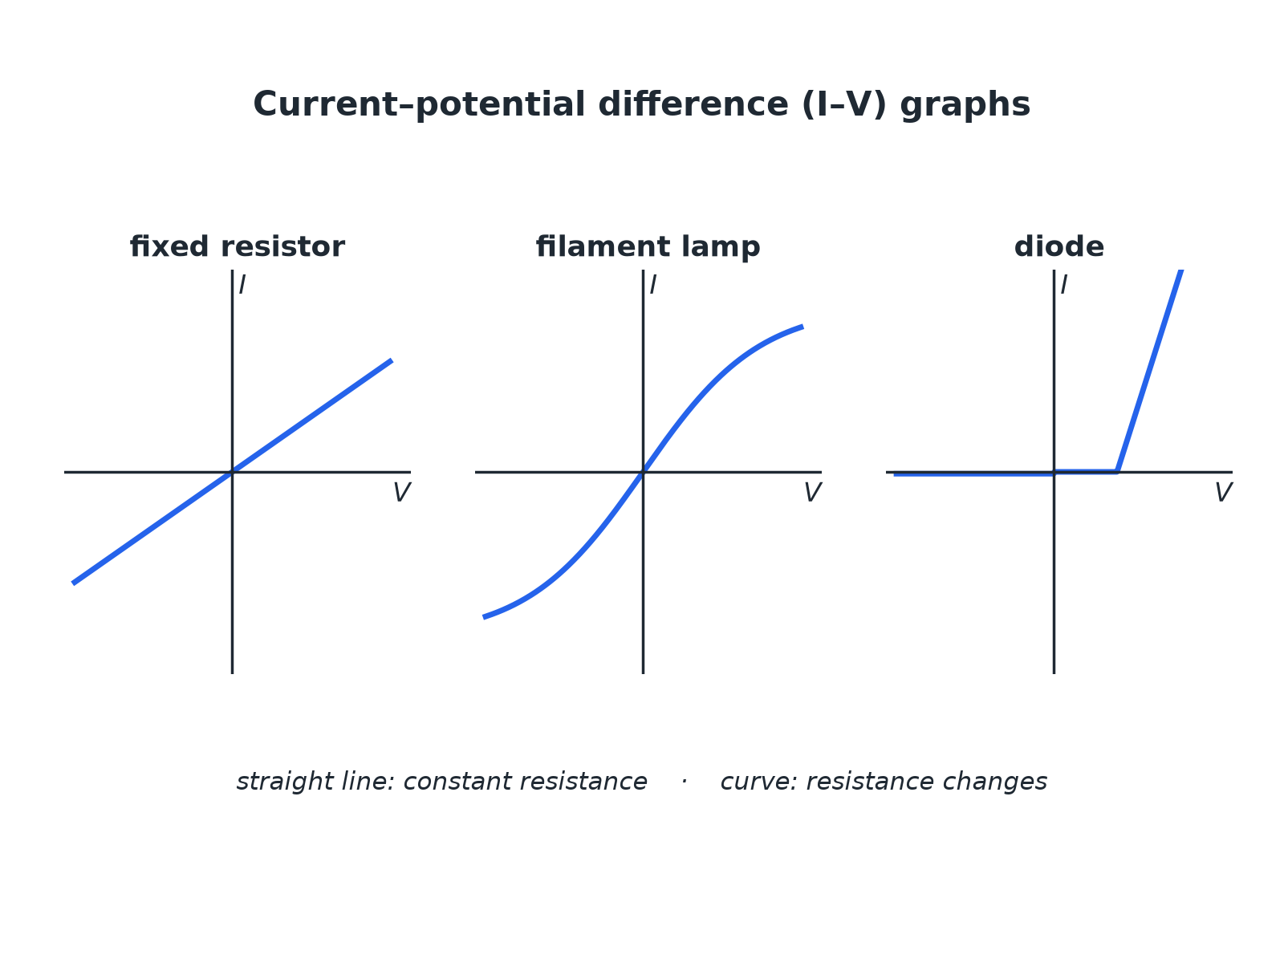

AQA GCSE PHYSICS · PAPER 1 · FOUNDATION & HIGHER
I–V Graphs
Straight line: constant resistance. Curve: changing resistance.
Electricity
openrevise.com
Lesson 3 of 10

Slide 7
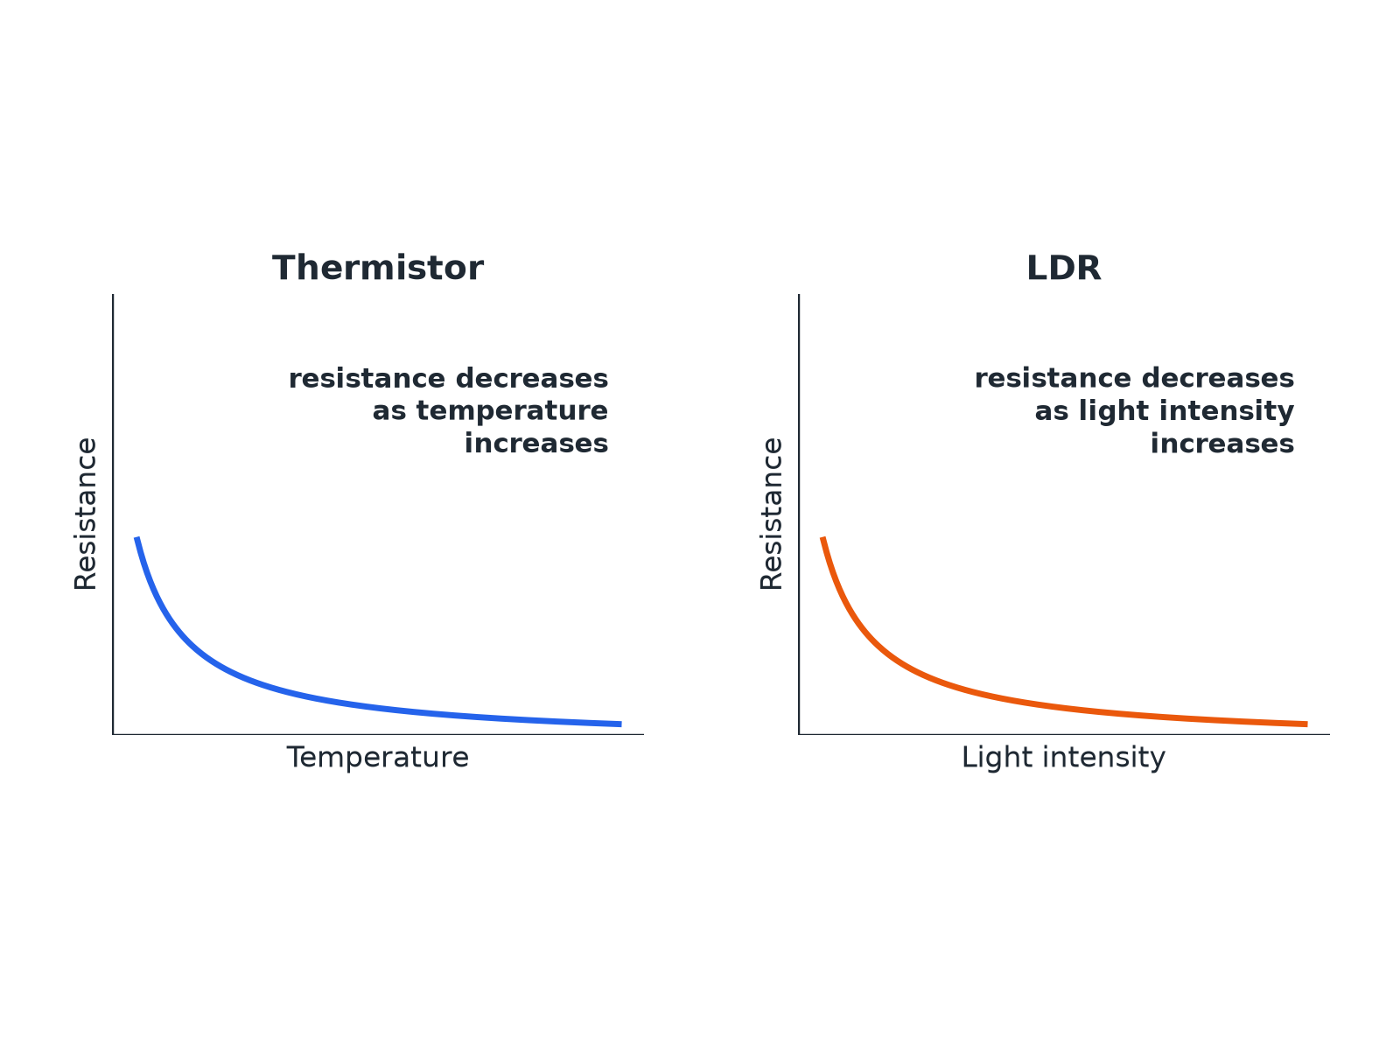
AQA GCSE PHYSICS · PAPER 1 · FOUNDATION & HIGHER
Thermistor and LDR
Both fall as the quantity increases.
Electricity
openrevise.com
Lesson 3 of 10

Slide 8
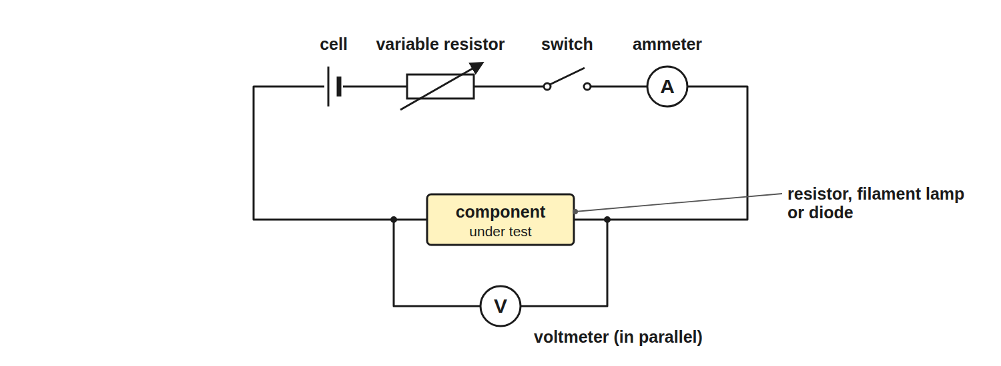
AQA GCSE PHYSICS · PAPER 1 · FOUNDATION & HIGHER
Required Practical 4: I–V Circuit
Vary the pd and measure the current each time.
Electricity
openrevise.com
Lesson 3 of 10

Slide 9

AQA GCSE PHYSICS · PAPER 1 · FOUNDATION & HIGHER
Component Behaviour
Learn each description.
Component
Resistance
Graph or behaviour
Fixed resistor
Constant at constant temperature
Straight line through the origin
Filament lamp
Increases as the filament gets hotter
Curve that flattens; gradient decreases
Diode
Very high in the reverse direction
Current flows in one direction only
Thermistor
Decreases as temperature increases
Used in thermostats and temperature sensors
LDR
Decreases as light intensity increases
Used in automatic lights
Electricity
openrevise.com
Lesson 3 of 10

Slide 10

AQA GCSE PHYSICS · PAPER 1 · FOUNDATION & HIGHER
Required Practical 4: Method
Find the I–V characteristic of a component.
1
2
3
4
5
6
Set up
Connect the component in series with the ammeter and variable resistor, and the voltmeter across the component.
Vary
Change the variable resistor to get different pds.
Record
For each setting record V and I.
Reverse
Swap the connections and repeat to get negative values (not for a diode with a protective resistor).
Plot
Draw current against pd and draw a smooth line.
Repeat
For the filament lamp and the diode.
Electricity
openrevise.com
Lesson 3 of 10

Slide 11

AQA GCSE PHYSICS · PAPER 1 · FOUNDATION & HIGHER
Resistance of a Filament Lamp
The current through a filament lamp is 0.34 A at 2.0 V and 0.62 A at 6.0 V. Calculate the resistance at each pd and explain the difference.
At 2.0 V
R = 2.0 ÷ 0.34 = 5.9 Ω
1
At 6.0 V
R = 6.0 ÷ 0.62 = 9.7 Ω
2
Explain
At the higher pd the current is greater, so the filament is hotter and its resistance is higher
3
ANSWER
5.9 Ω and 9.7 Ω; the resistance increases as the filament gets hotter.
Electricity
openrevise.com
Lesson 3 of 10

Slide 12

AQA GCSE PHYSICS · PAPER 1 · FOUNDATION & HIGHER
Uses in Circuits
Applications you need to know.
Thermistor
In a thermostat: as the temperature rises the resistance falls, changing the pd across it to switch heating off.
LDR
In automatic lights: as it gets dark the resistance rises, which switches the light on.
Diode
Allows current in one direction only, protecting circuits from being connected the wrong way round.
Electricity
openrevise.com
Lesson 3 of 10

Slide 13

AQA GCSE PHYSICS · PAPER 1 · FOUNDATION & HIGHER
Key Terms
Ohmic conductor
A conductor whose resistance is constant at constant temperature.
Filament lamp
A lamp with a thin wire that gets hot and glows.
Diode
A component that lets current flow in one direction only.
Thermistor
A resistor whose resistance decreases when the temperature increases.
LDR
A resistor whose resistance decreases when the light intensity increases.
Linear
Following a straight line graph.
Electricity
openrevise.com
Lesson 3 of 10

Slide 14

AQA GCSE PHYSICS · PAPER 1 · FOUNDATION & HIGHER
YOUR TASK
10 minutes
Match the Graph
Match each component to its I–V graph description: resistor, filament lamp, diode. (1) Curve that flattens as pd increases. (2) Straight line through the origin. (3) Almost no current one way, then a rapid increase the other way.
Look at the shape.
1
Explain the resistance change.
2
WHAT A GOOD ANSWER SHOWS
Resistor: (2). Filament lamp: (1). Diode: (3).
Electricity
openrevise.com
Lesson 3 of 10
Notes:
Ask learners to explain each in terms of resistance.

Slide 15
AQA GCSE PHYSICS · PAPER 1 · FOUNDATION & HIGHER
Can I...?
Draw and describe the I–V graph of a resistor.
Describe how a thermistor behaves.
Describe the I–V graph of a filament lamp.
Describe how an LDR behaves.
Describe the I–V graph of a diode.
Describe Required Practical 4.
Explain why a filament lamp's resistance increases.
Give one use each of a thermistor and an LDR.
Electricity
openrevise.com
Lesson 3 of 10

Slide 16
AQA GCSE PHYSICS · PAPER 1 · FOUNDATION & HIGHER
Summary & Exam Focus
Resistor: constant resistance, straight line through the origin.
Filament lamp: resistance increases with temperature.
Diode: current in one direction only.
Thermistor and LDR resistances decrease as temperature or light increases.
EXAM FOCUS
Explain why the resistance of a filament lamp increases as the current increases. (3 marks)
Say the filament gets hotter and link it to resistance.
openrevise.com

Slide 17
AQA GCSE PHYSICS · PAPER 1 · FOUNDATION & HIGHER
Exam Practice: Resistors and I–V characteristics
Answer all questions. Use the mark allocation as a guide to how much to write. · 22 minutes
Question 1 · 3 marks · Complete
Name the component whose I–V characteristic shows current flowing in one direction only, and the component whose resistance decreases as…
Question 2 · 4 marks · Use the graph
The graph shows the I–V characteristic of a filament lamp. (a) Calculate the resistance of the lamp when the potential difference is 6.0 V…
Question 3 · 3 marks · Explain
A thermistor is used in a circuit to control a heating system. Explain how the resistance of the thermistor changes as the room warms up.
Electricity
openrevise.com
Lesson 3 of 10

Slide 18
AQA GCSE PHYSICS · PAPER 1 · FOUNDATION & HIGHER
Exam Practice: Resistors and I–V characteristics (cont.)
Question 4 · 6 marks · Describe
Describe how you would investigate the relationship between the current through a filament lamp and the potential difference across it…
Question 5 · 2 marks · Explain
A student measures the resistance of a diode. Explain why the resistance is very high when the diode is connected the other way round.
Question 6 · 3 marks · Suggest
An automatic outdoor light contains an LDR. Explain how the light switches on when it gets dark.
Electricity
openrevise.com
Lesson 3 of 10

Slide 19
AQA GCSE PHYSICS · PAPER 1 · FOUNDATION & HIGHER
Question 1 · 3 marks · Complete
“
Name the component whose I–V characteristic shows current flowing in one direction only, and the component whose resistance decreases as the temperature increases. Then state what happens to the resistance of an LDR in bright light.
HOW TO ANSWER IT
Command word: Complete. Worth 3 marks, so plan before writing.
Electricity
openrevise.com
Lesson 3 of 10

Slide 20
AQA GCSE PHYSICS · PAPER 1 · FOUNDATION & HIGHER
Question 1 · mark scheme
3 marks available. Award a mark for each point made.
Diode
1 mark
Thermistor
1 mark
LDR resistance decreases
1 mark
Electricity
openrevise.com
Lesson 3 of 10

Slide 21
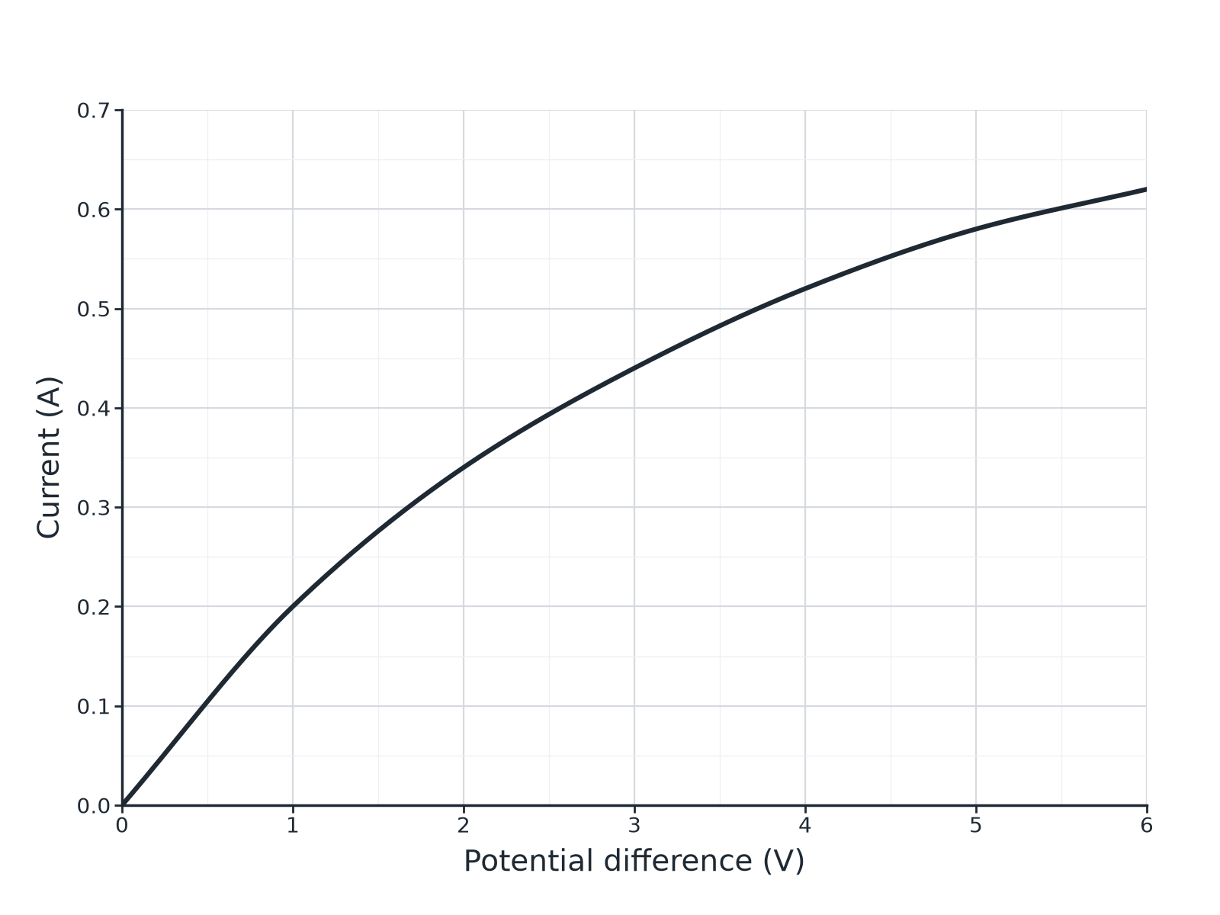
AQA GCSE PHYSICS · PAPER 1 · FOUNDATION & HIGHER
Question 2 · 4 marks · Use the graph
The graph shows the I–V characteristic of a filament lamp. (a) Calculate the resistance of the lamp when the potential difference is 6.0 V. (b) The resistance at 2.0 V is 5.9 Ω. Explain why the resistance at 6.0 V is different. (4 marks)
Electricity
openrevise.com
Lesson 3 of 10

Slide 22
AQA GCSE PHYSICS · PAPER 1 · FOUNDATION & HIGHER
Question 2 · mark scheme
4 marks available. Award a mark for each point made.
Reads 0.62 A
1 mark
9.7 Ω
1 mark
Higher current means higher temperature
1 mark
Resistance increases with temperature
1 mark
Electricity
openrevise.com
Lesson 3 of 10

Slide 23
AQA GCSE PHYSICS · PAPER 1 · FOUNDATION & HIGHER
Question 3 · 3 marks · Explain
“
A thermistor is used in a circuit to control a heating system. Explain how the resistance of the thermistor changes as the room warms up.
HOW TO ANSWER IT
Command word: Explain. Worth 3 marks, so plan before writing.
Electricity
openrevise.com
Lesson 3 of 10

Slide 24
AQA GCSE PHYSICS · PAPER 1 · FOUNDATION & HIGHER
Question 3 · mark scheme
3 marks available. Award a mark for each point made.
Resistance decreases as temperature increases
1 mark
Current or potential difference changes in the circuit
1 mark
Used to switch the heating off
1 mark
Electricity
openrevise.com
Lesson 3 of 10

Slide 25
AQA GCSE PHYSICS · PAPER 1 · FOUNDATION & HIGHER
Question 4 · 6 marks · Describe
“
Describe how you would investigate the relationship between the current through a filament lamp and the potential difference across it. Include a circuit diagram description, the readings to take and how you would present and use the results.
HOW TO ANSWER IT
Command word: Describe. Worth 6 marks, so plan before writing.
Electricity
openrevise.com
Lesson 3 of 10

Slide 26
AQA GCSE PHYSICS · PAPER 1 · FOUNDATION & HIGHER
Question 4 · mark scheme
6 marks available. Award a mark for each point made.
Level 3 (5 to 6 marks): a correct circuit (ammeter in series, voltmeter across the lamp, variable resistor or supply), a range of pd values and matching currents, a graph of I against V and a description of its shape or the changing gradient
5 to 6 marks
Level 2 (3 to 4 marks): a method with the main apparatus and some readings; the graph is mentioned
3 to 4 marks
Level 1 (1 to 2 marks): simple statements about measuring current and pd
1 to 2 marks
Electricity
openrevise.com
Lesson 3 of 10

Slide 27
AQA GCSE PHYSICS · PAPER 1 · FOUNDATION & HIGHER
Question 5 · 2 marks · Explain
“
A student measures the resistance of a diode. Explain why the resistance is very high when the diode is connected the other way round.
HOW TO ANSWER IT
Command word: Explain. Worth 2 marks, so plan before writing.
Electricity
openrevise.com
Lesson 3 of 10

Slide 28
AQA GCSE PHYSICS · PAPER 1 · FOUNDATION & HIGHER
Question 5 · mark scheme
2 marks available. Award a mark for each point made.
Very high resistance in reverse
1 mark
Almost no current flows
1 mark
Electricity
openrevise.com
Lesson 3 of 10

Slide 29
AQA GCSE PHYSICS · PAPER 1 · FOUNDATION & HIGHER
Question 6 · 3 marks · Suggest
“
An automatic outdoor light contains an LDR. Explain how the light switches on when it gets dark.
HOW TO ANSWER IT
Command word: Suggest. Worth 3 marks, so plan before writing.
Electricity
openrevise.com
Lesson 3 of 10

Slide 30
AQA GCSE PHYSICS · PAPER 1 · FOUNDATION & HIGHER
Question 6 · mark scheme
3 marks available. Award a mark for each point made.
Resistance of LDR increases in the dark
1 mark
Change in pd or current in the circuit
1 mark
Circuit switches the light on
1 mark
Electricity
openrevise.com
Lesson 3 of 10

