Slide 1

AQA GCSE PHYSICS · PAPER 1 · FOUNDATION & HIGHER
Specific latent heat
Particle model of matter
Lesson 4 of 6
openrevise.com

Slide 2

AQA GCSE PHYSICS · PAPER 1 · FOUNDATION & HIGHER
Warm-up
Answer each one, then check.
1
What happens to temperature during melting?
2
What is the unit of energy?
3
What is the equation for a temperature change?
4
Name the change from liquid to gas.
5
What is internal energy?
Particle model of matter
openrevise.com
Lesson 4 of 6

Slide 3
AQA GCSE PHYSICS · PAPER 1 · FOUNDATION & HIGHER
Warm-up - Answers
What happens to temperature during melting?
It stays constant
1
What is the unit of energy?
Joule
2
What is the equation for a temperature change?
ΔE = mcΔθ
3
Name the change from liquid to gas.
Boiling / evaporating
4
What is internal energy?
Total kinetic and potential energy of the particles
5
Particle model of matter
openrevise.com
Lesson 4 of 6

Slide 4

AQA GCSE PHYSICS · PAPER 1 · FOUNDATION & HIGHER
Learning Objectives
Define specific latent heat and distinguish fusion from vaporisation.
1
Apply E = mL.
2
Interpret heating and cooling graphs that include changes of state.
3
Distinguish specific heat capacity from specific latent heat.
4
Particle model of matter
openrevise.com
Lesson 4 of 6

Slide 5

AQA GCSE PHYSICS · PAPER 1 · FOUNDATION & HIGHER
SPECIFIC LATENT HEAT
The specific latent heat of a substance is the energy needed to change the state of 1 kg of the substance with no change in temperature.
E = mL is given on the equation sheet. Specific latent heat of fusion: solid to liquid. Specific latent heat of vaporisation: liquid to gas. L is in J/kg.
Particle model of matter
openrevise.com
Lesson 4 of 6

Slide 6
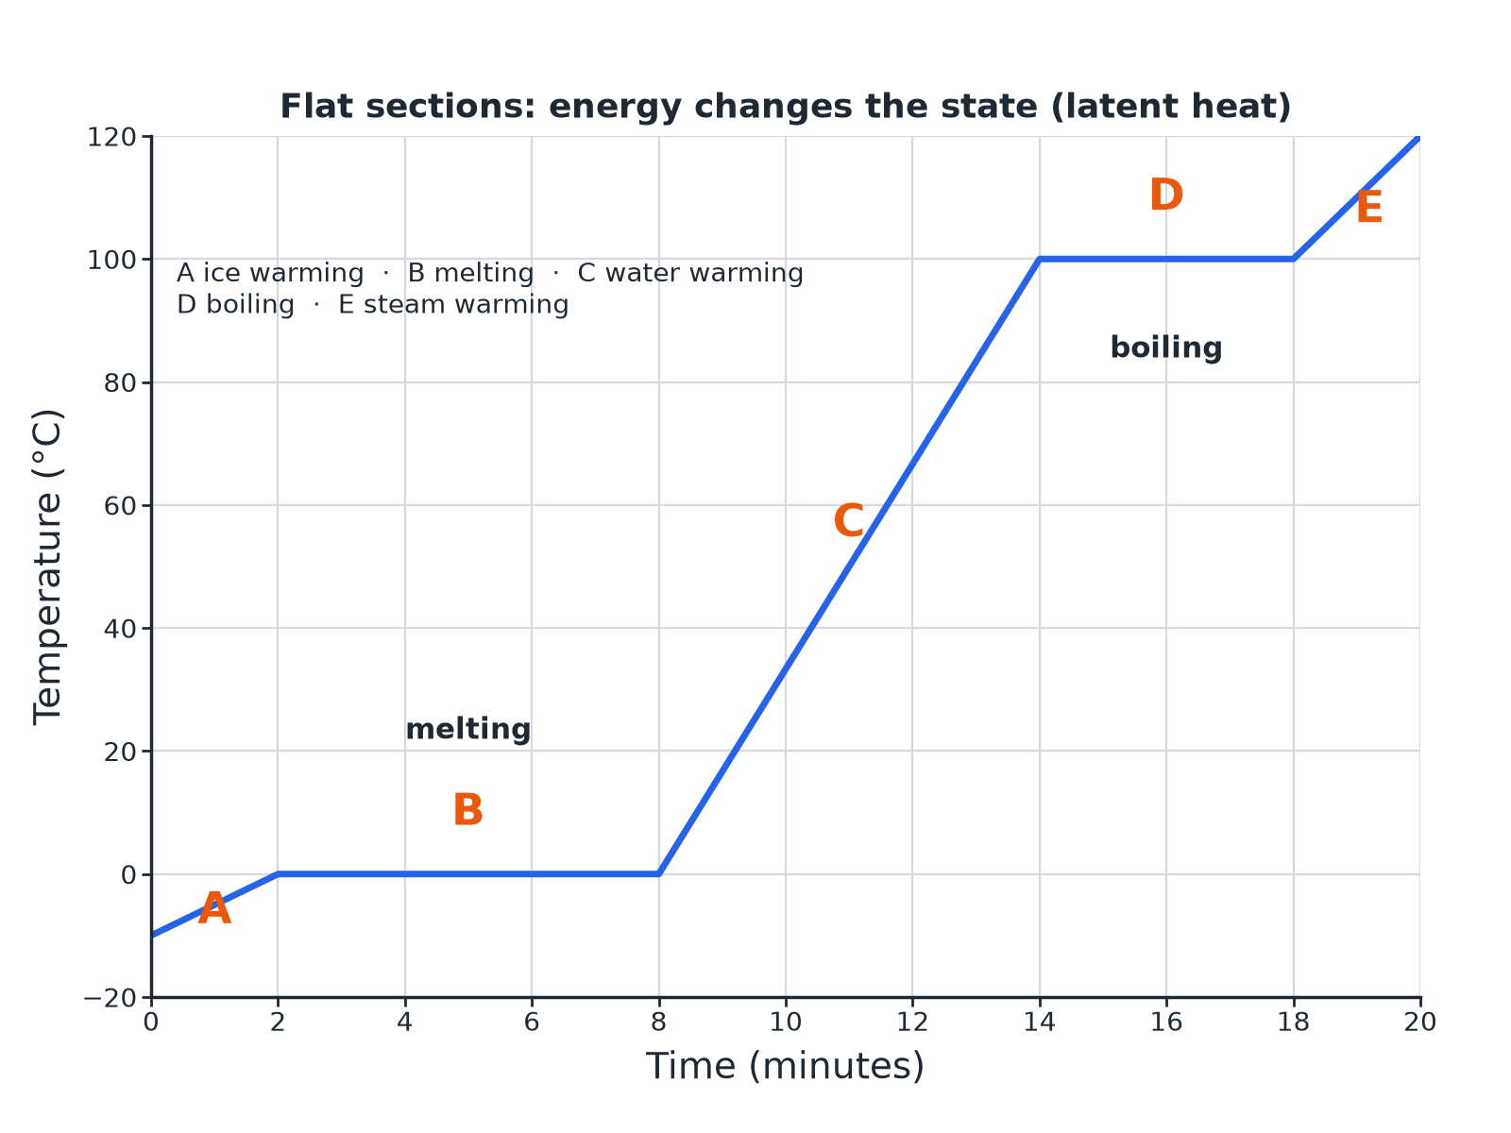

AQA GCSE PHYSICS · PAPER 1 · FOUNDATION & HIGHER
A Heating Curve
Flat sections show a change of state.
Particle model of matter
openrevise.com
Lesson 4 of 6

Slide 7

AQA GCSE PHYSICS · PAPER 1 · FOUNDATION & HIGHER
Two Different Ideas
SPECIFIC HEAT CAPACITY
SPECIFIC LATENT HEAT
• Energy to raise the temperature of 1 kg by 1 °C.
• The temperature changes.
• ΔE = mcΔθ; J/kg °C.
• Energy to change the state of 1 kg with no temperature change.
• The temperature stays the same.
• E = mL; J/kg.
Particle model of matter
openrevise.com
Lesson 4 of 6

Slide 8

AQA GCSE PHYSICS · PAPER 1 · FOUNDATION & HIGHER
Melting Ice
Calculate the energy needed to melt 0.20 kg of ice at 0 °C. Specific latent heat of fusion of water = 334 000 J/kg.
Write the equation
E = mL
1
Substitute
E = 0.20 × 334 000
2
Answer
E = 66 800 J
3
ANSWER
66 800 J
Particle model of matter
openrevise.com
Lesson 4 of 6

Slide 9
AQA GCSE PHYSICS · PAPER 1 · FOUNDATION & HIGHER
Boiling Water
Calculate the energy to change 0.50 kg of water at 100 °C into steam. Specific latent heat of vaporisation = 2 260 000 J/kg.
Substitute
E = 0.50 × 2 260 000
1
Answer
E = 1 130 000 J
2
ANSWER
1 130 000 J (1.13 MJ)
Particle model of matter
openrevise.com
Lesson 4 of 6

Slide 10
AQA GCSE PHYSICS · PAPER 1 · FOUNDATION & HIGHER
Reading the Graph
Explain why the temperature stays constant during section B of the heating curve.
Energy is still supplied
The particles are gaining energy
1
Where it goes
It increases the potential energy of the particles as the bonds are broken
2
So
The average kinetic energy, and the temperature, stay the same
3
ANSWER
The energy supplied breaks the bonds (changing potential energy) so the temperature does not rise.
Particle model of matter
openrevise.com
Lesson 4 of 6

Slide 11

AQA GCSE PHYSICS · PAPER 1 · FOUNDATION & HIGHER
Why Steam Burns More
A favourite exam idea.
Condensing
Steam at 100 °C condenses to water at 100 °C and releases a lot of latent heat.
Then
The water then cools and releases more energy.
So
Steam transfers more energy to skin than boiling water at the same temperature.
Particle model of matter
openrevise.com
Lesson 4 of 6

Slide 12

AQA GCSE PHYSICS · PAPER 1 · FOUNDATION & HIGHER
Key Terms
Specific latent heat
Energy to change the state of 1 kg with no temperature change.
Latent heat of fusion
For solid to liquid.
Latent heat of vaporisation
For liquid to gas.
Heating curve
A temperature-time graph for a heated substance.
Constant temperature
Temperature that does not change during a change of state.
Potential energy
Energy stored due to the forces between particles.
Particle model of matter
openrevise.com
Lesson 4 of 6

Slide 13

AQA GCSE PHYSICS · PAPER 1 · FOUNDATION & HIGHER
YOUR TASK
12 minutes
Read the Curve
On a heating curve for water there are flat sections at 0 °C and 100 °C. Explain what is happening in each and why the second is longer.
Name each change.
1
Compare the latent heats.
2
WHAT A GOOD ANSWER SHOWS
At 0 °C the ice is melting; at 100 °C the water is boiling. The boiling section is longer because the latent heat of vaporisation is much greater than the latent heat of fusion.
Particle model of matter
openrevise.com
Lesson 4 of 6
Notes:
Ask what would happen to the slope if the heater were more powerful.

Slide 14
AQA GCSE PHYSICS · PAPER 1 · FOUNDATION & HIGHER
Can I...?
State what specific latent heat is.
Explain flat sections.
Distinguish fusion from vaporisation.
Distinguish c from L.
Use E = mL.
Explain steam burns.
Read a heating curve.
Give units of L.
Particle model of matter
openrevise.com
Lesson 4 of 6

Slide 15
AQA GCSE PHYSICS · PAPER 1 · FOUNDATION & HIGHER
Summary & Exam Focus
E = mL.
Temperature is constant during a change of state.
Heating curves have flat sections at melting and boiling points.
Distinguish c and L.
EXAM FOCUS
Calculate the energy needed to melt 0.35 kg of ice at 0 °C. Specific latent heat of fusion = 334 000 J/kg. (2 marks)
Multiply mass by L.
openrevise.com

Slide 16
AQA GCSE PHYSICS · PAPER 1 · FOUNDATION & HIGHER
Exam Practice: Specific latent heat
Answer all questions. Use the mark allocation as a guide to how much to write. · 15 minutes
Question 1 · 2 marks · Calculate
Calculate the energy needed to melt 0.35 kg of ice at 0 °C. The specific latent heat of fusion of water is 334 000 J/kg. Use the equation…
Question 2 · 4 marks · Use the graph
The graph shows how the temperature of a solid changes as it is heated at a steady rate until it is a gas. (a) State the melting point. (b)…
Question 3 · 2 marks · Distinguish
Describe the difference between specific heat capacity and specific latent heat.
Particle model of matter
openrevise.com
Lesson 4 of 6

Slide 17
AQA GCSE PHYSICS · PAPER 1 · FOUNDATION & HIGHER
Exam Practice: Specific latent heat (cont.)
Question 4 · 3 marks · Calculate
Calculate the energy needed to change 0.50 kg of water at 100 °C into steam. The specific latent heat of vaporisation of water is 2 260 000…
Question 5 · 3 marks · Explain
Steam at 100 °C causes a more serious burn than boiling water at 100 °C. Explain why.
Particle model of matter
openrevise.com
Lesson 4 of 6

Slide 18
AQA GCSE PHYSICS · PAPER 1 · FOUNDATION & HIGHER
Question 1 · 2 marks · Calculate
“
Calculate the energy needed to melt 0.35 kg of ice at 0 °C. The specific latent heat of fusion of water is 334 000 J/kg. Use the equation: energy for a change of state = mass × specific latent heat
HOW TO ANSWER IT
Command word: Calculate. Worth 2 marks, so plan before writing.
Particle model of matter
openrevise.com
Lesson 4 of 6

Slide 19
AQA GCSE PHYSICS · PAPER 1 · FOUNDATION & HIGHER
Question 1 · mark scheme
2 marks available. Award a mark for each point made.
Correct substitution
1 mark
116 900 J
1 mark
Particle model of matter
openrevise.com
Lesson 4 of 6

Slide 20
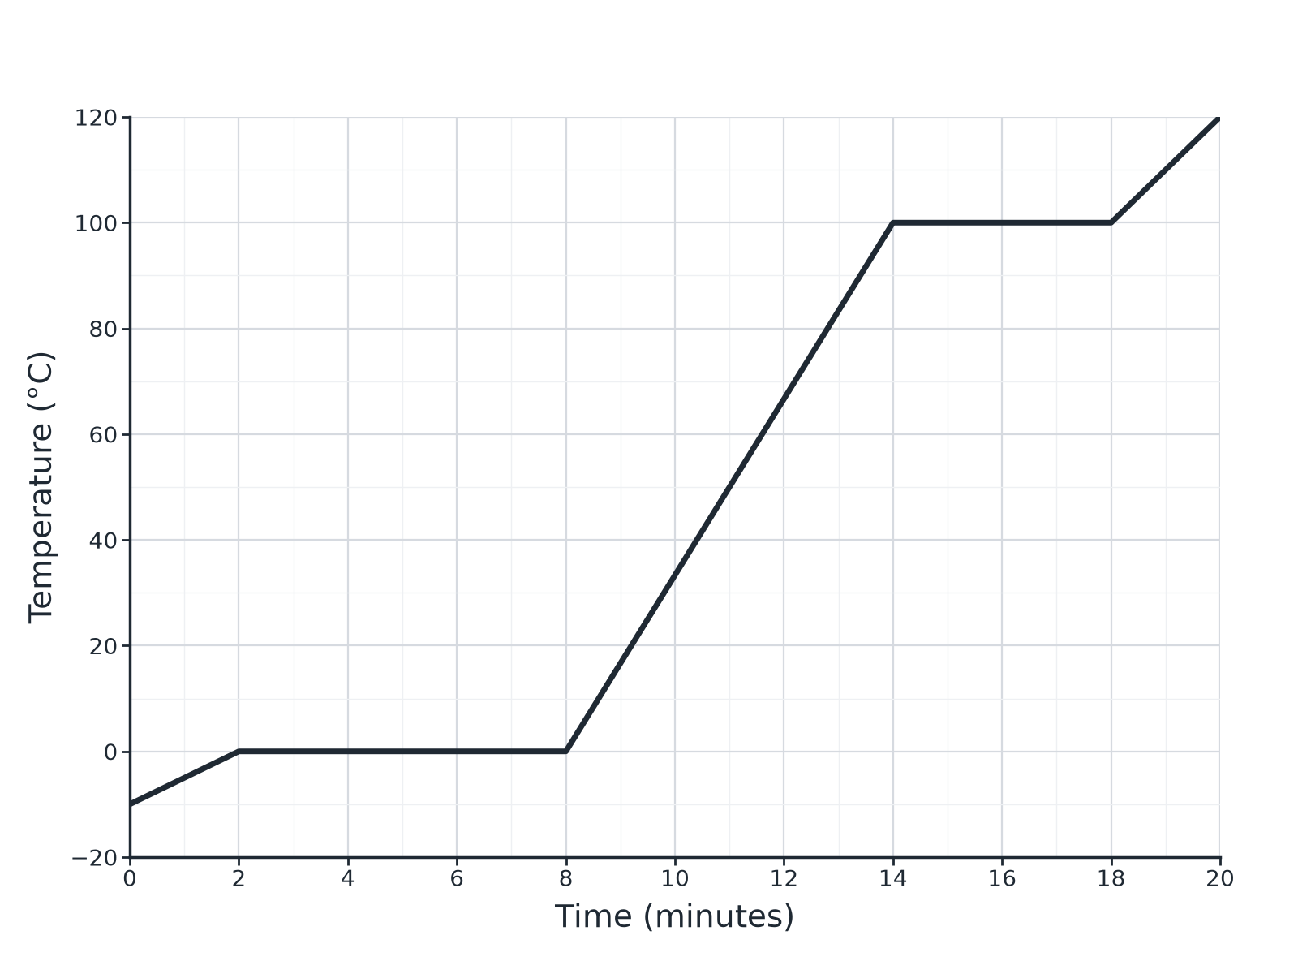
AQA GCSE PHYSICS · PAPER 1 · FOUNDATION & HIGHER
Question 2 · 4 marks · Use the graph
The graph shows how the temperature of a solid changes as it is heated at a steady rate until it is a gas. (a) State the melting point. (b) What is happening between 2 and 8 minutes? (c) Explain why the temperature stays constant during this time. (4 marks)
Particle model of matter
openrevise.com
Lesson 4 of 6

Slide 21
AQA GCSE PHYSICS · PAPER 1 · FOUNDATION & HIGHER
Question 2 · mark scheme
4 marks available. Award a mark for each point made.
0 °C
1 mark
Melting
1 mark
Energy used to break bonds or change potential energy
1 mark
Kinetic energy or temperature does not increase
1 mark
Particle model of matter
openrevise.com
Lesson 4 of 6

Slide 22
AQA GCSE PHYSICS · PAPER 1 · FOUNDATION & HIGHER
Question 3 · 2 marks · Distinguish
“
Describe the difference between specific heat capacity and specific latent heat.
HOW TO ANSWER IT
Command word: Distinguish. Worth 2 marks, so plan before writing.
Particle model of matter
openrevise.com
Lesson 4 of 6

Slide 23
AQA GCSE PHYSICS · PAPER 1 · FOUNDATION & HIGHER
Question 3 · mark scheme
2 marks available. Award a mark for each point made.
Specific heat capacity: temperature change
1 mark
Specific latent heat: change of state, no temperature change
1 mark
Particle model of matter
openrevise.com
Lesson 4 of 6

Slide 24
AQA GCSE PHYSICS · PAPER 1 · FOUNDATION & HIGHER
Question 4 · 3 marks · Calculate
“
Calculate the energy needed to change 0.50 kg of water at 100 °C into steam. The specific latent heat of vaporisation of water is 2 260 000 J/kg.
HOW TO ANSWER IT
Command word: Calculate. Worth 3 marks, so plan before writing.
Particle model of matter
openrevise.com
Lesson 4 of 6

Slide 25
AQA GCSE PHYSICS · PAPER 1 · FOUNDATION & HIGHER
Question 4 · mark scheme
3 marks available. Award a mark for each point made.
Correct substitution
1 mark
1 130 000 J
1 mark
Unit J
1 mark
Particle model of matter
openrevise.com
Lesson 4 of 6

Slide 26
AQA GCSE PHYSICS · PAPER 1 · FOUNDATION & HIGHER
Question 5 · 3 marks · Explain
“
Steam at 100 °C causes a more serious burn than boiling water at 100 °C. Explain why.
HOW TO ANSWER IT
Command word: Explain. Worth 3 marks, so plan before writing.
Particle model of matter
openrevise.com
Lesson 4 of 6

Slide 27
AQA GCSE PHYSICS · PAPER 1 · FOUNDATION & HIGHER
Question 5 · mark scheme
3 marks available. Award a mark for each point made.
Steam condenses on the skin
1 mark
Releases latent heat
1 mark
So more energy is transferred than from the water alone
1 mark
Particle model of matter
openrevise.com
Lesson 4 of 6

