Slide 1

AQA GCSE PHYSICS · PAPER 1 · FOUNDATION & HIGHER
Particle motion and pressure in gases
Particle model of matter
Lesson 5 of 6
openrevise.com

Slide 2

AQA GCSE PHYSICS · PAPER 1 · FOUNDATION & HIGHER
Warm-up
Answer each one, then check.
1
What is pressure?
2
What is the unit of pressure?
3
How do gas particles move?
4
Convert 100 kPa to Pa.
5
Write 3 × 4 = ?
Particle model of matter
openrevise.com
Lesson 5 of 6

Slide 3
AQA GCSE PHYSICS · PAPER 1 · FOUNDATION & HIGHER
Warm-up - Answers
What is pressure?
Force per unit area
1
What is the unit of pressure?
Pascal (Pa)
2
How do gas particles move?
Randomly and quickly
3
Convert 100 kPa to Pa.
100 000 Pa
4
Write 3 × 4 = ?
12
5
Particle model of matter
openrevise.com
Lesson 5 of 6

Slide 4

AQA GCSE PHYSICS · PAPER 1 · FOUNDATION & HIGHER
Learning Objectives
Explain how the motion of gas molecules is related to temperature and pressure.
1
Explain qualitatively the relation between temperature and pressure of a gas at constant volume.
2
Explain how changing the volume of a gas at constant temperature changes its pressure.
3
Use pV = constant.
4
Particle model of matter
openrevise.com
Lesson 5 of 6

Slide 5

AQA GCSE PHYSICS · PAPER 1 · FOUNDATION & HIGHER
GAS PRESSURE
Gas molecules are in constant random motion. Their collisions with the container walls cause the pressure, which acts at right angles to the wall.
For a fixed mass of gas at constant temperature, pressure × volume = constant, pV = constant. It is given on the equation sheet.
Particle model of matter
openrevise.com
Lesson 5 of 6

Slide 6
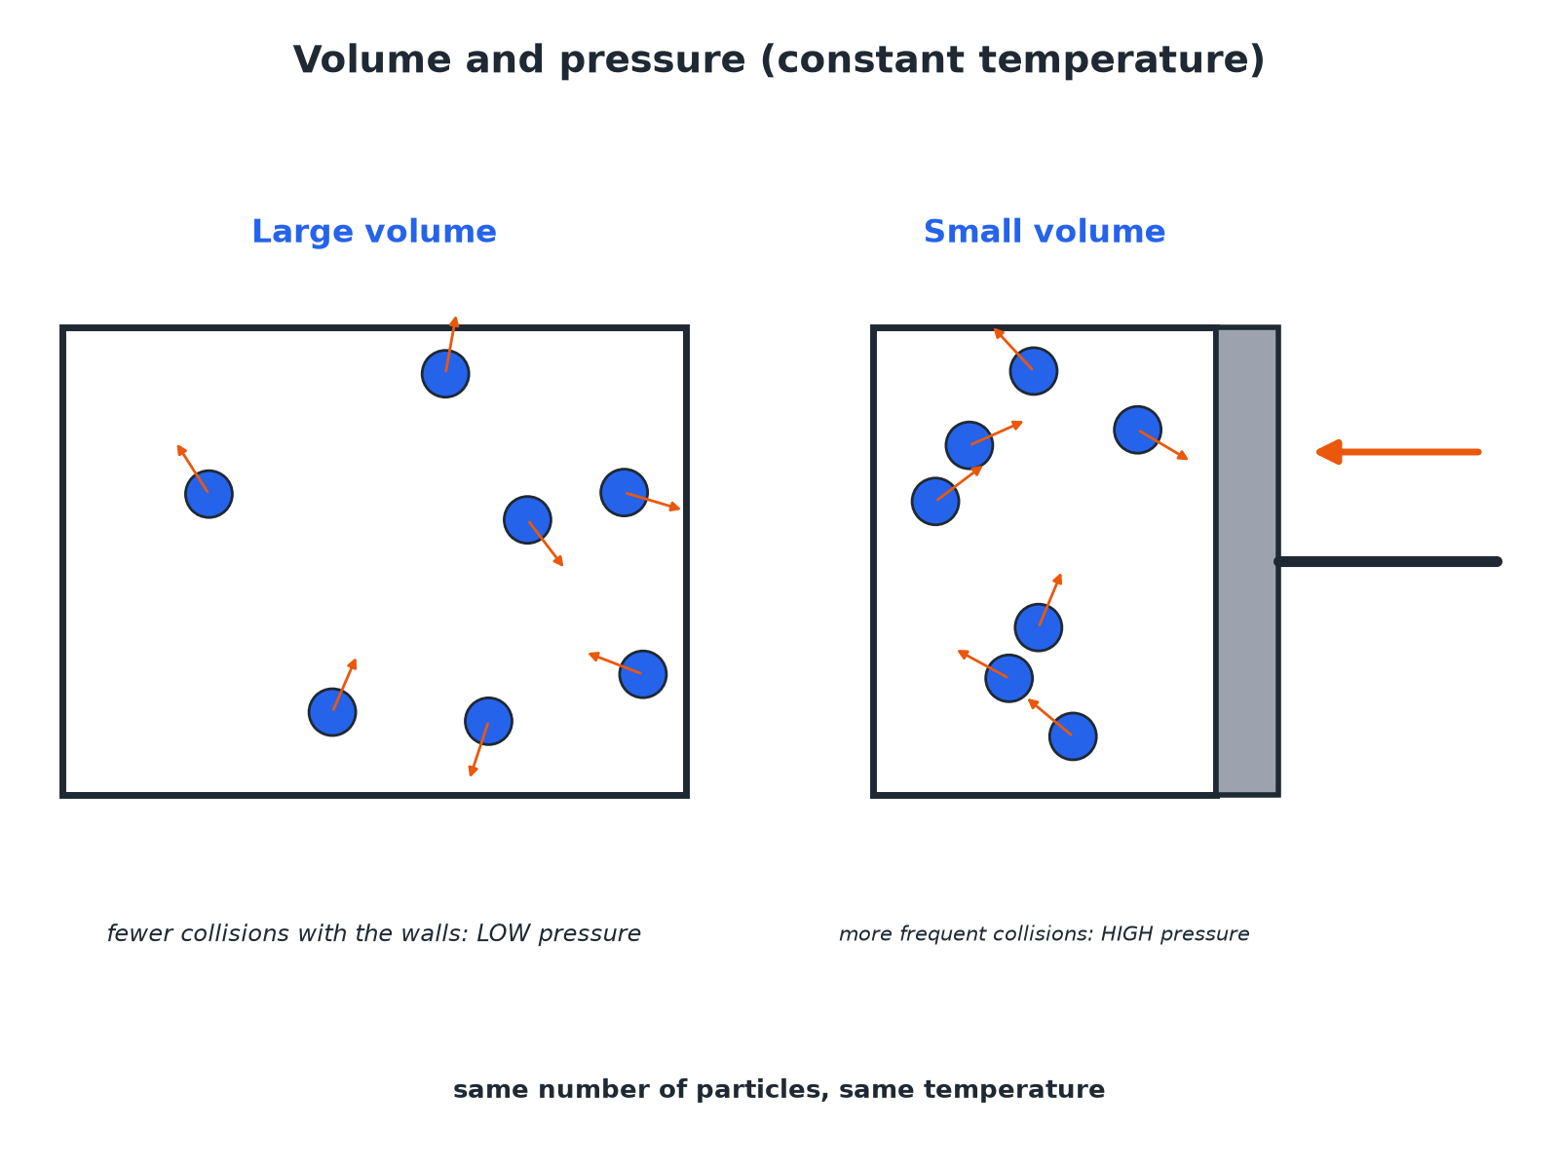

AQA GCSE PHYSICS · PAPER 1 · FOUNDATION & HIGHER
Gas in a Container
Smaller volume means more frequent collisions.
Particle model of matter
openrevise.com
Lesson 5 of 6

Slide 7

AQA GCSE PHYSICS · PAPER 1 · FOUNDATION & HIGHER
Explaining Pressure
Use this chain of reasoning.
1
2
3
Particles move randomly
They collide with the walls of the container.
Each collision exerts a tiny force
At right angles to the wall.
Many collisions
Together they give a steady force on the wall, and pressure = force ÷ area.
Particle model of matter
openrevise.com
Lesson 5 of 6

Slide 8

AQA GCSE PHYSICS · PAPER 1 · FOUNDATION & HIGHER
What Affects Gas Pressure
Learn the explanation for each.
Change
Effect on pressure
Explanation
Temperature up (constant volume)
Increases
Particles move faster, so collide harder and more often.
Volume down (constant temperature)
Increases
Particles are closer together so collide more often with the walls.
Volume up (constant temperature)
Decreases
Particles collide less often with the walls.
Particle model of matter
openrevise.com
Lesson 5 of 6

Slide 9

AQA GCSE PHYSICS · PAPER 1 · FOUNDATION & HIGHER
Using pV = constant
A gas at 100 000 Pa occupies 0.30 m³. It is compressed to 0.10 m³ at constant temperature. Calculate the new pressure.
Write the relationship
p₁V₁ = p₂V₂
1
Substitute
100 000 × 0.30 = p₂ × 0.10
2
Rearrange
p₂ = (30 000)/0.10
3
Answer
p₂ = 300 000 Pa
4
ANSWER
300 000 Pa
Particle model of matter
openrevise.com
Lesson 5 of 6

Slide 10
AQA GCSE PHYSICS · PAPER 1 · FOUNDATION & HIGHER
Heating at Constant Volume
Explain why the pressure in a sealed can increases when it is heated.
Temperature rises
The average kinetic energy of the molecules increases
1
Faster molecules
They hit the walls harder and more often
2
Result
The force on the walls, and so the pressure, increases
3
ANSWER
Pressure increases because the faster molecules collide with the walls more often and with greater force.
Particle model of matter
openrevise.com
Lesson 5 of 6

Slide 11

AQA GCSE PHYSICS · PAPER 1 · FOUNDATION & HIGHER
Common Mistakes
Avoid these.
Molecules expand
The molecules do not get bigger: they move faster.
Collisions
Say 'more frequent and harder', not just 'more collisions'.
Units
Pressure in pascals (Pa) and volume in m³.
Constant
pV = constant only for a fixed mass at constant temperature.
Particle model of matter
openrevise.com
Lesson 5 of 6

Slide 12

AQA GCSE PHYSICS · PAPER 1 · FOUNDATION & HIGHER
Key Terms
Pressure
Force per unit area.
Pascal
The unit of pressure; one newton per square metre.
Random motion
Movement in any direction with no pattern.
Fixed mass
A sealed amount of gas with no particles added or removed.
Compress
Squash into a smaller volume.
Kinetic energy
Energy of movement.
Particle model of matter
openrevise.com
Lesson 5 of 6

Slide 13

AQA GCSE PHYSICS · PAPER 1 · FOUNDATION & HIGHER
YOUR TASK
10 minutes
Squash the Gas
A syringe holds 60 cm³ of air at 100 kPa. The plunger is pushed until the volume is 20 cm³ at constant temperature. Predict and calculate the new pressure.
Use p₁V₁ = p₂V₂.
1
Explain with particles.
2
WHAT A GOOD ANSWER SHOWS
The pressure increases (particles hit the walls more often). p₂ = 100 × 60 ÷ 20 = 300 kPa.
Particle model of matter
openrevise.com
Lesson 5 of 6
Notes:
Ask what happens if the syringe is warmed.

Slide 14
AQA GCSE PHYSICS · PAPER 1 · FOUNDATION & HIGHER
Can I...?
Explain gas pressure with particles.
Use pV = constant.
Say the force is at right angles to the wall.
Give units of pressure.
Explain the effect of temperature.
Compress and expand gases.
Explain the effect of volume.
Give clear explanations.
Particle model of matter
openrevise.com
Lesson 5 of 6

Slide 15
AQA GCSE PHYSICS · PAPER 1 · FOUNDATION & HIGHER
Summary & Exam Focus
Gas pressure is caused by collisions with the walls.
Higher temperature: faster molecules, more force, more often.
Smaller volume at constant temperature: higher pressure.
pV = constant.
EXAM FOCUS
Explain, in terms of particles, why the pressure of a gas in a sealed container increases when the gas is heated. (3 marks)
Say faster molecules hit the walls more often and harder.
openrevise.com

Slide 16
AQA GCSE PHYSICS · PAPER 1 · FOUNDATION & HIGHER
Exam Practice: Particle motion and pressure in gases
Answer all questions. Use the mark allocation as a guide to how much to write. · 15 minutes
Question 1 · 3 marks · Explain
A sealed container of gas is heated and the volume is constant. Explain, in terms of the particles, why the pressure of the gas increases.
Question 2 · 3 marks · Explain
The volume of a gas in a syringe is reduced. The temperature is constant. Explain, in terms of the particles, why the pressure increases.
Question 3 · 3 marks · Calculate
A fixed mass of gas has a pressure of 100 000 Pa and a volume of 0.30 m³. The gas is compressed at constant temperature to a volume of 0.10…
Particle model of matter
openrevise.com
Lesson 5 of 6

Slide 17
AQA GCSE PHYSICS · PAPER 1 · FOUNDATION & HIGHER
Exam Practice: Particle motion and pressure in gases (cont.)
Question 4 · 1 mark · State
State the direction of the force exerted by gas particles on the wall of a container.
Question 5 · 4 marks · Calculate
A syringe contains 60 cm³ of air at a pressure of 100 kPa. The plunger is pushed in until the volume is 24 cm³. The temperature is…
Particle model of matter
openrevise.com
Lesson 5 of 6

Slide 18
AQA GCSE PHYSICS · PAPER 1 · FOUNDATION & HIGHER
Question 1 · 3 marks · Explain
“
A sealed container of gas is heated and the volume is constant. Explain, in terms of the particles, why the pressure of the gas increases.
HOW TO ANSWER IT
Command word: Explain. Worth 3 marks, so plan before writing.
Particle model of matter
openrevise.com
Lesson 5 of 6

Slide 19
AQA GCSE PHYSICS · PAPER 1 · FOUNDATION & HIGHER
Question 1 · mark scheme
3 marks available. Award a mark for each point made.
Particles move faster or gain kinetic energy
1 mark
Collide with walls more often or harder
1 mark
So pressure increases
1 mark
Particle model of matter
openrevise.com
Lesson 5 of 6

Slide 20
AQA GCSE PHYSICS · PAPER 1 · FOUNDATION & HIGHER
Question 2 · 3 marks · Explain
“
The volume of a gas in a syringe is reduced. The temperature is constant. Explain, in terms of the particles, why the pressure increases.
HOW TO ANSWER IT
Command word: Explain. Worth 3 marks, so plan before writing.
Particle model of matter
openrevise.com
Lesson 5 of 6

Slide 21
AQA GCSE PHYSICS · PAPER 1 · FOUNDATION & HIGHER
Question 2 · mark scheme
3 marks available. Award a mark for each point made.
Volume decreases so the particles are closer
1 mark
More frequent collisions with the walls
1 mark
Pressure increases
1 mark
Particle model of matter
openrevise.com
Lesson 5 of 6

Slide 22
AQA GCSE PHYSICS · PAPER 1 · FOUNDATION & HIGHER
Question 3 · 3 marks · Calculate
“
A fixed mass of gas has a pressure of 100 000 Pa and a volume of 0.30 m³. The gas is compressed at constant temperature to a volume of 0.10 m³. Calculate the new pressure. Use the equation: pressure × volume = constant
HOW TO ANSWER IT
Command word: Calculate. Worth 3 marks, so plan before writing.
Particle model of matter
openrevise.com
Lesson 5 of 6

Slide 23
AQA GCSE PHYSICS · PAPER 1 · FOUNDATION & HIGHER
Question 3 · mark scheme
3 marks available. Award a mark for each point made.
Correct substitution
1 mark
Rearranges
1 mark
300 000 Pa
1 mark
Particle model of matter
openrevise.com
Lesson 5 of 6

Slide 24
AQA GCSE PHYSICS · PAPER 1 · FOUNDATION & HIGHER
Question 4 · 1 mark · State
“
State the direction of the force exerted by gas particles on the wall of a container.
HOW TO ANSWER IT
Command word: State. Worth 1 mark, so plan before writing.
Particle model of matter
openrevise.com
Lesson 5 of 6

Slide 25
AQA GCSE PHYSICS · PAPER 1 · FOUNDATION & HIGHER
Question 4 · mark scheme
1 mark available. Award a mark for each point made.
At right angles to the wall
1 mark
Particle model of matter
openrevise.com
Lesson 5 of 6

Slide 26
AQA GCSE PHYSICS · PAPER 1 · FOUNDATION & HIGHER
Question 5 · 4 marks · Calculate
“
A syringe contains 60 cm³ of air at a pressure of 100 kPa. The plunger is pushed in until the volume is 24 cm³. The temperature is constant. Calculate the new pressure of the air in kPa.
HOW TO ANSWER IT
Command word: Calculate. Worth 4 marks, so plan before writing.
Particle model of matter
openrevise.com
Lesson 5 of 6

Slide 27
AQA GCSE PHYSICS · PAPER 1 · FOUNDATION & HIGHER
Question 5 · mark scheme
4 marks available. Award a mark for each point made.
pV constant
1 mark
Correct substitution
1 mark
Correct rearrangement
1 mark
250 kPa
1 mark
Particle model of matter
openrevise.com
Lesson 5 of 6

